Slide 1
Using MFIX to Solve Multiphase Flow Problems: a tool for better understanding fluidization processes
Janine Galvin
U.S. Dept. of Energy, National Energy Technology Laboratory, Albany, OR 97321
PNNL, November 28th, 2011
Thanks to Sofiane Benyahia (NETL) and Sreekanth Pannala (ORNL)

Slide 2
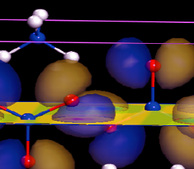
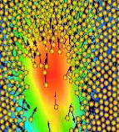
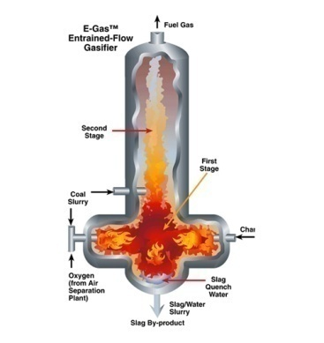
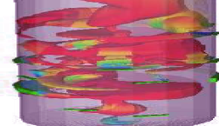

NETL Motivation
Computational Science Division
Various Computational Modeling Scales
Goal
Atoms – Molecules
Develop and apply simulation and visualization tools for designing/analyzing zero-emission fossil energy plants.
Particles
Approach
Integrate experimental and computational sciences at multiple scales, to generate information beyond the reach of experiments alone
Unit Ops
Benefits
Speeds design, reduces risk, and saves money
Plant
Notes:
Generating environmentally clean and affordable power and ensuring the energy security of nation is a major goal of research at NETL. Coal is a major source of electric power but coal burning is a major source of pollution. Coal gasification is a technology expected to become part of advanced power plants. One of the primary issues drive up costs for coal-based energy is handling and processing of solids.
Gasification team:
Use an integrated approach to combine theory, computational modeling, experimental and industrial input to develop physics-based methods, models, and tools to support the development of advanced gasification based devices and systems (transport or entrained flow gasifiers)
optimization of operating conditions and establishing performance trends in gasifiers –
aid in their understanding of gasification reactions under different co-feed conditions and potential for commercialization.
Based on a hierarchy of models of numerical simulations of gasifiers – improve trade-offs between physical details and computational cost

Slide 3
Outline
Brief overview on
  multiphase flows (challenges/issues)
  modeling approaches to multiphase flows & CFD
  MFIX & sample applications
Hands on Work
  code installation and general CFD steps
  example 1: pipe flow
    simulation setup (mfix.dat)
    code compilation (mfix.exe)
    post processing (paraview)
  quick overview of MFIX solver (theory and numerical technique)
  example 2: bubbling bed
  example 3: spouted bed combustor
Coarse Goal: Setup cases and carry out simulations with different levels of difficulty

Slide 4
Outline
Brief overview on
  multiphase flows (challenges/issues)
  modeling approaches to multiphase flows & CFD
  MFIX & sample applications
Hands on Work
  code installation and general CFD steps
  example 1: pipe flow
    simulation setup (mfix.dat)
    code compilation (mfix.exe)
    post processing (paraview)
  quick overview of MFIX solver (theory and numerical technique)
  example 2: bubbling bed
  example 3: spouted bed combustor
Coarse Goal: Setup cases and carry out simulations with different levels of difficulty

Slide 5
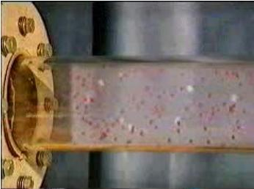
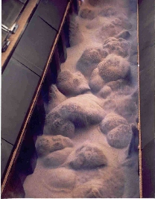
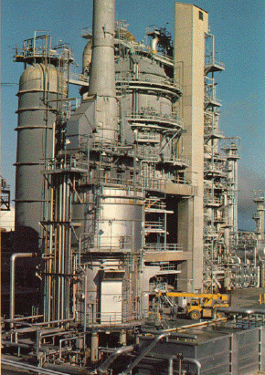
Overview Multiphase Flows
What is Multiphase Flow?
Fluid flow consisting of more than one phase or component – separation of scale above molecular level
Pneumatic Transport
Multiphase Flow in Industry
Industry: Chemical, petrochemical, metallurgical, environmental, energy, etc
Fluidized Beds
Devices: fluidized beds, pneumatic transport, risers, cyclones, etc (see end of presentation)
Multiphase Flow in our Environment
Snow, avalanches, mud slides, debris flows, etc
Chemical Process & Energy
Industries
Notes:
Multiphase flows – any fluid flow consisting of more than one phase or component – so that the flows are considered to have some level of phase or component separation at a scale above the molecular level.
There are many types of solid flows. Herein we are primarily concerned with systems containing massive, solid particles so that inertial effects dominate in the role of particle motion and viscous forces are negligible (high stokes flow). An example of a massive particle is a grain of sand which size is on the order of 100’s of microns. In contrast, aerosol particles (smoke, dust) are not considered massive since inertial effects are small and viscous effects typically dominate.
(when thermal fluctuations of the gas phase have influence on the motion of the large particles (brownian motion) not the case for fluidized beds wherein inertial effects dominate in the role of particle motion and viscous forces are negligible (high stokes flow)).
Solid particulate flows are ubiquitous feature of our environment (snow, fog, mud slides, debris flows). They are present as biological flows (e.g., blood flow is pumped by the heart, circulates throughout the body and is cleansed by being filtered by the kidneys). And they have a large presence in industries ranging from pharmaceuticals to fossil fuel processes for the manufacturing of chemicals.

Slide 6
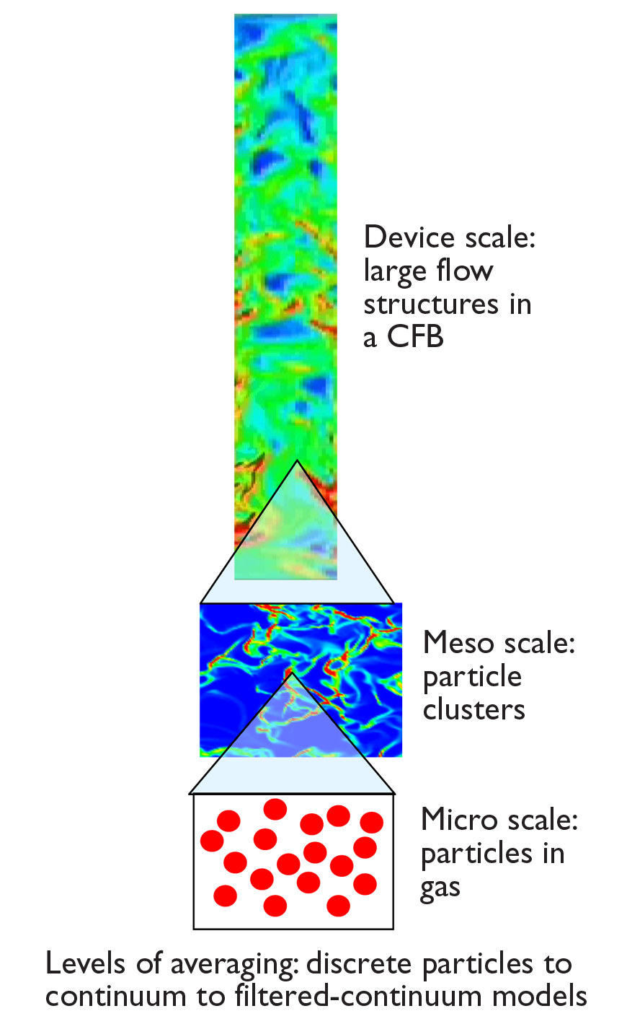
General Characteristics
Classifications of fluid flow
  viscous/inviscid
  compressible/incompressible
  steady/unsteady
  laminar/turbulent
  Single-phase/multiphase
Challenges of mulitphase flow
  Spatio-temporal variations
  Arbitrary particle shape
  Particle-particle interactions
  Particle interactions with turbulence
Need to model and predict detailed behavior of these flows
Notes:
Traditionally, the design, optimization, and scaling of multiphase systems is preformed using empirical models obtained from experimental observations. These models typically require a large investment in both capital and time to develop while there predictive capabilities remain limited. As a result, multiphase computational fluid dynamics (CFD) modes based on more rigorous mathematical modeling are gaining in popularity for testing design considerations and determining flow characteristics.
Fluid flows are complex and varied. Here are some general classifications of fluid flow: viscous/inviscid; compressible/incompressible; steady/unsteady; laminar/turbulent; Single-phase/multiphase
Multiphase gas solid flows are especially challenging. They are not homogenous. Largest flow structure can be on the order of meters but these structures may be directly influenced by details of the particle-particle collisions and particle-gas interactions which take place below the millimeter scale.

Slide 7
Reactor Design
The objective of reactor design is to create the right conditions for reactions. The temperature and reactant species distribution, appropriate residence time and removal of products must be considered. Including the effect of a catalyst may be necessary. A comprehensive understanding of all the competing and interacting mechanisms is required to arrive at better designs and improved processes. In particular, gas-solids reacting flows involve, not only complex interactions of granular materials with gas flow, but also phase-change, heterogeneous and homogeneous reactions, heat and mass transfer. Moreover, the spatial and temporal scales may vary over many orders of magnitude. Thus modeling gas-solid reacting flows requires the integration of the best physics and chemistry models from various science and engineering fields with the most advanced computational algorithms. These algorithms must be scalable to large high-performance computers in order to bear on this important topic.
Except from preface of an Edited Book on “Computational Gas-Solids Flows and Reacting Systems: Theory, Methods and Practice,” May, 2010, Eds. S. Pannala, M. Syamlal and T. O’Brien,
Notes:
Most engineering processes involve multiple phases undergoing reactions. For example coal gasification involves both gas (oxygen and sometimes water vapor) and solids (coal). To accurately capture the hydrodynamics and chemistry effects in modeling, one is required to consider the coupled governing equations for mass transport, energy transport and fluid flow.
CHALLENGES – multi level/ multi scale physics!

Slide 8
Multiphase Flow Modeling Approaches
Continuum (Eulerian)
Discrete particle (Lagrangian)
Average out details of flow field around particles and individual particle collisions
  Track interacting particle motion for all particles
Pros/Cons
+ Computationally cheap – single equation of motion for each particle phase
- Averaging process gives rise to unknown terms requiring constitutive relations
- Computationally intensive
+ “Straightforward” to incorporate physics
Notes:
Most generally the dynamics of these phases are described by one of either two basic approaches
1) Treat the phase as a collection of discrete particles that obey Newton’s law (Lagrangian type of model)
2) adopting a continuum description of the phase, which is then governed by a Navier-Stokes type equation (Eulerian model)
In the continuum or (Eulerian) monitor the flow characteristics in a fixed control volume. In the discrete particle or (Lagrangian) track individual fluid particles as they move through the flow field. Note eulerian and lagrangian are used as labels for modeling techniques but they relate to the frame of reference.
Lagrangian – most fundamental. The phase is represented by particles. The positions and velocities are updated by molecular dynamic type methods, that is, newton’s law (conservation of linear angular momentum) are solved numerically for short time steps by using different schemes for integrating ordinary differential equations. Useful for modeling small scales
Eulerian – continuum description is used for a phase. The model equations are obtained by averaging local instantaneous behavior. Information is lost in this process that requires additional ‘constitutive relations’ for closure of the model. These relations specify how phases behave and interact with each other.
One single simulation method cannot cover all time and length scales. A hierarchy of models has developed that model the gas-solid flow phenomena on different length and time scales and thus also with different levels of detail. Depending on need, there is a range of fluid bed modeling approaches

Slide 9
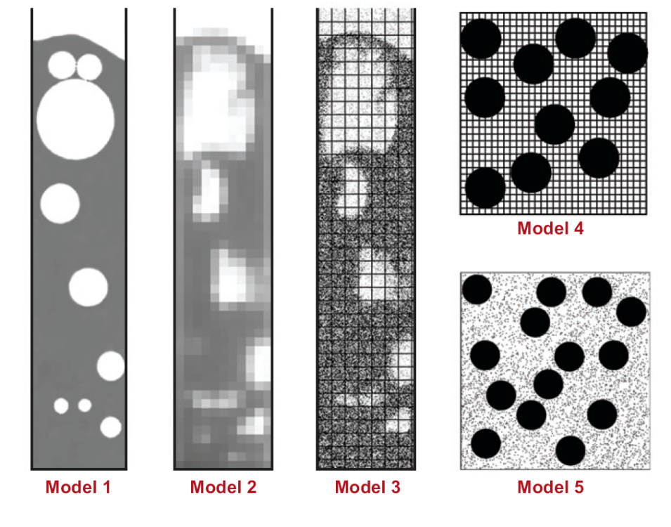
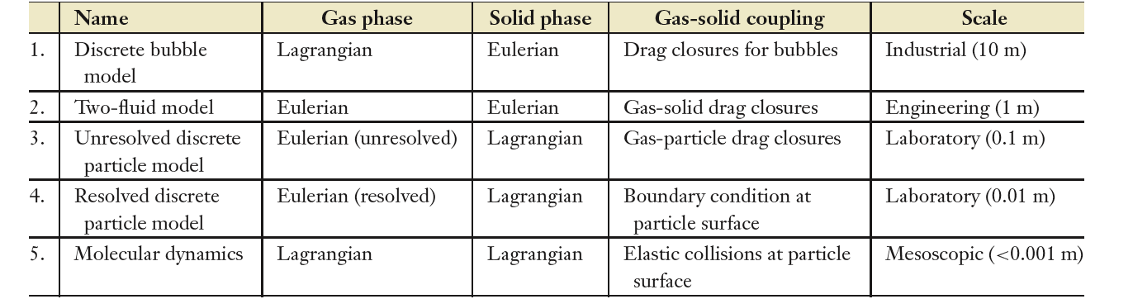
Multiphase Flow Modeling Approaches
Resolved Bubbles
Resolved Particles
Molecular Dynamics
Two-Fluid
Under-resolved discrete particle
Van der Hoeff et al. , Annual Review of Fluid Mechanics, 2008
Notes:
9
Based on these two model approaches a variety of different approaches can be employed for modeling multiphase flows. Van der Hoeff categorized the available schemes by considering the possible models for the gas and solids phases separately.
MFIX is based on an Eulerian description for the gas phase and an eulerian description of the solids. More recently the Lagrangian modeling ability for the solids was incorporated.
Thus MFIX generally encompasses types 2 and 3.
The difference between models 3 and 4 is how resolved the grid is.
Fully Resolved: particles larger than the grid
Sub-grid: particles smaller than the grid resolution
Partially resolved: particles resolved in one or more directions and under-resolved in others
In model 4 the gas phase is usually treated via a lattice boltzmann method (~continuum wherein the Boltzmann equation is solved rather than NS).
Model 5 is a very detailed molecular dynamics type method. Such a detailed description of fluid very expensive! Generally such a detailed description not necessary and simplified methods may be employed (for the gas): Dissipative particle dynamics, direct simulation Monte Carlo, LGCA (lattice gas cellular automata).
Model 1 presents another combination wherein a Lagrangian model is employed for the gas (particle based methods of fluid flow) but a continuum description is used for the solids. In it the gas bubbles are treated as discrete entities which can collide coalesce, break up, shrink and grow.
Within these broad frameworks there are different modeling techniques which generally depend on the scale being examined. For example DNS , LES, Navier Stokes are all ‘continuum’ based models but solved at different scales. All of these solution/simulation/model approaches are based on continuum assumption wherein scale separation is achieved (Knudsen number). Molecular dynamics is used to solve systems at the molecular level. Approximations to this are the dissipative particle dynamics or direct simulation Monte Carlo. Bridge between Eulerian and Lagrangian (molecular/discrete) description is the lattice Boltzmann approach (kinetic theory based) wherein the Boltzmann equation is solved (describes evolution of density function)

Slide 10
Multiphase Flow Modeling Approaches
S. Pannala et al., Edited Book on “Computational Gas-Solids Flows and Reacting Systems: Theory, Methods and Practice,” May, 2010.
Notes:
As discussed there are multiple techniques for modeling multiphase flow systems. Here, several techniques found in the literature are shown. The figure illustrates the connection between the modeling and computing expense. Techniques with simpler mathematical models tend to have a higher computational cost than those with more complex models.
Trade-off between modeling effort and computational cost: DNS, LBM, DEM, continuum.
The y-axis demonstrates the time scale that the indicated model is applied (operates) and the x-axis the relevant length scale.
MFIX is again described by the techniques highlighted. The models for the gas and solids phases are presented later.

Slide 11
Continuum Modeling Fluid Flows
  Fluid flow is governed by the hydrodynamic, or Navier-Stokes (N-S) equations that simply states that the flow of a fluid is subject to the universal laws of conservation of mass, momentum and energy.
These laws form a set of coupled non-linear partial differential equations. It is not possible to solve these equation analytically for most engineering problems
Applied Math / Numerical Methods
Physics / Mathematical Modeling
Computational Science /
Software Tools
CFD is the art of replacing such PDE systems by a set of algebraic equations which are solved using computer based simulations
Enables us to perform ‘numerical experiments’ (i.e. computer simulations) of fluid flows in a ‘virtual laboratory’
  Can aid in design, increase safety, reduce cost
    a better understanding of phenomena
  a qualitative (and sometimes quantitative) prediction of fluid flows*
*true predictive capability can be achieved with inadequate (or even incorrect) model(s)
Notes:
CFD is an interdisciplinary topic: Numerical Analysis, Fluid Mechanics, Computer Science
Consider the continuum mathematical models for fluid flows which are partial differential equations that represent conservation laws for mass, energy and momentum. These equations (NS-presented later) are generally not solvable for typical engineering fluid flow problems. In CFD these PDE systems are replaced by a set of algebraic equations which can be solved using computers.
CFD codes are based on mathematical models of the physical process and are structured around numerical algorithms that can solve these mathematical models.
Model - mathematical representation of physical phenomena (partial differential equations)
Method - numerical algorithms (discretization, solution methods, etc.)
Software tools – software implementation ( solvers, pre and postprocessing utilities)
As mentioned earlier in the presentation: computer simulations can be useful: Increased safety, Reduced cost, Aid in design:
Increased safety: more accurate analysis of both normal operation and accident scenarios; risk mitigation; identification of issues/problems that could lead to failure
Reduced cost: rapid screening and prototyping; exploration of materials and geometries; fewer, more targeted experiments; improved manufacturing processes; reduced margins; dramatically improved quantification of uncertainties
Aid in design: improved understanding of underlying physical phenomena; geometric effects; coupled effects previously studied separately
These simulations can then be used to perform analysis / design. However it requires tight integration with experiments and must provide information on inherent uncertainties (not discussed here). The goal of CFD is deep understanding of phenomena while true predictive capability is by-product as successful prediction can be achieved with inadequate (or even incorrect) model(s)

Slide 12



http://mfix.netl.doe.gov
air
General multiphase flow CFD code which couples hydrodynamics, heat & mass transfer and chemical reactions in fluid-solids systems
Development at NETL started in 1991
  Open source distribution started in 2001
Collaborations with ORNL, Fluent, Parsons, Aeolus Research, Princeton, Iowa State …
Users/developers grew from an initial team of 3 in 1991 to over 70 in 2006. Over 2000 researchers from over 500 institutions around the world
fuel gas
air + Steam
ash
air+coal
The first application of MFIX was for PyGAS gasifier design, as shown in this CO mass fraction plot, Syamlal and Venkatesan 1993
Serves as a testing platform for physics and numerical techniques development
Notes:
MFIX is a general multiphase flow CFD code based on mass, momentum, energy and species balance equations for gas and multiple solids phases. It solves a generally accepted set of partial differential equations for the conservation of mass, momentum, species, and energy for multiple phases. MFIX has been used for modeling bubbling, circulating fluidized beds, and spouted beds. The calculations give transient data on the three-dimensional distribution of volume fractions, pressure, velocity, temperature, and species mass fractions.
MFIX development started at NETL in 1991. The main goal was to develop a tool for modeling fluidized-bed reactors such as coal gasifiers, commonly used in fossil fuel plants. The first version was completed by January 1993.
A website, http://www.mfix.org/, was launched in 2001 for distributing the source code and disseminating information related to computational gas-solids flow.
Note as open source you have access to the entire source code – more extendible, potentially more rapid contributions (i.e. linux, apache, firefox are examples),lower cost (can be an advantage for Universities and small companies). Since then it has undergone several revisions (updating language, parallelization, new models, new numerical algorithms).
By 2006, over 1 000 researchers from 250 research institutions worldwide had registered at the website. The website typically receives between 5 000 and 10 000 hits every month.
MFIX serves as a testing platform for trying out different ideas, approaches and constitutive relations. Success algorithms and models can be adopted by commercial companies

Slide 13
General MFIX Features
http://mfix.netl.doe.gov/
Fortran 90 code base with allocatable arrays
  120,000+ lines of FORTRAN 90 code, organized into ~469 files and ~969 subprograms
Serial, shared-memory parallel (SMP) or distributed-memory parallel (DMP) executables can be generated from the same code base supported on various platforms
Simulations are setup with a simple input data file (mfix.dat)
Conducts error checking of user input (check_data_##.f routines)
Includes post-processing codes for the animation and retrieval of output data (ani_mfix and post_mfix), however, Paraview (www.paraview.org) is the recommended post processing tool
Multiple, single-precision, binary, direct-access output files that reduces disk space and increases data retrieval speed (.RES and .SPX files)
Notes:
MFIX has undergone many revisions over the years. Today, MFIX consists of 100,000+ lines of Fortran 90 code, organized into 450+ files and 900+ subprograms.
The code is parallelized to run on shared-memory processors (SMP), distributed-memory processors (DMP) on different architectures and platforms.
Simulations are set up using an input data file, and in some cases, user-defined subroutines.
Two post-processing codes are used for visualizing the results and extracting data in the form of tables from the output files.
Recall the code was primarily designed for dense gas solids flows and therefore has several physical models for the solids. Granular stress equations based on kinetic theory and frictional flow theory. Uses either Cartesian or cylindrical coordinate systems with non-uniform mesh size. Also Cartesian Grid cut cell technique (capability allows the definition of curved or sloping boundaries)

Slide 14
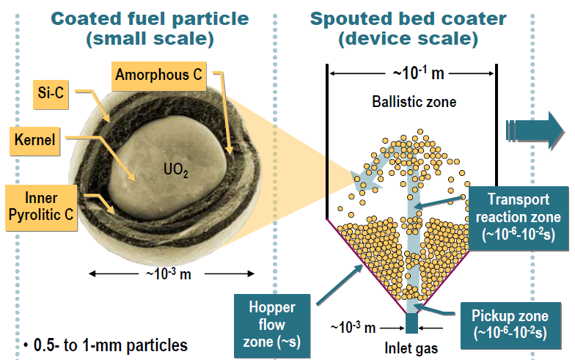
Sample MFIX Application: Nuclear Fuel Coating Process
Design challenge:
Maintain optimal temperatures, species, residence times in each zone to attain right microstructure of coating layers at nm scale
Truly multiscale problem:
~O(13) time scales
~O(8) length scales
0.5- to 1-mm particles
Coating encapsulates fission products; failure rate < 1 in 10⁵
Quality depends on surface processes at nm length scale and ns time scales
Coating at high temperature (1300–1500°C) in batch spouted bed reactor for ~10⁴ s
Particles cycle thru deposition and annealing zones where complex chemistry occurs
S. Pannala, et al., “Simulating the dynamics of spouted-bed nuclear fuel coaters” CVD, 13, 481-490.
Notes:
In this problem nuclear fuel coating via batch-mod CVD in spouted-bed coating reactors is examined. The motivation of this work was to create simulations with sufficient detail that the spouted-bed design and operating parameters can be linked to coating quality through explicit physics and chemistry. As the choice of bed design and operating parameters was stated to be largely empirical with little fundamental understanding of this type of reactor available in open literature that can be used to optimization.
Work was driven by lack of fundamental understanding of nuclear fuel coaters. Involves multi-layer particles with a typical diameter of 0.5- to 1-mm particles. Coating encapsulates fission products. Fuel standards require no more than 1 in 105 coating failures on individual particles. Quality depends on surface processes at nm length scale and ns time scales

Slide 15
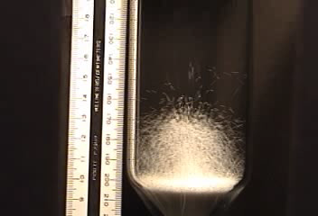
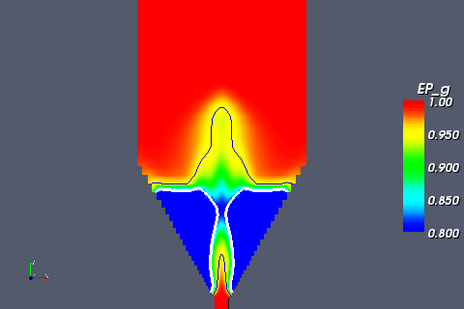
Sample MFIX Application: Nuclear Fuel Coating Process
Ambient Univ. Tenn. experiment
MFIX Simulation
500 μm ZrO₂ at V_{g}=12m/s
Correctly predicts major flow zones
Some hydrodynamic parameters need 'tuning' based on experiments
    Coefficient of restitution (solids-solids, solids-wall friction)
    Solids internal angle of friction (solids flowability)
    Solids stress formulation
    Drag Correlation
    Boundary conditions (e.g. specularity coefficient)
S. Pannala, et al., “Simulating the dynamics of spouted-bed nuclear fuel coaters” CVD, 13, 481-490.
Notes:
The effort focused on the hydrodynamics which controls how the fuel particles and reactant gases are mixed and heated - will yield spatial and temporal changes that may be inaccessible via experiment. The work was validated with experimental observations conducted under high temperature conditions with surrogate particles. The simulations were able to capture the main features of the solids circulation and spout formation. Develop improved fundamental understanding of the dynamics of spouted bed reactors which are used in nuclear fuel coating process. Develop analytical tools that aid coater scale-up and design. Demonstrate simulations with sufficient detail to capture known effects of coater operation and design on quality
While MFIX has the ability to include chemical reactions in both phases, this information would need to be known or approximated. Moreover, highly specialized chemical kinetics and microstructure surface transitions associated with this process would require specialized code modifications to address such issues.

Slide 16
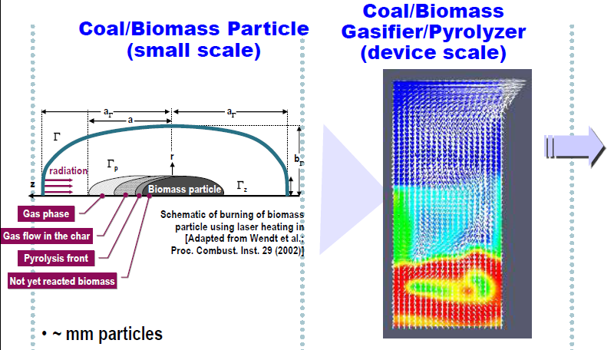
Sample MFIX Application: Coal/Biomass Gasification
Coal/Biomass Particle
(small scale)
Coal/Biomass Gasifier
(device scale)
Design challenge:
Maintain optimal temperatures, species, residence times in each zone to attain right gasification / pyrolysis
Multiscale problem:
~O(13) time scales
~O(10) length scales
~ mm particles
Complex flow: gas phase, gas phase in char, pyrolysis front, unreacted biomass
Wide range of species
Surface processes at nm length scale and ns time scales
~ m in size
Gasification/pyrolysis at high temperatures (~1000°C) in reactor with large residence times ~10 s
Coal/Biomass particles cycle thru wide range of conditions where complex chemistry occurs
Pannala S., et al., Computational Fluid Dynamics in Chemical Reaction Engineering V, Whistler BC Canada — 2008 June 15–20
Notes:
Coal-based power plants are made up of complex devices for handling and processing coal, such as feed systems, gasifiers and combustors of various designs, gas cleanup systems, heat exchangers, etc. These devices are extremely difficult to probe experimentally and are difficult to design using standard engineering tools used for more traditional process industries.
The primary focus of this study is to use computational science with high performance computing to reduce the uncertainties in the design of the industrial-scale gasifier, which is the heart of an Integrated Gasification Combined Cycle (IGCC) plant. The essential function of a gasifier is to convert coal into synthesis gas (a mixture of H2 and CO), which can then be cleanly and efficiently converted into power or transportation fuels and other chemicals. A typical gasifier model consisting of one gas and one solids phase involves solving a number (twenty-two) of coupled partial differential equations for conservation of mass (2), momentum (6), energy (2) and species mass-fraction (remaining 12 equations). A time dependent solution needs to be determined because of the fluctuations in the local flow variables and time-averaged approximations, analogous to single-phase turbulence models, are not yet well developed to model reacting multiphase flows As a result, a gasifier simulation will generally involve hundreds of thousands of time-steps. In addition, typical gasifier problems require computational grids of millions of cells. Such calculations are computationally very intensive and may require days or weeks of computation even on high-end parallel computers

Slide 17
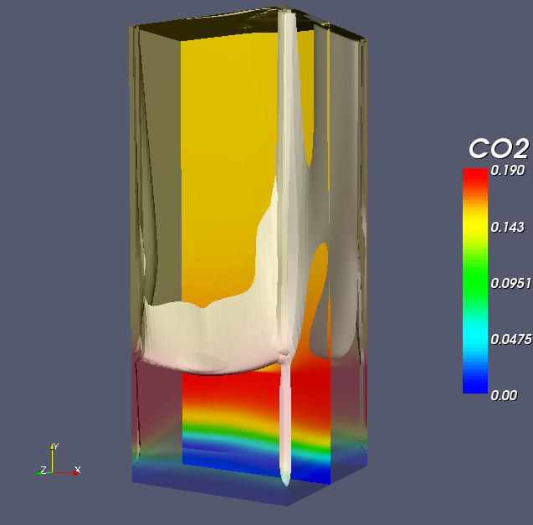
Sample MFIX Application: Coal/Biomass Gasification
  MFIX simulation: 2M cells:10-days run-time for 15s on 256-512 processors
Inlet 3
d_{p} = 200 μm
ρ_{p} = 1.0 g/cm³
ε* = 0.40
Inlet 2
Inlet 1
  Solids accumulate primarily at the corners and top wall
  Gas temperature and CO₂ concentration are strongly correlated
Notes:
For these gasifier simulations, substantial high performance computing resources (i.e., super computer level) are needed to obtain an acceptable turn around time, to refine the computational grid to improve the predictability and to be able to provide timely feedback in the design cycle. Not only is the gasifier model highly complex but the results predicted by the model are also complex and require a significant amount of time to post-process, analyze and formulate a hypothesis
Physics-based models help shorten the design cycle by enabling engineers to conduct what-if studies with models and by increasing the accuracy of scale-up studies for commercial scale operation. High performance computing (HPC) helps us to considerably reduce the time-to-solution and provide the capability to address important problems that need urgent solutions.

Slide 18
Outline
Brief overview on
  multiphase flows (challenges/issues)
  modeling approaches to multiphase flows & CFD
  MFIX & sample applications
Hands on Work
  code installation and general CFD steps
  example 1: pipe flow
    code compilation (mfix.exe)
    simulation setup (mfix.dat)
    Post processing (paraview)
  quick overview of MFIX solver (theory and numerical technique)
  example 2: bubbling bed
  example 3: spouted bed combustor
Coarse Goal: Setup cases and carry out simulations with different levels of difficulty
Notes:
Switch Gears

Slide 19
MFIX Installation (1)
https://mfix.netl.doe.gov/members/index.php
Go to http://mfix.netl.doe.gov/, click on the members link, & sign-in
Download options
  CVS version - users can view latest changes to code and download desirable files through CVSWEB. All modifications are immediately available to user. CVS allows users to retrieve any version of the code and is forever available for public scrutiny.
CVS web interface shows file names, version number, age of the version, developer name, and development notes
Notes:
In 1999, version tracking of MFIX was started by using the concurrent versioning system (CVS) software. CVS (http://ximbiot.com/cvs/) is used for source code revision control. CVS allows several developers to work on the same file at the same time and merge their revisions of the code. User contributions are checked into CVS by gatekeepers.
A test harness, is used to conduct software regression tests. Such testing seeks to uncover regression bugs or broken software functionality that was previously working. Typically, regression bugs occur as an unintended consequence of code changes. The test harness checks out the current version of MFIX every night, builds executables, and runs the test cases identified by the developers.
Three versions of the code can be downloaded from the website: cvs, development and stable verions.
GOTO website
Shown here is CVS version.

Slide 20
MFIX Installation (2)
https://mfix.netl.doe.gov/members/index.php
Go to http://mfix.netl.doe.gov/, click on the members link, & sign-in
Download options
  CVS version - users can view latest changes to code and download desirable files through CVSWEB. All modifications are immediately available to user. CVS allows users to retrieve any version of the code and is forever available for public scrutiny.
  Download 2012-1 version from https://mfix.netl.doe.gov/members/download/mfix.tar.gz
  2012-1 version – New release after major revision. The latest bug fixes are made available for download (updated daily).
  Other major revisions will be available when the next new release is launched (once or twice a year).

Slide 21
MFIX Installation (3) : Linux
Place mfix.tar.gz in your home directory on your system
  For example: /pic/people/your_user_name
At the command prompt, type: gunzip –d mfix.tar.gz
  This will create mfix.tar
Type: tar xvf mfix.tar
  This should create the directory mfix which contains several files and subdirectories
Notes:
Install MFIX (version m.n) from the tar file, go to the home directory and type
For the most part, MFiX is installed, and run through command lines only.
Uncompress the file, read the file
This will create a directory named mfix, which contains the several subdirectories: doc, model, post_mfix, tests, tutorials, and tools.

Slide 22
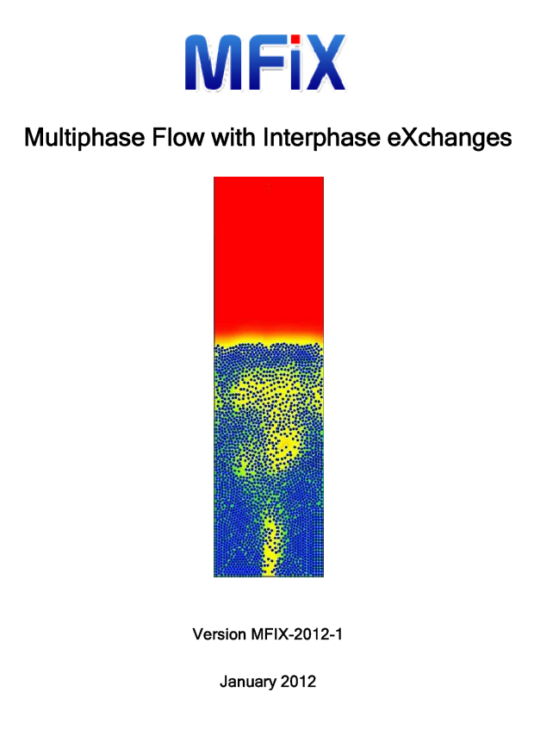
MFIX Download Contents
CHANGES – lists changes from previous versions
Readme.pdf – very important file to get started
doc – various documents, another good resource in addition to the documents online
tutorials – good cases to run and to get familiar with the code and capabilities
model – all the code lies here
tests – good set of cases to go through
tools – various tools, e.g. to generate make files if you add new source files in the model directory
post_mfix – post-processing data analysis tool (extract data from output files)
visualization_tools – post-processing graphical analysis tools (ani_mfix)
Readme.pdf - needed to setup and understand the mfix.dat input file. All keywords used in the input file are explained there, be sure to have it handy!
Notes:
Tests and tutorials. The MFIX directory contains over 40 test cases and 13 tutorial cases. The test cases verify various features of the code in isolation (e.g., fluid flow without solids), and typically run in a short period of time. When a new feature is added to the code, a new case to test that feature is also added to the test-cases directory. The
Documentation. The documentation section provides detailed manuals and developer notes, written for each new feature implemented. It is impractical to synchronize the detailed manuals with a code that is constantly evolving. So, two minimalist manuals are maintained that are continually synchronized with the code: a readme file that lists all the user inputs and an MFIX equations file that lists the current set of equations. The equations file is a version-controlled, citable web document. Also, the code is internally documented with comment lines, which constitute about 62% of the code.
Simple explanations of the keywords used in mfix.dat input file are given in the readme.pdf file. The model directory contains all the source code. Good place to go digging. Going through the MFIX code and understanding how these keywords are used is also very important. Keep in mind that MFIX is an open-source software, so in a sense the source code can also serve as a “documentation”.
“MFIX is an expert user’s software with minimal user support and no training provided”

Slide 23
Steps in CFD
pre-processor
solver
post-processor
problem formulation (the setup)
numerical solution of the governing equations (theory & numerical techniques)
plotting and analysis of the results (examining the data)
mfix.dat – text file with all parameters that define a simulation
mfix.exe – executable of the compiled mfix files
post_mfix.exe – data analysis
ani_mfix.exe – graphical analysis
or
Paraview, Visit, etc…
This is seldom a one-way process. The sequence may be repeated several times with different meshes to establish desired accuracy or with different parameter values to examine sensitivity to that variable
Notes:
CFD applies numerical methods (called discretization) to develop approximations of the governing equations of fluid mechanics in the fluid region of interest. The solution is post-processed to extract desired information
Consists of 3 general steps:
pre processing: Formulation of the problem (governing equations and bc). Construction of the mesh. All parameters that define a simulation are set up in a text file called mfix.dat, that can be edited through a visual text editor such a gedit, or the usual Linux text editor vi. In some cases user-defined subroutines may need to be modified and in more advanced cases some of the source code.
Solving: Discretization of the governing equations, solution of the resulting algebraic equations. This is where we run the mfix executable program.
Post processing: this involves visualization and analysis – discussed on next slide.
Often find we need to do it all over again based on the results!

Slide 24
Pre-processor: General Setup
What is the problem?
  Spend as much time to learn and understand the problem as you can.
  Talk to people with expertise in the application you are trying to simulate. Develop a “feel” about the physics of the flow.
  Flow visualization and experimental data are excellent sources
Once you’re familiar with the problem, then you can attempt to solve it.
  Always start with a simplified case.
  Never start by solving a complicated problem
Notes:
The best way we understand problems is a step-by-step approach. What is the objective of the CFD analysis? What physical phenomena need to be taken into account? What is the geometry of the domain and operating conditions?
The same step-by-step approach applies to numerical solutions. Simplifications of a problem brings it to a level that we can easily understand. Then we incrementally add complexity, so that we understand their effects.

Slide 25
General Setup Advice for Beginners
Simplification of the case is usually done in terms of the physics and geometry of the flow, and the numerics
  All physical geometries are 3D but consider starting with 2D, 1D and/or 0D.
    For example, use 0D geometry to understand chemical reactions (a perfectly stirred reactor).
  Simplification of physics is not straightforward. Here are some examples:
    Before attempting to solve for a hot reacting flow consider a cold non-reacting flow then add heat transfer.
    For reacting flow consider simplifying the reaction kinetics to only a few basic steps then add reactions stems incrementally (if possible).
    If a flow is turbulent, first solve for a laminar flow.
    If a flow has several solid phases, first understand the flow of a monodisperse powder then add solids phases.
  Numerics
    Start with a coarse grid, then refine the mesh incrementally.
    Never run a simulation for a long time without checking the results.
      Run a simulation for a few time-steps and stop it. Examine .OUT file. Check the geometry and grid (using ani_mfix). Check the boundary conditions (using post_mfix). You may detect mistakes and save yourself time!
    Start with a lower order discretization scheme, then select a higher order method.
S. Benyahia
Notes:
Geometry:
Definition of geometry of region of interest (computational domain). Grid generation – sub-division of domain into number of smaller sub-domains: grid (mesh) of cells (control volumes/ elements). Specification of appropriate boundary conditions
Physics:
Selection of physical and chemical phenomena that needs to be modeled.
Definition of fluid properties.
Numerics:

Slide 26
Simulation Setup in MFIX
Build mfix.dat from scratch or modify an existing mfix.dat
  Review test and tutorial cases
    Run cases closet to your desired configuration (physical setup)
    Consult the Readme.pdf to get yourself familiar with the keywords in the mfix.dat file
  Pick the mfix.dat closest to your interest
  Make necessary changes (remember start simple!)
    Start with hydrodynamics (laminar then turbulent; single then multi-phase)
    Next add heat transfer
    Then add mass transfer with chemical reactions (incrementally)
Notes:
All other important documentation, such as readme.pdf file needed to set-up and understand the mfix.dat input file can be downloaded from the MFIX website. All keywords used in the input file are explained there, be sure to have it handy.
Simple explanations of the keywords used in mfix.dat input file are given in the readme.pdf file. Going through the MFIX code and understanding how these keywords are used is also very important. Keep in mind that MFIX is an open-source software, so in a sense the source code can also serve as a “documentation”.

Slide 27
Post-processer: Tools/Utilities
In-house
  post_mfix – command line tool for data retrieval and manipulation
    Use your own post_mfix compiled in the same environment you ran mfix
    Or use a pre-compiled Windows executable
      Download from https://mfix.netl.doe.gov/members/download.php
  ani_mfix – older minimal GUI tool for visualizing results (not supported anymore)
    Use pre-compiled Linux or Windows versions.
      Available in mfix/ sub-folder: mfix/visualization_tools/animate/
External
  Visit (https://wci.llnl.gov/codes/visit/)
  Paraview (http://paraview.org/)
  Any software for creating/editing videos (taking still images and create a streaming video)
Notes:
Recall two post-processing codes are available for visualizing the results and extracting data in the form of tables from the output files. One is post_mfix which is a command line interface for data analysis. The post-processing program POST_MFIX is used for retrieving data from the .RES and .SPx files. POST_MFIX is compiled with fairly large array sizes, and hence it will work for most MFIX runs.
Graphical representation of MFIX results can be obtained by using the ANIMATE_MFIX program. This program should be accessed from the run directory, which contains the .RES and
.SPx files. First, the program will request a run name. After receiving a valid run name, the program will check whether the two files ani_mfix.ini and ani_mfix.mm (min max) exist in the run directory. If these files are not found in the directory, certain default values are used for configuring the ANIMATE_MFIX display and the files are written with these default values.
Ani_mfix has a limited GUI for visualizing the results but is not as well supported anymore. Users are now being encouraged to use the program Paraview.
Software for creating videos:
AVI (Audio Video Interleave) has been the long standing format to save and deliver movies and other video files. It has been around for a very long time and has been improved over time. AVI is used when you want to capture or show a lot of detail. The MPG MPEG (Moving Pictures Expert Group) format is a glossy encoding of video and audio, sacrificing a little bit of detail in order to save a lot of space. MPG videos are very prominent in the internet where bigger files take longer to download, so it makes sense to encode in a smaller file size even if there is a minor loss in quality.

Slide 28

http://www.paraview.org
ParaView is an open source data visualization application
  A reader has been created to allow the ParaView user to read native MFIX result files (.SPX, .RES) into ParaView without translating them
Download paraview for Windows http://paraview.org/paraview/resources/software.html
Proceed with installation
For more help on Paraview http://www.paraview.org/Wiki/ParaView/Users_Guide/Table_Of_Contents

Slide 29
Outline
Brief overview on
  multiphase flows (challenges/issues)
  modeling approaches to multiphase flows & CFD
  MFIX & sample applications
Hands on Work
  code installation and general CFD steps
  example 1: pipe flow
    simulation setup (mfix.dat)
    code compilation (mfix.exe)
    post processing (paraview)
  quick overview of MFIX solver (theory and numerical technique)
  example 2: bubbling bed
  example 3: spouted bed combustor
Coarse Goal: Setup cases and carry out simulations with different levels of difficulty

Slide 30
Setup
Steps in CFD: Pre-Processor

Slide 31
Hands on Example 1: Pipe Flow
Incompressible gas flows through a horizontal section of pipe 7 cm wide and 100 cm long. The pressure drop is 0.1 dyne/cm².
Simulate this pipe flow using a 100 x 7 grid.
L_{x}= 7 cm
Δp = -0.1 dyne/cm²
L_{y}=100 cm
fluid density (ρ_{g}) = 1 g/cm³
fluid viscosity (μ_{g}) = 0.01 g/(cm*s) [Poise]
Notes:
We know that for fully developed laminar flow a parabolic velocity profile will develop in a circular flow passage.
In this case we know the pipe geometry, fluid properties and pressure drop.

Slide 32
Pipe Flow Example: mfix.dat
#
# developed flow -- use cyclic condition
#
# F.B. Modeler 9-6-94
#
# V_g(2,j,k) = delp_y * XLENGTH^2/(4*mu_g0*YLENGTH) (BSL p.46)
#
#
# Run-control section
#
RUN_NAME = 'COL01'
DESCRIPTION = 'developed laminar flow'
RUN_TYPE = 'new' ! 'restart_1' !
UNITS = 'cgs'
# TIME =0.0 TSTOP = 1.0E-4 DT = 1.0e-4 DT_MAX = 1.0e-4 OUT_DT = 1.0e-4
ENERGY_EQ = .FALSE.
SPECIES_EQ = .FALSE. .FALSE.
MOMENTUM_X_EQ(1) = .FALSE.
MOMENTUM_Y_EQ(1) = .FALSE.
LEQ_IT(1) = 20
LEQ_IT(3) = 50
LEQ_IT(4) = 50
! UR_FAC(3) = 0.7 LEQ_METHOD(3) = 2
! UR_FAC(4) = 0.7 LEQ_METHOD(4) = 2
GRAVITY = 0.0
#
# Geometry Section
#
COORDINATES = 'cylindrical'
XLENGTH = 7.0 IMAX = 7
YLENGTH = 100.0 JMAX = 10
NO_K = .TRUE.
CYCLIC_Y_PD = .TRUE.
delp_y = -0.1
MAX_NIT = 3000
TOL_RESID = 1.E-4
#
# Gas-phase Section
#
RO_g0 = 1.0
MU_g0 = 0.01
MW_avg = 29.
#
# Solids-phase Section
#
MMAX = 0
#
# Initial Conditions Section
#
!
IC_X_w = 0.0
IC_X_e = 7.0
IC_Y_s = 0.0
IC_Y_n = 100.0
IC_EP_g = 1.0
IC_U_g = 0.0
IC_V_g = 0.0
#
# Output Control
#
RES_DT = 0.01
OUT_DT = 10.
!
! EP_g P_g U_g U_s ROP_s T_g X_g
! P_star V_g V_s T_s1 X_s
Note default wall boundaries are implied
More on this section in following slides
Notes:
The problem described above is coded into an MFIX data file called mfix.dat, which will be located in the directory in which the calculation is initiated. It is desirable to include a few (optional) comment statements to identify the problem, the author, creation date, etc., in the data file as shown below.
The variable names may be entered in any order. For the ease of writing and reading the data file, however, grouping of similar data items (as done in the examples) is suggested for readability. For details of the various data items, refer to the README
RUN CONTROL/NUMERICS
Section defines parameters that control how the computer runs the code, as the term suggests
The name used to label the output files when they are created is defined as RUN_NAME and the nature of the problem addressed by this run is defined (in 60 characters or less) in DESCRIPTION. The units used for data input and output are listed in UNITS. The type of run (a new run or a previous run that is being restarted) is listed in RUN_TYPE. For the very first run of any particular simulation, the RUN_TYPE must be set to 'new’. After that, if a normal restart run is desired (with no additional user-defined changes to the restart file), RUN_TYPE should be given the value 'restart_1'. The starting and stopping times are defined in TIME and TSTOP, respectively. The starting time step is defined in DT. If this variable is not defined, a steady state calculation is performed (THE CASE HERE). ENERGY_EQ controls whether or not energy equations are solved, by being set to '.TRUE.' or '.FALSE.' Similarly, the value of SPECIES_EQ controls whether or not species equations of phase m are solved. In this case, m has the value one (0- gas phase) and the '.F.' indicates that such equations are not to be solved. The value of the final variable in this section, CALL_USR, determines whether or not user-defined subroutines are called.
To reiterate note that this .dat a steady state calculation (dt is not set and so is ‘undefined’) is being used.. It is cold non-reactive flow. With no ‘species’. For ‘horizontal flow’ gravity is set to zero. (Due to definition of momentum equations – discussed below)
GEOMETRY/BOUNDARY CONDITION
The GEOMETRY section gives the basic parameters of the reactor. We have pipe flow so we select cylindrical coordinates. In MFIX, x represents the radial direction, y direction represents the axial direction and z the azimuthal. The width (in the length units defined in UNITS) is listed as XLENGTH. In cylindrical coordinates this is essentially the radius of the bed. T calculate the actual diameter of the reactor, XLENGTH must be doubled. The number of cells in the radial (x) direction is defined as IMAX. The height of the reactor is listed as YLENGTH and the number of cells in the axial (y) direction is defined as JMAX. We know the flow is symmetric. So select 2D axi symmetric by turning off the k direction (azimuthual direction. Y-axis is the axis of symmetry). In 3D cylindrical coordinates the centerline is the y-axis and it acts as a 'free-slip/zero-flux' wall. The reactor length in the z direction is defined as ZLENGTH and the number of cells in the z direction is defined as KMAX. In cylindrical coordinates, the z direction is the azimuthal angle.
Generally by using cyclic boundaries we can simulate a large system by modeling a small part. In periodic/cyclic boundaries when an object passes through one boundary it will appear on the opposite face with the same velocity. In MFIX we can specify pressure drop over periodic boundaries which enables us to model fully developed flow throughout domain. Fully developed flow = does not vary along axis of flow. Constant pressure drop
The PHYSICAL PARAMETERS section is rather small in this test case
GAS PHASE– define properties
The GAS section defines variables pertaining to the gas phase. The average molecular weight of the gas is listed in MW_avg and the specified constant gas
density is defined in MU_g0.
SOLIDS PHASE– MMAX = 1 by default so need to explicitly set to 0 to ‘not’ model solids. MFIX was designed for modeling multiphase dense fluid solid systems. So by default a solid phase is modeled. Thus we must explicitly turn it off.
INITIAL CONDITION
The INITIAL CONDITIONS section specifies the initial condition (IC) of a number of variables over a pie-shaped (cylindrical coordinates) or rectangular (Cartesian coordinates) region that corresponds to a numerical grid.
Although we are specifying a steady state problem IC are required. An occasional input-processing error is the inability to determine the flow plane for a boundary condition. The boundary planes defined in the input data file must have a wall-cell on one side and a fluid-cell on the other side. If the initial condition is not specified for the fluid-cell, MFIX will not recognize the cell as a fluid-cell and, hence, MFIX will be unable to determine the flow plane.
The radial boundaries are defined by the values of X_w and X_e (“west” and “east”), the axial boundaries by Y_s and Y_n (“south” and “north”), and the z-direction boundaries by Z_b and Z_t (“bottom” and “top”). Please note that x values are listed for only one side (wall) of the reactor (the other ‘side’ is the free-slip center line).
BOUNDARY CONDITION
The BOUNDARY CONDITIONS section general lists all the boundaries defining/surrounding the numerical domain. Note the default boundary for MFIX are wall boundaries. The inlet/outlet (north/south) face/edges are specified by cyclic. The x face/edges are wall boundaries by default (No slip boundary).
OUTPUT
This section contains directions for creating the output files.
These list the interval at which various files are written. The interval at which the restart file (Run_Name.RES) is updated is stored in RES_DT. Similarly, the interval at which the Run_Name.SPX files are updated is stored in SPX_DT. These are the files that contain the indicated field data. The interval at which user-defined outputs are written from the subroutine WRITE_USR1 is stored in USR_DT. The interval (in number of time steps) at which the Run_Name.LOG file is written is stored in NLOG. Giving the final variable, FULL_LOG, the value “.TRUE.” indicates that the compiler should display the residuals and messages about convergence on the screen and in the Run_Name.LOG file. The progress of the run will be displayed at the terminal as will be shown in our example case. Specify residuals to be printed as 4-character strings. First character specifies the field variable: P - pressure, R- density, U - u velocity, V - v velocity, W - w velocity, T - temperature, X - species mass fraction, G – Granular temperature. The second number specifies the phase (0 for gas). The last two numbers specify the species index; e.g., 'P0' - gas pressure, 'R1' - solids phase 1 density, 'X001'- gas phase, species 1; 'X203' - solids phase 2, species 3; 'K0' - k-ε residuals.
Note that besides this example the problem could be approached differently:
For example we could set it up for flow through a pipe with a specified uniform velocity inlet – allow flow to become fully developed. And/Or we could modify the inlet boundary so we have a parabolic velocity inlet. Easier done by modifying usr0.f routine to change inlet rather than modifying ‘bc’ in mfix.dat.

Slide 33
Boundary Conditions
Solution of a set of PDE’s requires a set of boundary conditions for closure
Boundary conditions are required at all boundaries that surround the flow domain
By default a wall boundary condition is assumed unless you specify otherwise
  A wall boundary condition specifies no slip. If you are solving mass or heat transfer then you need to specify the boundary conditions for these variables either as a flux or boundary concentration.
General WALL Momentum BC in MFIX
v – solids velocity
v_{w} – wall velocity
n – outward normal (from assembly to boundary)
h_{W} – coefficient
Notes:
The node value at the ghost cell center (i) is ‘solved’ so that the value at the boundary (i+1/2) meets the criteria given by the specified boundary condition

Slide 34
MFIX Output (1)
See the readme.pdf for details
.OUT
  A text file that in the first part echoes the input specified by mfix.dat and default values.
  The file also contains data on field variables written at intervals OUT_DT (if defined)
  Use this file to ensure the input data has been entered correctly. Pay attention to the IC and BC regions
.LOG – run time messages
  Contains errors that are reported while processing input data and during run time (information on convergence and number of iterations).
  File is written at frequency of NLOG (the number of time steps)
  A message is also written to this file whenever the .RES and .SPx files are written
  Keep track of the progress of the run by looking at the end of this file
.RES
  The .RES file is a double precision binary file containing all the data required for restarting a run
  The file is updated at intervals RES_DT
  Only the most recent data set is retained in this file
we’ll look at this file shortly
we’ll look at this file shortly
Notes:
MFIX reports errors while reading the data file, while processing input data, and during the run time.
TERMINAL: (covered earlier)
Errors in reading the data file and in opening files are reported to the terminal. All other errors are reported in the .LOG file. While reporting errors in reading the data file, MFIX displays the offending line of input, so that the error can be easily detected. The possible causes of error are (1) incorrect format for the name-list input, (2) unknown (misspelt) variable name, or (3) the dimension of the name-list item is too small. For example, if the dimension of DX is set as 5000 (DIM_I in param_mod.f ), and if the input data file contains an entry DX(5001), MFIX will report an input processing error.
If FULL_LOG is specified as true then the progress of the run will also be displayed at the terminal as earlier.
OUT FILE: (check your setup)
When a new problem is being set up, run MFIX with TSTOP=0 and OUT_DT specified. MFIX will then read the data file, write an .OUT file, and stop. Examine the .OUT file to verify that the input data has been entered correctly. Then start the MFIX run again by setting TSTOP to the appropriate value and leaving OUT_DT unspecified. Pay particular attention to the map of cell flags in the .OUT file to ensure that initial condition regions, boundary conditions, and internal surfaces are at the correct locations. The initial and boundary conditions specified are shown in the following map. Each computational cell is represented by a string of three characters. The first character represents the type of cell, and the last two characters give a number that identifies a boundary or initial condition. For example, .02 indicates a cell where Initial Condition No. 2 will be specified. Only the last two digits are written, although the number of initial and boundary conditions are only limited by the DIMENSION_IC and DIMENSION_BC statements in param
For problems using a large number of nodes, it is recommended that OUT_DT not be defined, to prevent the .OUT file from becoming voluminous. A similar text file of field-variable data may be written by using Option 5 of POST_MFIX.
LOG FILE: (check your progress)
The .LOG text file contains error messages, information on convergence and number of iterations, and messages about the output files being written.
While processing the input data, MFIX will report errors if the data specified is insufficient or physically unrealistic. MFIX will supply default values only when it is certain that giving a default value is reasonable.
While running this file contains error messages, information on convergence and number of iterations, and messages about the output files being written.
Specifically, MFIX will report any instance of non-convergence encountered to the LOG file. The message will show MbErr%=(errorpercent(0)). When converged it will show Sm= and MbError%(0,MMAX): errorpercent(M), M=0,MMAX.
Sm = total solids mass in the reactor at the given time step calculated in get_smass .
MbErr or MbError represents the overall mass balance error for a given time step as % of a maximum flux term (accumulation, flux_in, flux_out). The error is calculated in calc_resid_mb as (accum_new – acum_resid_g) – (flux_in-flux_out) where the first term represents the different in total mass of gas in reactor from one time step to the next will omitting any lost/gained by rxn. The second term represents the total mass entering/leaving the reactor in a given time step.

Slide 35
MFIX Output (2)
See the readme.pdf for details
.SPx
  The .SPx files are single precision binary files containing data for various field variables
  The files are augmented at intervals SPx_DT
  The files retain all the data sets written to them
SPX_DT(11) | Interval at which .SPX files are updated
.SP1 | void fraction (ep_g)
.SP2 | gas pressure, solids pressure (P_g, P_star)
.SP3 | gas velocities (u_g, v_g, w_g)
.SP4 | solids velocities (u_s, v_s, w_s)
.SP5 | solids density (rop_s)
.SP6 | gas and solids temperatures (T_g, T_s)
.SP7 | gas and solids mass fractions (X_g, X_s)
.SP8 | granular temperature (theta_m)
.SP9 | user defined scalars
.SPA | reaction rates – use NRR and REACTION_RATES
.SPB | turbulence quantities

Slide 36
Compile and Run mfix
Steps in CFD: Solver

Slide 37
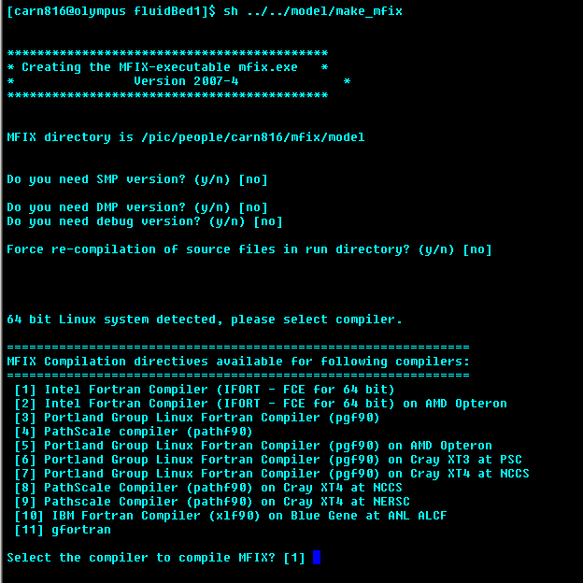
Create a Serial MFIX executable
From now on you can follow the instructions in the Readme.pdf for Linux installations. Here is a quick summary:
Go to the developed_pipe_flow test and type:
  cd mfix/tests/developed_pipe_flow
  sh ../../model/make_mfix
  Choose the default settings for compilation options and for the compiler, chose Intel Fortran (option 1)
Note: that makefile should be invoked as “sh make_mfix.” Erroneously invoking it as “make_mfix” will cause the user defined files not to be used for the build
Notes:
This should start the compilation process and depending on the computer this might take a long time
This requires loading the correct modules in your system: Module load <>

Slide 38
Notes on Compiling MFIX
Always compile in a directory outside mfix/model
  It can be your home directory or mfix/run or whatever you would like to name
The make_mfix script will exit if you attempt to compile in the model directory. This is to prevent you from inadvertently making any changes to the model directory.
Editing source files in the model directory (more advanced)
  Copy any files that you want to edit from the mfix/model directory to your run directory.
  Edit them in your run directory.
    Edit them Cygwin/Linux based editors such as vi, nedit, emacs, etc...
    Edit using Windows Notepad is not recommended
  The make_mfix script will automatically pick up your files.
    The make_mfix script backups the original files in the model directory (*.0f) and compiles the modified ones by copying them over to the model directory. When you go to a new run directory where you do not have these modified routines, it will restore the original files. That way you can keep track of your changes and corresponding results in a systematic way.
Notes:
See slide for details
Note that both Windows and Unix use ascii characters but the files are not the same. At the end of each line in the windows text file are two carriage control characters (to help the dot matrix printer work properly). (^M) (Cntl-M). But for Unix, the carriage return character is not used. There is just a line feed character at the end of the line. The result is that when you read a Windows file into Unix you are left with carriage return characters at the end of the lines. Linux will honor the carriage return character as being a real character and will add it to the end of a variable string, for example, if that occurs at the end of a line. This can become a problem during file transfer.
A common way to transfer files between a computer and a server is FTP. All FTP software can transfer files in "ascii" or "binary" mode. In "ascii" mode, the FTP software will convert line breaks, while in "binary" mode it will not. In "ascii" mode, transferring a Windows file from a Windows PC to a Linux server results in a UNIX file on the server. Downloading the file again converts it back to Windows. This system works perfectly if you remember to turn on "ascii" mode for text files. Many FTP clients also have an "automatic" mode that switches between ascii and binary depending on the extension of the file you're transferring.
Things go wrong when mixing "ascii" and "binary" transfers. When a webmaster uploads a Windows file to a Linux server in "binary" mode, the file has CR LF line breaks on the server. If you then download that file with your web browser on your Windows PC (which does the UNIX->Windows conversion), the browser will interpret the file on the server as a UNIX file, even though it is in Windows format. It will convert each LF into CR LF, resulting in a file that uses CR CR LF as line breaks.

Slide 39
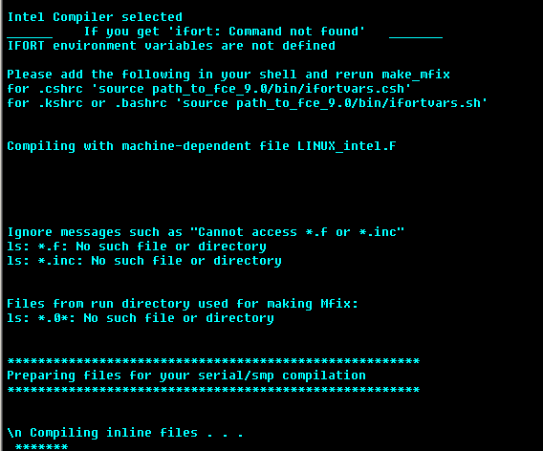
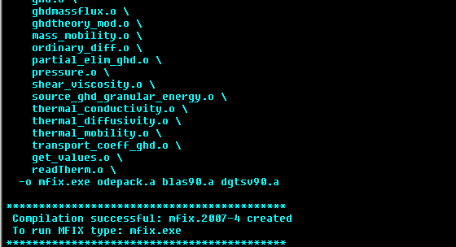
Successful Compilation
  mfix.exe will be copied into the run directory
  mfix.exe is only created when you have a successful compilation
Note: to get more familiar with Linux/Unix you can do a Google search on unix primer
Notes:
At the end you should have the executable mfix.exe in this directory. To list the files you can use the 'ls' command

Slide 40
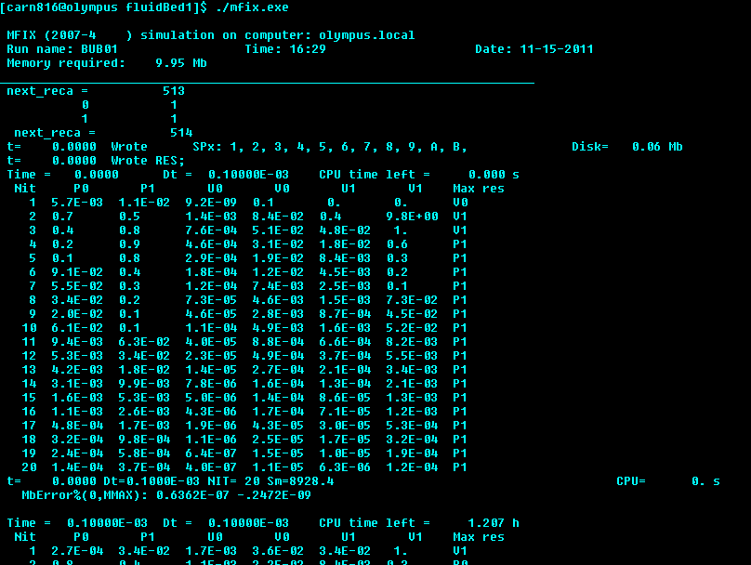
Running MFIX
After successful compilation, run the case by typing: /mfix.exe
Other useful variations
  Run mfix in the background: mfix.exe &
    Send existing job (running mfix simulation) to background: Ctrl-z (suspends the job) then bg (sends the job to the background) or fg (brings the job to the foreground)
  Run mfix.exe in the background and redirect screen output to file run.log: mfix.exe > run.log &
    You can then examine the contents of run.log. For example to examine the last part of the file: tail run.log
    Type top or ps to see the job running. Press q to leave top.
Arbitrarily chosen file name
Notes:
A separate subdirectory should be created for each run. Write or modify user defined files in the run directory. Write an MFIX data file and name it mfix.dat. Create an MFIX executable file by typing sh make_mfix. After the successful creation of the MFIX executable (mfix.exe), it is time to run the code.
To do so, you may run MFIX in the foreground For example, you might type: ./mfix.exe Or
You may run it in the background. Enter the command followed by the ampersand (the & symbol tells the computer to run the process in the background). This will return the command prompt allowing you to interact with your terminal and execute the job. When you run a job in the background the shell will respond with a number – the PID (process identification number). It is useful if you want to halt or kill the program. Type top or ps to see the job running. Press q to leave top. Or
You may run it in the background and pipe the output to a file. ./mfix.exe > run.log &
In this case the run.log is the name of the output file (arbitrarily chosen) and the & symbol tells the computer to run the process in the background. Note that the shell does redirection before it creates a process, not after, so if you have not redirected the output you may be out of luck there. While the code is running, you may check the status of the output using the tail command (type: tail -f run.log. After the run has finished, you may view the entire output file using a text editor, or view the last few lines of it using tail (e.g., to view the last 100 lines, type: tail -100 run.log).
OUTPUT with FULL_LOG = .TRUE.
Messages about divergence and recovery are displayed on the terminal and in the .LOG file. If FULL_LOG = .TRUE. the progress of the run will be displayed. The first line shows the time, the time-step, and the CPU time remaining to complete the run. The CPU time remaining is not accurate, especially in the beginning of the run. For each timestep, the normalized residuals for various equations are written out every iteration. MFIX uses a variable time step, which is automatically adjusted within user-defined limits to reduce the run time. At large values of Dt, the iterations may not converge. When this happens, the time step size is successively reduced until convergence is obtained. The subsequent lines display the iteration number, the normalized residuals for various equations (e.g., gas continuity, solids continuity, x and y gas momentum, and x and y solids momentum), and the equation with the maximum residual. The residuals P0 and P1 are normalized only when Nit>1. The residuals displayed can be selected with the keyword RESID_STRING.

Slide 41
Visualize the results
Steps in CFD: Post-Processing

Slide 42
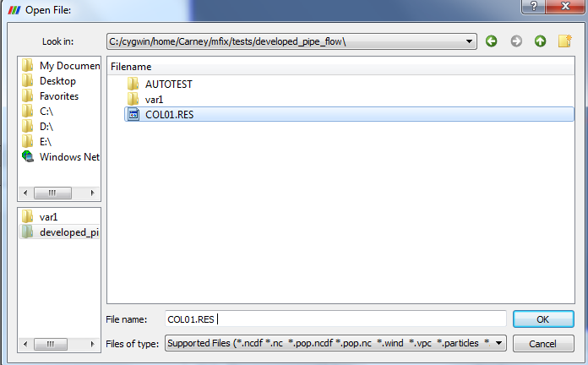
Pipe Flow Example: Visualize the Results
Launch paraview from desktop shortcut or from program menu and select the *.RES file

Slide 43
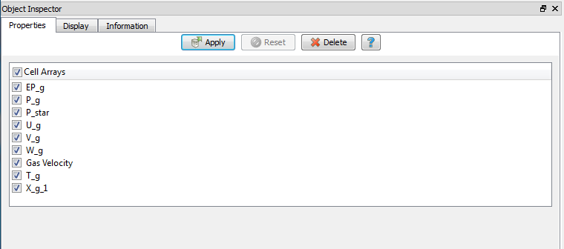
Pipe Flow Example: Visualize the Results
Select the data you need – safe to select all and press apply button

Slide 44
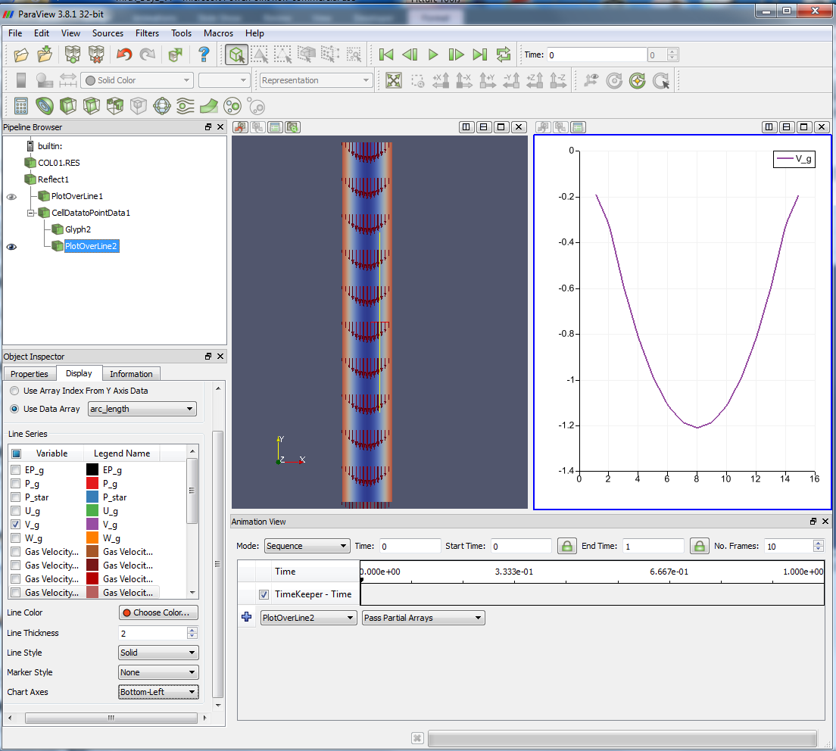
Pipe Flow Example: Visualize the Results
Notes:
Walk through pipeline.

Slide 45
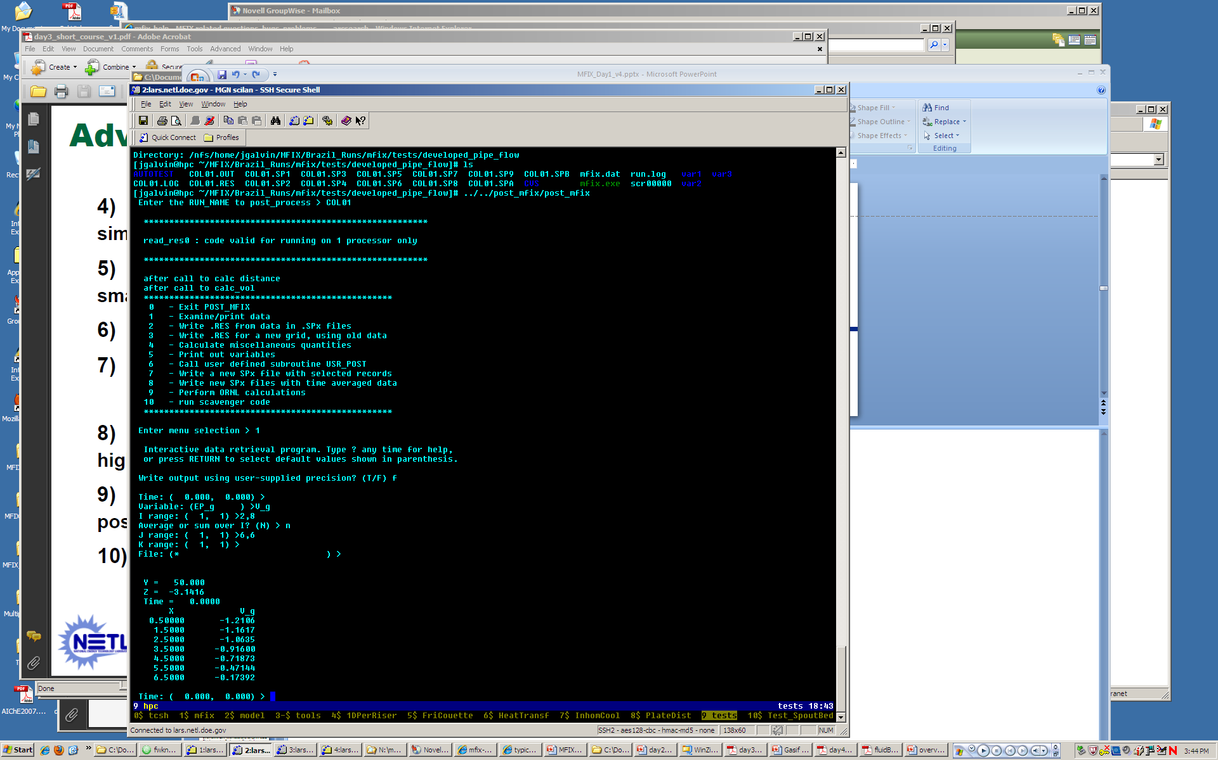
Pipe Flow Example: Visualize the Results
Launch post_mfix
  Go to the post_mfix folder and type sh make_post
  Choose the default settings for compilation options
  Post_mfix will be created in the post_mfix folder
  Start post processing from run folder by typing ../../post_mfix/post_mfix
  Enter run name : COL01
  Examine the data: option 1
Notes:
Post mfix can also be used to write special restart files (when it is necessary to restart a run from an earlier time).
For example consider a run that aborts at 5.3s and the data in .RES file is so corrupted that you cannot restart the run. The user might wish to restart the run from an earlier time step. It is not possible to do this directly since the .RES file contains only the most recent data. Option 2 becomes useful in this case since it enables the user to write the .RES file at a different time (option 2 will modify the files so the run is set back to the specified time).
Option 3 is useful for creating a .RES file from an existing .RES file. The new .RES file can be for a refined or coarser grid, for different dimension or even gas or solids species. This option requires a new mfix.dat file containing all disregard modification to geometry and species.
Other post mfix options are listed.

Slide 46
Pipe Flow Example: Visualize the Results
Option 1: interactive program for examining MFIX data and writing data into text files. Typical steps:
  time
  variable name (type ? for help/list)
  i, j, k range (if exceed range user will be reminded) and whether average/sum
  output to file/screen
Note: By specifying no file name or * the data is displayed at the terminal. If a ! Is specified then post_mfix returns to the beginning of option 1 menu without retrieving data
Notes:
In this example:
The axial gas velocity (V_G) is selected.
When the range of I indices is given as 2 to 10 the user may be reminded the maximum I in this run is 9.
No averaging is desired.
The velocity profile is at a desired axial location corresponding to J=6.
This is a 2D run so no need to specify the azimuthal direction.
By specifying no file name or (*) the data is displayed at the terminal.

Slide 47
Outline
Brief overview on
  multiphase flows (challenges/issues)
  modeling approaches to multiphase flows & CFD
  MFIX & sample applications
Hands on Work
  code installation and general CFD steps
  example 1: pipe flow
    simulation setup (mfix.dat)
    code compilation (mfix.exe)
    post processing (paraview)
  quick overview of MFIX solver (theory and numerical technique)
  example 2: bubbling bed
  example 3: spouted bed combustor
Coarse Goal: Setup cases and carry out simulations with different levels of difficulty

Slide 48


TFM Theory
Continuum Modeling of Multiphase Flow
N-S equations can be simply derived from a general balance (shell balance/control volume) approach for single- or multi-phase flows^{1,2}
The same N-S equations can be derived from a kinetic equation, such as the Boltzmann equation²
rate of ‘stuff’ accumulation in the element
+
rate that ‘stuff’ enters/exits the element
=
rate of ‘stuff’ formation/ consumption in the element
    The transport equations for any quantity can be obtained from the above equation:
    Note: The resulting equations take the same basic form for fluid and solids except for additional term in solids “energy” balance due to particle inelasticity!
    1. Bird-Stewart-Lightfoot, Transport Phenomena (1960)
    2. Gidaspow , Multiphase Flow and Fluidization (1994)
Notes:
The Boltzmann equation states that the probability density function f rate of change for a system of particles can only change due to collisions and nothing else. In this approach the solids conservation equations take the same basic form as the fluid with an additional term arising due to particle inelasticity.
The nice thing of using kinetic theory approach to derive NS equations is the fact that it will give you closures for the transport coefficients, such as pressure and viscosity. However, to solve the pertinent boltzmann equation is non-trivial. Variety of methods: grad moment of methods, chapman enskog expansion, or simply assuming a form of the probability density function.
(Recall boltzmann kinetic equation is for dilute flows (no excluded volume) versus enskog kinetic equation and revised enskog theory for spheres of finite sphere- moderate density).
Doing a shell balance will give you the conservation equations, but you won’t know how to close the problem.

Slide 49
Steps in CFD: Solver
Continuum Modeling of Multiphase Flow
“Derive” balance equations by averaging local, instantaneous behavior:
  Space, time, or ensemble averaging^{1,2,3,4,5}
Details of flow field around particles and individual particle collisions are averaged
Account for the information lost due to averaging through constitutive relations, which specify how the phases behave and interact with each other
Solids
Size 1
Gas
Size 2
1. Drew and Lahey (1993); 2. Anderson and Jackson (1967), 3. Drew and
Segel (1971), 4. Ishii (1975), 5. Joseph and Lundgren (1990),
Notes:
“shell balance approach”
Assuming that the different phases can be mathematically described as interpenetrating continua, different approaches can be used to derive the multiphase flow equations. In the averaging approach, the equations are derived by space, time, or ensemble averaging of the local, instantaneous balances for each of the phases
This process gives rise to unknown terms that require constitutive relations. Constitutive equations determine the behavior/flow of the phases and how they phases interact with each other

Slide 50
Continuum Modeling for Non-Reactive Flows
Continuity
ε_{g} = void fraction
ε_{sm} = m^{th} phase solids vol. fraction
ρ_{g} = gas density (material)
ρ_{sm} = m^{th} phase particle density (material)
g = gravitational acceleration
u_{g} = gas phase velocity
u_{sm} = m^{th} phase solids velocity
θ_{m} = m^{th} phase granular temperature
Momentum Balance
stress
g-s drag
s-s int. force
Granular Energy Balance
“heat” flux
dissipation
See https://mfix.netl.doe.gov/documentation/MFIXEquations2005-4-4.pdf
Notes:
Shown here are typical mixture mass and momentum balances. These equations are written in an Eulerian frame using the two-fluid model. New field variables, the phasic volume fractions, are introduced to track the fraction of the averaging volume occupied by each phase.
These are the non-conservative form of the momentum equations. MFIX solves non-conservative form of momentum.
When switching to the non-conservative form using continuity the additional terms do appear (you see this in the code). I think by doing this step, the solution is forced to satisfy continuity during iterations. If you have access then Patankar's book section 5.3-1 elaborates on the matter (subtracting continuity). That is, the terms that do appear in the source u/v/w file are terms that arise from subtraction of the appropriate form of the continuity equation. So, the solids phase u momentum equation will have its mass transfer term multiplied by U_s0 while the gas phase u momentum equation will have its mass transfer term multiplied by U_g0.
Boxed quantities are unknown terms that require a constitutive relation. For example, for a Newtonian fluid stress is closed using Newton’s law of viscosity. The solids conservation equations take the same basic form. The constitutive relations are solids stress, granular heat flux, and a granular energy sink due to particle collisions. Compared to the continuum equations for fluids the last term is the only new term and it arises due to particle inelasticity. Providing closure for the unknown terms in the solid conservation equations is quite challenging and is the subject of much research.
For a cold non-reacting flow, the only link between the phases is through drag. This term is very important in gas-solids flows and different approach are used to model it. Semi-empirical correlation are commonly used, but theoretical models from LBM simulations are also available. In terms of significance of all these terms, we can usually say that the pressure drop is balanced by the drag. Gas stresses can be easily ignored especially for dense systems.
Shown are the overall momentum balances.
NOT SHOWN:
The momentum balances can be written for each component (not shown). In the axial momentum balance, we can say (without much loss of accuracy) that the weight of the bed is balanced by the drag. From the previous slide we can conclude that from the global momentum balance, the solids weight is balanced by the gas pressure drop. In the radial direction, this is not true. This was the reason for expanding the solids stresses. This was the reason for expanding the solids stresses. The most important term is the solids pressure, it usually causes solids segregation in a riser simulation. Solids bulk viscosity is important mainly in an accelerating flow such as close to an inlet boundary as it is a resistance to expansion. Solids viscosity is important in riser flows to determine the right profile of solids velocity and hold-up. If it is too high, a low velocity and high solids hold-up is generally computed.
(Also notice that the solids viscosity doesn’t tend to zero as solids volume fraction tends to zero. This has been corrected in the literature (Jennifer Curtis Sinclair and Michel Louge) by setting a maximum mean free path for particles to the vessel diameter)

Slide 51
Continuum Modeling for Non-Reactive Flows
Behavior of Particulate Flow
Plastic flow
Transition
Rapid flow
Slowly shearing
Enduring contacts
Friction transfer of momentum
Rapidly shearing
Transient (binary) contacts
Translational or collisional transfer of momentum
Developing Closure Models
Experimental information
  Ergun equation -> fluid-particle drag
Microscopic description of the material behavior
  Kinetic theory (KT) -> granular stresses
  LBM -> fluid-particle drag
See https://mfix.netl.doe.gov/documentation/MFIXEquations2005-4-4.pdf and https://mfix.netl.doe.gov/documentation/Theory.pdf
Notes:
Recall constitutive equations describe the behavior/flow of the phases. Developing constitutive relations for the solids phase is a challenging task. This is a challenging task. A variety of techniques have been employed to provide closure, which range from heuristic arguments and empirical information to the more sophisticated methods based on dense-gas kinetic theory modified to account (as discussed earlier).
Solids flows are often categorized depending on the behavior of the individual grains. If the particles undergo long enduring contacts in which the bulk material exhibits a solid- like behavior (e.g. soil mechanics,silos), then the system is considered in the quasi-static or slow-flow regime. On the other hand, if the particles move freely and interact via nearly instantaneous collisions (e.g. ice particles in a planetary ring or particles in the top layer of a tumbling mixer), then the system is considered in the rapid-flow regime and is commonly referred to as either collision-dominated flow, rapid flow or a granular gas.
Many of the continuum-modeling efforts for particulate flows have targeted the rapid granular flow regime. As mentioned, in rapid granular flow particle collisions are considered binary and instantaneous. An analogy between the random motion of grains in rapid flow and the thermal motion of molecules is often employed. Correspondingly, granular models have been developed using dense-gas kinetic theory that is modified to account for their essential difference: inelasticity of grains. This approach provides the most sophisticated technique for developing the necessary constitutive relations for the particulate phase (e.g. stress tensor, granular heat flux and dissipation of granular energy) and these models have been successfully applied in both granular flows and to gas-solid flows
Limitations
theory for frictional particles not well developed (slow flow)
very dilute to very dense – no general theory applies to all regimes
Limitations of KT
Applies to spherical particles – not arbitrarily shaped particles
Friction as part of KT description is not well developed
Some KT only applicable to relatively dilute, but still limitations at most dilute (limit of mean free path) and while some may be technically applicable to dense regimes – dense regimes may introduce velocity correlations which are not accounted for by KT
Details of kinetic theory and plastic theory - granular stresses are modeled by the kinetic theory of granular material in the viscous regime and plasticity theory in the plastic regime
KT gives rise to a Granular temperature – Algebraic/PDE
Drag law -Drag law describes the interaction between the gas and the particles

Slide 52
TFM Solver
Discretization
Governing PDEs are discretized into (replaced with) simple algebraic equations
The N-S equations can be discretized using one of many discretization techniques, such as finite difference (FDM), finite volume (FVM), finite element (FEM) methods, etc.
  All these techniques require a computational “mesh” or grid where the equations are discretized in space. This is because N-S equations contain spatial derivatives.
MFIX and many CFD codes use the FVM where the equations are first integrated over a control volume (volume of a single “cell”), then discretized. MFIX uses a staggered mesh where fluxes (such as momentum) are located at cell faces and any scalar quantity (such as pressure or temperature) are located at cell centers.
References
  An excellent reference book to understand the FVM is by Patankar “Numerical heat transfer and fluid flow”, 1980 (Taylor & Francis).
  Specific details of the discretization of all multiphase flow equations can be found in the MFIX numerics guide: https://mfix.netl.doe.gov/documentation/numerics.pdf
Notes:
For numerical solution of the aforementioned equations, the governing differential equations are first replaced by algebraic relations via discretization. As is often used in the field of computational fluid dynamics, MFIX employs a control volume approach to convert the integrated balance equations into a system of algebraic equations.
In this scheme, the calculation domain is divided into a number of non-overlapping control volumes, with a control volume surrounding a grid point. The differential equation is then integrated over each control volume and the variation in the dependent variable over that control volume is represented using some piecewise profile. This approach provides conservation of the integrated quantities in each control volume, ensuring global conservation regardless of the grid definition. Thus, an overall balance is possible, as long as care is taken in calculating fluxes across control volume interfaces
The resulting solution of the CV approach implies that the integral conservation of quantities is exactly satisfied over any group of CVs and over the whole calculation domain. So this characteristic exists for any number of grid points and not just in the limiting sense when the number of grid points becomes large (as in method of weighted residuals).
A staggered grid is used to avoid the development of unrealistic pressure fields * (explained more later). Accordingly, momentum properties are determined at control volume surfaces and scalar properties are determined at control volume centers.

Slide 53
Solving N-S Equations: Single Phase
Pressure appears in the three single phase momentum equations, but there is no convenient equation for solving the pressure field.
A direct method would involve simultaneously solving all the equations. This is too expensive. How do we resolve this problem?
SIMPLE – pressure correction equation
guess pressure field (p*)
solve momentum equations (for u*)
solve pressure correction equation (get p’)
  use p’ to correct p* (get p)
  use p’ to correct u* using velocity correction equations (get u)
solve discretized equations for other φ’s,
treat new p as guessed pressure (p*), repeat until converged
p*, u* – guess pressure, velocity
p’, u’ – corrections to pressure, velocity
p, u – corrected pressure velocity
Patankar (1980)
Syamlal (1998), https://mfix.netl.doe.gov/documentation/numerics.pdf
Notes:
As evident, the governing equations are nonlinear and highly coupled. When considering all the terms in equations a special difficulty arises due to the weak coupling of the velocity and pressure fields. The continuity equation is only function of velocity and not a function of pressure. Only the momentum equations contain pressure terms. Since most of the terms in the momentum equations are functions of the velocity components it is natural to use these equations to produce the solutions for the velocity components. Then, the problem is how to obtain the pressure solution, since continuity does not contain pressure.
For incompressible flows density is constant and by definition not linked to pressure. In this case continuity essentially serves as a constraint in the solution of the flow field.
A direct method is to discretize all the equations, i.e., continuity and momentum, and solve them simultaneously. This results in a very large solution vector that contains all variables and consequently very large computational effort. Alternatively this problem can be resolved using a pressure-based method. In it an equation for pressure corrections is formulated, and then it is updated for the pressure and velocity fields until a divergence free velocity field is obtained. In MFIX, the equations are solved using an iterative solution strategy based on the SIMPLE (Semi-Implicit Method for Pressure Linked Equations) algorithm. This method is based on first guessing and then correcting the flow variables in an iterative manner to obtain the solution. The velocity components are first calculated from the momentum equations using a guessed pressure field. The pressure and velocities are then corrected in order to satisfy the continuity.
Note: For single phase compressible flows the continuity equation could be used as a transport equation for density, and the energy equation for temperature. An equation of state can be used to obtain the pressure. Thus we can get the pressure gradient based on this information.

Slide 54
Solving N-S Equations: Multiphase phase
SIMPLE in MFIX (typical steps)
Calculate physical and transport properties and exchange coefficients (calc_coeff or physical_prop, transport_prop, exchange)
Solve starred-velocity (solve_vel_star)
Calculate reaction rates (calc_rrate)
Solve solids volume fraction
  IF MMAX = 1 (monodisperse; 1 solids phase)
    Solve solids volume fraction correction equations (calc_k_cp, solve_epp)
    Correct solids volume fractions and velocities (correct_1)
  IF MMAX > 1 (polydisperse; multiple solids phases)
    Solve solids continuity for all solids phases (solve_continuity)
Calculate gas volume fractions (solve_vol_fr)
Calculate the face values of densities (conv_rop)
Solve pressure correction equation (solve_pp_g)
Correct gas pressure, velocities, and density (correct_0)
Calculate the face values of mass fluxes (calc_mflux)
Solve energy equations, granular energy equation, species equations, and turbulence equations (solve_energy_eq, solve_granular_energy, etc..)
Check for convergence (check_convergence)
Steps complete one ‘outer’ iteration
(iterate.f)
Syamlal (1998), https://mfix.netl.doe.gov/documentation/numerics.pdf
Notes:
An extension of SIMPLE (Patankar 1980) is used for solving the discretized equations. Several issues need to be addressed when this algorithm, developed for single phase flow, is extended to solve multiphase flow equations. Spalding (1980) lists three issues, which he rates as “the first is obvious, the second rather less so, and the third may easily escape notice.”
(i) There are more field variables, and hence more equations compared with single phase flow. This slows the computations, but does not in itself makes the algorithm any more complex.
(ii) Pressure appears in the three single phase momentum equations, but there is no convenient equation for solving the pressure field. The crux of SIMPLE algorithm is the derivation of such an equation for pressure -- the pressure correction equation. The pressure corrections give velocity corrections such that the continuity equation is satisfied exactly (to machine precision). There is no unique way to derive such an equation for multiphase flow, since there is more than one continuity equation in multiphase flow.
(iii) The multiphase momentum equations are strongly coupled through the momentum exchange term. Making this term fully implicit for the success of the numerical scheme is essential. This is the main idea in the Implicit Multifield Field (IMF) technique of Harlow and Amsden (1975), which is encoded in the K-FIX (Kachina- Fully Implicit Exchange) program of Rivard and Torrey (1977). In the MFIX algorithm the momentum equations are solved for the entire computational domain. To make the exchange term implicit all the equations for each velocity component (e.g., u-equations for gas and all solids phases) must be solved together, which leads to a nonstandard matrix structure. A cheaper alternative is to use the Partial Elimination Algorithm (PEA) of Spalding (1980).

Slide 55
Basic Solution Technique: Iterative Method
Solution of algebraic equations: an iterative process
Outer iterations: the coefficients of the discrete problem are updated using the solution values from the previous iteration so as to
  get rid of the nonlinearities by a Newton-like method
  solve the governing equations in a segregated/sequential fashion
Inner iterations: the resulting sequence of linear sub-problems is typically solved by an iterative method (conjugate gradients, multigrid) because direct solvers (Gaussian elimination) are prohibitively expensive
  Solve the dependent variables along a chosen grid line by a tridiagnoal matrix algorithm. Follow procedure for all grid lines in one direction and then repeat for lines in other directions.
Example solver thread
  mfix → time_march → iterate → solve_vel_star → conv_dif_u_g → source_u_g → partial_elim_u → calc_resid_u → under_relax_u → solve_lin_eq → leq_sor
Patankar (1980)
Syamlal (1998), https://mfix.netl.doe.gov/documentation/numerics.pdf
Notes:
The numerical methods used to solve the equation set are iterative whereby the equations are repeatedly re-constructed and solved until the solution has converged.
This is iterative. In iterative methods obtain the solution by iteratively guessing the solution until the correct one is found. In addition, in computational fluid dynamics, the governing equations are nonlinear and the number of unknown variables is typically very large. Under these conditions implicitly formulated equations are almost always solved using iterative techniques. Iterations are used to advance a solution through a sequence of steps from a starting state to a final, converged state. This is true whether the solution sought is either one step in a transient problem or a final steady-state result. In either case, the iteration steps resemble a time-like process.
The algebraic equations are constructed in such a way that if the coefficients were constant, a converged solution would be guaranteed using the Gauss-Siedel method (simplest numerical method for solving simultaneous equations).
The dependent variable coefficients contain the dependent variables themselves and are therefore not constant. In practice, if the coefficients are of similar magnitude throughout and change gradually, a converged solution can normally be achieved.
Outer and inner iterations
Because the coefficients are changing, the iterative procedure uses an inner iterative procedure to solve the dependent variable equations within an outer iterative procedure to update the dependent variable coefficients. At each outer iteration, only tentative values of the dependent variables are realised and consequently only a few inner iterations are required
The outer iterations are continued until the solution reaches the point where no inner iterations are needed, which implies that the existing solution satisfy all the discretized equations simultaneously in all the cells. When such a convergence is obtained or when the number of outer iterations exceeds a specified limit, which is typically 500, the calculations proceed to the next time step.
The steps on the previous slide list one complete one pass of the inner iteration for a cell. The inner iterations are continued until the fluid continuity equations and solids pressure equation (only for packed regions) are simultaneously satisfied or the number of iterations exceed a specified limit (MAX_NIT),
MAX_NIT: This is the maximum number of iterations conducted by the outer iterative calculation loop. The calculations will generally terminate (reduce time step) when the number of iterations reaches this value.
LEQ_IT - the number of iterations used for the calculation of the dependent variable. The inner iterations are continued for all the numerical cells to complete one pass of the inner iteration.

Slide 56
Basic Solution Technique: Iterative Method
Convergence?
Convergence criteria: it is necessary to check the residuals, relative solution changes and other indicators to make sure that the iterations converge.
Inevitably any iterative/numerical solution procedure will only give a solution which is “converged” relative to some criteria
In general residuals represent imbalance on conservation equations: how perfectly the discretized equations are satisfied by the current values in the dependent variables.
Underrelaxation and overrelaxation
Means of slowing of speeding up convergence (e.g. slowing down changes from iteration to iteration to avoid divergence).
Notes:
The solution may be considered converged
1) when there is no perceptible change in the dependent variables from one outer iteration to another. In cases where heavy under-relaxation or very small false time steps are employed, changes in dependent variables may not be obvious. Thus this method is not used.
2) When the current values of the dependent variables satisfy the discretized equation (A=mb) within a certain tolerance. (A measure of how perfectly the current dependent variables satisfy the discretized equations). Convergence is achieved when the calculated residuals are less than a specified tolerance. In particular, each type of equation (e.g. fluid continuity, solids continuity, gas and solids momentum for each coordinate direction, and granular energy) has its own residual. Generally speaking the residual represents the error in the predicted result or how perfectly the discretization equations are satisfied by the current values in the dependent variables. In MFIX, a tolerance is defined for the sum of the continuity residuals and momentum residuals, and for the granular energy residual (or sum of, in the event of more than one solids phase). For the code to declare convergence for a given time step both tolerances must be satisfied. Default values are set for the tolerances.
An attractive feature of the control volume formulation is that once convergence is achieved, integral conservation of quantities such as mass, momentum and energy is exactly satisfied for each cell, any group of cells and of course for the whole domain
Note that convergence is not the same as accuracy. The solution is accurate if it matches experimental data (which you obviously need to make the judgement). Thus there are qualitative and quantitative aspects to convergence.

Slide 57
Outline
Brief overview on
  multiphase flows (challenges/issues)
  modeling approaches to multiphase flows & CFD
  MFIX & sample applications
Hands on Work
  code installation and general CFD steps
  example 1: pipe flow
    simulation setup (mfix.dat)
    code compilation (mfix.exe)
    post processing (paraview)
  quick overview of MFIX solver (theory and numerical technique)
  example 2: bubbling bed (multiphase problem)
  example 3: spouted bed combustor
Coarse Goal: Setup cases and carry out simulations with different levels of difficulty

Slide 58
Hands-on Example 2: Bubbling Bed w/ Jet
Bed conditions
H_{b} = 50cm
ε_{g} = 0.42
7 cm, 7 cells
100cm,
100 cells
Particle properties
ρ_{p} = 2.0 g/cm³ (density)
d_{p} = 400 μm (diameter)
e = 0.8 (restitution coef.)
g
Models
Gas-Solid drag:
Syam_Obrien drag model: (U_{mf}=21.71)*
Solid frictional theory:
Schaeffer = T, phi=30, ep_star=0.42
Solid kinetic theory:
Granular_energy=.FALSE. (algebraic granular energy)
Wall BC: no-slip for gas & solids
H_{b}
v_{g} = 25.9 cm/s
d_{jet} = 2.0cm
v_{jet} = 124.6 cm/s
*From MFIX website in the members section “Building and Using MFIX, post-processing, visualization and more” go to link “Determining Drag Coefficients to Match Umf (Excel Spreadsheet)” https://mfix.netl.doe.gov/members/develop/umf.xls
Notes:
This tutorial demonstrates the modeling of bubbling fluidized beds. The fluidized bed is a cylindrical vessel 14 cm in diameter and 100 cm tall. Initially the bed is under
minimum fluidization conditions with a bed height of 50 cm. The bed consists of 400 μm sand particles of density 2 g/cm3. The void fraction at minimum fluidization is 0.42, and
the minimum fluidization velocity is 25.9 cm/s. The fluidizing gas is air at a constant density (0.0012 g/cm3) and viscosity (0.00018 g/[cm.s]).

Slide 59
Hands-on Example 2: Bubbling Bed w/ Jet
Go to mfix/tutorials/fluidBed1
Examine mfix.dat
  Note differences, e.g.:
    Need to specify additional physical properties of solids phase
      Particle size, density
    Need to specify model for how solids behaves (friction model, kinetic theory model)
      Angle of internal friction
      Maximum packing
    Need to specify model for how phases interact (drag model)
      Minimum fluidization
Notes:
Algebraic form:
The algebraic expression for granular temperature, Θ^{m}, is obtained from the energy equation of Lun et al. (1984), by assuming that the granular energy is dissipated locally; neglecting the convection and diffusion contributions; and retaining only the generation and dissipation terms.

Slide 60
Bubbling Bed w/ Jet Example: mfix.dat
!
! Bubbling Fluidized Bed Simulation
!
! bub01 - fluidized bed with a central jet
! CPU time on R10000 Octane - 1804 s, Storage = 1.34 Mb
! Run-control section
RUN_NAME = 'BUB01'
DESCRIPTION = 'fluid bed with jet'
RUN_TYPE = 'new'
UNITS = 'cgs'
TIME = 0.0 !start time
TSTOP = 2.0
DT = 1.0E-4 !time step
ENERGY_EQ = .FALSE. !do not solve energy eq
SPECIES_EQ = .FALSE. .FALSE. !do not solve species eq
! Geometry Section
COORDINATES = 'cylindrical'
XLENGTH = 7.0 !radius
IMAX = 7 !cells in i direction
YLENGTH = 100.0 !height
JMAX = 100 !cells in j direction
NO_K = .TRUE. !2D, no k direction
! Gas-phase Section
MU_g0 = 1.8E-4 !constant gas viscosity
RO_g0 = 1.2E-3 !constant gas density
! Solids-phase Section
RO_s = 2.0 !solids density
D_p0 = 0.04 !particle diameter
e = 0.8 !restitution coefficient
Phi =30.0 !angle of internal friction
EP_star = 0.42 !void fraction at minimum
! fluidization
! Initial Conditions Section
! 1. bed
IC_X_w(1) = 0.0 !lower half of the domain
IC_X_e(1) = 7.0 ! 0 < x < 7, 0 < y < 50
IC_Y_s(1) = 0.0
IC_Y_n(1) = 50.0
!initial values in the region
IC_EP_g(1) = 0.42 !void fraction
IC_U_g(1) = 0.0 !radial gas velocity
IC_V_g(1) = 61.7 !axial gas velocity
IC_U_s(1,1) = 0.0 !radial solids velocity
IC_V_s(1,1) = 0.0 !axial solids velocity
! 2. Freeboard
IC_X_w(2) = 0.0 !upper half of the domain
IC_X_e(2) = 7.0 ! 0 < x < 7, 50 < y < 100
IC_Y_s(2) = 50.0
IC_Y_n(2) = 100.0
IC_EP_g(2) = 1.0
IC_U_g(2) = 0.0
IC_V_g(2) = 25.9
IC_U_s(2,1) = 0.0
IC_V_s(2,1) = 0.0
Notes:
The problem described above is coded into mfix.dat.
BRIEF SYNOPSIS:
The data files are set up for a 2-second transient simulation (TSTOP = 2) in axisymmetric cylindrical coordinates with 100 cells in the axial direction and 7 cells in the radial direction. Constant mass inflow conditions are specified at the bottom boundary (distributor), and a constant pressure outflow condition is specified at the top boundary. The default boundary conditions of symmetry along the centerline and no-slip condition at the wall are used.
RUN CONTROL
The first section of the data file lists run-control information. The run name BUB01 specified here consists of the mnemonic BUB for bubbling beds and the number 01. In
subsequent parametric studies, usually only this number is changed; e.g., BUB02, BUB03, etc. The description specified will appear in the output files and in the graphical display. This run will use CGS units. This is a new run starting from time zero and ending at 1 s. The time step size is 10-4 s. Since this is an isothermal fluidized bed, the energy equations are not solved. Also the gas and solids species equations are not solved.
NUMERICS/PHYSICAL PARAMETERS
There are no inputs needed in the physical and numerical parameters section.
GEOMETRY
We choose to solve the problem in axisymmetric cylindrical coordinates with 7 cells in the radial direction and 100 cells in the axial direction. The domain length in the radial direction is 7 cm and 100 cm in the axial direction. Since a uniform mesh size is used, there is no need to
specify DX and DY values. Since this is an axisymmetric run, calculations in the azimuthal (K) direction are turned off.
PHYSICAL PROPERTIES
The gas-phase section specifies the viscosity and the density of the gas. By specifying the gas viscosity, it will be kept constant during the run.
The equation of state specified in the eosg.f file will be used to calculate the gas density if not specified (need to specify a MW).
The solids-phase section specifies the solids density, particle diameter, the coefficient of restitution, the angle of internal friction, and the void fraction at
maximum packing. We could setting the angle of internal friction to zero to turning off the frictional stress calculations in MFIX but a better way would be to set SCHAEFFER to .FALSE.
INITIAL CONDITIONS
For setting the initial conditions, the reactor is divided into two regions: the bed and the freeboard. These regions are identified by the coordinates of their edges. Each column
corresponds to an initial condition region. The entries are read from left to right as, for example, IC_X_w(1) and IC_X_w(2).
For each of the regions specified above, various initial conditions are specified. In the bed region, we specify a bed void fraction and a gas velocity in the axial direction. The gas velocity is calculated by dividing the bottom distributor velocity by the void fraction. In the freeboard region, the void fraction is set to 1.0 and the gas velocity is the same as that
at the bottom distributor. We have left the pressure unspecified. This forces MFIX to initialize a hydrostatic pressure distribution, assuming minimum fluidization. A reasonable initialization of the pressure is desirable for ensuring initial convergence. Since it is a minimally fluidized bed, the solids pressure and velocity are initialized to zero. In the specification of the solids velocity IC_U_s, for example, two indices are specified: the first index identifies the initial-condition number and the second index identifies the solids phase; in this example there is only one solids phase. Again, the different initial conditions are read from left to right as, for example, IC_U_s(1,1) and IC_U_s(2,1).

Slide 61
Bubbling Bed w/ Jet Example: mfix.dat
! Boundary Conditions Section
! 1. Central jet
BC_X_w(1) = 0.0 !central jet
BC_X_e(1) = 1.0 ! 0 < x < 1, y = 0
BC_Y_s(1) = 0.0
BC_Y_n(1) = 0.0
BC_TYPE(1) = 'MI' !specified mass inflow
BC_EP_g(1) = 1.0
BC_U_g(1) = 0.0
BC_V_g(1) =124.6
BC_P_g(1) = 0.0
! 2. Distributor flow
BC_X_w(2) = 1.0 !gas distributor plate
BC_X_e(2) = 7.0 ! 1 < x < 7, y = 0
BC_Y_s(2) = 0.0
BC_Y_n(2) = 0.0
BC_TYPE(2) = 'MI' !specified mass inflow
BC_EP_g(2) = 1.0
BC_U_g(2) = 0.0
BC_V_g(2) = 25.9
BC_P_g(2) = 0.0
! 3. Exit
BC_X_w(3) = 0.0 !top exit
BC_X_e(3) = 7.0 ! 0 < x < 7, y = 100
BC_Y_s(3) = 100.0
BC_Y_n(3) = 100.0
BC_TYPE(3) = 'PO' !specified pressure outflow
BC_P_g(3) = 0.0
!
! Output Control
!
OUT_DT = 10. !write text file BUB01.OUT
! every 10 s
RES_DT = 0.01 !write binary restart file
! BUB01.RES every 0.01 s
NLOG = 25 !write logfile BUB01.LOG
!every 25 time steps
FULL_LOG = .TRUE. !display residuals on screen
!SPX_DT values determine how often SPx files are written. Here BUB01.SP1, which
!contains void fraction (EP_g), is written every 0.01 s, BUB01.SP2, which contains
! gas and solids pressure (P_g, P_star), is written every 0.1 s, and so forth.
!
! EP_g P_g U_g U_s ROP_s T_g X_g
! P_star V_g V_s T_s X_s Theta Scalar
! W_g W_s
SPX_DT = 0.01 0.1 0.1 0.1 100. 100. 100. 100.0 100.
! The decomposition in I, J, and K directions for a Distributed Memory Parallel machine
NODESI = 1 NODESJ = 1 NODESK = 1
! Sweep Direction
LEQ_SWEEP(1) = 'ISIS'
LEQ_SWEEP(2) = 'ISIS'
LEQ_SWEEP(3) = 'ISIS'
LEQ_SWEEP(4) = 'ISIS'
LEQ_SWEEP(5) = 'ISIS'
LEQ_SWEEP(6) = 'ISIS'
LEQ_SWEEP(7) = 'ISIS'
LEQ_SWEEP(8) = 'ISIS'
LEQ_SWEEP(9) = 'ISIS'
Notes:
BOUNDARY CONDITIONS
Three flow boundary conditions are specified. No wall boundary conditions are specified, since by default MFIX will set the wall to be a no-slipwall and the center-line to be a symmetry plane or free-slip-wall. The boundary planes are defined by specifying the coordinates of the edges. Since the flow planes are normal to the y-axis in this example, the y-south and the y-north are equal.
For each of the flow planes, first a boundary condition type is specified. The first two, at the bottom of the bed, are specified massinflow (MI) boundaries, and the last one, at the top of the bed, is a specified pressure outflow (PO) boundary. The void fraction and the velocities are specified for each of the mass-inflow boundaries. Only the pressure needs to be specified for the pressure outflow boundary. At the mass-inflow boundaries the specified pressure is used only for computing the gas-mass flow into the reactor.
OUTPUT:
The last section of the data file is the output control section. In this section we have specified that the restart file will be updated (overwritten) every 0.01 s, the void fraction data will be written every 0.01 s, and the gas and solids velocities and pressures will be written every 0.1 s. The other SPX data files need not be written. Hence a large time interval is specified for writing those files. The NLOG specification tells how often the .LOG file is updated with information on iterations and other run-time diagnostics. The .OUT file is written every 10 s(well past TSTOP) so basically we will not write field-variable data into the .OUT file

Slide 62
Bubbling Bed w/ Jet Example
Compile mfix - in run directory
Run mfix.exe (set TSTOP = 0)
Examine .OUT file
Run mfix.exe (set TSTOP = 2)
Examine .LOG file
Visualize results - launch paraview
Variation - try increasing discretization order
“The bubble shape calculated by using the first-order upwind FOU scheme is unphysical and pointed, where as the bubble shape calculated by the second-order schemes is physically realistic and rounded.”
Guenther, C. and M. Syamlal, PT, 2001.
Notes:
The bubble shape calculated by using the first-order upwind FOU scheme is unphysical and pointed, where as the bubble shape calculated by the second-order schemes
SMART, Superbee, and MINMOD is physically realistic and rounded.
Guenther, C. and M. Syamlal, The effect of numerical diffusion on simulation of isolated bubbles in a gas-solid fluidized bed. Powder Technology, 2001. 116(2-3): p. 142-154

Slide 63
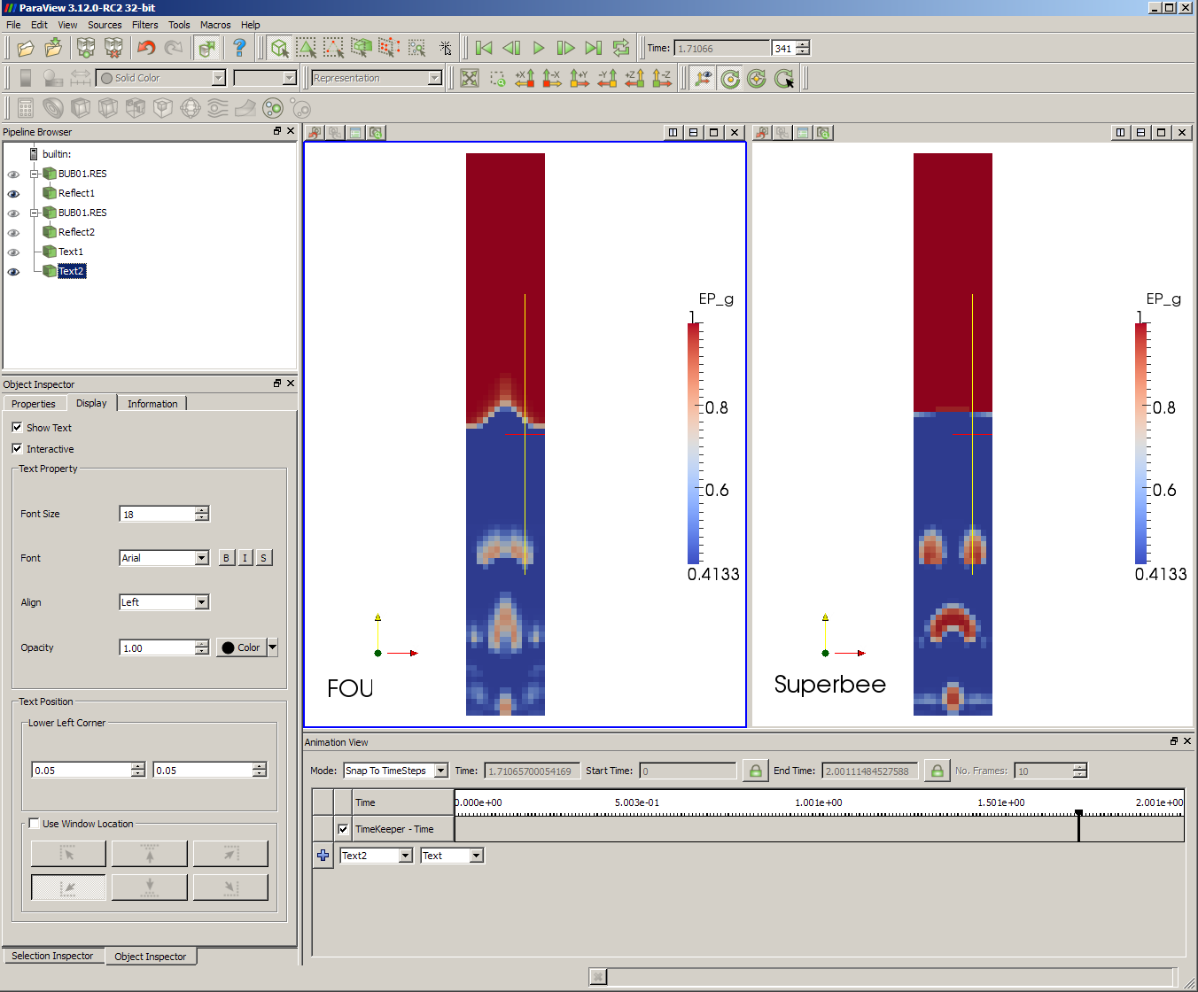

Slide 64
Outline
Brief overview on
  multiphase flows (challenges/issues)
  modeling approaches to multiphase flows & CFD
  MFIX & sample applications
Hands on Work
  code installation and general CFD steps
  example 1: pipe flow
    simulation setup (mfix.dat)
    code compilation (mfix.exe)
    post processing (paraview)
  quick overview of MFIX solver (theory and numerical technique)
  example 2: bubbling bed (multiphase problem)
  example 3: spouted bed combustor (reactions)
Coarse Goal: Setup cases and carry out simulations with different levels of difficulty

Slide 65
Continuum Modeling for Reactive Flows
Continuity
R_{gn} = rate of production of n^{th} chemical species in gas phase
R_{smn} = rate of production of n^{th} chemical species in m^{th} solid phase
X_{gn} = n^{th} chemical species in gas phase
X_{smn} = n^{th} chemical species in m^{th} solids phase
D_{gn} = diffusion coefficient of n^{th} species in gas phase
D_{smn} = diffusion coefficient of n^{th} species in m^{th} solids phase
Momentum Balance – see previous slide
Species mass balance
See https://mfix.netl.doe.gov/documentation/MFIXEquations2005-4-4.pdf
Notes:
Rgn = rate of production of nth chemical species in gas phase
Rsmn = rate of production of nth chemical species in nth chemical species in mth solid phase
Rkm = rate of transfer of mass from mth phase to kth phase
SUM_Ng(Rgn) = -SUM_m(SUM_Nm(Rsmn)) = SUM_m(Rom)
SUM_Nm(Rsmn) = -Rom+SUM_m(Rmk)
Following some discussion we came to the conclusion that the conservative form of the momentum equations should not contain an interphase mass transfer term (or if we do formally include the term then we are also assuming it has no directional preference, i.e., it is zero, since we have no other way of closing it).
Multiphase chemical reactions are described by tracking chemical species in each phase

Slide 66
Continuum Modeling for Reactive Flows
C_{pg} = specific heat of gas phse
C_{psm} = specific heat of m^{th} solids phase
T_{g} = gas temperature
T_{sm} = m^{th} solids phase temperature
Thermal energy balance*
heat flux (conduction)
g-s heat transfer
heats of reaction
radiation w/ environment
MWs, Cps and Heats of Reactions are automatically obtained/calculated from an open-source thermo-chemical database (burcat.thr) available in MFIX. Names of species need to match those in BURCAT.THR.
See https://mfix.netl.doe.gov/documentation/MFIXEquations2005-4-4.pdf
*From MFIX website in the members section “Developer’s Documentation” go to link “MFIX Energy Equation Implementation”: https://mfix.netl.doe.gov/members/develop/MFIXEnergyEquation.pdf
Notes:
Derivation of thermal energy balance see documentation. Contains specific formulation for heat of reaction.
Other properties: species molecular weight..
The database reader is set up such that the database is read only if necessary. One exception is that if gas species properties are needed the reader will look for solids species as well, whether or not needed. Any species name can be specified to get around this problem; e.g., O2, Al2O3.
Following some discussion it was concluded that the conservative form of the momentum equations should not contain an interphase mass transfer term (or if we do formally include the term then we are also assuming it has no directional preference, i.e., it is zero, since we have no other way of closing it).

Slide 67
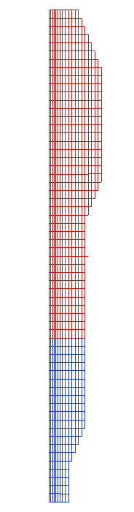
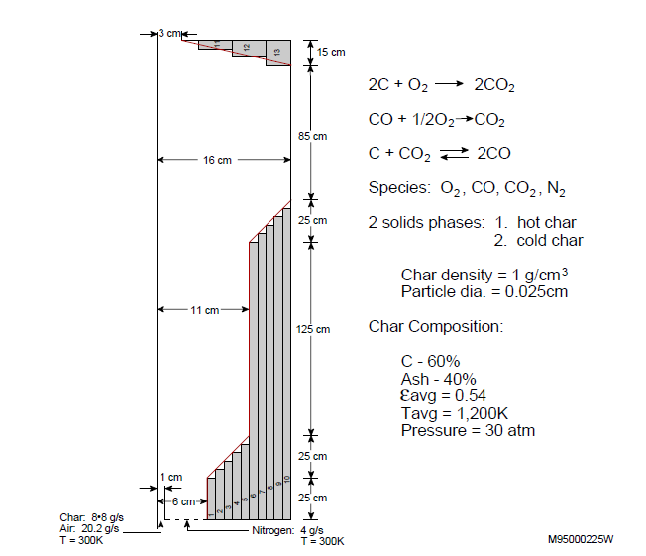
Hands-on Example 3: Spouted Bed Combustor
17.5 cm
Reactions
A: 2C + O₂ → 2CO₂
4 gas species:
x_{g1} =O₂
x_{g2} = CO
x_{g3}= CO₂
x_{g4}= N₂
B: C + CO₂ ↔ 2CO
35.0 cm
C: CO + ½ O₂ → CO₂
D: cold char → hot char
2 solids phase (MMAX=2 ):
M=1 is hot char
M=2 is cold char
each has 2 ‘species’:
x_{s11},x_{s21}= C
x_{s12},x_{s22}= Ash
10.0 cm
Reactor Conditions
H_{b}=50cm
ε_{g}=0.5
ε_{s1}(hot char)=0.5
T_{g},T_{s}=1050K
65.0 cm
Char properties
ρ_{p} = 1.0 g/cm³ density
d_{p} = 1000 μm diameter
e = 0.9
Inlet 1 (Jet)
Air: 10g/s
T=300K
Cold Char: 18 g/s
Char composition:
x_{s11}(C)=60%
x_{s12}(ash)=40%
Inlet 2 (Annulus)
Air: 116g/s
T=300K
10.0 cm
12.5 cm
Inlet 1
Inlet 2
Notes:
In this tutorial we will model a partial combustor with geometry as shown in Figure.
Char (18 g/s) and air (10 g/s) are fed into the combustor through a central tube.
A second stream of fluidizing air (116 g/s) enters the annular region surrounding the tube.
Partial combustion of the char occurs in the combustor.
The product gases exit from the top of the combustor.
The char density is 1 g/cm³ and the particle diameter is 1000 μm. The average void fraction in the reactor is estimated to be 0.5.
An MFIX simulation will be used to determine the characteristics of the gas-solids flow and combustion within the spouted bed combustor.
Since the incoming char is at a low temperature and it is critical to consider char heat-up, the incoming char will be treated as a second solids phase called "cold-char." The char already in the combustor will be called "hot-char." When the ash fraction in the cold chare exceeds a certain specified value, say 0.9, it is assumed to convert into hot-char. A fast pseudo-reaction is specified to convert the cold-char at temperatures above that value to hot-char. These ash fraction threshold and rate constant are specified in mfix.dat as constants C(1) and C(2), which are used in the subroutine rrates.
Four gas species are considered: 1. O², 2. CO, 3. CO², and 4. N². Two pseudo-species are considered in the solids phases: 1. Fixed carbon and 2. Ash. The numbering scheme shown above will be used for identifying the species in MFIX.
The chemical reactions considered are the following:

Slide 68
Hands-on Example 3: Spouted Bed Combustor
Go to mfix/tutorials/SpoutedBedCombustor
Examine mfix.dat
  Note differences, e.g.:
    Need to specify additional physical properties concerning how solids phases interact (MMAX=2)
      Coefficient of friction, correlation for maximum packing of mixture
    Heat and mass transfer are involved. Need to edit source files
      Need to specify additional physical properties, such as, conductivity & diffusivity
      Need to specify chemical reactions
Additional files in run directory
  rrates.f, usr0.f, usr1.f, usr_init_namelist.f, usrnlst.inc
Notes:
We’ll talk about the file contents after looking through mfix.dat

Slide 69
Spouted Bed Combustor Example: mfix.dat (1)
#
# Spouted Bed Combustor
#
# Author: E.F. Modeler Date: 9-28-94
! 1. Run control
Run_name = 'sbc01‘
Description = 'Spouted Bed Combustor‘
Units = 'cgs‘
Run_type = 'new‘
Time = 0.0
Tstop = 0.1
DT = 1.0E-4
ENERGY_EQ = .T.
SPECIES_EQ = .T. .T. .T.
CALL_USR = .T.
NORM_g = 0.
NORM_s = 0.
UR_FAC(1) = 0.7
UR_FAC(3) = 0.3
UR_FAC(4) = 0.3
! 2. User defined constants
C = 0.9 1.0E2
C_NAME ='Ash fraction threshold' 'Pseudo reaction const.‘
PAFC = 0.6
! 3. Geometry
Coordinates = 'Cylindrical‘
IMAX = 19
DX = 4*0.5, .59, .69, .81, .91, 11*1.0
JMAX = 60
YLENGTH = 150.0
NO_K = .T.
! 4. Gas phase
NMAX(0) = 4
SPECIES_NAME = 'O2' 'CO' 'CO2' 'N2‘
! MW_g = 32. 28. 44. 28.
! 5. Solids phase
MMAX = 2
D_p0 = .1 .1
RO_s = 1.0 1.0
NMAX(1) = 2 2
SPECIES_NAME(5) = 'Fixed Carbon' 'Coal Ash' 'Fixed Carbon' 'Coal Ash‘
! MW_s(1,1) = 12. 12.
! MW_s(1,2) = 56. 56.
EP_star = 0.5
e = 0.8
C_f = 0.1
Phi = 30.0
! FEDORS_LANDEL = .TRUE. !compute ep_star using Fedors_landel correlation
YU_STANDISH = .TRUE. !compute ep_star using Yu_Standish correlation
! 6. Initial conditions
! Bed !freeboard
IC_X_w = 2*0.0
IC_X_e = 2*16.0
IC_Y_s = 0.0 50.
IC_Y_n = 50. 150.0
IC_EP_g = 0.5 1.0
IC_P_Star = 2*0.0
IC_ROP_s(1,1) = 0.5 0.0
IC_ROP_s(1,2) = 2*0.0
IC_T_g = 2*1050.0
IC_T_s(1,1) = 2*1050.0
IC_T_s(1,2) = 2*1050.0
IC_U_g = 2*0.0
IC_V_g = 2*30.0
IC_U_s(1,1) = 2*0.0
IC_V_s(1,1) = 2*1.0
IC_X_g(1,1) = 2*0.0
IC_X_g(1,2) = 2*0.0
IC_X_g(1,3) = 2*0.0
IC_X_g(1,4) = 2*1.0
IC_X_s(1,1,1) = 2*0.1
IC_X_s(1,1,2) = 2*0.9
More on this in following slides
Notes:
The problem described above is coded into mfix.dat.
BRIEF SYNOPSIS:
The data files are set up for a 2-second transient simulation (TSTOP = 2) in axisymmetric cylindrical coordinates with 100 cells in the axial direction and 7 cells in the radial direction. Constant mass inflow conditions are specified at the bottom boundary (distributor), and a constant pressure outflow condition is specified at the top boundary. The default boundary conditions of symmetry along the centerline and no-slip condition at the wall are used.
RUN CONTROL
The input data file is mfix.dat. In the run-control section, the energy balance calculations and species balance calculations are turned on. Since the subroutines usr0.f and usr1.f are to be used, the CALL_USR switch is turned on.
The two user-defined constants C(1) and C(2), used in the subroutine RRATES, are specified. They have been given (optional) names, with which to label them in the .OUT file.
NUMERICS/PHYSICAL PARAMETERS
There are no inputs needed in the physical and numerical parameters section.
GEOMETRY
We are choosing to solve the problem in axisymmetric cylindrical coordinates. In the radial direction 19 cells of varying length.
In the radial direction, a nonuniform grid is used to get a better resolution near the jet. The first four radial grids are 0.5 cm wide and the next four grids expand to approach 1 cm. The last 11 grids have a size of 1 cm. The domain length in the axial direction is 150 with a uniform grid. The axial grid size is 2.5 cm.
In THE BC The reactor geometry is further specified with 17 obstacles. We have started the obstacles' specification as boundary condition number 20, so that any future additions or deletions of inlets or outlets can be accommodated without having to change the boundary condition indices for the obstacles. An internal surface has been specified to simulate the central tube at the bottom of the reactor.
PHYSICAL PROPERTIES
The gas-phase section specifies the number of gas phase species (4), their name (for identification in BURCAT) where their thermochemical properties are defined and MW.
The gas viscosity is specified according to the correlation found in calc_mu_g. The density is not specified so it will be calculated using the equation of state specified in eosg.f
Conductivity and diffusivity are not specified so these will be calculated.
The solids-phase section specifies the solids density, particle diameter, the coefficient of restitution, the angle of internal friction, and the void fraction at
maximum packing. We also must specify a coefficient of friction to describe solids-solids interaction. The number of solids phase species is specified as two.
In this case the solids are also composed of 2 pseudo species defined as C and ash. The thermo properties of these species are user defined in the mfix.dat in a format similar to what is found in BURCAT.
(The molecular weights of solids is not needed and is specified only to satisfy the error checker).
INITIAL CONDITIONS
For simplicity, the entire domain is divided into two sections (bed and freeboard) and uniform initial conditions are specified in each section. Although this is not appropriate for the many wall-cells in the range, such an initial condition specification will not cause any problem. Also, for the central jet region, the specified void fraction is too low. The solids will clear out of that region, as the MFIX calculations progress. There are two flow inlets and one outlet. Note that mass flows are specified instead of the axial velocity component. Also the composition of gases and solids at the inlet are specified. At the outlet only the pressure is specified.
BC – see geometry
OUTPUT
The keyword Report_mass_balance_dt=1 has been included to conduct an overall species mass balance check every 1 s. Use this feature only for debugging the run; for production runs disable this feature, as it slows down the simulation. To disable the feature comment out or delete the keyword (do not set it to 0 or a large value.)
The keyword nRR=7 has been included to write out seven reaction rate fields. The seven fields to be written out are chosen in the rrates routine.
The .RES file is written every 0.01 s and all the .SPx files are written every 0.1 s. Diagnostics from the code are printed out every 100th time step.

Slide 70
Spouted Bed Combustor Example: mfix.dat (2)
! 7. Boundary conditions
!Jet annulus outlet
BC_X_w = 0.0 1.0 0.0
BC_X_e = 1.0 6.0 3.0
BC_Y_s = 0.0 0.0 150.0
BC_Y_n = 0.0 0.0 150.0
BC_TYPE = 'MI‘ 'MI‘ 'PO‘
BC_EP_g = 0.9 1.0
BC_P_g = 3.04E7 3.04E7 3.04E7
BC_ROP_s(1,1) = 0.0
BC_ROP_s(1,2) = 0.1
BC_T_g = 2*300.0
BC_T_s(1,1) = 300.0
BC_T_s(1,2) = 300.0
BC_U_g = 0.0 0.0
BC_MASSFLOW_g = 10. 116.
BC_U_s(1,2) = 0.0 0.0
BC_MASSFLOW_s(1,2) = 18. 0.0
BC_X_g(1,1) = 0.2 0.2
BC_X_g(1,2) = 0.0 0.0
BC_X_g(1,3) = 0.0 0.0
BC_X_g(1,4) = 0.8 0.8
BC_X_s(1,2,1) = 0.6
BC_X_s(1,2,2) = 0.4
! Define Obstacles
! 1 2 3 4 5
BC_X_w(20) = 6.0 7.0 8.0 9.0 10.0
BC_X_e(20) = 7.0 8.0 9.0 10.0 11.0
BC_Y_s(20) = 0.0 0.0 0.0 0.0 0.0
BC_Y_n(20) =12.5 15.0 17.5 20.0 22.5
BC_TYPE(20) ='NSW' 'NSW' 'NSW' 'NSW' 'NSW’
BC_hw_T_g(20) = 5*0.
BC_C_T_g(20) = 5*0.
BC_hw_T_s(20,1) = 5*0.
BC_C_T_s(20,1) = 5*0.
BC_hw_T_s(20,2) = 5*0.
BC_C_T_s(20,2) = 5*0.
BC_hw_X_g(20,1) = 5*0.
BC_C_X_g(20,1) = 5*0.
BC_hw_X_g(20,2) = 5*0.
BC_C_X_g(20,2) = 5*0.
BC_hw_X_g(20,3) = 5*0.
BC_C_X_g(20,3) = 5*0.
BC_hw_X_g(20,4) = 5*0.
BC_C_X_g(20,4) = 5*0.
BC_hw_X_s(20,1,1) = 5*0.
BC_C_X_s(20,1,1) = 5*0.
BC_hw_X_s(20,1,2) = 5*0.
BC_C_X_s(20,1,2) = 5*0.
BC_hw_X_s(20,2,1) = 5*0.
BC_C_X_s(20,2,1) = 5*0.
BC_hw_X_s(20,2,2) = 5*0.
BC_C_X_s(20,2,2) = 5*0.
Notes:
In THE BC The reactor geometry is further specified with 17 obstacles. We have started the obstacles' specification as boundary condition number 20, so that any future additions or deletions of inlets or outlets can be accommodated without having to change the boundary condition indices for the obstacles. An internal surface has been specified to simulate the central tube at the bottom of the reactor.
Thermal BC: specified heat flux with no flux at wall (HW=0, C=0 => NO HEAT FLUX AT WALL)
Specified Mass Fraction: specified mass flux with no flux at wall (HW=0, C=0 => NO MASS FLUX AT WALL)
BC – see geometry

Slide 71
Spouted Bed Combustor Example: mfix.dat (3)
! 6 7 8 9 10
BC_X_w(25) = 11.0 12.0 13.0 14.0 15.0
BC_X_e(25) = 12.0 13.0 14.0 15.0 16.0
BC_Y_s(25) = 0.0 0.0 0.0 0.0 0.0
BC_Y_n(25) = 87.5 90.0 92.5 95.0 97.5
BC_TYPE(25) ='NSW' 'NSW' 'NSW' 'NSW' 'NSW'
BC_hw_T_g(25) = 5*0.
BC_C_T_g(25) = 5*0.
BC_hw_T_s(25,1) = 5*0.
BC_C_T_s(25,1) = 5*0.
BC_hw_T_s(25,2) = 5*0.
BC_C_T_s(25,2) = 5*0.
BC_hw_X_g(25,1) = 5*0.
BC_C_X_g(25,1) = 5*0.
BC_hw_X_g(25,2) = 5*0.
BC_C_X_g(25,2) = 5*0.
BC_hw_X_g(25,3) = 5*0.
BC_C_X_g(25,3) = 5*0.
BC_hw_X_g(25,4) = 5*0.
BC_C_X_g(25,4) = 5*0.
BC_hw_X_s(25,1,1) = 5*0.
BC_C_X_s(25,1,1) = 5*0.
BC_hw_X_s(25,1,2) = 5*0.
BC_C_X_s(25,1,2) = 5*0.
BC_hw_X_s(25,2,1) = 5*0.
BC_C_X_s(25,2,1) = 5*0.
BC_hw_X_s(25,2,2) = 5*0.
BC_C_X_s(25,2,2) = 5*0.
! 11 12 13 14 15 16 17
BC_X_w(30) = 9.0 10.0 11.0 12.0 13.0 14.0 15.0
BC_X_e(30) = 10.0 11.0 12.0 13.0 14.0 15.0 16.0
BC_Y_s(30) =147.5 145.0 142.50 140. 137.5 135. 132.5
BC_Y_n(30) =7*150.0
BC_TYPE(30) =7*'NSW’
BC_hw_T_g(30) = 7*0.
BC_C_T_g(30) = 7*0.
BC_hw_T_s(30,1) = 7*0.
BC_C_T_s(30,1) = 7*0.
BC_hw_T_s(30,2) = 7*0.
BC_C_T_s(30,2) = 7*0.
BC_hw_X_g(30,1) = 7*0.
BC_C_X_g(30,1) = 7*0.
BC_hw_X_g(30,2) = 7*0.
BC_C_X_g(30,2) = 7*0.
BC_hw_X_g(30,3) = 7*0.
BC_C_X_g(30,3) = 7*0.
BC_hw_X_g(30,4) = 7*0.
BC_C_X_g(30,4) = 7*0.
BC_hw_X_s(30,1,1) = 7*0.
BC_C_X_s(30,1,1) = 7*0.
BC_hw_X_s(30,1,2) = 7*0.
BC_C_X_s(30,1,2) = 7*0.
BC_hw_X_s(30,2,1) = 7*0.
BC_C_X_s(30,2,1) = 7*0.
BC_hw_X_s(30,2,2) = 7*0.
BC_C_X_s(30,2,2) = 7*0.
!8. Internal surfaces
IS_X_w = 1.0
IS_X_e = 1.0
IS_Y_s = 0.0
IS_Y_n = 12.5
IS_TYPE = 'IP‘
Notes:
In THE BC The reactor geometry is further specified with 17 obstacles. We have started the obstacles' specification as boundary condition number 20, so that any future additions or deletions of inlets or outlets can be accommodated without having to change the boundary condition indices for the obstacles. An internal surface has been specified to simulate the central tube at the bottom of the reactor.
Thermal BC: specified heat flux with no flux at wall (HW=0, C=0 => NO HEAT FLUX AT WALL)
Specified Mass Fraction: specified mass flux with no flux at wall (HW=0, C=0 => NO MASS FLUX AT WALL)
BC – see geometry

Slide 72
Spouted Bed Combustor Example: mfix.dat (4)
!9. Output control
!Use the following to check mass balance for debugging initial runs.
!For production runs comment out the line to disable this feature,
!as it slows down the simulation.
Report_mass_balance_dt = 0.1
nRR = 7 !number reaction rates written out to .SPA
OUT_DT = 100.
RES_DT = 0.01
SPX_DT = 10*0.1
NLOG = 100
FULL_LOG = .T.
resid_string = "P0", "V0", "V1", "V2", "T0", "T1", "T2“
THERMO DATA
The following are coal pseudo species specifications. Replace these
with appropriate coal properties. Also define the heat of formation (Hf298)
values (the fifteenth coefficient). The readme file describes the data format.
Fixed Carbon WARNING! 0.S 200.000 6000.000 B 12.01100 1
-7.94079328E-01 8.09779756E-03-6.56398654E-06 1.84781958E-09 0.00000000E+00 2
0.00000000E+00 0.00000000E+00-7.94079328E-01 8.09779756E-03-6.56398654E-06 3
1.84781958E-09 0.00000000E+00 0.00000000E+00 0.00000000E+00 0.00000000E+00 4
Coal Ash WARNING! 0.S 200.000 6000.000 B 56.00000 1
8.70769880E+00 8.45407650E-03 0.00000000E+00 0.00000000E+00 0.00000000E+00 2
0.00000000E+00 0.00000000E+00 8.70769880E+00 8.45407650E-03 0.00000000E+00 3
0.00000000E+00 0.00000000E+00 0.00000000E+00 0.00000000E+00 0.00000000E+00 4
Notes:
OUTPUT
The keyword Report_mass_balance_dt=1 has been included to conduct an overall species mass balance check every 1 s. Use this feature only for debugging the run; for production runs disable this feature, as it slows down the simulation. To disable the feature comment out or delete the keyword (do not set it to 0 or a large value.)
The keyword nRR=7 has been included to write out seven reaction rate fields. The seven fields to be written out are chosen in the rrates routine.
The .RES file is written every 0.01 s and all the .SPx files are written every 0.1 s. Diagnostics from the code are printed out every 100th time step.
The database reader is set up such that the database is read only if necessary. One exception is that if gas species properties are needed the reader will look for solids species as well, whether or not needed. Any species name can be specified to get around this problem; e.g., O2, Al2O3.

Slide 73
Spouted Bed Combustor Example: Files
Summary of MFIX Routines Commonly Modified
Routine | Details
physical_prop.f | gas phase MW, gas phase density (via eosg) and gas & solids phases specific heats (using thermo-chemical info)
transport_prop.f | viscosity (calc_mu_g, calc_mu_s), conductivity (calc_k_g, calc_k_s), diffusivity (calc_dif_g, calc_dif_s)
rrates.f | chemical reactions and heats of reaction
exchange.f | interphase terms (calc_drag, calc_gama)
let’s look at some of these files
discussed in following slides
Notes:
The reaction rates are specified in the file rrates.f, which is divided into five sections. User input is required in the first four sections only. In the first section, the reaction rates for the reactions are coded (four reactions in this case). The forward and backward reactions are written separately. For specifying the rate of the pseudo reaction, we have used the user-defined constants C(1) and C(2), so that they may be entered from the data file. In the second section, the reaction rates computed in the first section are used to compute the formation and consumption rates for individual species. In the third section, the reaction rates are used to compute the mass transfer between the phases. In the fourth section, the heats of reaction are used to compute the heat generation or consumption in each of the phases. In the fifth section, certain bookkeeping and error checking computations are performed, which require no user input
In addition to rrates.f, we also need to write the user-defined routines physical_prop.f, usr0.f, usr1.f, usr_init_namelist.f, and usrnlst.inc. In physical_prop.f, the gas density, gas specific heat, and solids specific heat are computed.
In usr0.f, the user-defined input data are checked for error and a constant is calculated based on the user-defined input. In usr_init_namelist.f, the two user-defined namelist variables are initialized as UNDEFINED, which is a number defined in MFIX to indicate undefined double precision numbers. By initializing values this way, the user is able to check whether the values are specified through the input file. usrnlst.inc file contains the definitions of user-defined variables, user-defined common blocks, and a namelist section.

Slide 74
Spouted Bed Combustor Example: Files (2)
Summary of User Routines Employed in this Example
Routine | Details
usr0.f | Called once before time loop. Used here to check user-defined input data, perform calculation and allocate a variable
usr1.f | Called once every time step. Used here to perform calculation of Nu correlation.
usrnlst.inc | List of user defined words so they can be entered in mfix.dat. Used here for 2 new keywords.
usr_int_namelist.f | Initialize user defined keywords.
usr_mod.f | User defined module for user variables. Used here for 2 variables.
Additional user routines include: usr2.f, usr3.f, write_usr0.f and write_usr1.f. See Readme.pdf for more details. Activate calls with call_USR=.T.
Notes:
The reaction rates are specified in the file rrates.f, which is divided into five sections. User input is required in the first four sections only. In the first section, the reaction rates for the reactions are coded (four reactions in this case). The forward and backward reactions are written separately. For specifying the rate of the pseudo reaction, we have used the user-defined constants C(1) and C(2), so that they may be entered from the data file. In the second section, the reaction rates computed in the first section are used to compute the formation and consumption rates for individual species. In the third section, the reaction rates are used to compute the mass transfer between the phases. In the fourth section, the heats of reaction are used to compute the heat generation or consumption in each of the phases. In the fifth section, certain bookkeeping and error checking computations are performed, which require no user input
In addition to rrates.f, we also need to write the user-defined routines physical_prop.f, usr0.f, usr1.f, usr_init_namelist.f, and usrnlst.inc. In physical_prop.f, the gas density, gas specific heat, and solids specific heat are computed.
In usr0.f, the user-defined input data are checked for error and a constant is calculated based on the user-defined input. In usr_init_namelist.f, the two user-defined namelist variables are initialized as UNDEFINED, which is a number defined in MFIX to indicate undefined double precision numbers. By initializing values this way, the user is able to check whether the values are specified through the input file. usrnlst.inc file contains the definitions of user-defined variables, user-defined common blocks, and a namelist section.

Slide 75
RXN A: Heterogeneous Reaction
C combustion
Kinetics equation¹ for 2C + O₂ → 2CO
Need a volume fraction, which depends upon the volumetric basis of the original rate expression
Mass transfer coefficient from Gunn equation²
core
ash
O₂
film
1. MFIX manual p.22

Slide 76
RXN B: Heterogeneous Reaction
CO₂ gasification
Kinetics eq¹ for C + CO₂ ←→ 2CO
Need a reaction temperature
  e.g., T_{gs} = (T_{g} + T_{s})/2
Need a volume fraction, which depends upon the volumetric basis of the original rate expression
reversible
1. Syamlal and Bissett (1992), Wen et al. (1982)

Slide 77
RXN C: Homogeneous Reaction
CO combustion
Kinetics equation¹ for CO + ½ O₂ → CO₂
In multiphase formulation the rate expression is multiplied by ε_{g}
1. Westbrook and Dryer (1981)

Slide 78
Species Mass Production
Based on above three rates the species mass production and mass transfer are
Mass production of each species
Mass transfer from solids to gas
Notes:
Note did not write balances on solids to include psuedo-reactions that convert coal to char when ash fraction exceeds a threshold (cold char to hot char)
Mass transfer terms: R_tmp

Slide 79
Spouted Bed Combustor Example: rrates.f
let’s look at this file
In the first section, the reaction rates for the reactions are coded (four reactions in this case). The forward and backward reactions are written separately.
In the second section, the reaction rates computed in the first section are used to compute the formation and consumption rates for individual species.
In the third section, the reaction rates are used to compute the mass transfer between the phases.
Note: Alternatively reaction rate information can be entered directly into mfix.dat. See Readme.pdf for details and tutorials/reactor1a and tutorials/reactor1b for examples
Notes:
The reaction rates are specified in the file rrates.f, which is divided into three/four sections.
User input is required in the first four sections only.
In the first section, the reaction rates for the reactions are coded (four reactions in this case). The forward and backward reactions are written separately.
For specifying the rate of the pseudo reaction, we have used the user-defined constants C(1) and C(2), so that they may be entered from the data file.
In the second section, the reaction rates computed in the first section are used to compute the formation and consumption rates for individual species.
In the third section, the reaction rates are used to compute the mass transfer between the phases.
In the fourth section, the heats of reaction are used to compute the heat generation or consumption in each of the phases. (NO LONGER NEEDED)
In heterogeneous rxns ΔH for each phase could change depending upon the representation of reactions
Averaging erases info on reaction front
e.g., in coal combustion the flame may reside at the core surface, in the ash layer, or in surrounding film¹
e.g., ΔH for coal combustion²:
C + 1/2O₂ → CO (solids); CO + 1/2O₂ → CO₂(gas)

Slide 80
Spouted Bed Combustor Example
Compile mfix - in run directory
  Note for the fourth question type y to use user-defined files. All the user-defined files will be copied into the mfix/model directory and an mfix executable will be created and copied into the run directory.
Run mfix.exe
Examine .OUT & .LOG files
  Verify the cells flags, examine wall cells
For longer run modify TSTOP
Visualize results - launch paraview

Slide 81
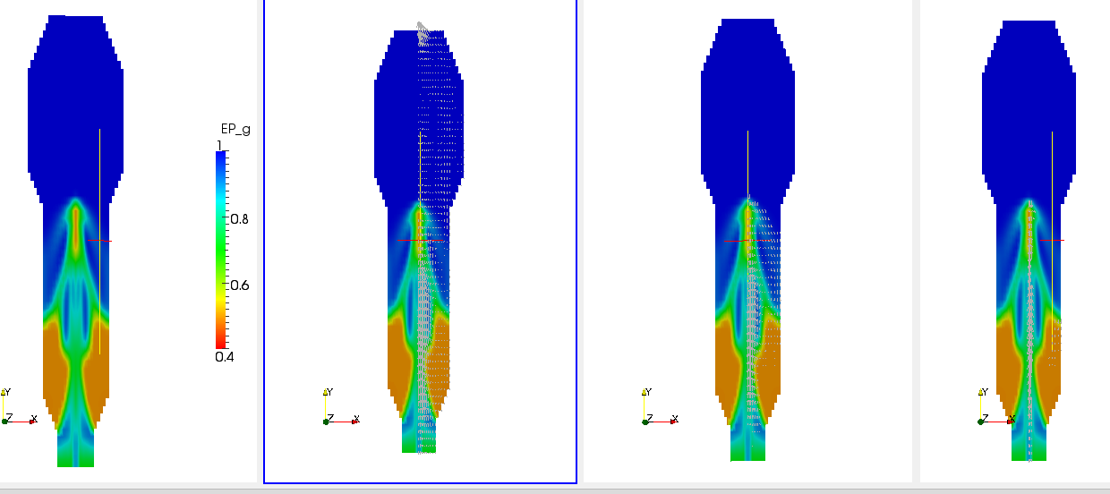
Spouted Bed Combustor Example: Hydrodynamic Results
All results corresponding to 10s
Void fraction distribution
Void fraction imposed by gas velocity vectors
Void fraction imposed by solids 1 velocity vectors
(hot char)
Void fraction imposed by solids 2 velocity vectors
(cold char)
Notes:
Requires changing display:
Display tab: edit color map, color scale tab, choose preset…
To add velocity vectors we need to change celldatatopointdata
This also smooth's the appearance of the distributions
Add glyph. I made a 2D glyph (3D is visually messy). Arrow. Edited the scale factor. Changed the color on display tab.
On the right 2 figures a ‘threshold1’ filter was applied to create a source of regions having void fractions between 0 and 0.99 (so solids must be in excess of 0.01 solids volume fraction). Thus we can limit plotting of solids velocity vectors to regions of non-negligible amount of solids.

Slide 82
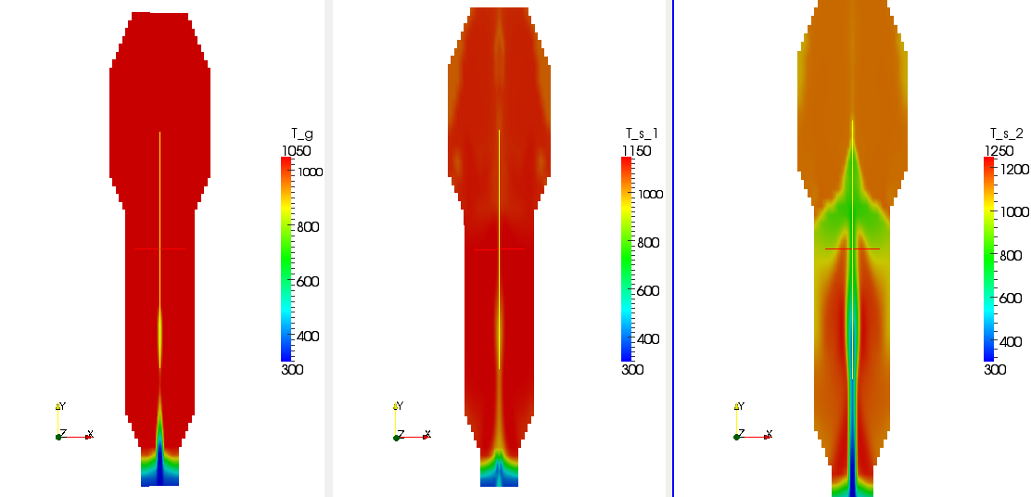
Spouted Bed Combustor Example: Temperature Distribution in Bed
All results corresponding to 10s
Gas temperature
Solids 1 Temperature
Hot Char
Solids 2 Temperature
Cold Char

Slide 83
Spouted Bed Combustor Example: Gas-phase Species
All results corresponding to 10s
mass fraction of O₂
mass fraction of CO
mass fraction of CO₂

Slide 84
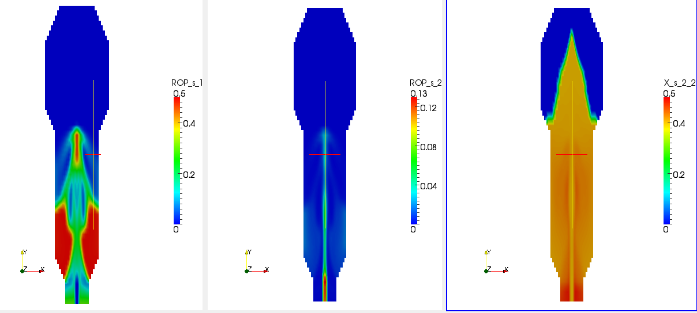
Spouted Bed Combustor Example: Solids-phase Species
All results corresponding to 10s
total hot char (g/cm³)
Solids phase 1
total cold char (g/cm³)
Solids phase 2
mass fraction of cold ash

Slide 85
Take away message
Complete multiphase flow reacting simulations can be quite complex
  Lot of care needs to be given when these cases are setup
  Systematic setup and testing
    Hydrodynamics
    Heat and Mass transfer
    Chemical reactions
  Good to verify all the changes even before the case is run
  Use the *.LOG, *.OUT, screen output, initial results etc. to guide the debugging

Slide 86
Additional Thoughts
Possible Improvements?
  Change resolution (increase imax,jmax) or order of the scheme (discretize)
    Unpredictable computational cost
    Can affect convergence - sometimes non-convergence
    It is recommended to go to a fine enough grid resolution beyond which the changes are not significant
  More detailed solids phase description via kinetic theory option (granular_energy=.t. and set kt_type)
    Default kinetic theory Lun (1984)
      See mfix/doc/theory.pdf for details or go to website in the documentation section “Theory Manual (PDF)”: https://mfix.netl.doe.gov/documentation/Theory.pdf (somewhat dated)
      See mfix/tests/granular_shear for example case
    Polydisperse kinetic theory Iddir and Arastoopour (2005)
      Go to website in the members section “Developer’s Documentation” go to link “Summary of Iddir-Arastoopour polydisperse kinetic theory implemented in MFIX”: https://mfix.netl.doe.gov/members/develop/MFIXIAEqns2006-4-1.pdf
      mfix/tutorials/IATheory for example case
    Polydisperse kinetic theory Garzo, Hrenya and Dufty (2007)
      See mfix/tests/ssfGHD for example case
  Geometry via Cartesian grid cut-cell method
    Not yet available for energy equation
    See mfix/doc/Cartesian_grid_user_guide.pdf for details or go to website in the documentation section “Cartesian Grid User Guide (PDF)”: https://mfix.netl.doe.gov/documentation/Cartesian_grid_user_guide.pdf
    See mfix/cartesian_grid_tutorials/ subdirectory for example cases
  ISAT for chemical reactions
    See mfix/doc/isat_dqmom.pdf for details

Slide 87
Final thoughts
Readme.pdf
Documents in the mfix directories and website
Tutorial & test cases
Use MFIX website (https://mfix.netl.doe.gov/) and mailing lists (mfix-help@mfix.netl.doe.gov)
This is an open-source project – you can participate by testing, contributing cases, developing methods/models

Slide 88
tips
What do I do now?

Slide 89
CFD for experts: first, what’s the meaning of expertise?
Expertise is a product of experience, meaning solving many cases related to a specific research field. Research takes a lot of patience, time and resources (smart people and lots of money!)
Expertise is developed by trial and error. Learning from your mistakes is more valuable then learning from an “expert”. An expert is most useful in answering specific questions related to specific issues that you face. The mfix-help mailing list is a good place to submit specific questions.
Read and examine the literature and try to reproduce published data before adopting the conclusions of papers (trust but verify, this is the scientific way!)
S. Benyahia

Slide 90
CFD for experts: how do I develop new models?
Complex models should be implemented incrementally. Implementing the full model (in the computer code) and then debugging can result in a huge waste of time.
Writing a code is always faster than debugging it. Take your time to write a good quality program. Put as much comments as necessary for someone else to understand what you did. We tend to forget (after some time) what the code that we wrote does. Good comments will remind you. Use variable and file names that make sense, do not use simple names (such as x, y, z). I suggest (although it’s up to you) to use simple English for comments and names. This will make it easier for others to understand your code in case you request help from the international MFIX community.
Even if the code compiles and runs fine, always use print or write commands to check what the code is computing. The printed values must make sense to you, at least from an order of magnitude point of view.
S. Benyahia

Slide 91
CFD for experts: how do I develop new models?
When a code compiles using one compiler (say gfortran), it’s always a good idea to compile it with a different compiler. Some compilers catch mistakes that others don’t!
Always compile your code first in serial debug and non-debug modes, then in parallel mode (SMP and DMP).
When a new model is implemented in MFIX, it’s a good idea to re-compile post-mfix to check for any possible conflicts.
During and after the development of a model in MFIX, test the code by designing some simple cases. More elaborate cases can be studies after you develop some confidence in the model.
If you have added new files use make_make (mfix/tools/make_make) to create a new make_mfix file (pick up new dependencies). The new files will need to be included within the mfix/model directory. Alternatively you can include your new subroutines in existing .f files.
S. Benyahia

Slide 92
How can I get familiar with the details of the code?
You have access to the source code (advantage of open source)
  You can browse through individual files although this can be tedious.
  You can also use either the STI or Doxygen code analysis available from the Developer Documentation section of the MFIX website https://mfix.netl.doe.gov/members/development.php.
  Users can also browse through the latest code using CVSWEB https://mfix.netl.doe.gov/members/development.php.
Handy unix/linux tool for looking through the code files: fgrep
What does it do? Searches a file for a string
Example: Search for all instances of ‘calc_coeff’ in source code.
Go to your model directory level
At command prompt type: fgrep –i calc_coeff *.*
Will return all instances of calc_coeff found in the model directory files
Command option to ignore case
Useful variation
Filter text output to one screen at a time
grep –i calc_coeff *.* | more
Additional information: man grep

Slide 93
How can I get familiar with the details of the code?
You have access to the source code (advantage of open source)
  You can browse through individual files although this can be tedious.
  You can also use either the STI or Doxygen code analysis available from the Developer Documentation section of the MFIX website https://mfix.netl.doe.gov/members/development.php.
  Users can also browse through the latest code using CVSWEB https://mfix.netl.doe.gov/members/development.php.
Documentation (from the webpage or with the MFIX package)
  Internal documentation (comment lines in the code)
  Constantly updated Readme.pdf and MFIX_equations files
  Legacy manuals, presentations and developer notes
Number of test and tutorial cases
Communication through various mailing lists including mfix-help@mfix.netl.doe.gov

Slide 94
MFIX program
MFIX is a modular program consisting of subroutines that have a single purpose (see contents of mfix/model)
See mod files for names of major variables (e.g., fldvar_mod)
  A subscript or superscript in the name is identified by a underscore (e.g., ε_{g} => EP_g)
  An ‘o’ represents division and ‘x’ represents multiplication (e.g., dt/dx = dtodx)
Pay attention to indices used in MFIX. The three dimensional arrays (I,J,K) are stored as a one-dimensional arrays with the index IJK, which is calculated using the function FUNIJK (see function.inc and set_index1.f).
MFIX has several statement functions (convenience, minimize errors). For example fun_avg1.inc contains functions for spatially averaging variables.

Slide 95
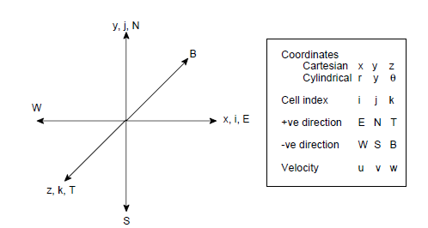
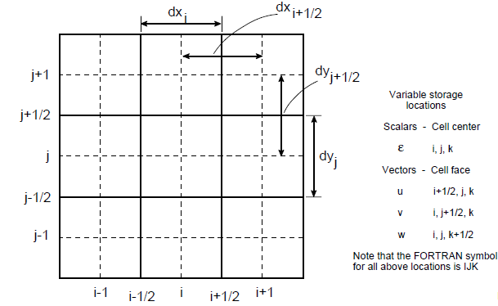
For your reference
Coordinate System and Grid
Numerical Grid and Naming Conventions
Notes:
MFIX uses a staggered grid arrangement as shown in Figure. Scalars are stored at the cell centers and the components of velocity vector are stored at the cell faces. The equations for scalar quantities, pressure, void fraction, temperature, and mass fractions, are solved on the main grid. The equations for the velocity vector components are solved on staggered grids. Thus there are four grids used for the solution.

Slide 96
Four your Reference
Computational Cell
i, j + l, k
V
North Face
U
W
i + 1, j, k
i, j, k
i, j, k + 1
East Face
Top Face
From MFIX website under documentation see ‘MFIX Training Appendix’

Slide 97
For your reference: Fortran Symbols
C_pg Fluid-phase specific heat, C_{pg}
C_ps Solids-phase specific heat, C_{psm}
F_gs Fluid-solids drag coefficient, F_{gm}
F_ss Fluid-solids drag coefficient, F_{slm}
EP_g Void fraction, ε_{g}
GAMMA_gs Fluid-solids heat transfer coefficient, γ _{gs}
HOR_g Heat of reaction for fluid phase, H_{rg}
HOR_s Heats of reaction for solids phases
LAMBDA_s Solids-phase second coefficient of viscosity, λ_{sm}
MU_g Fluid viscosity, µ_{g}
MU_s Solids-phase viscosity, µ_{sm}
P_g Fluid pressure, P_{g}
P_s Solids pressure, P_{s}
P_star Solids pressure in plastic regime, P*
R_gp Rate of production of gas species n (part of R_{gn})
RoX_gc Rate of consumption of gas species n divided by X_{gn} (part of R_{gn}/X_{gn})
R_sp Rate of production of solids species n (part of R_{smn})
RoX_sc Rate of consumption of solids species n divided by X_{smn} (part of R_{smn}/X_{smn})
RO_g Fluid density, ρ_{g}
ROP_g Macroscopic (effective) density of the fluid: ρ_{g}' ~=~ ε_{g} ρ_{g}
SUM_R_g ΣR_gn
SUM_R_s ΣR_smn
Theta_m Granular temperature
T_g Fluid temperature, T_{g}
T_s Solids phase temperature, T_{s}
U_g X-component of fluid velocity, u_{g}
U_s X-component of solids velocity, u_{sm}
V_g Y-component of fluid velocity, v_{g}
V_s Y-component of solids velocity, v_{sm}
W_g Z-component of fluid velocity, w_{g}
W_s Z-component of solids velocity, w_{sm}
X_g Fluid species mass fraction, X_{gn}
X_s Solids species mass fraction, X_{sm}
M Index for solids phase
N Index of gas or solids species
From MFIX website under documentation see ‘MFIX Training Appendix’

Slide 98
For your reference: Fortran Symbols
I X-direction index
J Y-direction index
K Z-direction index
IJK Composite index for i, j, k
IMJK Composite index for i-1, j, k
IPJK Composite index for i+1, j, k
IJMK Composite index for i, j-1, k
IJPK Composite index for i, j+1, k
IJKM Composite index for i, j, k-1
IJKP Composite index for i, j, k+1
IJKW = IMJK, if IMJK is a fluid cell; else IJK
IJKE = IPJK, if IPJK is a fluid cell; else IJK
IJKS = IJMK, if IJMK is a fluid cell; else IJK
IJKN = IJPK, if IJPK is a fluid cell; else IJK
IJKB = IJKM, if IJKM is a fluid cell; else IJK
IJKT = IJKP, if IJKP is a fluid cell; else IJK
From MFIX website under documentation see ‘MFIX Training Appendix’
Notes:
If the user wants to modify MFIX routines, particular attention must be paid to the indices used in MFIX. The three-dimensional arrays (I,J,K) are stored as one-dimensional arrays with the index IJK, which is calculated using the function FUNIJK. The coefficients of the neighboring cells are obtained by calling the subroutine SET_INDEX1. The definitions of the frequently used indices are shown.

Slide 99
For your reference: Some functions
FUNIJK(I,J,K) Calculate the composite index IJK from I, J, and K values.
IM_OF(IJK) Calculate IMJK
IP_OF(IJK) Calculate IPJK
JM_OF(IJK) Calculate IJMK
JP_OF(IJK) Calculate IJPK
KM_OF(IJK) Calculate IJKM
KP_OF(IJK) Calculate IJKP
EAST_OF(IJK) Calculate IJKE
WEST_OF (IJK) Calculate IJKW
NORTH_OF(IJK) Calculate IJKN
SOUTH_OF(IJK) Calculate IJKS
TOP_OF(IJK) Calculate IJKT
BOTTOM_OF(IJK) Calculate IJKB
FLUID_AT(IJK) Logical function to determine whether the cell IJK is a fluid cell.
WALL_AT(IJK) Logical function to determine whether the cell IJK is a wall cell.
For more complete listing see function.inc
In addition to the above, see fun_avg1.inc and fun_avg2.inc for averaging functions
From MFIX website under documentation see ‘MFIX Training Appendix’
Notes:
If the user wants to modify MFIX routines, particular attention must be paid to the indices used in MFIX. The three-dimensional arrays (I,J,K) are stored as one-dimensional arrays with the index IJK, which is calculated using the function FUNIJK. The coefficients of the neighboring cells are obtained by calling the subroutine SET_INDEX1. The definitions of the frequently used indices are shown.

Slide 100
Reference
Additional material

Slide 101
Additional Material
Background information on fluidization
  Fluidization & mapping regimes
  Geldart classification
  Basic terminology
More on numerics
  General governing equation and terminology
  Terms of the momentum equation in MFIX code
  Partial Elimination Algorithm
  Reference of MFIX conventions: grid, indicing
MFIX installation on Windows
Notes:
Provide an introduction to multiphase flow modeling of gas-solids fluidized beds

Slide 102
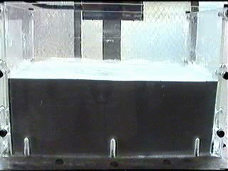
Fluidization General
The pressure drop in a fluid flowing upward through a bed of solids supports the weight of the bed
For U > U_{mf} the bed behaves like a fluid:
  lighter objects float,
  solids material readily mix and circulate,
  levels are equalized,
  good gas-solids contacting
  uniform temperature distribution
For U < U_{mf} the bed is fixed (moving)
Fixed bed
Fluidized bed
U_{mf} - minimum fluidization velocity
bed weight
U_{mf}
U, Fluidization velocity
(Ideally suited for many gas-solids unit operations)
Rhodes (2001)

Slide 103
Geldart Particle Type Classification
Based on fluidization characteristics at ambient conditions
Geldart (1986)
Notes:
Based on fluidization Characteristics
Classification of powders according to their fluidization properties at ambient conditions. Thus the fluidization properties of a powder may be predicted by knowing which group it lies. If the operating temperatures and pressures are above the ambient conditions then a powder may appear in a different group from that which it occupies at ambient conditions.

Slide 104
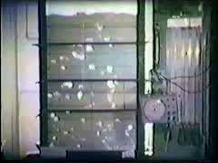
Group A (Aeratable)
Interparticle forces of van der Waals type
Bubble-free expansion when U_{mf} < U < U_{mb}
Bubbles when U > U_{mb}
  Bubbles reach a maximum stable size
Bubble rise velocity usually less than interstitial gas velocity (slow bubbles)
Slow deaeration upon defluidization
High solids mixing and gas backmixing
Examples: FCC catalyst
Limited success with CFD models
Bubbles achieve a maximum stable size through splitting and coalescence that is effectively independent of the gas velocity or vessel size
Rhodes (2001)
http://www.erpt.org/012q/rhod-04.htm
Notes:
Cohesion is an intrinsic property of a substance (particles) sticking together or being attractive.
Van der waals – induced polarity in non-polar molecules as opposed to covalent or ionic bonds
A short-range force also known as particle surface-active force
Back mixing – gas circulation pattern has gas back mixing aginst the maind irection of flow
Gas by passing – gas flowing through voids (bubbles)

Slide 105
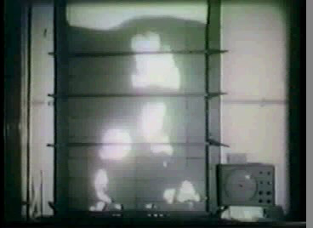
Group B (Sand-like)
Interparticle forces are negligible
Bubbles when U > U_{mf} (U_{mf} = U_{mb})
  Bubbles continue to grow as they rise and size is limited only by the bed height
Bubble rise velocity is usually greater than U and increases with height in bed (bubble size)
Fast bed deaeration upon defluidization
Moderate solids mixing and gas back mixing
Examples: glass beads, sand, table salt
Good success with CFD models
Bubble size continues to increase with distance from the distributor and with increasing gas velocity
Rhodes (2001)
http://www.erpt.org/012q/rhod-04.htm
Notes:
Can spout in shallow beds
When the size of the bubble is greater than about one third the diameter of the equipment then the rise velocity is controlled by the equipment and the bubbles become slugs of gas

Slide 106
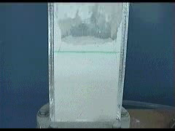
Group C (Cohesive)
Significant interparticle forces compared with the inertial forces
No bubbles only channels and cracks
Very low solids mixing and gas back mixing
Examples: flour, cement
No success with CFD models
An attempt to fluidize a Group C powder produces channels or a discrete plug
Rhodes (2001)
http://www.erpt.org/012q/rhod-04.htm
Notes:
Slugging is accompanied by large pressure fluctuations which is generally avoided in large units since it causes vibrations to plant
Since the particles are not fully supported by the gas the pressure loss across the bed is always less than the apparent weight of the bed per unit cross sectional area

Slide 107
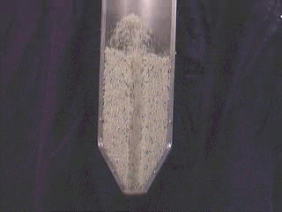
Group D (Spouting)
Negligible interparticle forces
Bubbles (spouts) when U > U_{mf}
  Able to produce deep spouting beds
Bubble rise velocity less than U
Fast bed deaeration upon defluidization
Low solids mixing and gas back mixing
Annular region is a moving bed
Examples: crushed limestone, grains, coffee beans, gravel
Well describe by CFD simulations, for the limited studies done.
Spouted bed of rice
Rhodes (2001)
http://www.erpt.org/012q/rhod-04.htm

Slide 108
Fluidization Regimes
Bubbling: Bubbles form in a bed with a distinct bed surface
Slugging: Bubble diameter is equal to bed diameter
Spouted: Bed with a central spout and a fountain of solids above
Turbulent : Two different coexisting regions – a bottom dense, bubbling region below a dilute, dispersed flow region
Fast fluidization: A relatively dense suspension flow with no distinct upper surface
Circulating: Upward gas-solids flow
  Solids are circulated back through a cyclone and standpipe arrangement
  low density: <5% solids fraction, low solids flux < 200 kg/m²∙s
  high density: 10-20% solids fraction, high solids flux ~400 kg/m²∙s
Pneumatic conveying
  Similar regimes as above
  Solids are not recycled

Slide 109
Fluidization Terminology
Attrition: breakdown of particles
Choking: collapse of a dilute-phase suspension into a dense-phase flow as the gas velocity is reduced at constant solids flow
Distributor or Grid: support plate at bottom which introduces the gas to the bottom of the bed and supports the weight of the bed when gas flow is shut down
Elutriation: tendency for fine particles to be preferentially entrained from the Reactor
Entrainment: Removal of solids from bed by fluidizing gas (carryover)
Freeboard: region extending from top of bed surface to top of reactor vessel
Fines: generally particles smaller than 37 μm in diameter (smallest regular sieve size)
Jetsam/Flotsam: Solids that sink/float
Minimum fluidization velocity: Superficial velocity at which bed weight equals pressure drop
Mixing: Mixing of particles of different size and/or density
Saltation velocity: minimum velocity for horizontal gas-solids flow
Segregation: tendency for particles to gather in different zones according to their size and/or density
Transport disengagement zone: region in freeboard beginning at bed surface in which particle flux decreases with height and above which the entrainment is independent of height

Slide 110
Fluidization Devices/Applications
Bin/Hopper – solids storage
Chutes – solids transfer
Cyclones – solids separation
Downer – column where particles fall under gravity, assisted by co-current gas flow
Non-mechanical valves (L-, N-, ..) – solids transfer (e.g., from a standpipe to the riser)
Risers – solids are carried upwards by the gas, with no distinct bed surface
Standpipes – moving beds for returning solids down-flow while matching the pressure drop in the riser
Notes:
Cyclone – inlet gas is brought tangentially into the cylindrical section creating a strong vortex inside the cyclone body. Particles in the gas are subjected to centrifugal forces which move them radially outward against the inward flow of gas. The gas leaves the cyclone via the outlet in the top (the solids outlet is sealed to the gas)
Standpipe – transferring solids downwards from a region of low pressure to a region of higher pressure

Slide 111
Brief review of numerical technique (2)
Equations are cast in general form
φ – dependent variable of interest
Γ - transport coefficient for diffusion
S – source term
transient
convection-diffusion
source
Source term
If S depends on φ, then need to express dependence in a linear form (since tools from linear algebra provides the means for solution).
Transient term
If fully implicit (MFIX default) then the new value of the dependent variable prevails over the entire time step. Other examples include explicit, Crank-Nicolson schemes.
Convection Term
Power law scheme is a good approximation of the exact solution but not as computationally intense. Other examples include exact (exponential) scheme, center difference (unstable), upwind scheme (MFIX default), superbee.
Patankar (1980)
https://mfix.netl.doe.gov/documentation/numerics.pdf
Notes:
For ease of implementation, the assorted governing equations are typically cast into the same general form as illustrated by equation 4.70, which consists of four terms: an unsteady term, a convection term, a diffusion term, and a source term
The source term serves as a catch-all quantity to include whatever terms that cannot be fitted into the nominal forms of the convection-diffusion terms
MFIX follows a semi-implicit scheme for time discretization. Most terms are considered fully implicit; however, some terms are handled in an explicit manner. Specifically, those terms arising from the closure model of the momentum viscous stress tensor that do not fit the nominal form of the diffusion term (i.e. G∇f) are treated explicitly as part of the source term (b
A number of different options are available in MFIX for the discretization of the convection-diffusion terms. In MFIX a first order upwind model is the default scheme. The central difference formulation of the combined convection-diffusion coefficient whereby the interface convection coefficient is determined from a simple average of the grid point velocity and the neighboring grid point velocity is found to result in very unstable solutions
*The momentum, energy, species, GE balance equations are differenced in a non-conservative manner by subtracting the differenced mass balance equations (continuity) from (upwind?) differenced conservative forms of the equations. (It is unclear whether such an implementation is entirely correct/consistent when given different difference discretization schemes for the convection term – to check this would require a lot of careful math and combing through the code)
The algebraic equations are constructed to comply with a set of rules that would guarantee convergence for an equation set involving constant coefficients
One of the rules requires that coefficients must not become negative. The simple average convection coefficient formulation can lead to a negative coefficient and consequently a non-convergent solution
Other rules:
consistency at control-volume faces (flux across a face must be same in the neighboring control volumes)
Positive coefficients (see above)
‘negative-slope’ linearization at the source term (so that we get the source to ‘add positively’ to the center coefficient and the source)
Sum of neighbor coefficients equals the center coefficient.

Slide 112
Brief review of numerical technique (3)
General equation for a single phase
simplification of Newtonian stress
transient
convection-diffusion
source
The momentum equation:
Now if we …
1) Employ full Newtonian stress relation
2) Incorporate multiple phases
- phase volume fractions
- interphase (interaction term) (nf₁)
Patankar (1980)
https://mfix.netl.doe.gov/documentation/numerics.pdf
Notes:
Shown here is how the momentum equation is treated in this formulation.

Slide 113
Brief review of numerical technique (4)
The momentum equation becomes
transient
convection
diffusion ~ only terms that take the form μ∇u
source terms
handled independently (partial elimination algorithm)
Additional items…
3) Account for other coordinate systems (e.g. cylindrical)
Additional terms arise from cylindrical coordinates, and the equations for the discretized geometry are altered (area, volume)
Discretized version
a_{p}, a_{nb} – coefficients of dependent variable at various grid locations
p – at center gird point
nb – neighbor grid points
b – discretized source term
https://mfix.netl.doe.gov/documentation/numerics.pdf
Notes:
Discretization of the governing equations results in set of algebraic equations, which are also cast into a similar form as illustrated by equation
In this equation, a_{p} and a_{nb} are the coefficients of the dependent variable at various grid locations and b is represents a constant discretized source term. In particular, for a given control volume a_{p} represents the coefficient of the dependent variable at the center grid point (f_{p}), while a_{nb} represents the coefficient of the dependent variable at the neighboring grid points (f_{nb}). The summation is taken over all neighboring grid point.
Recall, the source term serves as a catch-all quantity to include whatever terms that cannot be fitted into the nominal forms of the convection-diffusion terms

Slide 114
Example
The momentum equation implemented in MFIX code
transient
convection
diffusion ~ only terms that take the form μ∇u
source terms
handled via partial elimination algorithm
  conv_dif_u_g.f
  conv_dif_v_g.f
  conv_dif_w_g.f
  tau_u_g.f
  tau_v_g.f
  tau_w_g.f
  source_u_g.f
  source_v_g.f
  source_w_g.f
  partial_elim_u
  partial_elim_v
  partial_elim_w
solve_vel_star.f

Slide 115
Interphase coupling
Equation in general form
*Patankar (1980) recommends for convergence reasons
general
sources
transient
convection
‘simple’
diffusion
Interphase momentum
transfer
(from continuity*) interphase mass transfer
the interphase term couples equations
e.g., momentum equations coupled via components of velocity in each phase
How can the interphase term be handled?
Decoupling equations – calculate interphase terms based on previous iteration values
Makes iterations unstable or force time step to be very small
2) Leave completely coupled – solve all discretized equations together
Leads to a larger, nonstandard matrix – high computation requirements
Partial Elimination Algorithm – Spalding (1980)
Maintains a higher degree of coupling between equations and still yields a standard septadiagonal matrix
https://mfix.netl.doe.gov/documentation/numerics.pdf
Notes:
In addition to the four terms of the general discretization equation just discussed (an unsteady term, a convection term, a diffusion term, and a source term), interphase transfer terms that are present in multiphase flow warrant further mention. Strong coupling between the fluid and solids phase(s) exists due to the interaction terms (e.g., drag force). The equations can be decoupled by calculating the interphase transfer terms from the previous iterations values but this tends to slow convergence. To maintain a higher degree of coupling between the equations, the two-phase partial elimination algorithm [36] is generalized for multiple phases
The linear equation for f is:
ap fp = sum(anb fnb) + b
The homogenous part of the partial differential equation for f has an infinite number of solutions [e.g. no b term] of the form (f+c) where c is an arbitrary constant. The finite difference equation for f must have the same number of solutions. Otherwise, small mass imbalances during the iterations may produce large fluctuations in the values of f, and the convergence will be adversely affected. The finite difference equations will have this property (infinite solutions) if : ap = sum (anb).
To obtain this property the continuity equation is subtracted from the general governing equation. Thus the interphase mass transfer term appears in the generalized transport equation. Including this interphase mass transfer term in the source term would slow convergence and including it in the center coefficient would destablize the iterations (when sum Rml < 0). Therefore the term is manipulated and included in both terms.

Slide 116
Interphase coupling: Partial Elimination Algorithm (PEA)
Corresponding discretized equation
See Patankar (1980) or MFIX numerical guide for more details
Partial Elimination Algorithm
Implementation found in partial_elim.f
Method for MMAX = 1 (i.e. gas phase & 1 solids phase)
1) Write above equation for m = 0 (gas phase)
2) Solve equation m = 0 for (φ₀)_{p} and substitute into equation m = 1 (solids phase). Vice versa. Yields:
New term in center coefficient
New source term with (φ₁)_{nb} given from previous iteration
https://mfix.netl.doe.gov/documentation/numerics.pdf

Slide 117
Interphase coupling: Partial Elimination Algorithm (PEA)
Partial Elimination Algorithm
Method for MMAX > 1 (i.e. multiple solids phases)
Solving multiple solids phases requires matrix inversion for an exact treatment of the partial elimination scheme → expensive computation
MFIX has proposed an approximate alternative which may not be as effective as exact partial elimination but still helps stabilize computations and is faster than the exact method
Method is similar to that for MMAX = 1 but formulations are more extensive …

Slide 118
Windows Options: Visual Fortran or Cygwin
Visual Fortran
  https://mfix.netl.doe.gov/members/wininst.html
  https://mfix.netl.doe.gov/members/develop/MFIX%20Intel%20Fortran%202010%20instructions.txt
What is Cygwin?
  Cygwin is a linux-like environment for Windows.
    A collection of tools which provide Linux look and feel. NOT a way to run native Linux apps on Windows
    A DLL (cygwin1.dll) which acts as a Linux API emulation layer providing substantial Linux API functionality.
    The Cygwin DLL currently works with all recent, commercially released x86 32 bit and 64 bit versions of Windows.
Notes:
Although it is not very well supported, it is possible to compile MFiX on Windows, using Visual Fortran. Please go to https://mfix.netl.doe.gov/members/wininst.html for specific instructions. There is no self-installing package. The successful compilation of the source code will produce an executable file called mfix.exe. This file must be executed from a DOS console window and requires an input file called mfix.dat.
Another option is to install Cygwin, which is a Linux-like environment for Windows. You will still need to be familiar with Linux to use Cygwin.
Note that Cygwin does not provide a means for running GNU/Linux or other Unix binary executables under MS-Windows. In order to run such software using Cygwin, that software must be compiled from its sources
API = application programming interface
DLL = dynamic link library

Slide 119
Cygwin Installation
Download Cygwin (setup.exe) from http://cygwin.org/
  A nice summary is available at http://www.physionet.org/physiotools/cygwin/
Once downloaded, click on setup.exe
  Choose a download site close to you
  Choose the following configuration options to proceed with the installation
    Under devel tab,
      choose ‘gcc4-fortran’, ‘make’, ‘gdb’
    Under docs tab,
      choose ‘xpdf’ – to view pdf files (optional)
    Under edit
      choose ‘nedit’ or ‘gedit’ – nedit and gedit are simple editors like note pad but provide syntax coloring, etc. (optional)
    Under Graphics
      choose ‘gnuplot’ and ‘ImageMagick’ (optional)
    Under X11 (see http://x.cygwin.com/docs/ug/setup-cygwin-x-installing.html),
      choose whatever is most appropriate for your needs – cygwin can be used as an x-terminal but it is also needed if you want to use nedit, etc. (optional) – xorg-server, & x-init needed xterm
  Proceed with the installation
Notes:
The procedure for installing and running MFIX is given in the following section. The commands shown are for the UNIX operating system. Command procedures are available for UNIX only, but can be easily developed for other operating systems

Slide 120
MFIX Installation (3) : Cygwin
Place mfix download (mfix.tar.gz) in your home directory on cygwin.
  If you installed cygwin at c:\cygwin, the home directory would be c:\cygwin\home\your_user_name
Open the cygwin terminal
  click on the shortcut on the desktop
If you want X support, just type in ‘startx’ and you should get a new terminal which supports X or using the links Cygwin-x under program menu.
  If you have any problems, try to follow the steps at: http://x.cygwin.com/docs/ug/setup-cygwin-x-installing.html
To begin with you will be in your home directory. If you have mfix.tar.gz at that location, at the command prompt, type: tar xzvf mfix.tar.gz
  This should create the directory mfix which contains several files and six subdirectories
Notes:
To install MFIX (version m.n) from the tar file, go to the home directory and uncompress and read the file by typing ….
This will create a directory named mfix, which contains several subdirectories: doc, model, post_mfix, tests, tutorials, tools, etc…
For the most part, MFiX is installed, and run through command lines only.

Slide 121
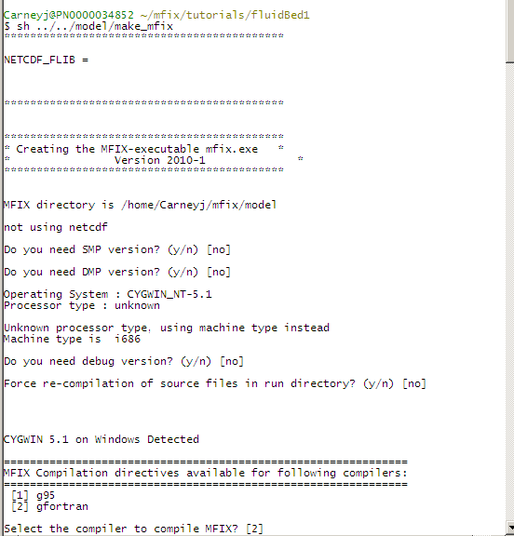
Create a Serial MFIX executable : Cygwin
From now on you can follow the instructions in the Readme.pdf for Linux installations. Here is a quick summary:
Go to the fluidBed1 tutorial and type:
  cd mfix/tutorials/fluidBed1
  sh ../../model/make_mfix
  Choose the default settings for compilation options and for the compiler, chose gfortran (option 2)
Note: that makefile should be invoked as “sh make_mfix.” Erroneously invoking it as “make_mfix” will cause the user defined files not to be used for the build
Notes:
This should start the compilation process and depending on the computer this might take a long time.
premade windows executables of post_mfix and ani_mfix are available that can be used to process the results
Compile post_mfix using gfortran is not supported.
It is unclear whether cygwin supports intel fortran compilation (test: does MFIX, compiled using linux, run on cygwin?).

