Slide 1
Numerical simulation and experimental study of a small-scale circulating fluidized bed
Yupeng Xu, Jordan Musser, Tingwen Li, William Rogers, Rupen Panday, Balaji Gopalan, Greggory Breault, Jonathan Tucker
Month 31, 2016

Slide 2
Outline
Background and Objective
Experimental setup and simulation settings
Results and discussion
Grid size and statistical time selection
Selection of drag model
Direct comparison between simulation and measurement
Further analyses
Conclusions

Slide 3
Background and Objective
Circulating fluidized beds (CFB) are deployed for a wide variety of processes.
Numerical simulations of full-loop CFB at particle-scale are extremely useful to understand flow behaviors that are crucial in the design and operation of systems, including particle residence time distribution and cluster formation.
A thorough comparison between numerical predications and experimental measurements is needed to evaluate the accuracy of computational models for CFBs.

Slide 4
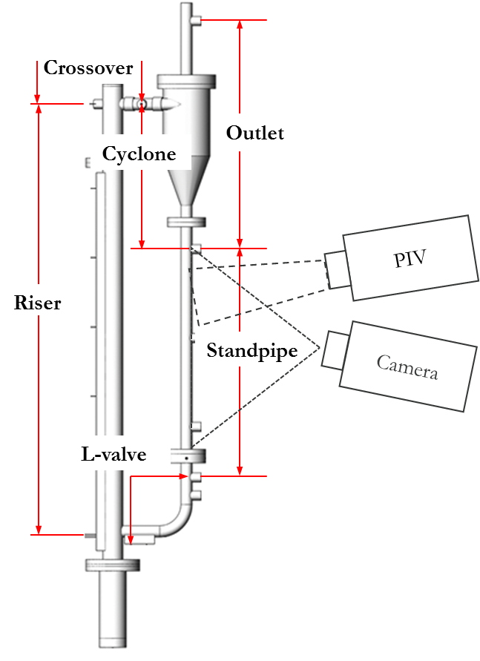
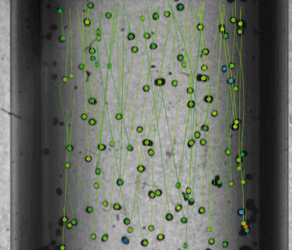
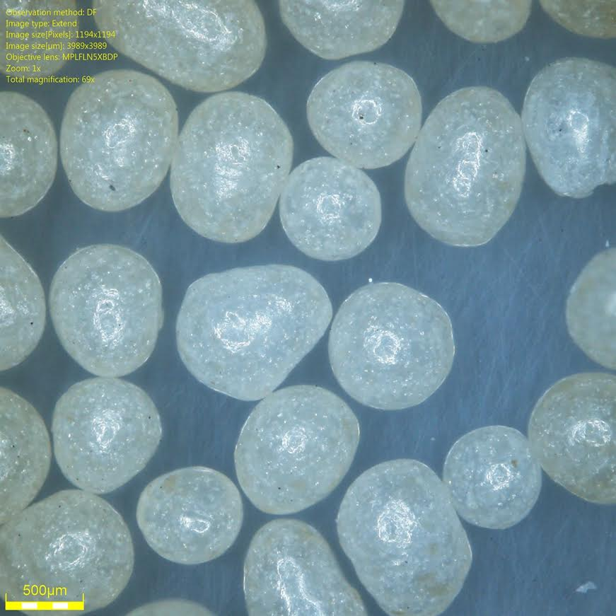
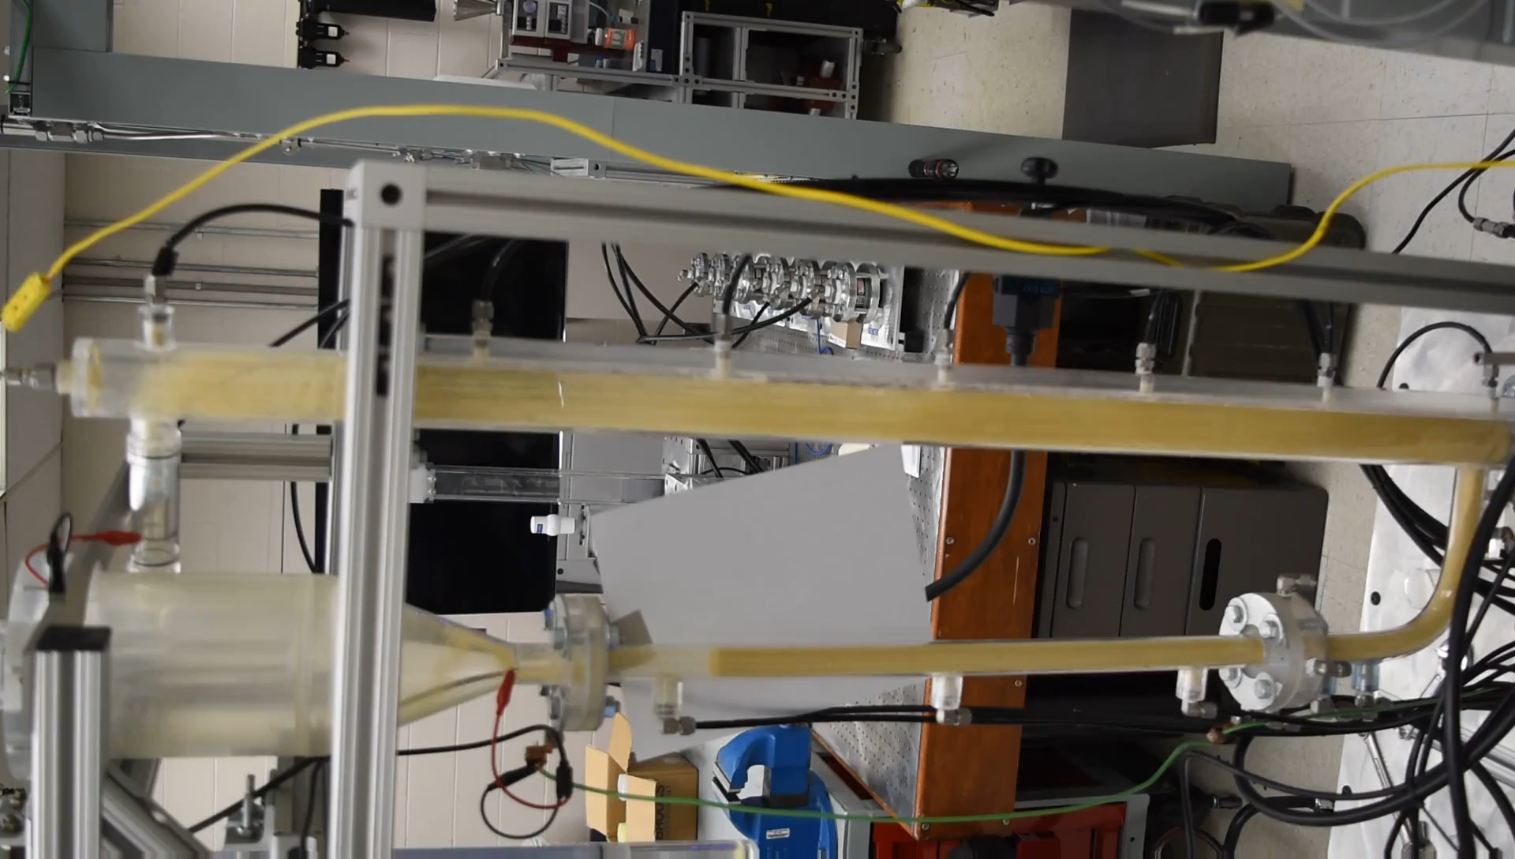
Experimental setup & operation conditions
A 3D printed cold-flow CFB of 1.32m high is used. The internal diameters of the cyclone, riser and standpipe are 0.127m, 0.0508m and 0.0254m, respectively. Three conditions are tested with operational parameters carefully measured.
circulation rate
ΔP
Gas flow rates (SLPM)
ΔP
ΔP
ΔP
Gas |  |  | Solids
P_{std} (Pa) | 101325 |  | ρ_{p} (kg/m³) | 863.3
T_{std} (K) | 293.15 |  | d_{p} (m) | 8.71E-04
ρ_{g}^{std} (kg/m³) | 1.2 |  | ϕ | 0.95
μ_{g}^{std} (Pa-s) | 1.85E-05 |  | ε_{packed} | 0.3462
Mw (g/mol) | 29 |  | ε_{fluffed} | 0.4100
 |  |  | U_{mf} (m/s) | 0.13
ΔP
ΔP
standpipe height
FTC115
ΔP: pressure drops in different parts
FTC135
FTC180
Panday et al. NETL-PUB-21385

Slide 5
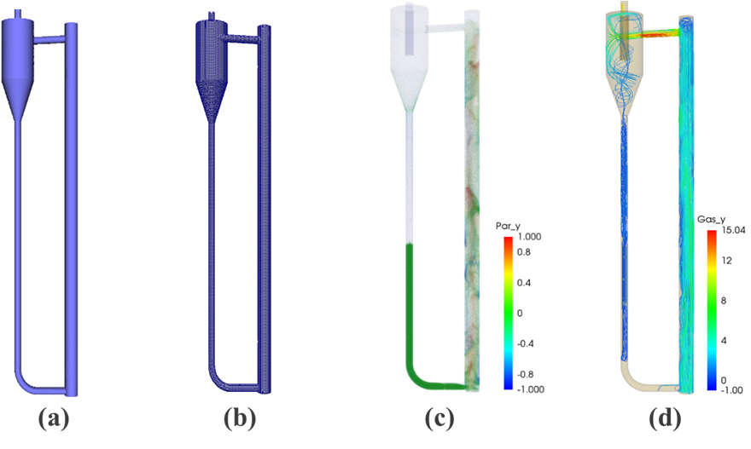
Simulation approach
Multiphase Flow with Interphase eXchanges-Discrete Element Model (MFIX-DEM)
Cartesian grids are used to discretize the computational domain.
Boundary cells are truncated to conform the domain surface.
Hybrid parallel mode with distributed memory parallel (DMP) and shared memory parallel (SMP) using message passing interface (MPI) and open multi-processing (OpenMP).
CAD geometry Numerical grid Solids distribution Gas streamline

Slide 6
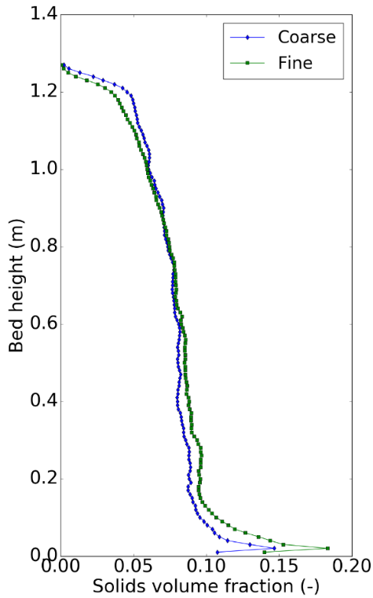
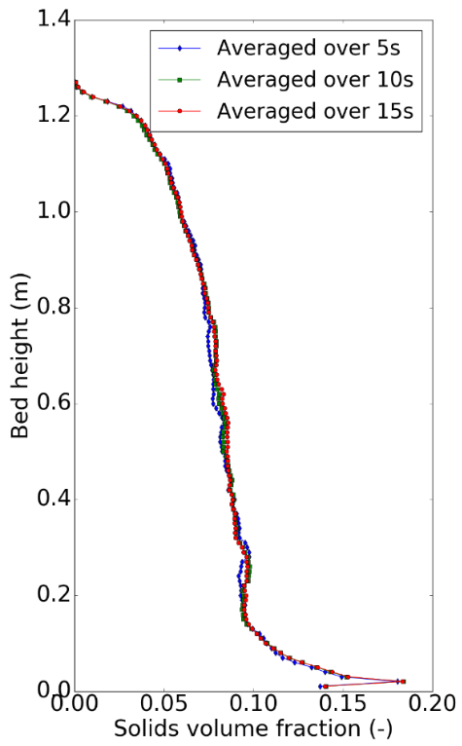
Grid size and statistical time selection
 | X (W) | Y (H) | Z (D)
 | 0.32 m | 1.32 m | 0.15 m
Fine (4.6Dp) | 80 | 330 | 38
Coarse (9.2Dp) | 40 | 165 | 20
15 s
10 s
10 s
5 s
Averaging time
Y
Z
X
Grid coarsening from 4.6 Dp to 9.2 Dp lead to no significant change in results. Fine grid of 4.6 Dp was used for all simulations.
The total simulated time was around 25 s. In post-processing, the first 10 s were discarded to exclude start-up effects. The rest 15 s were used for analysis.

Slide 7
Selection of drag law
Animation
Wen and Yu (Wen and Yu, 1966), Gidaspow (Ding and Gidaspow, 1990), BVK (Beetstra et al., 2007), and Hill-Koch-Ladd (Hill et al., 2001) are compared with experimental data.
These drag models can be classified into two groups. Group 1 includes the empirical models: Wen & Yu and Gidaspow. Group 2 includes the DNS models: BVK and HKL.

Slide 8
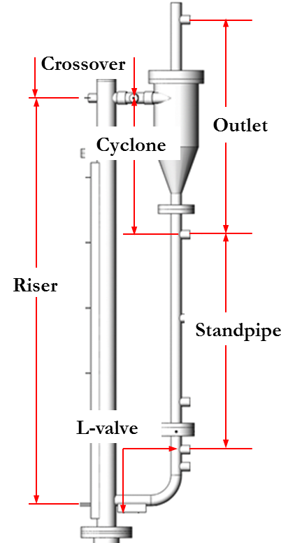
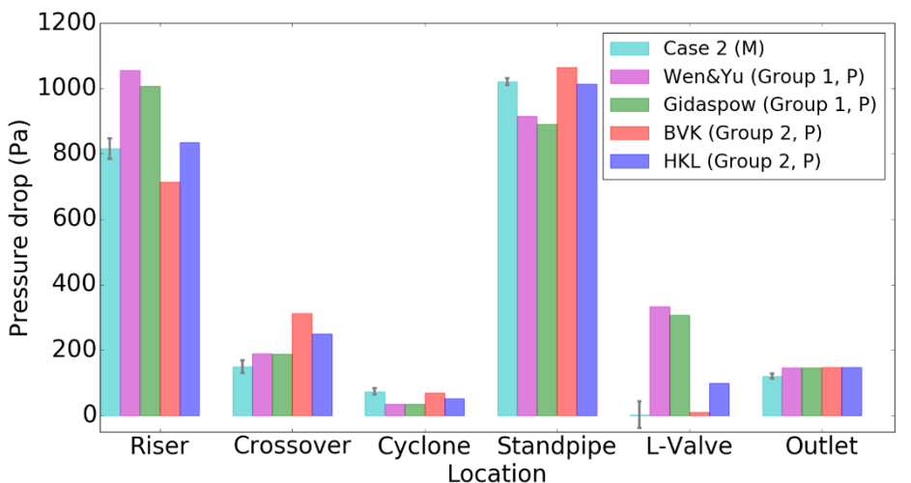
Selection of drag law
Pressure drop
Overall, the Group 2 models do a better job predicting pressure drops in different parts
HKL is the best.

Slide 9
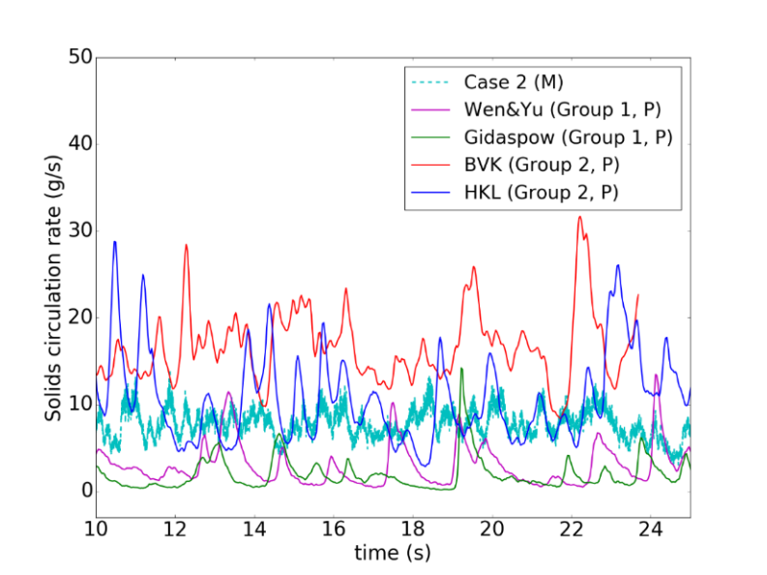
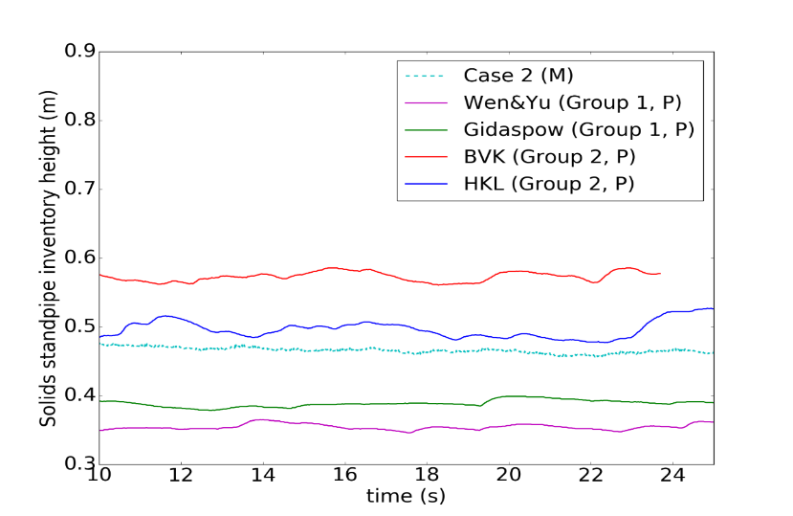
Selection of drag law
Solids circulation rate & standpipe height
 | Circulation Rate (g/s)
Experiment | 6.8 +/- 1.5
BVK | 16.9 +/- 4.14
HKL | 10.38 +/- 4.76
Wen & Yu | 2.99 +/- 2.42
Gidaspow | 2.17 +/- 1.93
PIV
camera
 | Standpipe height (m)
Experiment | 0.47 +/- 0.02
BVK | 0.57 +/- 0.01
HKL | 0.50 +/- 0.02
Wen & Yu | 0.36 +/- 0.01
Gidaspow | 0.39 +/- 0.01
HKL drag model yields the best agreement with experimental measurements of solids circulation rate and standpipe height.

Slide 10
Detailed comparison
Qualitative comparison
Case 1
Case 2
Case 3

Slide 11
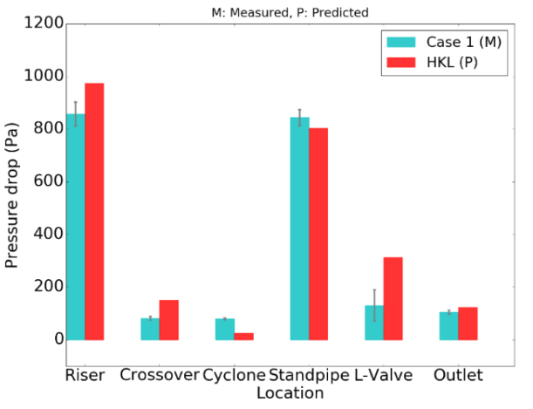
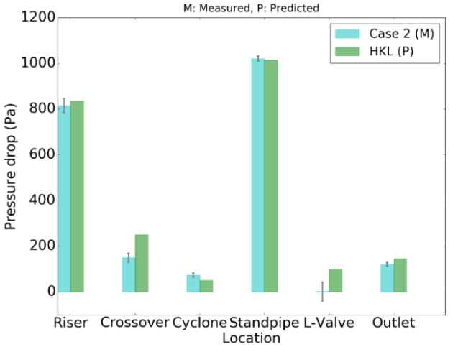
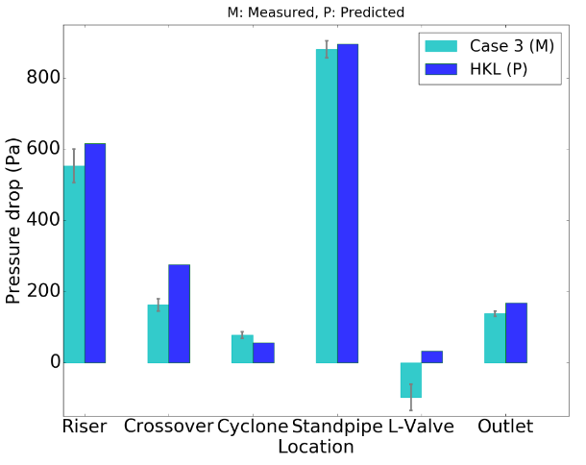
Detailed comparison
Pressure drops, standpipe height and circulation rate
Pressure drops
Case 1
Case 2
Case 3
Standpipe bed height (m)
Solids circulation rate (g/s)
 | Experiment | Simulation
Case 1 | 0.43 +/- 0.01 | 0.42 +/- 0.01
Case 2 | 0.47 +/- 0.01 | 0.50 +/- 0.02
Case 3 | 0.65 +/- 0.01 | 0.68 +/- 0.01
 | Experiment | Simulation
Case 1 | 0.06±0.1 | 0.36 +/- 0.37
Case 2 | 6.8±1.5 | 10.38 +/- 4.76
Case 3 | 7.9±1.5 | 10.66 +/- 4.09
Consistently good agreement has been achieved for all operating conditions for most quantities of interest.

Slide 12
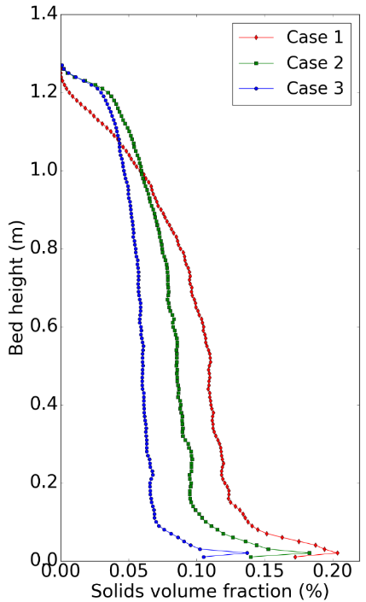
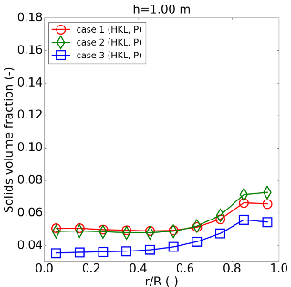
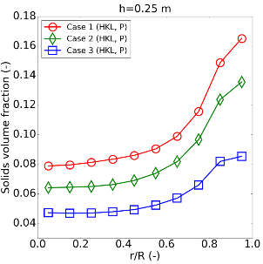
Further analyses
Axial solid volume fraction Radial solid volume fraction Voidage Vertical solid velocity
An “S-shape” axial profile of solids volume fraction along the riser has been shown under all flow conditions.
Quantitatively different solid distributions are predicted by the numerical simulations for different operating conditions.
Typical core-annular structure with upward flow in center and downward flow near wall are predicted.
Notes:
With the successful validation, we are confident to perform further analyses on the numerical results. First we examine the axial solid distribution in each condition as well as the radial profiles. Here I also show the central slice of voidage distribution as well as solid velocity distribution at different elevations. Basically, An “S-shape” axial profile of solids volume fraction along the riser has been shown under all flow conditions. Quantitatively different solid distributions are predicted by the numerical simulations for different operating conditions. Typical core-annular structure with upward flow in center and downward dense flow near wall are predicted.

Slide 13
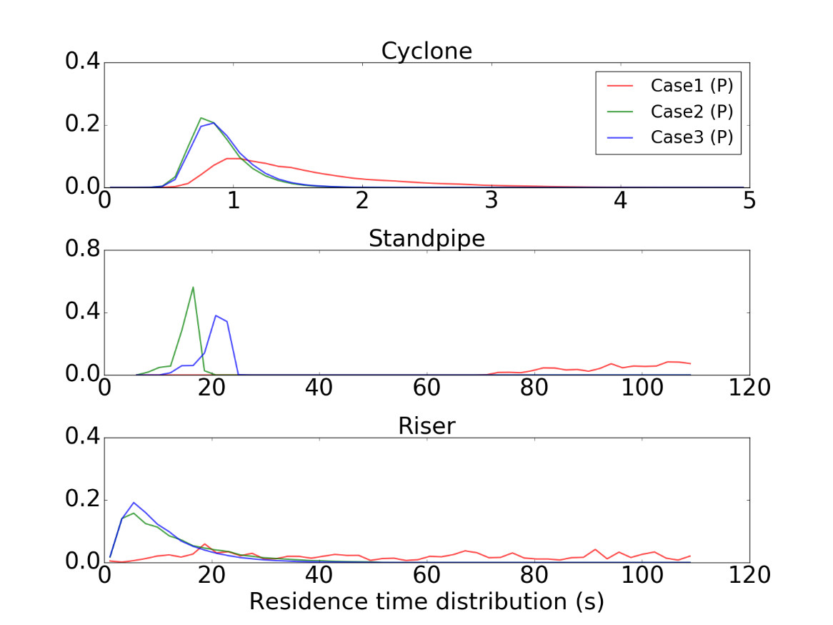
Residence time distribution
Solid residence time distributions in different parts under different operating conditions by analyzing trajectories of particles

Slide 14
Conclusions
Detailed comparison of simulations and experiments for a full-loop CFB system have been performed over a range of operating conditions;
Simulation results and experimental data match very well for all operating conditions while keeping model parameters fixed;
MFiX-DEM model has demonstrated its value as a high fidelity simulation tool capable of predicting key performance parameters for challenging CFB flow conditions.

Slide 15
Acknowledgements & Disclaimer
Acknowledgements
This technical effort was performed in support of the U.S. Department of Energy, Office of Fossil Energy's Advanced Numerical Simulation of Multiphase Flow through the National Energy Technology Laboratory under the RES contract DE-FE0004000. This research was also supported in part by an appointment to the National Energy Technology Laboratory Research Participation Program, sponsored by the U.S. Department of Energy and administered by the Oak Ridge Institute for Science and Education.
Disclaimer
This report was prepared as an account of work sponsored by an agency of the United States Government. Neither the United States Government nor any agency thereof, nor any of their employees, makes any warranty, express or implied, or assumes any legal liability or responsibility for the accuracy, completeness, or usefulness of any information, apparatus, product, or process disclosed, or represents that its use would not infringe privately owned rights. Reference herein to any specific commercial product, process, or service by trade name, trademark, manufacturer, or otherwise does not necessarily constitute or imply its endorsement, recommendation, or favoring by the United States Government or any agency thereof. The views and opinions of authors expressed herein do not necessarily state or reflect those of the United States Government or any agency thereof.

Slide 16
NETL 2018 Workshop on Multiphase Flow Science
August 7-9, 2018
University of Houston, Houston, TX
Abstract submission: workshop@mfix.netl.doe.gov by June 1, 2018

Slide 18
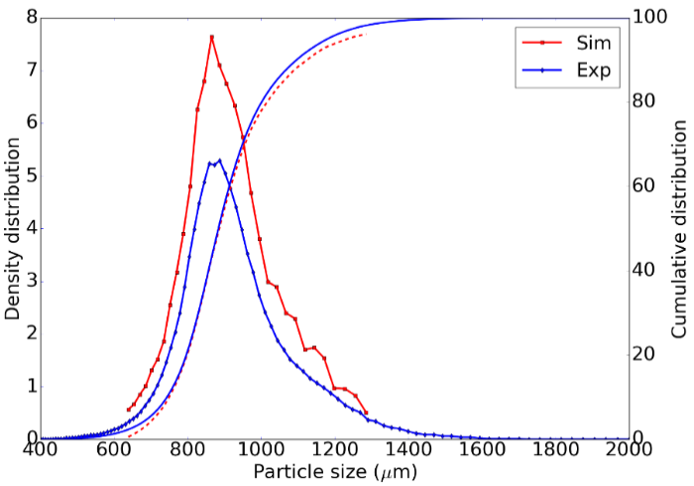
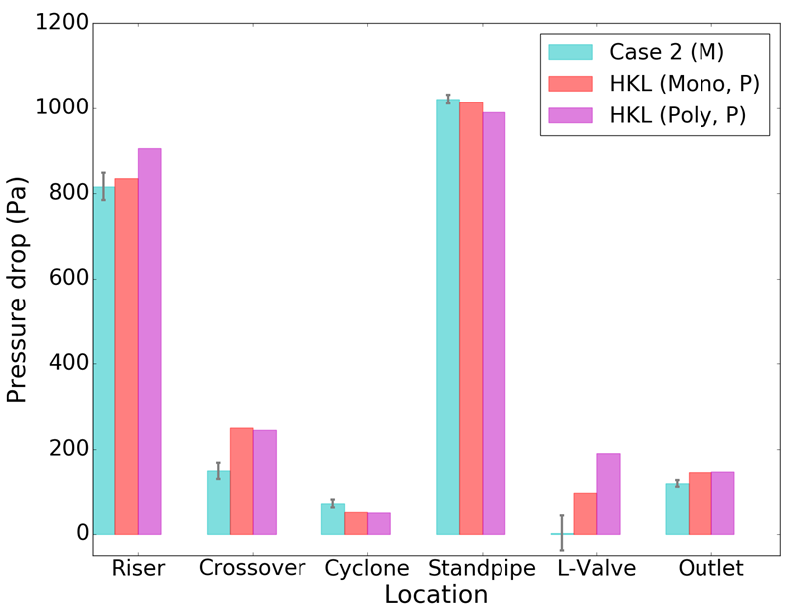
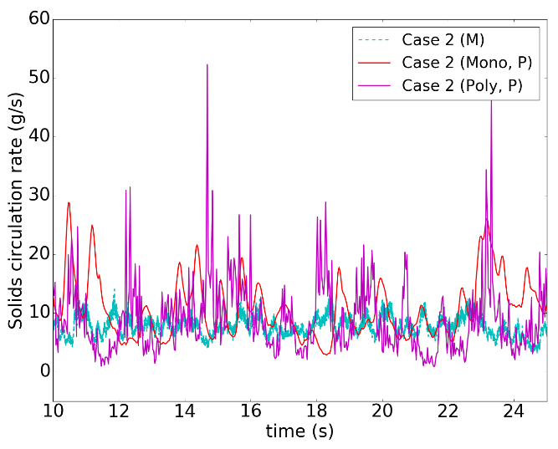
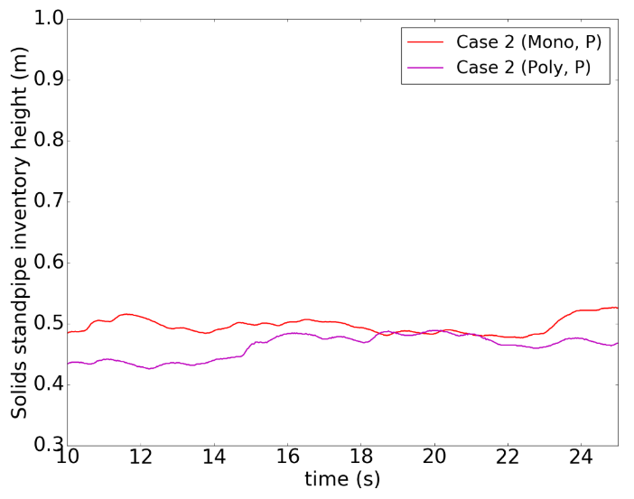
Influence of particle size distribution
HDPE-870, Geldart B
No significant improvement in predictions of pressure drops, solid circulation rate and standpipe height for the current system.
Notes:
We also investigated the effect of particle size distribution. For all results presented so far, a mono-disperse system was assumed.

