Slide 1
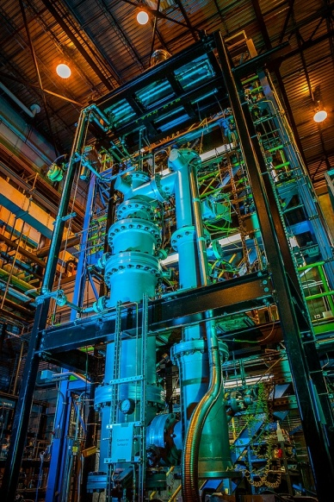
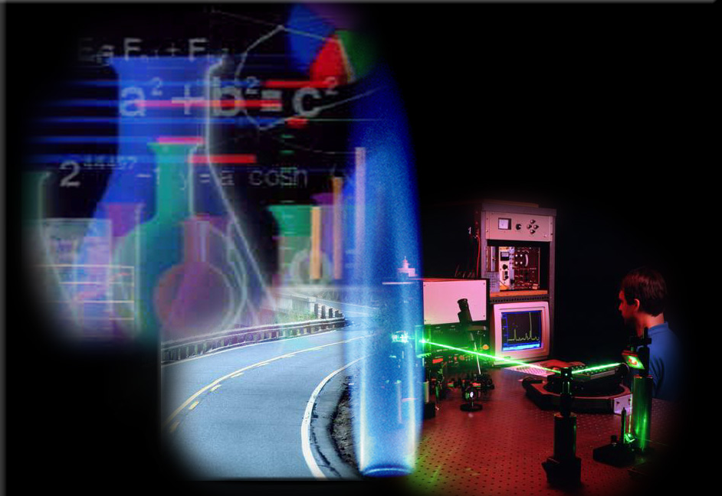
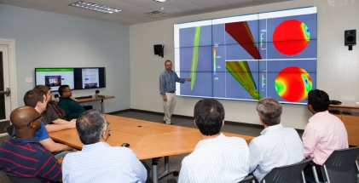
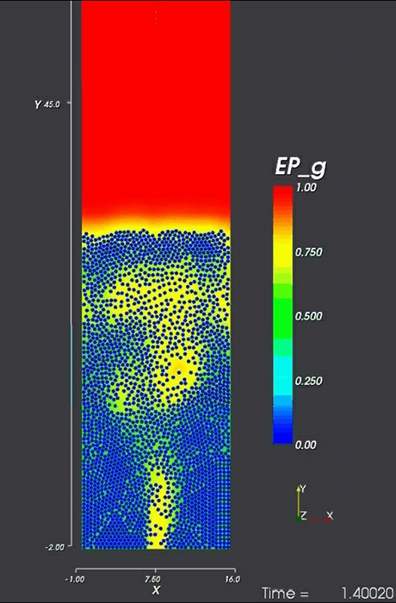
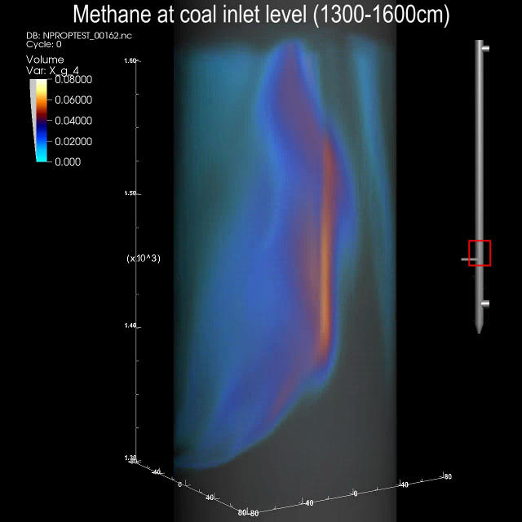
Computational Fluid Dynamic Simulations of a Pilot-Scale Transport Gasifier Using Mississippi Lignite Feedstock
Tingwen Li^{a,c} , William Rogersª , Douglas McCarty^{b}, Jenny Tennantª
a: National Energy Technology Laboratory, Morgantown, WV
b: Southern Company Services, Wilsonville, AL
c: URS Corporation, Morgantown, WV
2014 Gasification Technologies Conference

Slide 2
Outline
Objectives
Introduction to Power Systems Development Facility ( PSDF ) & Transport Integrated Gasification ( TRIGTM )
The Modeling Tools
Model Setup
Simulation Results
Conclusions
2

Slide 3
Objectives
Use data available from PSDF TRIGTM operations to validate NETL Computational Fluid Dynamic (CFD) models and chemical kinetics tools
Demonstrate the capability of NETL CFD tools to model gasifier performance over a wide range of operating conditions
Demonstration with Mississippi lignite fuel
Build on previous simulations for bituminous and low rank coals
Provide insight to guide the continued development and validation of computational tools to support gasifier designers and operators
3

Slide 4
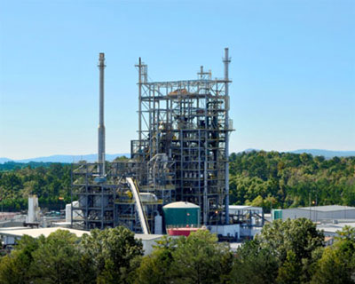
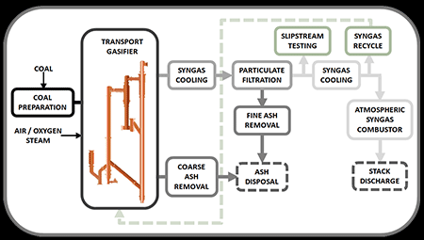
Power Systems Development Facility
Power Systems Development Facility (PSDF)
Test center sponsored by the U.S. Department of Energy (DOE) dedicated to the advancement of clean coal technology
major areas of testing involve pressurized solids handling systems, coal gasifier optimization using a variety of fuels, and syngas conditioning
home of the National Carbon Capture Center
features key components of an IGCC plant
www.nationalcarboncapturecenter.com
4

Slide 5
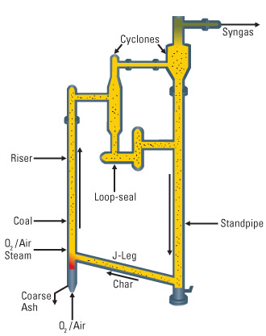
Transport Integrated Gasifier (TRIGTM)
TRIGTM (Transport Integrated Gasification)
Developed by KBR, Southern, and DOE
Based on KBR FCC technology
Air- and oxygen-blown
Good for low-rank coal
Major components:
Mixing zone
Riser
Cyclone/disengage, loop-seal
Standpipe, J-leg
TRIGTM Schematic
www.kbr.com
5

Slide 6
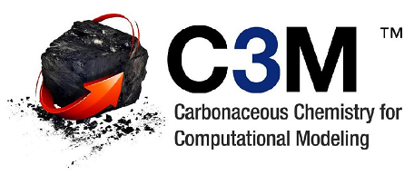
The Modeling Tools
The NETL MFIX (Multiphase Flow with Interphase eXchanges) Computational Fluid Dynamics Code is the basis
MFIX is NETL’s open-source CFD software platform for hydrodynamics, heat transfer, and chemical reactions in multiphase systems
MFIX provides transient, 3D predictions of pressure, velocity, temperature, and species for all phases
The NETL C3M (Carbonaceous Chemistry for Computational Modeling) is used for determining the coal reaction mechanism
C3M is chemistry management software focused on computational modeling of reacting systems
Provides direct links between kinetic information and CFD
Virtual kinetic laboratory – allows evaluation of complex kinetic expressions
Simulations are performed on the NETL Supercomputer
Ranked in top 100 supercomputers in the world
6
Notes:
This slide summarizes the basic model components. The simulation was conducted by using NETL’s open-source code MFIX which has been widely used for gas-solid flow modeling.
3800 registered users, 73 countries
68% university
18% industry
4% other labs
10% other

Slide 7
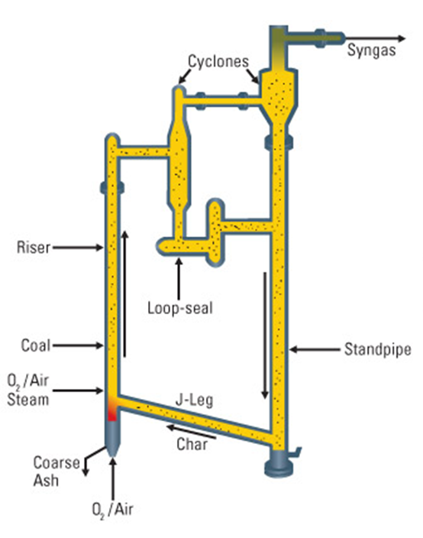
The MFIX Model Setup
Simulation with Detailed Setup
Fine grid: 1.3 Million Computational Cells
Well-resolved inlets & outlet for all streams
Two solid “phases” used for coal and recycled ash with different sizes & densities
Although high geometric fidelity, model is expensive to run
long simulation time
large datasets to manipulate
Created Simplified Setup
Compared this to Detailed Setup results to verify acceptable accuracy
Now able to do more simulations over a range of operating conditions
Simulation Geometry – To Scale
Detail of Inlets
7

Slide 8
The MFIX Model Setup
Simplified Setup
Coarse grid: 400,000 computational cells
Major inlets & outlets are still well resolved
Point sources near walls used to capture smaller inlet flows
Single representative solid phase for coal and recycled ash
A ‘filtered’ model used for momentum, heat & mass transfer to capture subgrid-scale physics
Resultant model is much less expensive to run – still retains the major flow features
Comparison to Detailed Case is very good
Temperature and outlet composition are close
Li et al. Energy & Fuels, 2013, 27, 7896-7904.
8
Notes:
SMD = Typical values are around 80 microns
Filtered model – based on Igci model
Filtered approach analogous to various turbulence models where you don’t resolve the scale of the turbulence, but you model the effects turbulence has on the flow

Slide 9
Chemical Kinetics
Detailed coal devolatilization and gasification reaction kinetics were developed for Mississippi lignite
17 gas-phase species and 4 solids-phase components are tracked
Use the PC Coal Lab database through C3M to determine rate constants
This approach accounts for the effects of local bed conditions and feed stock properties on the kinetics
Thermodynamic properties provided by C3M from standard databases
Other reactions included in the scheme
Char combustion: shrinking core model
Gas phase combustion: global reaction mechanisms for hydrocarbons
Water-gas shift: combination of catalytic and non-catalytic kinetics
Chemical kinetics parameters were held constant for all simulations
No ‘tweaking’ of parameters was done to improve agreement
Van Essendelft et al. Advanced Chemistry Surrogate Model Development within C3M for CFD Modeling, Part 1: Methodology Development for Coal Pyrolysis, I&ECR 2014, 53, 7780-7796
Westbrook and Dryer, Simplified Reaction Mechanisms for the Oxidation of Hydrocarbon Fuels in Flames, Combustion Science and Technology, 1981, Vol. 27, pp. 31-43.
Notes:
Westbrook and Dryer (1981) mechanisms for HC fuels
gas phase species: considered
O2, CO, CO2, CH4, H2, H2O, N2, Tar, Soot, PAH, OIL, H2S, C3H6, HCN, C2H4, C2H6, SO3
solid species:
char, volatiles, moisture, ash
PCCL is run over many conditions of temperature, pressure, gas composition, particle diameter to produce a gasification rates at each of these conditions
The thermo properties for most species are from the Burcat's database.
Tar, volatiles, ash, PAH and OIL, we have to calculate them based on their composition. Use the method developed by Dirk to calculate the heat of formation, heat capacity etc.
Initially, the experimental data we found on lignite was used to calibrate the PCCL runs. However, the results were far off. After that, I turned off the calibration and use the default factor recommended by PCCL.
No tweaking of rate constants:
NO. What I did is very similar to Mehrdad. Basically, I ran many PCCL runs covering a wide range of operating conditions (different gas compositions for gasification), then fitted the rate from those runs. The same rate expression was used for all PSDF runs.
Shrinking core model – from MGAS
Water-gas shift – switch between catalytic and non-catalytic rates based on solids content

Slide 10
PSDF Tests using Mississippi Lignite
Operating conditions that were simulated – 11 Runs
Gasifier temperature (~1600-1750F)
Pressure (~191-211 psig)
Steam-to-coal ratio (~0.005-0.174)
Coal feed rate (~3500-4340 lb/hr)
Lignite coal composition used for the simulations (after drying):
Proximate analysis |  | Ultimate analysis
Fixed carbon (%) | 31 | Carbon (%) | 46
Volatile matter (%) | 37.1 | Hydrogen (%) | 3.5
Moisture (%) | 17.1 | Oxygen (%) | 17.1
Ash (%) | 14.8 | Nitrogen (%) | 1
 |  | Sulphur (%) | 0.6
POWER SYSTEMS DEVELOPMENT FACILITY TOPICAL REPORT: GASIFICATION TEST CAMPAIGN TC25, 2008
10
Notes:
Range of the 11 runs that were simulated

Slide 11
Visualization of Transient Results
11

Slide 12
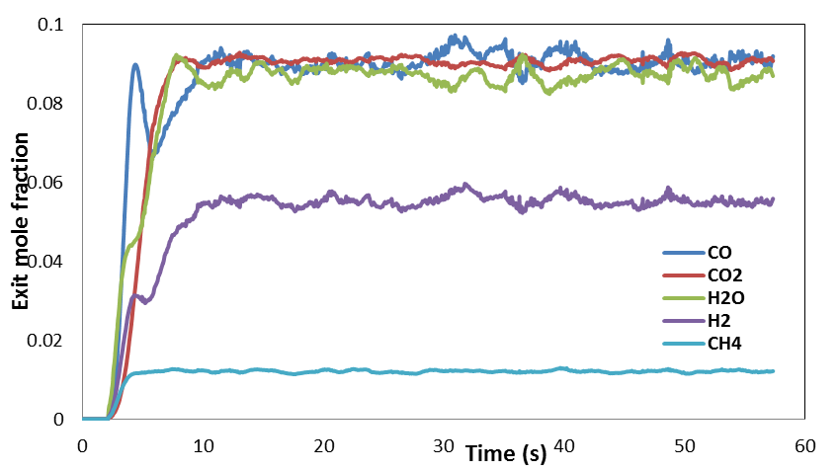
Comparison of Model and Operating Data
Time-averaged model predictions were used for comparison with data
e.g. Time history of syngas composition at riser exit for one case
Time average window
12

Slide 13
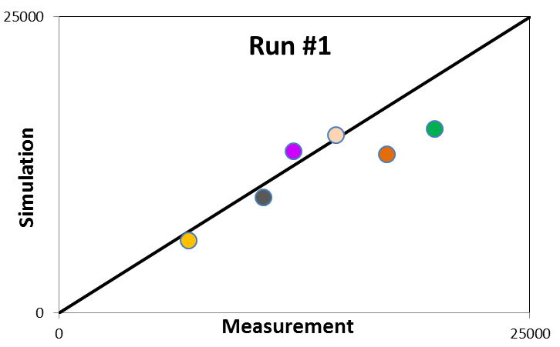
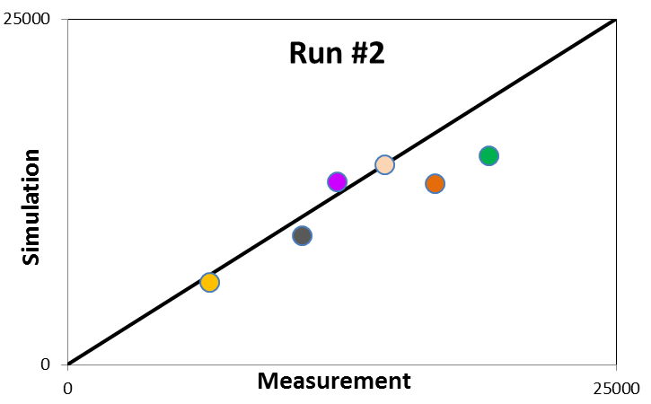
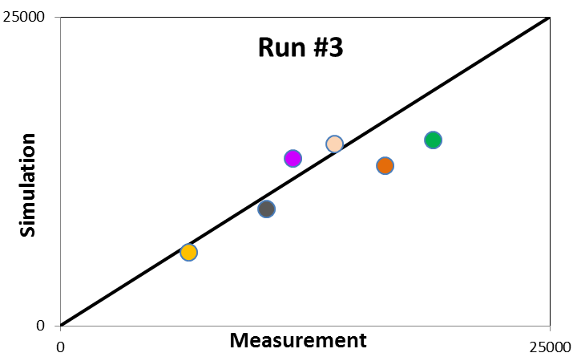
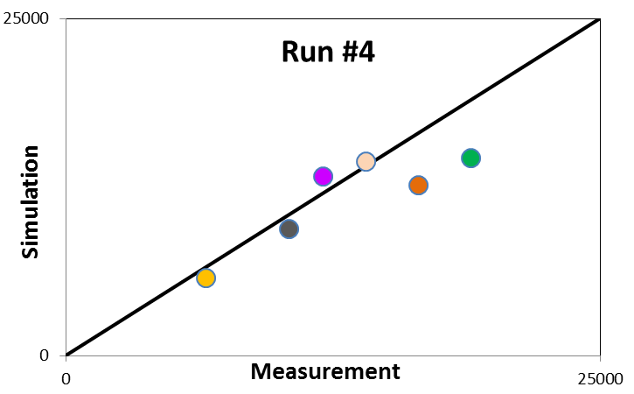
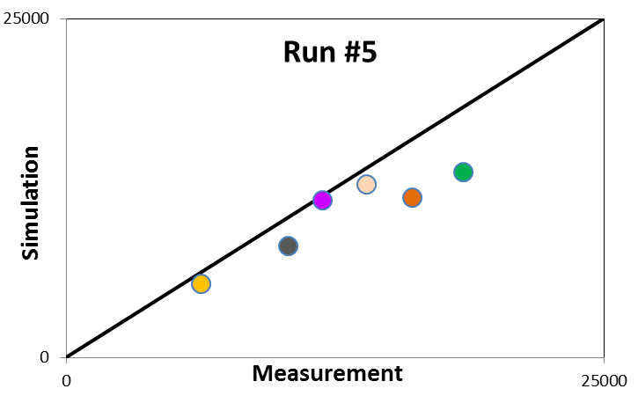
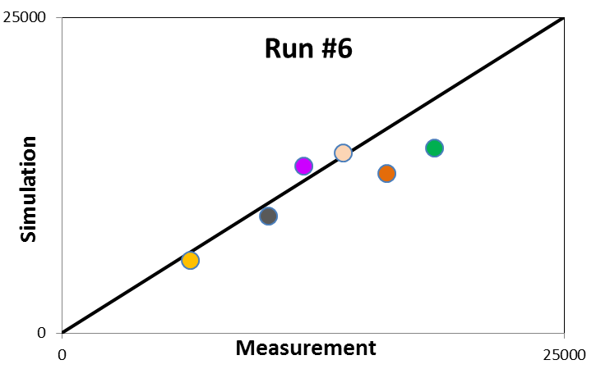
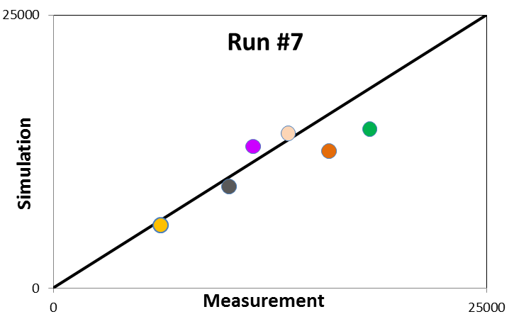
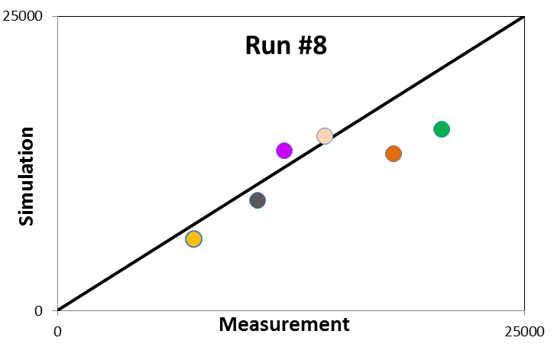
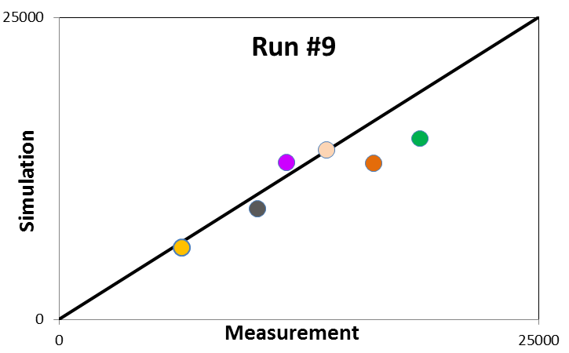
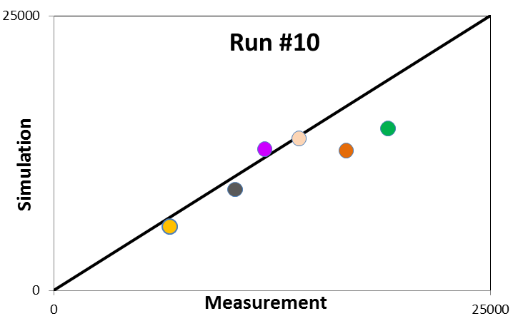
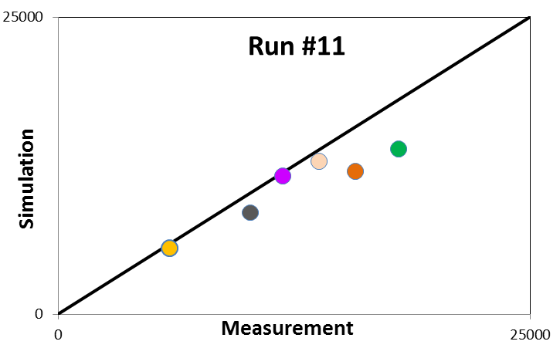
Comparison of Model and Operating Data
Time-averaged pressure drop values – parity plots comparing prediction to measurement
Above the Lower Mixing Zone (LMZ), measured and predicted pressure data are in good agreement, with maximum discrepancy < 30%
Pressure drop values for the LMZ are excluded here - the simulation consistently underpredicts pressure drop in LMZ
LMZ
13
Notes:
How much lower were dP / holdup in the LMZ?

Slide 14
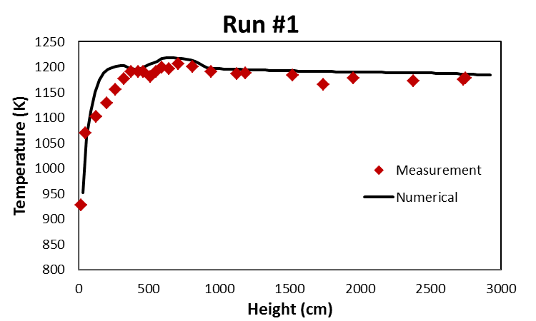
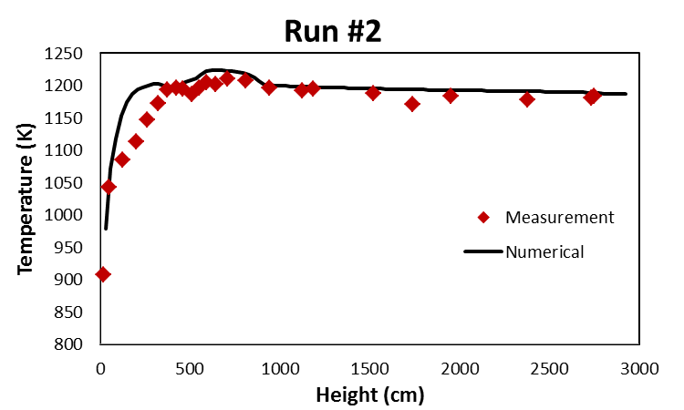
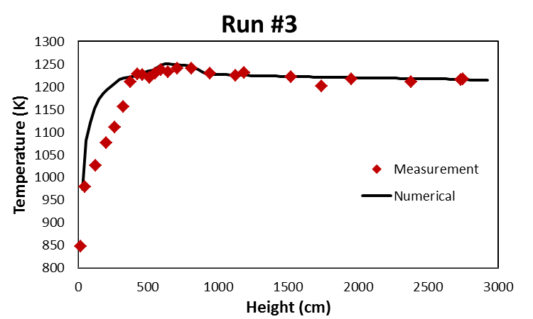
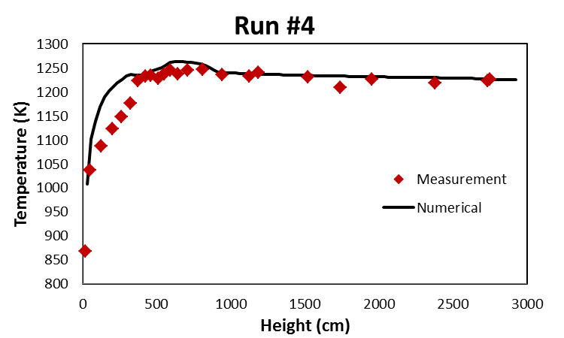
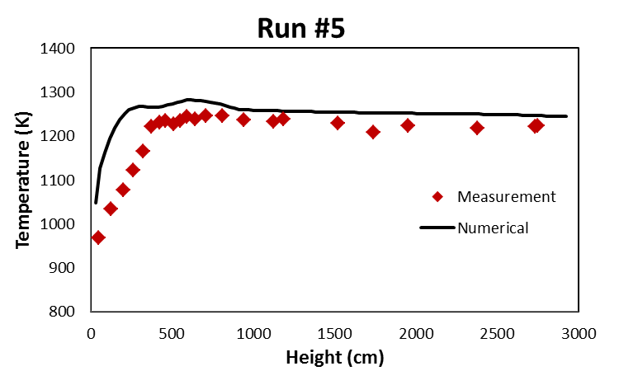
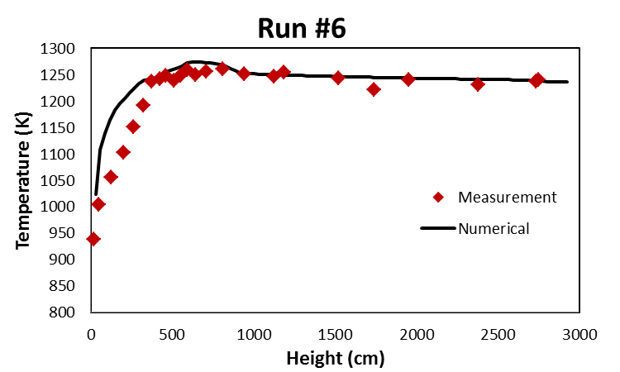
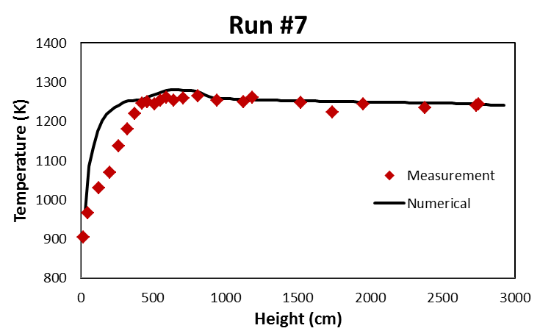
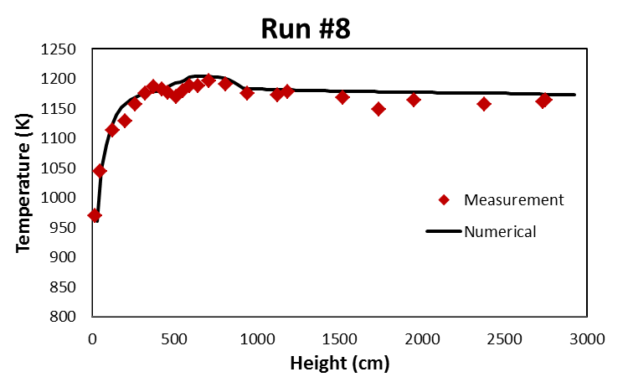
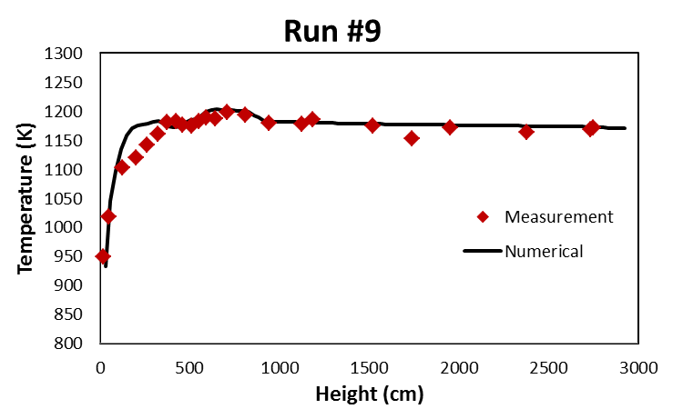
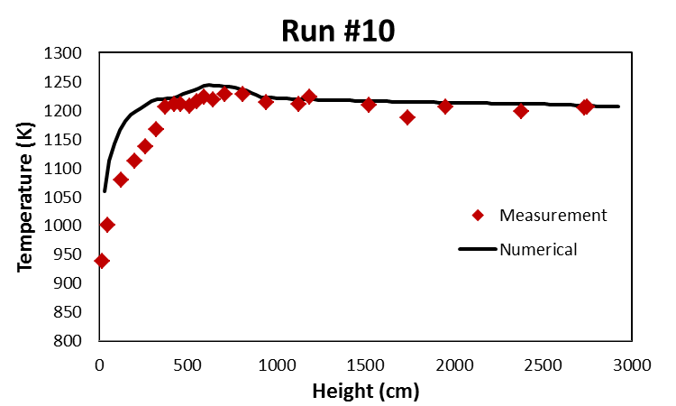
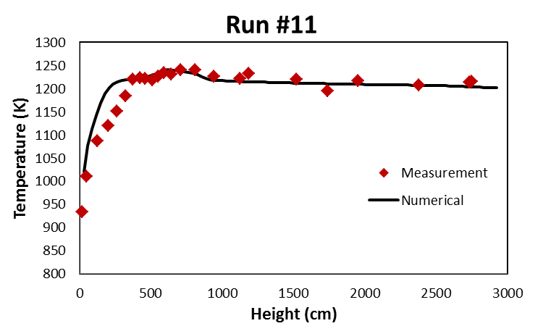
Comparison of Model and Operating Data
Time-averaged Temperature at varying height
Temperature profiles are in good agreement with measurements
Lower Mixing Zone temperatures from the model are slightly higher than data
Model overpredicts carbon and resultant combustion in LMZ

Slide 15
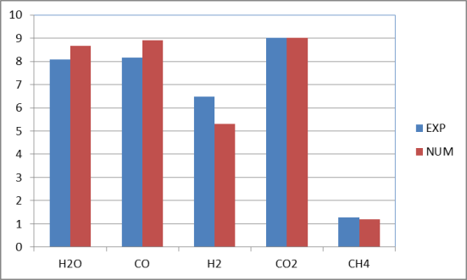
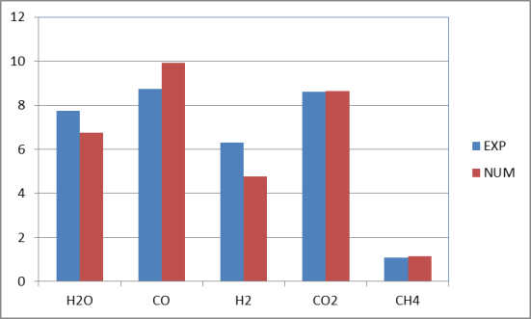
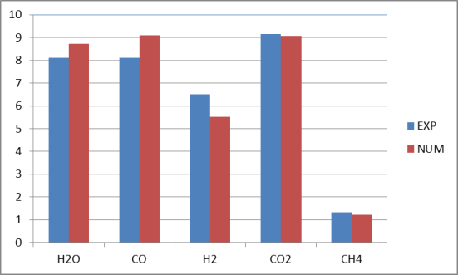
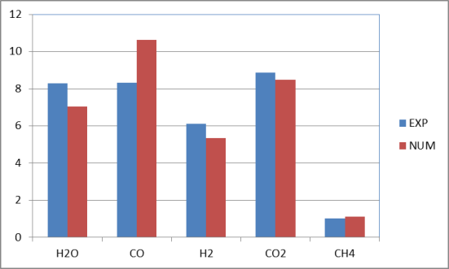
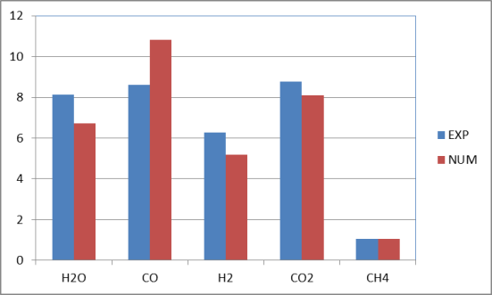
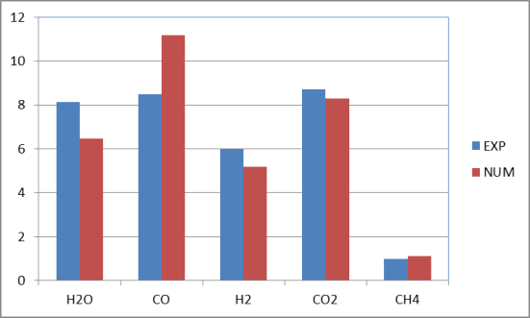
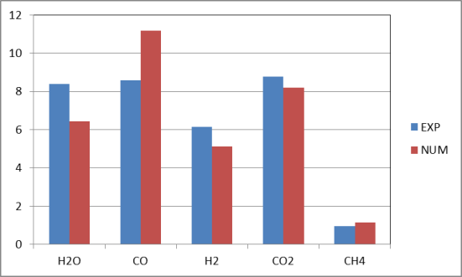
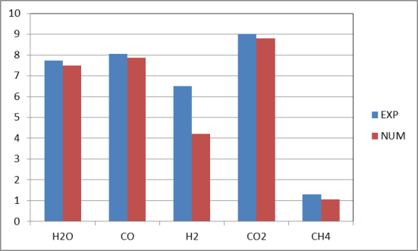
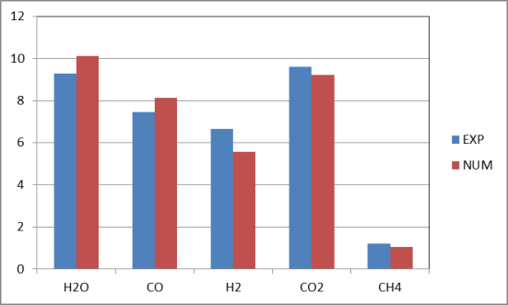
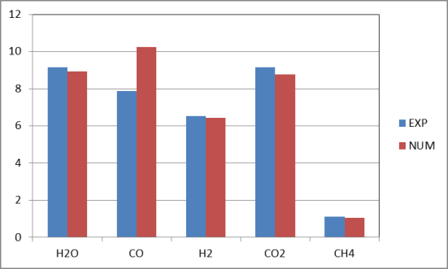
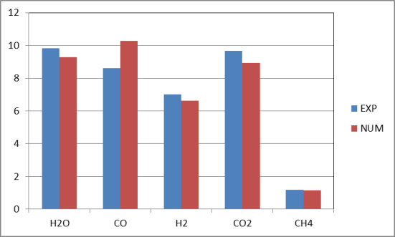
Comparison of Model and Operating Data
Time-averaged syngas composition at riser exit
Run #1
Run #2
Run #3
Run #4
Run #5
Run #6
Run #7
Run #8
Run #9
Run #10
Run #11
Predicted
Measured
Predicted exit syngas compositions are in good agreement with measurements - with most discrepancies within 20%.
15

Slide 16
Conclusions
The MFIX simulation of the TRIGTM gasifier showed very good agreement with PSDF operating data over a broad range of operating conditions for Mississippi lignite fuel
Syngas composition and temperature profiles are in good agreement with PSDF data
Predicted pressure drops for all conditions match data well for most locations - except for the Lower Mixing Zone
Model underpredicts the solids loading in the LMZ
Use of PC Coal Lab database and C3M software provides accurate devolatilization and gasification kinetics
Kinetic parameters were accurate for all operating conditions
Improvement in prediction of LMZ solids loading is needed
May be potential for size segregation - lower mixing zone could accumulate larger size particles from recycle flow
Model may need to consider a distribution of sizes to allow for size segregation at the J-leg return
Notes:
Carbon content in each size range is key as well.

Slide 17
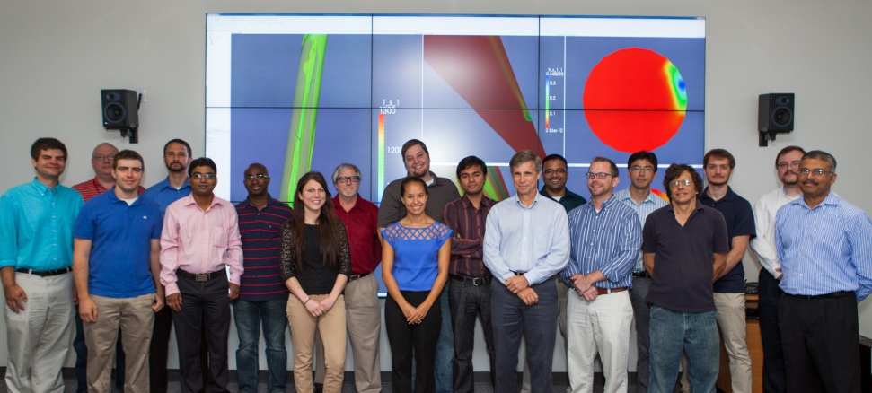
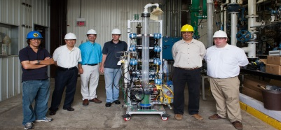
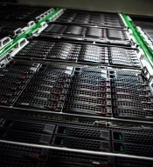
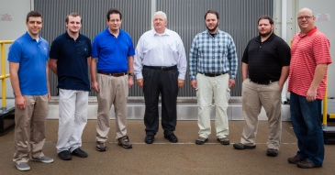
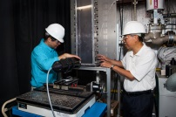
Thank you - Questions?
NETL Multiphase Flow Research Team
Develop and maintain numerical and physical models to promote understanding of multiphase flow physics critical to advanced energy and environmental systems
MFIX Suite of Multiphase Codes
Open Source Code – available to the public
Supported and validated
Over 3800 registered users from 73 countries and 250+ institutions
70% University; 20% Industry; 10% NLs and misc.
Ongoing Code Development for increased:
Accuracy
Speed
Multiphase physics capability
Ease of use
2 updates per year on average
Industry Suggestions for Code Capability and Collaboration are Welcome!

