Slide 1
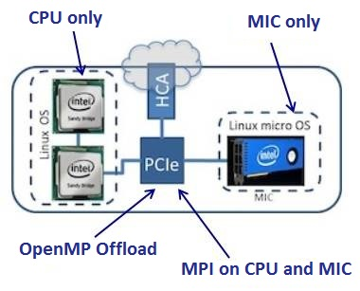
Accelerating MFIX-DEM code on the Intel Xeon Phi
Dr. Handan Liu Dr. Danesh Tafti
Research Scientist W.S. Cross Professor
Virginia Tech Virginia Tech
High Performance Computational Fluid-Thermal Sciences & Engineering Lab

Slide 2
Motivation /Objectives /Executive Summary
Motivation
The motivation for this research is to accelerate the performance of the NETL code MFIX for multiphase flows.
Different parallelization strategies are being considered on modern computer architectures that can lead to large performance gains of MFIX to allow calculations on more physically realistic systems.
Objectives
Different parallelization strategies (MPI , OpenMP and hybrid MPI+OpenMP) for MFIX code (TFM and DEM) have been completed in the previous work at Virginia Tech group.
Enhance parallelization flexibility on Intel Xeon Phi architecture, namely Intel MIC;
Extend OpenMP instrumentation to Intel MIC.
Notes:
Goals/Challenges/Objectives
How clear are the project’s objectives, and to what extent does this project support program goals?
Are challenges identified and appropriate to the project’s objectives? (“Challenges” in this context are defined as gaps in scientific knowledge or technical capabilities.)
Excellent - The project clearly and directly addresses a critical research need of the program.
Very Good - Objectives are clear, concise and have well established relevance to the program.
Good - Objectives are clear, concise and are relevant to the program.
Fair - Objectives are not very clear or have limited relevance to the program.
Poor - Objectives are not clear and/or have no relevance to the program.

Slide 3
Executive Summary
Investigate different models of computing on the Intel-MIC architectures.
Choose offloading paradigm in MFIX to enhance performance on Intel MIC.
Incorporate explicit offloading directives in MFIX code in order to port DEM solver to Intel MIC.
OpenMP performance of MFIX-DEM is about 5 times faster on CPU offloading MIC compared to the CPU only.
Validation studies to ascertain that offloading code gives same results as OpenMP on CPU only.
Notes:
Goals/Challenges/Objectives
How clear are the project’s objectives, and to what extent does this project support program goals?
Are challenges identified and appropriate to the project’s objectives? (“Challenges” in this context are defined as gaps in scientific knowledge or technical capabilities.)
Excellent - The project clearly and directly addresses a critical research need of the program.
Very Good - Objectives are clear, concise and have well established relevance to the program.
Good - Objectives are clear, concise and are relevant to the program.
Fair - Objectives are not very clear or have limited relevance to the program.
Poor - Objectives are not clear and/or have no relevance to the program.

Slide 4
Executive Summary
Investigate different models of computing on the Intel-MIC architectures.
Choose offloading paradigm in MFIX to enhance performance on Intel MIC.
Incorporate explicit offloading directives in MFIX code in order to port DEM solver to Intel MIC.
OpenMP performance of MFIX-DEM is about 5 times faster on CPU offloading MIC compared to the CPU only.
Validation studies to ascertain that offloading code gives same results as OpenMP on CPU only.
Notes:
Goals/Challenges/Objectives
How clear are the project’s objectives, and to what extent does this project support program goals?
Are challenges identified and appropriate to the project’s objectives? (“Challenges” in this context are defined as gaps in scientific knowledge or technical capabilities.)
Excellent - The project clearly and directly addresses a critical research need of the program.
Very Good - Objectives are clear, concise and have well established relevance to the program.
Good - Objectives are clear, concise and are relevant to the program.
Fair - Objectives are not very clear or have limited relevance to the program.
Poor - Objectives are not clear and/or have no relevance to the program.

Slide 5
Advantages of Intel MIC
Intel’s MIC is based on x86 technology
x86 cores w/ caches and cache coherency
SIMD instruction set
Programming for MIC is similar to programming for CPUs
Familiar languages: C/C++ and Fortran
Familiar parallel programming models: OpenMP and MPI
MPI on host and on the coprocessor
Any code can run on MIC, not just kernels
Optimizing for MIC is similar to optimizing for CPUs

Slide 6
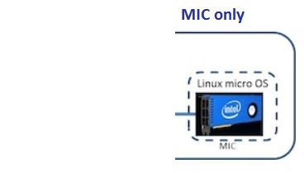
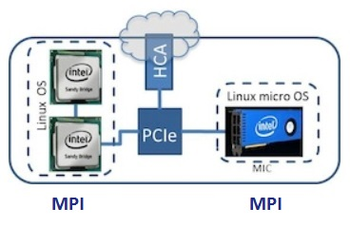
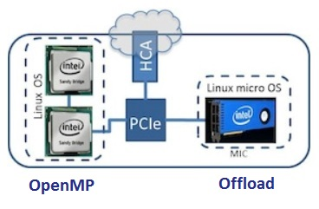
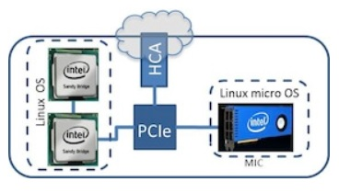
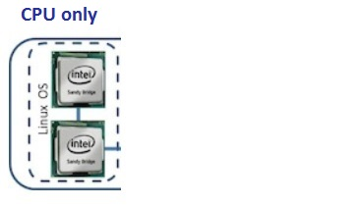
Programming Models
Four programming models on Intel-MIC architecture
CPU only
Run only on the CPU, traditional HPC cluster
MIC only
Run natively on the MIC card
TACC Stampede: Each node is outfitted with two 8-core Intel Xeon E5 processors (CPU) and one 61-core Intel Xeon Phi coprocessor (MIC). The compiler is Intel composer_xe_2013.2.146.
MPI on CPU and MIC
Treat the MIC (mostly) like another host
Offload
OpenMP on CPU, Offload to MIC

Slide 7
Executive Summary
Investigate different models of computing on the Intel-MIC architectures.
Choose offloading paradigm in MFIX to enhance performance on Intel MIC.
Incorporate explicit offloading directives in MFIX code in order to port DEM solver to Intel MIC.
OpenMP performance of MFIX-DEM is about 5 times faster on CPU offloading MIC compared to the CPU only.
Validation studies to ascertain that offloading code gives same results as OpenMP on CPU only.
Notes:
Goals/Challenges/Objectives
How clear are the project’s objectives, and to what extent does this project support program goals?
Are challenges identified and appropriate to the project’s objectives? (“Challenges” in this context are defined as gaps in scientific knowledge or technical capabilities.)
Excellent - The project clearly and directly addresses a critical research need of the program.
Very Good - Objectives are clear, concise and have well established relevance to the program.
Good - Objectives are clear, concise and are relevant to the program.
Fair - Objectives are not very clear or have limited relevance to the program.
Poor - Objectives are not clear and/or have no relevance to the program.

Slide 8
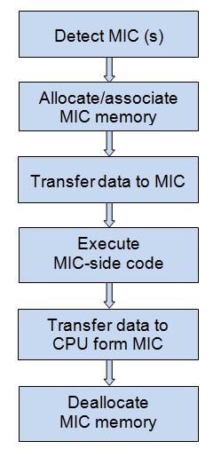
Offloading: MIC as co-processor
OpenMP on CPU, Offload to MIC
Targeted offload through OpenMP extensions
Offload model : the data to be exchanged between the host and the MIC consists of scalars, arrays, and Fortran derived types
Offloading directives are used to specify that a code block can be offloaded.
A program running on the host “offloads” work by directing the MIC to execute a specified block of code.

Slide 9
Offloading Method for MFIX-DEM
Migrating the DEM solver to the Intel MIC Architecture
Identify the major (time-consuming) routines of DEM solver according to our previous work.
Offload most subroutines of DEM solver to MIC except:
message passing, involved with communicating and exchanging the ghost cells and ghost particles between multiple nodes; and
dealing with I/O data.
Identify the different transfer types of global variables between CPU and MIC.

Slide 10
Challenges
Most important consideration in offloading is whether there is any performance gain in offloading or not.
Reduce unnecessary data transfer between CPU and MIC for large code like MFIX.
Identifying variables that are only transferred in, or only transferred out or both is a challenge.
It is important to identifying different types of global variables between CPU and MIC for offloading MIFX DEM solver.
When and where the variables are offloaded is also a challenge.

Slide 11
Executive Summary
Investigate different models of computing on the Intel-MIC architectures.
Choose offloading paradigm in MFIX to enhance performance on Intel MIC.
Incorporate explicit offloading directives in MFIX code in order to port DEM solver to Intel MIC.
OpenMP performance of MFIX-DEM is about 5 times faster on CPU offloading MIC compared to the CPU only.
Validation studies to ascertain that offloading code gives same results as OpenMP on CPU only.
Notes:
Goals/Challenges/Objectives
How clear are the project’s objectives, and to what extent does this project support program goals?
Are challenges identified and appropriate to the project’s objectives? (“Challenges” in this context are defined as gaps in scientific knowledge or technical capabilities.)
Excellent - The project clearly and directly addresses a critical research need of the program.
Very Good - Objectives are clear, concise and have well established relevance to the program.
Good - Objectives are clear, concise and are relevant to the program.
Fair - Objectives are not very clear or have limited relevance to the program.
Poor - Objectives are not clear and/or have no relevance to the program.

Slide 12
MFIX-DEM Flow Chart
Initialize and transfer data to MIC, including necessary parameters, constants and global arrays for DEM calculation
3) global variables are transferred in MIC and back to CPU in different subroutines.
4) global variables are not transferred to CPU, only calculated in DEM on MIC.
Transfer data between CPU and MIC:
1) global variables transferred at each solid time step;
2) global variables transferred before/after DEM calculation.
Handan Liu, Danesh Tafti and Tingwen Li. Hybrid Parallelism in MFIX CFD-DEM using OpenMP. Powder Technology, 259 (2014) 22-29.

Slide 13
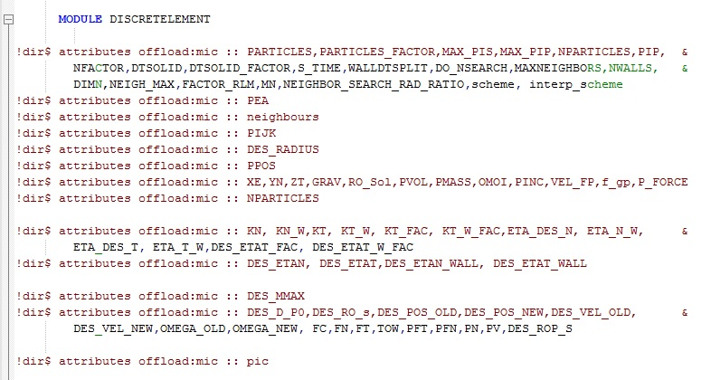
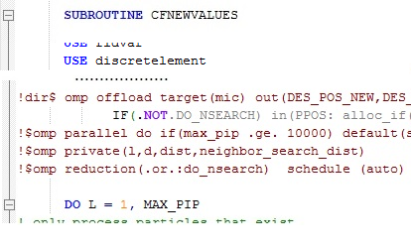
Global Variables for Offloading (1)
In MFIX-DEM, we analyzed to give four types of global variables for offloading.
Global variables that are used in subroutines must be given the offload attributes directives defined in functions or modules;
Code snippet in the module ‘DISCRETELEMENT’ shows giving the offload attributes to global variables which need to be offloaded in the subroutine ‘CFNEWVALUES.f’.

Slide 14
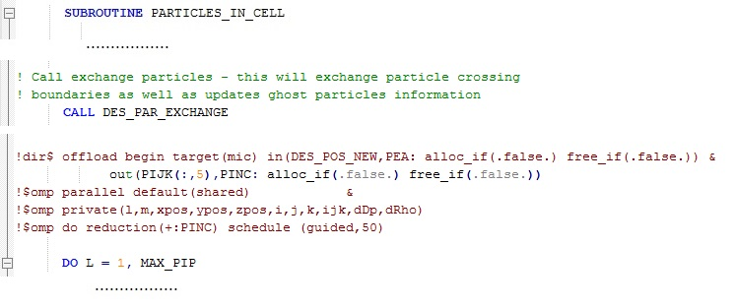
Global Variables for Offloading (2)
Four types of global variables for offloading MFIX-DEM
Global variables need to be transferred in MIC and back to CPU at each solid time step in different subroutines; e.g. particle’s position: des_pos_new
Code snippet in the routine ‘particles_in_cell.f’ shows that the do_loop is offloaded to MIC for calculation and the global variables ‘des_pos_new’ is transferred from CPU to MIC after ghost particles are exchanged by invoking des_par_exchange on CPU.

Slide 15
Global Variables for Offloading (2)
Four types of global variables for offloading MFIX-DEM
Global variables need to be transferred in MIC and back to CPU at each solid time step and in/out in different subroutines; e.g. particle’s position: des_pos_new
Then ‘des_pos_new’ is transferred back to CPU after updating the values in the routine ‘cfnewvalues.f’ on MIC at each solid time step.

Slide 16
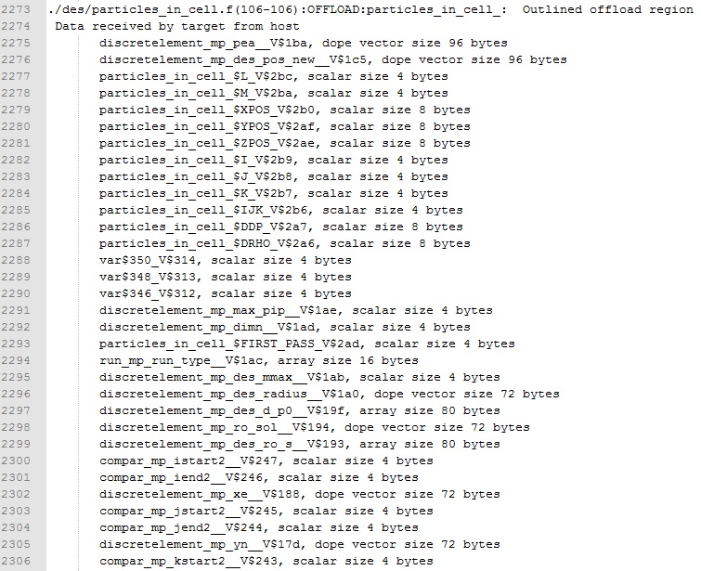
When compiling, the snapshot shows the bytes of data transferred between CPU and MIC.
Continue to compile

Slide 17
Global Variables for Offloading (3)
Other types of global variables in DEM solver
Global variables that need to be transferred to MIC before DEM calculation, such as gas velocity (u_g, v_g, w_g) and some fluid data used for DEM calculation;
Global variables that need to be transferred to MIC just one time before going to the first pass of DEM, such as particles properties defined in input file;
Global variables in DEM calculation that don’t need to be transferred between CPU and MIC, such as total contact force and torque (fc,tow).
Initializing routines for offloading
Other subroutines outside DEM solver are related for offloading DEM calculation

Slide 18
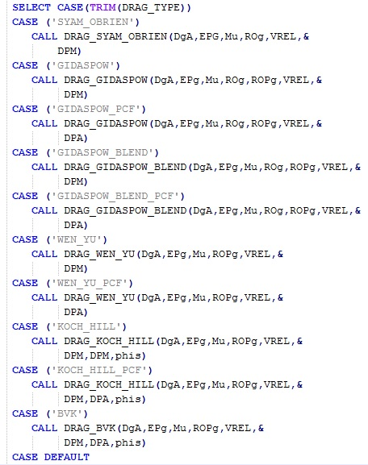
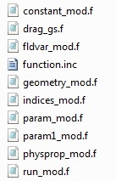
MFIX-DEM Flow Chart
Necessary offloading routines, modules and functions, including CFD solver and DEM solver
Offload for CFD solver
Offload for DEM solver
: DES_DRAG_GP
Handan Liu, Danesh Tafti and Tingwen Li. Hybrid Parallelism in MFIX CFD-DEM using OpenMP. Powder Technology, 259 (2014) 22-29.

Slide 19
Executive Summary
Investigate different models of computing on the Intel-MIC architectures.
Choose offloading paradigm in MFIX to enhance performance on Intel MIC.
Incorporate explicit offloading directives in MFIX code in order to port DEM solver to Intel MIC.
OpenMP performance of MFIX-DEM is about 5 times faster on CPU offloading MIC compared to the CPU only.
Validation studies to ascertain that offloading code gives same results as OpenMP on CPU only.
Notes:
Goals/Challenges/Objectives
How clear are the project’s objectives, and to what extent does this project support program goals?
Are challenges identified and appropriate to the project’s objectives? (“Challenges” in this context are defined as gaps in scientific knowledge or technical capabilities.)
Excellent - The project clearly and directly addresses a critical research need of the program.
Very Good - Objectives are clear, concise and have well established relevance to the program.
Good - Objectives are clear, concise and are relevant to the program.
Fair - Objectives are not very clear or have limited relevance to the program.
Poor - Objectives are not clear and/or have no relevance to the program.

Slide 20
Scaling Analysis of 80,000 particles
The 3D fluidized bed with 80,000 particles and 18,000 cells was evaluated with OpenMP performance on CPU compared with OpenMP performance on CPU and offloaded on MIC on a single node on TACC Stampede.
Table 1: OpenMP performance on CPU only with 1, 2, 4 and 8 cores compared with OpenMP on CPU and offloaded on MIC
Number of core on CPU (single node) | CPU Only | CPU+MIC (60 cores) | Speed factor (CPU only / CPU+MIC)
 | Total wall clock time (s) | Total wall clock time (s)
1 | 2091.8 | 581.1 | 3.60
2 | 1136.0 | 352.8 | 3.22
4 | 579.1 | 152.2 | 3.80
8 | 321.2 | 103.1 | 3.12

Slide 21
Larger System – OpenMP Offloading
The performance of OpenMP offloading was evaluated on the CPU and MIC on a single node of TACC Stampede, compared with the performance of OpenMP on only CPU.
Total Particles – 1.28 million; Total cells – 409,600
Total physical simulation time is 0.5 seconds
Compiler: Intel composer_xe_2013.2.146
Parameter | Value
Total Particles | 1.28 million
Diameter | 4 mm
Density | 2700 kg/m³
Coef. of restitution Particle, Wall | 0.95, 0.95
Friction coefficient Particle, Wall | 0.3, .03
Spring constant Particle, Wall | 2400, 2400 N/m
Dimension Grid size | 64×100×64 cm 64×100×64
Superficial Velocity | 2.0 m/s
Time Step (Fluid, Solid) | 5.0e⁻⁵ s, 8.6e⁻⁶ s
Number of processors | 1,2,4,8,16 cores on CPU with 60 cores on MIC
Notes:
Accomplishments/Results
Was adequate technical progress made since the last review based on the technical challenges and resources allocated to this project?
Excellent - Significant progress has been made. All milestones have been met or exceeded.
Very Good - Substantial progress has been made and all significant milestones have been met.
Good - Some progress has been made and most significant milestones have been met.
Fair - Progress has been limited. Some significant milestones have not been met.
Poor - Productivity has been significantly lacking. There are few or no results to report.

Slide 22
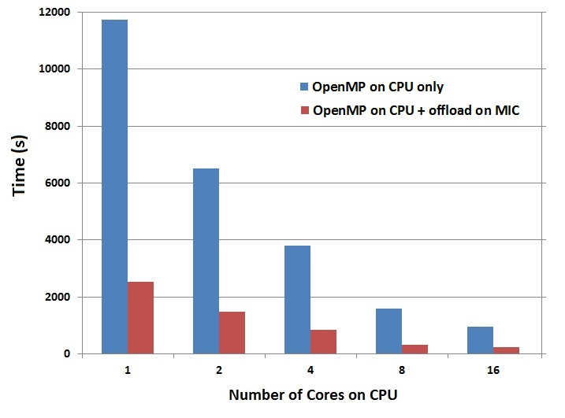
Scaling Analysis of 1.28 million particles
Table 2: OpenMP performance on 1, 2, 4, 8 and 16 cores of the only CPU compared with OpenMP offloading on the corresponding cores on the CPU and 60 cores on the MIC
Number of cores on CPU (single node) | CPU Only | CPU+MIC (60 cores) | Speed factor (CPU only / CPU+MIC)
 | Total wall clock time (s) | Total wall clock time (s)
1 | 11732.6 | 2523.1 | 4.65
2 | 6521.0 | 1488.8 | 4.38
4 | 3817.4 | 842.7 | 4.53
8 | 1600.3 | 322.0 | 4.97
16 | 947.3 | 230.5 | 4.11

Slide 23
Executive Summary
Investigate different models of computing on the Intel-MIC architectures.
Choose offloading paradigm in MFIX to enhance performance on Intel MIC.
Incorporate explicit offloading directives in MFIX code in order to port DEM solver to Intel MIC.
OpenMP performance of MFIX-DEM is about 5 times faster on CPU offloading MIC compared to the CPU only.
Validation studies to ascertain that offloading code gives same results as OpenMP on CPU only.
Notes:
Goals/Challenges/Objectives
How clear are the project’s objectives, and to what extent does this project support program goals?
Are challenges identified and appropriate to the project’s objectives? (“Challenges” in this context are defined as gaps in scientific knowledge or technical capabilities.)
Excellent - The project clearly and directly addresses a critical research need of the program.
Very Good - Objectives are clear, concise and have well established relevance to the program.
Good - Objectives are clear, concise and are relevant to the program.
Fair - Objectives are not very clear or have limited relevance to the program.
Poor - Objectives are not clear and/or have no relevance to the program.

Slide 24
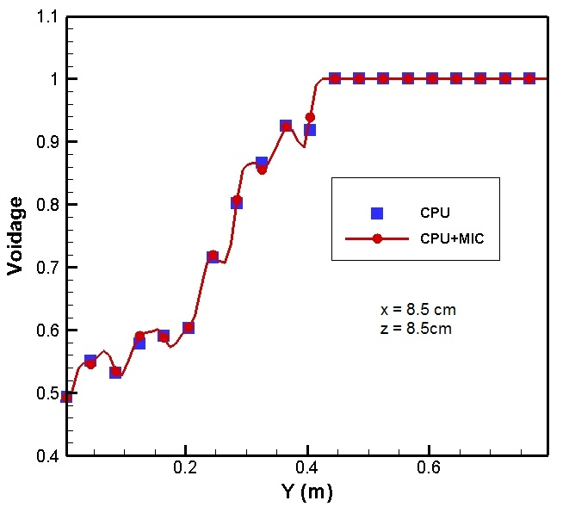
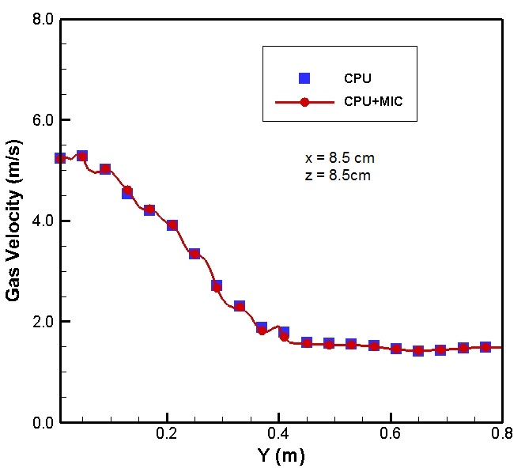
Validation
The 3D fluidized bed with 80,000 particles of 4mm diameter was simulated for this validation.
The simulation was carried out for a total of 5 seconds.
The time averaged profiles were obtained from 2.0-5.0 seconds.
Comparison of time averaged profiles of void fraction and gas velocity for OpenMP and offloading implementation on CPU and CPU+MIC on a single node.
The validation shows that the parallel simulation does not alter the accuracy of the solution.
Notes:
Accomplishments/Results
Was adequate technical progress made since the last review based on the technical challenges and resources allocated to this project?
Excellent - Significant progress has been made. All milestones have been met or exceeded.
Very Good - Substantial progress has been made and all significant milestones have been met.
Good - Some progress has been made and most significant milestones have been met.
Fair - Progress has been limited. Some significant milestones have not been met.
Poor - Productivity has been significantly lacking. There are few or no results to report.

Slide 25
Summary
Ported MFIX to the Intel MIC architecture;
Chose the offload paradigm in MFIX
OpenMP on CPU and offloading to MIC on a single node (done)
hybrid MPI+OpenMP on CPU and offloading to MIC on multiple nodes (ongoing)
Incorporated offload directives in MFIX-DEM subroutines;
OpenMP performance of MFIX-DEM was evaluated with CPU versus CPU+ offloading MIC on a single node;
Accelerated MFIX-DEM code about 5 times on the Intel MIC architecture compared to the Intel CPU only;
Validated the offloading directives;
Further tune offloading code for DEM solver to gain more performance in the next work.

Slide 26
Future Work
FY14 –
Next work will continue to refine the code to further improve the MFIX-DEM performance on Intel-MIC.
Investigating performance of MFIX-TFM on Intel-MIC.
FW – Evaluate OpenMP 4.x/OpenACC directives on heterogeneous CPU/GPU systems.
Notes:
Future Work
Is the proposed future work appropriate? Does the proposed future work effectively address the project objectives?
Is the proposed schedule challenging but feasible? Have key decision points been addressed (where appropriate)? Is the schedule of milestones reasonable?
Have the previous progress/results from this project (as well as any new information from other organizations) been effectively assessed in charting the future directions?
Excellent - The project is sharply focused on reaching its objectives. Research is unique, yet complements other research in the field. It would be difficult to significantly improve the approach. The plan shows a solid command of related work.
Very Good - The approach is well thought out and is likely to be successful in making progress toward the objectives. The plan shows good understanding of related work.
Good - The approach is sound and difficulties in making progress toward the objectives should be rectifiable. The plan shows understanding of related work.
Fair - Feasibility of the project is questionable. The project has significant weaknesses or little chance for success. Research will make little progress beyond previous work. The plan shows little understanding of related work.
Poor - The approach is not at all feasible or the research plan is unlikely to meet its goals. It shows a lack of understanding of previous and on-going work in the field.

