Slide 1
Investigating Trilinos Integration with MFIX
Vinod Kumar
Assistant Professor, Mechanical Engineering
Core faculty, Computational Science Doctoral Program
The University of Texas at El Paso (UTEP)
Visiting Professor, Sandia National Labs

Slide 2
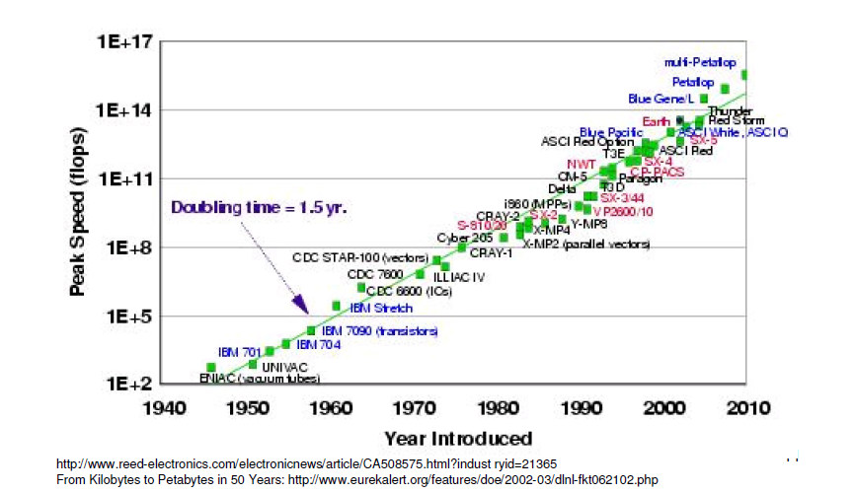
Supercomputers
Introduction
Some Examples
MFiX
What is Trilinos?
Why Trilinos?
Concluding remarks

Slide 3
About myself
UTEP | Assistant Professor, Mechanical Engineering | 2008-Present
Princeton Univ/NOAA/GFDL | Research Scientist, Climate Modeling | 2007-2008
Rice Univ, | PostDoc, Physic & Astronomy | 2005-2007
Rice Univ, | Ph.D., Mechanical Engineering | 1999-2005
IIT Kanpur | B.Tech., Aerospace Engineering | 1993-1997
Visiting Professor Visiting Professor AFOSR Res. Fellow DOE FaST Fellow Cons/Smr-faculty DOE FE Fellow ORNL MI Fellow | Sandia, CSP Sandia, Climate Modeling KAFB/Maui, Atmospheric turbulence NREL, Thermal-fluid/CSP Sandia, Climate Modeling NETL, Geological Sequestration ORNL, Climate Modeling | 09/2012 – Present 09/2010 – Present 06/2012 –08/2012 06/2011 – 08/2011 06/2010 – 08/2010 06/2010 – 08/2010 06/2009 – 08/2009
Engineer | Fluent (now ANSYS) | 07/1997 – 05/1999
UG RA | IIT Kanpur | 07/1995 – 07/1997
Recent Research Activities:
V. Kumar (PI), Collaborator: Glatzmaier/Bharathan/Ma (NREL), “Comp. ana. of Nano Particles-Molten Salt Thermal Energy Storage for Concentrated Solar Power Systems," DOE- EERE/SunShot, Active
A. Bronson (PI), V. Kumar (CO-PI), Comp-Expl proc of BrC Composites by Reactive Infusion of Hf Alloy Melts into B4C, AFOSR, Active
A. Bronson (PI), V. Kumar (CO-PI), Computational-Experimental Study of the Plasma Proc. of Carbides at High Temp, NETL– DOE, Active
V. Kumar (PI), "High fidelity computational analysis of CO2 trapping at pore scales" NETL – DOE, Completed
Notes:
3

Slide 4


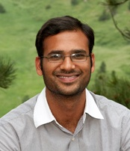

Who we are ? My Research Group
Faculty Advisor - Vinod Kumar, Assistant Professor, Mechanical Engineering
Core faculty, Computational Science Doctoral Program
Collaborators: M. Taylor & C. Ho (Sandia), Z. Ma & G. Glatzmaier(NREL), V. Balaji (Princeton), D. Banerjee (Texas A&M), S. Kumar (UTB), A. Bronson (UTEP), G. Rao (KAFB), V. Udeowa (Google), S. Mittal (IIT K)
Current Doctoral
Current MS
1. Kiran K. Katta
Computational Science
(Graduated, May 2013)
2. Samia Afrin
Energy
3. Paul Delgado
Computational Science
4. Arturo Sepulveda
Energy, Graduated May 2014
1. Nazmul Hossain
Computational Science
2. Jesus Ortega
Mech. Eng.
Current UG Research Assistants
1. A. Cabral
2. Alexandra
Alumni:
M.S.:
T. Dorethy (Comp., 2014 US Army),
P. Delgado(Comp., 2014)
J. Valles (Mechanical, 2011 US Army),
U. Parimi (Mechanical, 2010),
N. Kavoori (Mechanical, 2010),
K. Katta (Computational, 2011)
Alumni: UG RAs
Claudia Guevara, S. D. Rosa, Daniel Llausas, Daniel Landis, Christian Barraza, Enrique Busquets, Rene Chacon, Javier Motta, Jesus Presa, Paul Rodriguez, Karla Corral US Army), Jesus Mijares, Jesus Valles, Raul Corral, T. Brown, D. Alvarez, L. Valles (Mech, US Army)

Slide 5
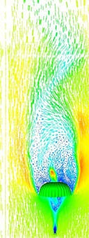
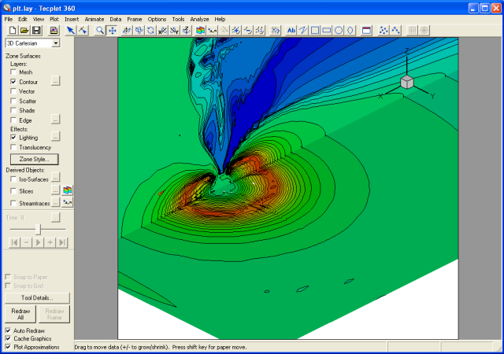
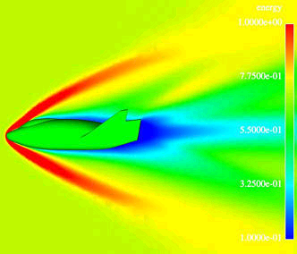
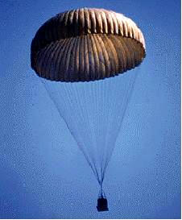
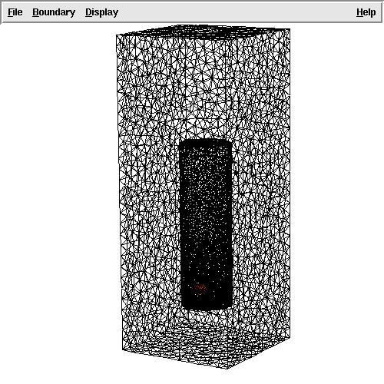
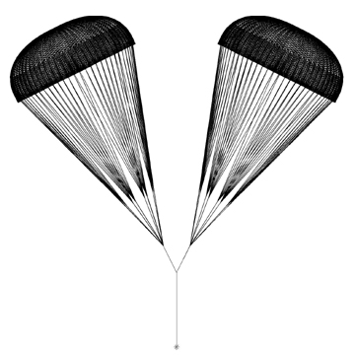


HPC Experience
PRE-PROCESS
Geometry Modeling
Gambit/ICEMCFD
Fluid
MPI Init.
Domain Partitioning
Load Balancing
Solver
Δp^{F} → Δp^{I}
Δp^{I} ← Δp^{S}
Begin Loop
Iterative Solver:
Sparse-Matrix Storage
Generalized Minimal Residual
Block Preconditioning Matrix
Parallel Computing
Mapping
Interface
Projection
Structure
Nonlinear Interaction Loop
t=t+dt
Not Converged
Δx^{F} ← Δx^{I}
V^{F} ← V^{I}
Δx^{I} ← Δx^{S}
V^{I} ← V^{S}
Converged
ΔP^{S}
Apply BCs
ΔP^{S} fΔP^{I}
ΔP^{F}
Solve Linear Systems
ΔP^{I} fΔP^{F}
Time-step loop
Structural Dyn.
Least-Sq.
Proj.
Interface
Mapping
Fluid Dyn.
V^{I} ’V^{F}
March to the next time-step
Δx^{S} ’Δx^{I}
V^{S} ’V^{I}
Δx^{I}’Δx^{F}
Δx^{S}, V^{S}
Δx, V^{F}
Δx^{F}
Mesh Motion
Δx
Time Marching
POST-PROCESS
Ensight/Tecplot/Matlab
Analyze/Repeat
OUTPUT
Write data
End
MPI Finalize

Slide 6
Developed in-house codes
Old days!
- MHD Solver (Postdoc work)
- Navier-Stokes, Fluid – Structure/Solid interaction (PhD work)
- MPI, Fortran/HPC, CrayT3E/Linux clusters
Developed in-house code that I don’t use any more because…

Slide 7
Incompressible Flows
Old days!
Fluid dynamics: Navier-Stokes equation
Conservation of momentum
Continuity
Stress-strain relationship
Boundary conditions
Initial conditions

Slide 8
Compressible Flows
Old days!
Density
Velocity vector
Pressure
Stress-tensor
Conservation of mass/Continuity equations
Momentum conservation
Energy conservation
Energy per unit volume
Heat-flux
Internal energy per unit volume
Constitutive relationship
Specific gas constant
Viscosity
Heat Conduction
Energy gHeat Equation (steady state)
Conductivity
Temperature

Slide 9
Mesh and Membrane
Old days!
Mesh Motion
Equations of motions: Pseudo-solid
Stress-strain relationship:
Linear elastic solid
Boundary conditions
Structural Dynamics
Force balance
σ: Cauchy stress
g_{ij} : Covariant metric in deformed configuration
G_{ij} : Contravariant metric in original configuration
Lame’s constant: λ^{s}, μ^{s}
Notes:
9

Slide 10
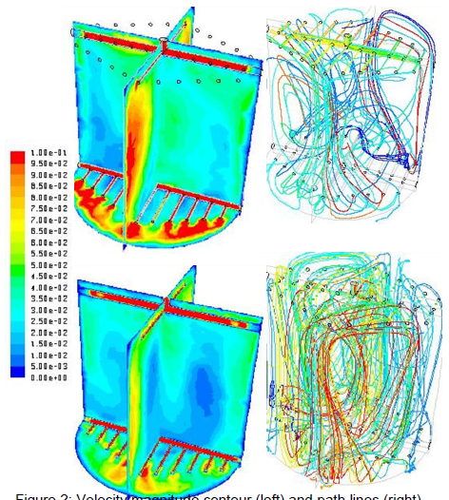
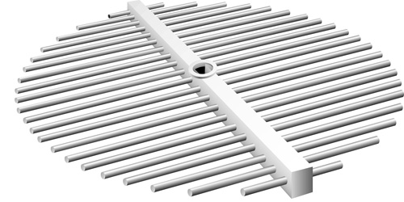
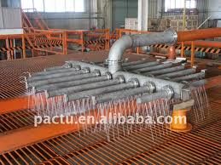
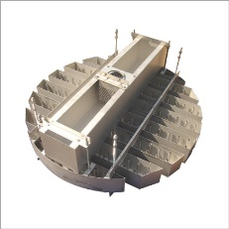
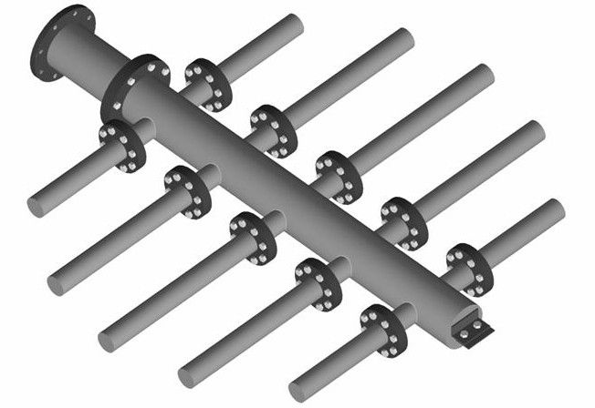
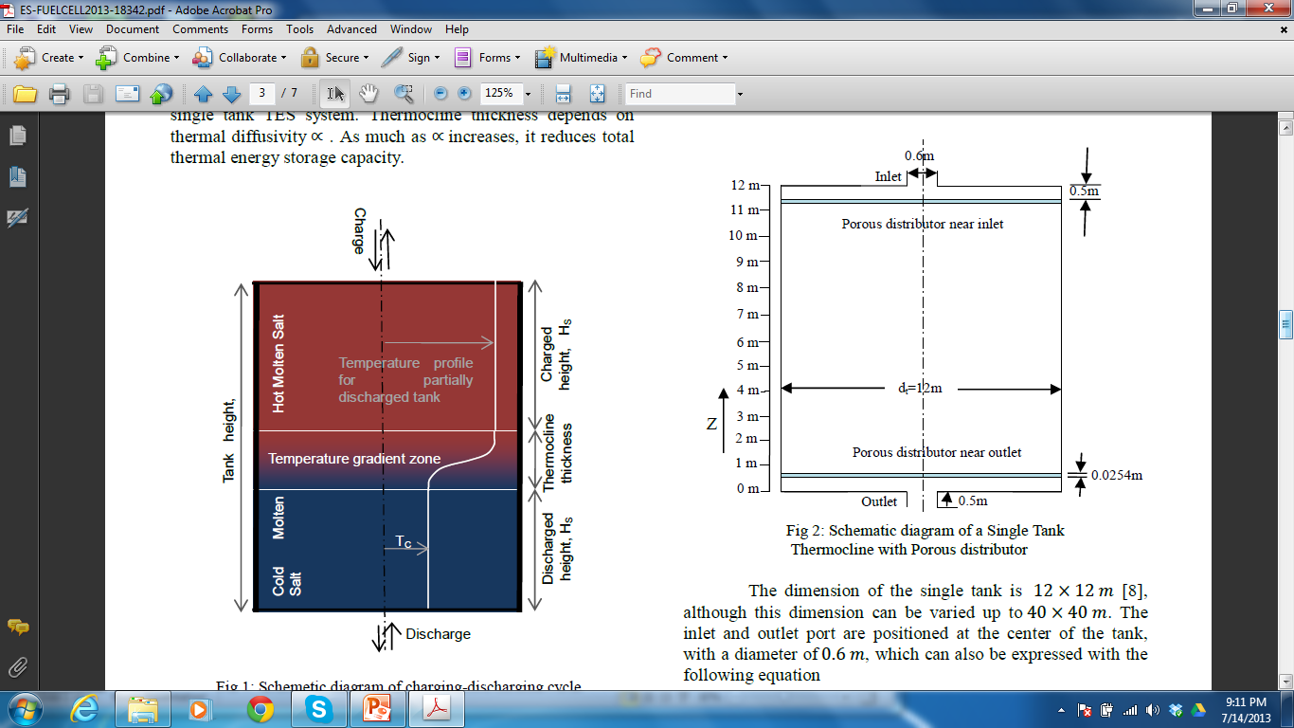
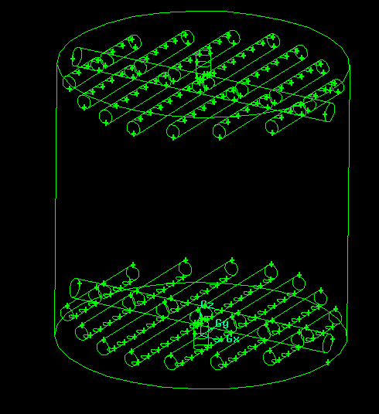
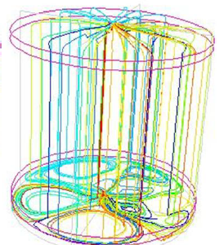
Flow distributors, temperature profile Nanofluid (modeled as Eulerian approach)
Recent days!
Amacs.com
NREL
www.raschig.de
Notes:
10

Slide 11

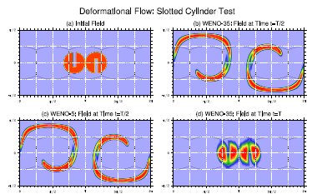
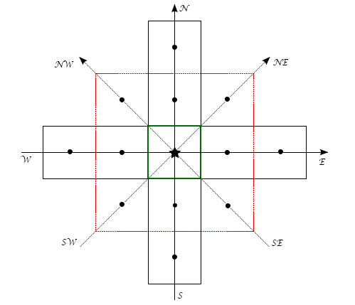
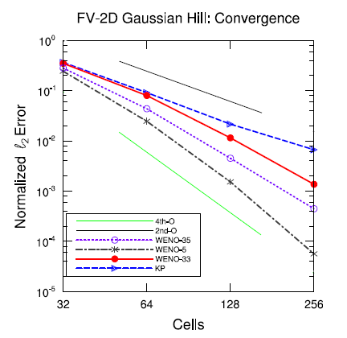
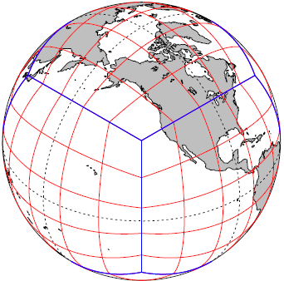
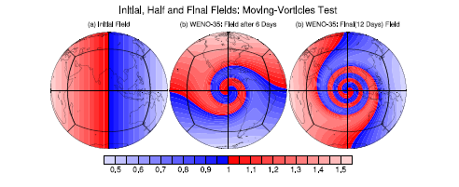

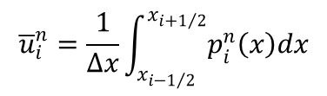

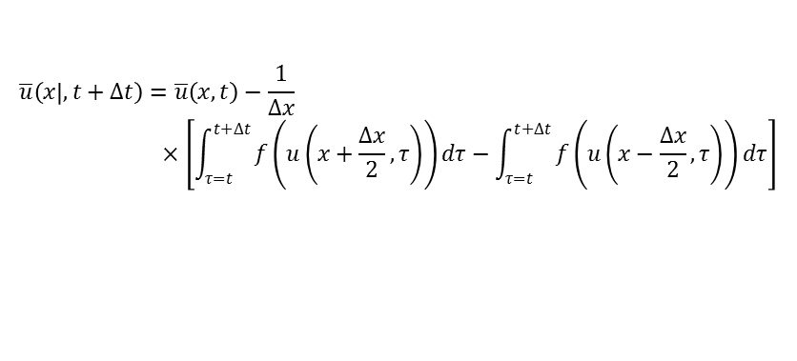
High order scheme for Thermocline Advection
Recent days!
Collaborators:
Dr. Ram Nair, National Center for Atmospheric Science (NCAR), Boulder
Dr. Mark Taylor, Sandia National Lab, Albuquerque
Student: Dr. Kiran K. Katta (adviser – Dr. V. Kumar, co-adviser: Dr. Ram Nair)
High-Order Central schemes for conservation laws
$$\overline{u}\left(x | ,t+∆t\right)=\overline{u}\left(x,t\right)−\frac{1}{∆x}×\left[\int_{τ=t}^{t+∆t}{f\left(u\left(x+\frac{∆x}{2},τ\right)\right)dτ−\int_{τ=t}^{t+∆t}{f\left(u\left(x−\frac{∆x}{2},τ\right)\right)dτ}}\right]$$
$$p\left(x,t^{n}\right)=u\left(x,t^{n}\right)+𝒪\left({\left(∆x\right)}^{r}\right)$$
$${\overline{u}}_{i}^{n}=\frac{1}{∆x}\int_{x_{i−1/2}}^{x_{i+1/2}}{p_{i}^{n}\left(x\right)dx}$$
$$\frac{d}{dt}{\overline{u}}_{i}\left(t\right)=−\frac{H_{i+1/2}\left(t\right)−H_{i−1/2}\left(t\right)}{∆x}$$
$$H_{i+1/2}\left(t\right)=\frac{f\left(u_{i+1/2}^{+}\left(t\right)\right)+f\left(u_{i+1/2}^{−}\left(t\right)\right)}{2}−\frac{a_{i+1/2}\left(t\right)}{2}\left[u_{i+1/2}^{+}\left(t\right)−u_{i+1/2}^{−}\left(t\right)\right]$$

Slide 12
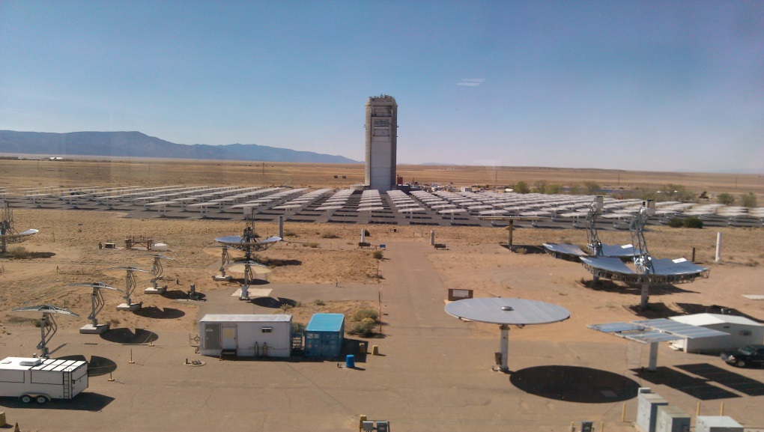
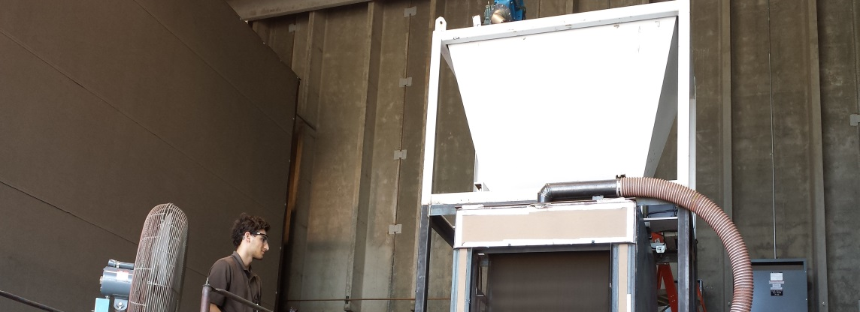
Problem Definition
0.99 m
Particle injection
1.50 m
6.30 m
Aperture
3.0 m
Solar Radiation
The SPR consist of an arrangement of a vertical chamber with a rectangle shape with supply of material on the top
18

Slide 13

Application CSP
Future!
Falling particle receiver
Sandia+NETL?

Slide 14
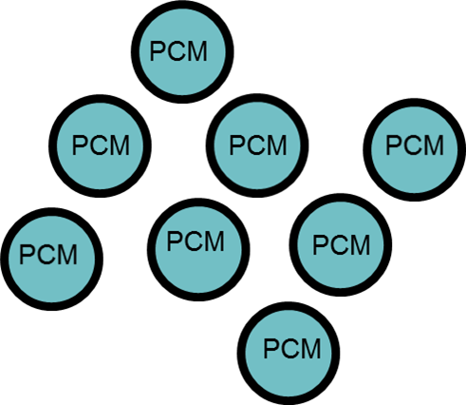
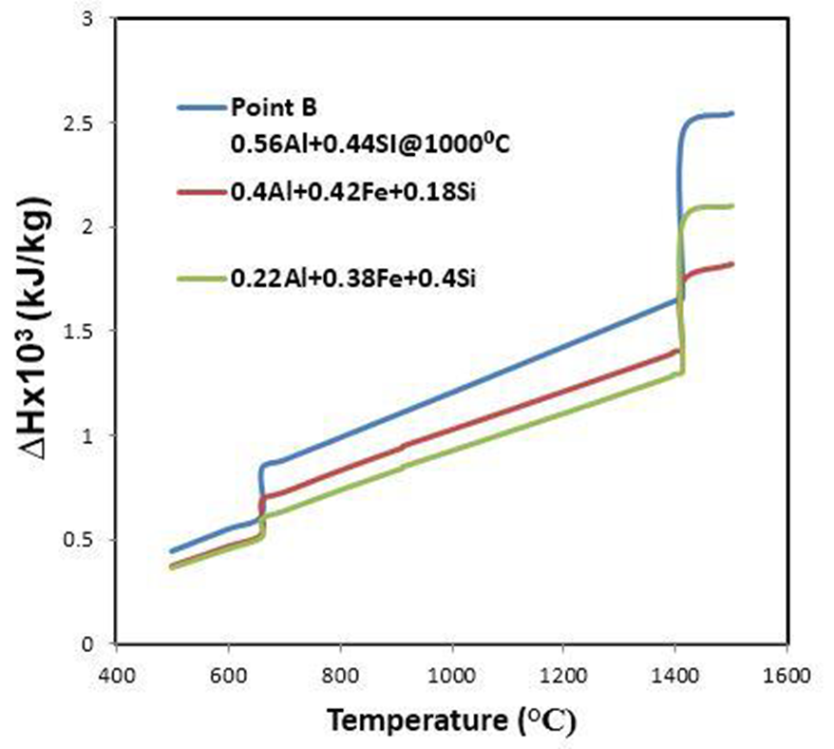
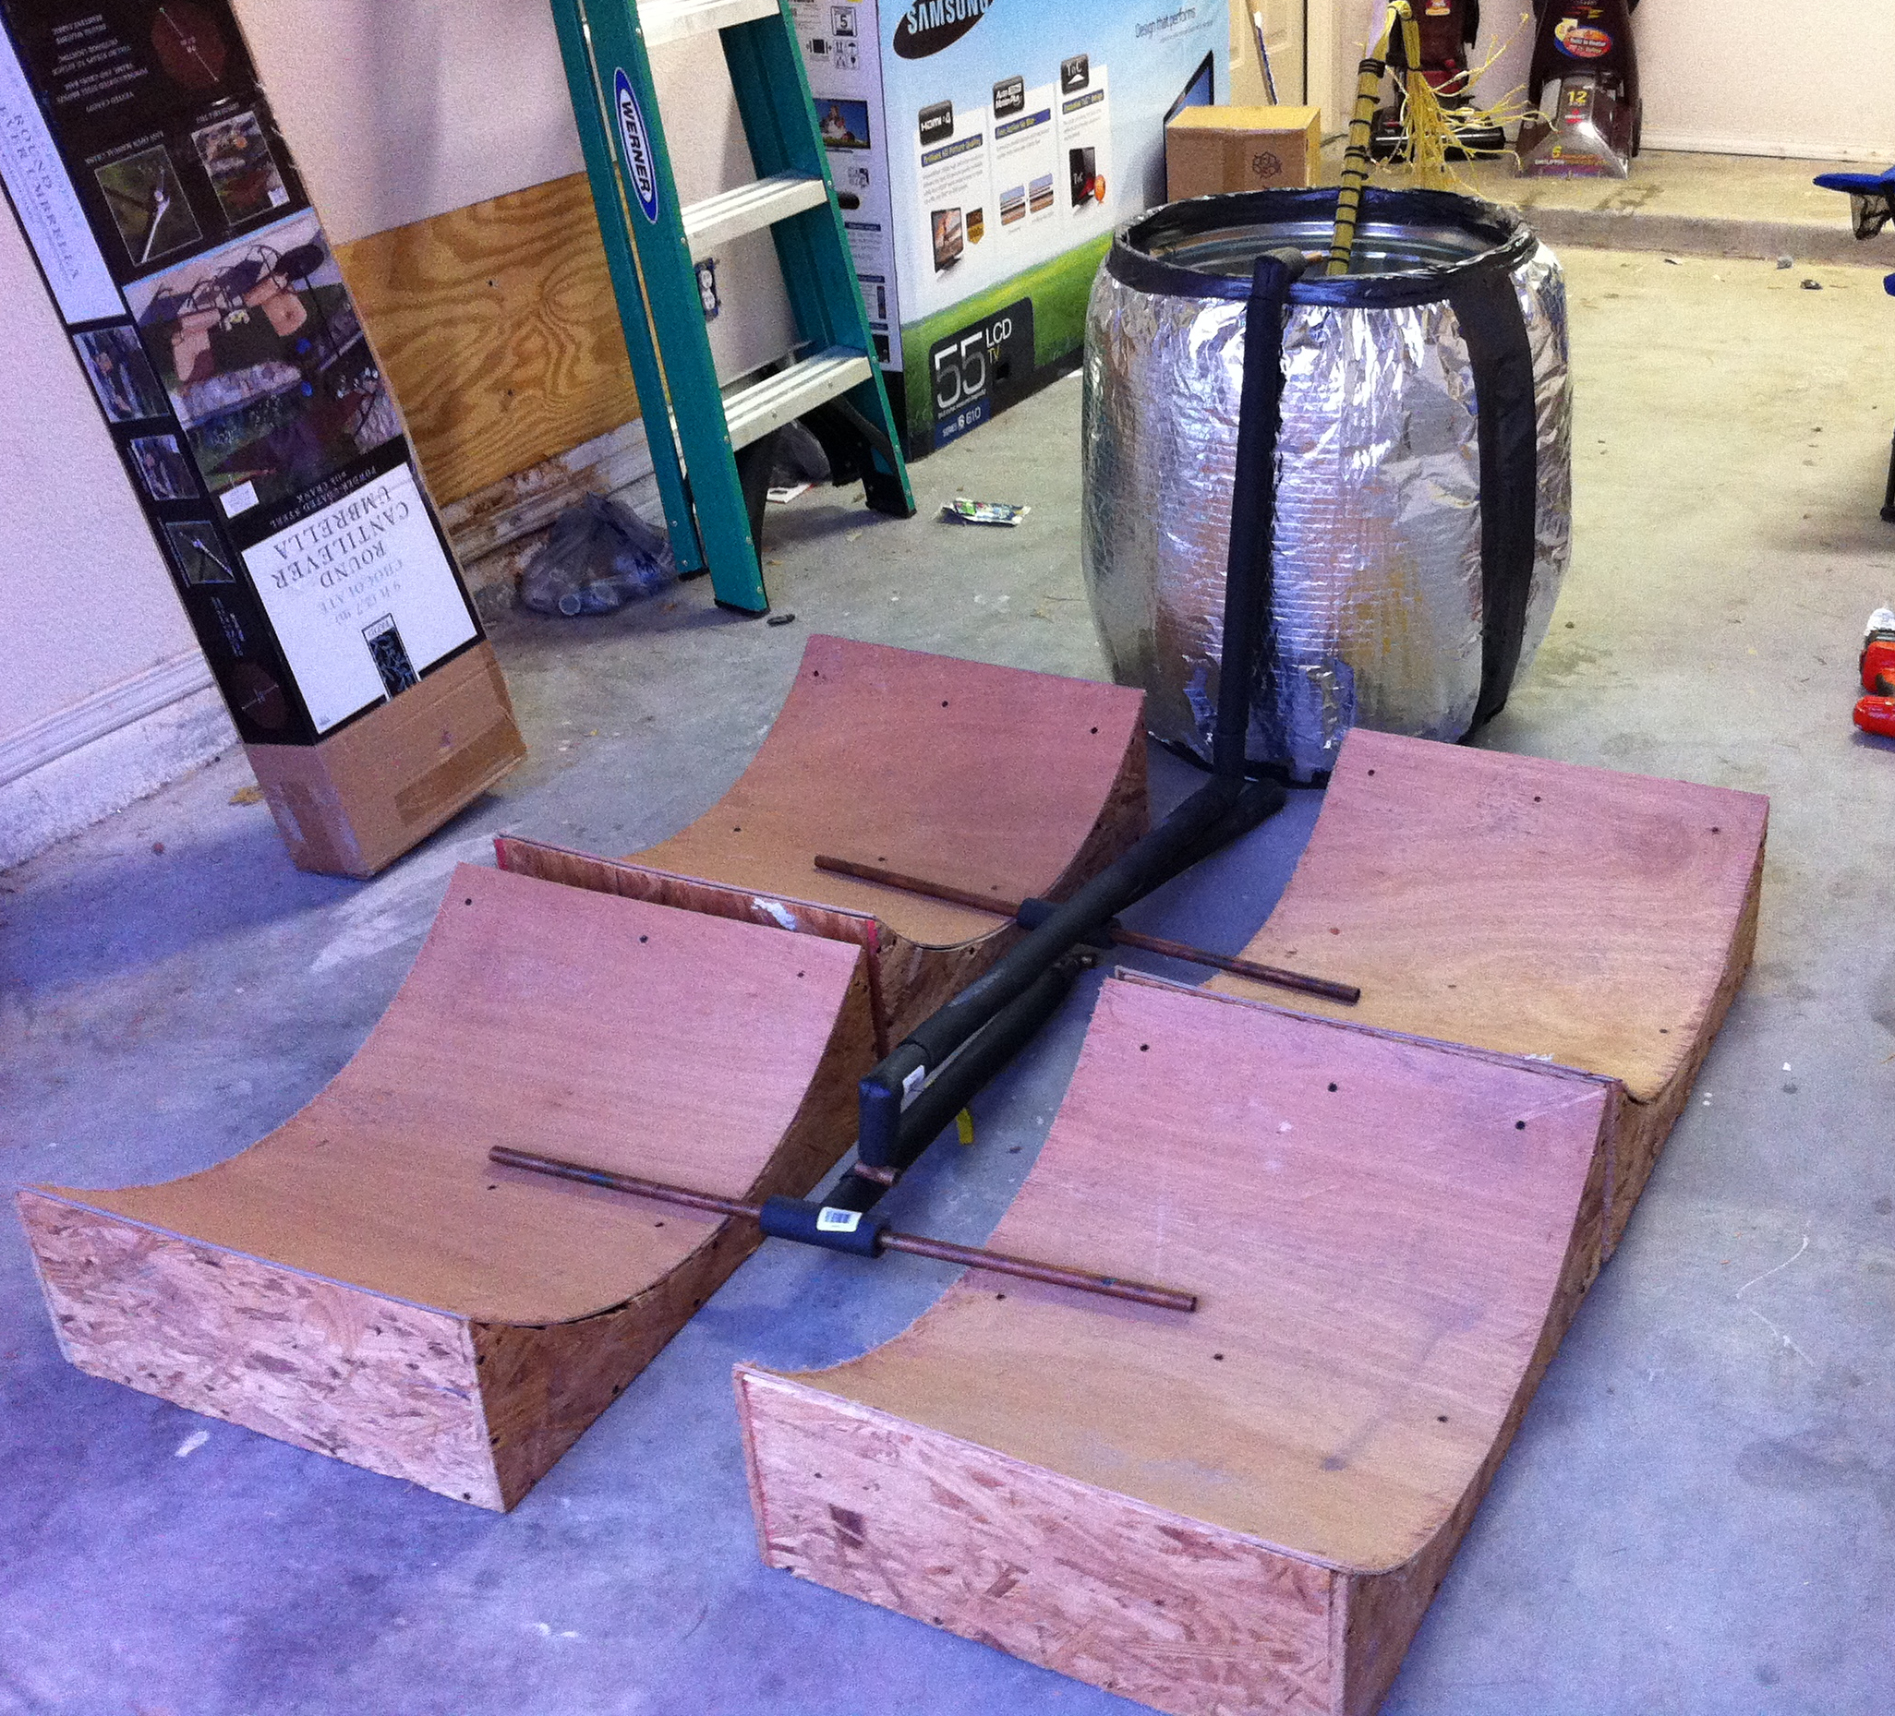
Future!
Application CSP
Falling particle receiver
With Sandia+NETL?
High temperature (>1000C)
Cp & k: f(t,T)
Solid particle
Engineered phase change materials
Encapsulated PCM particles
Coating
Attrition

Slide 15
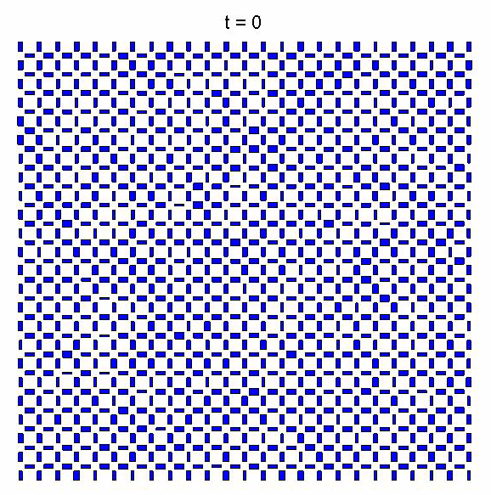
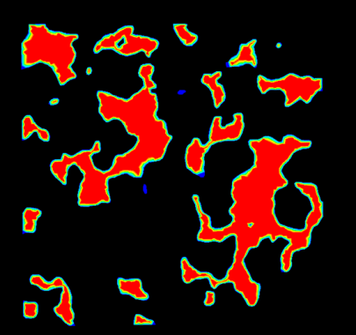
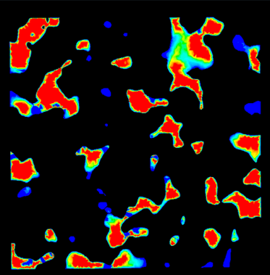
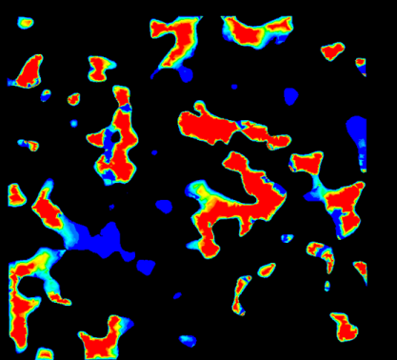
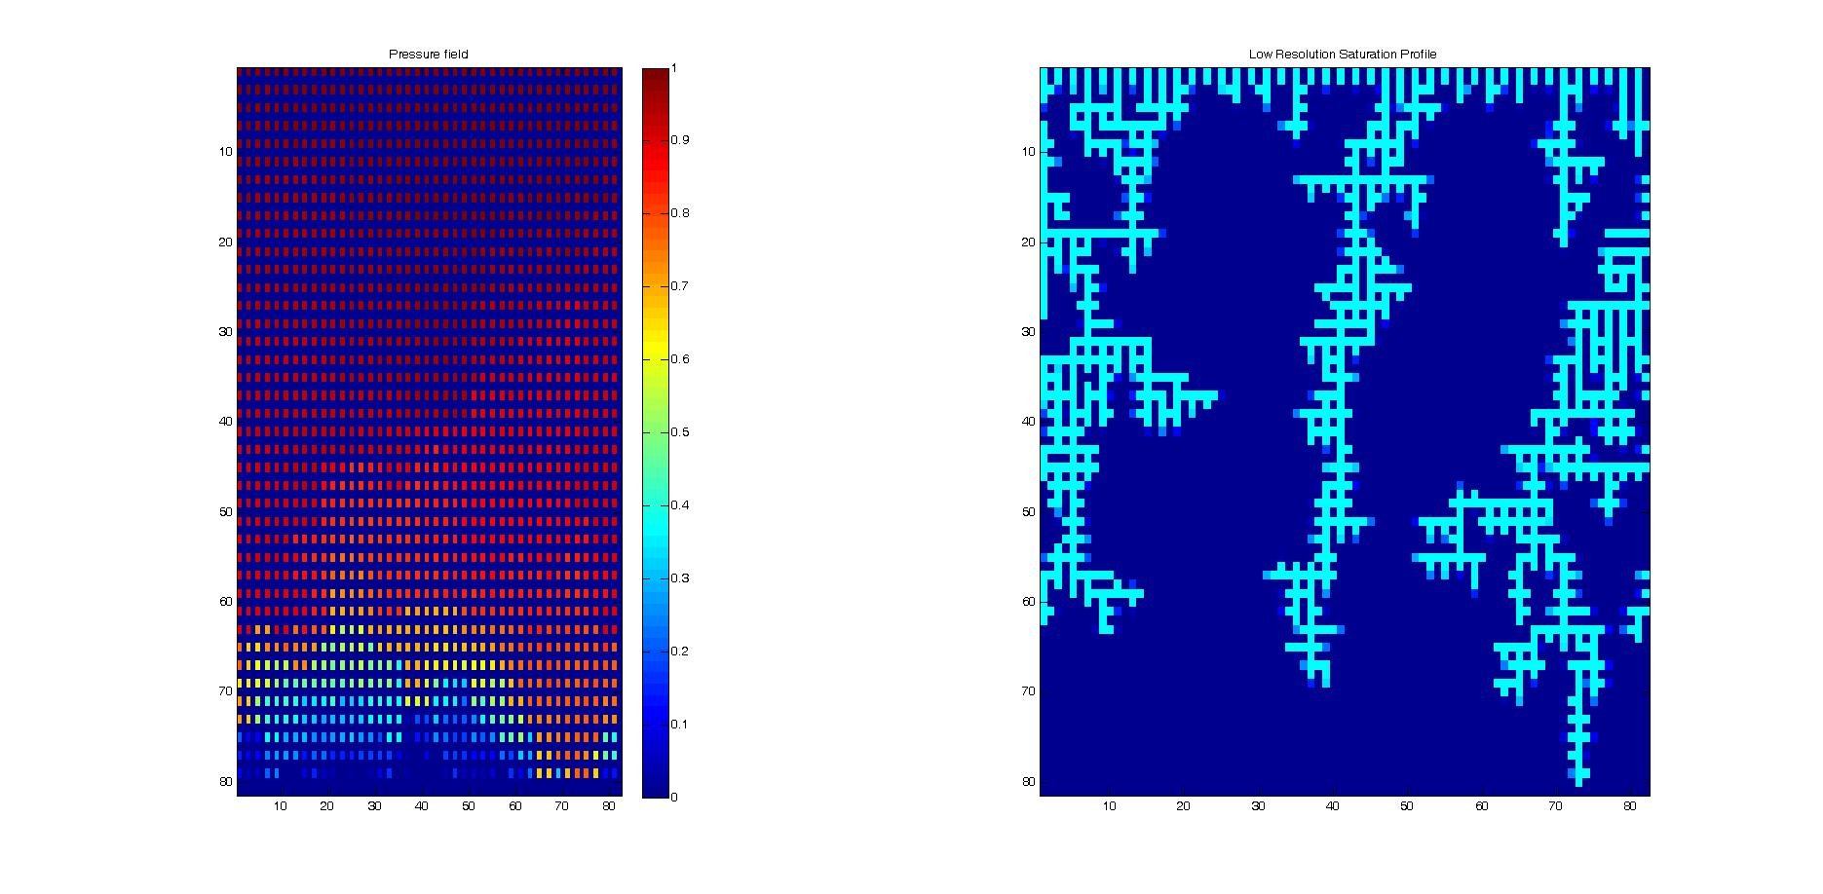
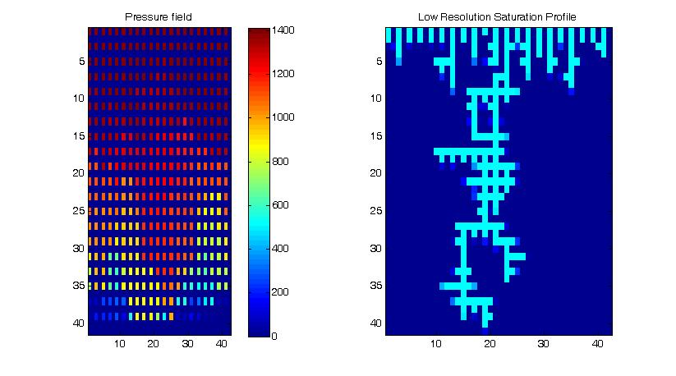
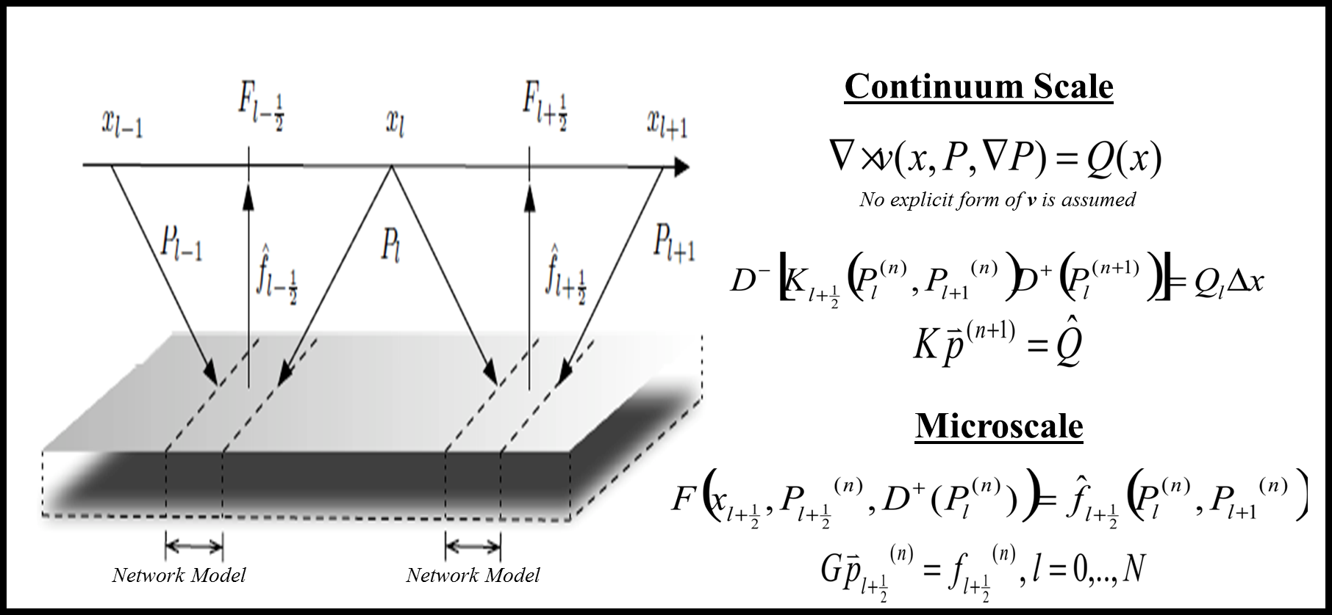
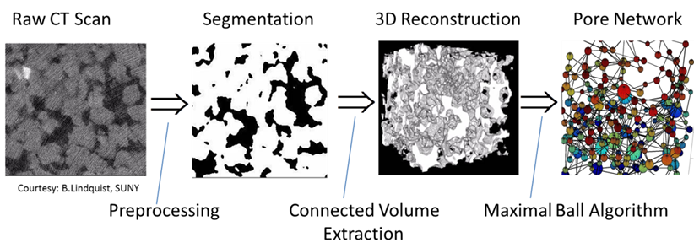
Recent!
Application Multiphase flow
Multiscale scheme: Block iterative coupling

Slide 16
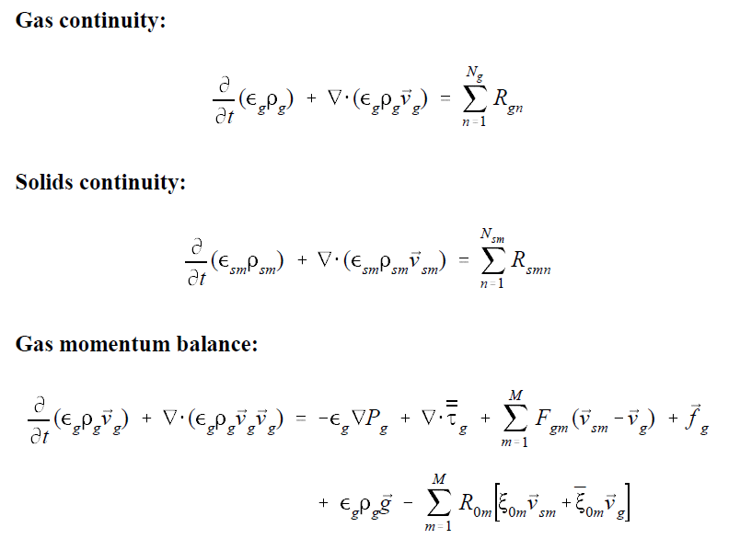
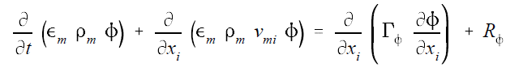

MFiX Eqs & Schemes (From MFiX reports) Rogers, Syamlal, O’Brien
Current!
Convection-diffusion/Transport of species
First-order schemes/Second-order/High-order schemes
The use of higher order methods may result in a violation of Patankar’s Rule 2 in some regions!
Downwind factors
Numerical diffusion
Consistency
Notes:
16

Slide 17
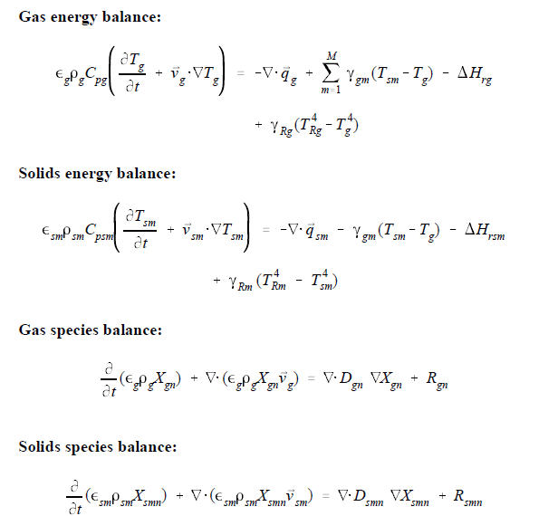
MFiX Eqs & Schemes (From MFiX reports) Rogers, Syamlal, O’Brien
Current!
Notes:
17

Slide 18
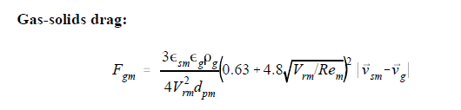
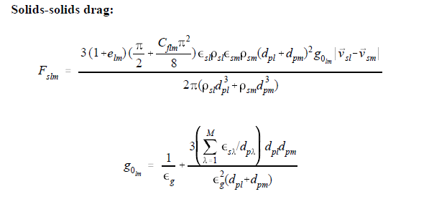
MFiX Eqs & Schemes (From MFiX reports) Rogers, Syamlal, O’Brien
Current!
And, Even More Equations…
Notes:
18

Slide 19
MFiX
Current!
Solution algorithms
SIMPLE (Patankar 1980)
More variables than single phase (slows computations)
The multiphase momentum equations are strongly coupled through the momentum exchange term
Handling of close-packed regions
Fluid-pressure correction
Boundary conditions
Numerical schemes
Linear/Non-linear system of equations solver
Parallel/Distributed computing
Partitioning/Domain decomposition
I/O , Data management/Cloud
Number crunching – HPC/GPU?
Graphics
Data-storage
Rendering
Notes:
19

Slide 20
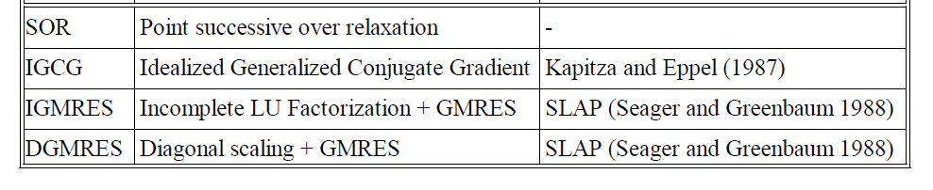
MFiX
Current!
Time-step adjustment
No-linear solver
Linear Solver
Notes:
20

Slide 21
Trilinos
Future!
The Trilinos Project is an effort to develop and implement robust algorithms and enabling technologies using modern object-oriented software design, while still leveraging the value of established libraries such as PETSc, Metis/ParMetis, SuperLU, Aztec, the BLAS and LAPACK. It emphasizes abstract interfaces for maximum flexibility of component interchanging, and provides a full-featured set of concrete classes that implement all abstract interfaces. Research efforts in advanced solution algorithms and parallel solver libraries have historically had a large impact on engineering and scientific computing. Algorithmic advances increase the range of tractable problems and reduce the cost of solving existing problems. Well-designed solver libraries provide a mechanism for leveraging solver development across a broad set of applications and minimize the cost of solver integration. Emphasis is required in both new algorithms and new software (Heroux, Hu, & et.al., http://trilinos.sandia.gov/).
Funded by DOE Office of Science/NNSA
Note: Slides in this topic mostly borrowed from M.Heroux & other trilinos members
Notes:
21

Slide 22

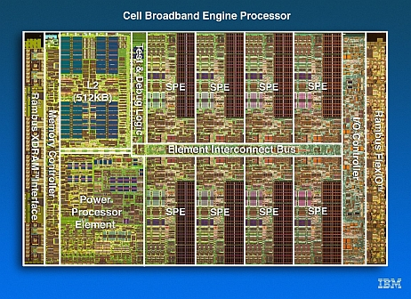
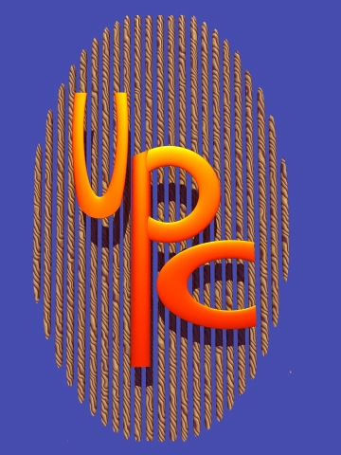
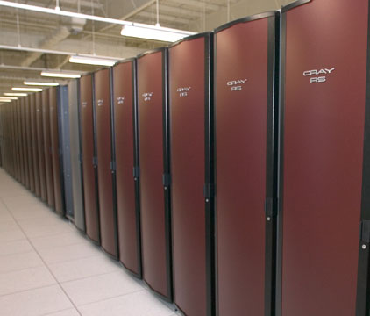
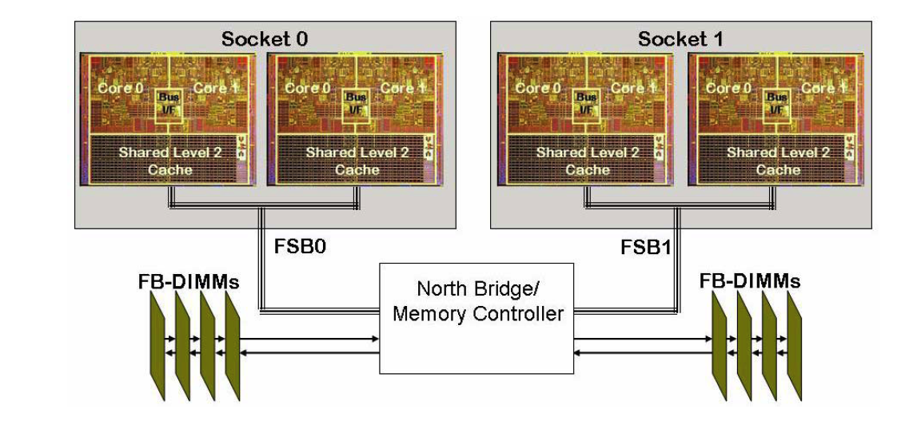
Target Platforms
Desktop: Development and more…
Capability machines:
Redstorm (XT3), Clusters
Roadrunner (Cell-based).
Multicore nodes.
Parallel software environments:
MPI
UPC, CAF, threads, vectors,…
Combinations of the above.
User “skins”:
C++/C, Python
Fortran.
Web, CCA.

Slide 23
Evolving Trilinos Solution
Trilinos¹ is an evolving framework to address these challenges:
Fundamental atomic unit is a package.
Includes core set of vector, graph and matrix classes (Epetra/Tpetra packages).
Provides a common abstract solver API (Thyra package).
Provides a ready-made package infrastructure (new_package package):
Source code management (cvs, git, bonsai).
Build tools (autotools, soon Cmake).
Automated regression testing.
Communication tools (mailman mail lists).
Specifies requirements and suggested practices for package SQA.
In general allows us to categorize efforts:
Efforts best done at the Trilinos level (useful to most or all packages).
Efforts best done at a package level (peculiar or important to a package).
Allows package developers to focus only on things that are unique to their package.
1. Trilinos loose translation: “A string of pearls”

Slide 24

Evolving Trilinos Solution
physics
Beyond a “solvers” framework
Natural expansion of capabilities to satisfy application and research needs
L(u)=f
Math. model
discretizations
methods
Numerical math
Convert to models that can be solved on digital computers
Time domain
Space domain
Automatic diff.
Domain dec.
Mortar methods
L_{h}(u_{h})=f_{h}
Numerical model
solvers
core
Algorithms
Find faster and more efficient ways to solve numerical models
Linear
Nonlinear
Eigenvalues
Optimization
Petra
Utilities
Interfaces
Load Balancing
u_{h}=L_{h}⁻¹•f_{h}
Algorithms
Discretization methods, AD, Mortar methods, …
computation

Slide 25
Trilinos Strategic Goals
Scalable Computations: As problem size and processor counts increase, the cost of the computation will remain nearly fixed.
Hardened Computations: Never fail unless problem essentially intractable, in which case we diagnose and inform the user why the problem fails and provide a reliable measure of error.
Full Vertical Coverage: Provide leading edge enabling technologies through the entire technical application software stack: from problem construction, solution, analysis to optimization.
Grand Universal Interoperability: All Trilinos packages will be interoperable, so that any combination of packages that makes sense algorithmically will be possible within Trilinos and with compatible external software.
Universal Accessibility: All Trilinos capabilities will be available to users of major computing environments: C++, Fortran, Python and the Web, and from the desktop to the latest scalable systems.
Universal Capabilities RAS: Trilinos will be:
Integrated into every major application at Sandia (Availability).
The leading edge hardened, efficient, scalable solution for each of these applications (Reliability).
Easy to maintain and upgrade within the application environment (Serviceability).
Algorithmic
Goals
Software
Goals

Slide 26
Trilinos Packages
Trilinos is a collection of Packages.
Each package is:
Focused on important, state-of-the-art algorithms in its problem regime.
Developed by a small team of domain experts.
Self-contained: No explicit dependencies on any other software packages (with some special exceptions).
Configurable/buildable/documented on its own.
Sample packages: NOX, AztecOO, ML, IFPACK, Meros.
Special package collections:
Petra (Epetra, Tpetra, Jpetra): Concrete Data Objects
Thyra: Abstract Conceptual Interfaces
Teuchos: Common Tools.
New_package: Jumpstart prototype.

Slide 27
Trilinos Package Summary http://trilinos.sandia.gov
 | Objective | Package(s)
Discretizations | Meshing & Spatial Discretizations | phdMesh, Intrepid, Pamgen, Sundance
 | Time Integration | Rythmos
Methods | Automatic Differentiation | Sacado
 | Mortar Methods | Moertel
Core | Linear algebra objects | Epetra, Jpetra, Tpetra
 | Abstract interfaces | Thyra, Stratimikos, RTOp
 | Load Balancing | Zoltan, Isorropia
 | “Skins” | PyTrilinos, WebTrilinos, Star-P, ForTrilinos, CTrilinos
 | C++ utilities, I/O, thread API | Teuchos, EpetraExt, Kokkos, Triutils, TPI
Solvers | Iterative (Krylov) linear solvers | AztecOO, Belos, Komplex
 | Direct sparse linear solvers | Amesos
 | Direct dense linear solvers | Epetra, Teuchos, Pliris
 | Iterative eigenvalue solvers | Anasazi
 | ILU-type preconditioners | AztecOO, IFPACK
 | Multilevel preconditioners | ML, CLAPS
 | Block preconditioners | Meros
 | Nonlinear system solvers | NOX, LOCA
 | Optimization (SAND) | MOOCHO, Aristos
 | Stochastic PDEs | Stokhos

Slide 28
Example: Trilinos’s Nonlinear Analysis Tools
SAND2008-7504P
Embedded Nonlinear Analysis Tools Capability Area
solution of nonlinear equations
time integration
bifurcation tracking / stability analysis
parameter continuation
optimization (PDE-constrained)
uncertainty quantification
Governing Philosophy: “Analysis beyond Simulation,”
Goal: to automate many computational analysis and design tasks using good algorithms and good math, replacing trial-and-error or repeated simulation.
parameter studies
sensitivity analysis
calibration
optimization
error control in transient integration
locating instabilities
Trilinos Strategic Goals that we align with:
Full Vertical Coverage
Hardened Solvers
Scalability

Slide 29
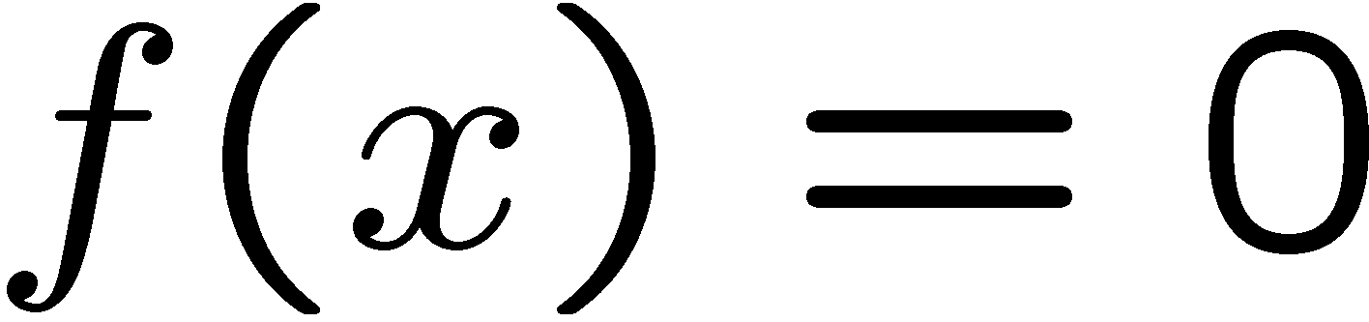

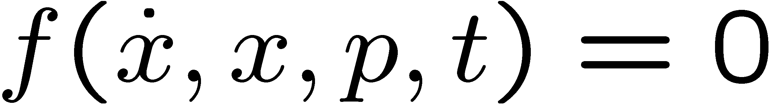
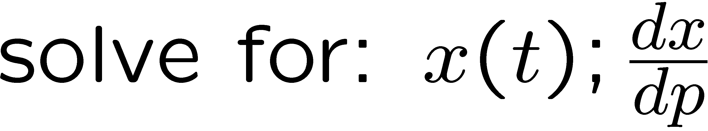
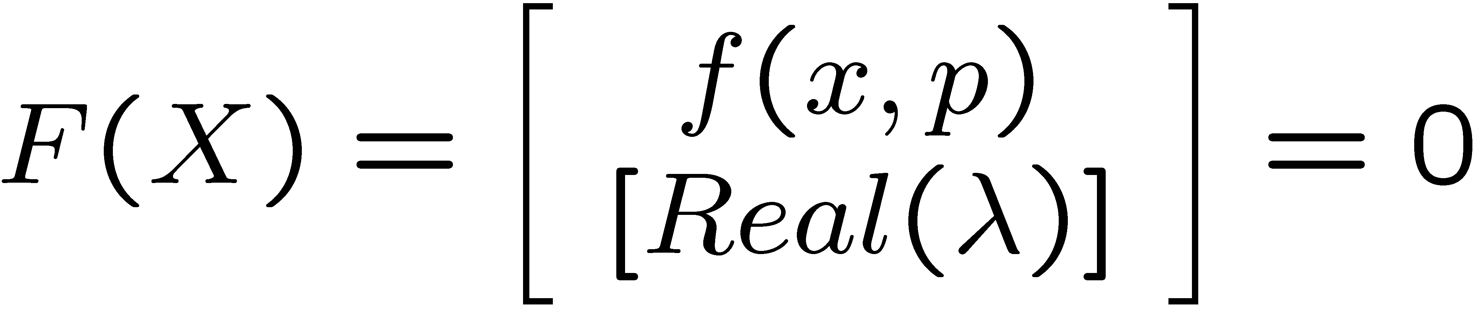








Exmaple: Math for Embedded Nonlinear Analysis Capabilities:
Nonlinear Solver (NOX):
Time Integration (Rythmos):
Bifurcation Tracking / Constraint Enforcement (LOCA):
Parameter Continuation (LOCA):
Stability Analysis (LOCA→Anasazi):
PDE-Constrained Optimization (Moocho/Aristos):
Embedded UQ (Stokhos):

Slide 30

HPC/Cloud/GPU
Future!
Notes:
30

Slide 31




HPC/Cloud/GPU
Future!
Notes:
31

Slide 32
Next Gen MFiX
Desktop to Supercomputers
Latest solver capability
Extreme (Exa?) Scale computing
Scalable Linear Algebra Themes:
Multicore/GPUs: Pre-requisite for extreme scale.
Multi-precision algorithms.
Cloud based Supercomputer to Tablet Computing?

Slide 33
UTEP
At Texas, New Mexico and Mexico Border
23,000+ Students and growing
>70% Hispanic (a Minority Serving Institution)
Mechanical Engineering
~700 Mechanical UG, ~100 MS
Energy track PhD program in the interdisciplinary ESE
The UTEP community - faculty, students, staff, and administrators - commits itself to the two ideals of excellence and access. In addition, the University accepts a strict standard of accountability for institutional effectiveness as it educates students who will be the leaders of the 21st century. Through the accomplishment of its mission and goals via continuous improvement, UTEP aspires to be an educational leader in a changing economic, technological, and social environment [with 21st century demography]: a new model for Texas higher education.
Notes:
33

