Slide 1
Numerical Simulation of Film Flow over an Inclined Plate: Effects of Solvent Properties and Contact Angle
Janine Carney and Rajesh Singh
Multiphase Flow Science Workshop
August 5-6, 2014
Lakeview Golf Resort & Spa, Morgantown, WV

Slide 2
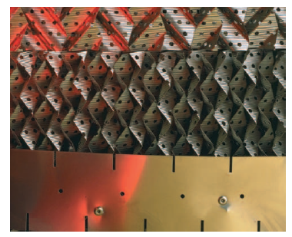

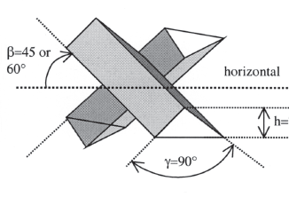
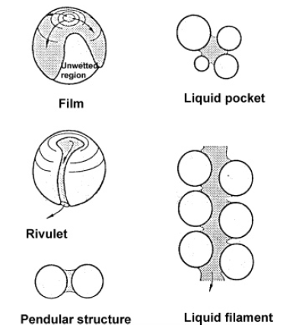
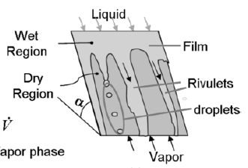
CFD Modeling of Solvent Absorption
Motivation: efficiency of CO₂ absorption is closely related to local flow behavior
Purified
Gas
Lean Solvent
Column²:
Φ ~10m
H ~30m
FLEXIPAC® ¹
layer height²:
~20cm
Challenges:
  Cannot model entire column focusing in on all physical phenomenon
  Multi-scale approach required
  Suitable closure models for interphase interactions have not been developed
Intalox® Ultra^{tm 1}
corrugation height²:
O(1mm)-O(1cm)
packing³:
25-80 mm
Flue Gas
to stripper
Rich Solvent
Source⁵
film thickness²:
~ O(0.1mm)
Source⁴
(1) Koch-Glitsch: http://www.koch-glitsch.com/default.aspx; (2) Raynal & Royon-Lebeaud, CES, 2007; (3) Mackowiak, Fluid Dynamics of Packed Columns, Springer, 2010; (4) Xu et al., Chem. Eng. Tech., 2008; (5) Maiti et al., IECR, 2006
Notes:
Highlights the motivation and challenges associated with CFD modeling solvent absorption.
Using CFD one may obtain very detailed flow field solutions of all relevant variables, such as velocities, pressure, eddy viscosity, etc.
Due to the current computational capacity available, it is not possible to perform simulations of the entire absorbing column that focus on every physical phenomenon
References: (1) Koch-Glitsch: http://www.koch-glitsch.com/default.aspx; (2) Raynal & Royon-Lebeaud, CES, 2007; (3) Mackowiak, Fluid Dynamics of Packed Columns, Springer, 2010; (4) Xu et al., Chem. Eng. Tech., 2008; (5) Maiti et al., IECR, 2006

Slide 3
Liquid Films
Features depend upon various flow parameters and liquid properties
Current Goal: study the impact of solvent properties, contact angle, flow rates, inclination angle on hydrodynamics
film thickness
wetted area
interfacial area
flow regime
Method: Volume of Fluid Simulations
Xu et al., Chem. Eng. Tech., 2008

Slide 4
Volume of Fluid (VOF)¹ Multiphase Model
Governing Equations
– Continuity and momentum equation of average phase
– Transport equation for volume fraction
Stress : turbulence neglected
Interfacial forces
– Force at interface resulting from surface tension
Challenges
– preserving a sharp boundary between immiscible fluids
– computations of surface tension
¹Hirt & Nichols, J. Comput. Phys, 1981

Slide 5
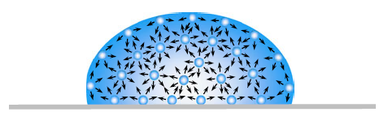
Computation of Interfacial Force
Surface tension force acts only at surface and is required to maintain equilibrium
– balances inward intermolecular attractive force with outward pressure gradient force
– minimizes free energy by decreasing area of interface
figure¹
Continuum surface force model – Brackbill et al., J. Comput Phys., (1992):
Other techniques are available²
– Force at surface expressed as volume force using divergence theorem
<= For two phase flow
– Surface curvature is computed from local gradients in the surface normal to the interface
– Effects of wall adhesion at fluid interfaces in contact with boundaries is also estimated within the CSF model
The contact angle that the fluid is assumed to make with the wall is used to adjust the surface normal in cells near the wall
¹Yuan, Y. and Lee, T. R., Contact Angle and Wetting Properties, in Surface Science Techniques , Bracco, G., and Holst B. (eds), 2013.
²Haroun et al., CES, 2010
Notes:
Calculation of external force acting on both gas and liquid at wall uses specified contact angle and curvature at the interfacial surface in calculation cell next to wall..

Slide 6
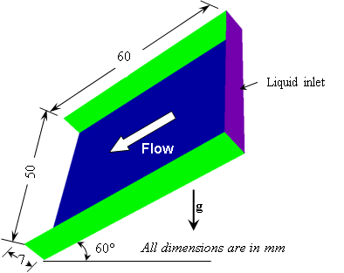
Liquid Film Down Inclined Plate
Inlet: constant velocity (through plane)
Outlet: pressure (0 Pa)
Plate: smooth wall (no slip)
Sides: smooth walls (no slip)
Top: pressure outlet (0 Pa)
z
y
x
Base case
Physical Properties | Air | Water
Density ρ (kg/m³) | 1.185 | 997
Viscosity μ (Pa.s) | 1.831x10⁻⁵ | 0.8899x10⁻³
Surface Tension σ (N/m) | – | 0.0728
Static contact angle with air-steel γ (°) | 70
1.05x10⁻⁶ ≤ Q_{in} ≤ 1.05x10⁻⁵ kg/m³
0.003 ≤ v_{in} ≤ 0.03 m/s
0.03 ≤ We_{N} ≤ 1.49
23.5 ≤ Re_{N} ≤ 235
Notes:
Study hydrodynamics of liquid film in a small element. VOF simulations tend to be limited to small computational domains. Shown here simulation plate 50mm wide by 60mm long with a depth of 7 mm.
Liquid flow down inclined plate. Stagnant gas layer. Highly resolved to identify film, rivulet and droplets.
The purpose of the study is to get familiar and streamline the problem setup of multiphase flow simulation.
Liquid Film development over the corrugated sheet significantly affects the efficiency of the structure packing column
Type of walls: no slip ?
Bottom and Side Walls: Smooth Wall with 70° Contact angle
Top: Pressure Outlet with Zero gauge pressure
Exit: Pressure Outlet with Zero gauge pressure
Inlet: uniform film flow defined by constant velocity perpendicular to boundary with set height (7mm)
Liquid flow over an inclined plate was selected as the geometry to begin the VOF work. The setup is relatively simple so we can gain some familiarity with the software and troubleshoot any potential issues running the simulations without further complications. this problem may give us an idea of the time commitments that may be required by such computationally intense simulations. In addition, a lot of work has been published on film flow down inclined plates against we can validate and compare while also gaining some experience with film flow.
Other groups who studied this problem (flow on flat plate (smooth or textured)):
Ataki, A., and Bart, H-J., 2004, “The Use of the VOF-Model to Study the Wetting of Solid Surfaces.” Chemical Engineering Technology, Vol 27, No. 10.
Hoffmann, A., Ausner, I., Repke, J.U., Wozny, G., 2005, “Fluid dynamics in multiphase distillation processes in packed towers”. Computers and Chemical Engineering, Vol. 29, pp. 1433-1437
Hoffmann, A., Ausner, I., Repke, J.-U., and Wozny G., Detailed investigation of multiphase (gas-liquid and gas-liquid-liquid) flow behavior on inclined plates), Chemical Engineering Research and Design, Vol. 84, A2, pp. 147-154.
Xu, Y. Y., Paschke, S., Repke, J. U. , Yuan, J. Q. and Wozny, G., “Portraying the Countercurrent Flow on Packings by Three-Dimensional Computational Fluid Dynamics Simulations.” Chemical Engineering and Technology, Vol 31, No. 10, pp. 1445-1452.
Iso, Y., Huang, J., Kato, M., Matsuno, S., Takano, K., 2013, “Numerical and experimental study on liquid film flows on packing elements in absorbers for post-combustion CO2 capture”, Energy Procedia, Vol. 37, pp 860–868.
Cooke, J.J., Gu, S., Armstrong, L.M., Luo, K.H., 2012, “Gas-Liquid Flow on Smooth and Textured Inclined Planes”, World Academy of Science, Engineering and Technology, Vol. 68, pp1712-1719
Sebastia-Saez, D., Gu, S., Ranganathan, P., Papadikis, K., 2013, “3D modeling of hydrodynamics and physical mass transfer characteristics of liquid film flows in structured packing elements”, International Journal of Greenhouse Gas Control, Vol. 19, pp 492–502

Slide 7
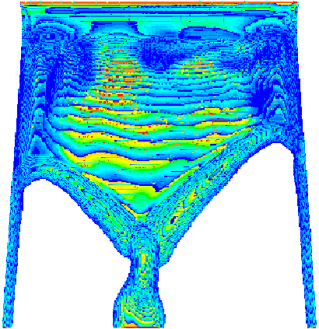
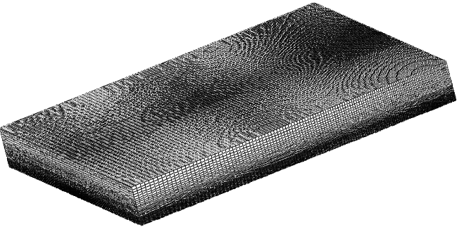
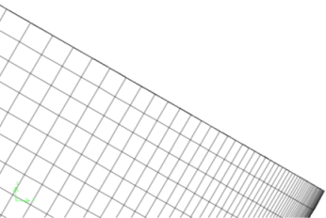
Computational Domain
Film flow
Fine mesh required to resolve rivulets
Rivulets
3D view showing mesh of domain
higher mesh density near plate
z
y
x
higher mesh density near center line
Simulations conducted for pseudo-steady state
Δt = 1×10⁻⁵ – 1×10⁻⁴ (Co=0.50)
Typical Run Times
Case | No of Cells | Simulation time | Wall Time | No of Processor
Coarse | 500K | 2s | 24hrs | 32
Fine 1 | 1.12M | 2s | 48 hrs | 128
Fine 2 | 1.37M | 2s | 48 hrs | 128
Fails to correctly predict flow behavior
Number of elements: 1.15M*
(Literature: 1.0 – 1.5M elements)
Notes:
The simulations were run using a variable time-step to keep the global Courant number (time step in calculation to characteristic time scale of flow) at 0.5.
Courant number: (Compares the time step in a calculation to the characteristic time Scale of flow)
This results in time steps of the order 1x10-5s. Pseudo-steady state determined by approximately constant liquid flow rate at the exit (fluctuation of liquid flow rate about constant).
SS determined by the approx. constant liquid flow at the exit
Variable time step based on global Courant Number = 0.50
Courant number: (Compares the time step in a calculation to the characteristic time Scale of flow)
Δt is chosen according to CFL condition
Type of cells: structured hexahedral elements
Fine mesh needed to resolve various film behavior: inlet condition and film to rivulet to droplet transition
The computational grid is made very fine to ensure accurate resolution of the liquid flow. The grid is non-uniform such that the density inside the liquid film and near the interfacial surface region is finer than the region adjacent to the surrounding gas.
Type of cells: structured hexahedral elements
Fine mesh needed to resolve various film behavior: inlet condition and film to rivulet to droplet transition

Slide 8
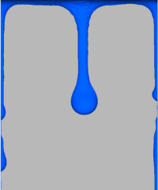
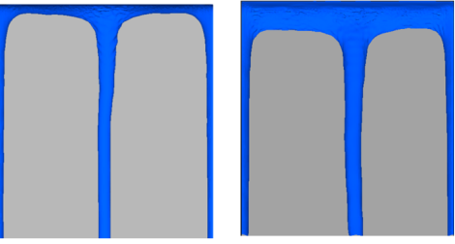
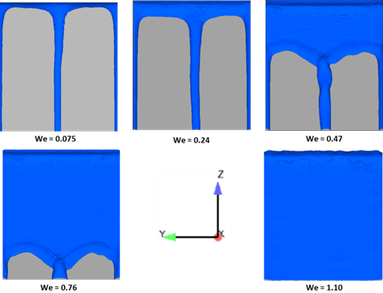

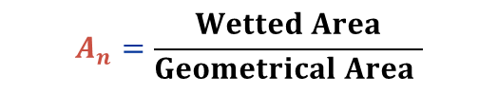
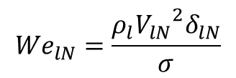
Comparison with Experiments
Impact of inertia on flow transition & wetted area
Snapshot of Interface (ε_{L} = 0.5)
Specific Wetted Area
$$A_{n}=\frac{Wetted Area}{Geometrical Area }$$
We=0.02 We=0.075 We=0.24
We=0.47 We=0.76 We=1.10
CFD-Hoffman (2006)
Exp-Hoffman (2005)
Increasing We
Droplet Rivulet Full Film
$${We}_{lN}=\frac{ρ_{l}{{V_{lN}}^{2}δ}_{lN}}{σ}$$
Excellent Match with Experiments
Hoffman et al., Trans IChemE, 2006 and Hoffman et al., Comp. Chem. Eng. 2005
Notes:
Liquid films can exhibit a range of flow regimes: full film, rivulet and droplet flow. The formation of these features is dependent upon various flow parameters, such as liquid flow rate, plate surface texture, plate geometry, etc., and solvent properties
At high Re the liquid may form a closed stable film yielding a specific wetted area of 1. When the Re decreases, the liquid flow rate cannot support a closed film and the film breaks up so the specific wetted area is less than 1.
Inertia = rhol . V^2 . L^2
Gravity = (rhol – rhog) . g . L^3
Viscous = rhol . mul . L
Capillary = sigma * L
We = inertia/surface tension
We >> 1 (inertia dominates)
Ca = viscous/surface tension
Ca >> 1 (viscous)
Surface tension minimizes spreading
Inertia increases wetting
Fig. 3: Effect of the inertia on the flow pattern over the inclined plate. Flow develops from droplet to rivulet and finally to full film (a fully wetted plate).
Figure 4: Comparison of the computed normalized wetted area of the plate with experimental results of Hoffman et al (2005) at different Weber numbers. In the validation, water is used as solvent.

Slide 9
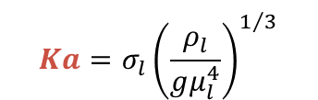
Effect of Solvent Properties on Hydrodynamics
Film thickness
Wetted area
Interfacial area
Kapitza Number only depends on fluid properties
Fixed for each solvent
Independent of flow rate
$$Ka={σ_{l}\left(\frac{ρ_{l}}{gμ_{l}^{4}}\right)}^{1/3}$$
Low Ka ↔ high solvent viscosity
Solvent | μ_{l} (Pa-s) | ρ_{l} (kg/m³) | σ_{l} (N/m) | ν_{l} | Ka
Water | 0.00089 | 997.0 | 0.07280 | 8.92578E-07 | 3969.04
30% MEA | 0.00252 | 1013.0 | 0.05480 | 2.48766E-06 | 749.71
26.7% AMP | 0.00270 | 995.80 | 0.04301 | 2.71136E-06 | 533.65
40% MEA | 0.00371 | 1015.3 | 0.05500 | 3.64917E-06 | 450.42
0.075m MPZ | 0.00556 | 1005.3 | 0.05442 | 5.53489E-06 | 258.27
48.8% MDEA | 0.00925 | 1016.6 | 0.04756 | 9.09896E-06 | 116.60
0.51m MPZ | 0.01336 | 946.41 | 0.03437 | 1.41165E-05 | 49.72
0.41m MPZ | 0.02348 | 962.20 | 0.03589 | 2.44022E-05 | 24.62
0.31m MPZ | 0.03642 | 981.31 | 0.03840 | 3.71137E-05 | 14.77
Flow rate computation
Q_{l} = liquid flow rate
We = Weber number
W = Width of plate
ρ_{l} = density of liquid
Δρ = ρ_{l} − ρ_{g}
μ_{l} = viscosity of liquid
σ_{l} = surface tension of liquid
g = gravitational acceleration
Notes:
In this problem, a number of parameters are involved and their effects were investigated separately. A number of correlations were derived separately for each parameter. In this section, we try to show the effect of fluid properties in term of the Kapitza number to get collective effect of all fluid parameters. It is defined by the fluid properties and inclination of the plate. Eventually, it will be fixed for each fluid and plate orientation angle and independent of the flow parameters.
Note that highly viscous fluid results in low Ka.

Slide 10

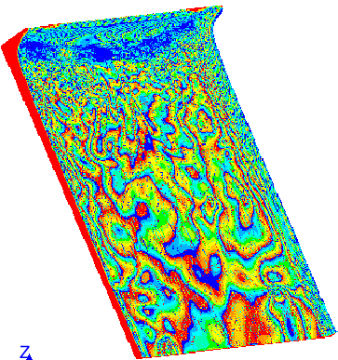
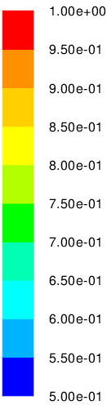
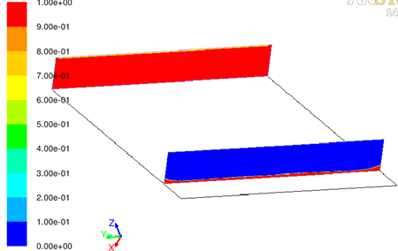
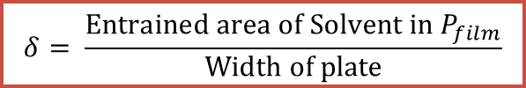
Film Thickness for Fully Wetted Plate
Fixed Q = 1.053×10⁻⁵ m³/s
To yield fully wetted plate
Snapshot of liquid and gas distribution in the central xz-plane
Longitudinal Plane
Flow
Solvent
Plane P_{film}
Air
Volume Fraction of Water
$$δ= \frac{Entrained area of Solvent in P_{film}}{Width of plate}$$

Slide 11
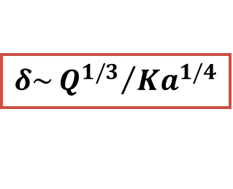
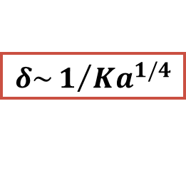
Film Thickness for Fully Wetted Plate
Impact of solvent properties
δ decreases with increase Ka
$$δ\sim 1/{{Ka}^{1/4}}$$
Increasing viscosity
Excellent agreement with Nusselt theory
Flow rate:
$$δ\sim {Q^{1/3}}/{{Ka}^{1/4}}$$
Notes:
For Fixed Q = 1.053×10⁻⁵ m³/s. We = 0.81 – 1.5
Surface tension have significant impact of thickness
The flow rate is chosen in such way that plate gets fully wetted for all cases
The time for getting fully wetted plate increases with solvent viscosity.
Film thick was computed at a cross-section sufficient away from the inlet
The film thickness decreases with increased Ka (increasing Ka corresponds to reducing solvent viscosity)
A plot of indicated scaling shows the excellent match. Note that computation of film thickness in classical Nusselt theory does not account the surface tension. The surface tension is an important fluid property that dictates the shape of liquid-gas interface
Excellent matching with Nusselt theory
Figure 5: (b) Comparison of the computed film thickness with Nusselt theory (1916) at different Kapitza numbers (Ka). The lower value of the Kapitza number corresponds to highly viscous solvent. (c) Scaling of the film thickness with Ka shows relation as
Tested with several Weber number. Shows same scaling for those tested.
Higher We results in slightly higher film thickness and more impact on higher viscosity solvents…
Tested varying contact angle…next slide
What about inclination angle? The effects of gravity can be altered by changing the inclination angle and film thickness decreases with increased inclination angle owing to enhanced film velocity. It can be altered by changing the inclination angle of the plate. The initial increment shows significant impact on the film thickens but its effect is not significant after 60°. the film thickness can be altered by the changing the inclination. As expected, it has significant effect shows inclination angle of the plate

Slide 12
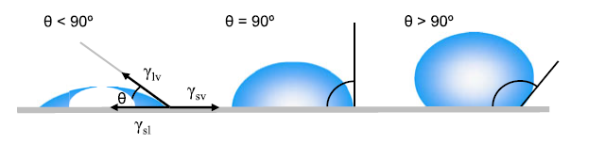

Film Thickness for Fully Wetted Plate
Impact of contact angle
γ < 90°
γ
γ > 90°
γ = 90°
σ_{lv}
γ
σ_{sv}
¹figure
σ_{sl}
Characteristics of solid- liquid system in specific environment
Dictates the wetting behavior of solvent
Two Contact Angles
(γ= 70° and 40°)
Film thickness unaffected by contact angle for fully wetted plate
What about for partially wetted plate?
$$δ\sim 1/{{Ka}^{1/4}}$$
Ka^{-1/4}
¹Yuan, Y. and Lee, T. R., Contact Angle and Wetting Properties, in Surface Science Techniques , Bracco, G., and Holst B. (eds), 2013.
Notes:
Surface tension is responsible for shape of liquid droplets (spherical) which gives minimum surface area for fixed volume. In practice external forces (such as gravity) deform the droplet.. And contact angle is determined by combination of surface tension and external forces..
Contact angle on rough surfaces are meaningless in terms of Young’s equation… such contact angle are not equivalent to ‘young’s contact angle’, General conclusion on contact angle hysteresis is that it arises from surface tension or heterogeneity. For a given solid, measure contact angle do not vary randomly upon changing the testing liquid. Instead the change of cosine of contact angle versus liquid surface tension varies linearly for a homologous series of liquids..

Slide 13
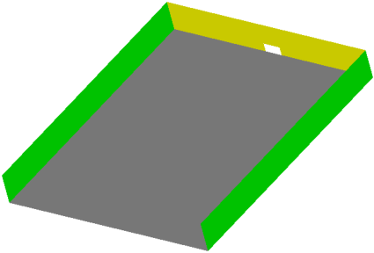
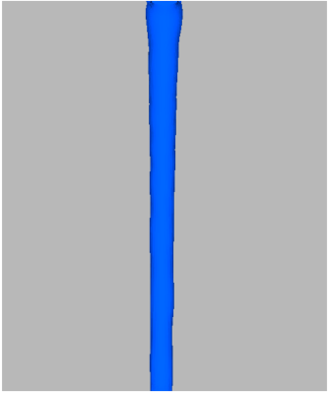
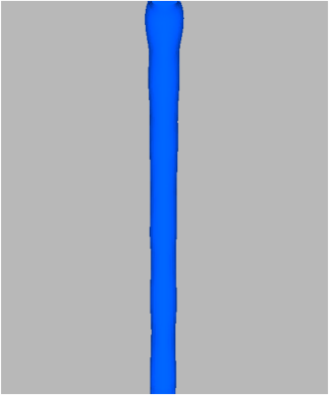
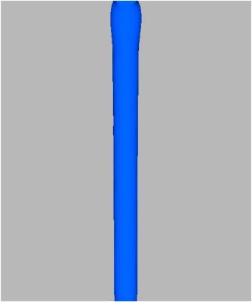
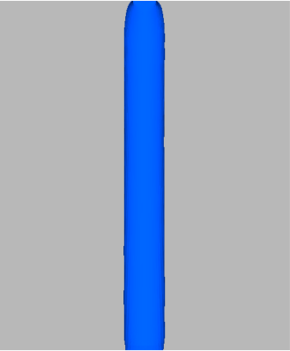
Modified Setup for Rivulet Flow
Inlet (4×2 mm²)
Fixed Q = 2×10⁻⁶ m³/sec
Normalized Areas
Interface
Flow
Base
Snapshot of Interface (ε_{L} = 0.5)
Water
Ka=3969
30MEA
Ka=749
48MDEA
Ka=116
31MPZ
Ka=15
Notes:
Fixed flow rate 2×10⁻⁶ m³/sec. We varies from 2.28- 4.26 (uses hydraulic diameter)
These waves form by instabilities triggered by gravity and surface tension.

Slide 14
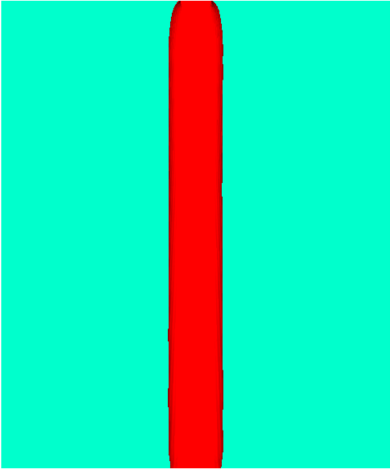
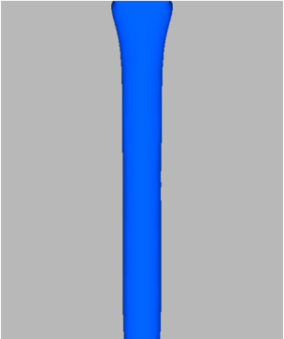
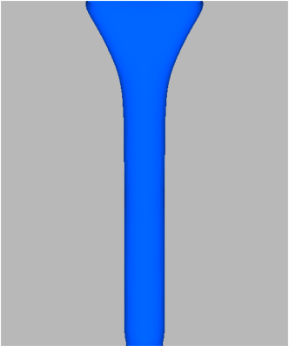
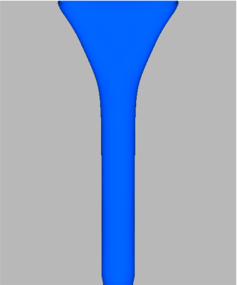
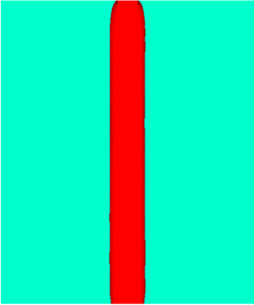
Interfacial Area for Rivulet Flow
Impact of inlet size and solvent property
Interface at ε_{L} = 0.5 for 0.31m MPZ (Ka=15)
10mm
20mm
25mm
4mm
4mm
4mm
4mm
Developed width of rivulet remains constant at a fixed Q
Developed width only depends on Q
Slight increase in interfacial area is due to entrance effects
A_{In} decreases with increased Ka
Notes:
Fixed flow rate 2×10⁻⁶ m³/sec. We varies from 2.28- 4.26 (uses hydraulic diameter)
At fixed flow rate the developed width insensitive to inlet size. Increase is due to entrance effects

Slide 15

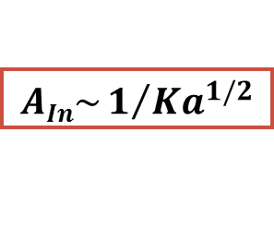
Interfacial Area for Rivulet Flow
Impact of inlet size and solvent property
$$AIn\sim 1/{{Ka}^{1/2}}$$
Flow rate:
$$AIn\sim {Q^{1/3}}/{{Ka}^{1/2}}$$
Notes:
Fixed flow rate 2×10⁻⁶ m³/sec. We varies from 2.28- 4.26 (uses hydraulic diameter)
Scaling for the variation of the interface area with Ka shows that
Also tested for several flow rates.. (figure not shown)

Slide 16
Wetted/Interfacial Areas for Rivulet Flow
Impact of contact angle
For 0.31m MPZ (Ka=15)
For all solvents
Normalized Interfacial Area
Normalized Areas
Interface
x
Base
Contact Angle
Contact Angle
Wettability decreases with increased γ
Impact is greater on wetted area
Leads to increase in δ with increased γ
Notes:
Fixed Q = 2×10⁻⁶ m³/sec

Slide 17
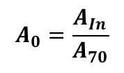
Re-normalized Interfacial Areas for Rivulet Flow
Impact of contact angle
$$A_{0}=\frac{A_{In}}{A_{70}}$$
  A₇₀ = Interfacial area at γ = 70°
Pioneering work of Zisman and co-workers¹ found²:
For given solid, contact angle (γ) does not vary randomly with liquid
The change of cos γ vs surface tension (σ) falls in a linear trend
Lower values of σ corresponds to smaller γ
Low σ
Medium, High σ
Contact Angle
Two regimes are evident for
Low σ ( < 50 mN/m)
Medium & High σ (>50 mN/m; 70 mN/m)
¹Yuan, Y. and Lee, T. R., Contact Angle and Wetting Properties, in Surface Science Techniques , Bracco, G., and Holst B. (eds), 2013.
2W.A. Zisman, in Contact Angle, Wettability and Adhesion: Advances in Chemistry Series, vol. 43, ed. by R.F. Gould (ACS, Washington, 1964), p. 1
Notes:
122. W.A. Zisman, in Contact Angle, Wettability and Adhesion: Advances in Chemistry Series,
vol. 43, ed. by R.F. Gould (ACS, Washington, 1964), p. 1
Cosγ and σ follows in a linear tend for a homogenous series of liquid

Slide 18
Interfacial Area for Rivulet Flow
Impact of contact angle
Areas scale as
Low σ
Interfacial Area (A_{In})
m = 0.50 σ < 50mN/m
= 0.33 ≥ 50mN/m
Medium, High σ
Wetted Area (A_{n})
m = 0.60 σ < 50mN/m
= 0.45 ≥ 50mN/m
Notes:
Cosγ and σ follows in a linear tend for a homogenous series of liquid

Slide 19

Interfacial Area for Rivulet Flow
Impact of Ka at various γ
Impact of Ka and γ
$$AIn\sim 1/{{Ka}^{1/2}}$$
Valid for all γ

Slide 20
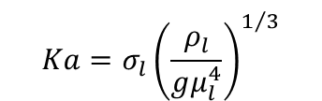
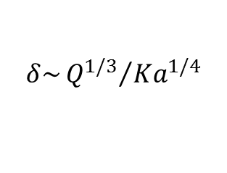
Summary & Conclusions
Multiphase flow VOF simulations can be used to explore film flow down a plate
Results presented in terms of the Kapitza number
Scaling relations were obtained to describe impact of solvent properties and contact angle on interfacial area
  Full Film Flow:
    Film thickness decreases with increase Ka
  Rivulet Flow:
    Wetted/Interfacial areas decrease
    with increased Ka
    Wetted/Interfacial areas decrease
    with increased γ
$$Ka={σ_{l}\left(\frac{ρ_{l}}{gμ_{l}^{4}}\right)}^{1/3}$$
$$δ\sim {Q^{1/3}}/{{Ka}^{1/4}}$$
Work in progress
  Identifying critical We for flow regime transition
  Impact of varying inclination angle
Notes:
We also investigate the spreading of solvent for small inlet to demonstrate the flow regime. This has been done from a rigorous simulations to identify the flow regime and a critical value of the Weber number is identified (We_{D}) for each Kapitza number. In Figure a, we note that critical value of Weber number increased with increased Ka, indeed At low Ka, viscous stress dominates over the restoring interfacial force. Note that the viscous force stabilizes film.

Slide 21
Disclaimer of Liability/Endorsement
This work is made available by an agency of the United States Government. Neither the United States Government, the Department of Energy, the National Energy Technology Laboratory, nor any of their employees, makes any warranty, express or implied, including warranties of merchantability and fitness for a particular purpose, or assumes any legal liability or responsibility for the accuracy, completeness, or usefulness of any information, apparatus, product, or process disclosed, or represents that its use would not infringe privately owned rights.
Reference herein to any specific commercial product, process, or service by trade name, trademark, manufacturer, or otherwise, does not necessarily constitute or imply its endorsement, recommendation, or favor by the United States Government, the Department of Energy, or the National Energy Technology Laboratory. The views and opinions of authors expressed herein do not necessarily state or reflect those of the United States Government, the Department of Energy, or the National Energy Technology Laboratory, and shall not be used for advertising or product endorsement purposes.

Slide 22
Extra Slides

Slide 23
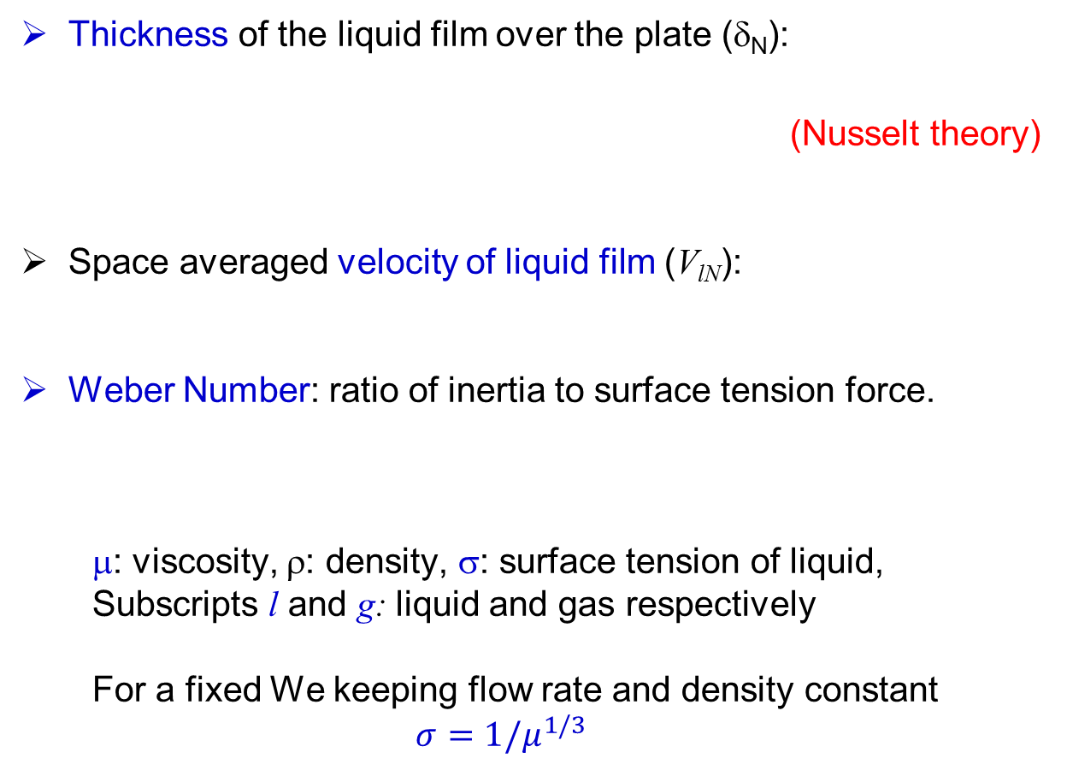
Dimensionless number used
Thickness of the liquid film over the plate (δ_{N}):
                (Nusselt theory)
Space averaged velocity of liquid film (V_{lN}):
Weber Number: ratio of inertia to surface tension force.
μ: viscosity, ρ: density, σ: surface tension of liquid,
Subscripts l and g: liquid and gas respectively
For a fixed We keeping flow rate and density constant
$$σ={1/μ}^{1/3}$$
Notes:
The weber number gives the ratio of inertia to surface tension and is one of the dimensionless groups often used to characterize this type of flow (important/useful parameter for flow transition).

Slide 24
Implementation for Gas-Liquid Interfacial Force
Continuum Surface Force Model (Brackbill et al, J. Com. Phys, 1992)
  surface curvature is computed from local gradients in the surface normal at the interface.
  n is the surface normal,
  Defined as the gradient of the volume fraction
  Curvature is divergence of unit normal
For Two phase the simplified equation of the force is
Only two phases are present in a cell, then

Slide 25
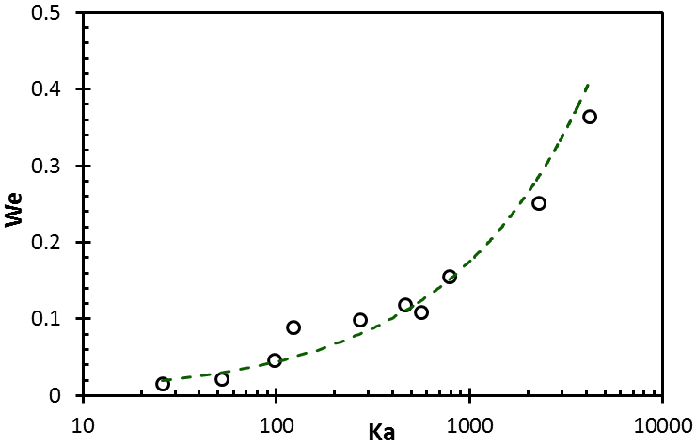
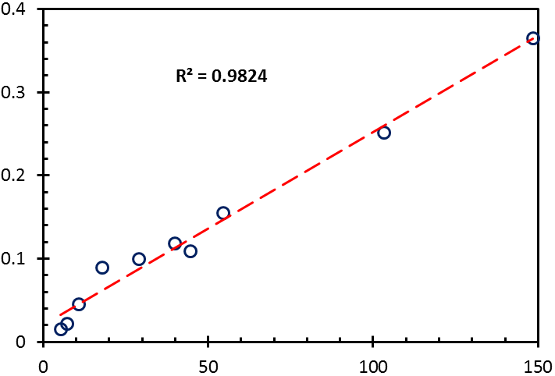
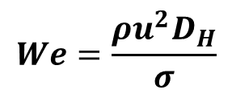

Variation of Critical Weber number with Kapitza number
Weber number based on hydraulic diameter of inlet
$$We=\frac{ρu_{}^{2}D_{H}}{σ}$$
D_{H}: Inlet Hydraulic diameter
We_{D}: Critical Weber number for droplet regime
Rivulet & Film
Rivulet & Film
We_{D}
Droplet
Droplet
Ka^{0.625}
$${We}_{D}\sim {Ka}^{0. 5}$$
Notes:
So far we have discussed the effects of solvent properties on the interfacial area and film thickness. Note that the mass transfer area (interfacial area) in the structure packing is always greater than the wetted area owing to existence of different flow regimes due to formation of droplets and rivulets. It is an important to identify the flow regimes: droplet, rivulets and fully developed film. We have conducted a rigorous simulation to identify such regimes for droplet formations.
. Flow regimes were identified by varying the flow rate. The CFD simulations were started from higher flow rate and flow regimes were identified by reducing flow rate. For this, around 100 sets of simulations were conducted to predict the flow regimes. Effect of the inertia was characterized by Weber numbers based on inlet hydraulic diameter and flow rate. The critical weber number (We_{D}), where flow regime changes from droplet to rivulet increases with increased Kapitza numbers. Elementary analysis shows that .
The critical Weber number of the fundamental, steady velocity profile also depends on the angle of inclination of the plate. The
Inclination angle of 60. Inclination angle of 45 and 75 shows same scaling.

Slide 26

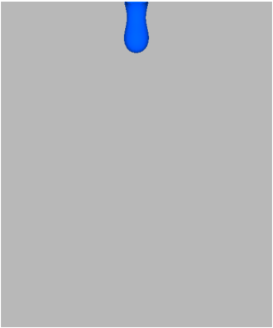
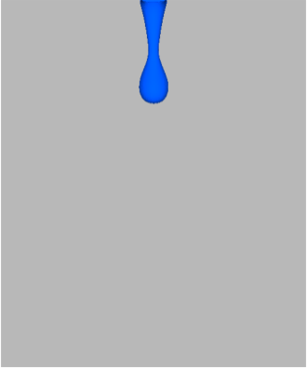
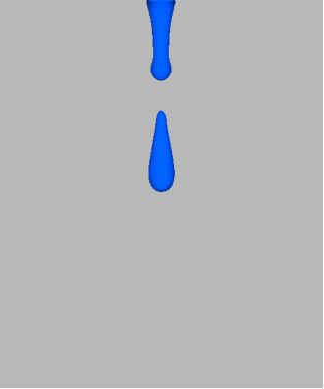
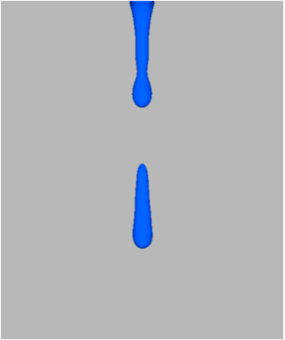
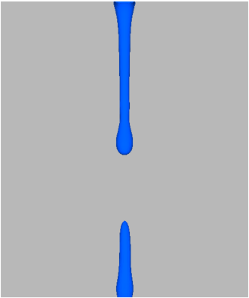

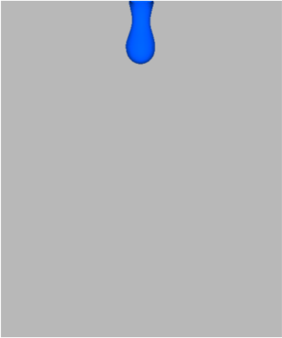
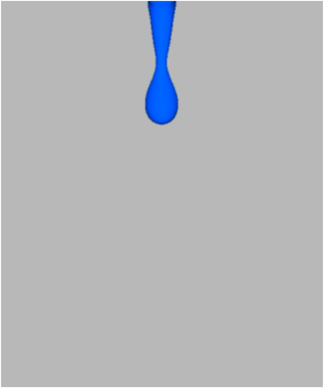
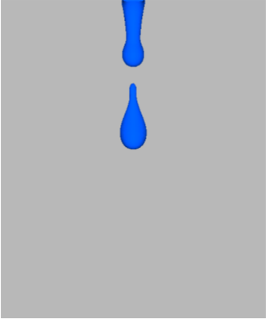
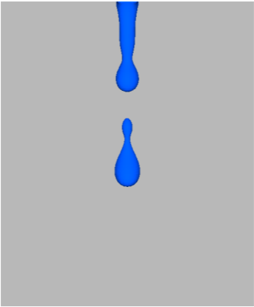
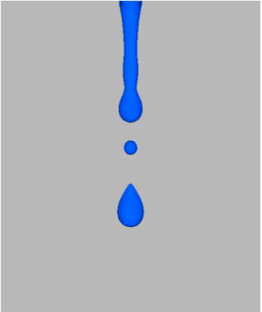
Droplet formation
AMP (Ka=533)
0.35s
0.08s
0.17s
0.21s
0.25s
0.29s
MDEA (Ka=116.6)
0.17s
0.22s
0.27s
0.32s
0.37s
0.43s

Slide 27
Wetted area with contact angle
C: Empirical constant

