Slide 1
Reduced Network Model Development for Fluidized Bed Biomass Gasification: Capturing Gas Bypassing and Devolatilizing Particle Segregation with CFD
Addison K. Stark, Richard B. Bates, Christos Altantzis, Ahmed F. Ghoniem
Reacting Gas Dynamics Laboratory, Department of Mechanical Engineering, MIT.
NETL Workshop on Multi-Phase Flow, August 5th – 6th , 2014

Slide 2
Brief Overview and Background
Biomass as a Feedstock-
Reactor Network Modeling of Reactive FBBG
The Current CFD Study-
NETL Workshop on Multi-Phase Flow, August 5-6, 2014

Slide 3
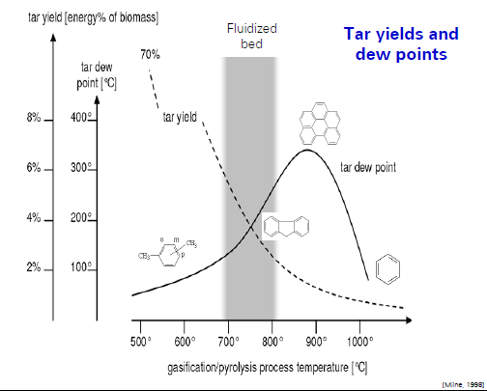
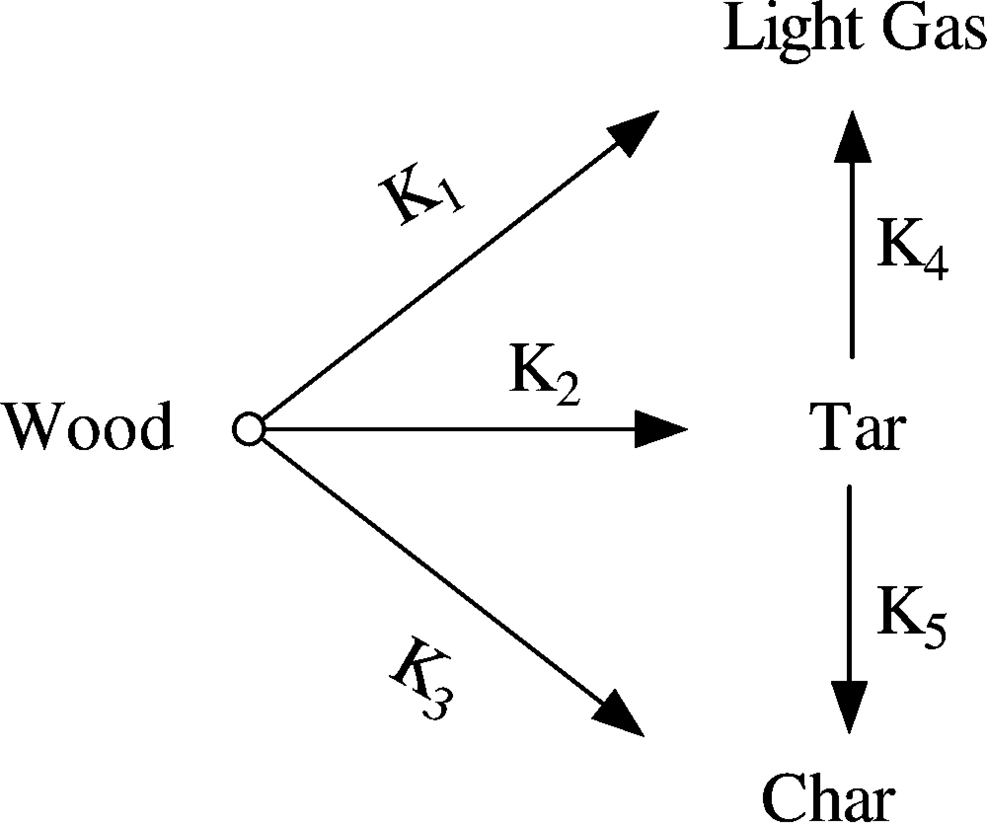
The Importance of Predictive Pyrolysis Chemistry in Fluidized Bed Gasifier Modeling
Number of species, computational intensity, Stiffness
Stoichiometric pyrolysis
Competing Pathways
Competing Pathways for Cellulose, Hemicellulose & Lignin
Wood
Vol + Char
[Yang et al., 2008]
[Shafizadeh and Chin, 1977]
Tar Yields and Dew Points
[Koufopanos et al, 1989]
Milne, T.A. et al. NREL/TP-570-25357 1998.

Slide 4
Multi-Scale Chemistry Modeling of Fluidized Bed Biomass Gasification
Gas-Phase modeling
State of the art mechanism:
Ranzi et al.
400+ species
16K+ reactions
Solids Phase Modeling
Heat transfer dependence
Lagrangian in nature

Slide 5
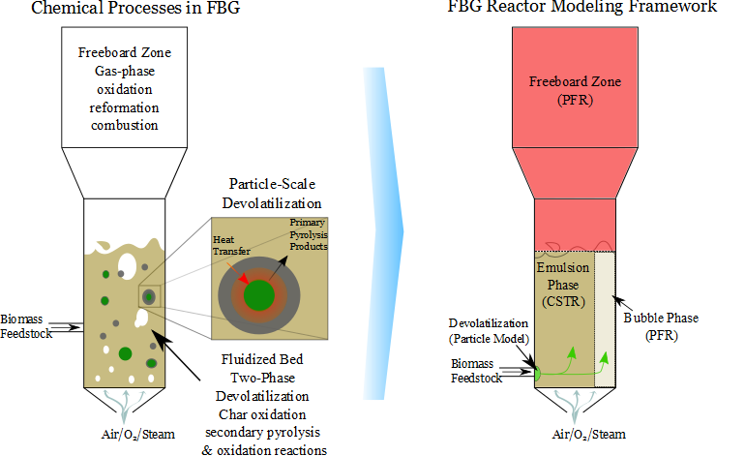
Reactor Network Model (RNM) Formulation

Slide 6
Impact of bubble-phase on gas-phase conversion.
Freeboard
(PFR)
Emulsion
(CSTR)
Bubble
(PFR)
~40% difference
x
1-x
Devol.
Gases
Air

Slide 7
Impact of bubble-phase on gas-phase conversion.
How can we calculate x?
Freeboard
(PFR)
$$1−x=f(U_{0},U_{mf},…)$$
Exist a number of correlations…
Davidson (1963)
Babu et al. (1978)
Johnsson et al. (1991)
Emulsion
(CSTR)
Bubble
(PFR)
x
1-x
Devol.
Gases
Would like to verify with CFD.
Air

Slide 8
Validation Study, reactive 3D simulation: van Paasen & Kiel, 2004
Simulation parameters
Quantity | Value
Reactor height, m | 1.1
Reactor diameter, m | 0.074
Gas density, kg/m³ | Variable
Gas viscosity, kg/(m s) | Variable
Solid phase 1 | Pine wood
Solid phase 1 particle diameter, mm | 1
Solid Phase 1 particle density, kg/m³ | 650
Solid Phase 1 feedrate, kg/hr | .10,.14,.28,.5, .75, 1, 1.5
Inert solid phase | Silica sand
Inert particle diameter, mm | 0.27
Inert particle density, kg/m³ | 2100
Superficial gas velocity, m/s | .039,.052,.10,.19, .285, 0.38, .57
Initial bed height, m | 0.2
Pressure, atm | 1
Inflow gas temperature. K | 1073
Initial inert material temperature. K | 1073
Biomass import temperature, K | 300
Devolatilization Chemistry | Competing pathway Shrinking Core
diameter
0.074 m
Static bed
height
0.149 m
Reactor height 1.1 m
Gas
Wood
Tar
(Shafizadeh, 1982)
Char

Slide 9
Simulation parameters – van Paasen & Kiel 2004, air blown FBBG
Simulation parameters
Quantity | Value
Reactor height, m | 1.1
Reactor diameter, m | 0.074
Gas density, kg/m³ | Variable
Gas viscosity, kg/(m s) | Variable
Solid phase 1 | Pine wood
Solid phase 1 particle diameter, mm | 1
Solid Phase 1 particle density, kg/m³ | 650
Solid Phase 1 feedrate, kg/hr | .10,.14,.28,.5, .75, 1, 1.5
Inert solid phase | Silica sand
Inert particle diameter, mm | 0.27
Inert particle density, kg/m³ | 2100
Superficial gas velocity, m/s | .039,.052,.10,.19, .285, 0.38, .57
Initial bed height, m | 0.2
Pressure, atm | 1
Inflow gas temperature. K | 1073
Initial inert material temperature. K | 1073
Biomass import temperature, K | 300
Devolatilization Chemistry | Competing pathway Shrinking Core

Slide 10
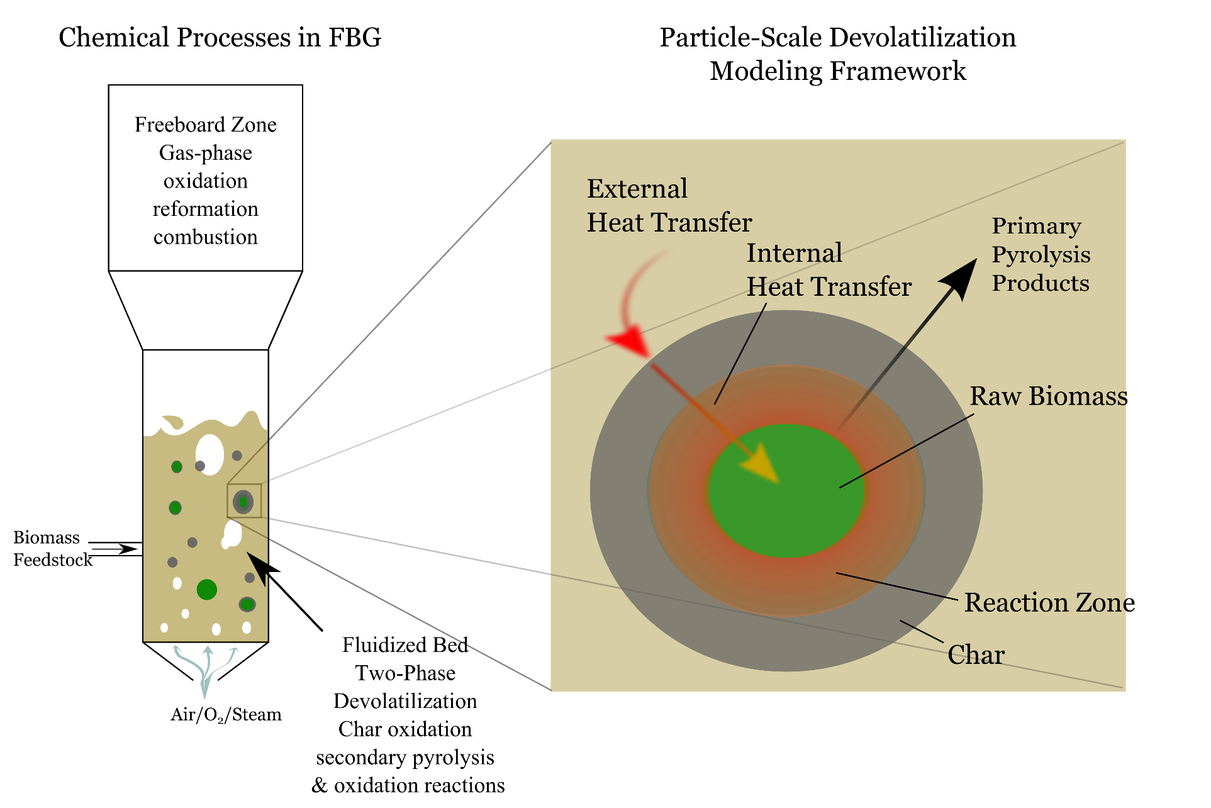
Devolatilization Modeling
Devolatilization dynamics are strongly influenced by particle radius.
Shrinking Core Model Implemented for Eulerian Modeling Framework:
$K_{eff}=\frac{1}{\frac{1}{K_{kin}}+\frac{a}{K_{cond}}}$
Trade-off of devolatilization time and mixing time important for well-stirred assumption.

Slide 11
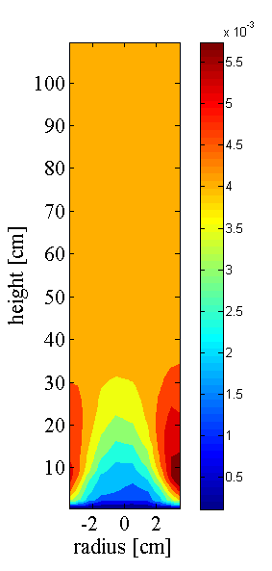
Data Analysis and Visualization
θ
y
r
Cylindrical coordinates (Bakshi et al.)
For 2D visualization hemispheres averaged.

Slide 12
Results
Mixing of biomass and char in reacting bed-
NETL Workshop on Multi-Phase Flow, August 5-6, 2014

Slide 13
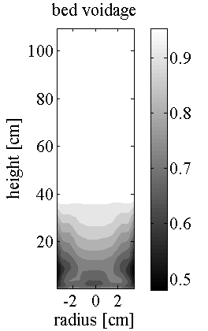
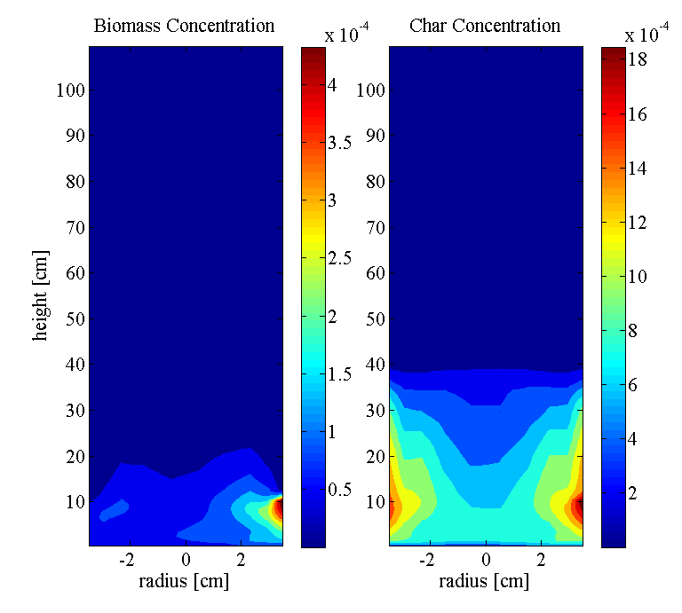
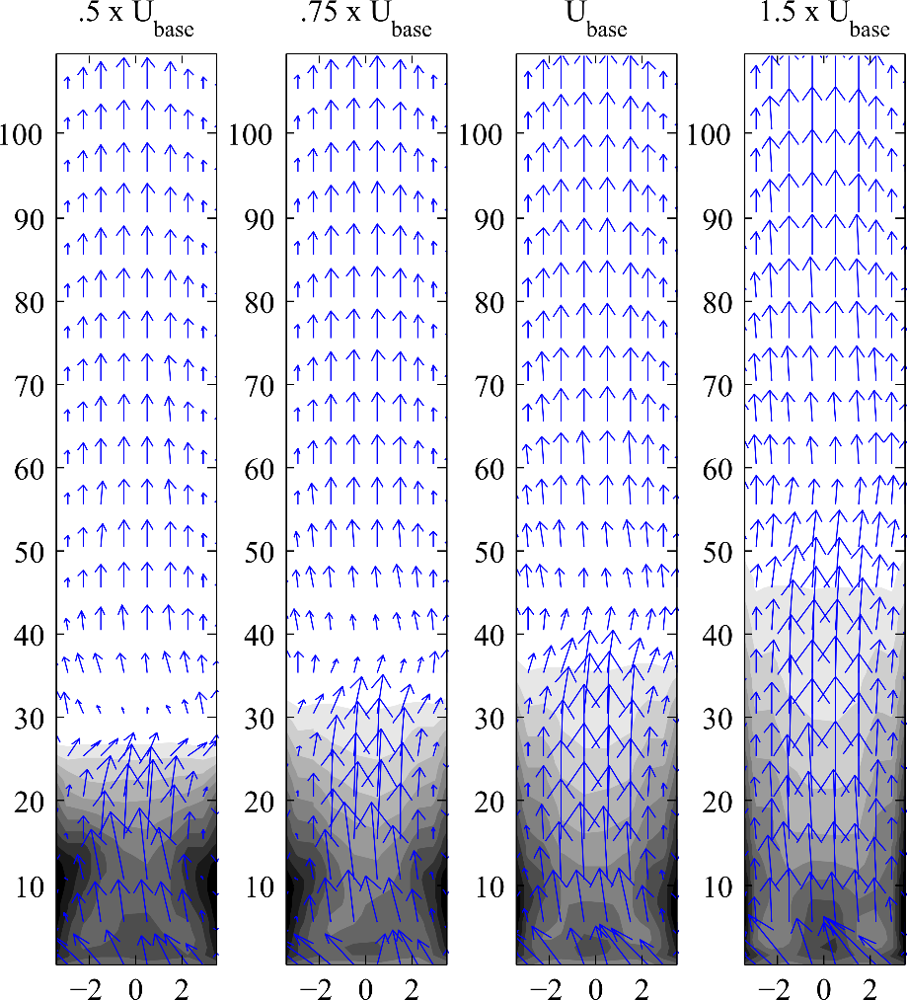
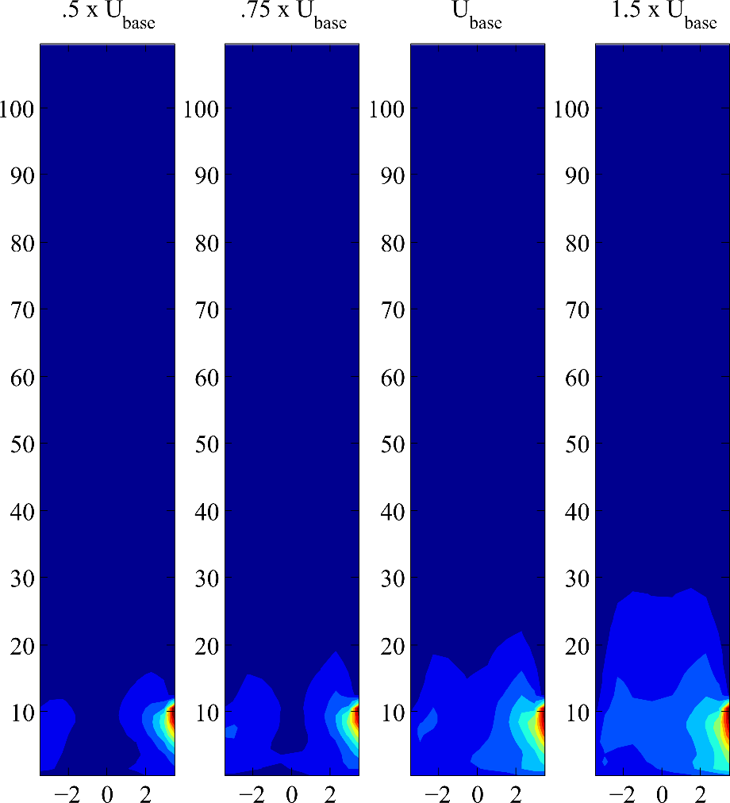
Time Averaged Solids Distributions
Voidage and Gas Velocity
Biomass Concentration

Slide 14
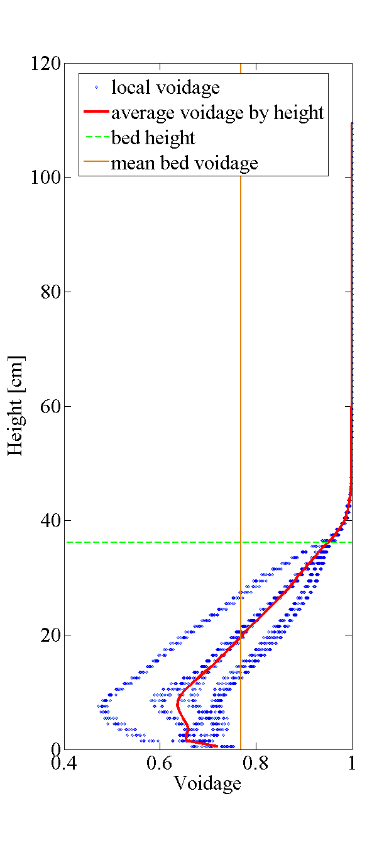
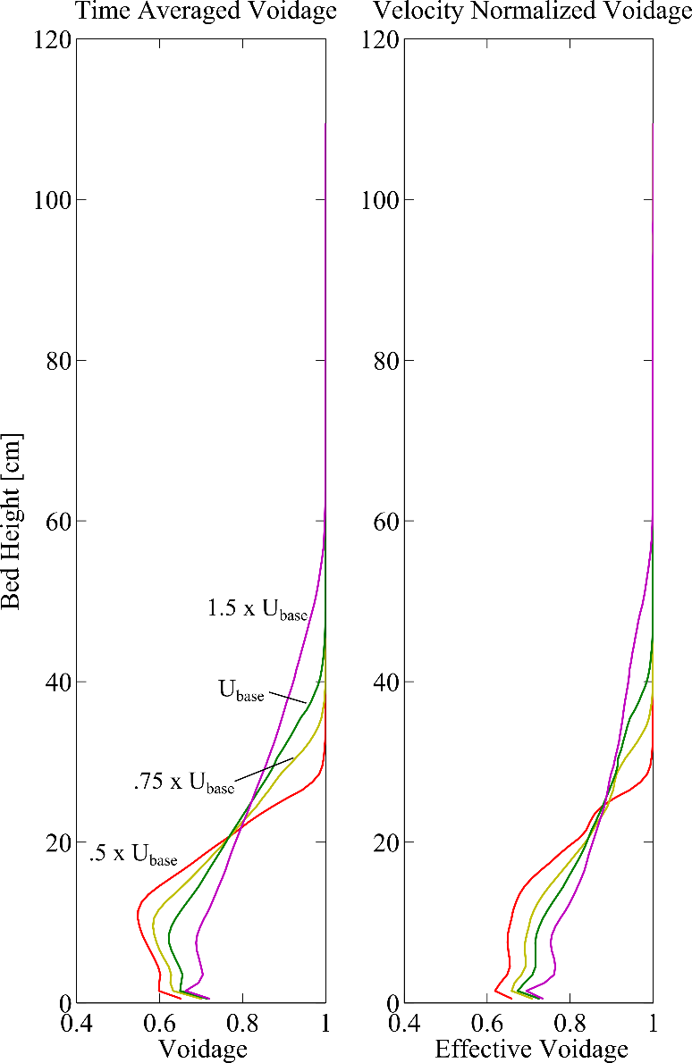
Bubble-Phase vs Emulsion Phase
Time averaged data is used to analyze pseudo-steady state operation.
Average bed height
Average voidage
Reaction zones
Velocity normalized voidage is used to calculate bubble bypassing fraction
Gives the effective voidage experienced by gaseous flow through the bed.

Slide 15
Dependence of gas distribution on inlet velocity

Slide 16
Conclusion and Summary
Summary of outcomes-
Implications for modeling and reactor design-
Next steps-
NETL Workshop on Multi-Phase Flow, August 5-6, 2014

Slide 17
Summary and Implications for Modeling
Summary of work
Conclusions
A 3D reactive CFD study was conducted to test the main assumption of the Davidson two-phase theory and related correlations:
All gas in excess of minimum fluidization velocity is in the bubble phase.
Devolatilization chemistry with a shrinking core model was employed
Allows for study of impact of particle diameter on mixing timescales as well as devolatilization timescales
Influence of fluidization rate on chemical phenomena was investigated.
Davidson TPT and Johnsson Models Under-predict Gas bypassing at high slugging flow-rates
Babu Captures overall trend, however. Easily implemented without CFD.
A large amount of bubble bypassing is observed.
As the reactor approaches slugging, do not achieve well mixed zone until high in the freeboard
Lab-scale studies which utilize saw dust (<=1mm particles) are far from representing realistic fluidized bed reactors
Timescale of devolatilization is too fast.
Devolatilizing particles are not well distributed.

Slide 18
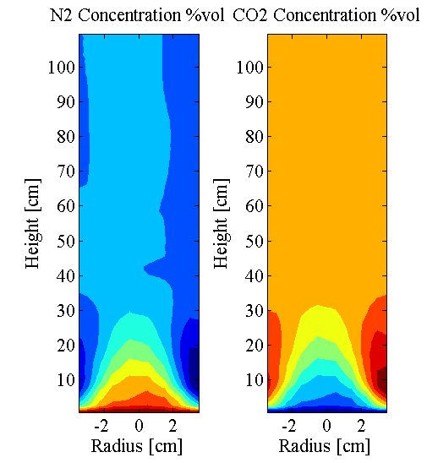
Other Observations and Next Steps
At high flow-rates with large amounts of bubble bypassing mixing is poor in the bed.
Therefore Davidson model is incomplete to describe full reactor.
Freeboard
(PFR)
Freeboard
(PFR)
Emulsion
(CSTR)
Emulsion
(CSTR)
Bubble
(PFR)
Bubble
(PFR)
1-x
x
1-z
1-y
z
y
Devol.
Gases
Devol.
Gases
Air
Air

Slide 19
References and Acknowledgements
Bakshi, A., C. Altantzis, and A. F. Ghoniem. "Towards Accurate Three-Dimensional Simulation of Dense Multi-Phase Flows Using Cylindrical Coordinates." Powder Technology, 2014, 264, 242-255.
Davidson, J. “The two-phase theory of fluidization: successes and opportunities.” AIChE Symposium Series, 1991, 87, 1-12.
Koufopanos, C. A. et al. “Modelling of the pyrolysis of biomass particles. Studies on kinetics, thermal and heat transfer effects.” The Canadian Journal of Chemical Engineering, 1991, 69, 907-915.
Milne, T., et al. “Biomass gasifier tars: Their nature, formation and conversion.” National Energy Technology Laboratory (NETL), 1998.
Shafizadeh, F. “Introduction to Pyrolysis of Biomass.” Journal of Analytical and Applied Pyrolysis, 1982, 3, 283-305.
van Paasen, S. V. B. & Kiel, J. H. A. “Tar formation in a fluidised bed gasifier.” Energy Research Center of the Netherlands, 2004.
Yang, Y. B.et l. “Combustion of a Single Particle of Biomass.” Energy & Fuels, 2008, 22, 306-316.
This work was generously funded by BP

