Slide 1
Non-intrusive Uncertainty Quantification for Reacting Multiphase Flows in Coal Gasifiers
2014 NETL Multiphase Flow Science Conference
Morgantown, WV
August 5-6 , 2014
Performance Measures x.x, x.x, and x.x
Aytekin Gel^{1,2} , Mehrdad Shahnam¹,
Arun K. Subramaniyan³ , Jordan Musser¹,
Jean-François Dietiker^{1,4}
(1) National Energy Technology Laboratory , Morgantown, WV, U.S.A.
(2) ALPEMI Consulting LLC, Phoenix, AZ
(3) GE Global Research Center, NY (4) West Virginia University Research Corporation, WV

Slide 2
Outline
Motivation and Objective
Brief review of Gasification
Overview of Uncertainty Quantification Frameworks Used
Preliminary Findings from Non-intrusive UQ Analysis:
Chemically Reacting case
Observations and Concluding Remarks

Slide 3
Motivation and Objectives
Computational science and simulation based engineering (SBE) have become an indispensible tool for resolving complex engineering problems through simulation.
Reactive multiphase flow models and simulation tools play important role in development of new technologies for fossil fuel based clean energy, such as coal gasification.
Increasingly strong need for assessment of credibility of the predictions from simulations for wider acceptance of SBE.
Uncertainty quantification (UQ) methods provide a yardstick.
Objective:
Determine the best set of UQ methods and tools applicable for reactive multiphase flow simulation.

Slide 4
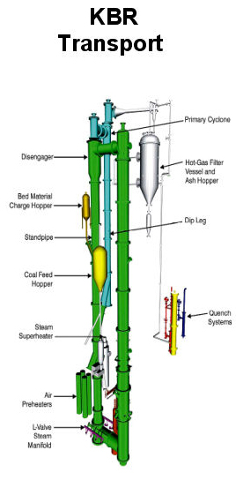
Gasification
Gasification is the process where a solid fuel, such as coal reacts with steam, carbon dioxide or hydrogen in a high pressure, high temperature reactor to produce a fuel gas, or synthesis gas (H₂, CO, CO₂ )
Steam is added to the fuel gas and sent through a water-gas shift reactor, where CO and steam are converted to H2 and CO2
After removal of CO2, hydrogen rich syngas can be utilized in a gas turbine or steam turbine for producing electricity or used to generate chemicals
http://www.netl.doe.gov/File%20Library/Research/Coal/energy%20systems/gasification/gasifipedia/

Slide 5
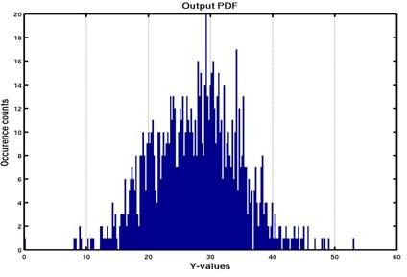
Quick Overview of Uncertainty Quantification (UQ) Methods Employed
Intrusive UQ
Several Available Methods:
Polynomial Chaos Expansions (PCE)
Stochastic Expansion
Pro:
Quick prediction
Con:
Surgery in the code and long development time
Non-Intrusive UQ
Several Available Methods:
Surrogate Model + Monte Carlo
Polynomial Chaos Expansions
Bayesian Techniques
Pro:
Short development time
Con:
Sampling error
UQ Toolbox
Uncertain
inputs
Model
Uncertainty
information
Uncertain
inputs
Model
Stochastic simulation
(UQ embedded in the model)
UQ achieved by sampling
many deterministic simulations
Source: An Introduction to Uncertainty Quantification Methodologies and Methods, C. Tong (2012) & Comparing Uncertainty Quantification Methods Under Practical Industry Requirements, Wang (2012)

Slide 6
Non-Intrusive UQ Methodology
Test Problems
Demonstration of applicability of UQ methods in answering questions through representative problems:
Case A: Non-reacting 3D Transient Fluidized Bed Riser Simulation¹
Circulating Fluidized Bed riser at NETL with experimental data from 2010 NETL/PSRI Fluidization Challenge Problem.
Non-reacting multiphase flow simulation with MFiX.
Case B: Chemically Reacting Transient Fluidized Bed Gasifier Simulation (work in progress)
Experimental data available for lab-scale setup.
2D & 3D reacting multiphase flow simulation
Bayesian Calibration for reaction rates with available experimental data.
1 Gel et al. “Validation and Uncertainty Quantification of a Multiphase CFD Model”. Industrial & Engineering Chemistry Research (2013) 52(33), pp 11424-11435, DOI: http://pubs.acs.org/doi/abs/10.1021/ie303469f

Slide 7
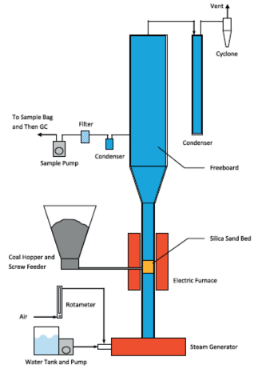
Case B: Transient Fluidized Bed Gasifier Simulation (work in progress)
Outlet
Uncertainty Quantification Study Properties:
Input parameters with Uncertainty [min-max range]: Coal Flow Rate (g/s) : [0.036 – 0.063] (2) Particle Size (μm) : [70 – 500] (3) H2O / O2 ratio : [0.5 – 1.0]
Quantities of Interest: Carbon Conversion (%) Gas Yield (%) Gasification Efficiency (%) H2/CO CH4/H2 Species mole fractions at exit
Experimental Sampling Method: Central Composite Design (CCD) Sample Size = 15 + 5 replications
Coal inlet
Air inlet
Schematic diagram of the lab-scale fluidized-bed gasifier used for experiments

Slide 8
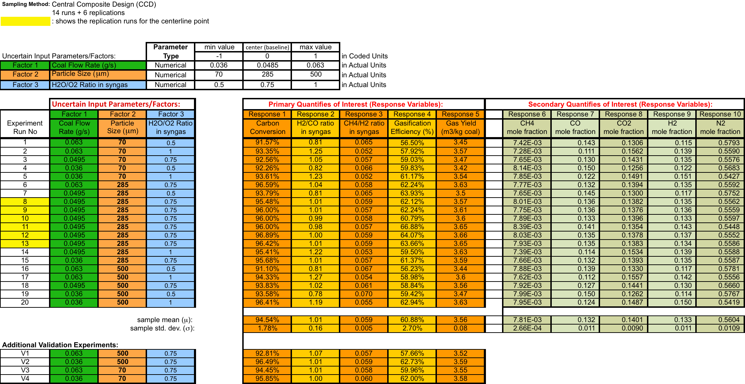
Case B: Transient Fluidized Bed Gasifier Simulation (work in progress)
Physical Experiments
Reference:
(1) Shayan Karimipour, Regan Gerspacher, Rajender Gupta, Raymond J. Spiteri, “Study of factors affecting syngas quality and their interactions in fluidized bed gasification of lignite coal”, Fuel, Vol. 103, January 2013, Pages 308-320, ISSN 0016-2361, http://dx.doi.org/10.1016/j.fuel.2012.06.052.
(http://www.sciencedirect.com/science/article/pii/S0016236112004723)

Slide 9
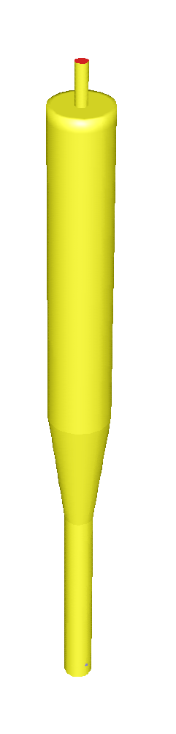
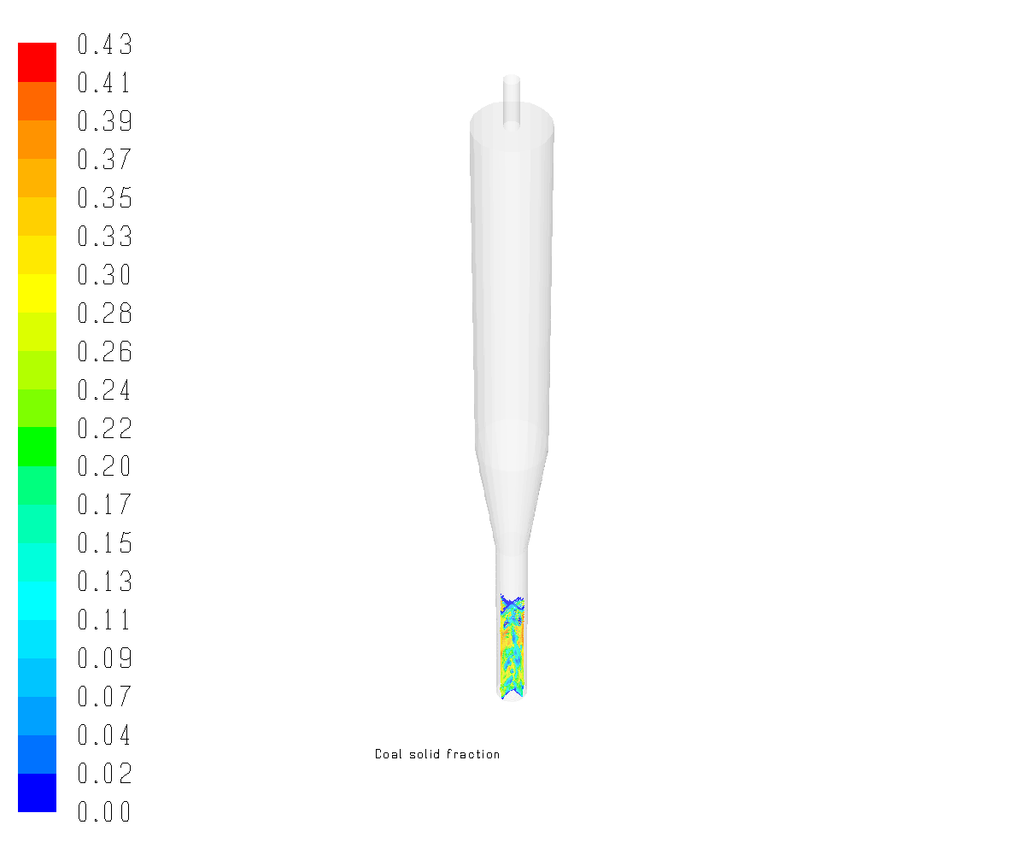
Case B: Transient Fluidized Bed Gasifier Simulation (work in progress)
Computational Fluid Dynamics Simulations
CFD simulations performed with ANSYS FLUENT for same set of input parameters.
Coal pyrolysis, combustion, steam & CO₂ gasification along with H₂, CO and CH₄ combustion are modeled using 11 chemical reactions.
Total of 33 transport equations are simultaneously solved for transport of 21 species and multiple phases.
Computational cost per simulation:
2D : 2~3 weeks on 16 cores
3D : 7~8 weeks on 64 cores
Outlet
Coal inlet
Air inlet
3D CFD Model of
Fluidized Bed Gasifier
Contour plot of
coal volume fraction

Slide 10
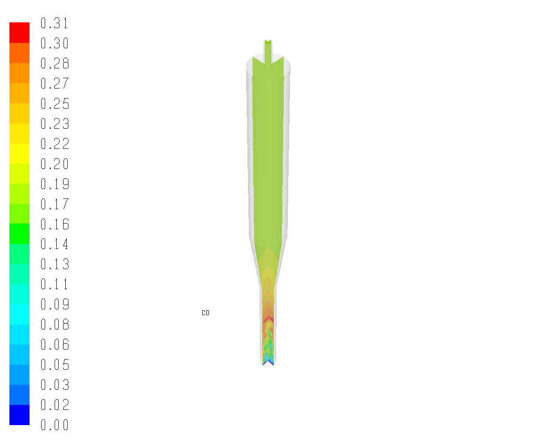
Case B: Transient Fluidized Bed Gasifier Simulation (work in progress)
Computational Fluid Dynamics Simulations
Due to inherently complex nature of transient reacting multiphase flows and the expensive computational cost, several different strategies were investigated. 2D and 3D simulations at multiple grid resolutions (coarse, medium & fine) were initiated.
Different sampling strategies were employed:
Optimal Latin Hypercube Sampling (e.g. 30 samples for 2D runs)
Central Composite Design (25 samples)
Contour plot of
CO mole fraction

Slide 11
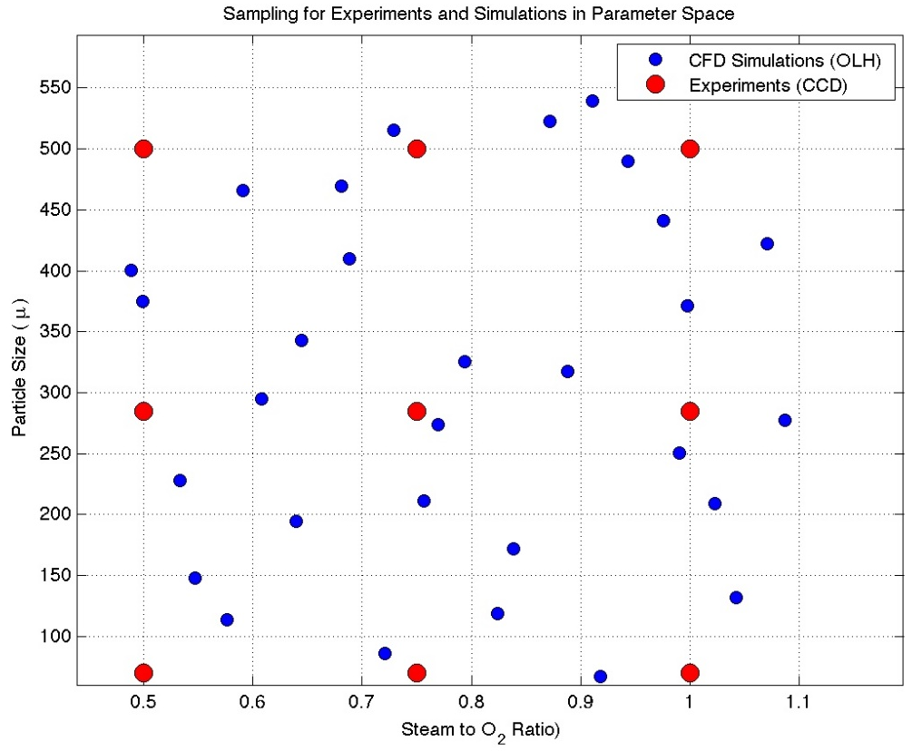
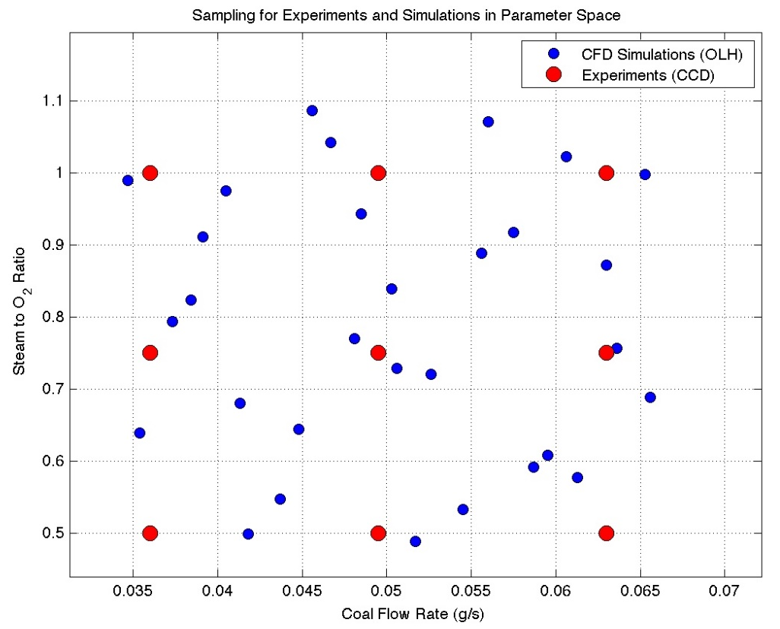
Case B: Transient Fluidized Bed Gasifier Simulation (work in progress)
Illustration of experiment and CFD sampling in the parameter space
Scatter plot of the sampling locations in the parameter space for the physical experiments (14 samples based on Central Composite Design) and CFD simulations (30 samples based on Optimal Latin Hypercube sampling)

Slide 12
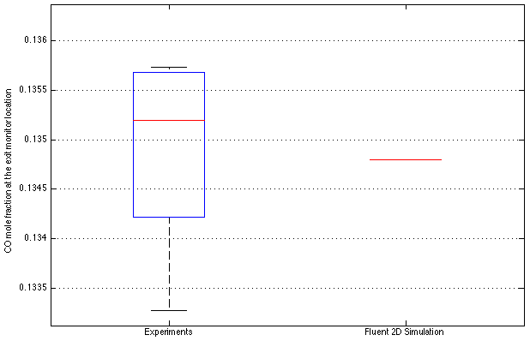
Case B: Transient Fluidized Bed Gasifier Simulation (work in progress)
Computational Fluid Dynamics Simulations- Review of initial results
Comparison of Fluent simulation (Run # 1) with the corresponding experiments (Run # 8-13)
Discrepancy < 1 %
Individual comparison of initial Fluent simulation result with the corresponding replicated experiment data (Runs 8-13) show good agreement for that sample
However, review of the full picture with scatter plot matrix tells a different story…

Slide 13
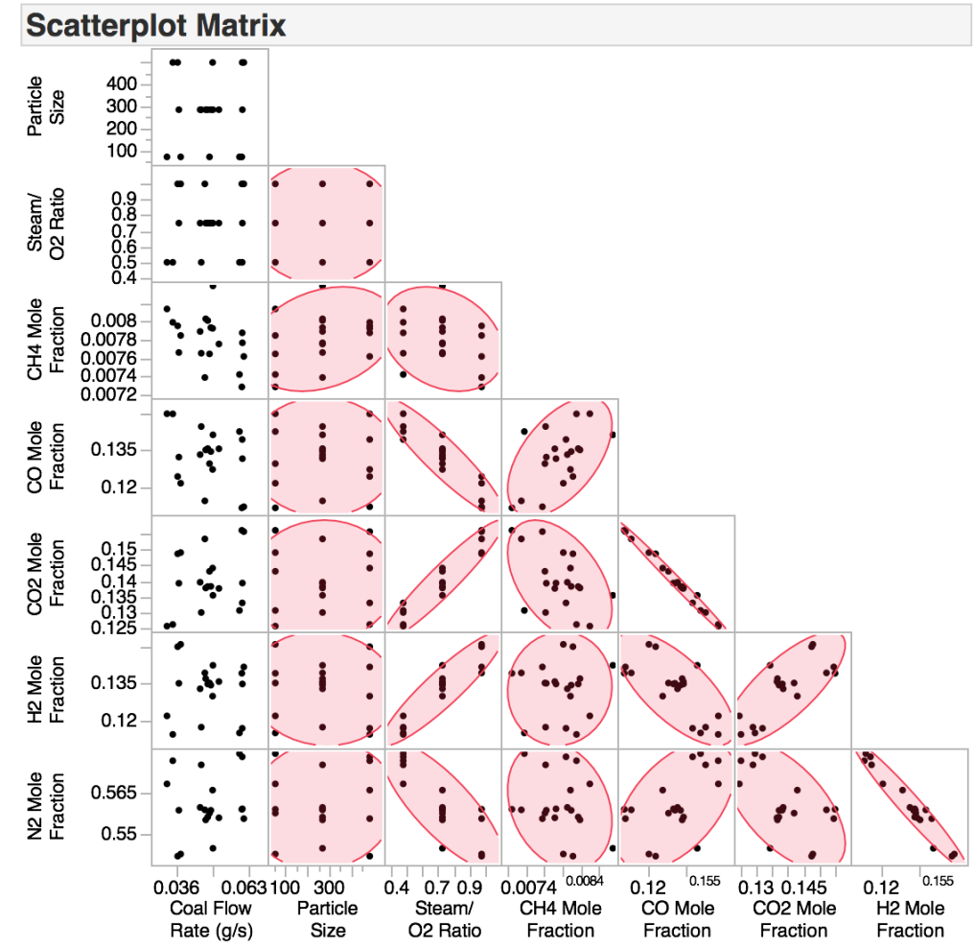
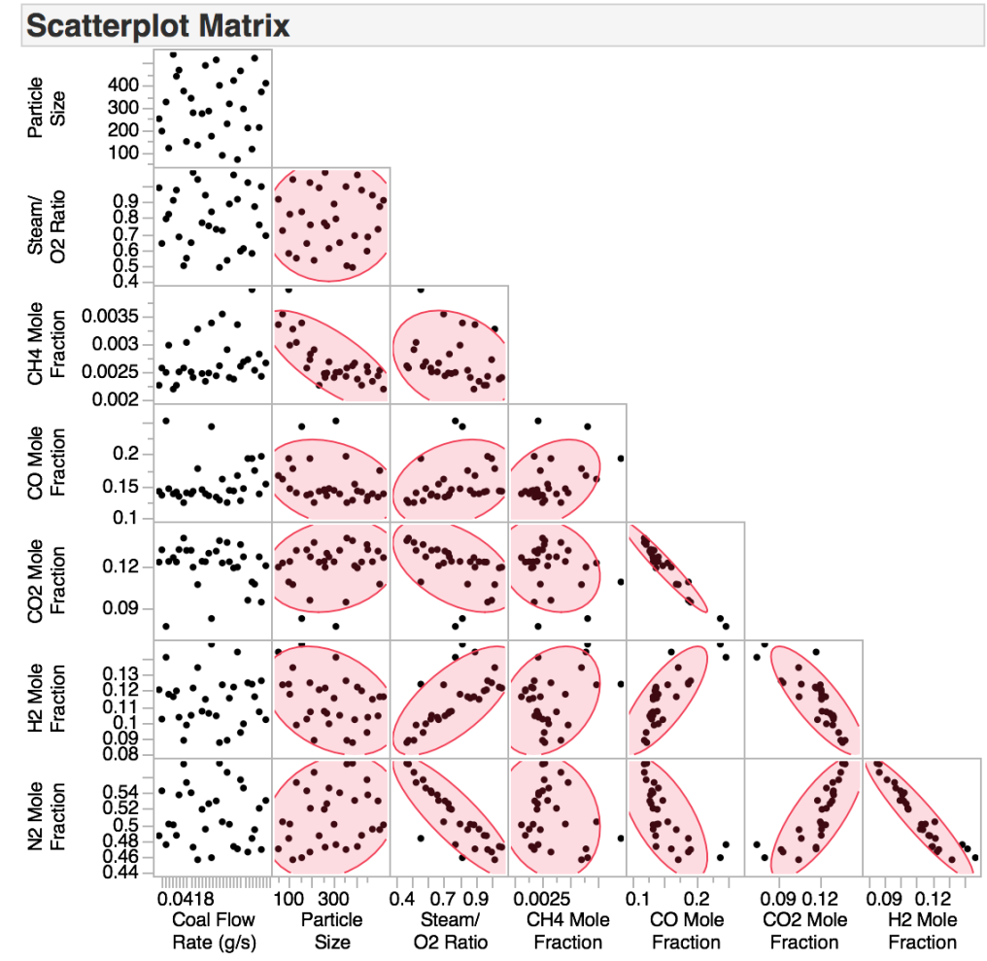
Case B: Transient Fluidized Bed Gasifier Simulation (work in progress)
Computational Fluid Dynamics Simulations- Review of initial results
Experiments
Initial Fluent 2D Simulations (v.1)
Individual CO mole fraction compared in the previous slide
Opposite trends observed between experiments and simulations triggered further inquiry and revisions in several aspects of the model such as reactions
Scatter Plot Comparison of Secondary Quantities of Interest

Slide 14
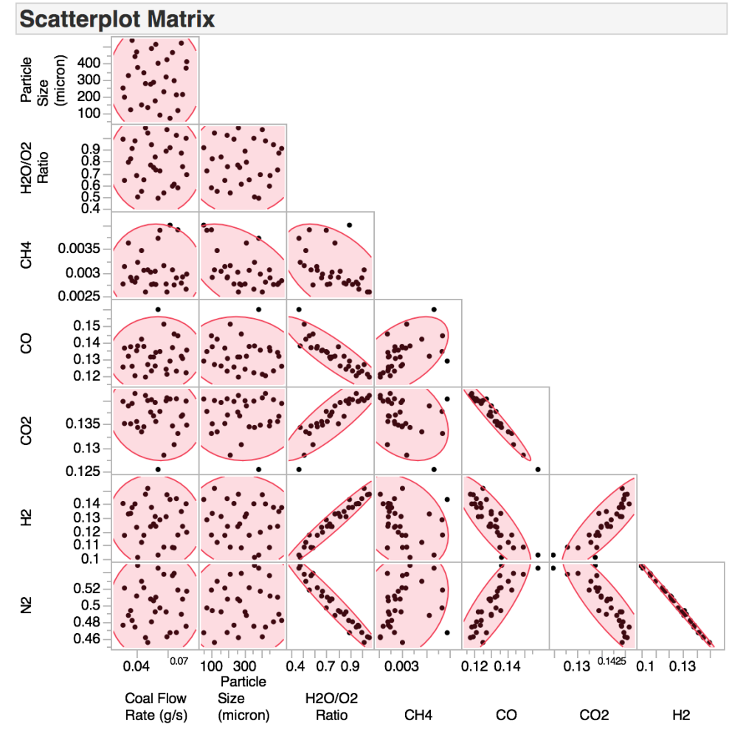
Case B: Transient Fluidized Bed Gasifier Simulation (work in progress)
Computational Fluid Dynamics Simulations – Review of results v.2
Experiments
New Fluent 2D Simulations (v.2)
Same trends observed between experiments and new 2D simulations
Scatter Plot Comparison of Secondary Quantities of Interest

Slide 15
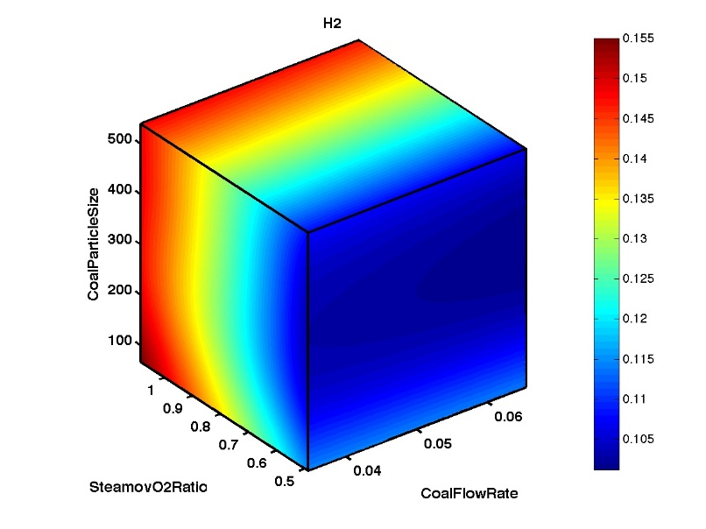
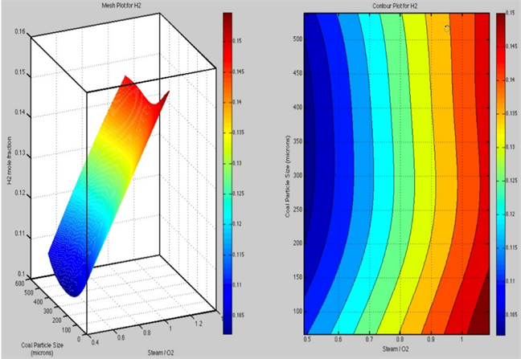
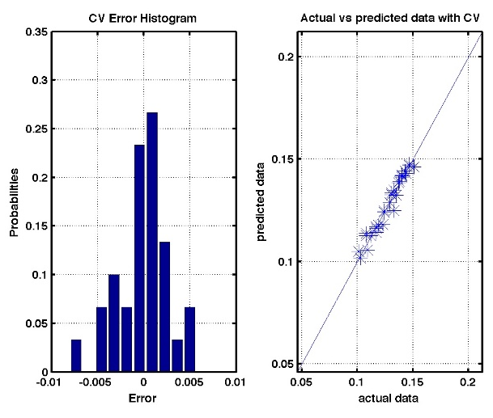
Case B: Transient Fluidized Bed Gasifier Simulation (work in progress)
Surrogate model for H2 mole fraction at the exit monitor location
3D plot of the surrogate model for
H2 mole fraction
2D plot of H2 mole fraction surrogate model at Coal Flow Rate = 0.05 g/s
Cross-validation errors to assess quality of the surrogate model
PSUADE UQ toolbox from LLNL employed in surrogate model construction.
Several surrogate models tested with the available simulation data (e.g., 1st, 2nd and 3rd order polynomial, MARS, etc.)
Gaussian Process Model (GPM) provided the best fitted surrogate model for H2 mole fraction at the exit monitor location as shown.

Slide 16
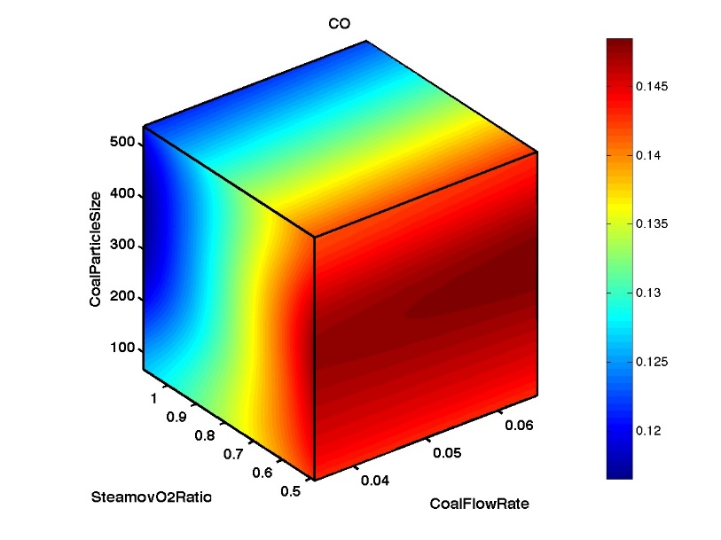
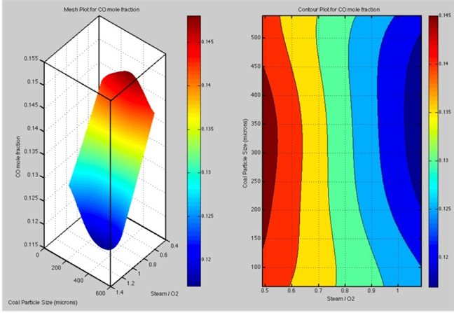
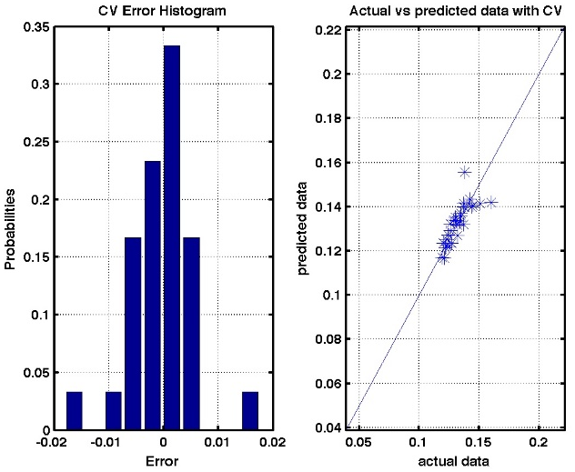
Case B: Transient Fluidized Bed Gasifier Simulation (work in progress)
Iterative Process to Construct the Best Surrogate model for each QoI
3D plot of the surrogate model for
CO mole fraction
2D plot of CO mole fraction surrogate model at Coal Flow Rate = 0.05 g/s
Cross-validation errors to assess quality of the surrogate model
Surrogate model is performing poorly for CO mole fraction
> 0.14
PSUADE UQ toolbox from LLNL employed in surrogate model construction.
Several surrogate models tested with the available simulation data (e.g., 1st, 2nd and 3rd order polynomial, MARS, etc.)
Gaussian Process Model (GPM) provided the best fitted surrogate model for CO mole fraction at the exit monitor location as shown.

Slide 17
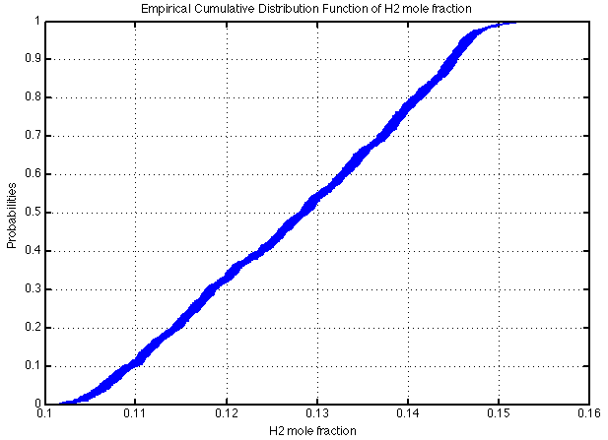
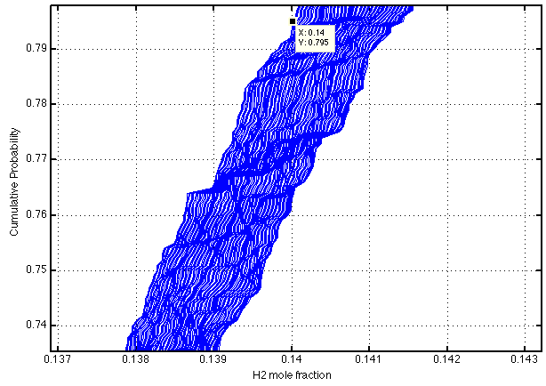
Case B: Transient Fluidized Bed Gasifier Simulation (work in progress) Input uncertainty forward propagation for H2 – Mixed Uncertainty
Enlarged view of the region marked with circle:
0.795
0.761
76 % < Prob (H2 mole fraction ≤ 0.14) < 80 %
Prob (H2 mole fraction ≤ 0.14) ≈ 78 %
Forward propagation of input uncertainties
Deciding on the proper treatment of uncertainties with adequate characterization is quite challenging.
For demonstration purposes, some of the input parameters treated as epistemic uncertainty and the rest as aleatory.
Coal flow rate treated as epistemic uncertainty between interval of [3.47e-2,6.56e-2]

Slide 18
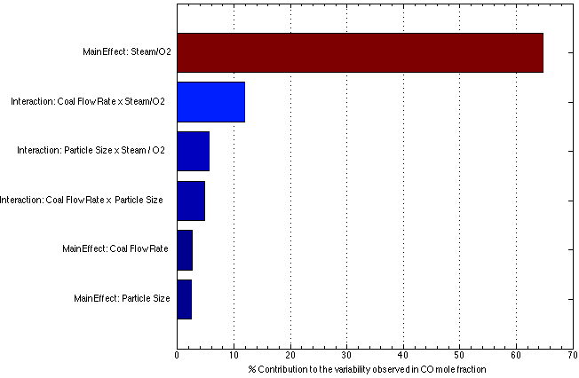
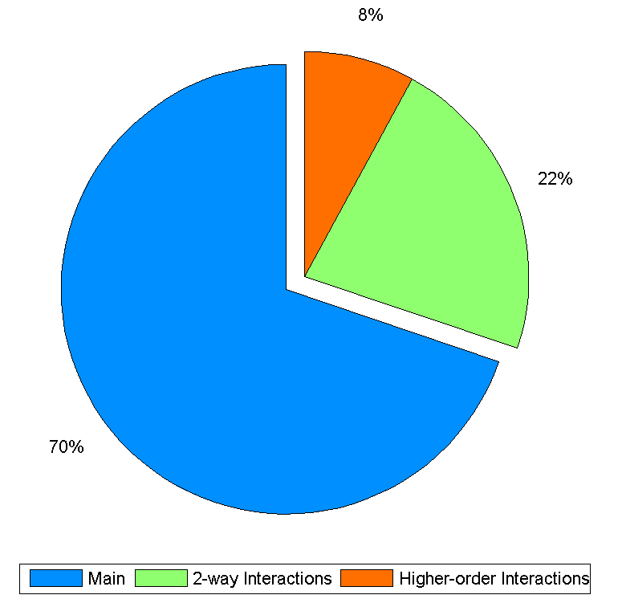
Case B: Transient Fluidized Bed Gasifier Simulation
Global Sensitivity Analysis with Bayesian Framework
Analysis of the simulation and experimental results with Bayesian framework performed
> Global sensitivity analysis for CO mole fraction

Slide 19
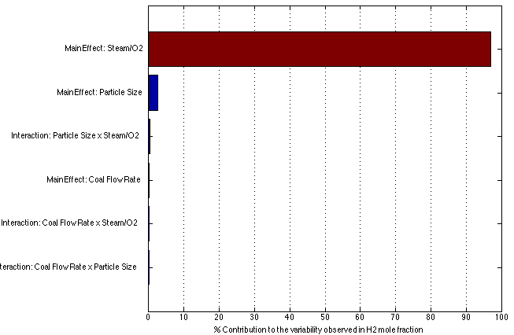
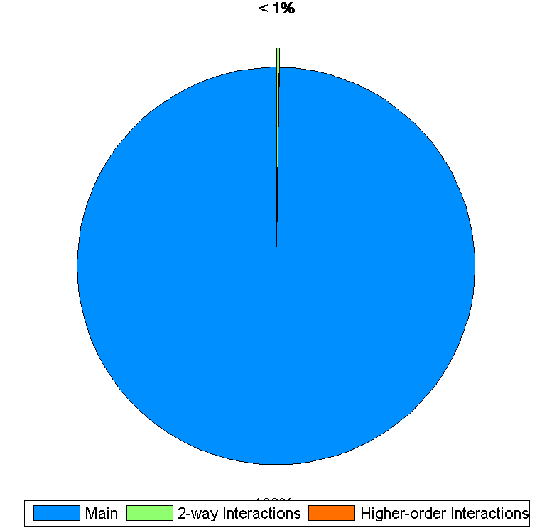
Case B: Transient Fluidized Bed Gasifier Simulation
Global Sensitivity Analysis with Bayesian Framework (continued)
Analysis of the simulation and experimental results with Bayesian framework performed
> Global sensitivity analysis for H2 mole fraction

Slide 20
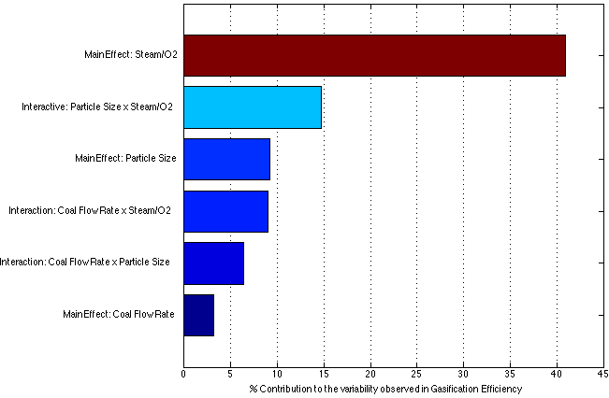
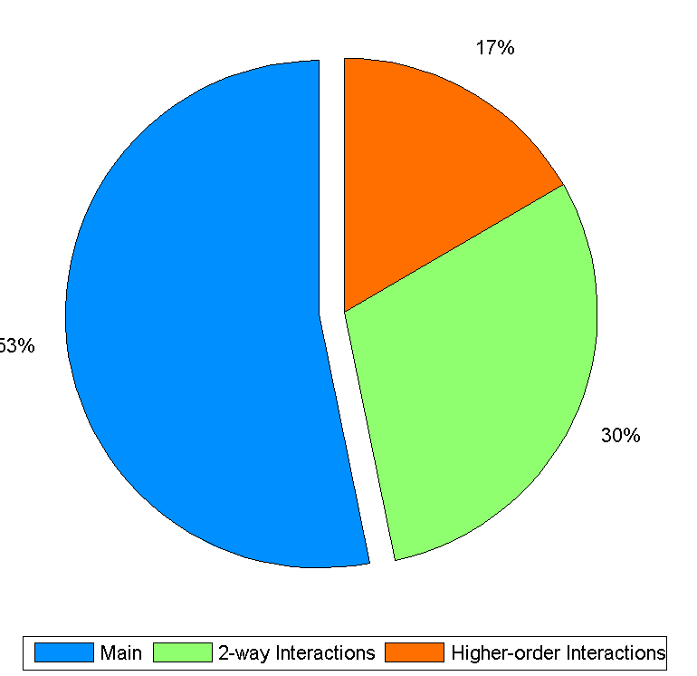
Case B: Transient Fluidized Bed Gasifier Simulation
Global Sensitivity Analysis with Bayesian Framework
Analysis of the simulation and experimental results with Bayesian framework performed
> Global sensitivity analysis for gasification efficiency

Slide 21
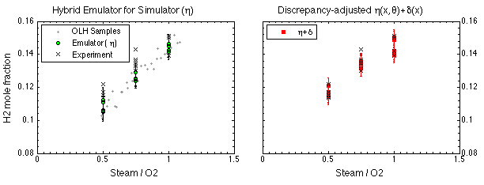
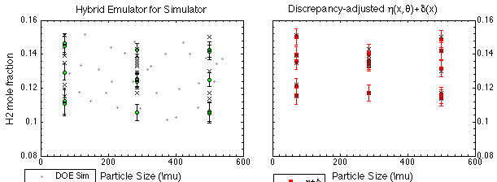
Case B: Transient Fluidized Bed Gasifier Simulation H2 mole fraction surrogate model with discrepancy adjustment
(μ)
(μ)

Slide 22
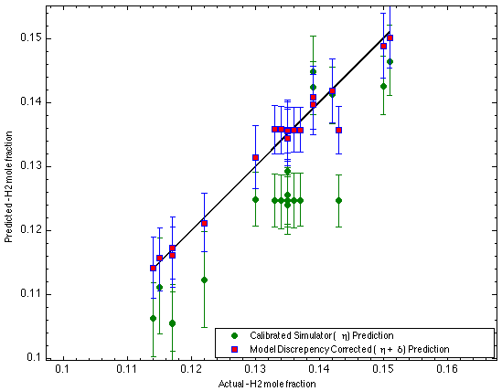
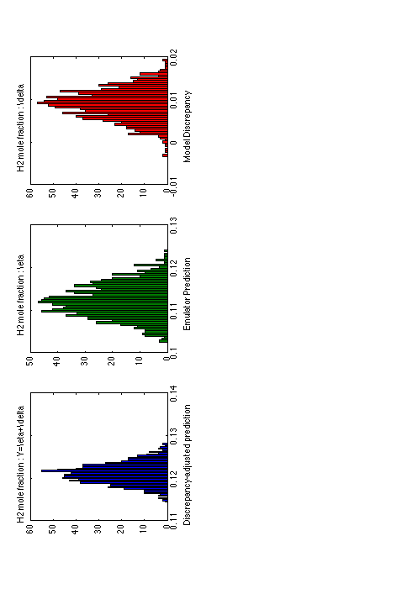
Case B: Transient Fluidized Bed Gasifier Simulation
H2 mole fraction surrogate model with discrepancy adjustment
Predictions of Experiment
Sample # 4
Model discrepancy corrected emulator prediction of # 4
=
Gaussian process model based model discrepancy
+
Prediction of
the emulator constructed from both simulation & experiments

Slide 23
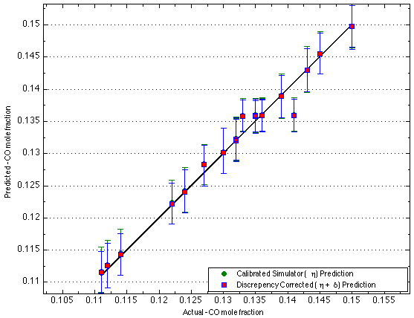
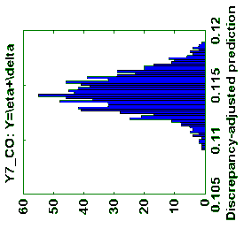


Case B: Transient Fluidized Bed Gasifier Simulation
CO mole fraction surrogate model with discrepancy adjustment
Predictions of Experiment
Sample # 14
=
+

Slide 24
Some observations and concluding remarks
Our goal continues to be exploring different non-intrusive UQ techniques to identify those that are best suited for reacting multiphase flows.
Large part of the effort is spent on constructing adequate surrogate models.
Bayesian methods appear to offer various favorable features such as quantification of model discrepancy and inclusion of prior information, which can be used effectively to alleviate lack of data.

Slide 25
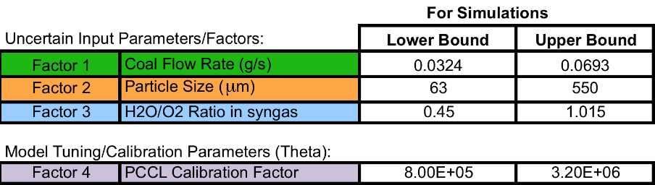
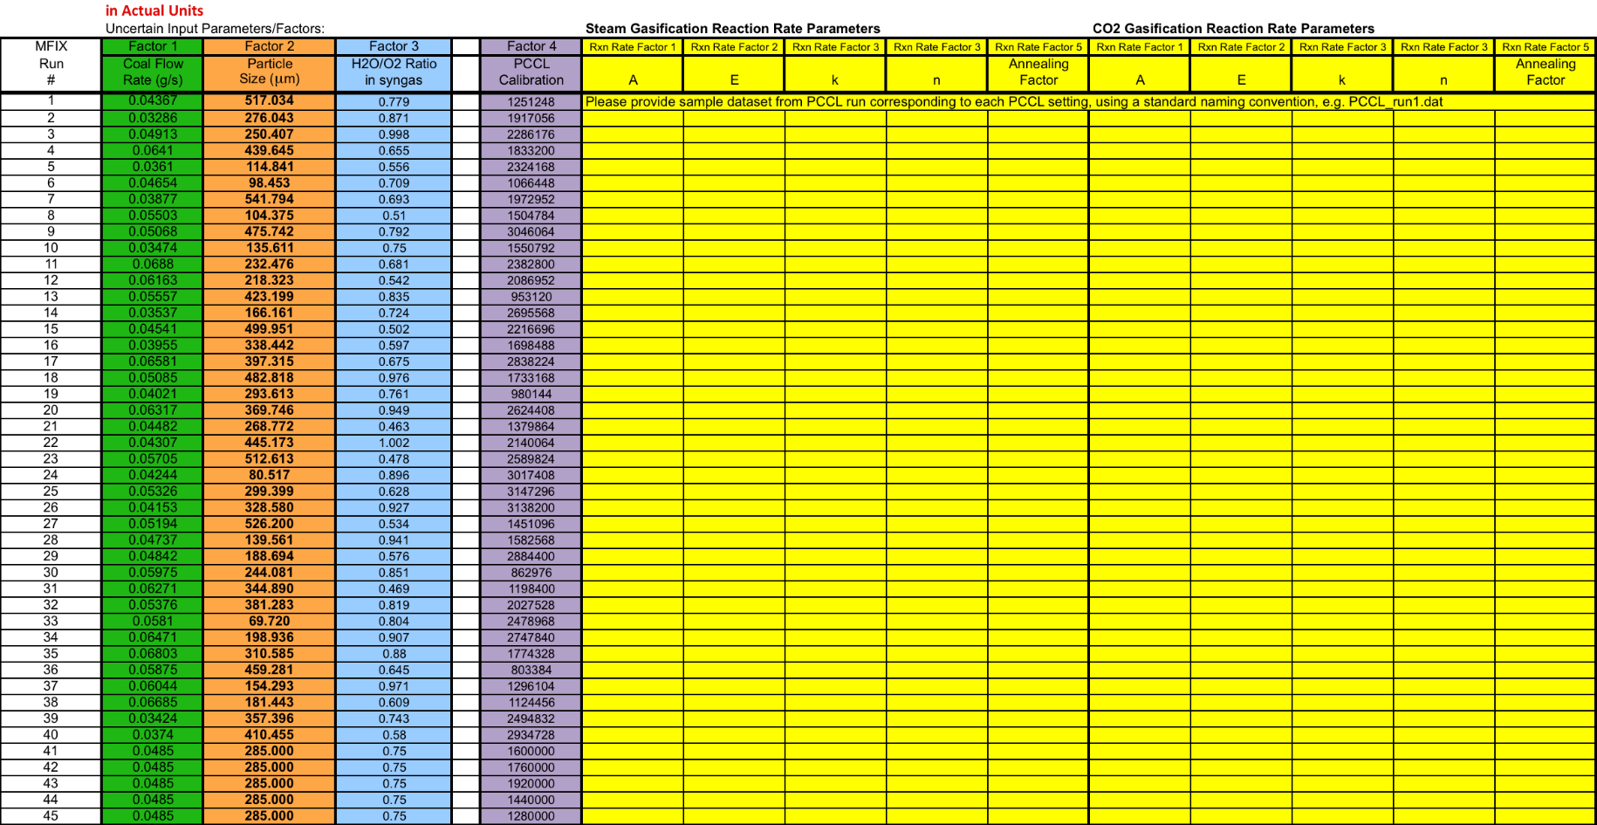
Future Work
Bayesian calibration for the most uncertain model parameter:
=> kinetic reaction rates

Slide 26
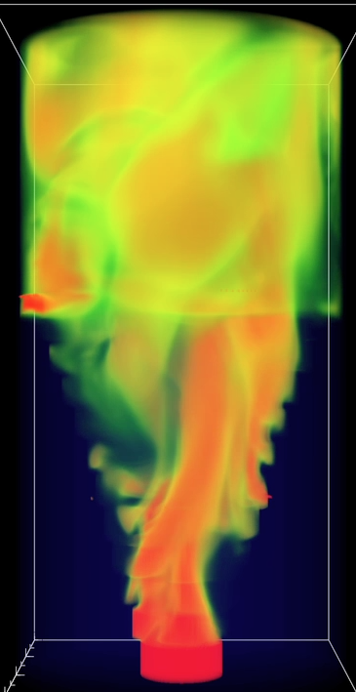
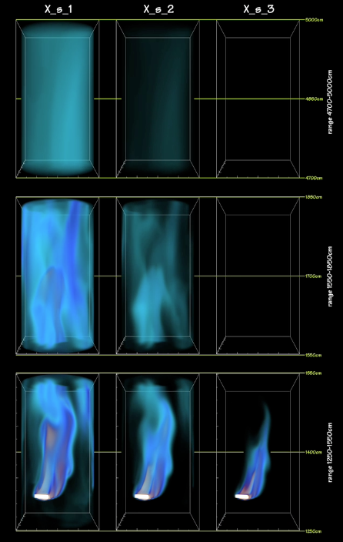
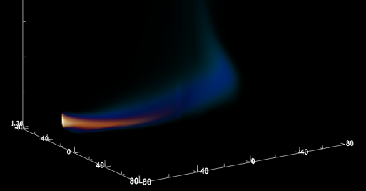
Thank you for your attention. Questions?
https://mfix.netl.doe.gov
Acknowledgments:
Dr. Charles Tong, CASC, Lawrence Livermore National Laboratory (LLNL).
Prof. Esma Gel, Arizona State University
This technical effort was performed in support of the National Energy Technology Laboratory’s ongoing research in multiphase flows under the RDS contract DE-AC26-04NT41817 and RES contract DE-FE0004000.
Volume rendering visualizations of first-of-its-kind
commercial scale gasifier simulation on Cray XT6
at OLCF by A. Gel.

