Slide 1
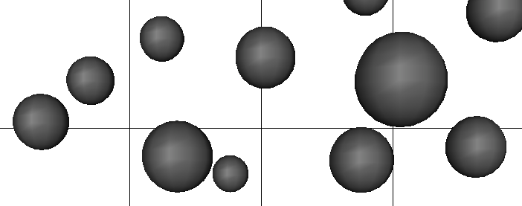
An adaptive filter strategy for extracting multiphase flow statistics from Euler-Lagrange simulations NETL 2014 Workshop on Multiphase Flow Science
Olivier Desjardins¹, Jesse Capecelatro¹, Rodney Fox^{2,3}
¹Sibley School of Mechanical and Aerospace Engineering, Cornell University
²Department of Chemical and Biological Engineering, Iowa State University
³Laboratoire EM2C-UPR, Ecole Centrale Paris
Partially supported by the HPC equipment purchased through the U.S. National Science Foundation MRI and CRI

Slide 2
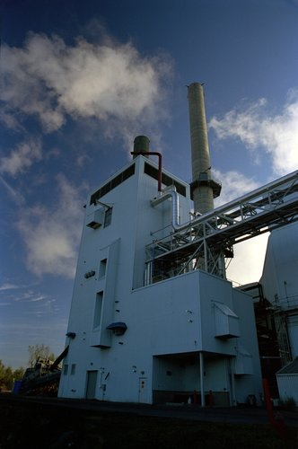
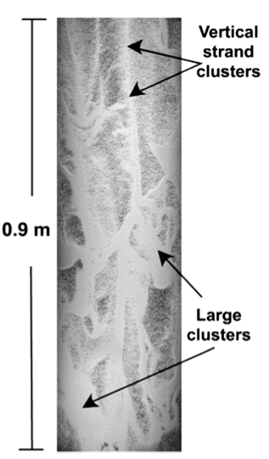
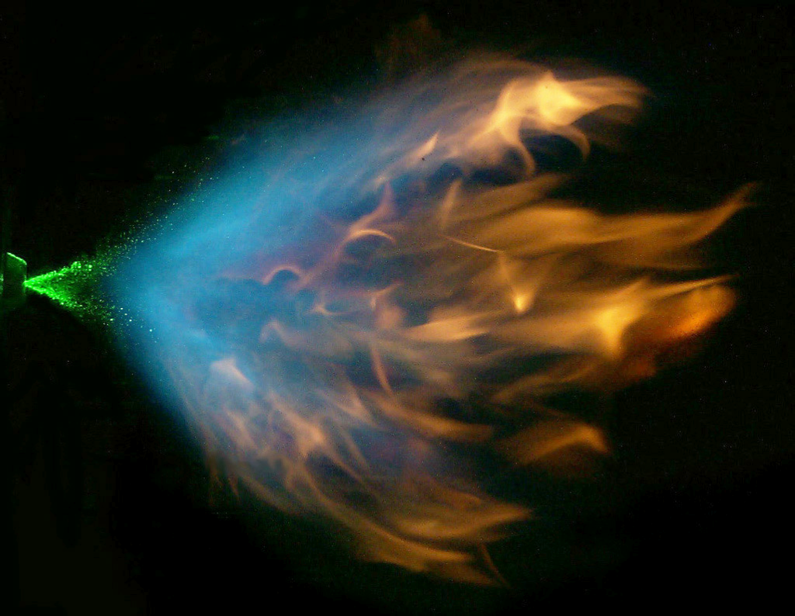
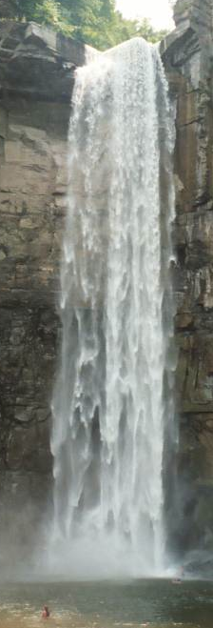
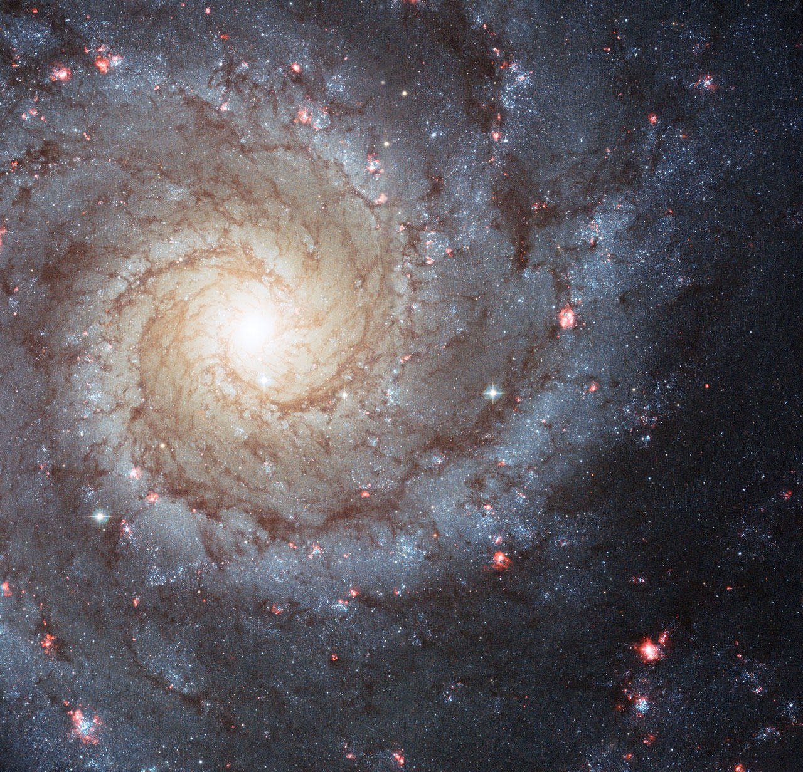
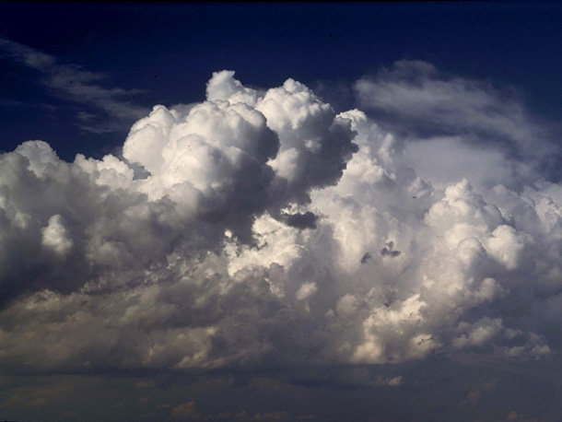
Inhomogeneities encountered in fluid-particle flows
Power generation
Catalytic reactors
Spray flames
Taughannock falls
C.T. Bowman, Stanford
NETL
Star formation
Preferential concentration of cloud droplets

Slide 3
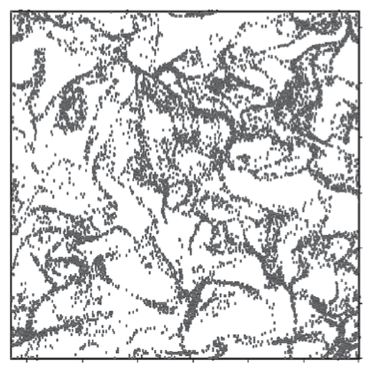
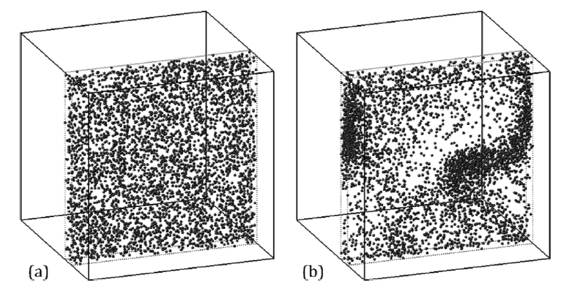
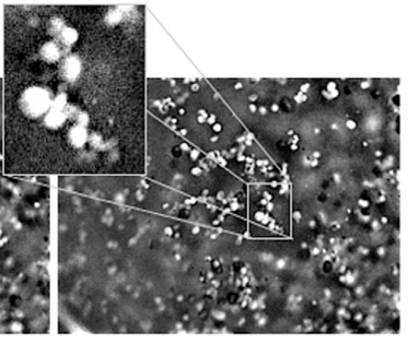
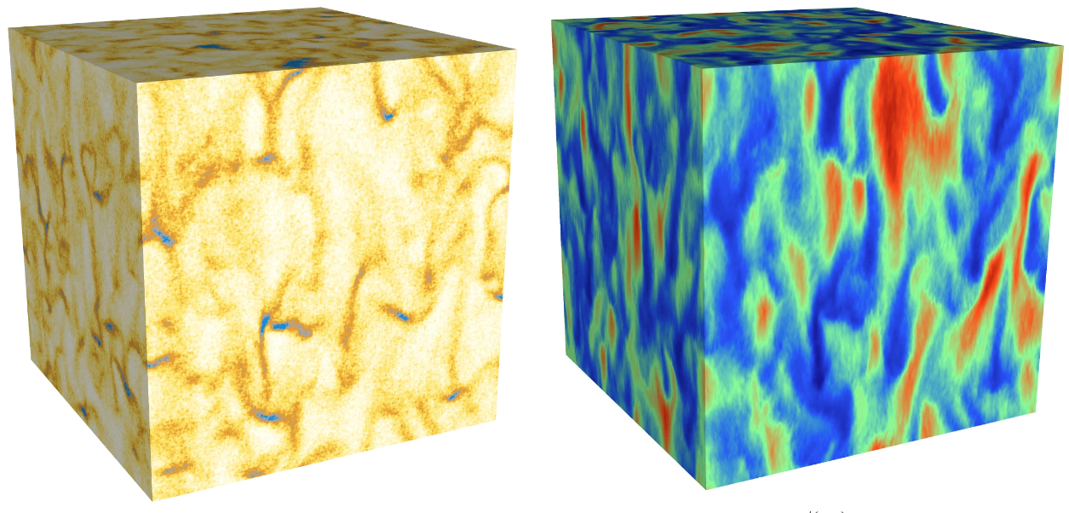
Various mechanisms responsible for clustering
Preferential concentration
Dissipation
Occurs in a turbulent flow
Most evident when
Collisional dissipation
Hydrodynamic dissipation
Ray & Collins (2011)
Mitrano et al. (2011)
Cohesion
Interphase coupling
Electrostatics
Capillary forces
Van der Waals
Cocco et al. (2010)

Slide 4
Spatial decomposition of the particle velocity
Consider a system of inertial particles in a carrier phase
Total granular energy

Slide 5
Spatial decomposition of the particle velocity
Consider a system of inertial particles in a carrier phase
Total granular energy
Turbulent kinetic energy
Granular temperature
S. Dasgupta, R. Jackson, and S. Sundaresan (1994), AIChE J.
P. Fevrier, O. Simonin and K.D. Squires (2005) J. Fluid Mech.

Slide 6
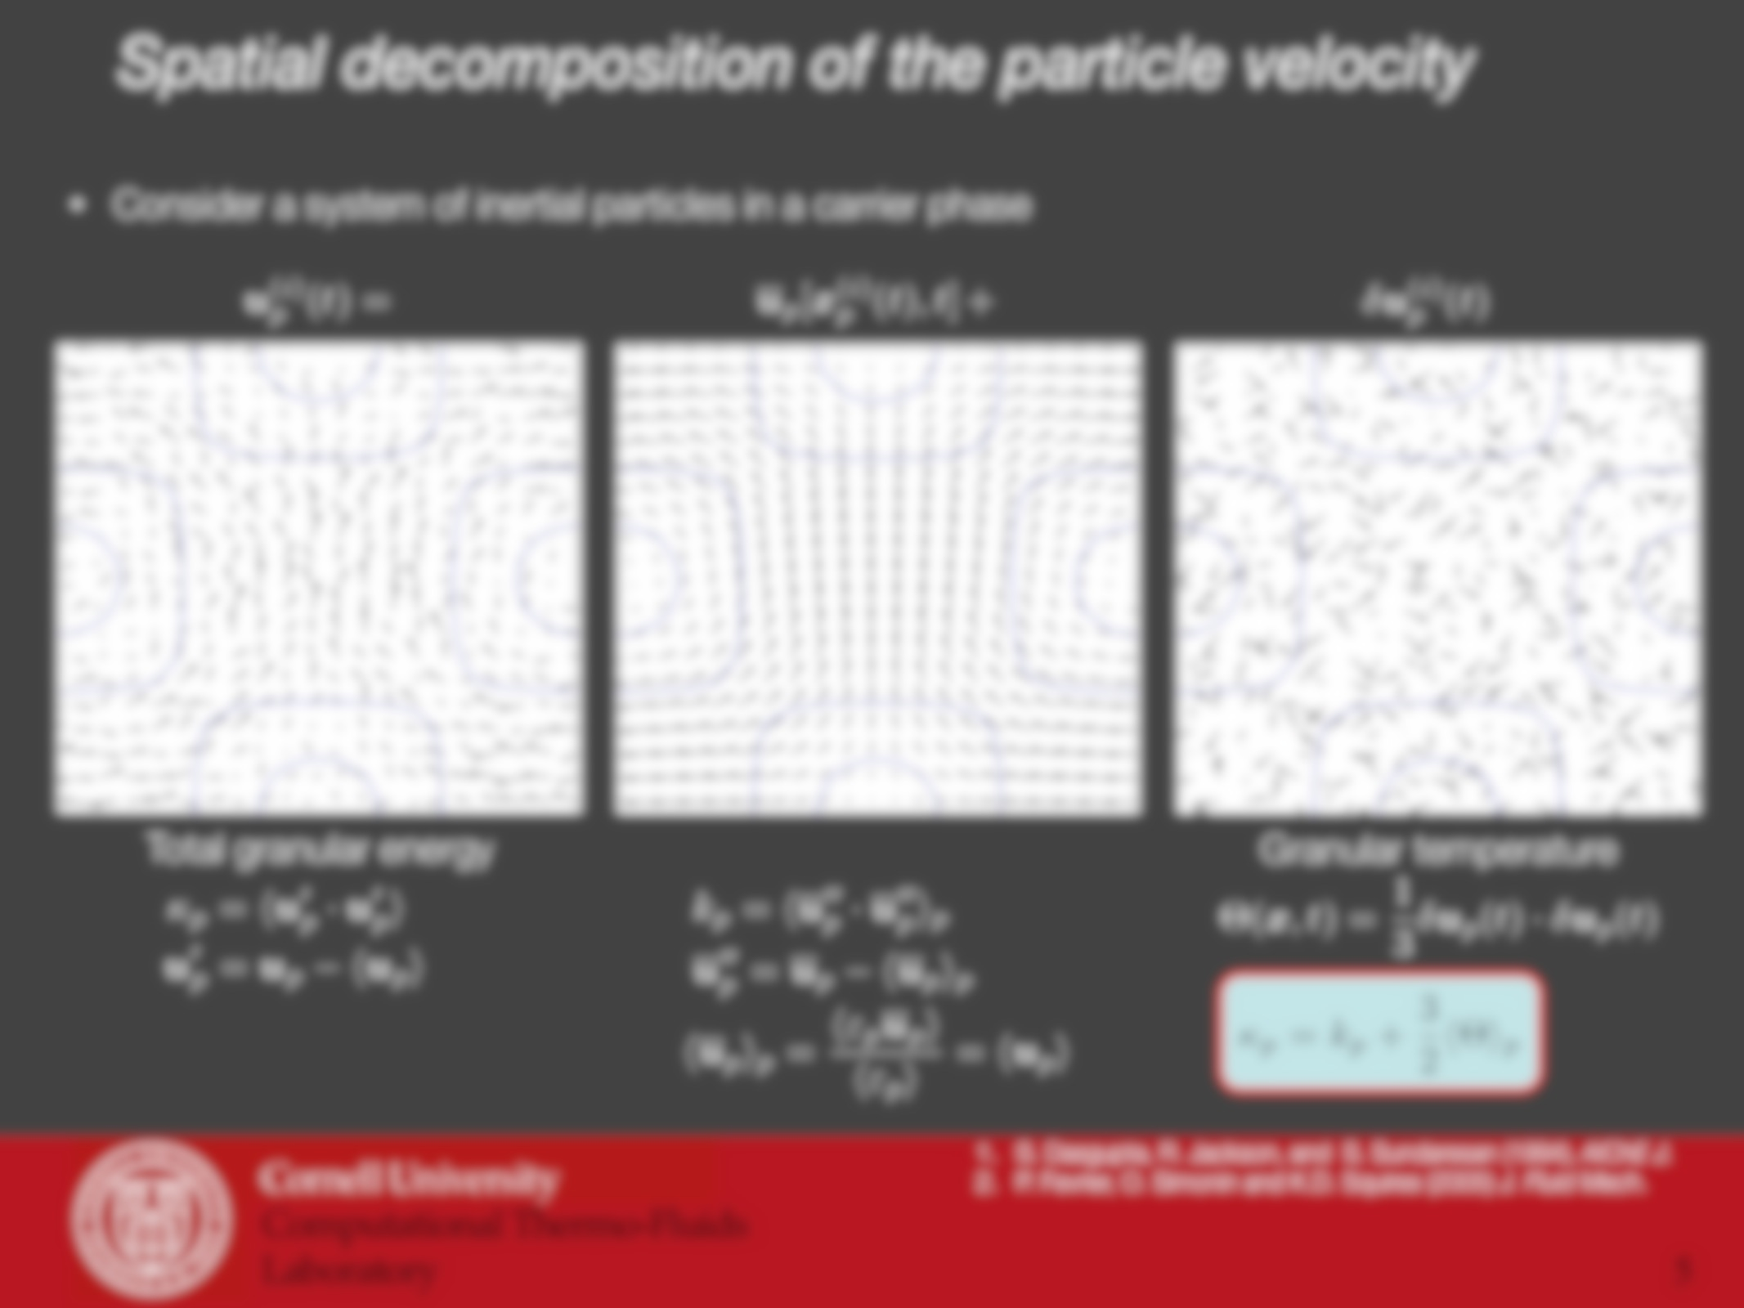
Accurately separating the two contributions is crucial in turbulence modeling!
Main Objective:
Develop an approach capable of accurately extracting and in the context of fully-developed cluster-induced turbulence
Granular temperature
Needed for computing particle pressure and viscosity.
Failure to separate leads to gross over-prediction in collision rate
Particle turbulent kinetic energy
Dissipation of enters as source term for

Slide 7
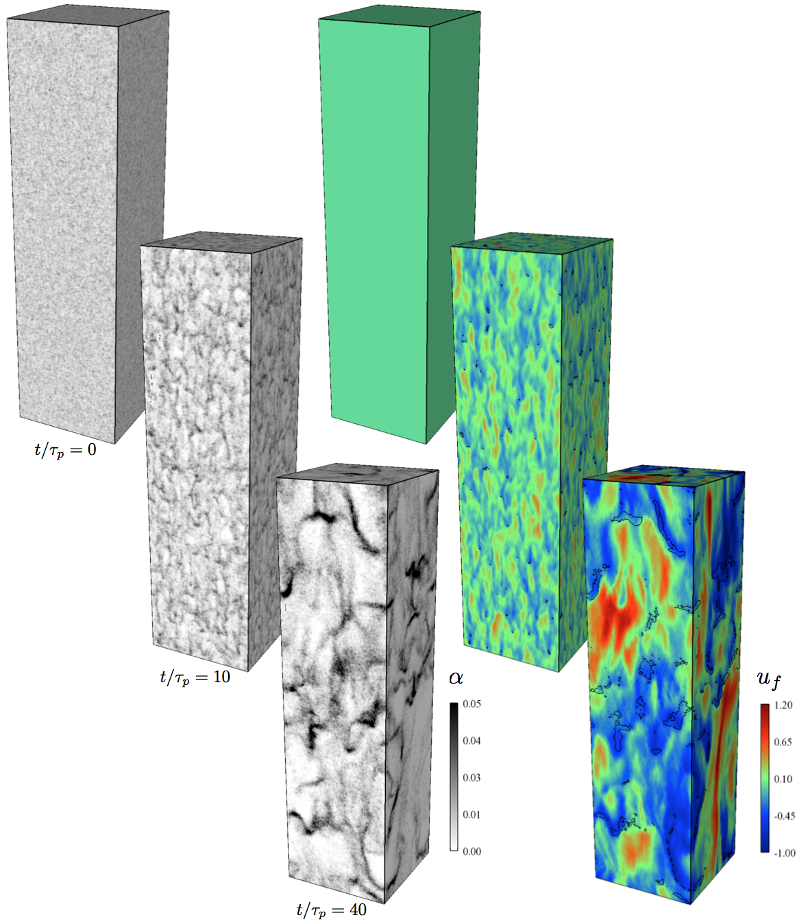
Cluster-induced turbulence¹
Mean velocity difference between phases (body forces, inlet conditions)
Mass loading
J. Capecelatro, O . Desjardins, R.O. Fox (2014), J. Fluid Mech.

Slide 8
Cluster-induced turbulence¹
Mean velocity difference between phases (body forces, inlet conditions)
Mass loading
Particle collisions become important
J. Capecelatro, O . Desjardins, R.O. Fox (2014), J. Fluid Mech.

Slide 9
Cluster-induced turbulence¹
Mean velocity difference between phases (body forces, inlet conditions)
Mass loading
Particle collisions become important
Spontaneous cluster formation
Characteristic timescale
Terminal velocity
Particle Reynolds number
Cluster size
Fluid Reynolds number
J. Capecelatro, O . Desjardins, R.O. Fox (2014), J. Fluid Mech.

Slide 10
Cluster-induced turbulence¹
Mean velocity difference between phases (body forces, inlet conditions)
Mass loading
Particle collisions become important
Spontaneous cluster formation
Characteristic timescale
Terminal velocity
Particle Reynolds number
Cluster size
Fluid Reynolds number
New turbulence production term²
J. Capecelatro, O . Desjardins, R.O. Fox (2014), J. Fluid Mech.
R. O. Fox (2014), J. Fluid Mech.

Slide 11
Cluster-induced turbulence¹
Mean velocity difference between phases (body forces, inlet conditions)
Mass loading
Particle collisions become important
Spontaneous cluster formation
Characteristic timescale
Terminal velocity
Particle Reynolds number
Cluster size
Fluid Reynolds number
New turbulence production term²
*Many challenges in understanding CIT!
J. Capecelatro, O . Desjardins, R.O. Fox (2014), J. Fluid Mech.
R. O. Fox (2014), J. Fluid Mech.

Slide 12
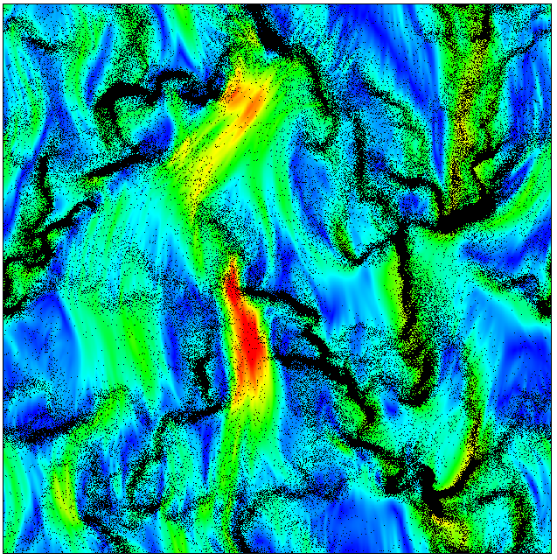
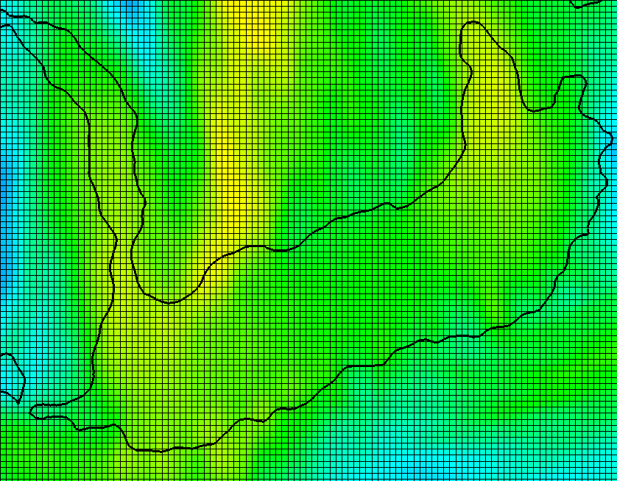
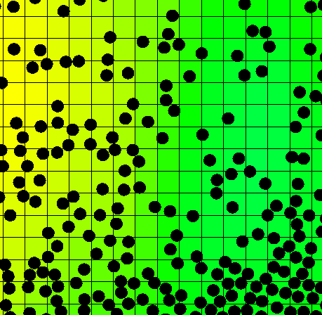
Computational framework
NGA¹
Arbitrarily high-order DNS/LES code
Massively parallel
Conservation of mass, momentum, and kinetic energy
Lagrangian particle tracking²
Newton’s 2nd law
2nd-order Runge-Kutta for particle ODEs
Soft-sphere collision model
Interphase exchange
Need to transfer particle volume and momentum to fluid
Fully conservative and consistent filtering approach²
Transferred data converges under mesh refinement
Desjardins et al., High order conservative finite difference scheme for variable density low Mach turbulent flow, JCP, 2008.
Capecelatro, J., Desjardins, O., An Euler-Lagrange strategy for simulating particle-laden flows, JCP, 2013.

Slide 13
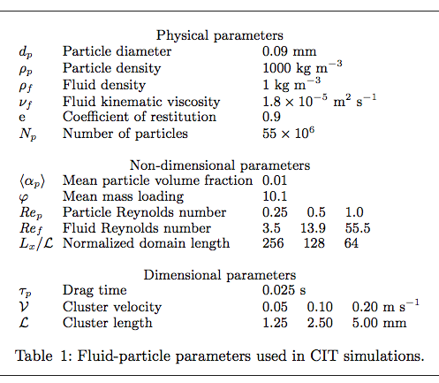
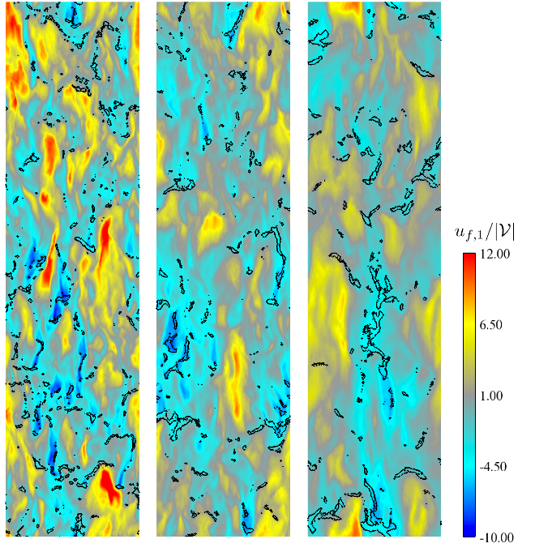
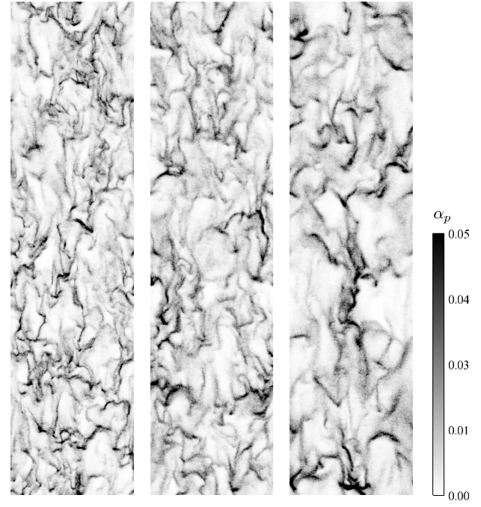
Fully-developed CIT simulations
Mesh: ( )
Particles:

Slide 14
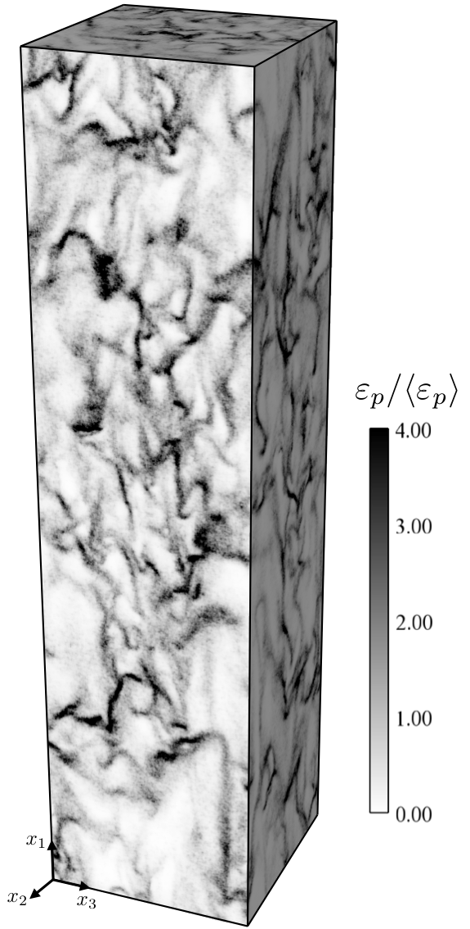

Extracting multiphase statistics via filtering
Influence of the filter size
Separation of length scales must be established
Any Lagrangian property is filtered to the mesh by:
Use implicit two-step filter
Total fluctuating energy:

Slide 15
Extracting multiphase statistics via filtering
Influence of the filter size
Separation of length scales must be established
Any Lagrangian property is filtered to the mesh by:
Use implicit two-step filter
Total fluctuating energy:
If:

Slide 16
Extracting multiphase statistics via filtering
Influence of the filter size
Separation of length scales must be established
Any Lagrangian property is filtered to the mesh by:
Use implicit two-step filter
Total fluctuating energy:
If:
If:

Slide 17
Extracting multiphase statistics via filtering
Influence of the filter size
Separation of length scales must be established
Any Lagrangian property is filtered to the mesh by:
Use implicit two-step filter
Total fluctuating energy:
If:
If:

Slide 18
Extracting multiphase statistics via filtering
Influence of the filter size
Constant filter

Slide 19
Extracting multiphase statistics via filtering
Influence of the filter size
Variable filter

Slide 20
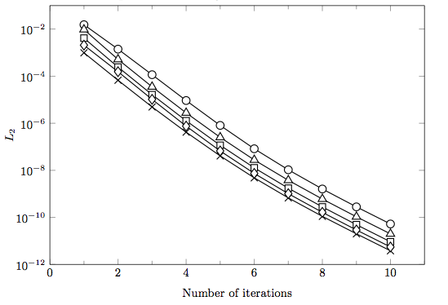
Extracting multiphase statistics via filtering
Influence of the filter size
Computing requires knowledge of
Compute with initial filter
Compute
Re-compute

Slide 21
Extracting multiphase statistics via filtering
Influence of the filter size
Computing requires knowledge of
Compute with initial filter
Compute
Re-compute
Only parameter required for adaptive filter is

Slide 22
Validation via two-point statistics
Two-point statistics do not require sampling volume!
Radial distribution function (RDF)
Number of particles at a pair separation r
implies no clustering (homogeneous)
implies clustering
Two-point velocity correlation
P. Fevrier, O. Simonin and K.D. Squires (2005) J. Fluid Mech.

Slide 23
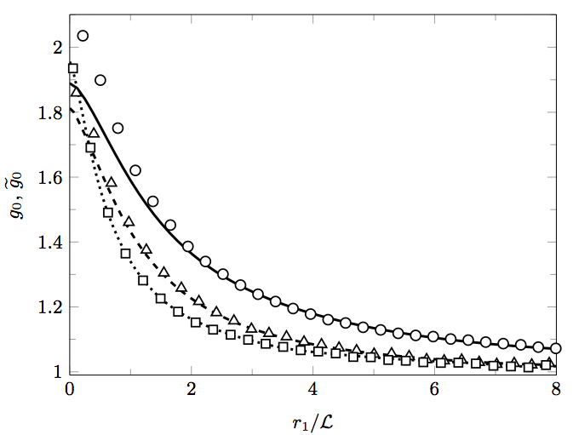
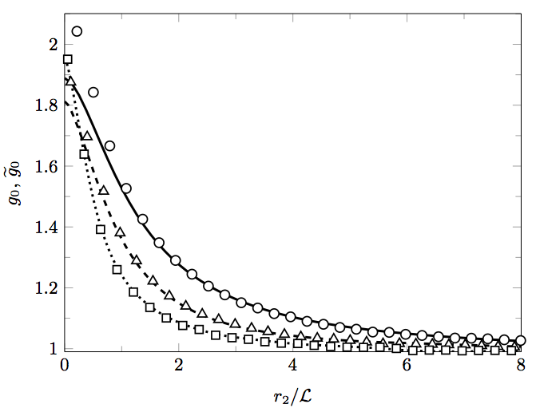
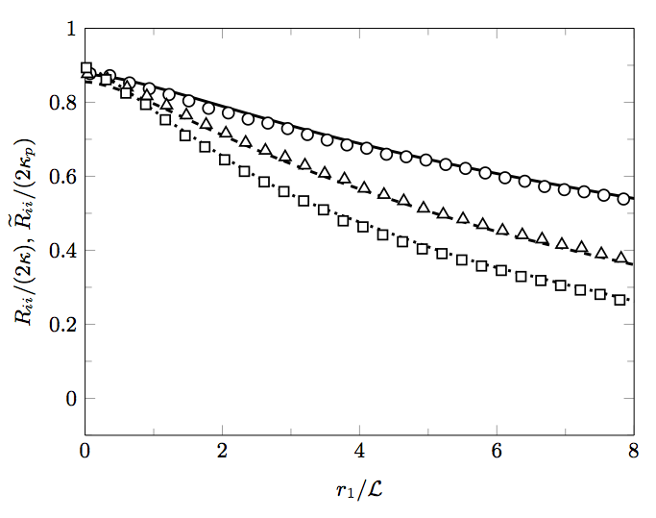
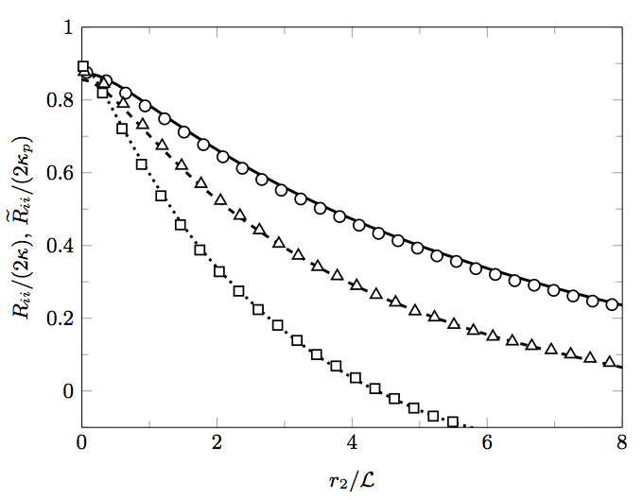
Validation via two-point statistics
Lagrangian (symbols) vs. filtered Eulerian (lines) two-point statistics
RDF measured in the vertical direction
RDF measured in the spanwise direction
Velocity correlation measured in the spanwise direction
Velocity correlation measured in the vertical direction

Slide 24
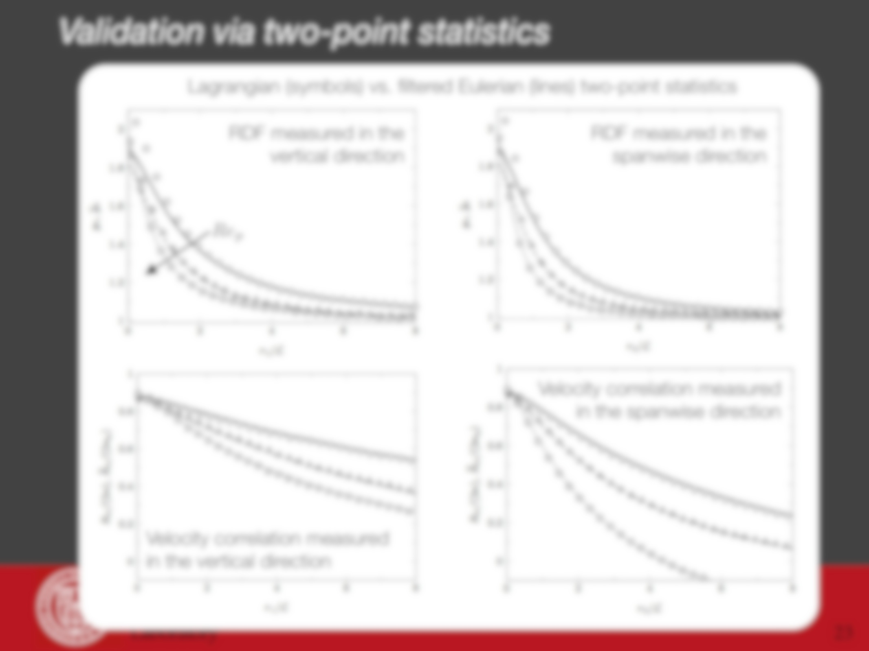
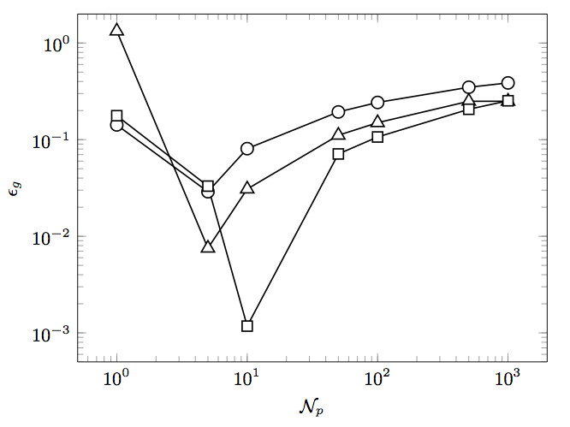
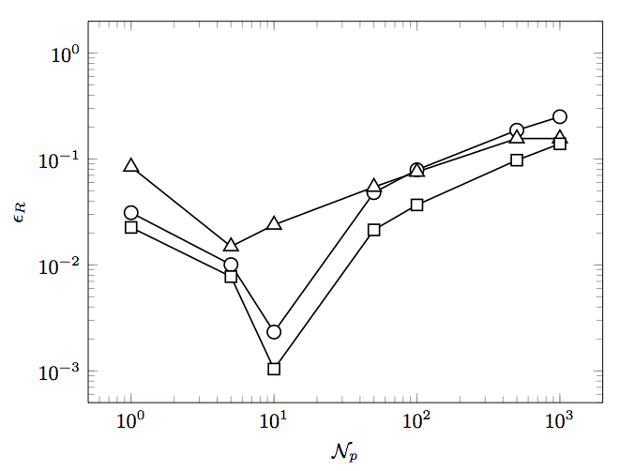
yields lowest overall minimum error

Slide 25
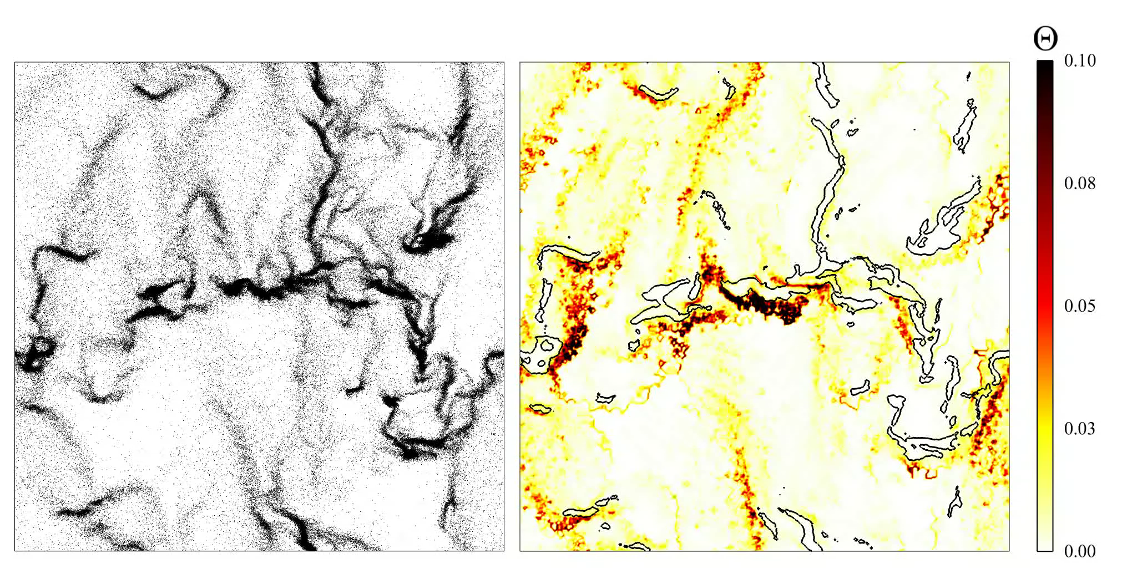
Granular temperature field (2D)
Particle position Granular temperature
Minimum agitation within clusters
Maximum granular temperature located at the upstream boundary of clusters

Slide 26
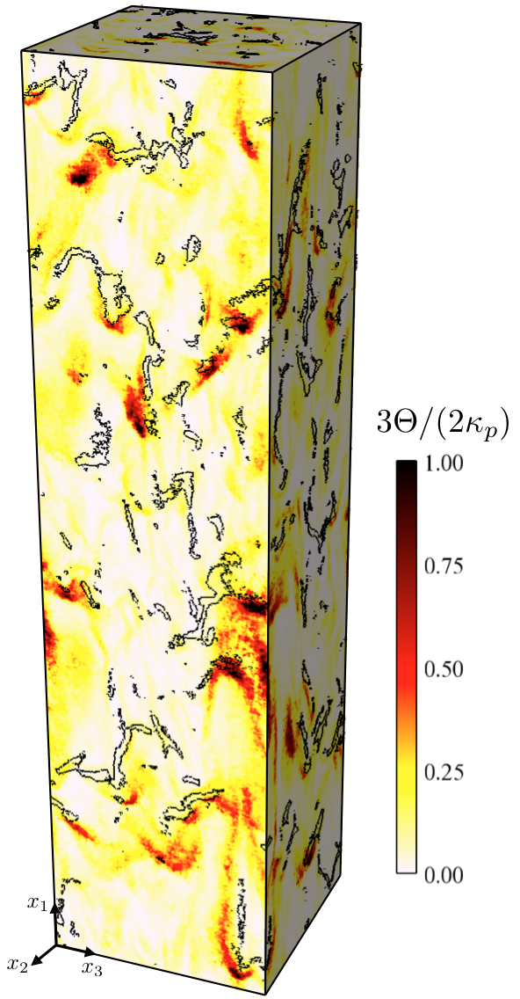
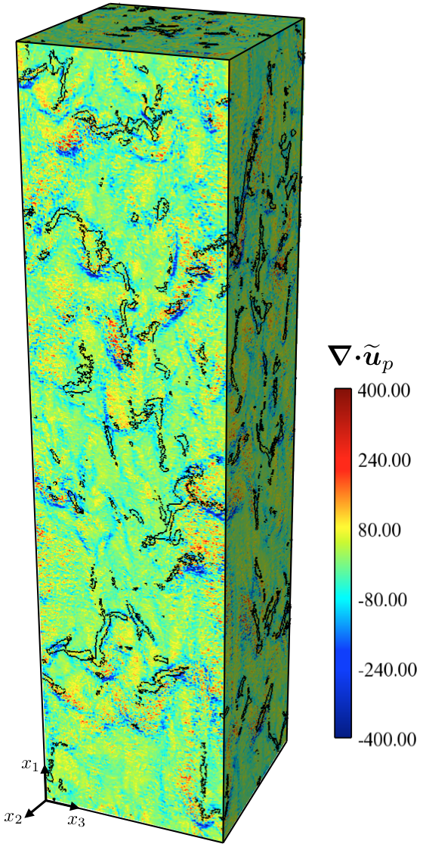
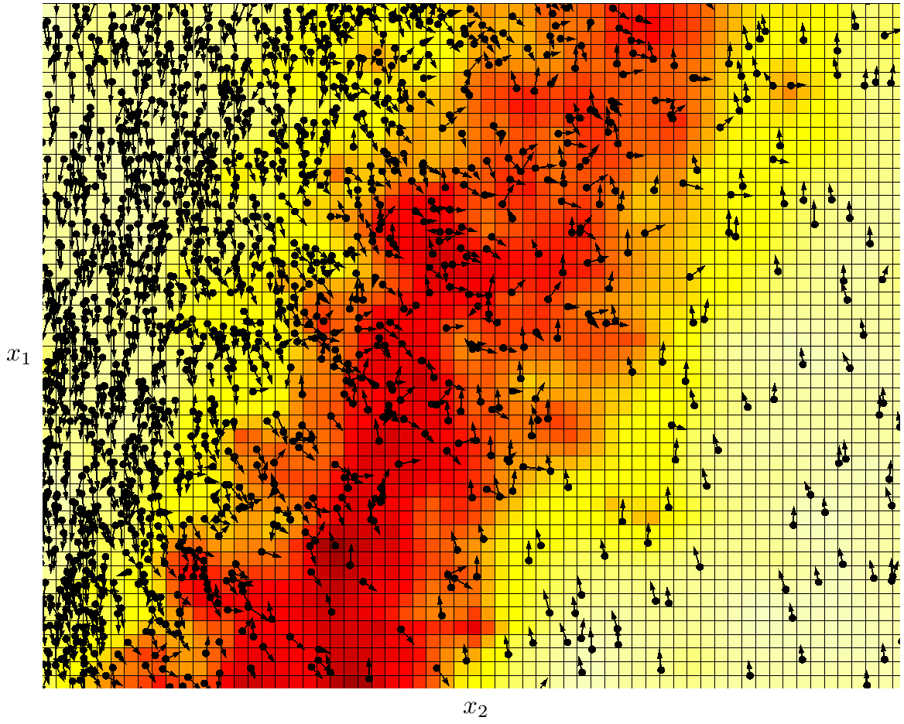
Compressive “heating” of particle phase
Maximum compression ( ) at same location of maximum
Cluster fall velocity reduced by granular pressure

Slide 27
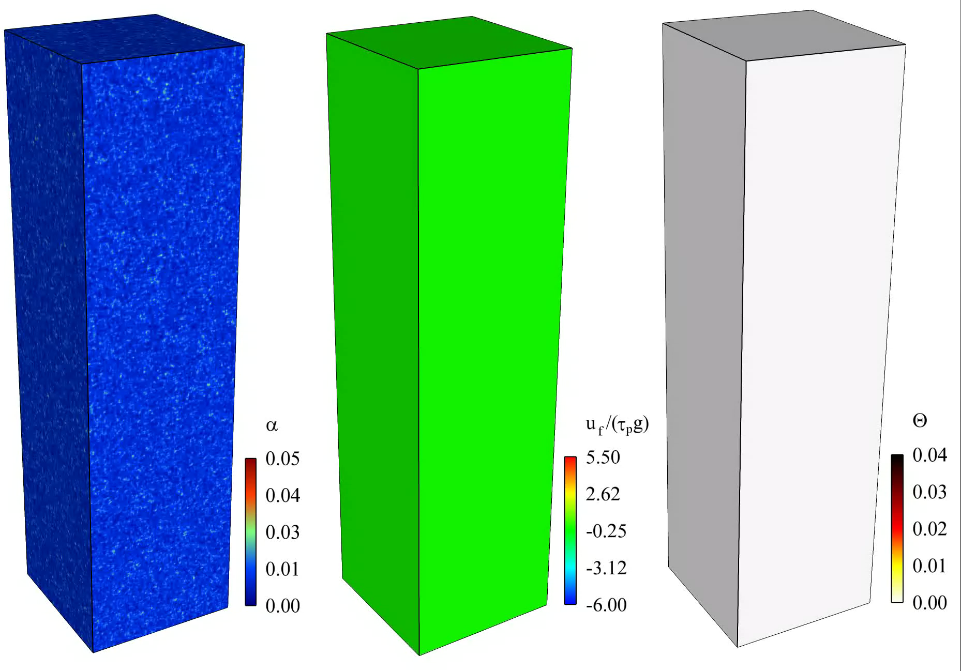
Summary & conclusions
Fully-developed cluster-induced turbulence (CIT) isolates two-way coupling effects
Developed an adaptive spatial filter capable of accurately extracting Lagrangian statistics
Maximum granular temperature exists upstream of clusters, corresponding to

