Slide 1
A New Drag Law for the Accurate Prediction of the Pressure Drop in a Bubbling Fluidized Bed
O. O. Ayeniª, C.L. Wu^{a,b}, J. B. Joshi^{c}, K. Nandakumarª*
ªCain Department of Chemical Engineering, Louisiana State University, Baton Rouge 70803, U.S.A.
^{b}ANSYS Inc, 15915 Katy Fwy, Houston 77094, U.S.A.
^{c}Homi Bhabha National Institute, Training School Complex, Anushaktinagar, Mumbai – 400 094

Slide 2
Objective
To validate an in-house computational code against the NETL-SSCP Experimental results
To attempt to “improve the reliability of computational modeling of multiphase flows”
Outline
Present Governing equations
Show disparity between our initial computational effort and the NETL-SSCP experiments
Present an alternative drag law

Slide 3
Governing Equations (DEM-CFD)

Slide 4
Drag Correlations
Wen & Yu
Gidaspow (Hybrid of Wen & Yu and Ergun)
$$S_{WY}=\frac{3C_{D}^{∗}ρε^{2}}{d_{p}}\left|u−u_{p}\right|\left(u−u_{p}\right)f(ε)$$
$$S_{G}=\left\{\begin{aligned}S_{Ergun}, ε≤0.8 \\ S_{WY}, ε>0.8\end{aligned}\right.$$
$$C_{D}^{∗}=\left\{\begin{aligned}6/Re_{p}(1+0.15Re_{p}^{0.687}) \\ 0.11, Re≥1000 \end{aligned}\right.$$
$S_{Ergun}=K_{sg}(u−u_{p})$
$$K_{sg}=150\frac{μ{\left(1−ε\right)}^{2}}{ε^{2}d_{p}^{2}} + 1.75 ρ\frac{\left|u−u_{p}\right|\left(1−ε\right)}{εd_{p}}$$
$$f\left(ε\right)=ε^{−4.7}$$
$ε$is volume fraction of gas
$S_{}$ is a constitutive drag source term
$C_{D}^{∗}=C_{D}/f(ε)$ where $C_{D}$ is drag coefficient
$d_{p}$ Particle diameter

Slide 5
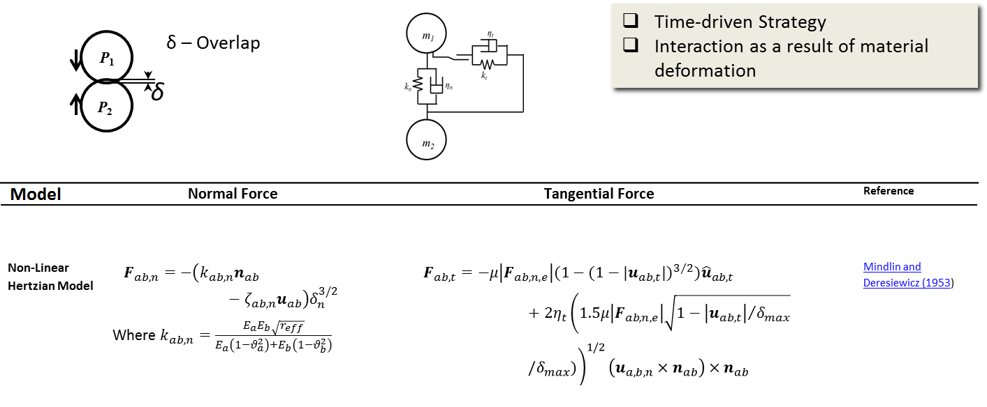
Soft Sphere Model
$k$ – spring constant
$μ$ – Friction factor
$η$ – Damping constant
E – Young’s modulus
$θ$ – Poisson ratio
Mindlin, R. D. and H. Deresiewicz (1953). "Elastic spheres in contact under varying oblique forces." Transactions of the ASME-Series E 20: 327-344.

Slide 6
Material Properties
Particle Properties(Nylon Beads)
$$d_{p}$$ | 3256$μm$
$$ρ_{p}$$ | 1131$kgm^{−3}$
Normal Restitution coeff. | 0.84
Friction Coefficient | 0.35
$$N_{p}$$ | 95,356
$$u_{mf}$$ | 1.09m/s
$$u_{terminal}$$ | 11m/s
Fluid Properties(Air)
$$ρ$$ | 1.03$kgm^{−3}$
$$μ$$ | 1.8E-05$kg{(ms)}^{−1}$
P-V coupling | SIMPLE
$$Re_{p}$$ | 1948

Slide 7
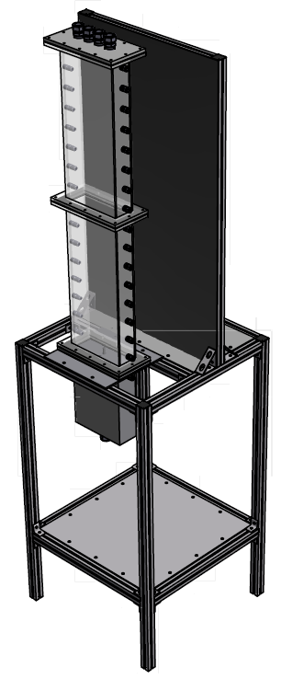
Test Facility
Test Section
Plenum

Slide 8
Geometry, Boundary Conditions, Numerics
0.23m
Cell Count |  | 16 × 80 × 5
Cell Size |  | 0.014375×0.015×0.015375m³
$$Δt$$ |  | 0.001s
$$Δt_{DPM}$$ |  | 2E-5s
Numerics
Momentum discretization |  |  | 3rd order MUSCL
P-V coupling |  |  | SIMPLE
Cases
1 | Inlet velocity |  | $$2U_{mf}$$
2 | Inlet velocity |  | $${3U}_{mf}$$
3 | Inlet velocity |  | $$4U_{mf}$$
0.075m
Pressure Outlet
Impenetrable, No-slip Walls(4)
1.22m
Uniform Velocity Inlet
Notes:
Monotone Upstream-Centered Schemes for Conservation Laws

Slide 9
Animations
$$2U_{mf}$$
$$3U_{mf}$$
$$4U_{mf}$$

Slide 10
Flow Features
Non-Uniform flow patterns due to:
Non-linear drag
Non-ideal particle collisions
Intense Bubbling and Slugging

Slide 11
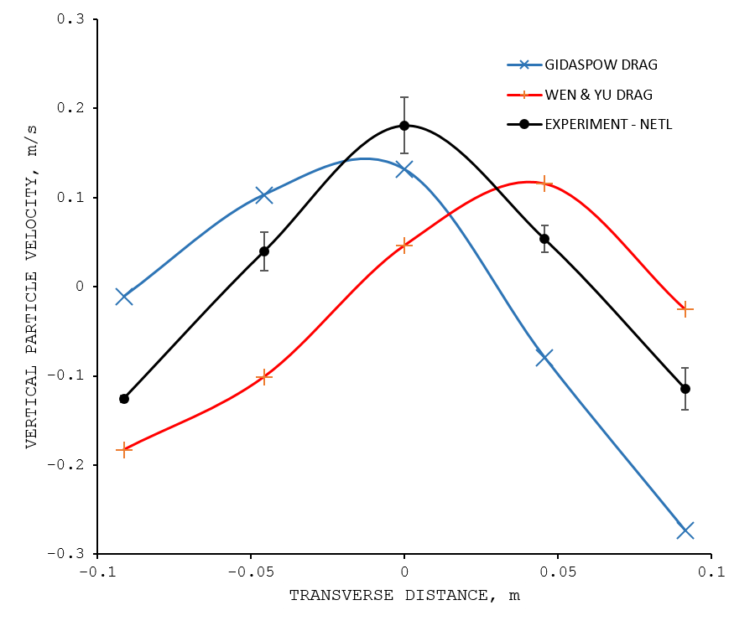
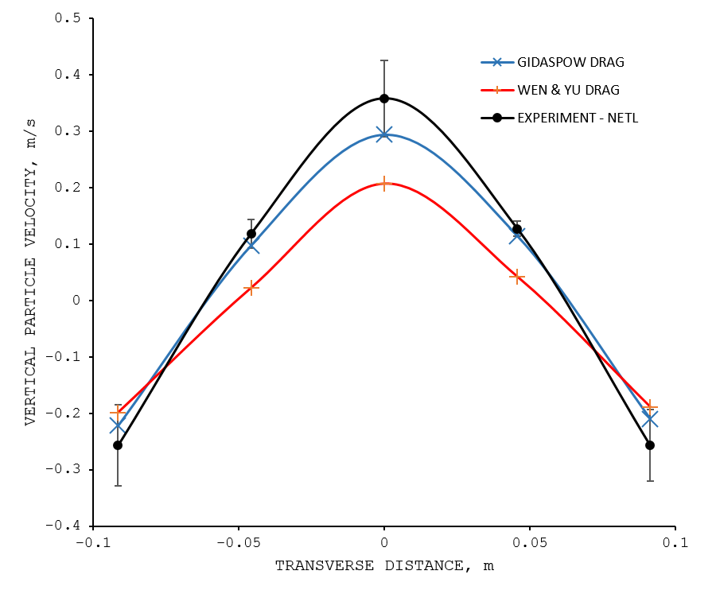
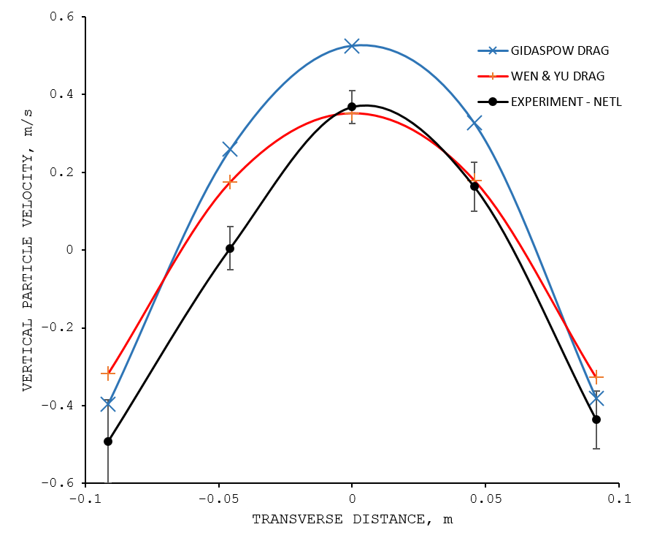
Time-Averaged Vertical Velocity
$$2U_{mf}$$
$$3U_{mf}$$
$$4U_{mf}$$
Samples taken at 0.076m from the distributor

Slide 12
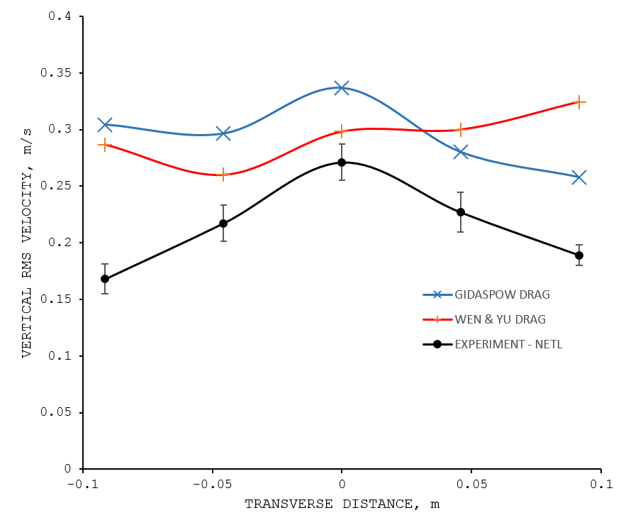
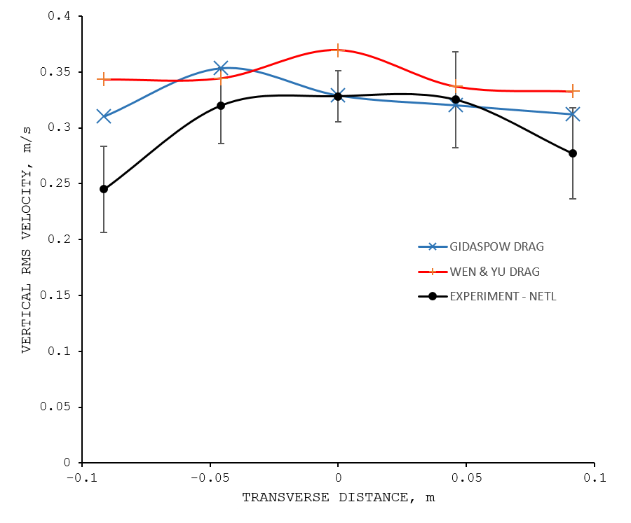
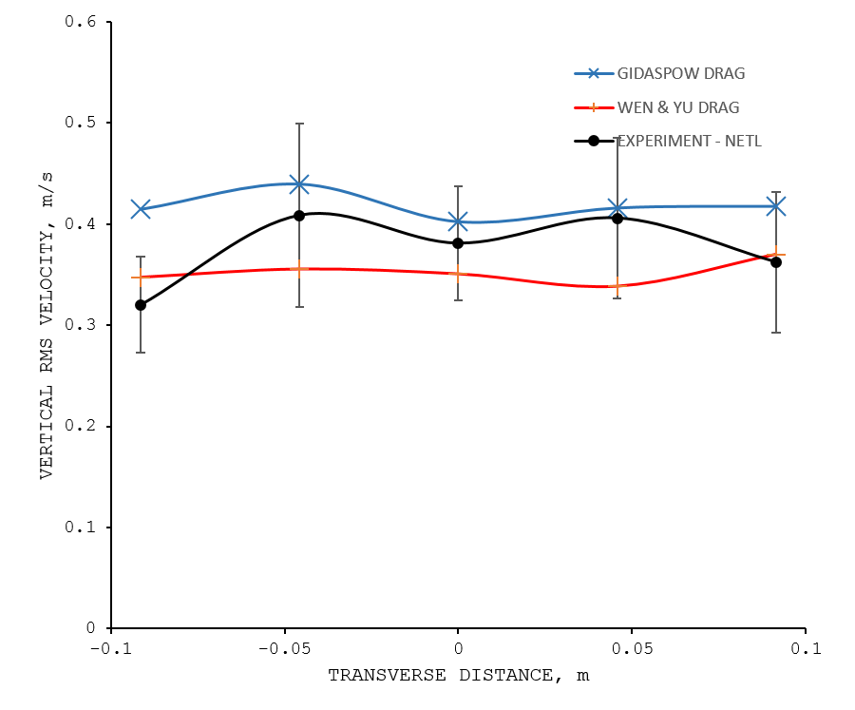
RMS Vertical Velocity
$$2U_{mf}$$
$$3U_{mf}$$
$$4U_{mf}$$
Samples taken at 0.076m from the distributor

Slide 13
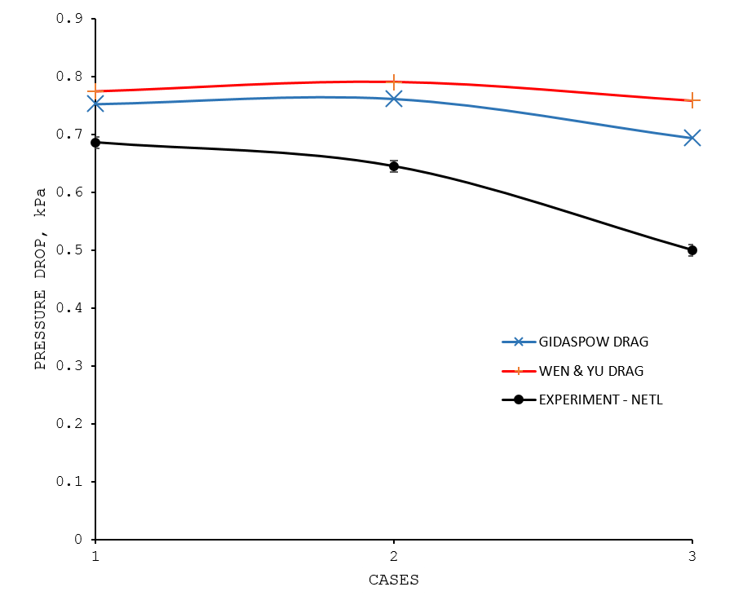
Pressure Drop
TIME-AVERAGED PRESSURE DROP ACROSS BED (Taps at 0.0413m and 0.3461)

Slide 14
New Drag Law
Pandit and Joshi (1998) Present the derivation for drag experienced by a particle in fixed and expanded beds under uniform fluidization
Energy balances employed, $E_{i}−E_{e}=E_{B}$
$E_{i}$ - Energy input rate, $E_{e}$ - Potential energy at top of bed, $E_{B}$ - Net dissipation in bulk of bed
Use force balance to find expression for $C_{D}$ in terms of $E_{m}$, the net dissipation per unit mass of fluid
Turbulence intensity, $I≈2d_{p}$
Account for additional energy head to generate bubbles
Pandit, A. and J. Joshi (1998). "Pressure drop in fixed, expanded and fluidized beds, packed columns and static mixers-A unified approach." Reviews in Chemical Engineering 14(4-5): 321-371.

Slide 15
New Drag Law
$$C_{D}=0.11\left(\frac{40.9ε_{s}^{2}K^{2}}{ε^{2}}+1\right)$$
Where
As $U_{G}→U_{mf}$, $H_{bed}→H_{mf}$
$ε→0.4$ (fixed bed)
$$K=\frac{U_{mf}}{U_{G}}+\left(1−\frac{U_{mf}}{U_{G}}\right)\left(\frac{H_{mf}}{H_{bed}}\right)$$
$ε$is volume fraction of gas
$ε_{s}$is volume fraction of solids
$U_{mf}$ is Minimum fluidization velocity
$U_{G}$ is Superficial gas velocity
$H_{mf}$ Bed height at incipient fluidization
$H_{bed}$ is Dynamic Bed Height
$$3C_{D}ε^{3}→1.93$$
${\left(3C_{D}ε^{3}\right)}_{Ergun, turbulent}$=1.75

Slide 16
Notes
Bed is turbulent providing justification for using the turbulent drag term alone
Bed is not fixed, hence use of Ergun equation in its original form suspect
Drag is modified in two ways
By allowing $C_{D}$ to become applicable to expanded beds
Including additional energy dissipation into bubbles that appears as the factor $K$

Slide 17
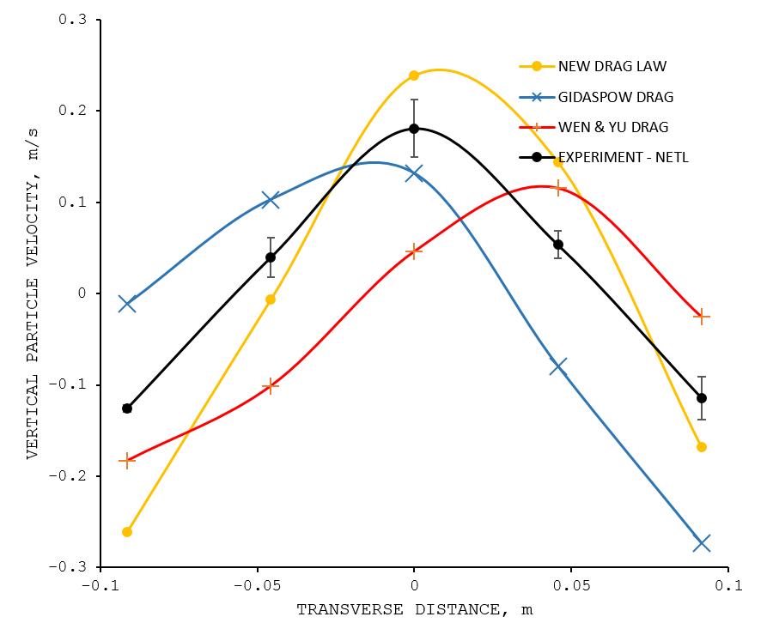
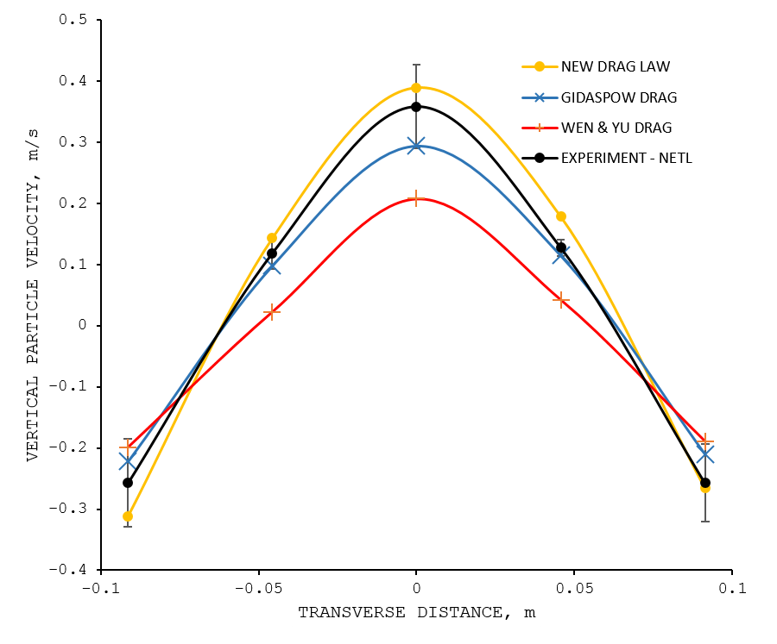
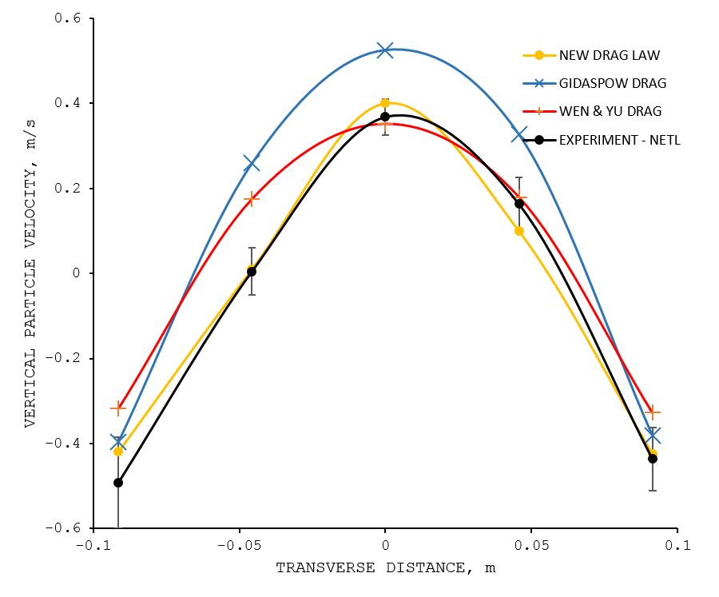
Time-Averaged Vertical Velocity
$$2U_{mf}$$
$$3U_{mf}$$
$$4U_{mf}$$
Taps at 0.076m from the distributor

Slide 18
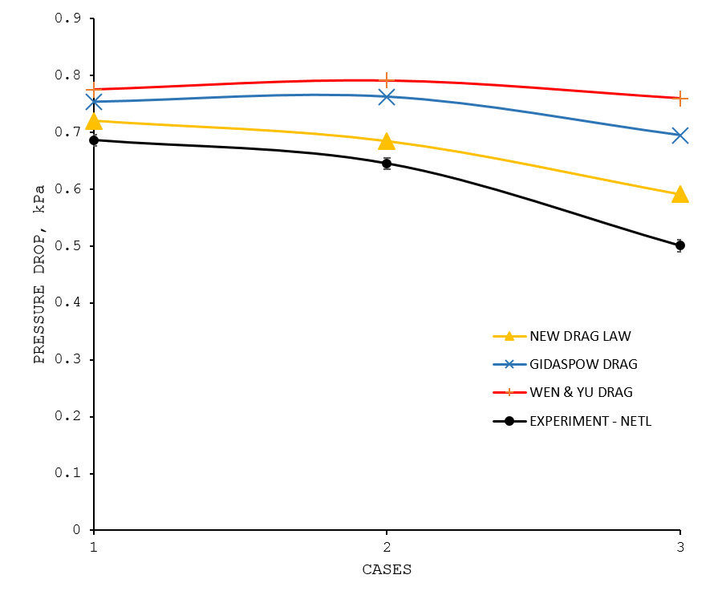
Pressure Drop
TIME-AVERAGED PRESSURE DROP ACROSS BED (Taps at 0.0413m and 0.3461)

Slide 19
Conclusions
Shown the inadequacy of conventional drag laws in bubbling fluidized beds
Energy required in creating bubbles has been taken into account
A new drag law based on energy and force balances proposed
Necessary to make modifications for transition from laminar to turbulent for generality

Slide 20
Acknowledgements

