Slide 1
Modeling and validation of coal combustion in a circulating fluidized bed using Eulerian-Lagrangian approach
U.S. Department of Energy, National Energy Technology Laboratory (NETL)
2015 Workshop on Multiphase Flow Science
August 12, 2014
Allan Runstedtler, Haining Gao, Patrick Boisvert

Slide 2
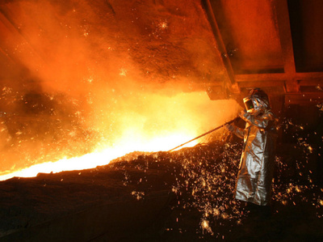
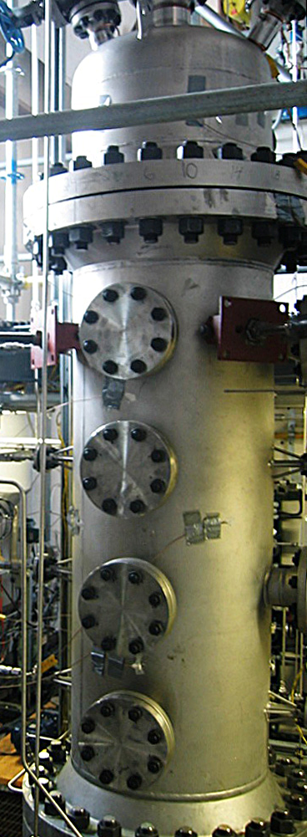
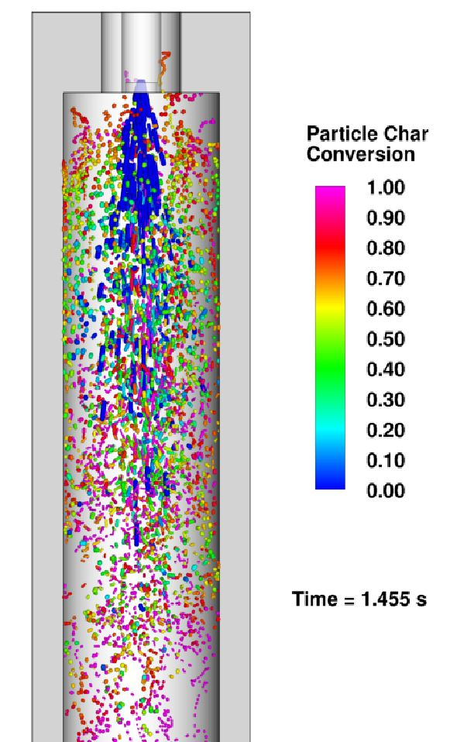
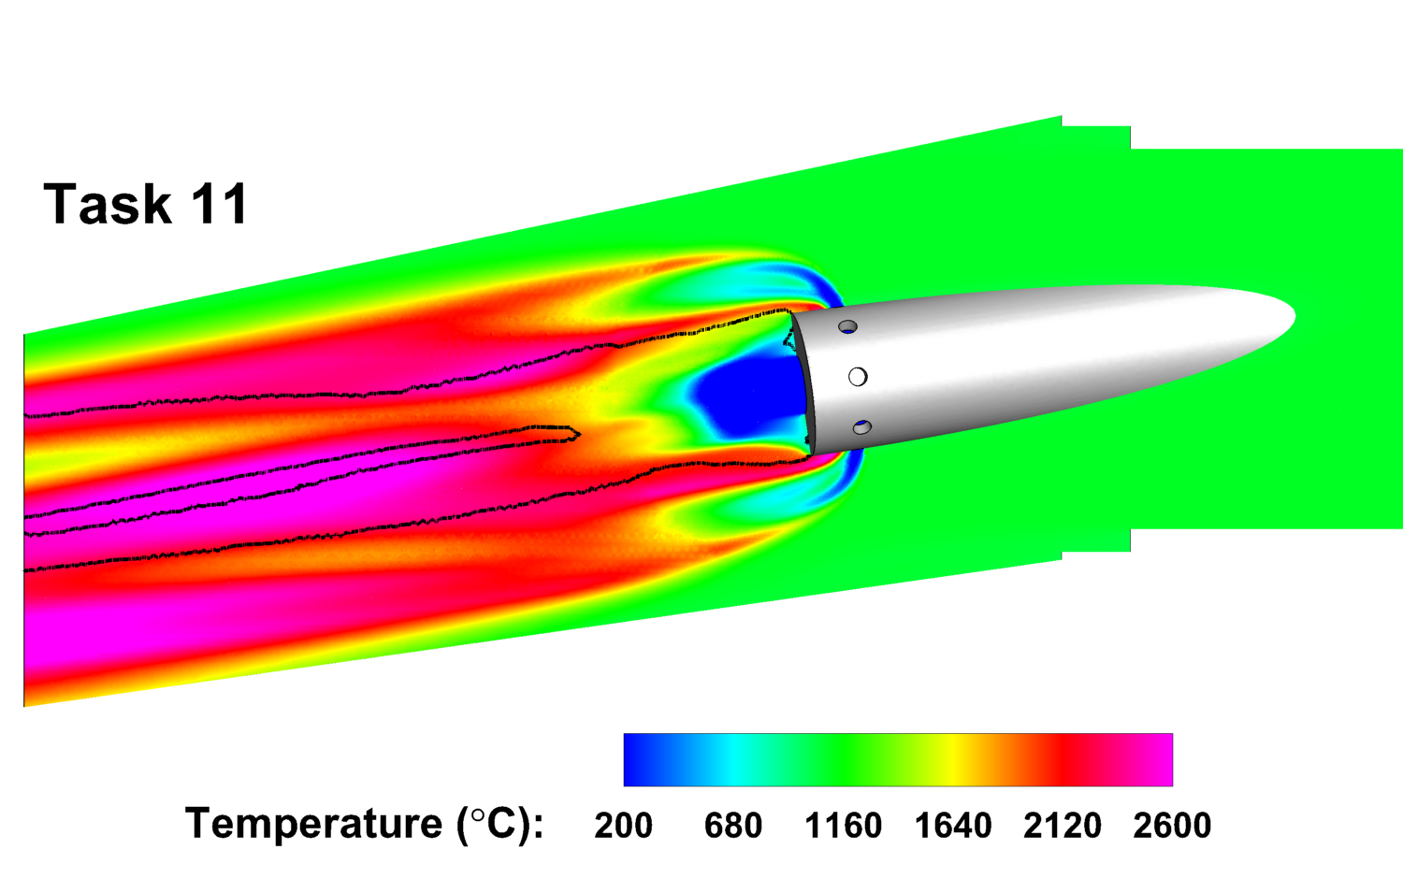
Multiphase Reacting Flows
CanmetENERGY high pressure entrained flow gasifier/combustor
U. S. Steel Canada blast furnace – coal and natural gas injection

Slide 3
Fluid Bed Combustion
Improve efficiency and cost of CCS by 20+% compared to conventional PC boilers with 98% capture
Oxy-Pressurized Fluid Bed Combustion (Oxy-PFBC)
< 30% electricity cost increase
High efficiency
Fuel flexibility
Power and steam
Low water consumption
Pressurized Chemical Looping Combustion (PCLC)
Shale gas, fuel gas and asphaltene, coke
High efficiency
H₂, power and steam
Flexible operating pressure

Slide 4
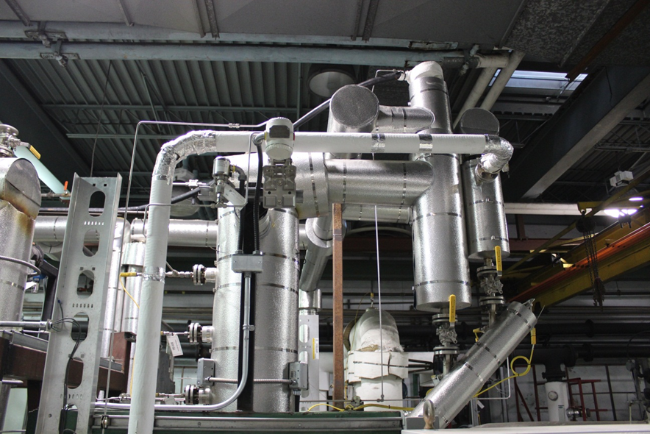
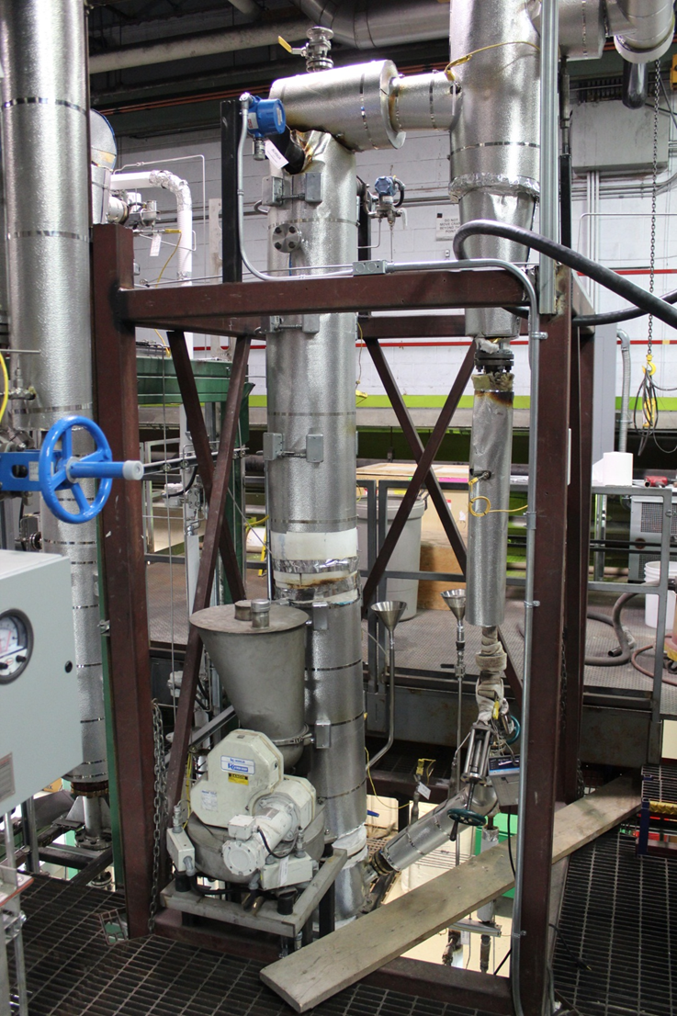
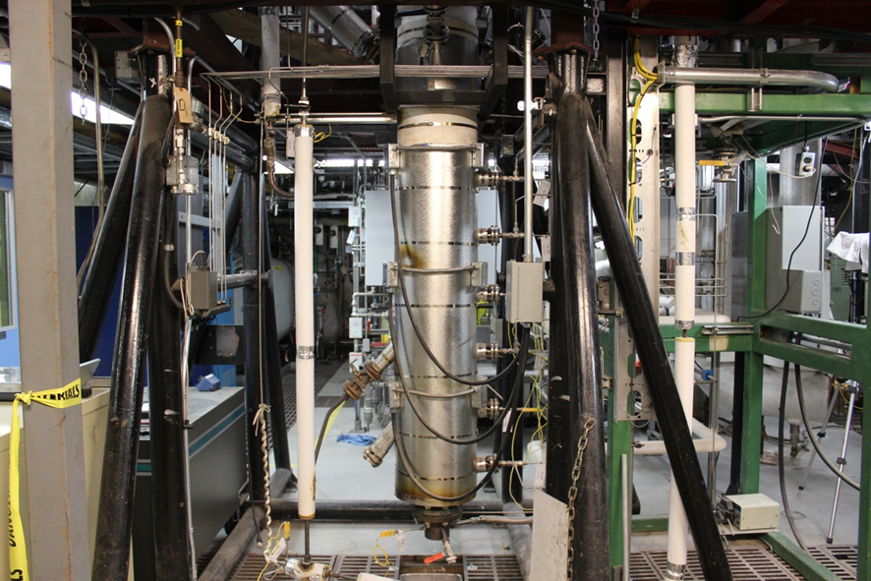
Model Validation: Pilot Plant – “Minibed”
CanmetENERGY
Dual Fluid Bed System for CaL, CLC, oxy-fuel
Specifications
Calciner / Oxy-Combustor:
T < 1050 °C
P – atmospheric
ID = 0.1 m
H = 5.0 m
Vf < 6.0 m/s
Fuel type: solid fuels
Fuel feed rate < 10 kg/h
Oxygen stream = 99.9%
Carbonator / Air Reactor:
T < 1050 °C
P – atmospheric
ID = 0.1 m
H = 3.0 m
Vf < 2.0 m/s
Solid transfer < 50 kg/h

Slide 5
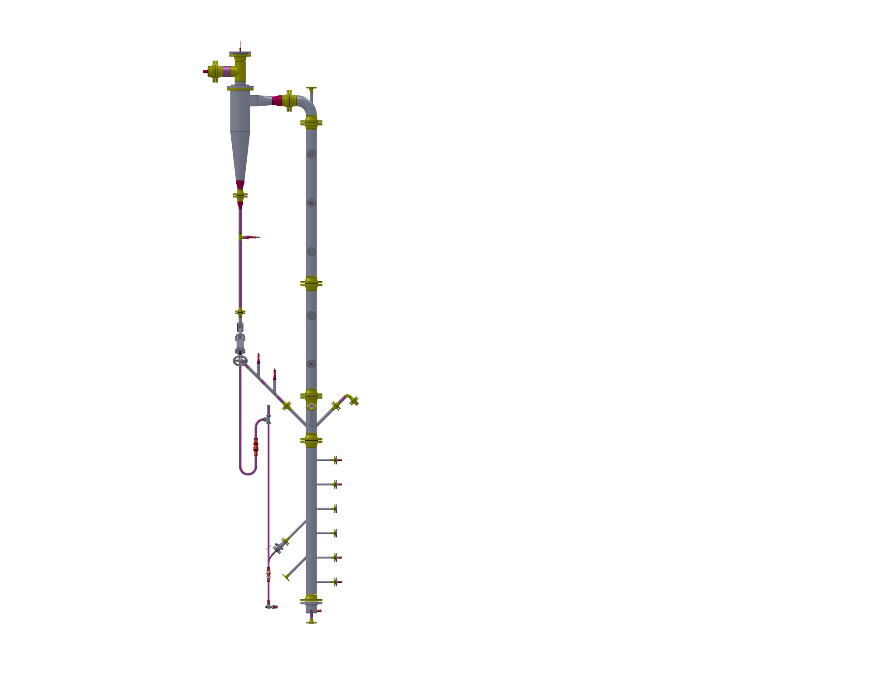
Circulating Fluid Bed – “Minibed”
Feed inlet

Slide 6
Modeling approach: Eulerian-Lagrangian
Treat particles as particle parcels
Drag force model: Gidaspow
Particle interactions are modeled using granular model
- Granular Viscosity: Gidaspow
- Granular Bulk Viscosity: Lun et al.
- Packing limit: 0.6
With respect to Eulerian-Eulerian calculation:
Pros:
Straightforward to include particle size distribution
Straightforward to setup heterogeneous reactions
Cons:
Longer calculation time
Restrictions on computational grid
More challenging to achieve numerical stability

Slide 7
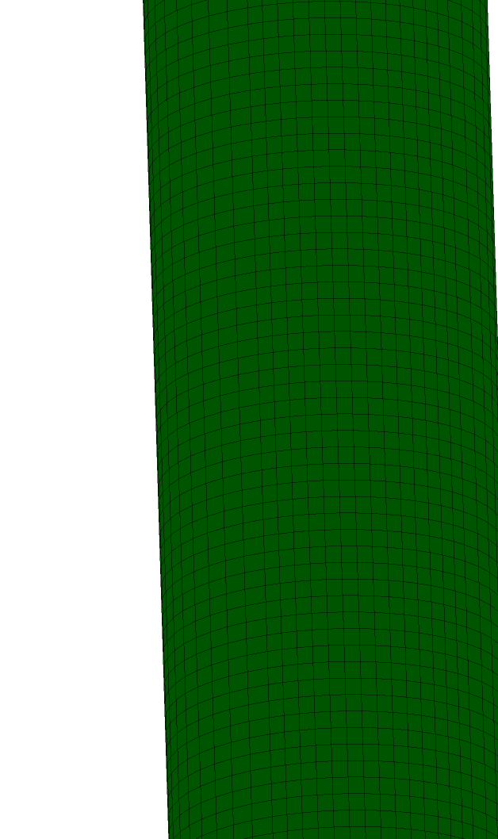

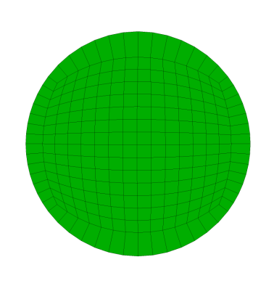
Geometry and Mesh

Slide 8
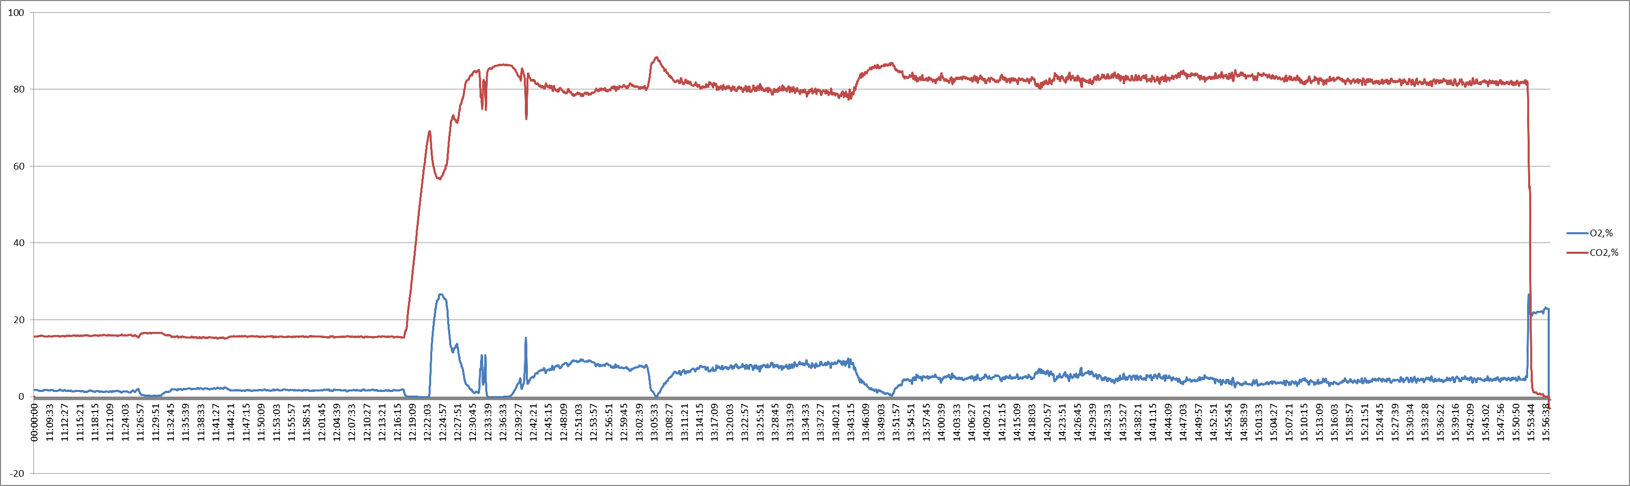
Highvale Coal Combustion
CO₂ volume percent
O₂ volume percent
Time
11:40
12:14
Oxy-fuel combustion
Air combustion

Slide 9
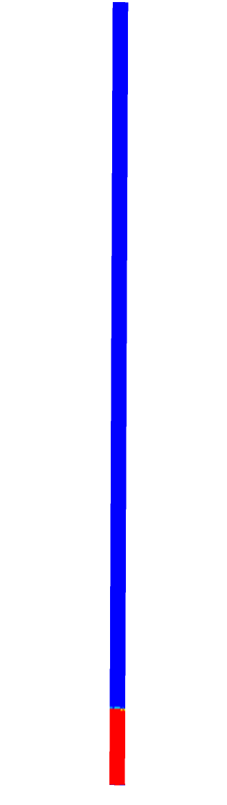
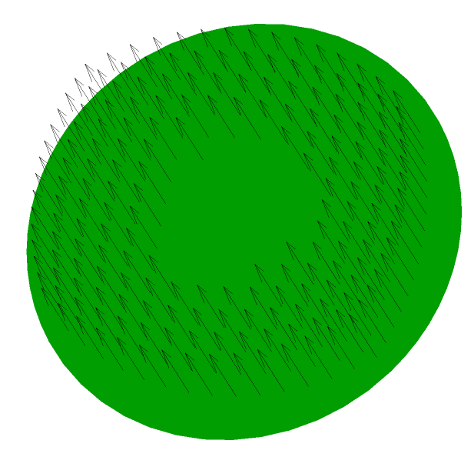
Boundary Conditions, Properties
Sand weight: 5.5 kg
Sand particle density: 3300 kg/m³
Sand size distribution:
Olivine sand 32B4:35-70=2:1
1180.0μm | 0.0055
1015.0μm | 0.0275
725.0μm | 0.1765
512.5μm | 0.3947
362.5μm | 0.1714
256.0μm | 0.1689
181.0μm | 0.0388
128.0μm | 0.0083
53.0μm | 0.0083
Input gas: air
Velocity: 3.96 m/s
(31.97 kg/hr)
Temperature:800°C (after sintered plate)
>0.9
0.5m

Slide 10

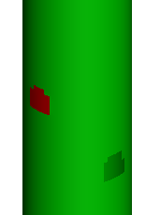
Fuel Inlet
Highvale analysis data:
Coal feed rate: 6.69 kg/hr
Air rate: 1.54 kg/hr
Temperature (air & coal): 18°C
Coal injection velocity: 0.1 m/s,
normal to surface
Coal particle density: 1069 kg/m³
Coal specific heat: 1530 J/(kg·K)
Proximate analysis
Moisture | 16.8
Ash | 22.8
Volatile | 24.5
Fixed carbon | 35.9
Ultimate analysis
Carbon | 44.01
Hydrogen | 2.85
Nitrogen | 0.67
Oxygen (diff) | 12.87
Coal size input:
Size (mm) | wt %
0.15 | 10
0.3 | 26.5
0.85 | 46.5
2.36 | 13.9
5.35 | 3.1

Slide 11
Recycle Inlet—Gases
Return leg gas rate: 1.29 kg/s
Temperature: 604°C
Gas compositions:
O2, % | 1.65
CO2, % | 15.58
CO, ppm | 90.99
SO₂ and NO not included, the balance gas is nitrogen

Slide 12
Recycle inlet Determine recycle sand rate per size group
Particle density: 3300 kg/m³
Temperature: 604°C
Particle injection velocity: 0.1 m/s, normal
Recycled sand based on simulation results of sand particles escaping at the outlet:
Particles larger than 700 µm neglected because relatively small fraction leaving outlet
Particles smaller than 128 µm not recycled (not captured by the cyclone)—also a small fraction
Particle size, μm | mass rate, kg/hr
512.5 | 15.5
362.5 | 83.3
256.0 | 103.6
181.0 | 25.5
Total | 227.9

Slide 13
Recycle inlet Determine recycle coal rate per size group
Total coal particle escape rate: 4.32 kg/hr at 42.25 s flow time
 | density, kg/m³ | char mass fraction | Volatile mass fraction | Mass fraction
0.15mm | 312 | 0.0861 | 0.00 | 0.0330
0.3mm | 465 | 0.3871 | 0.00 | 0.1141
0.85mm | 608 | 0.5311 | 0.00 | 0.8221
2.36mm | 168 | 0.0750 | 0.00 | 0.0309
>0.93
No particles larger than 5.30 mm in diameter escaped the minibed at 42.25 s flow time
Only include 0.3 mm and 0.85 mm coal particles in recycled material

Slide 14
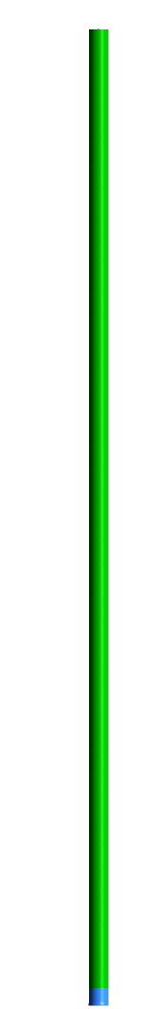
Wall Heat Flux
Heat flux (out): 3296 W/m²
(Calculated assuming 800ºC inner wall temperature and 75ºC outer wall temperature)
Heat flux (out): 271 kW/m²
(Heat flux to account for the energy from mini
bed to heat air from 57ºC to 800ºC)

Slide 15
Coal Reactions
Heterogeneous reactions:
Coal → volatile
Char + O₂ → CO
Gas-phase reactions:
Volatile +O₂ → CO + H₂O
CO + O₂ → CO₂
Coal Reaction Data
Devol A | 200000
Devol E (J/kmol) | 4.9884e7
Char A | 0.002
Char E (J/kmol) | 7.9e7
Constant diameter model

Slide 16
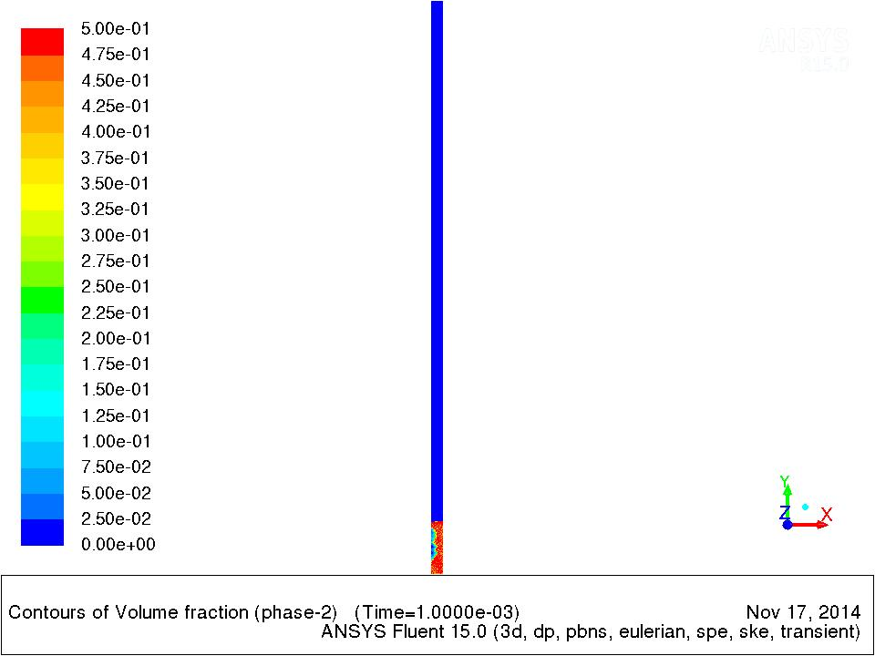
Results: Sand Fluidization
Start-up

Slide 17

Results: Sand Fluidization
Sand volume fraction at 52.2 s flow time

Slide 18
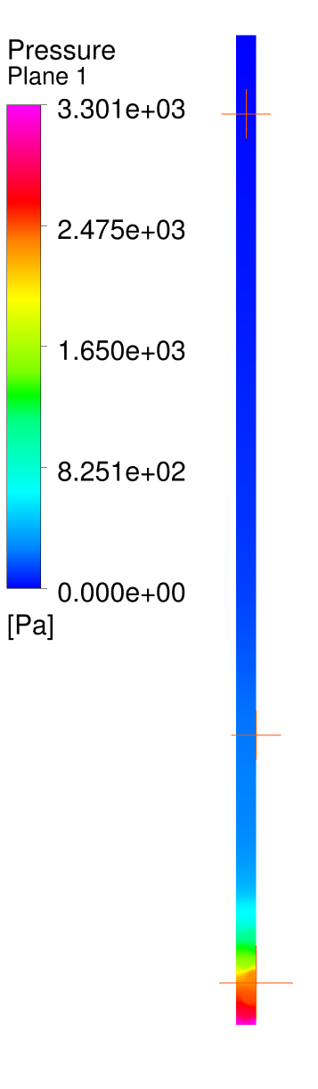
Pressure boundary condition: 0 Pa
Pressure drop
Predicted: 1500-3000 Pa
Measured: 2500-3600 Pa

Slide 19
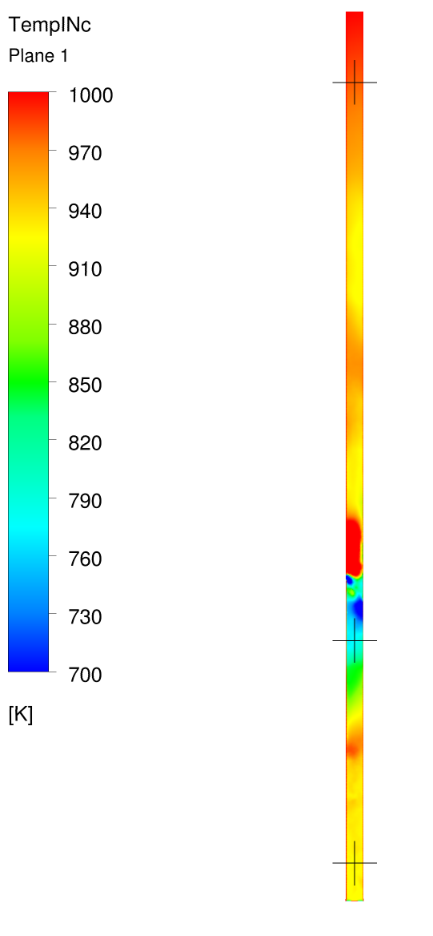
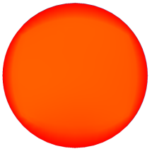
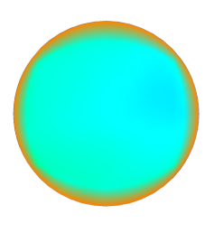
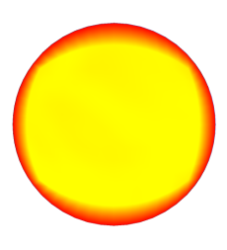
Temp. ºC
Measured: 820-828⁰C
Predicted: 955-1001⁰C
Measured: 787-794⁰C
Predicted: 767-827⁰C
Measured: 800-801⁰C
Predicted: 912-942⁰C

Slide 20
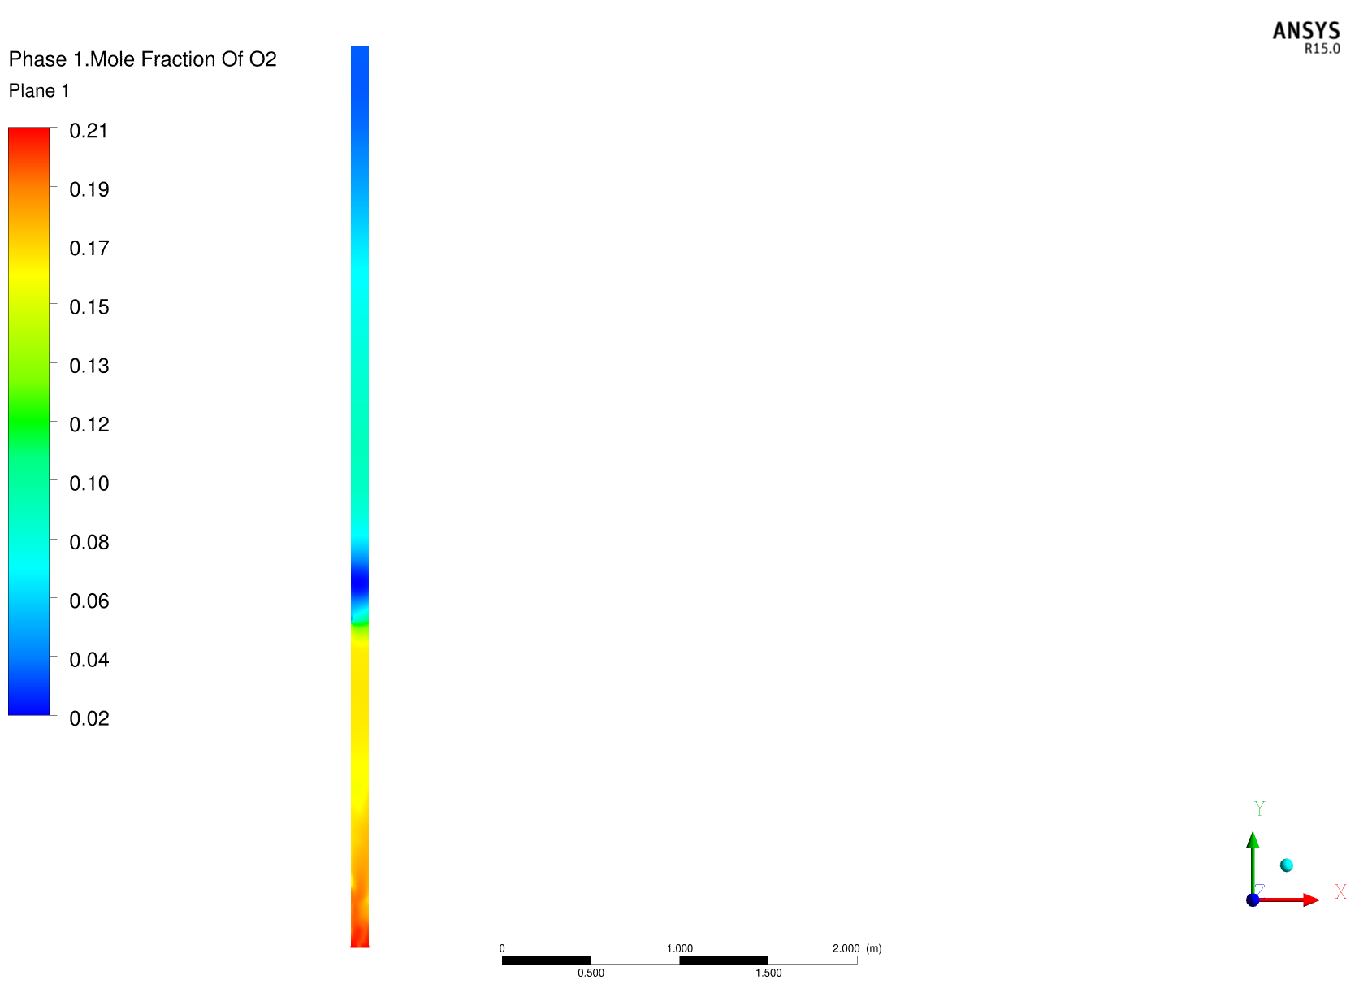
O₂ mole fraction
Measured: 1.3-1.8%
Predicted: 1.7-4.2%

Slide 21
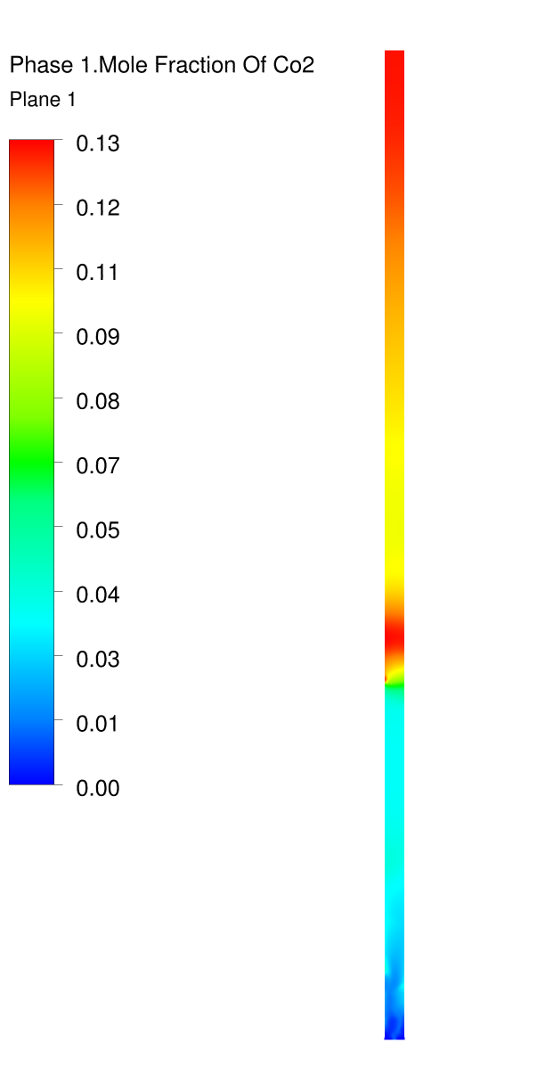
CO₂ mole fraction
Measured: 15%
Predicted: 13-16%

Slide 22
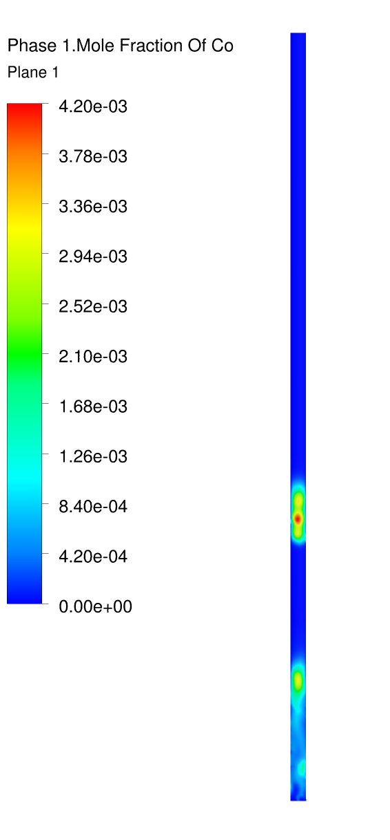
CO mole fraction
Measured: 55-155 ppm
Predicted: 0 ppm

Slide 23
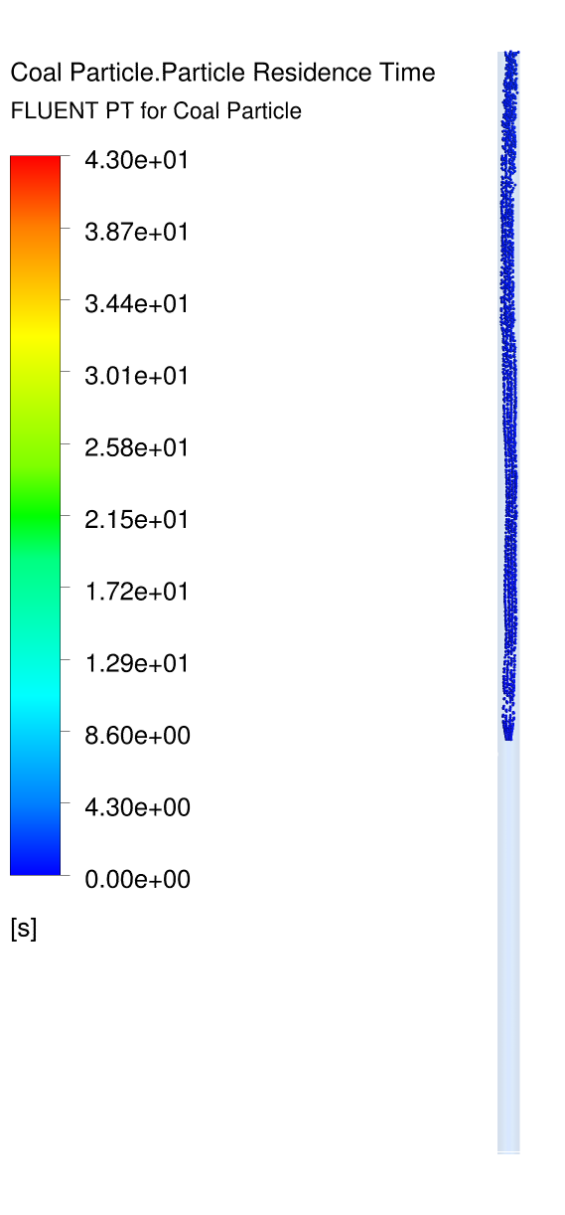

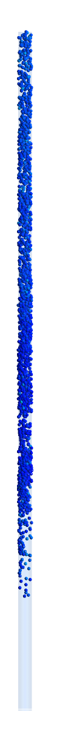
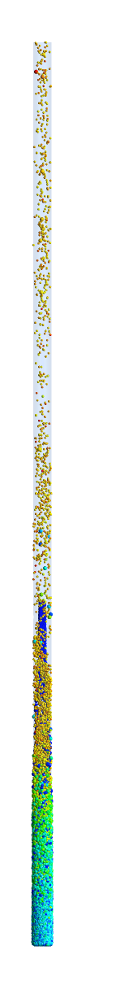
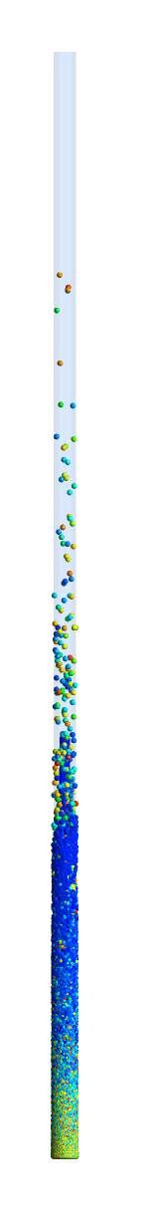
150um
300um
850um
2.36mm
5.35mm
Coal particles residence time at 50 s flow time

Slide 24
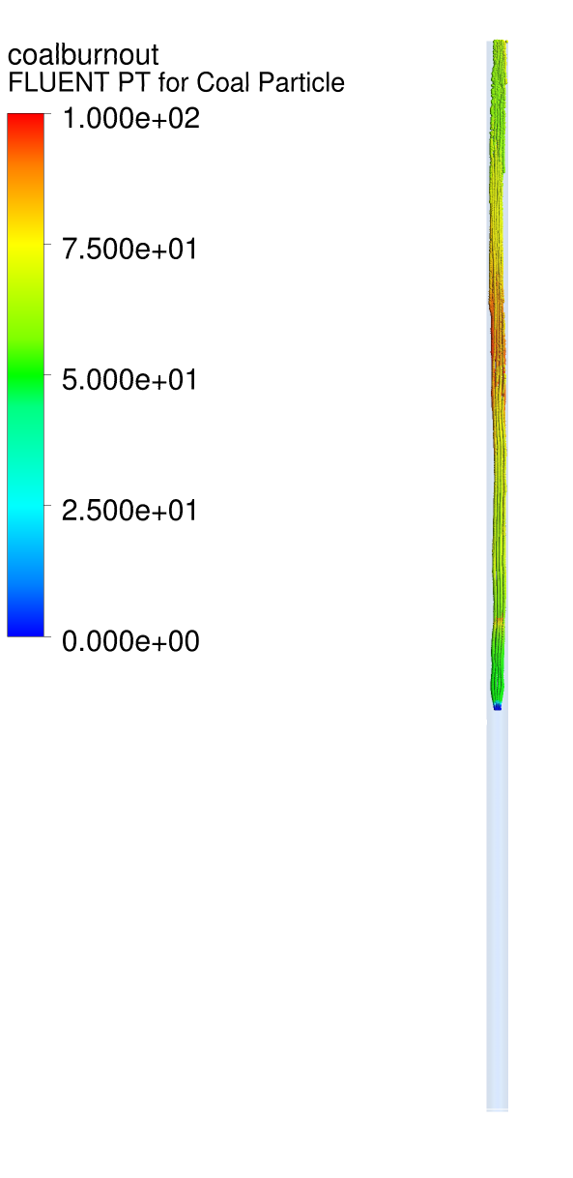
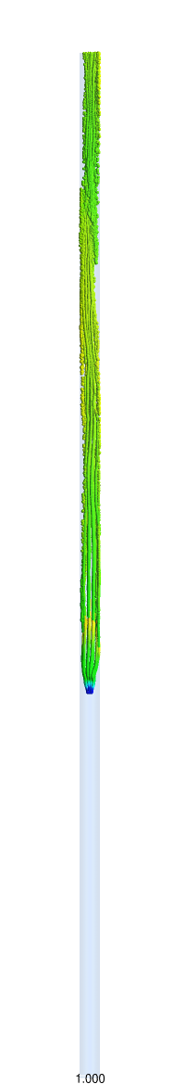
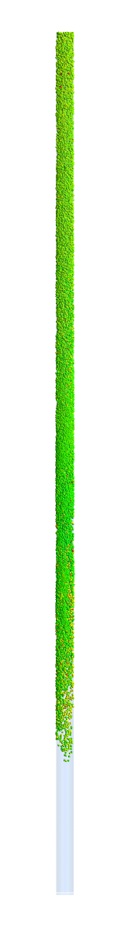
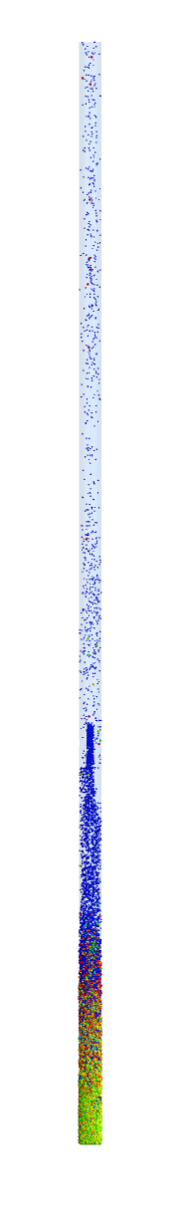
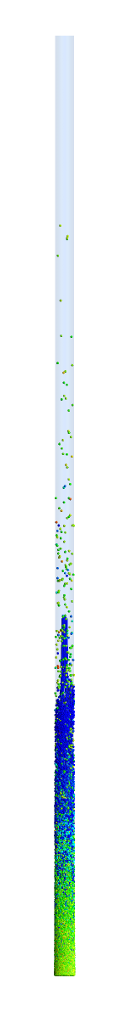
Coal particle burnout at 52 s flow time
1
2
3
150um
300um
850um
2.36mm
5.35mm

Slide 25
Summary
The modeling approach has demonstrated its capacity to predict complicated fluidized bed coal combustion operation.
Various input conditions need further verification such as size distributions for coal and sand, and coal reaction data.
Different drag laws, particle interaction models need further investigation.
The simulation time is very long.

Slide 26
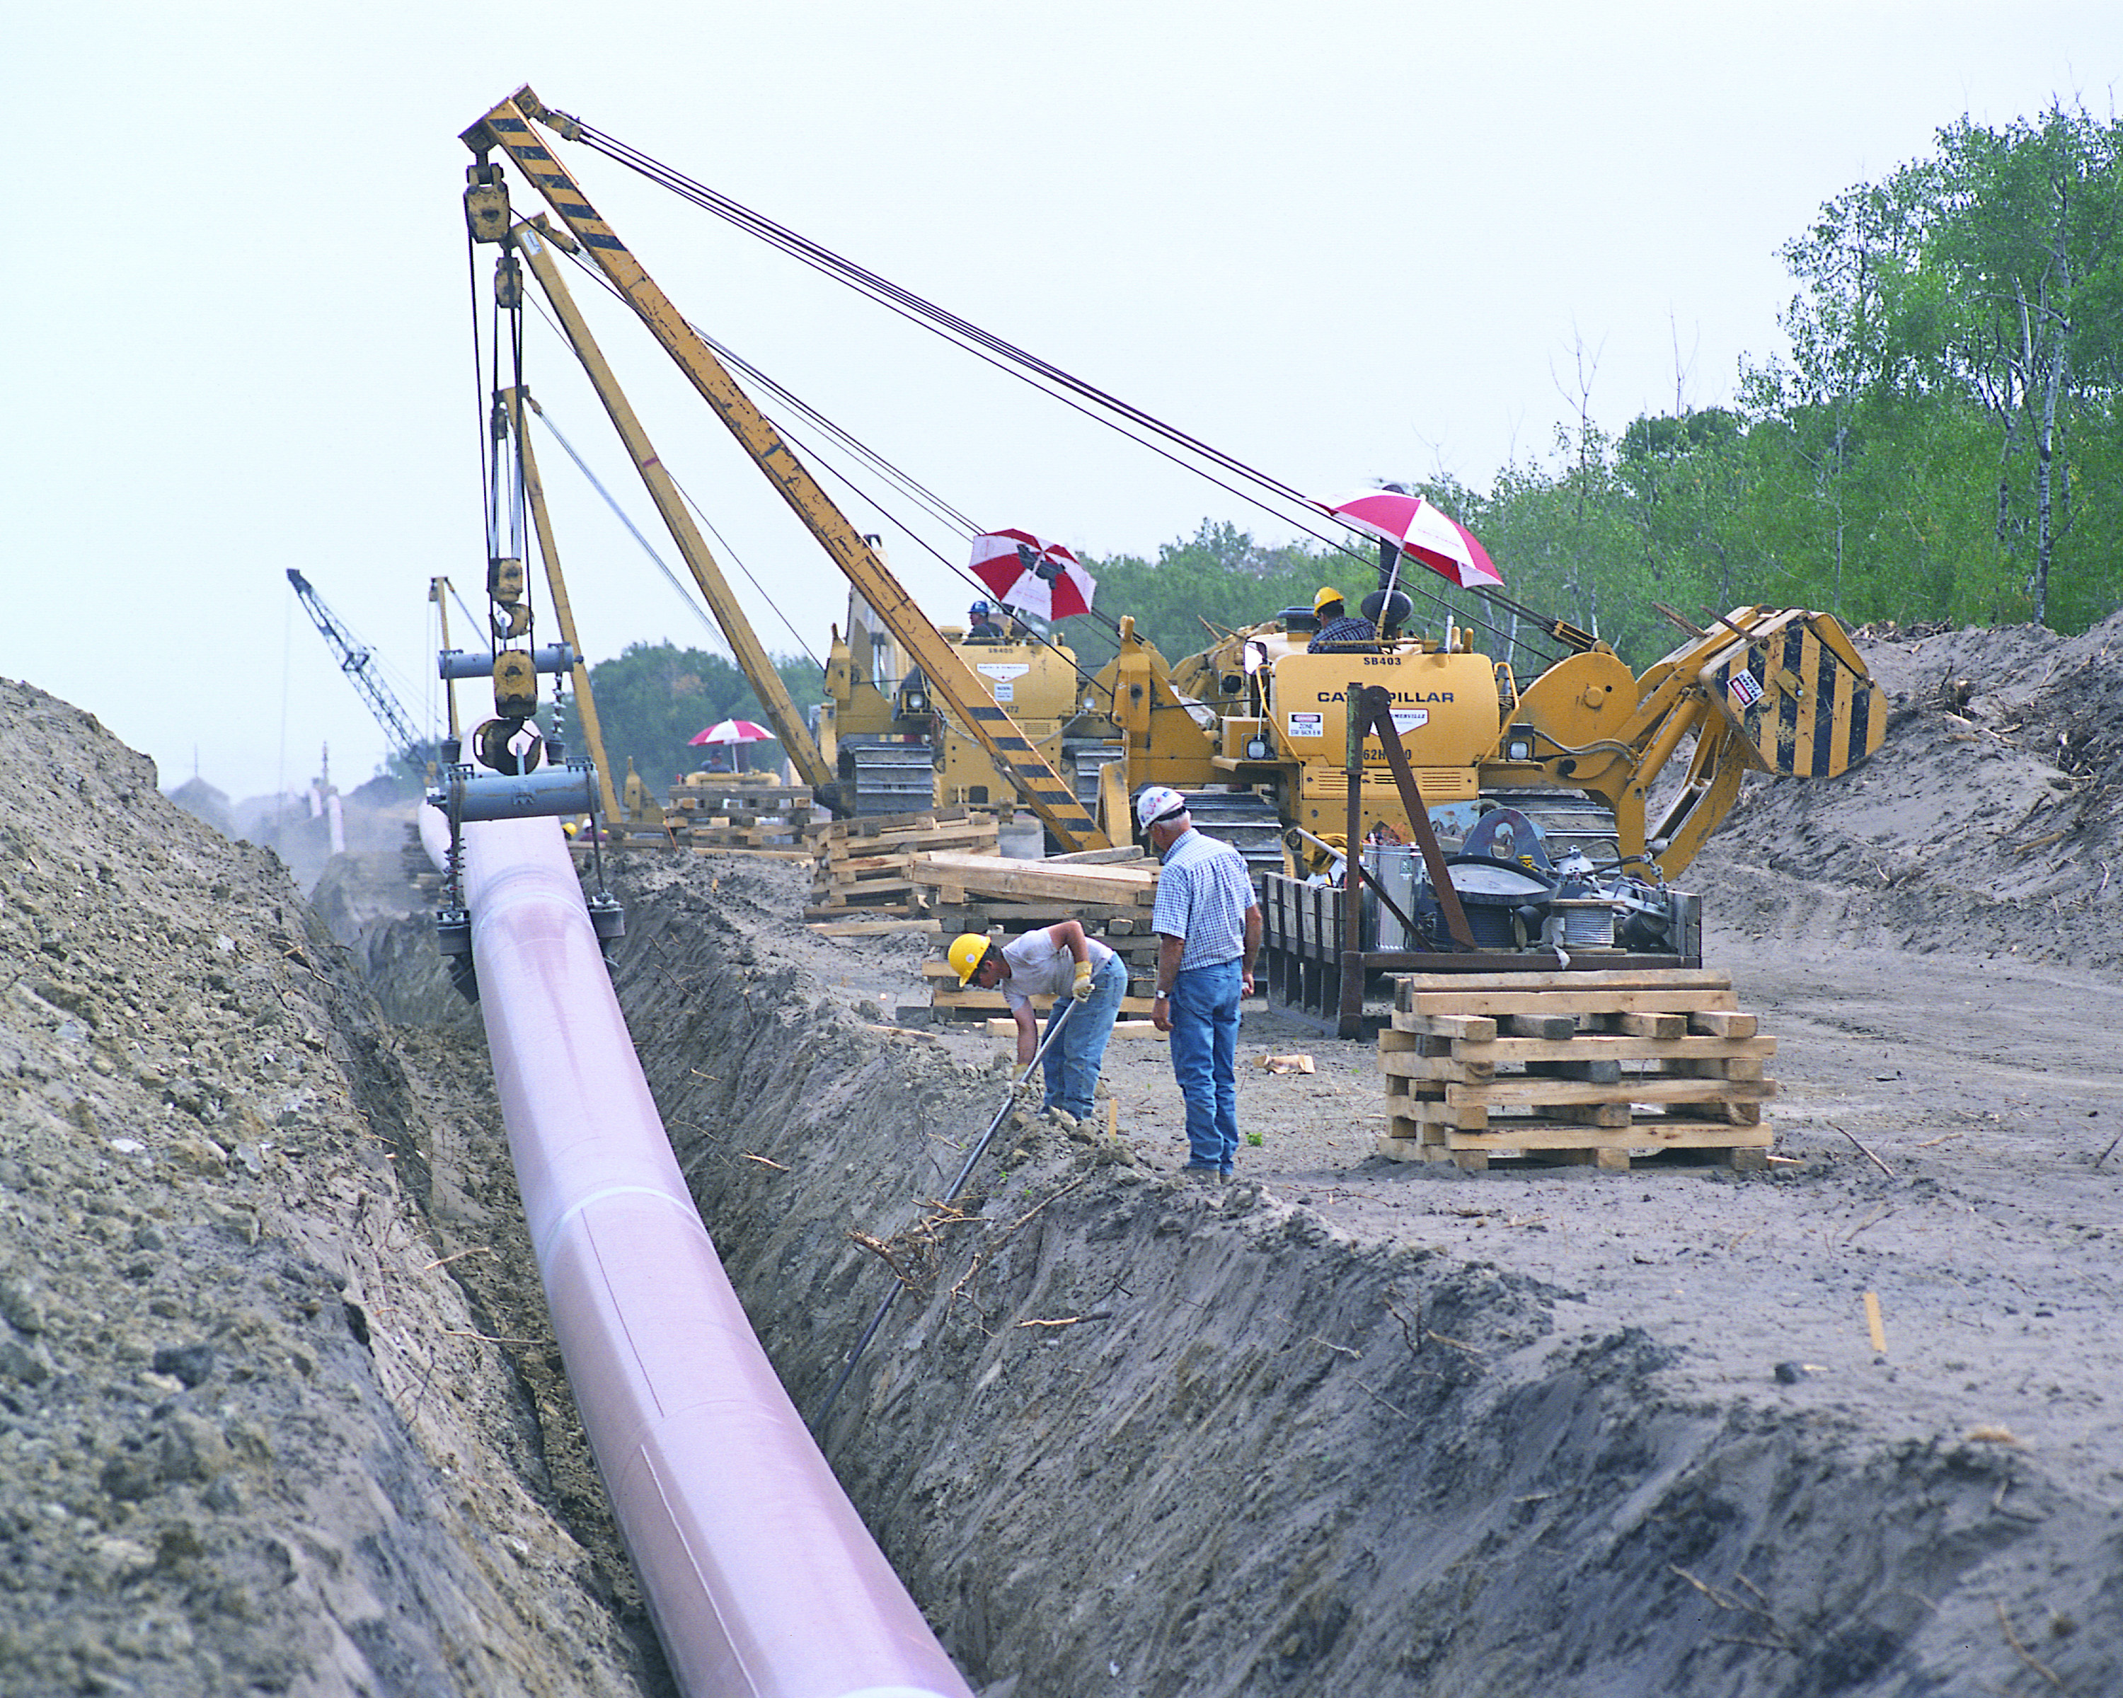
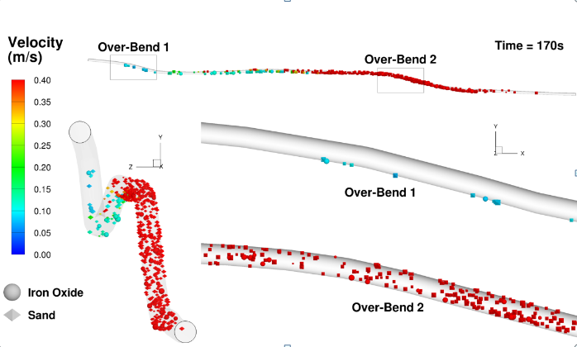
Multiphase Flows
Enbridge oil transmission pipeline
Sediment deposition and under-deposit corrosion
Notes:
ASTM G184-06. Standard Practice for Evaluating and Qualifying Oil Field and Refinery Corrosion Inhibitors Using Rotating Cage
ASTM G202-12. Standard Test Method for Using Atmospheric Pressure Rotating Cage
ASTM G170-01a. Standard Guide for Evaluating and Qualifying Oilfield and Refinery Corrosion Inhibitors in the Laboratory

