Slide 1

Simulations of Heat Transfer to Solid Particles Flowing through a Solar Receiver
2015 NETL Workshop on Multiphase Flow Science
August 12th 2015

Slide 2
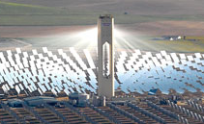
Concentrating Solar Power

Slide 3
Challenges for CSP technology
How different heat transfer fluids impact design
Operate at high temperatures; T Efficiency
Limit on/off cycling; Day/night and cloud cover
  Thermal storage (Run 24hr/day)

Slide 4
Challenges for CSP technology
How different heat transfer fluids impact design
Operate at high temperatures; T Efficiency
Limit on/off cycling; Day/night and cloud cover
  Thermal storage (Run 24hr/day)
Candidate Fluids | High Temp? | Thermal Storage?
Steam | Yes | No High pressure overhead
Molten Salts | No they explode | Yes chemical storage

Slide 5
Challenges for CSP technology
How different heat transfer fluids impact design
Operate at high temperatures; T Efficiency
Limit on/off cycling; Day/night and cloud cover
  Thermal storage (Run 24hr/day)
Candidate Fluids | High T? | Thermal Storage?
Steam | Yes | No High storage costs
Molten Salts | No chemically unstable | Yes
Sand | Yes | Yes

Slide 6
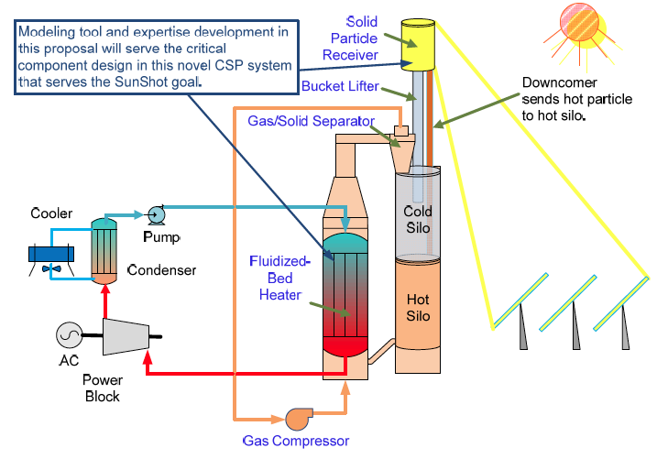
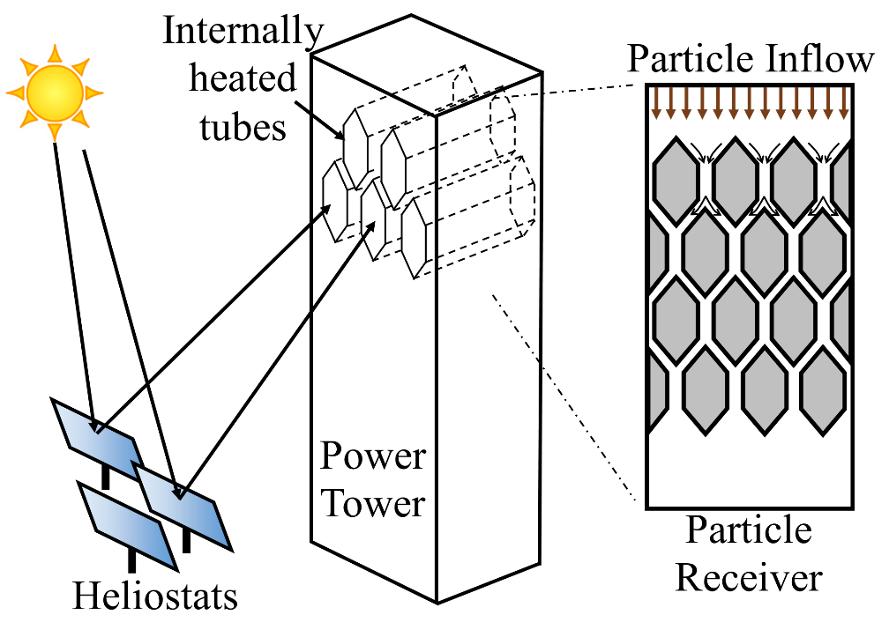
NREL SunShot CSP Award (PI: Zhiwen Ma)
  Overall Goal: Fundamental, continuum modeling tool that can be used for design of particle receiver: understanding and prediction of heat transfer in solids flows, including radiation
  Why fundamental? Counterintuitive/non-monotonic trends, correlations unreliable for extrapolation
  Why continuum model? Discrete-particle models computationally infeasible

Slide 7
Model Development for Solar Collector
Overall Approach: Use DEM simulations as “ideal experiment” to test continuum theory
  DEM: instantaneous, local, non-intrusive measurements of
  concentration, velocity, and temperature
  DEM: can turn various mechanisms on/off to assess relative contributions
Computational Tool: MFIX (Multiphase Flow with Interface eXchanges)
DEM
Continuum

Slide 8
Heat transfer mechanisms
Conduction
Particle-wall and particle-fluid-wall
Conduction to particles

Slide 9
Heat transfer mechanisms
Conduction
Particle-wall and particle-fluid-wall
Convection
Entrained gas warmed heated and then heats particles
Conduction to particles
Convective transfer to gas

Slide 10
Heat transfer to flowing particles
Conductive heat transfer: Particle vs. molecular fluids
Thermal contact “resistance” for particle flows
  Thermal slip for particle flows – molecular fluids often no slip
Slip
T_{s,∞}
T_{s,w}
T_{wall}

Slide 11
Heat transfer to flowing particles
Conductive heat transfer: Particle vs. molecular fluids
Thermal contact “resistance” for particle flows
  Thermal slip for particle flows – molecular fluids often no slip
  Contact resistance depends on how particles contact wall
    Solids concentration near wall
    Particle size / morphology
Slip
T_{s,∞}
T_{s,w}
T_{wall}

Slide 12
Heat transfer to flowing particles
Conductive heat transfer: Particle vs. molecular fluids
Thermal contact “resistance” for particle flows
  Thermal slip for particle flows – molecular fluids often no slip
  Contact resistance depends on how particles contact wall
    Solids concentration near wall
    Particle size / morphology
  Often modeled using Nusselt number correlation
    Existing models are empirical or analytically derived
    for packed beds
Slip
T_{s,∞}
T_{s,w}
T_{wall}

Slide 13
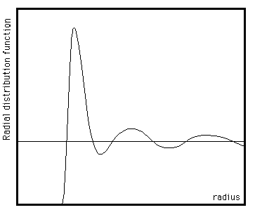
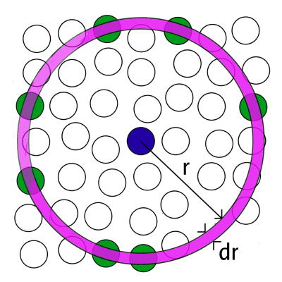
New continuum heat transfer model
Heat transfer for flowing particles
Account for particle arrangement via “particle-wall” distribution function
  Analogous to radial distribution function
Integrate heat transfer contributions from particles y distance from wall
Measured particle-wall DF from DEM and developed Nu correlation for flowing particles
“classic”
radial distribution function g(r)
new “particle-wall”
distribution function χ(y)
¹Morris, A. B., Pannala, S., Ma, Z., and Hrenya, C. M., “A conductive heat transfer model for particle flows over immersed surfaces,” International Journal of Heat and Mass Transfer, vol. 89, 2015, pp. 1277-1289.

Slide 14
Local Heat Transfer Coefficient: New Model vs. Previous
New model tested for particle flow down top surface of hexagon
  Not tested for full receiver

Slide 15
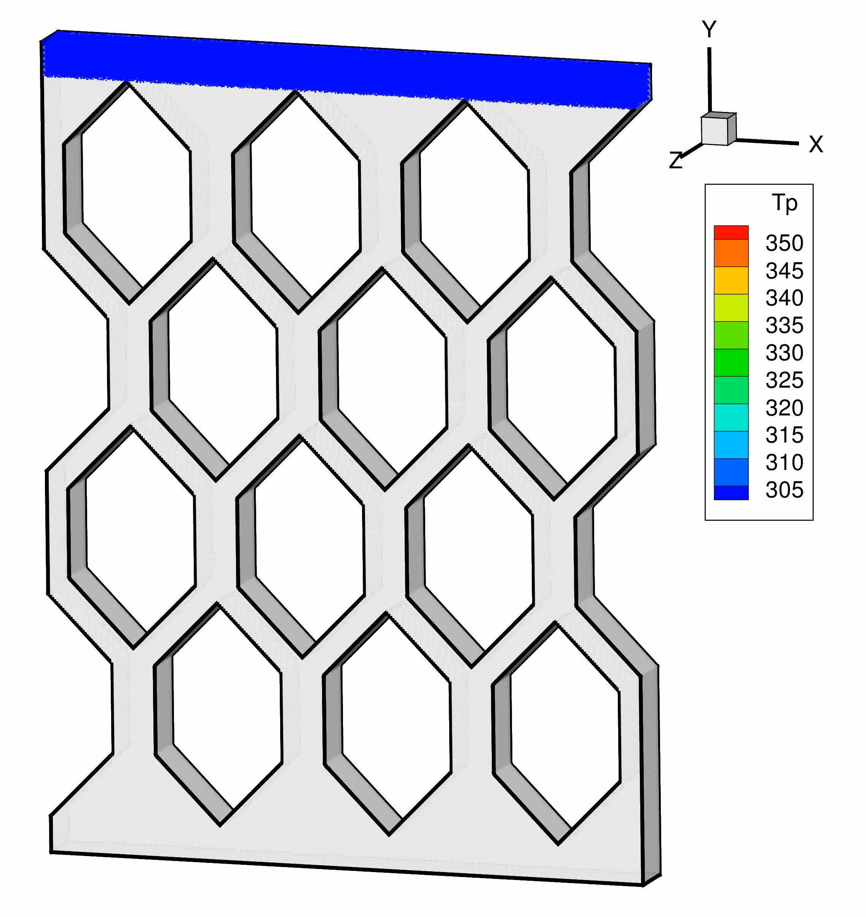
DEM Simulations of hexagonal tube array
Base case
~ 6 million particles
Also varied…
Tube spacing
Apex angle
Flow rate
Particle size
Particle Diameter | 300 µm
e (rest. coeff) | 0.9
Solids Mass Flux | 258.2 kg/m²-s
Inlet Temperature | 300 K
Wall Temperature | 600 K
X-spacing | 5.04 cm
Y-spacing | 4.98 cm
Hexagon Width | 3.78 cm
Hexagon Height | 6.42 cm
Apex Angle | 89°

Slide 16
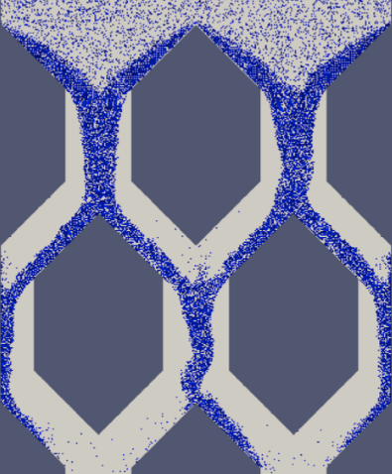
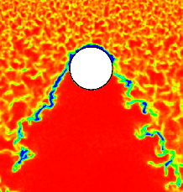
DEM Simulations of hexagonal tube array
Hydrodynamic instabilities in 2-D vs 3-D
Instabilities develop later in 3-D than 2-D. Still similar to experiments
Experiments
2-D DEM
3-D DEM

Slide 17
DEM Simulations of hexagonal tube array
Role of Apex Angle
Heat transfer decreases as
apex steepens
Apex Angle | Average h [W/m²-K]
89° | 487.41
75° | 371.42
60° | 344.14
Apex = 89°
Apex = 60°

Slide 18
DEM Simulations of hexagonal tube array
Role of Apex Angle
Heat transfer decreases as
apex steepens and as velocity
increases
Opposite trend for molecular
fluids
Apex Angle | Average h [W/m²-K]
89° | 487.41
75° | 371.42
60° | 344.14
Apex = 89°
Apex = 60°

Slide 19
DEM Simulations of hexagonal tube array
Role of Particle Size
** Only two rows of hexagons simulated
Slightly stronger instabilities for small particles
Particle size | Average h [W/m²-K]
300 micron | 487.41
200 micron | 780.34
100 micron | 997.23**
D_{p} = 300µm
D_{p} = 200µm
~12 million
particles

Slide 20
DEM Simulations of hexagonal tube array
Role of Mass Flow Rate
Less heat transfer at low mass flux (lower concentration)
Mass Flux | Average h [W/m²-K]
258.2 kg/m²-s | 487.41
129.1 kg/m²-s | 313.28
Local heat transfer coefficient
Local heat transfer coefficient

Slide 21
Comparisons: Local heat transfer coefficient
Particle Diameter
Good agreement for hexagons in 1st and 2nd rows
Lines are continuum model
Symbols are DEM
Local heat transfer coefficient
Local heat transfer coefficient

Slide 22
New continuum model vs DEM
Heat transfer most sensitive to
Particle size
Solids flow rate
Apex angle
New continuum model closely matches DEM

Slide 23
Conclusions
Conductive heat transfer strongly depends on solids concentration and particle-wall contacts
  Previous models were derived for packed beds and are inaccurate for flowing particles
Heat transfer to flowing particles can be counter-intuitive
  Higher velocity -> less heat transfer
  Increased agitation -> less heat transfer (sometimes)
New model accounts for solids concentration via use of ‘particle-wall’ distribution function
  Accurately matches average heat transfer coefficient (average error less than 5% over all test cases)
  Accurately predicts local heat transfer coefficient
Heat transfer is most sensitive to particle size
  More heat transfer for smaller particles (caveat: no jamming)

Slide 24


Acknowledgements
Ben Grote (Undergraduate researcher)
University of Colorado
Aaron Lattanzi (PhD candidate)
University of Colorado
This work was funded under the SunShot initiative through the U.S. DOE BRIDGE program (grant no. DE-EE0005954).
The simulations in this work were performed using resources at the Oak Ridge Leadership Computing Facility located at Oak Ridge National Laboratory. This computing facility is supported by the Office of Science of the DOE under contract DE-AC05-00OR22725.
Simulations were also performed on the Janus supercomputer, NSF award number CNS-0821794
New!
New!

Slide 25
Backup slides

Slide 26
DEM Simulations of hexagonal tube array
Particle Diameter | 300 µm
e (rest. coeff) | 0.9
Solids Mass Flux | 258.2 kg/m²-s
Inlet Temperature | 300 K
Wall Temperature | 600 K
Role of Horizontal Gap Spacing
Δx = {5.04cm, 4.80cm, 4.44cm}
Flow chokes for narrow gap
Δx = 5.04cm
Δx = 4.44cm

Slide 27
DEM Simulations of hexagonal tube array
Role of Horizontal Gap Spacing
Heat transfer increases ~20% for
narrowest gap
  Flow chokes and improved side
  wall contact
  Higher surface conc. in top row
x-spacing | Average h [W/m²-K]
5.04 cm | 487.41
4.80 cm | 484.90
4.44 cm | 584.16
Local heat transfer coefficient

