Slide 1
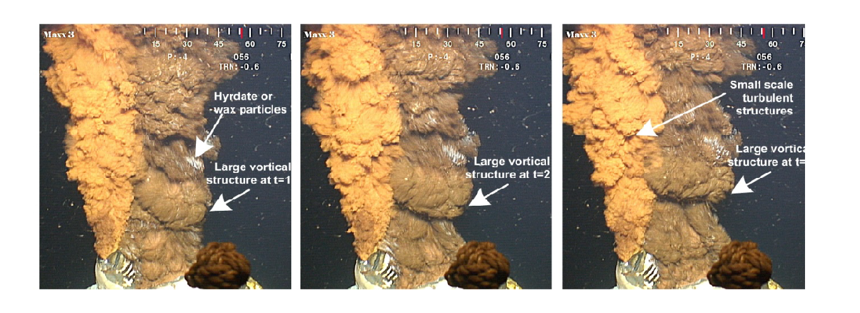
Pankaj Saha, Ph.D
Numerical Study of Submerged Oil Leak Jet
ORISE Research Fellow
August 13, 2015

Slide 2
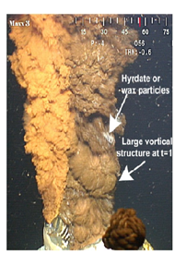
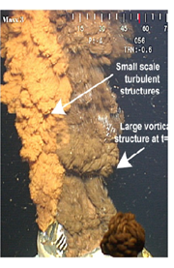
Motivation:
An Opaque Jet stream discharging into sea water.
Jet is turbulent and oil-water interface shows eddies with different size.
How to calculate oil discharge rate?
No information inside the Jet core is available due to Opaque Oil.
Only option is to use the information of visible large scale features at the outer-edge
No reliable correlation available between jet core velocity and outer-edge velocity for multiphase jet.
Plan is to pursue lab scale experiment and their CFD simulation to find relationship between outer-edge velocity and jet –core velocity.
Camera Images of Oil discharge from Macondo wellhead at the bottom of Gulf of Mexico (June 3, 2010). Re=125,000
Deepwater Horizon video clip by Oceaneering International Inc

Slide 3
Outline of the Talk
Introduction and Motivation
Problem Description
Numerical Approach
Result and Discussion
Conclusion

Slide 4
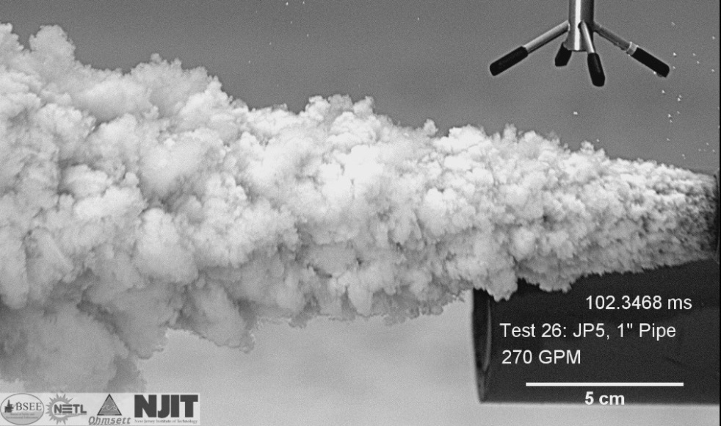
Problem Description: Experimental Test Case
Experimental Test Case used for CFD Study
Video Image of Submerged Turbulent Oil Jet (JP-Fuel) : Experiment done by NETL Group at OHMSETT, Dec , 2014.
Oil Jet is Discharged from a long submerged pipe end into Water.
Jet Condition at pipe exit is fully turbulent.
Flow rate: 270GPM, D=1”, Re=20,000
Properties:
Surface Tension:
The Images show large and small scale vortices and sharp interfaces
Large Scale spatial Structures
Small Scale Turbulence Structures

Slide 5
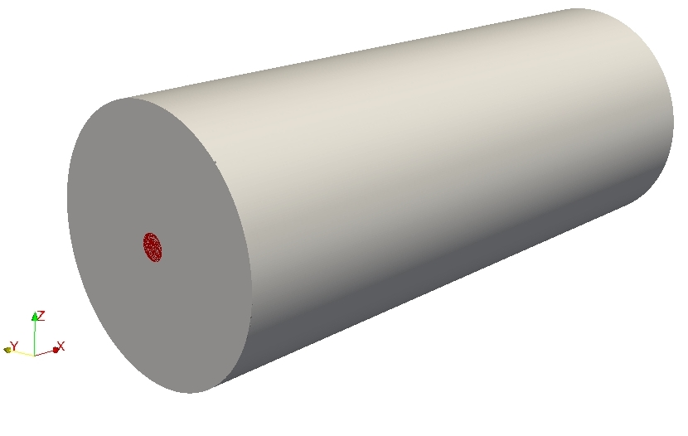
Numerical Set Up
Fully developed turbulent oil jet from exit of circular pipe end discharged into quiescent water .
Computational Domain: 25Dx10Dx10D
D=Diameter of Jet=1 inch, Re=20,000
Oil-Water properties taken from Experimental flow conditions
Imposed Boundary Condition:
Jet Inlet: Fully developed realistic turbulent inflow condition
All Other Planes: Pressure-Outlet
10D
25D
Jet Inlet
Schematic of computational domain
Energy consumption: DOE EIA, http://www.eia.gov/cfapps/ipdbproject/IEDIndex3.cfm?tid=44&pid=44&aid=2, accessed 12/01/14
GDP: UNDP, http://hdr.undp.org/en/content/gdp-per-capita-2011-ppp, accessed 12/01/14

Slide 6
Numerical Approach: Solution Technique
Numerical package: OpenFOAM, an open source FVM based Unstructured Collocated solver. It has collection of libraries to describe different mathematical terms of the governing fluid flow equations. The libraries are embedded to make a specific Solver
Multiphase Incompressible 3D N-S solvers flow solver- interFoam.
Single-Fluid Approach- Both the fluids use same set of governing equations. The mixture properties are calculated by volume weighted average based on volume Fraction.
Immiscible Oil-Water interface is captured using VOF method.
VOF employ High Resolution Interface Capturing convective Scheme (HRIC) to accurately predict the interface.
Turbulence is modelled by Large Eddy Simulation (LES) approach
LES: One equation eddy model is used.
Energy consumption: DOE EIA, http://www.eia.gov/cfapps/ipdbproject/IEDIndex3.cfm?tid=44&pid=44&aid=2, accessed 12/01/14
GDP: UNDP, http://hdr.undp.org/en/content/gdp-per-capita-2011-ppp, accessed 12/01/14

Slide 7
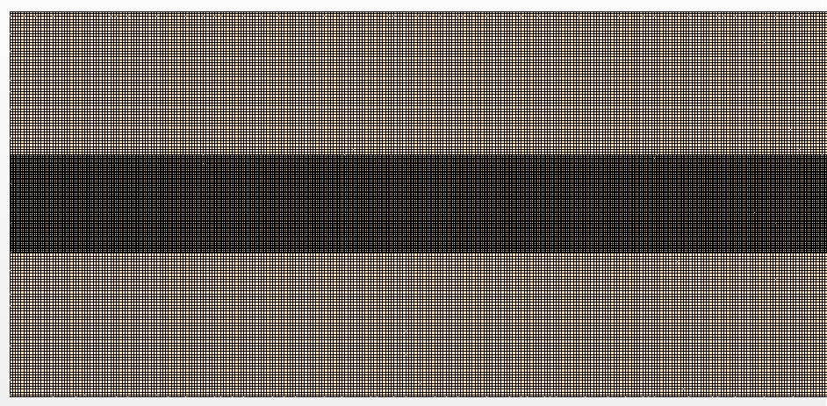
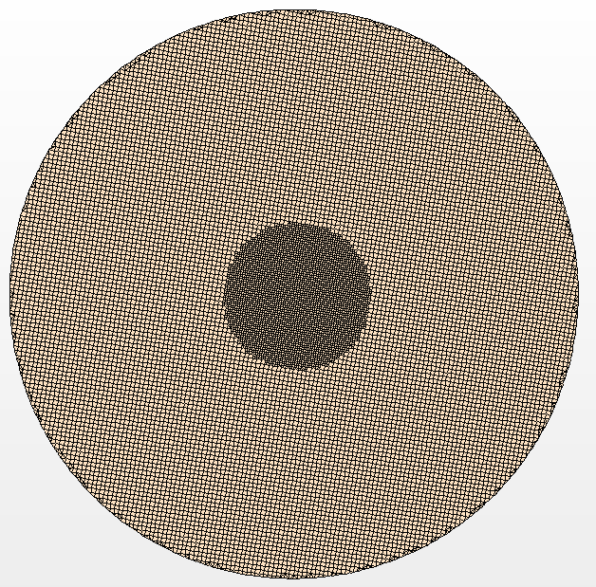
Numerical Approach: Grid
LES needs fine grid to resolve scales upto inertial range.
Shear layer and Jet regions need finer grid to resolve fine scales.
“Hinze” relation for dissipation length scale:
length scale at inertial sub-range:
Re=20000,
Grid: 7 M Cells
Time Step=10⁻⁰⁵
Energy consumption: DOE EIA, http://www.eia.gov/cfapps/ipdbproject/IEDIndex3.cfm?tid=44&pid=44&aid=2, accessed 12/01/14
GDP: UNDP, http://hdr.undp.org/en/content/gdp-per-capita-2011-ppp, accessed 12/01/14

Slide 8
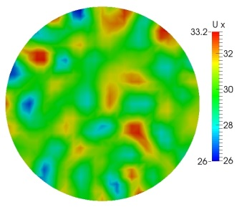
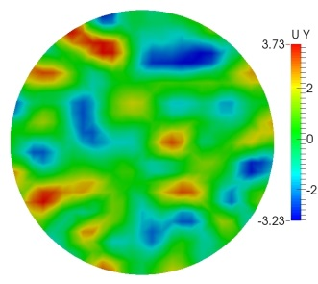
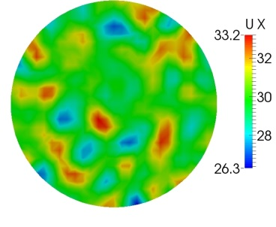
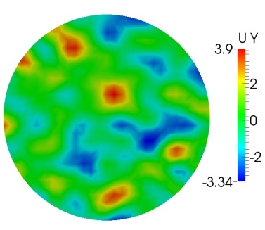
Turbulent Inlet B.C: Synthetic Turbulence Generator
LES needs realistic turbulent inflow at inlet
Turbulence at Inlet is specified by Synthetic Turbulence Generator.
The Technique uses random spot method by using the information of initial velocity profile , stress component and turbulence Intensity.
The Technique ensure well spatial and temporal coherence.
Initial specification of turbulence intensity for inflow generator was calculated using standard pipe flow correlations.
T=0 s
T=3 s
Spatial coherent structures
Generate spatial coherent Structures
The structures does not attenuate over time
Energy consumption: DOE EIA, http://www.eia.gov/cfapps/ipdbproject/IEDIndex3.cfm?tid=44&pid=44&aid=2, accessed 12/01/14
GDP: UNDP, http://hdr.undp.org/en/content/gdp-per-capita-2011-ppp, accessed 12/01/14

Slide 9
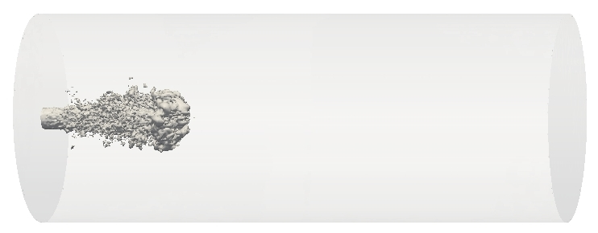
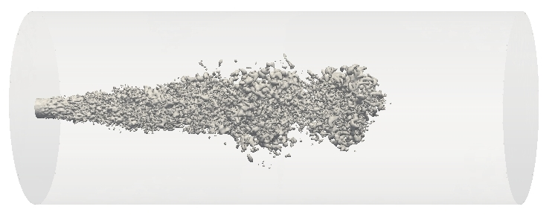
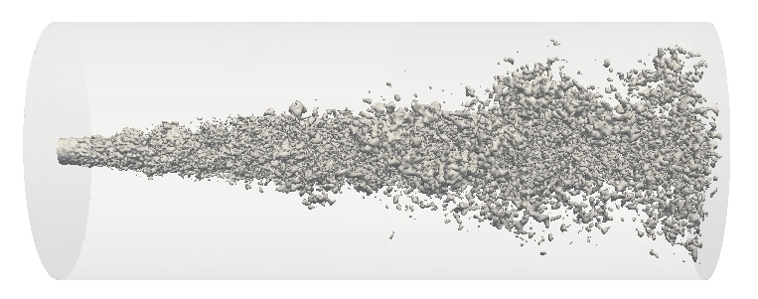
Result and Discussion: Stages of Jet Formation
Top Fig.: Shows roll up of Shear layer eddies
T=0.01 s
Bottom Fig.: Shows formation of Jet ligaments, and breaks into smaller size droplets.
Transient development shows Jet leaves the domain in 0.1 Seconds.
Flow through Time is ~0.2 Seconds
T=0.04 s
T=0.1 s
Iso-Surface of volume Fraction
Energy consumption: DOE EIA, http://www.eia.gov/cfapps/ipdbproject/IEDIndex3.cfm?tid=44&pid=44&aid=2, accessed 12/01/14
GDP: UNDP, http://hdr.undp.org/en/content/gdp-per-capita-2011-ppp, accessed 12/01/14

Slide 10
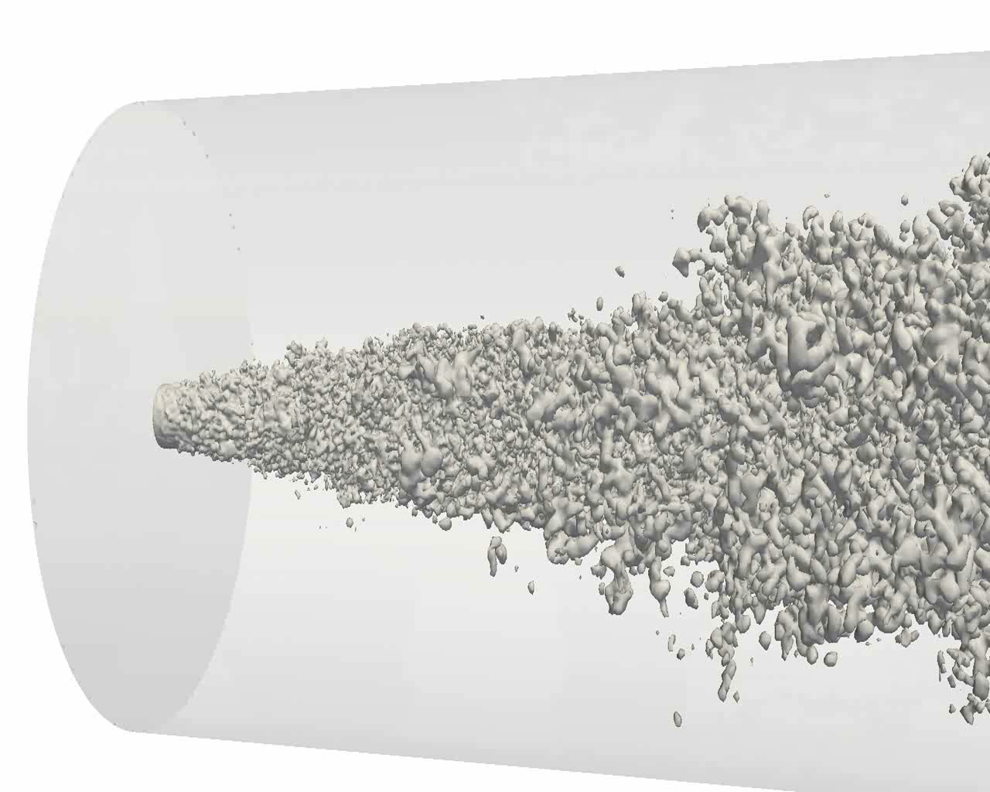
Result and Discussion: Experimental Validation
Energy consumption: DOE EIA, http://www.eia.gov/cfapps/ipdbproject/IEDIndex3.cfm?tid=44&pid=44&aid=2, accessed 12/01/14
GDP: UNDP, http://hdr.undp.org/en/content/gdp-per-capita-2011-ppp, accessed 12/01/14

Slide 11

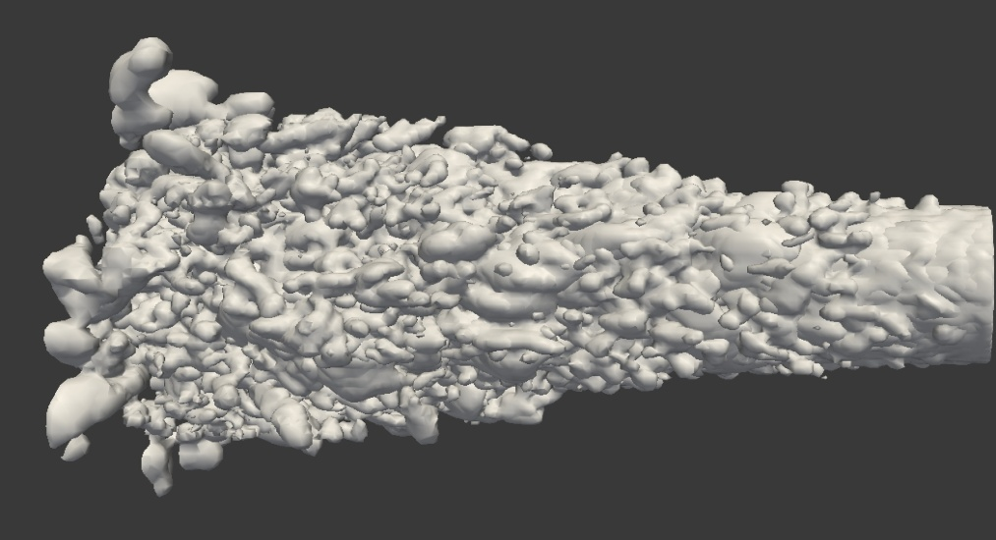
Results: Experimental Validation
Top: Image of Jet Structures from Exp.
Bottom: CFD predicted Jet Structures using iso-surface volume fraction
Both the Jet shows similar shapes of small and large scale spatial structures.
The Jet expansion angle is also same for both CFD and Experiment(~9⁰ )
Literature provide expansion angle of (10±1)
Energy consumption: DOE EIA, http://www.eia.gov/cfapps/ipdbproject/IEDIndex3.cfm?tid=44&pid=44&aid=2, accessed 12/01/14
GDP: UNDP, http://hdr.undp.org/en/content/gdp-per-capita-2011-ppp, accessed 12/01/14

Slide 12
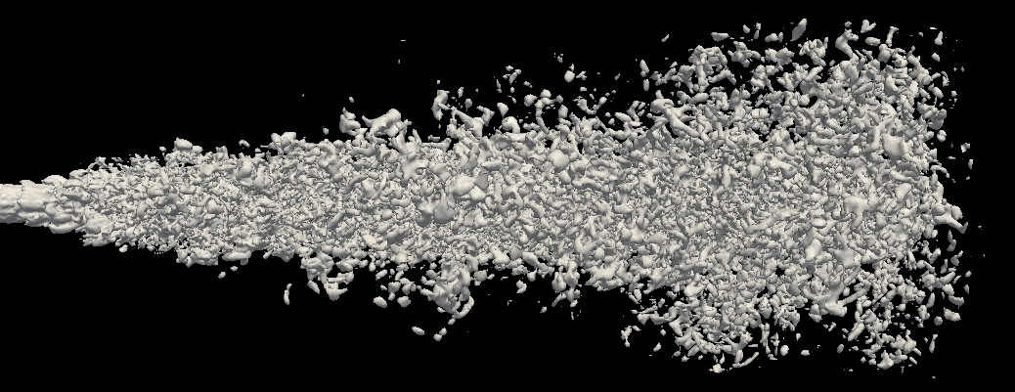
Results: 3D-Visulization of Jet
Instantaneous Jet Structures using iso-surface of volume fraction (0.5)
Ligament Formation(lobe)
Droplets Formation and striped off from jet
Energy consumption: DOE EIA, http://www.eia.gov/cfapps/ipdbproject/IEDIndex3.cfm?tid=44&pid=44&aid=2, accessed 12/01/14
GDP: UNDP, http://hdr.undp.org/en/content/gdp-per-capita-2011-ppp, accessed 12/01/14

Slide 13
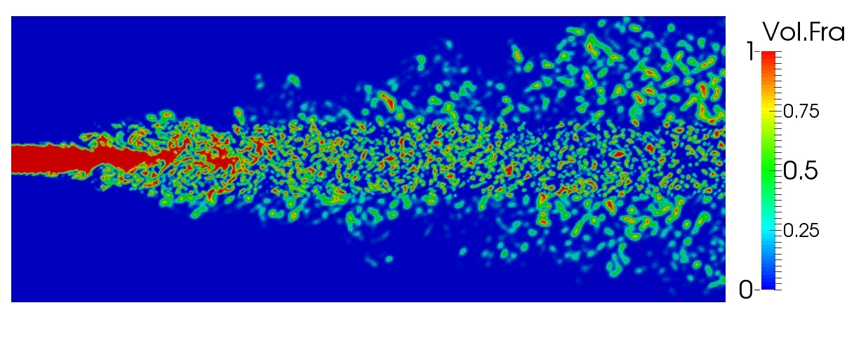
Results: 2D-Visulization at MidPlane through Jet Center
Jet Structures using iso-surface of volume fraction at Mid-Plane
Shear layer Roll Up and Sheet formation
Jet Breaks up into Droplets
Energy consumption: DOE EIA, http://www.eia.gov/cfapps/ipdbproject/IEDIndex3.cfm?tid=44&pid=44&aid=2, accessed 12/01/14
GDP: UNDP, http://hdr.undp.org/en/content/gdp-per-capita-2011-ppp, accessed 12/01/14

Slide 14
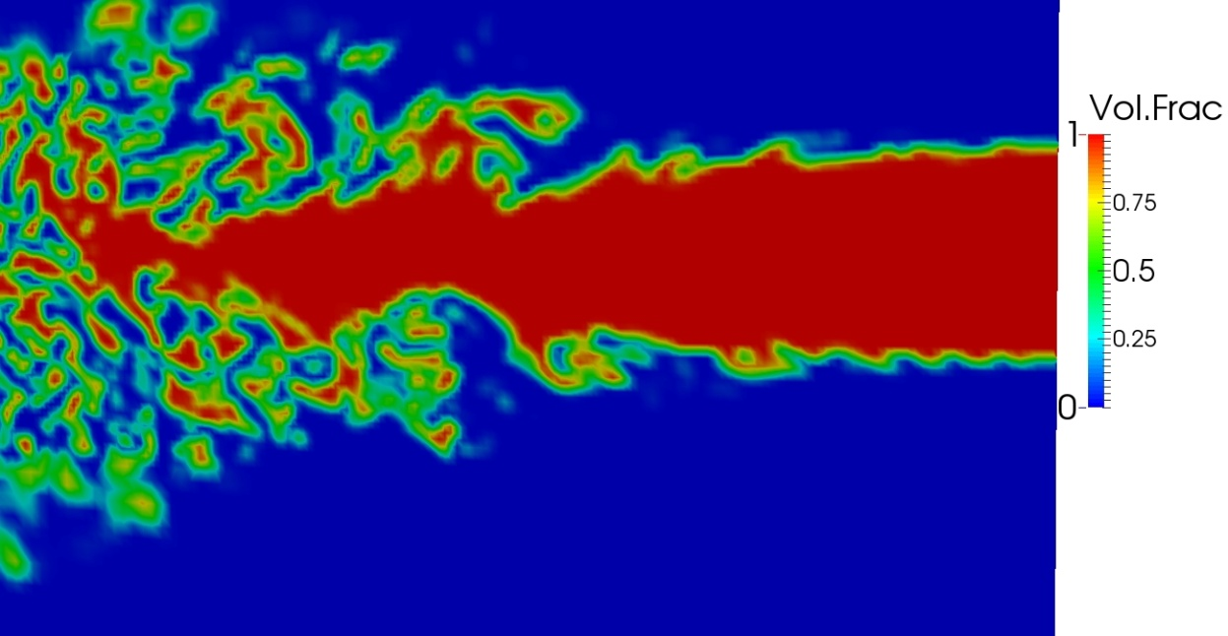
Results: Jet Near Field view at MidPlane
Contour of volume fraction at Mid-Plane shows Jet Structures
VOF Model clearly reproduce sharp interface between Oil and water
Sharp Interface with larger wavelength
Relatively finer turbulent scale
Energy consumption: DOE EIA, http://www.eia.gov/cfapps/ipdbproject/IEDIndex3.cfm?tid=44&pid=44&aid=2, accessed 12/01/14
GDP: UNDP, http://hdr.undp.org/en/content/gdp-per-capita-2011-ppp, accessed 12/01/14

Slide 15
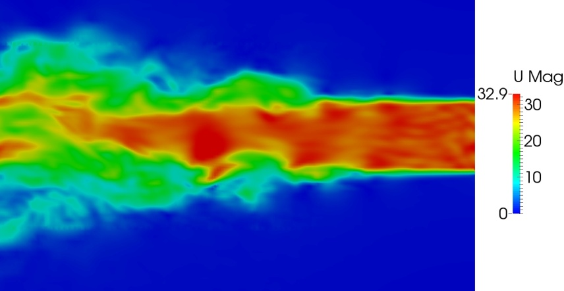
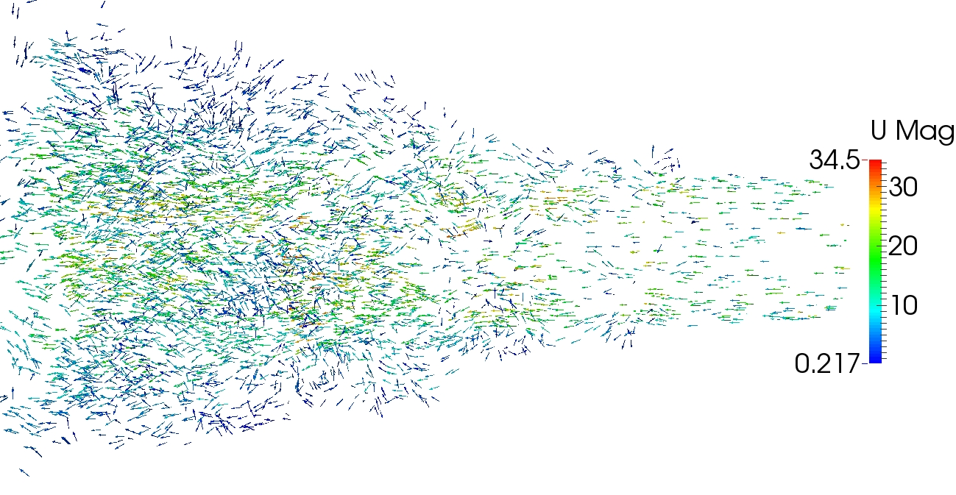
Results: Jet Near Field view at MidPlane
Contour of Velocity and Velocity Vector
Finer turbulent scale at the interface
Strong inward motion and entrainment of ambient water at interface
Energy consumption: DOE EIA, http://www.eia.gov/cfapps/ipdbproject/IEDIndex3.cfm?tid=44&pid=44&aid=2, accessed 12/01/14
GDP: UNDP, http://hdr.undp.org/en/content/gdp-per-capita-2011-ppp, accessed 12/01/14

Slide 16
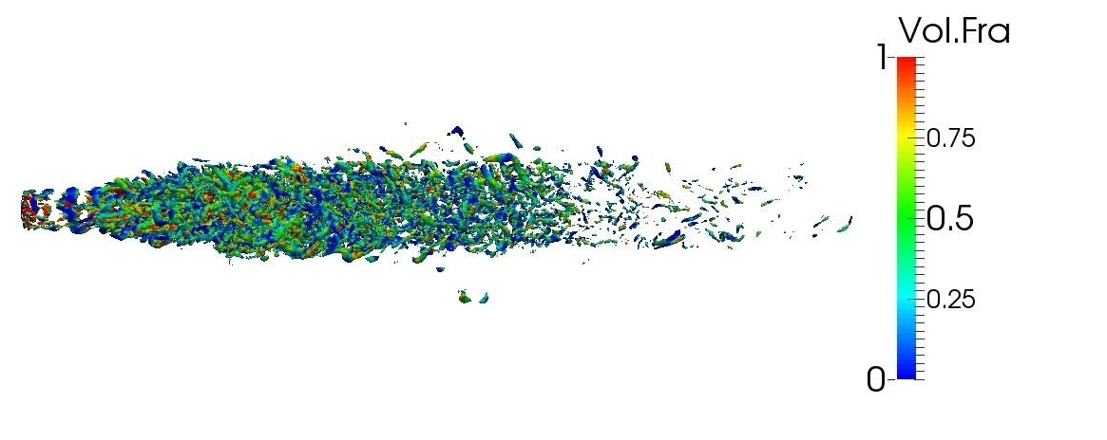
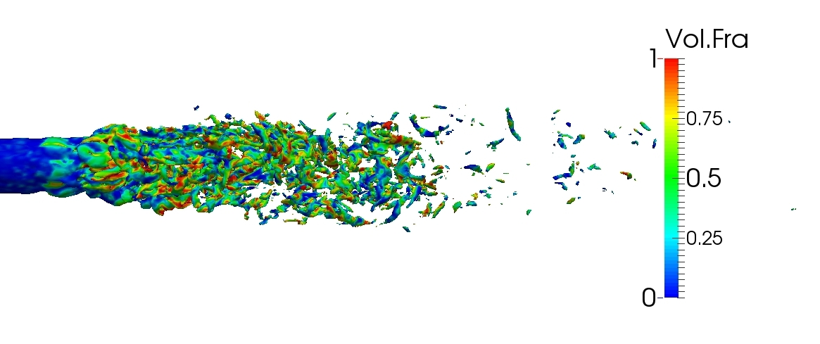
Results: Identification of large-Scale turbulent Structures
Iso-Surface of Second-invariant
Turbulent Structures are characterize by spatial structures with pure rotation not the shear.
Second invariant technique can isolate shear from strain rate tensor, while vorticity cannot.
Both the technique identifies large-scale tubular vortical structures at the outer-edge.
Downstream no visible structures due to small scale droplets.
Unlike Second Invariant, Vorticity technique captures strong shear layer at Jet Inlet, which is not turbulent structures.
Large Scale structures posses volume fraction threshold of ~0.4. This volume fraction is used to identify outer edge interface of large scale structures.
Convection velocity of these structures is representative of outer-edge velocity.
Iso-Surface of vorticity
Energy consumption: DOE EIA, http://www.eia.gov/cfapps/ipdbproject/IEDIndex3.cfm?tid=44&pid=44&aid=2, accessed 12/01/14
GDP: UNDP, http://hdr.undp.org/en/content/gdp-per-capita-2011-ppp, accessed 12/01/14

Slide 17
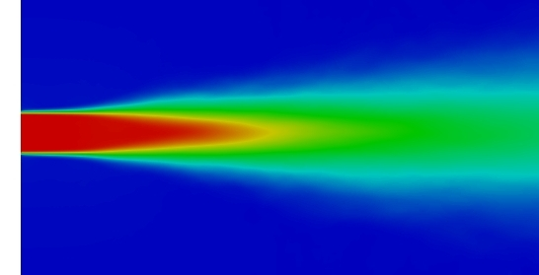
Results: Core Length of primary Jet break Up
Contour of Mean Volume Fraction
Core Length of Jet primary break up is defined as the axial length where the area of Jet is reduced by 5%.
Lc~2D
Energy consumption: DOE EIA, http://www.eia.gov/cfapps/ipdbproject/IEDIndex3.cfm?tid=44&pid=44&aid=2, accessed 12/01/14
GDP: UNDP, http://hdr.undp.org/en/content/gdp-per-capita-2011-ppp, accessed 12/01/14

Slide 18
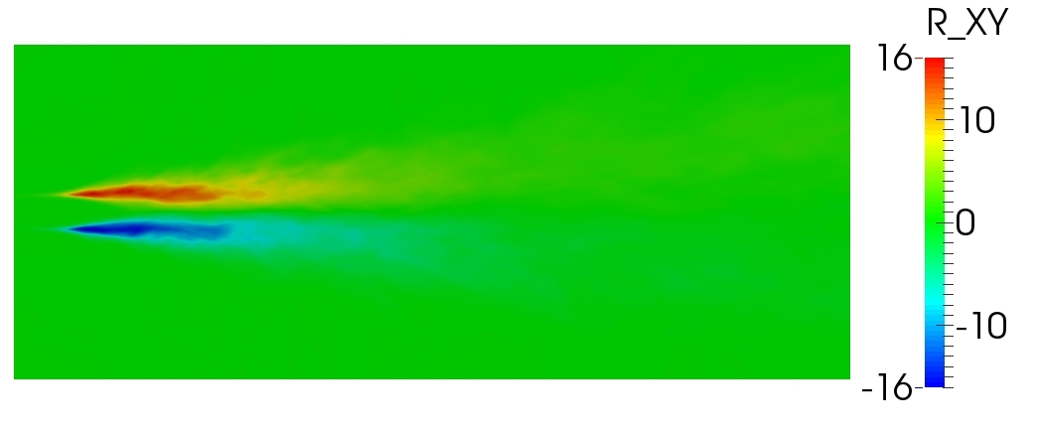
Results: Turbulence Statistics: Axial Mid Plane
Contour of resolved Reynolds Stress
Reynolds stresses are dominant in shear layer
Energy consumption: DOE EIA, http://www.eia.gov/cfapps/ipdbproject/IEDIndex3.cfm?tid=44&pid=44&aid=2, accessed 12/01/14
GDP: UNDP, http://hdr.undp.org/en/content/gdp-per-capita-2011-ppp, accessed 12/01/14

Slide 19
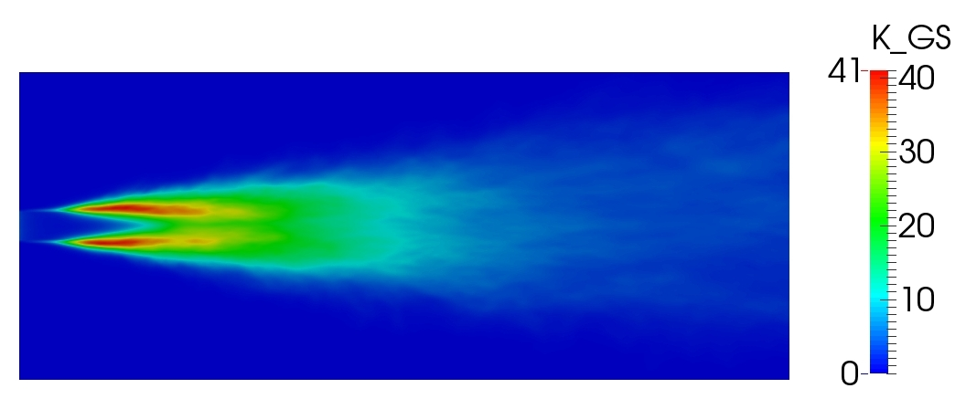
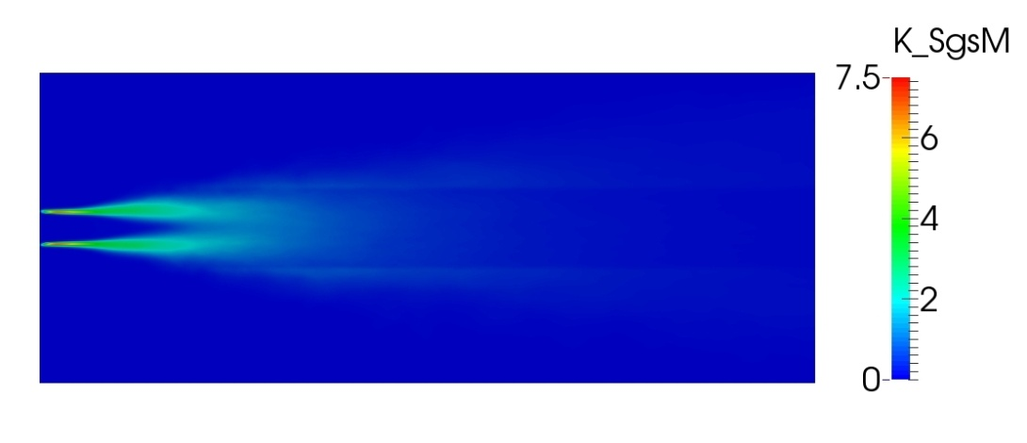
Results: Turbulence Statistics: Axial Mid Plane
Distribution of Turbulent Kinetic Energy
Top: Resolved TKE
Bottom: SGS TKE
Distribution shows larger turbulent activity in the Shear layer region
The turbulence activity are less in the downstream region where droplets are dominant.
Suggest fine grid in Shear layer and in initial Jet formation region.
Ratio of K_GS/(K_GS+K_SGS)= 85%.
Ensures LES is resolving good amount of TKE. And the grid is fine enough.
Energy consumption: DOE EIA, http://www.eia.gov/cfapps/ipdbproject/IEDIndex3.cfm?tid=44&pid=44&aid=2, accessed 12/01/14
GDP: UNDP, http://hdr.undp.org/en/content/gdp-per-capita-2011-ppp, accessed 12/01/14

Slide 20
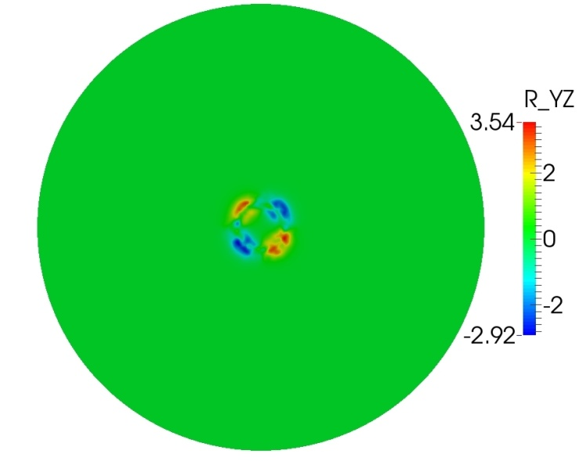
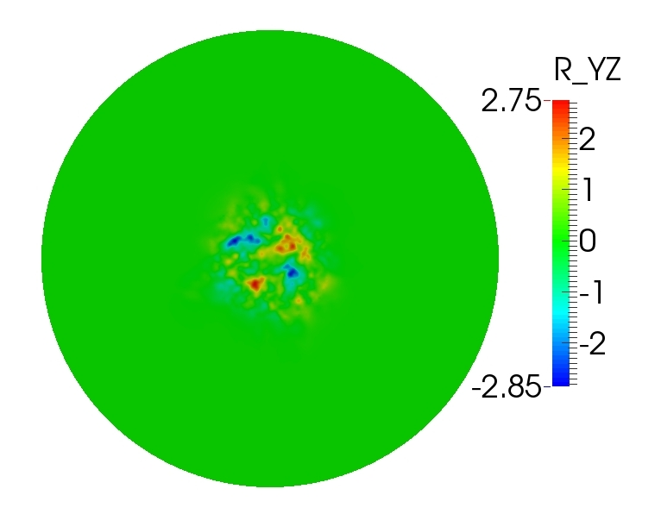
Results: Turbulence Statistics: Cross-Flow Planes
Distribution of Reynolds Stresses at cross-flow planes
X=2D
Cross-flow Plane Stress are dominated in shear layer.
The turbulence is diffusing with the Jet break up and droplet formations
X=5D
Energy consumption: DOE EIA, http://www.eia.gov/cfapps/ipdbproject/IEDIndex3.cfm?tid=44&pid=44&aid=2, accessed 12/01/14
GDP: UNDP, http://hdr.undp.org/en/content/gdp-per-capita-2011-ppp, accessed 12/01/14

Slide 21
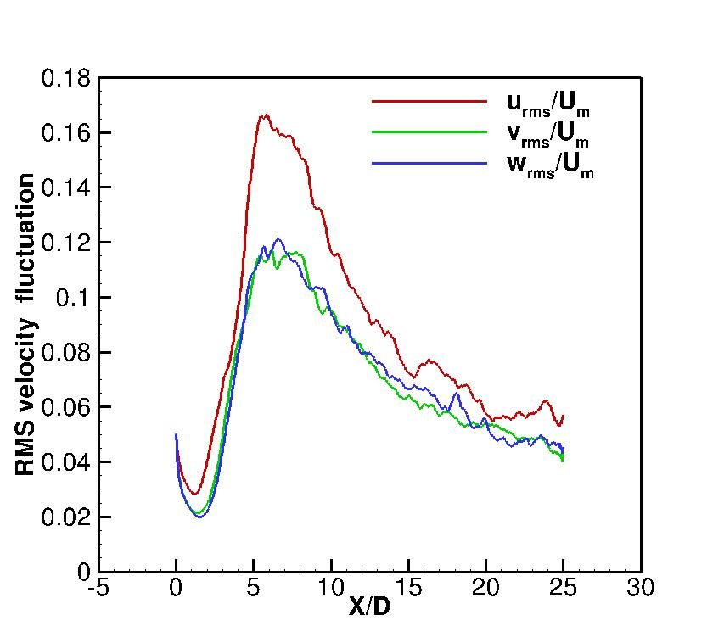
Results: Turbulence Statistics: Axial Line Plots
Velocity fluctuations and turbulent intensity reduces with droplets formation in downstream region.
Anisotropy reduces with droplet formation in far field region.
Axial Distribution of velocity fluctuations at Jet centerline
Energy consumption: DOE EIA, http://www.eia.gov/cfapps/ipdbproject/IEDIndex3.cfm?tid=44&pid=44&aid=2, accessed 12/01/14
GDP: UNDP, http://hdr.undp.org/en/content/gdp-per-capita-2011-ppp, accessed 12/01/14

Slide 22
Conclusions
The Jet expansion angle from CFD agrees with experiment(~9⁰ )
VOF method captures sharp interfaces
Large Scale structures are visible in upstream jet region
No Visible structures seen in downstream region
LES is well resolved
Large Scale structures corresponding to volume fraction threshold of ~0.4 , identifies interface of outer edge large scale structures.
Core length was found to be twice the diameter of jet.
Anisotropy reduces in fully developed jet flow region
Energy consumption: DOE EIA, http://www.eia.gov/cfapps/ipdbproject/IEDIndex3.cfm?tid=44&pid=44&aid=2, accessed 12/01/14
GDP: UNDP, http://hdr.undp.org/en/content/gdp-per-capita-2011-ppp, accessed 12/01/14

Slide 23
Team Members:
Frank Shaffer, USDOE National Energy Technology Laboratory
Mehrdad Shahnam, USDOE National Energy Technology Laboratory
Ömer Savaş, U.C. Berkeley, Department of Mechanical Engineering
Dave DeVites, OHMSETT Mar Inc
Timothy Steffeck, DOI Bureau of Safety and Environmental Enforcement
Energy consumption: DOE EIA, http://www.eia.gov/cfapps/ipdbproject/IEDIndex3.cfm?tid=44&pid=44&aid=2, accessed 12/01/14
GDP: UNDP, http://hdr.undp.org/en/content/gdp-per-capita-2011-ppp, accessed 12/01/14

Slide 24
Questions?
Thanks

