Slide 1

Updates: MFIX with Trilinos for High Fidelity Multiphase Computational Fluid Dynamics Simulations
Trilinos Overview & Installation Progress for MFIX
Vinod Kumar, Ph.D.
Associate Professor, Mech. Engg. & Core faculty, Computational Science,
University of Texas, El Paso (UTEP)
William (Bill) Spotz, Ph.D.
Senior Staff Scientist, Sandia National Labs, Albuquerque
Leo. Hernandez, HPC System Administrator, UTEP

Slide 2
Outline
Introduction
Some Examples
MFiX
Trilinos – What & why?
Concluding remarks

Slide 3
Narrative
MFIX is increasingly being used to design & scale-up of fossil fuel reactors,
- Overall utility of the multiphase models remains limited due to the computational expense of large scale simulations
- The time-to-solution can be reduced by leveraging the state-of-the-art in preconditions and linear solver libraries
  - Majority of processor-level time is spent solving large systems of linearized equations
Trilinos provides the state-of-the-art in preconditions and linear solver libraries
- demonstrate scalability on current HPC systems
- illustrate plans for continued maintenance
- include support for new hardware technologies

Slide 4
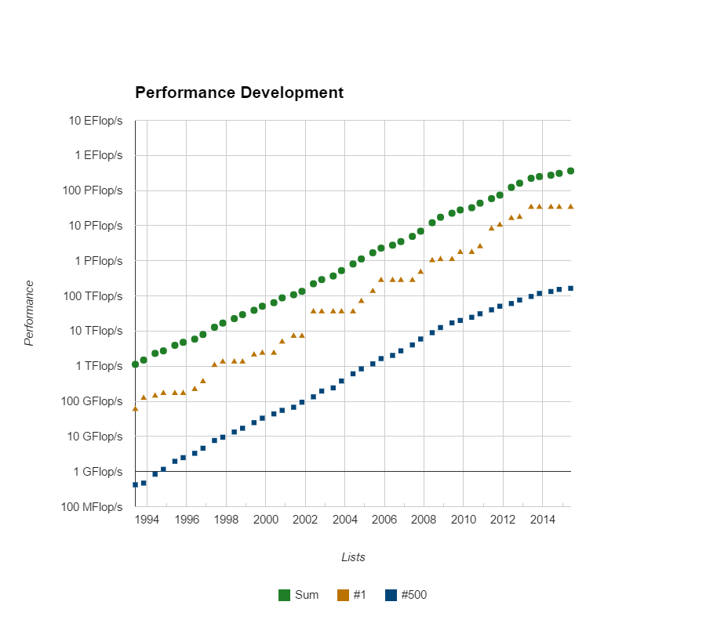
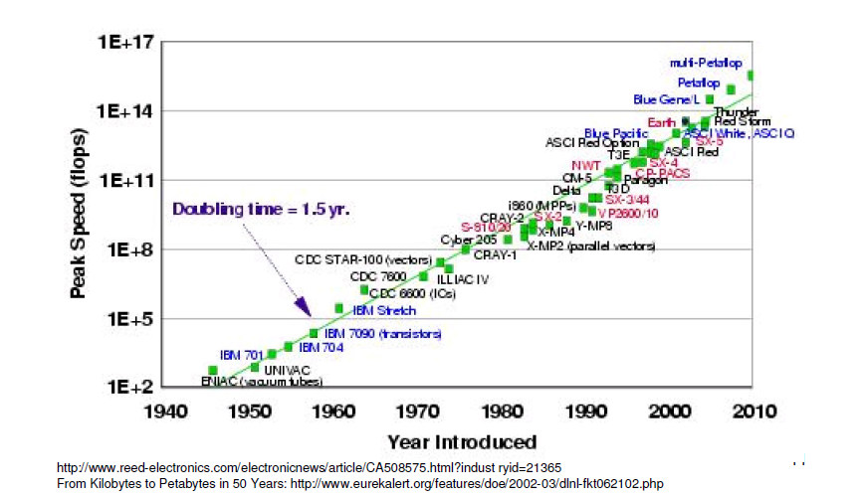
Detour - Supercomputers
Top500
Notes:
Top500 Supercomputer

Slide 5
Myself
UTEP | Associate Professor Assistant Professor, Mechanical Engineering | 2014 - Present 2008-2014
GFDL(Princeton Univ./NOAA) | Research Scientist, Climate Modeling | 2007-2008
Rice Univ, | PostDoc, Physic & Astronomy | 2005-2007
Rice Univ, | Ph.D., Mechanical Engineering | 1999-2005
IIT Kanpur | B.Tech., Aerospace Engineering | 1993-1997
Sabbatical Visiting Professor Visiting Professor AFOSR Visiting Faculty DOE FaST Fellow Cons/Smr-faculty ORISE Visiting Faculty Visiting Faculty | Sandia, Trilinos/CSRI Sandia, CSP Sandia, Climate Modeling KAFB/Maui, Atmospheric turbulence NREL, Thermal-fluid/CSP Sandia, Climate Modeling NETL, Geological Sequestration ORNL, Climate Modeling | 08/2015 – 2016 09/2012 – 12/2014 09/2010 – 08/2013 06/2012 –08/2012 06/2011 – 08/2011 06/2010 – 08/2010 06/2010 – 08/2010 06/2009 – 08/2009
Development Engineer | Fluent (now ANSYS) | 07/1997 – 05/1999
UG RA | IIT Kanpur | 07/1995 – 07/1997
Recent Research Activities:
V. Kumar (PI), Collaborator: Glatzmaier/Bharathan/Ma (NREL), “Comp. ana. of Nano Particles-Molten Salt Thermal Energy Storage for Concentrated Solar Power Systems," DOE- EERE/SunShot, $348K, Completed
A. Bronson (PI), V. Kumar (CO-PI), Comp-Expl proc of BrC Composites by Reactive Infusion of Hf Alloy Melts into B4C, AFOSR, $396K, Completed
A. Bronson (PI), V. Kumar (CO-PI), Computational-Experimental Study of the Plasma Proc. of Carbides at High Temp, NETL– DOE, $200K, Completed
V. Kumar (PI), "High fidelity computational analysis of CO2 trapping at pore scales" NETL – DOE, $288K, Completed
Notes:
5

Slide 6

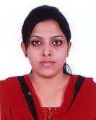
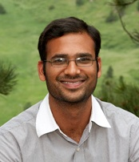

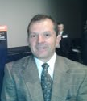


My Research Group
Faculty Advisor - Vinod Kumar, Assistant Professor, Mechanical Engineering
Core faculty, Computational Science Doctoral Program
Collaborators: B. Spotz, M. Taylor & C. Ho (Sandia), Z. Ma & G. Glatzmaier(NREL), V. Balaji (Princeton), D. Banerjee (Texas A&M), S. Kumar (UTB), A. Bronson (UTEP), G. Rao (KAFB), V. Udeowa (Google), S. Mittal (IIT K)
Doctoral
M.S.
Dr. Kiran K. Katta
Computational Science
Graduated, May 2013
Samia Afrin
Energy (Dec 2015, expected)
Dr. Paul Delgado
Computational Science, May 2015
Dr. A. Sepulveda
Energy, Graduated May 2015
Nazmul Hossain
Computational Science
Jesus Ortega
Mech. Eng.
Current UG Research Assistants
1. A. Cabral
2. Alexandra
Alumni:
M.S.:
T. Dorethy (Comp., 2014 US Army),
P. Delgado(Comp., 2014)
J. Valles (Mechanical, 2011 US Army),
U. Parimi (Mechanical, 2010),
N. Kavoori (Mechanical, 2010),
K. Katta (Computational, 2011)
Alumni: UG RAs
Claudia Guevara, S. D. Rosa, Daniel Llausas, Daniel Landis, Christian Barraza, Enrique Busquets, Rene Chacon, Javier Motta, Jesus Presa, Paul Rodriguez, Karla Corral US Army), Jesus Mijares, Jesus Valles, Raul Corral, T. Brown, D. Alvarez, L. Valles (Mech, US Army)

Slide 7
(Co-) Developed in-house codes
Old days!
Codes I (co-)developed but don’t use any more because…
- MHD Solver (Space plasma, Fortran, MPI, Postdoc work)
- Navier-Stokes, Fluid-Structure/Solid interaction (Fortran/C, MPI, PhD work)
- Climate Models
- GFDL (Princeton/NOAA)-CM2.1 (Fortran, MPI) &
- HOMME (DOE/NCAR) (Fortran/C, MPI, Trilinos)

Slide 8
Incompressible Flows
Old days!
Fluid dynamics: Navier-Stokes equation
Conservation of momentum
Continuity
Stress-strain relationship
Boundary conditions
Initial conditions

Slide 9
Compressible Flows
Old days!
Density
Velocity vector
Pressure
Stress-tensor
Conservation of mass/Continuity equations
Momentum conservation
Energy conservation
Energy per unit volume
Heat-flux
Internal energy per unit volume
Constitutive relationship
Specific gas constant
Viscosity
Heat Conduction
Energy gHeat Equation (steady state)
Conductivity
Temperature

Slide 10
Mesh and Membrane
Old days!
Mesh Motion
Equations of motions: Pseudo-solid
Stress-strain relationship:
Linear elastic solid
Boundary conditions
Structural Dynamics
Force balance
σ: Cauchy stress
g_{ij} : Covariant metric in deformed configuration
G_{ij} : Contravariant metric in original configuration
Lame’s constant: λ^{s}, μ^{s}
Notes:
10

Slide 11
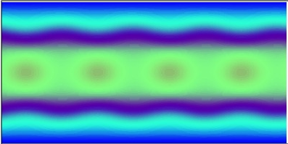
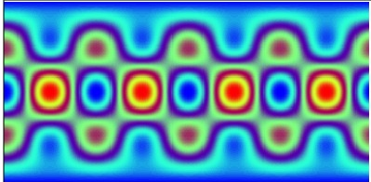
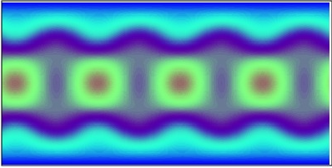
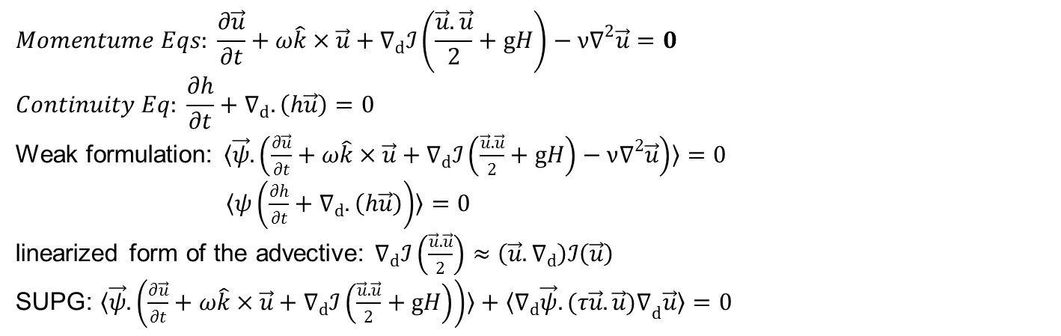
Hydrodynamics equation
Old days!
$$Momentume Eqs: \frac{∂\vec{u}}{∂t}+ω\hat{k}×\vec{u}+∇_{d}ℐ\left(\frac{\vec{u}.\vec{u}}{2}+gH\right)−ν∇^{2}\vec{u}=0$$
$$Continuity Eq: \frac{∂h}{∂t}+∇_{d}.\left(h\vec{u}\right)=0$$
Weak formulation: $〈\vec{ψ}.\left(\frac{∂\vec{u}}{∂t}+ω\hat{k}×\vec{u}+∇_{d}ℐ\left(\frac{\vec{u}.\vec{u}}{2}+gH\right)−ν∇^{2}\vec{u}\right)〉=0$
$〈ψ\left(\frac{∂h}{∂t}+∇_{d}.\left(h\vec{u}\right)\right)〉=0$
linearized form of the advective: $∇_{d}ℐ\left(\frac{\vec{u}.\vec{u}}{2}\right)≈\left({\vec{u}.∇}_{d}\right)ℐ\left(\vec{u}\right)$
SUPG: $〈\vec{ψ}.\left(\frac{∂\vec{u}}{∂t}+ω\hat{k}×\vec{u}+∇_{d}ℐ\left(\frac{\vec{u}.\vec{u}}{2}+gH\right)\right)〉+〈∇_{d}\vec{ψ}.(τ{\vec{u}.\vec{u})∇}_{d}\vec{u}〉=0$
Notes:
11

Slide 12
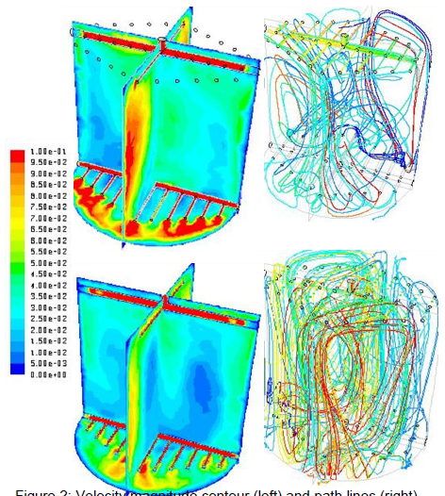
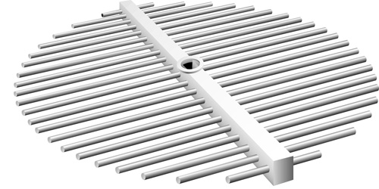
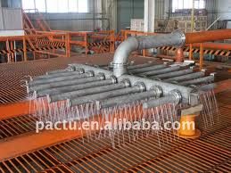
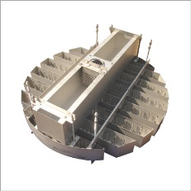
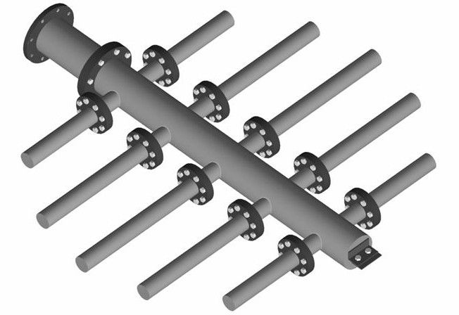
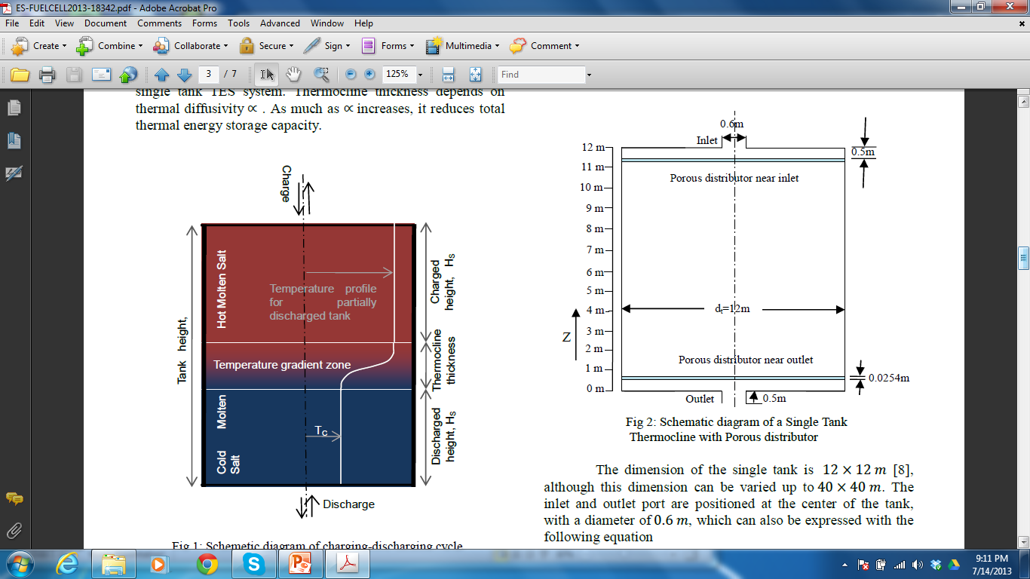
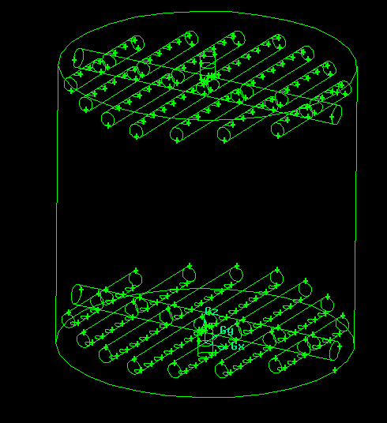
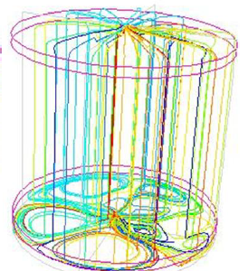
Flow distributors, temperature profile
Nanofluid (modeled as Eulerian approach)
Recent days!
Amacs.com
NREL
www.raschig.de
Notes:
12

Slide 13

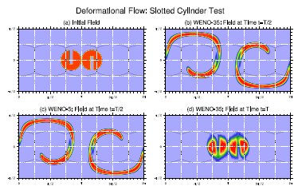
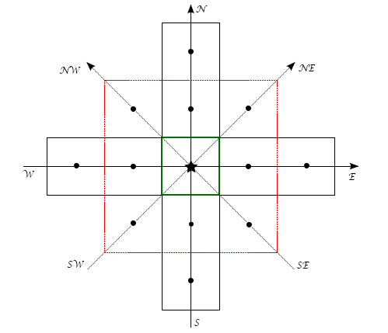
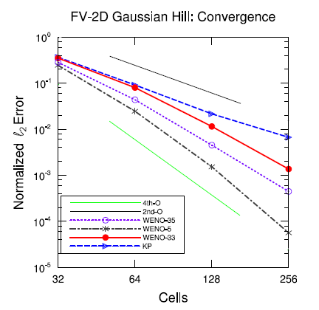
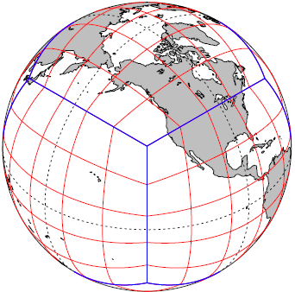
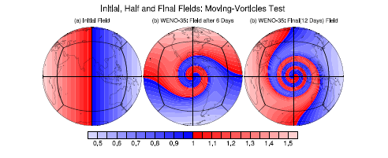

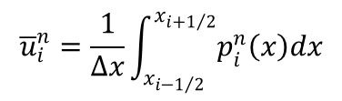

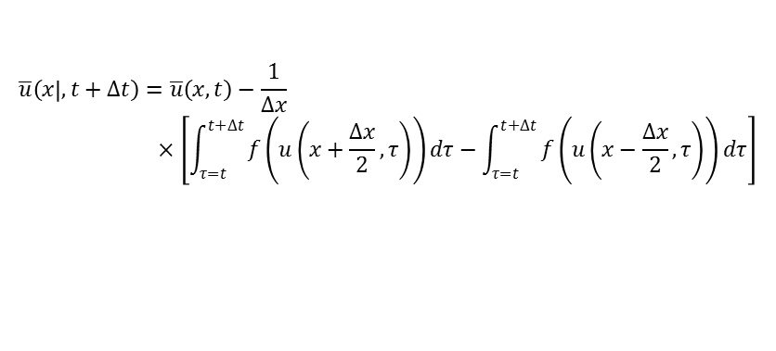
High order scheme for Thermocline Advection
Recent days!
Collaborators:
Dr. Ram Nair, National Center for Atmospheric Science (NCAR), Boulder
Dr. Mark Taylor, Sandia National Lab, Albuquerque
Student: Dr. Kiran K. Katta (adviser – Dr. V. Kumar, co-adviser: Dr. Ram Nair)
High-Order Central schemes for conservation laws
$$\overline{u}\left(x | ,t+∆t\right)=\overline{u}\left(x,t\right)−\frac{1}{∆x}×\left[\int_{τ=t}^{t+∆t}{f\left(u\left(x+\frac{∆x}{2},τ\right)\right)dτ−\int_{τ=t}^{t+∆t}{f\left(u\left(x−\frac{∆x}{2},τ\right)\right)dτ}}\right]$$
$$p\left(x,t^{n}\right)=u\left(x,t^{n}\right)+𝒪\left({\left(∆x\right)}^{r}\right)$$
$${\overline{u}}_{i}^{n}=\frac{1}{∆x}\int_{x_{i−1/2}}^{x_{i+1/2}}{p_{i}^{n}\left(x\right)dx}$$
$$\frac{d}{dt}{\overline{u}}_{i}\left(t\right)=−\frac{H_{i+1/2}\left(t\right)−H_{i−1/2}\left(t\right)}{∆x}$$
$$H_{i+1/2}\left(t\right)=\frac{f\left(u_{i+1/2}^{+}\left(t\right)\right)+f\left(u_{i+1/2}^{−}\left(t\right)\right)}{2}−\frac{a_{i+1/2}\left(t\right)}{2}\left[u_{i+1/2}^{+}\left(t\right)−u_{i+1/2}^{−}\left(t\right)\right]$$

Slide 14
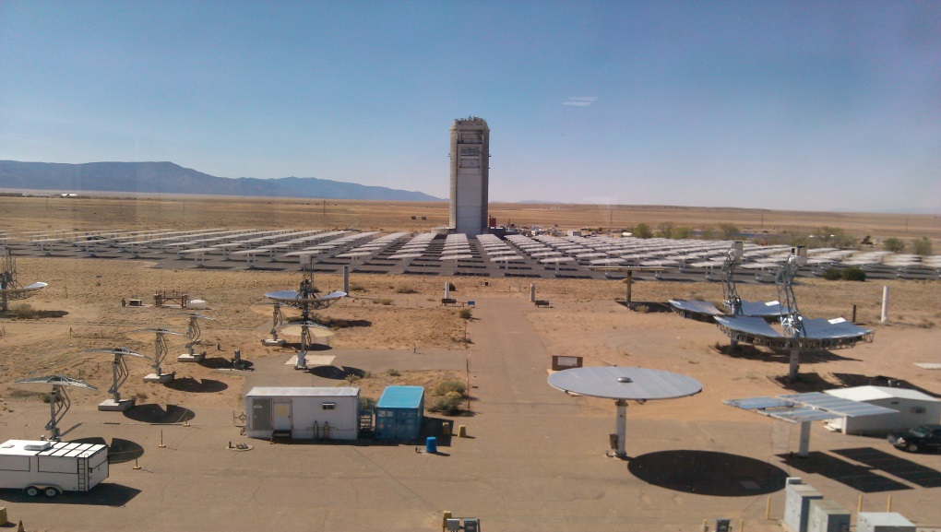
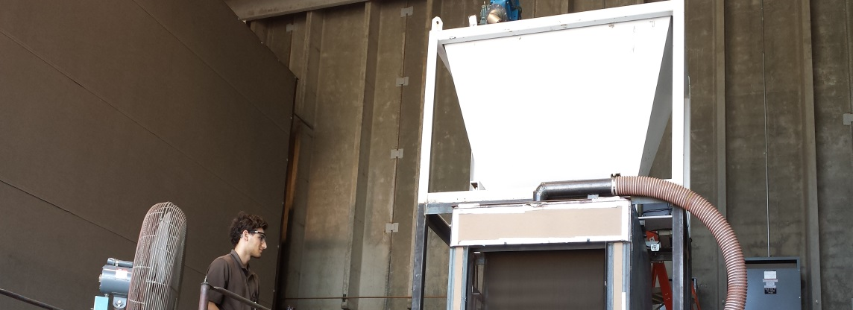
Fluidizedization Problem
0.99 m
Particle injection
1.50 m
6.30 m
Aperture
3.0 m
Solar Radiation
The SPR consist of an arrangement of a vertical chamber with a rectangle shape with supply of material on the top
18

Slide 15

Application CSP
Falling particle receiver
Sandia

Slide 16
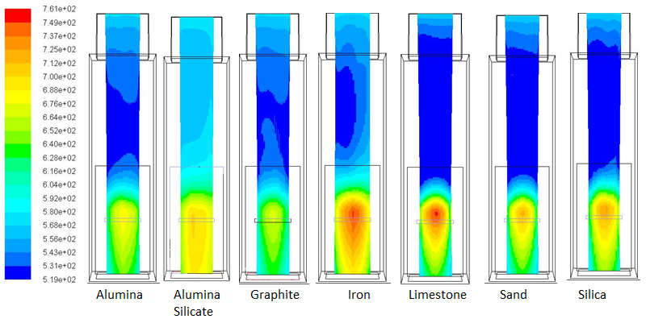
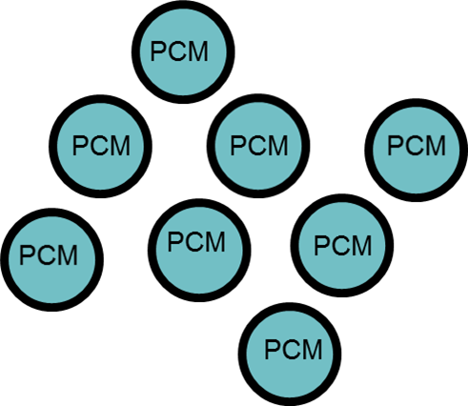
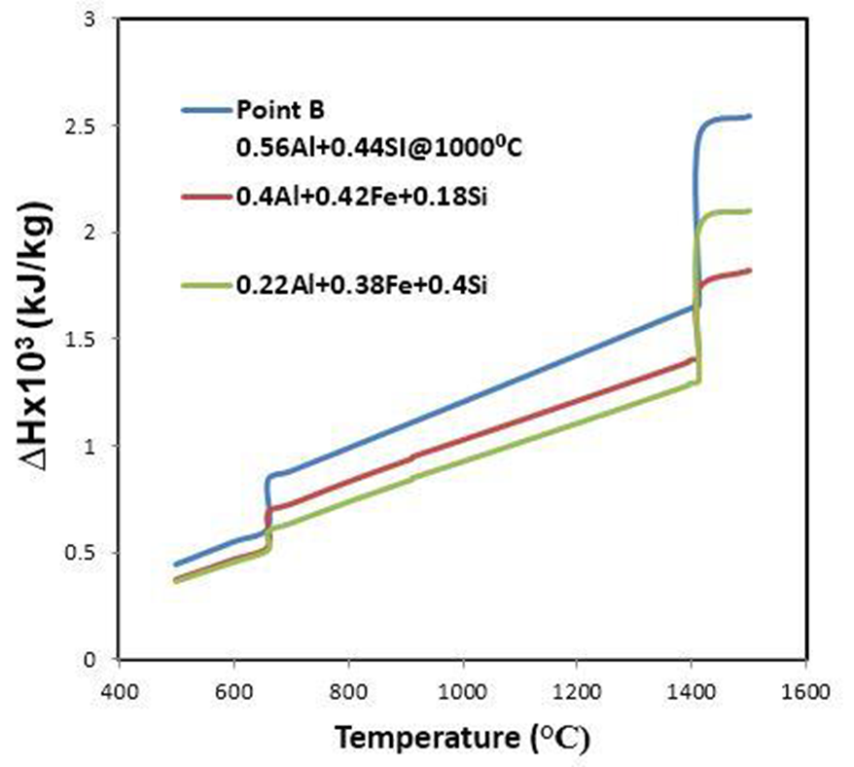
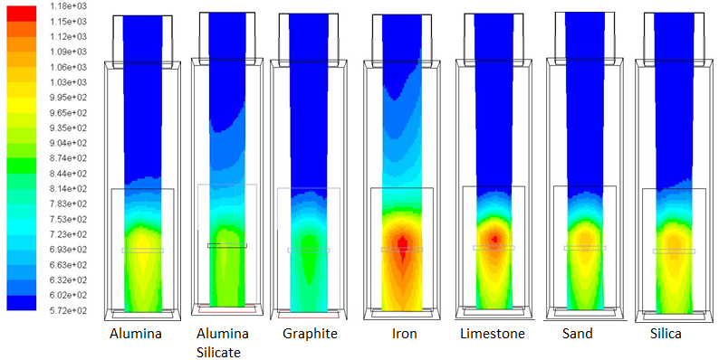
Application CSP
Falling particle receiver
With Sandia
Mass flow rate = 3.84 Kg/s & Heat Flux = 3MW/m²
High temperature (>1000C)
Cp & k: f(t,T)
Solid particle
Engineered PCM
materials
  Encapsulated PCM particles
  Coating
  Attrition
Mass flow rate = 3.84 Kg/s & Heat Flux = 7MW/m²

Slide 17
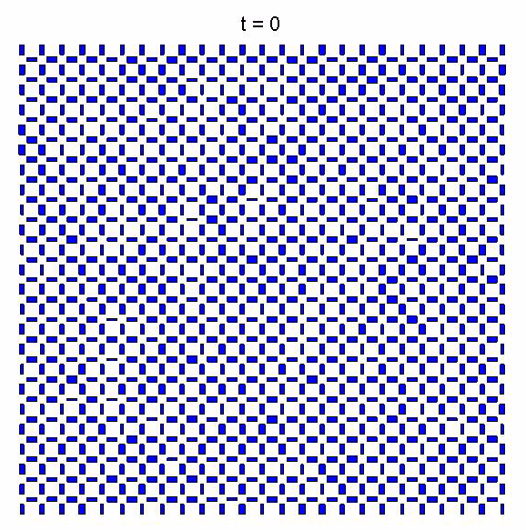
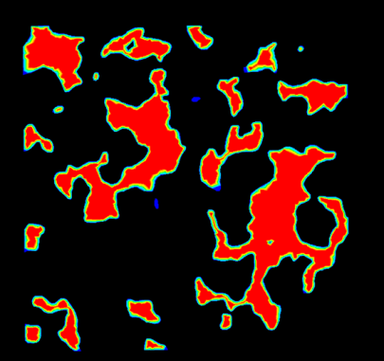
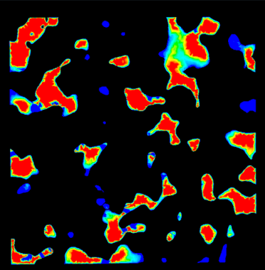
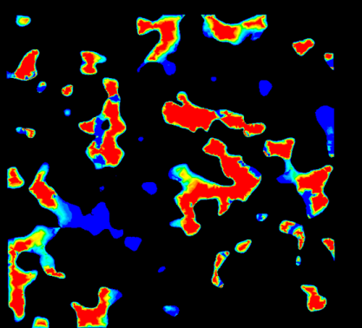
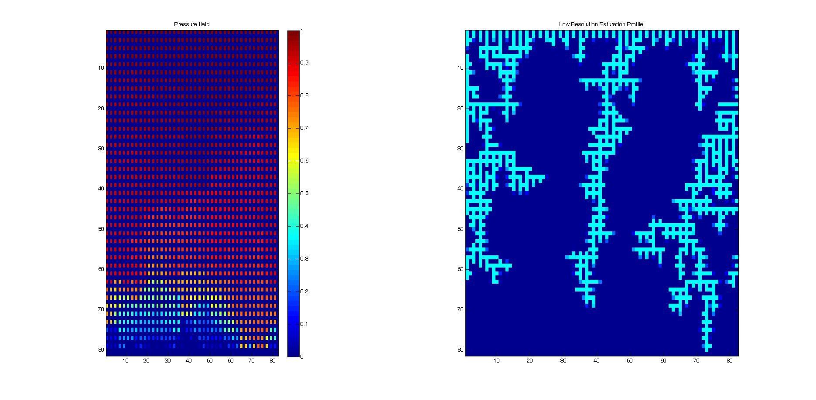
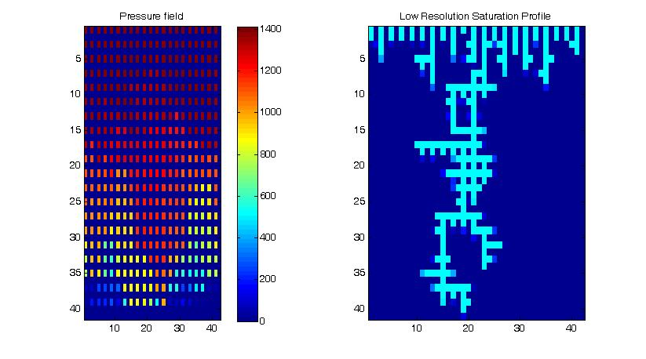
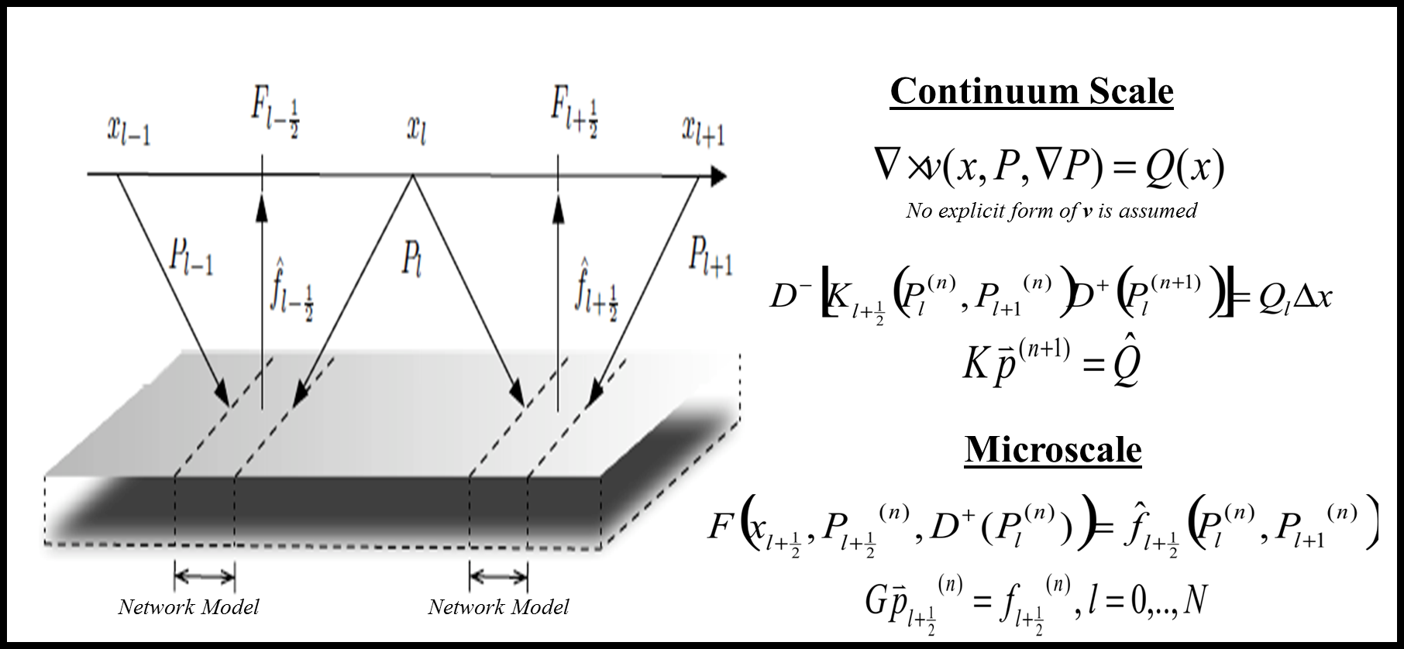
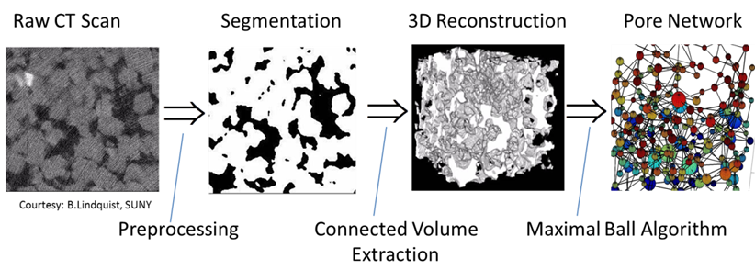
Recent!
Multiscale: CO2 Sequestration
Multiscale scheme: Block iterative coupling

Slide 18
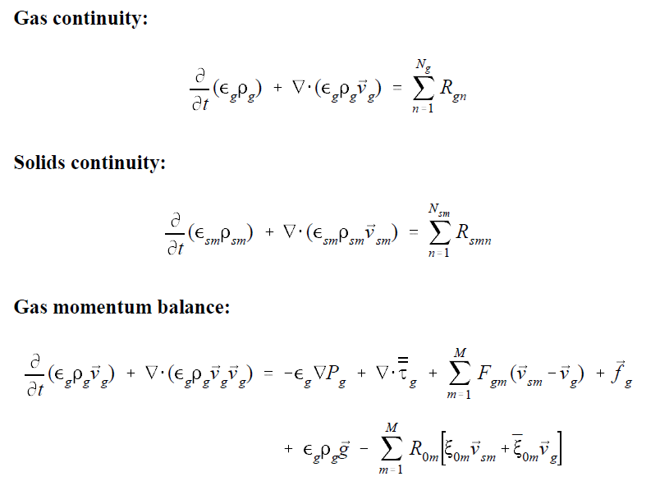
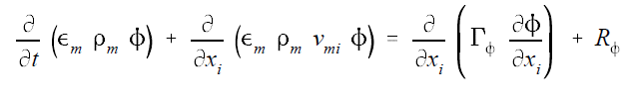

Detour Ends - MFiX (From MFiX reports)
Rogers, Syamlal, O’Brien
Convection-diffusion/Transport of species
First-order schemes/Second-order/High-order schemes
The use of higher order methods may result in a violation of Patankar’s Rule 2 in some regions!
Downwind factors
Numerical diffusion
Consistency
Notes:
18

Slide 19
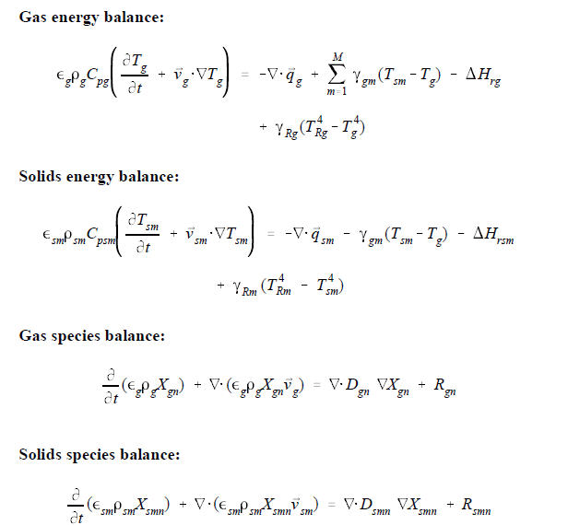
MFiX Eqs & Schemes (From MFiX reports)
Rogers, Syamlal, O’Brien
Notes:
19

Slide 20
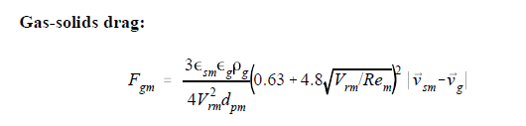
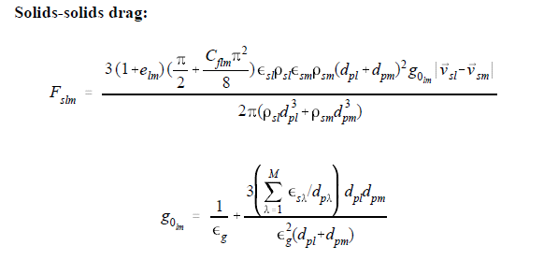
MFiX Eqs & Schemes (From MFiX reports)
Rogers, Syamlal, O’Brien
And, Even More Equations…
Notes:
20

Slide 21
MFiX
Solution algorithms
  SIMPLE (Patankar 1980)
    More variables than single phase (slows computations)
    The multiphase momentum equations are strongly coupled through the momentum exchange term
  Handling of close-packed regions
  Fluid-pressure correction
  Boundary conditions
  Numerical schemes
    Linear/Non-linear system of equations solver
    Parallel/Distributed computing
      Partitioning/Domain decomposition
      I/O , Data management/Cloud
      Number crunching – HPC/GPU?
  Graphics
    Data-storage
    Rendering
Notes:
21

Slide 22
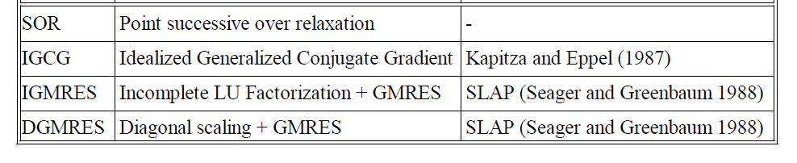
MFiX
Time-step adjustment
Nonlinear solver
Linear Solver
Notes:
22

Slide 23
Trilinos
The Trilinos Project is an effort to develop and implement robust algorithms and enabling technologies using modern object-oriented software design, while still leveraging the value of established libraries such as PETSc, Metis/ParMetis, SuperLU, Aztec, the BLAS and LAPACK. It emphasizes abstract interfaces for maximum flexibility of component interchanging, and provides a full-featured set of concrete classes that implement all abstract interfaces. Research efforts in advanced solution algorithms and parallel solver libraries have historically had a large impact on engineering and scientific computing. Algorithmic advances increase the range of tractable problems and reduce the cost of solving existing problems. Well-designed solver libraries provide a mechanism for leveraging solver development across a broad set of applications and minimize the cost of solver integration. Emphasis is required in both new algorithms and new software (Heroux et.al., http://trilinos.sandia.gov/).
Funded by various DOE entities mainly NNSA -Advanced Simulation and Computing (ASC)/DOE Office of Science (SciDAC), Advanced Scientific Computing Research (ASCR)
Note: Slides in this topic mostly borrowed from M.Heroux & other trilinos members
Notes:
23

Slide 24

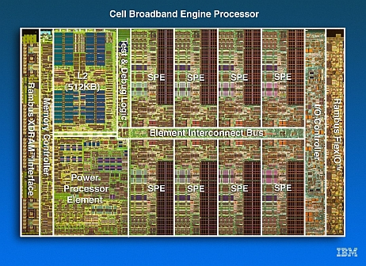

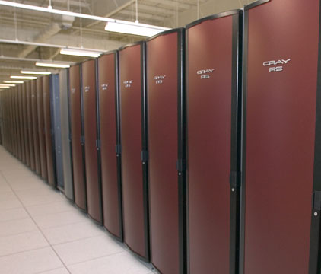
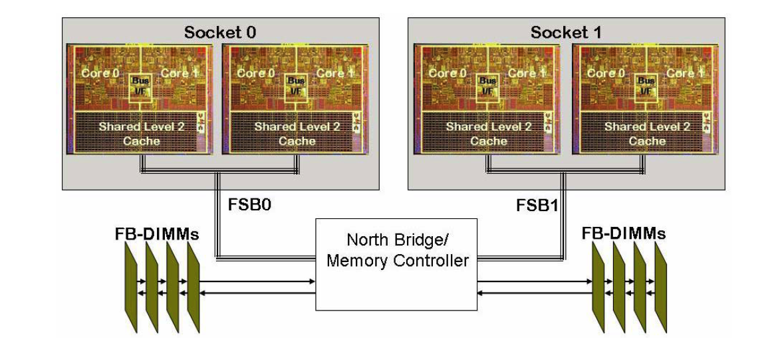
Target Platforms
Desktop: Development and more…
Capability machines:
  Redstorm (XT3), Clusters
  Roadrunner (Cell-based).
  Multicore nodes.
Parallel software environments:
  MPI
  UPC, CAF, threads, vectors,…
  Combinations of the above.
User “skins”:
  C++/C, Python
  Fortran.
  Web, CCA.

Slide 25
Evolving Trilinos Solution
Trilinos¹ is an evolving framework to address these challenges:
  Fundamental atomic unit is a package.
  Includes core set of vector, graph and matrix classes (Epetra/Tpetra packages).
  Provides a common abstract solver API (Thyra package).
  Provides a ready-made package infrastructure (new_package package):
    Source code management (cvs, git, bonsai).
    Build tools (Cmake).
    Automated regression testing.
    Communication tools (mailman mail lists).
  Specifies requirements and suggested practices for package SQA.
In general allows us to categorize efforts:
  Efforts best done at the Trilinos level (useful to most or all packages).
  Efforts best done at a package level (peculiar or important to a package).
  Allows package developers to focus only on things that are unique to
  their package.
1. Trilinos loose translation: “A string of pearls”

Slide 26

Evolving Trilinos Solution
physics
Beyond a “solvers” framework
Natural expansion of capabilities to satisfy application and research needs
L(u)=f
Math. model
discretizations
methods
Numerical math
Convert to models that can be solved on digital computers
Time domain
Space domain
Automatic diff.
Domain dec.
Mortar methods
L_{h}(u_{h})=f_{h}
Numerical model
solvers
core
Algorithms
Find faster and more efficient ways to solve numerical models
Linear
Nonlinear
Eigenvalues
Optimization
Petra
Utilities
Interfaces
Load Balancing
u_{h}=L_{h}⁻¹•f_{h}
Algorithms
Discretization methods, AD, Mortar methods, …
computation

Slide 27
Trilinos Strategic Goals
Scalable Computations: As problem size and processor counts increase, the cost of the computation will remain nearly fixed.
Hardened Computations: Never fail unless problem essentially intractable, in which case we diagnose and inform the user why the problem fails and provide a reliable measure of error.
Full Vertical Coverage: Provide leading edge enabling technologies through the entire technical application software stack: from problem construction, solution, analysis to optimization.
Grand Universal Interoperability: All Trilinos packages will be interoperable, so that any combination of packages that
makes sense algorithmically will be possible within Trilinos and with compatible external software.
Universal Accessibility: All Trilinos capabilities will be available to users of major computing environments: C++, Fortran, Python and the Web, and from the desktop to the latest scalable systems.
Universal Capabilities RAS: Trilinos will be:
  Integrated into every major application at Sandia (Availability).
  The leading edge hardened, efficient, scalable solution for each of these applications (Reliability).
  Easy to maintain and upgrade within the application environment (Serviceability).
Algorithmic
Goals
Software
Goals

Slide 28
Trilinos Packages
Trilinos is a collection of Packages.
Each package is:
  Focused on important, state-of-the-art algorithms in its problem regime.
  Developed by a small team of domain experts.
  Self-contained: No explicit dependencies on any other software packages (with some special exceptions).
  Configurable/buildable/documented on its own.
Sample packages: NOX, AztecOO, ML, IFPACK, Meros.
Special package collections:
  Petra (Epetra, Tpetra, Jpetra): Concrete Data Objects
  Thyra: Abstract Conceptual Interfaces
  Teuchos: Common Tools.
  New_package: Jumpstart prototype.
Multi-scale/physics simulation– Panzer
  User Physics Kernels + Problem Description = Thyra::ModelEvaluator

Slide 29
Trilinos Package Summary http://trilinos.sandia.gov
 | Objective | Package(s)
Discretizations | Meshing & Spatial Discretizations | phdMesh, Intrepid, Pamgen, Sundance
 | Time Integration | Rythmos
Methods | Automatic Differentiation | Sacado
 | Mortar Methods | Moertel
Core | Linear algebra objects | Epetra, Jpetra, Tpetra
 | Abstract interfaces | Thyra, Stratimikos, RTOp
 | Load Balancing | Zoltan, Isorropia
 | “Skins” | PyTrilinos, WebTrilinos, Star-P, ForTrilinos, CTrilinos
 | C++ utilities, I/O, thread API | Teuchos, EpetraExt, Kokkos, Triutils, TPI
Solvers | Iterative (Krylov) linear solvers | AztecOO, Belos, Komplex
 | Direct sparse linear solvers | Amesos
 | Direct dense linear solvers | Epetra, Teuchos, Pliris
 | Iterative eigenvalue solvers | Anasazi
 | ILU-type preconditioners | AztecOO, IFPACK
 | Multilevel preconditioners | ML, CLAPS
 | Block preconditioners | Meros
 | Nonlinear system solvers | NOX, LOCA
 | Optimization (SAND) | MOOCHO, Aristos
 | Stochastic PDEs | Stokhos

Slide 30
Example: Trilinos’s Nonlinear Analysis Tools
SAND2008-7504P
Embedded Nonlinear Analysis Tools Capability Area
  solution of nonlinear equations
  time integration
  bifurcation tracking / stability analysis
  parameter continuation
  optimization (PDE-constrained)
  uncertainty quantification
Trilinos Strategic Goals that we align with:
  Full Vertical Coverage
  Hardened Solvers
  Scalability
Governing Philosophy: “Analysis beyond Simulation,”
Goal: to automate many computational analysis and design tasks using good algorithms and good math, replacing trial-and-error or repeated simulation.
  parameter studies
  sensitivity analysis
  calibration
  optimization
  error control in transient integration
  locating instabilities

Slide 31
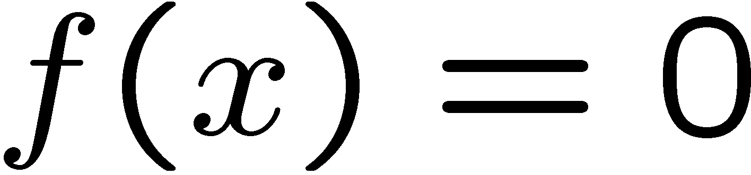


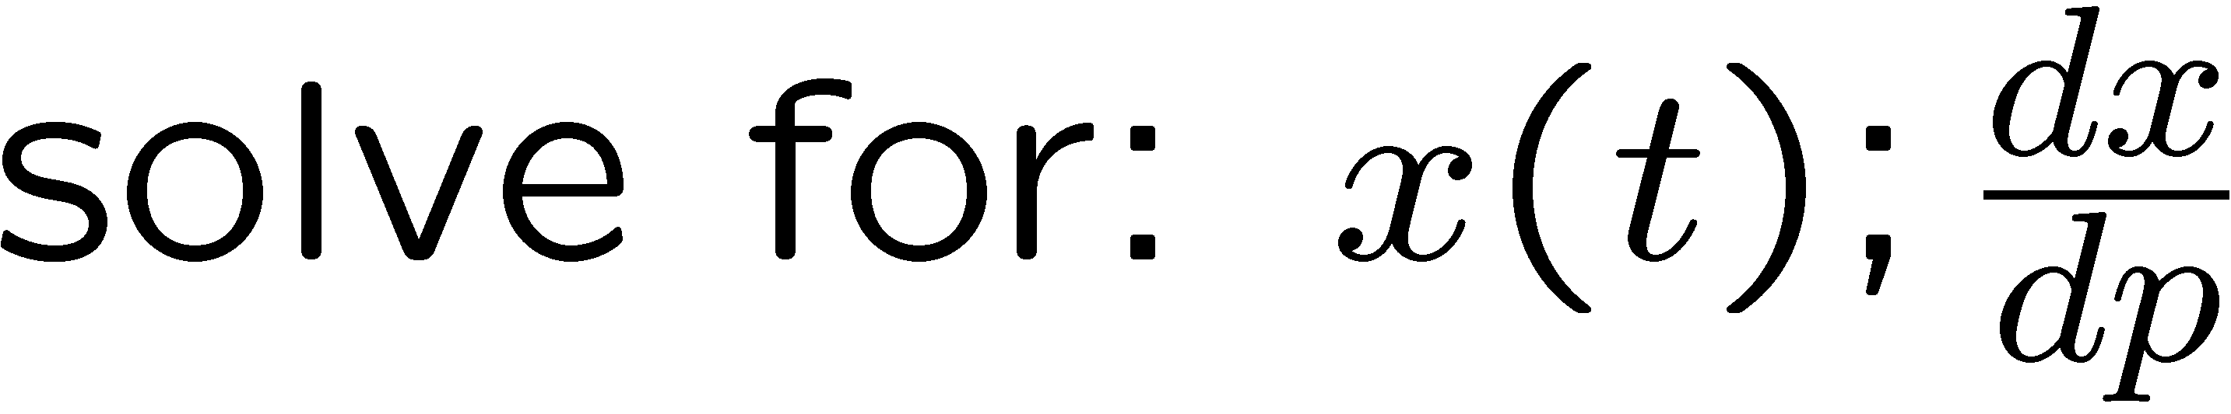
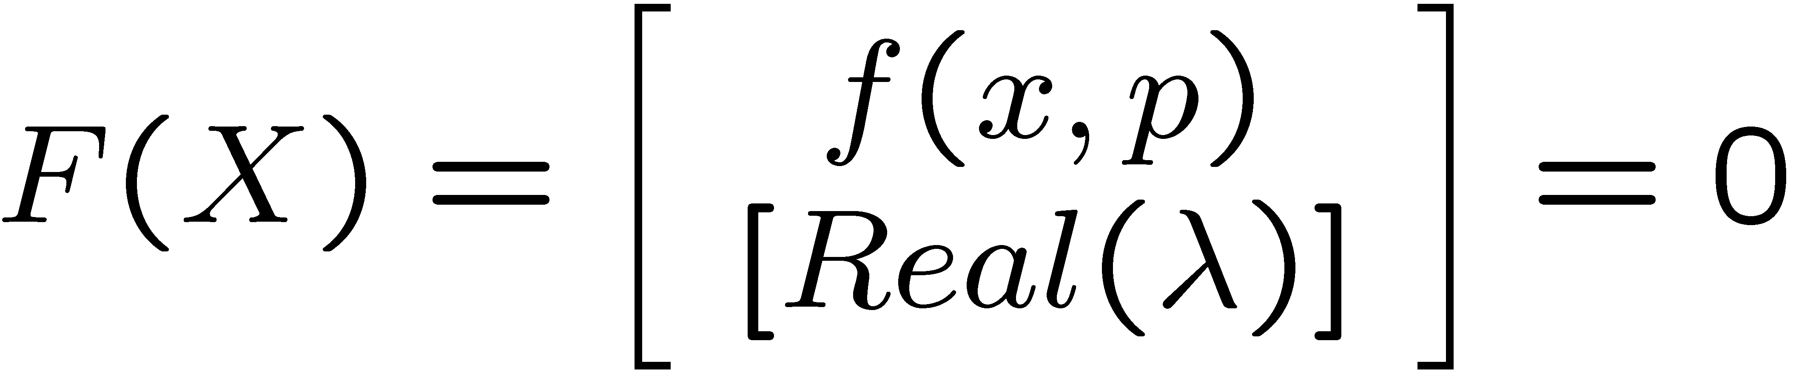








Exmaple: Math for Embedded Nonlinear Analysis Capabilities:
Nonlinear Solver (NOX):
Time Integration (Rythmos):
Bifurcation Tracking / Constraint Enforcement (LOCA):
Parameter Continuation (LOCA):
Stability Analysis (LOCA→Anasazi):
PDE-Constrained Optimization (Moocho/Aristos):
Embedded UQ (Stokhos):

Slide 32
Compilation Script – Trilinos 11.10.2
Install cmake28
Install Python Modules: Numpy, Scipy, Cython
Install matio libraries
Install swig 2.0.8
Install mpi4py
Install openGLM
Install Trilinos
-----------------------------
#!/bin/bash
# Base on https://code.google.com/p/trilinos/wiki/BuildScript
#
# ============================================
# Requirements:
# Install python Numpy and Scipe
# ============================================
#
# Trilinos Source location
SOURCE_BASE="/root/trilinos-11.10.2-Source/"
# Path to build source
BUILD="$SOURCE_BASE/Build"
# Installation path:
PREFIX="/shared/trilinos/11.10.2/"
# Third party software installation paths
MPI_HOME="/shared/gcc/4.4.7/openmpi/1.8.1"
MPI_BIN="${MPI_HOME}/bin"
MKLROOT="/shared/lib/lib64"
NETCDF="/shared/netcdf"
cmake28 \
-D CMAKE_INSTALL_PREFIX="${PREFIX}" \
-D Trilinos_INSTALL_INCLUDE_DIR:PATH="${PREFIX}/include" \
-D Trilinos_INSTALL_LIB_DIR:PATH="${PREFIX}/lib" \
-D Trilinos_INSTALL_RUNTIME_DIR:PATH="${PREFIX}/bin" \
-D CMAKE_BUILD_TYPE:STRING=RELEASE \
-D TPL_ENABLE_MPI:BOOL=ON \
-D MPI_BASE_DIR:FILEPATH="${MPI_HOME}" \
-D MPI_EXEC:FILEPATH="${MPI_BIN}/mpiexec" \
-D MPI_Fortran_COMPILER:FILEPATH="${MPI_BIN}/mpif90" \
-D MPI_CXX_COMPILER:FILEPATH="${MPI_BIN}/mpicxx" \
-D MPI_C_COMPILER:FILEPATH="${MPI_BIN}/mpicc" \
-D CMAKE_CXX_FLAGS:STRING="-ansi -Wall" \
-D BLAS_LIBRARY_DIRS:FILEPATH="${MKLROOT}" \
-D BLAS_LIBRARY_NAMES:STRING="mkl_rt" \
-D LAPACK_LIBRARY_DIRS:FILEPATH="${MKLROOT}/" \
-D LAPACK_LIBRARY_NAMES:STRING="mkl_rt" \
-D Netcdf_INCLUDE_DIRS:FILEPATH="${NETCDF}/include"\
-D Netcdf_LIBRARY_DIRS:FILEPATH="${NETCDF}/lib"\
-D Netcdf_LIBRARY_NAMES:STRING="netcdf"\
-D Trilinos_ENABLE_OpenMP:BOOL=ON \
-D BUILD_SHARED_LIBS:BOOL=ON \
-D Trilinos_ENABLE_TESTS:BOOL=ON \
-D Trilinos_ENABLE_DEBUG:BOOL=ON \
-D Trilinos_SHOW_DEPRECATED_WARNINGS:BOOL=OFF\
-D Trilinos_ENABLE_ALL_PACKAGES:BOOL=ON \
-D Trilinos_ENABLE_SECONDARY_STABLE_CODE:BOOL=OFF\
-D Trilinos_ENABLE_PyTrilinos:BOOL=ON \
$EXTRA_ARGS \
${SOURCE_BASE}

Slide 33
Web-Trilinos
A web-based interface to Trilinos
Most of Trilinos from the Web
  Teuchos, Epetra, EpetraExt, Galeri
  AztecOO, Amesos, IFPACK, ML, PyTrilinos
XML, PHP, PyChart
C++ module, which allows the programs
MPI hack, web-socket
HTML5 – SVG, WebGL
Install Pychart
  Untar, CD into folder
  # python setup.py install
  Testing
    # python ./demo/date.py > ../../date.pdf
    # evince ../../date.pdf
Install Apache/httpd
Install PHP
Installing the Web interface
- Trilinos install by default the minimal WebTrilinos requirements
  # vi Build-Webtrilinos
  #!/bin/bash
  # Third party software installation paths
  MPI_HOME="/shared/gcc/4.4.7/openmpi/1.8.1"
  MPI_BIN="${MPI_HOME}/bin"
  MKLROOT="/shared/lib/lib64"
  NETCDF="/shared/netcdf/4.3.2"
./configure --prefix=/shared/WebTrilinos --enable-mpi --enable-tests --enable-webtrilinos-tests --enable-webtrilinos-examples --with-mpi-compilers="${MPI_BIN}"
# sh Build-Webtrilinos

Slide 34


Apache+PHP

Slide 35

Web-Trilinos

Slide 36


Web-Trilinos: Error!
Adding the /shared/trilinos/11.2.3/lib to LD_LIBRARY_PATH does not work!
Fix adding ldconfig it does:
Touch /etc/ld.so.conf.d/trilinos-11.2.3.conf
  /shared/trilinos/11.2.3/lib
# ldconfig -v (update the library path)

Slide 37
Trilinos MFIX: Future
Project: High Fidelity Computational Model for Fluidized Bed Experiments, 09/2015-08/2018, DOE FE / NETL
Setup GIT/version-control repository
Select optimumTrilinos software package
Develop ForTrilinos based Fortran interface for MFIX
Test and compare the linear solver packages in Trilinos
  Run test cases of fluidized bed simulations in MFIX using the various Trilinos linear equations preconditioner. Compare the performance (computing time and accuracy) of the MFIX- Trilinos package with solutions that use MFIX and its existing linear solvers
Perform scalability analysis of Trilinos-MFIX
  Conduct scalability tests of the Trilinos-MFIX package on single node and multi-core computer clusters using distributed/shared or in hybrid environment HPC systems. Test multi-core clusters containing 4, 16, 64, 128, 512, 1024, 8192(?) cores.
Address Trilinos-MFIX performance bottlenecks via profiling and debugging tools in Trilinos
Run fluidized bed test problems (various particle sizes and shapes, 2D/3D, Small/Large Scale, etc.)
Notes:
setup a GIT/version-control repository for development of the Trilinos-MFIX interface, choose the most suitable Trilinos software package for this project, and develop a ForTrilinos based Fortran program interface for MFIX.
evaluate the performance of the preconditions and linear solver libraries, perform a scalability analysis for use of the selected libraries on large parallel computing systems, and improve computing performance of the Trilinos-MFIX interface.
Define equivalence of numerical solutions and demonstrate that the Trilinos-MFIX package provides faster solutions of gas-solid fluidized bed riser simulations than MFIX with its current linear equation solvers, and that the numerical solutions using Trilinos-MFIX converge to the equivalent/same solution as solutions of the same problems using MFIX with its current linear solvers. Run test cases in both two dimensional (2D) and 3D Cartesian coordinates.

Slide 38

HPC/Cloud/GPU
Future!
Notes:
38

Slide 39




HPC/Cloud/GPU
Future!
Notes:
39

Slide 40
Next Gen MFiX
Desktop to Supercomputers
Latest solver capability
Extreme (Exa?) Scale computing
Scalable Linear Algebra Themes:
  Multicore/GPUs: Pre-requisite for extreme scale.
  Multi-precision algorithms.
  Cloud based Supercomputer to Tablet Computing?

Slide 41
UTEP
At Texas, New Mexico and Mexico Border
23,000+ Students and growing
>70% Hispanic (a Minority Serving Institution)
Mechanical Engineering
  ~700 Mechanical UG, ~100 MS
  Energy track PhD program in the interdisciplinary ESE
The UTEP community - faculty, students, staff, and administrators - commits itself to the two ideals of excellence and access. In addition, the University accepts a strict standard of accountability for institutional effectiveness as it educates students who will be the leaders of the 21st century. Through the accomplishment of its mission and goals via continuous improvement, UTEP aspires to be an educational leader in a changing economic, technological, and social environment [with 21st century demography]: a new model for Texas higher education.
Notes:
41

