Slide 1
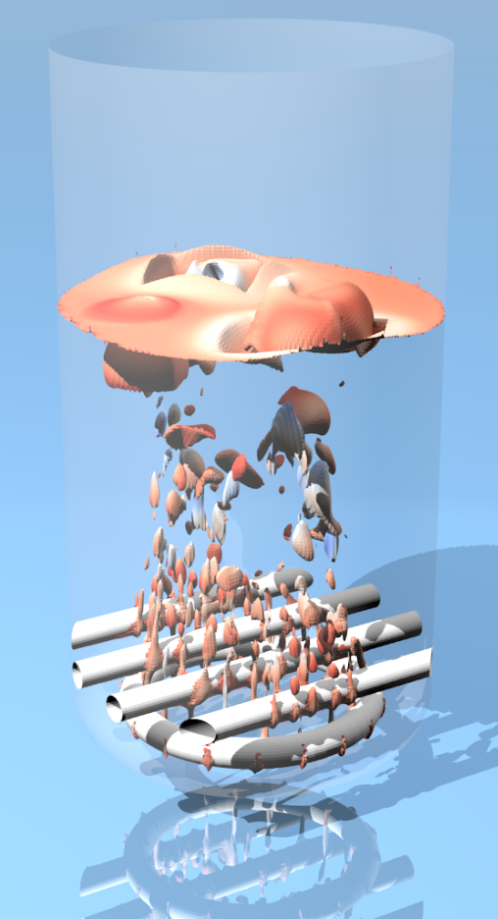
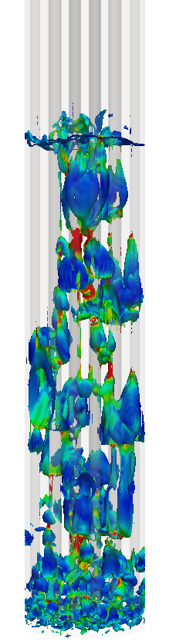
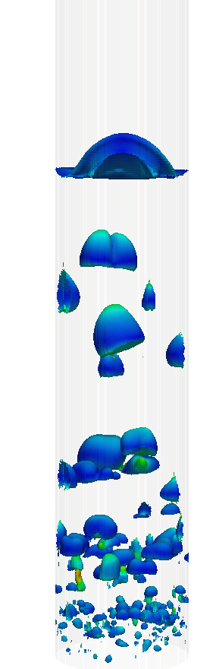
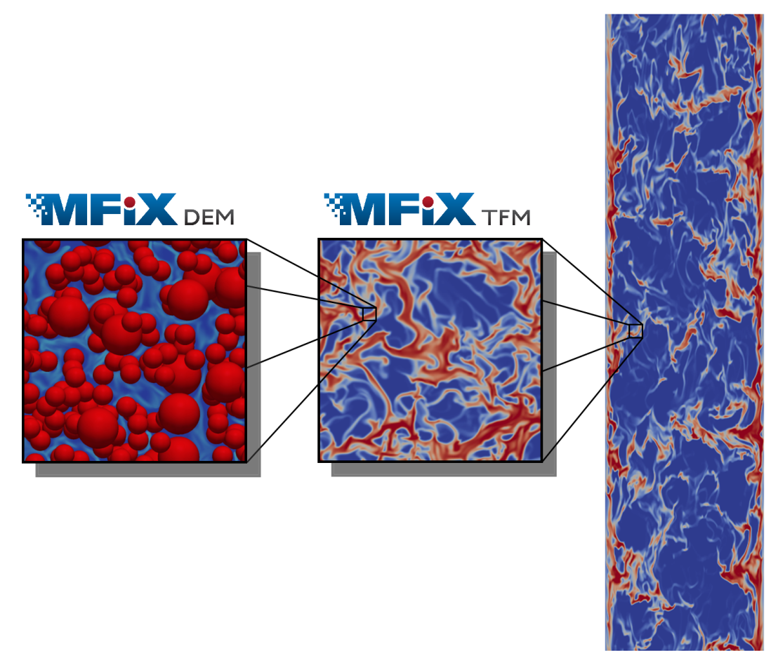
MFiX Simulations
Hydrodynamics of gas-solids flow in a bubbling fluidized bed with immersed vertical U-tube banks
Vikrant Verma
Tingwen Li, Jean-François Dietiker, William A. Rogers
12th August, 2015

Slide 2
Outline
Fluidization
Motivation
Two fluid model
Cut-cell method
Geometry configuration
Post processing
Simulations results
Bubble properties
Solids motion
Conclusions

Slide 3
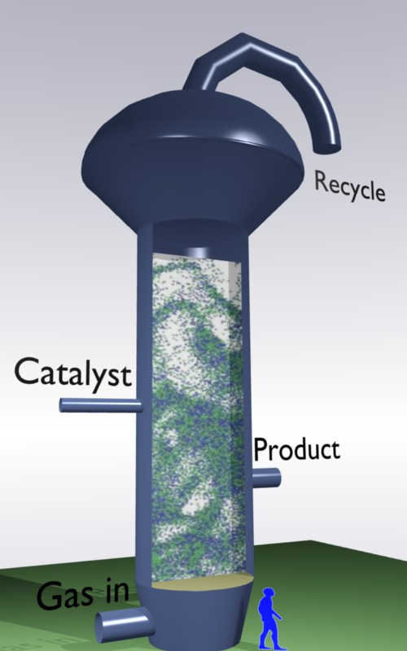
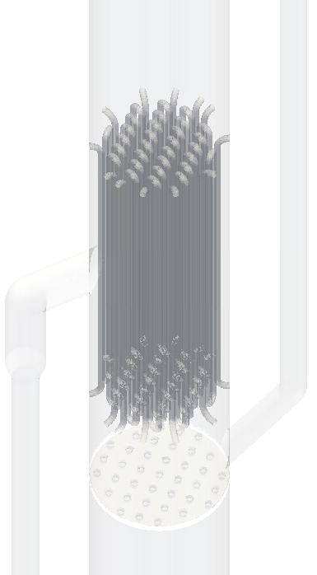
Fluidization
Gas-solid contacting in many different processes:
polymerization
fluid-catalytic cracking
dry roasting
Combustion and gasification
…
Key characteristics: intrinsically multiscale
p-p & p-g interactions at 1-5 d_{p}
flow structures (10-100 d_{p})
gas-solid behavior (industrial size: many other factors)
Image Courtesy : Multiphase Reactor group , TU/e, Netherlands

Slide 4
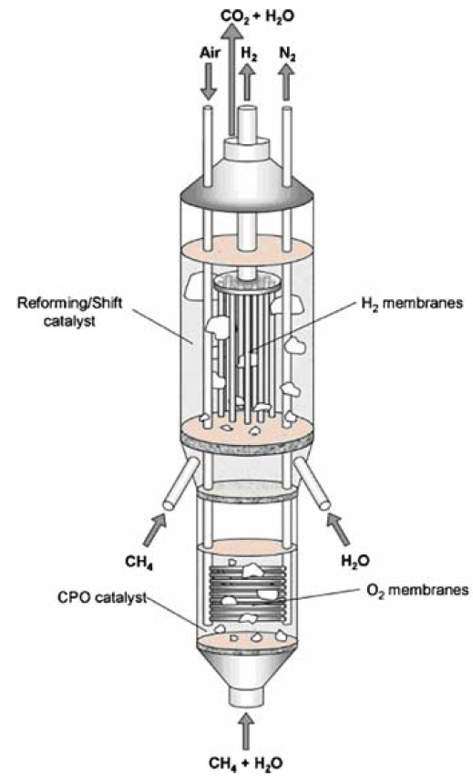
Motivation
In industrial fluidized-bed applications, internals such as heat exchanger tubes and baffles are regularly employed
Immersed internals modify the gas−solid flow structure and thus may have significant effects on the fluidization
Complex hydrodynamics in bubbling fluidized beds with immersed internals are still difficult to describe.
The effectiveness of internals is greatly dependent on their design (horizontal/vertical tubes, packing, baffles…)
Experimental study of FBs with internals is challenging
CFD has an advantage to investigate this complex hydrodynamics
Supporting CFD study of 1 MW pilot plant at ADA-Inc under CCSI, where internal vertical tubes in the FB act as a heat exchanger.
Membrane FB reactor
Image reference : J.F. de Jong, PhD Thesis, Eindhoven University of Technology

Slide 5
Two-fluid model
Generalized Navier-Stokes equations for interacting continua
Mass conservation equations
Momentum conservation equations
Granular temperature balances

Slide 6
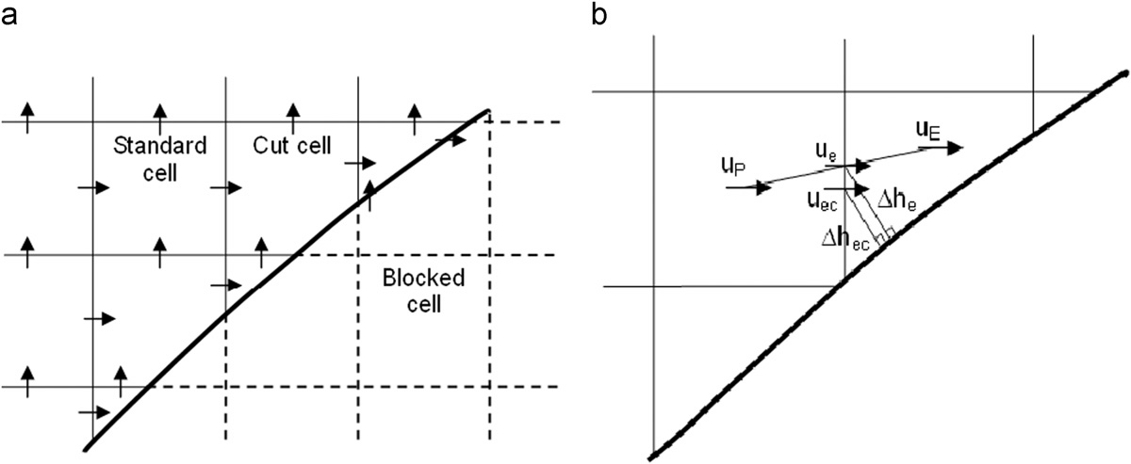
Cut cell method for internal surface
The internal surface (thick solid line) partition computational domain into three types of cells :
(1) standard (uncut) cells;
(2) cut-cells that require special treatment to incorporate the presence of the solid wall/surface (velocity nodes are adjusted to the center of the cut cell)
(3) blocked cells that are excluded from computations since they are located outside the active computational domain.
A no-slip or free-slip velocity boundary condition can be applied for each phase at the wall.
Reference: Dietiker et al., 2009, AIChE Annual Meeting

Slide 7
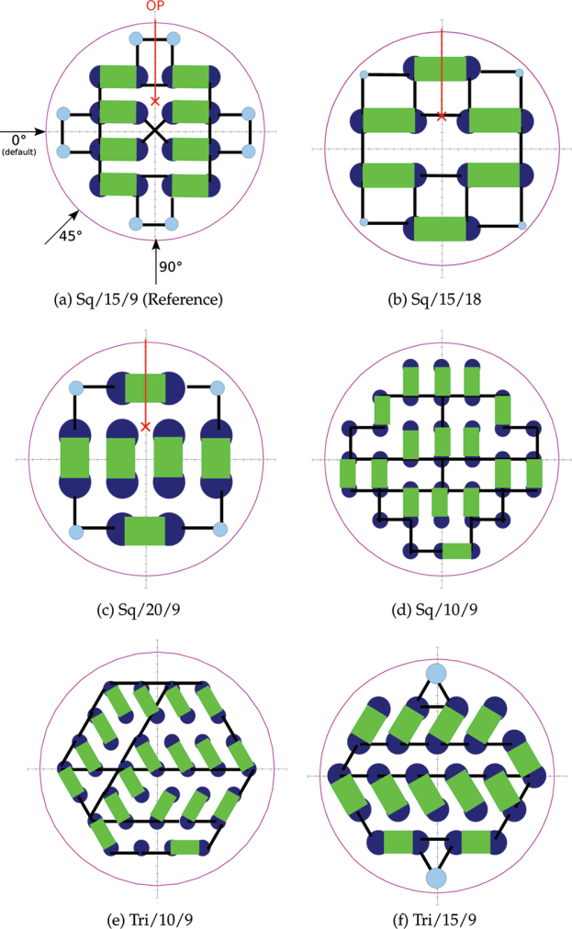
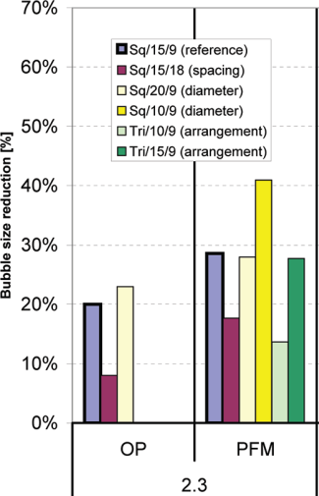
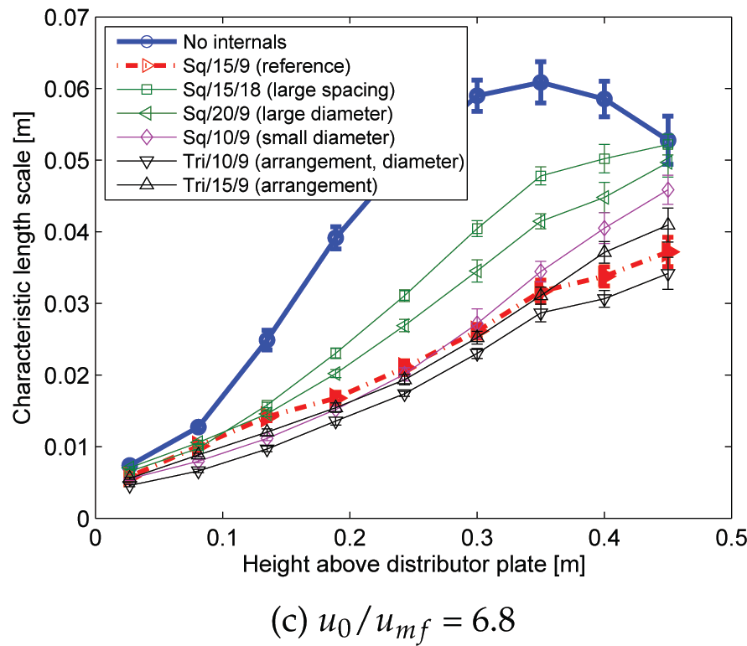
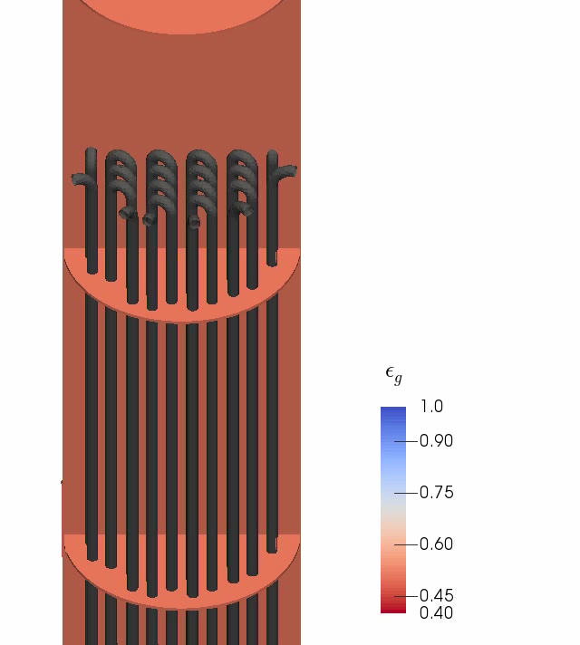
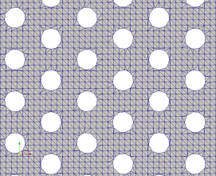
Experimental work: Rudisuli et al. 2012
OP: optical probe measurements
PFM: Pressure fluctuation measurements
Conf. similar to ADA.inc 1MW pilot plant study
Reference : Rudisuli et al., 2012, Ind. Eng. Chem. Res. 51: 4748-4758

Slide 8
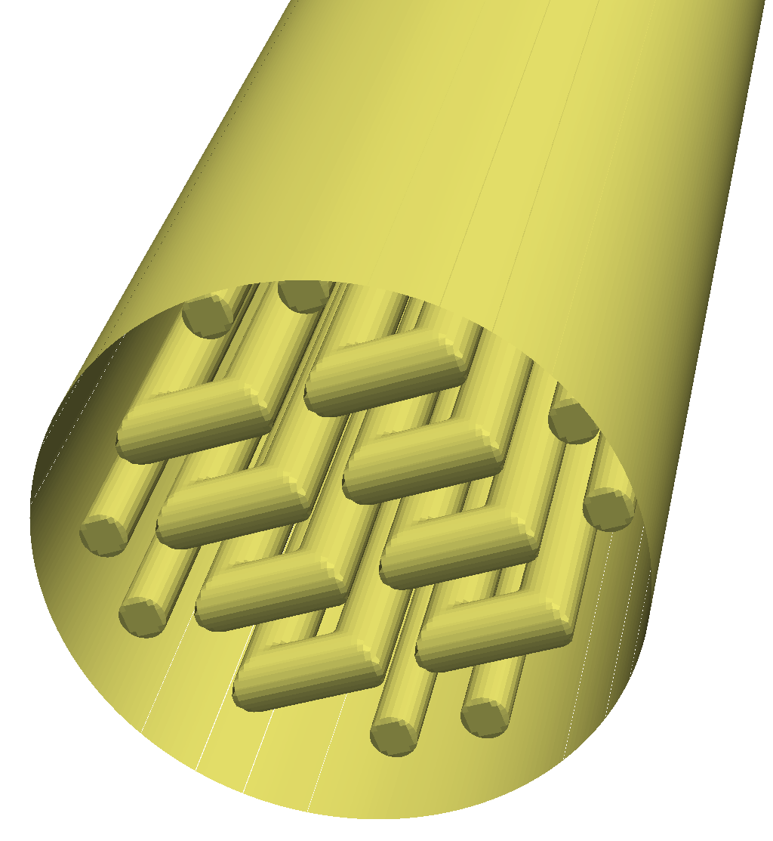
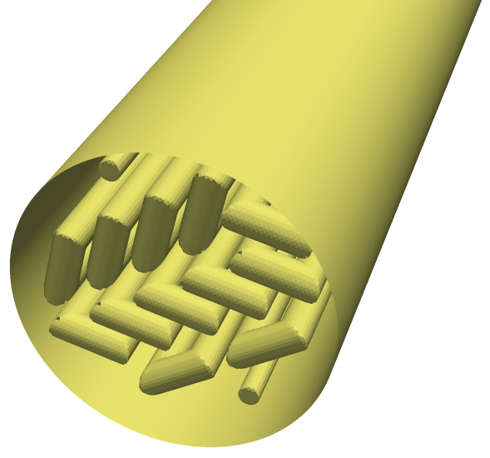
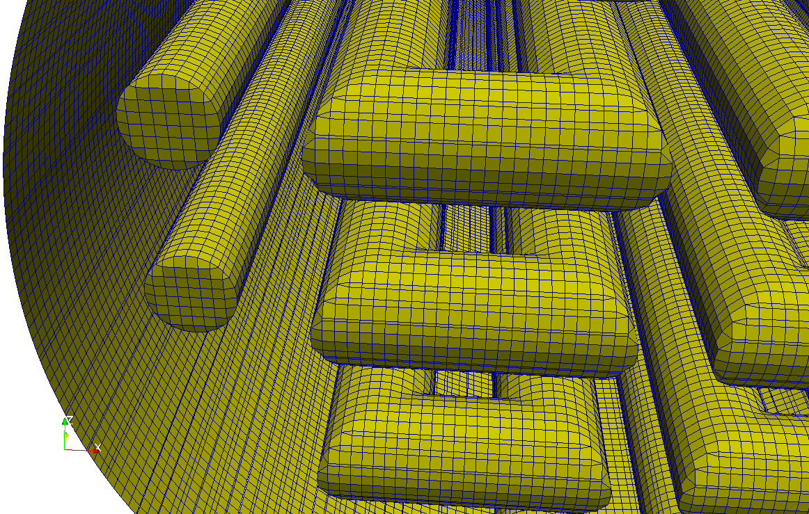
Computational geometry
Fluidized bed configurations
Properties | Without tubes | Sq. arrangement | Tri. arrangement
Column width (number of grids) | 0.15 m (100) | 0.15 m (100) | 0.15 m (100)
Column depth (number of grids) | 0.15 m (100) | 0.15 m (100) | 0.15 m (100)
Column height (number of grids) Bed diameter from cut-cells | 0.96 m (640) 0.145 m | 0.96 m (640) 0.145 m | 0.96 m (640) 0.145
Number of principal tubes (diameter) | - | 16 (15 mm) | 24 (15 mm)
Number of auxiliary tubes (diameter) | - | 8 (12 mm) | 2 (10 mm)
Particle properties
Properties | Values
Particle type | Aluminum oxide
Particle density | 1350 kg/m³
Particle diameter | 289µm
Coefficient of restitution | 0.90
Minimum fluidizing velocity(U_{mf}) | 0.041 m/s
Superficial velocity at inlet (U₀) | 2.3U_{mf}, 4.5U_{mf}, 6.8U_{mf}
Square arrangement
Triangular arrangement
Computational grids
Computational time: Real time of 1 s per day using 128 processors on NETL supercomputers for 6.4 million computational cells
Simulations were performed for 25 s of real time

Slide 9
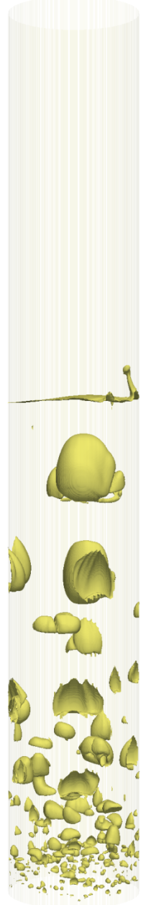
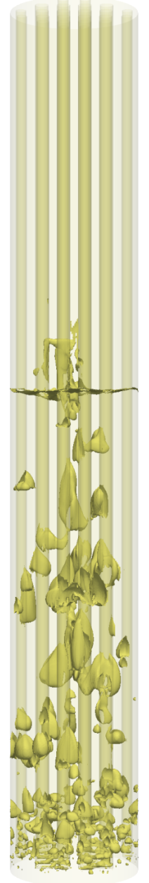
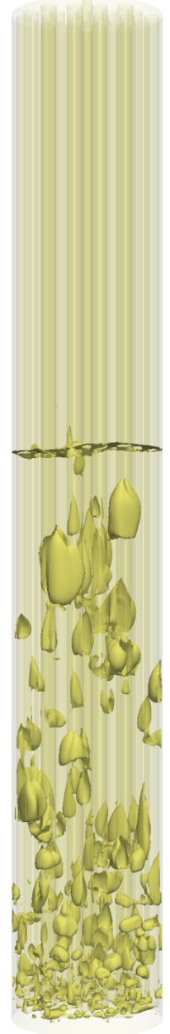
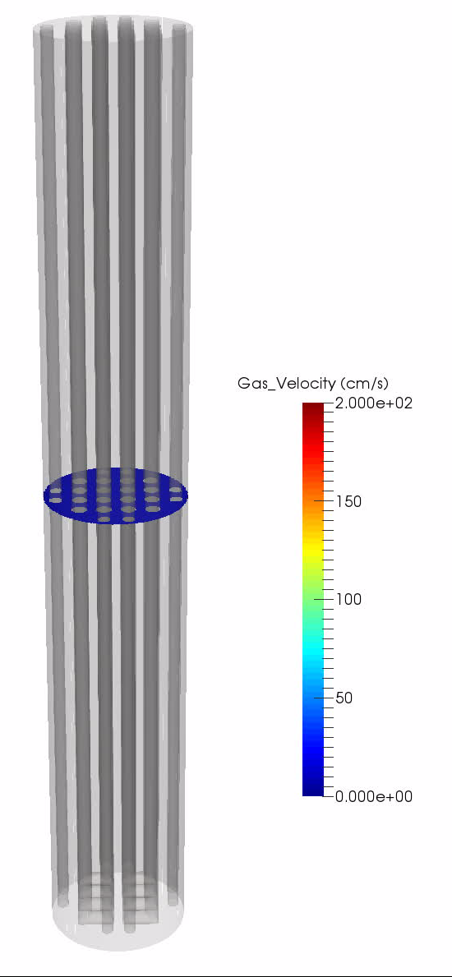
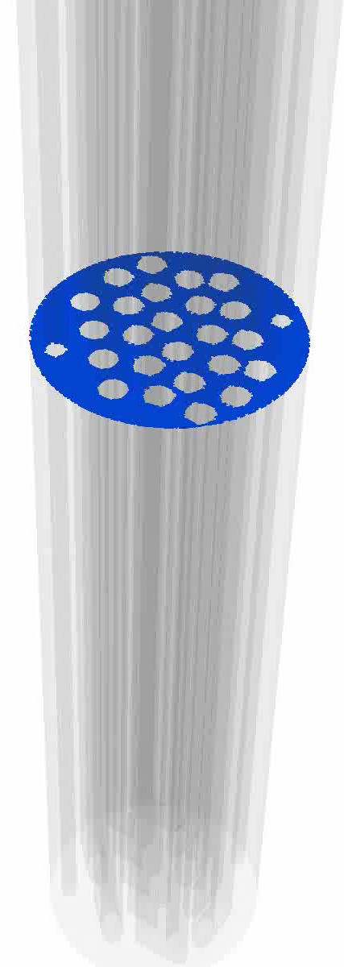
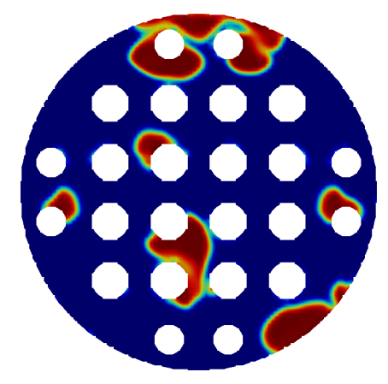
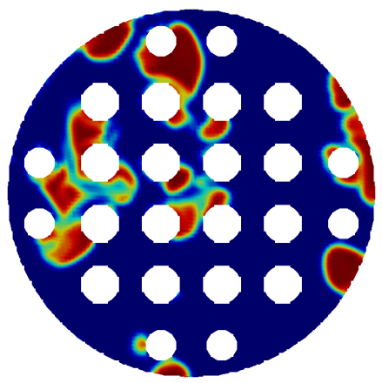
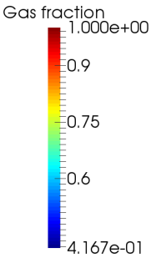
Snapshots

Slide 10
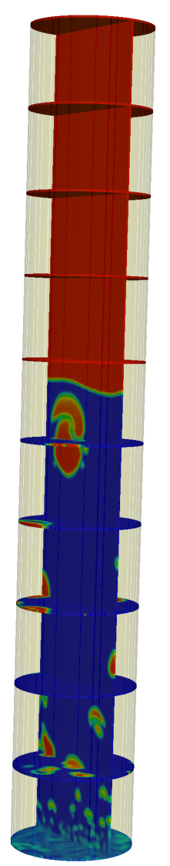
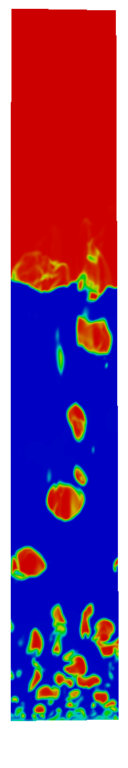
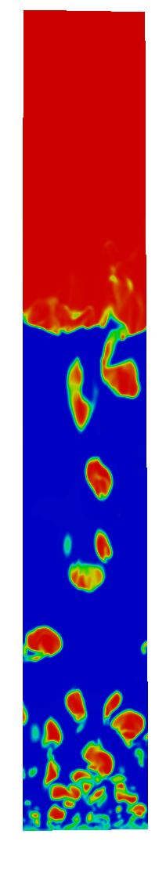

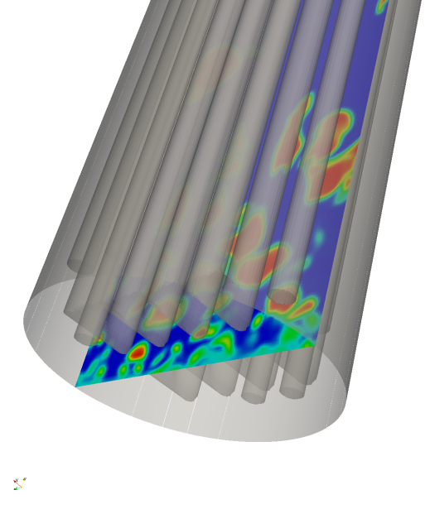

Post processing
Plane of measurements
Data storage 3D domain
Bubble tracking
Sq. arrangement
Tri. arrangement
t
t+∆t
t+2∆t
Where ∆t=0.01s
Reference : Bubble tracking algorithm: Verma et al., 2015 AIChE J. 61: 4

Slide 11
Simulation Results

Slide 12
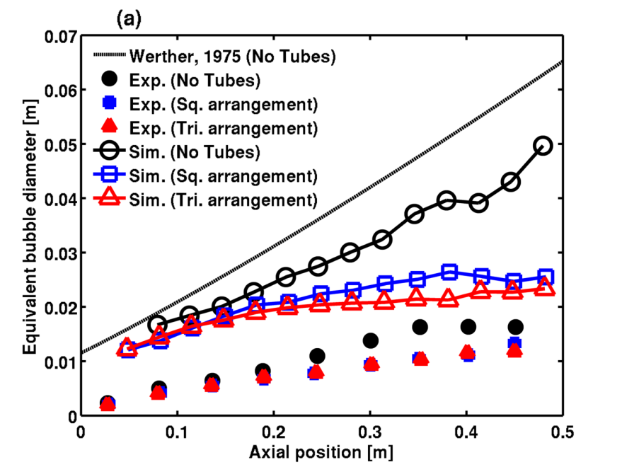
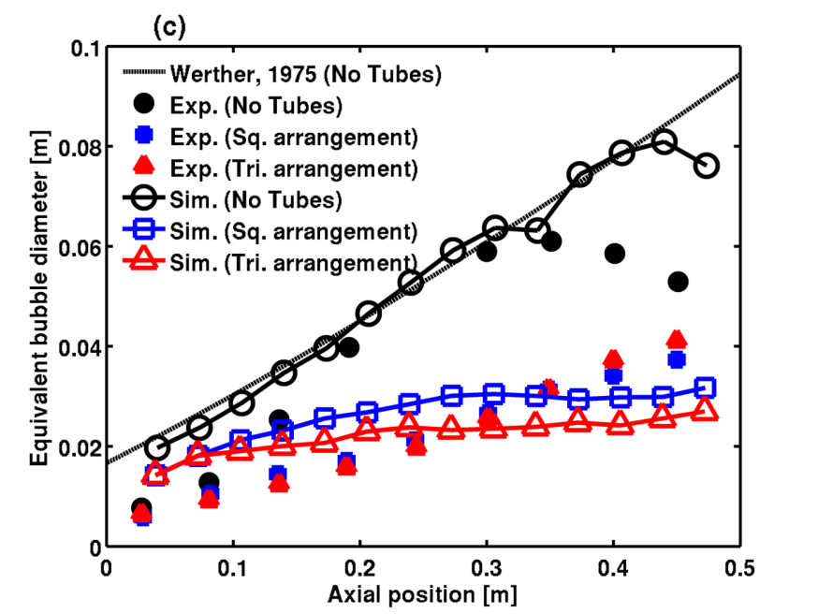
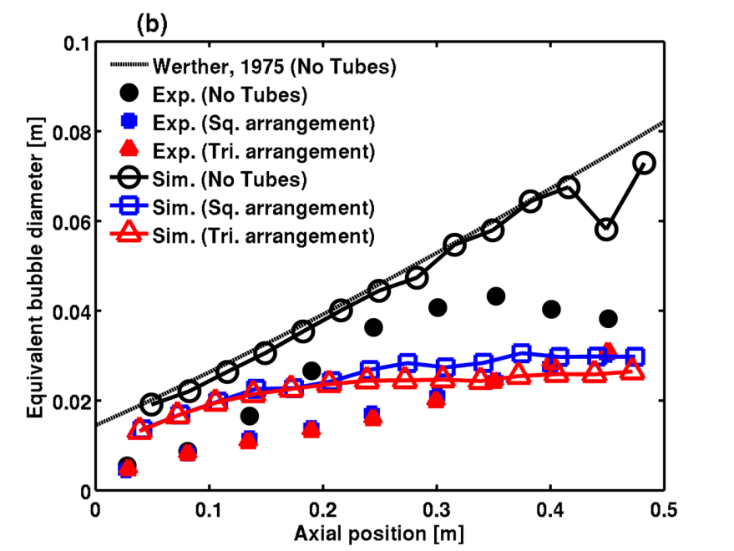
Equivalent bubble diameter
U/U_{mf} =2.3
U/U_{mf} =6.8
Predicted bubble size for no tube is in good agreement with literature correlation of Werther
Bubble size decreases with the effect of vertical tubes
Sim. and Exp. results are in good agreement for the higher inlet gas velocities of U/U_{mf} = 4.8 and 6.8
At U/U_{mf} = 2.3 Exp. results are under predicted, considering Sim. result in a close agreement with bubble size correlation of Werther
U/U_{mf} =4.5
Reference (Exp.): Rudisuli et al., 2012, Ind. Eng. Chem. Res. 51: 4748-4758

Slide 13
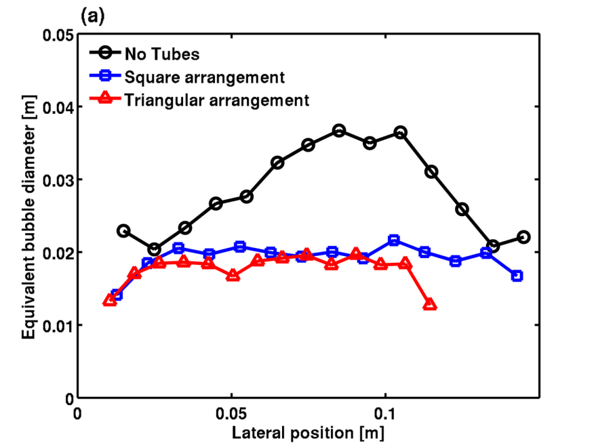
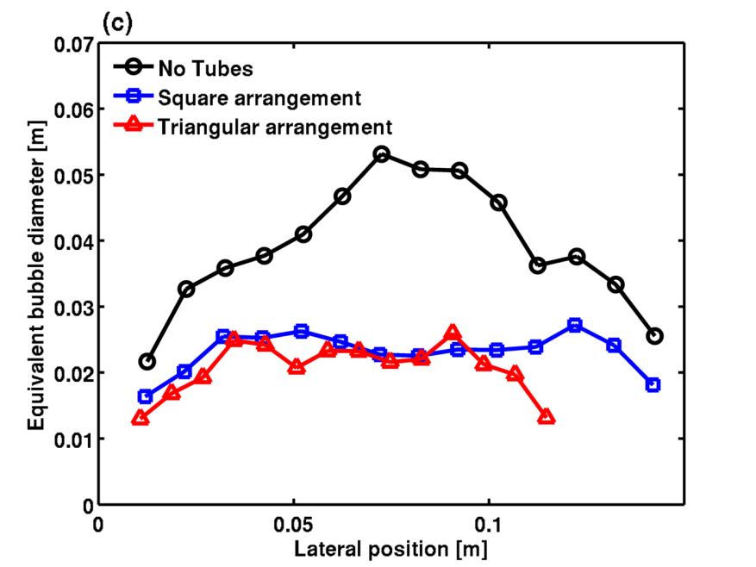
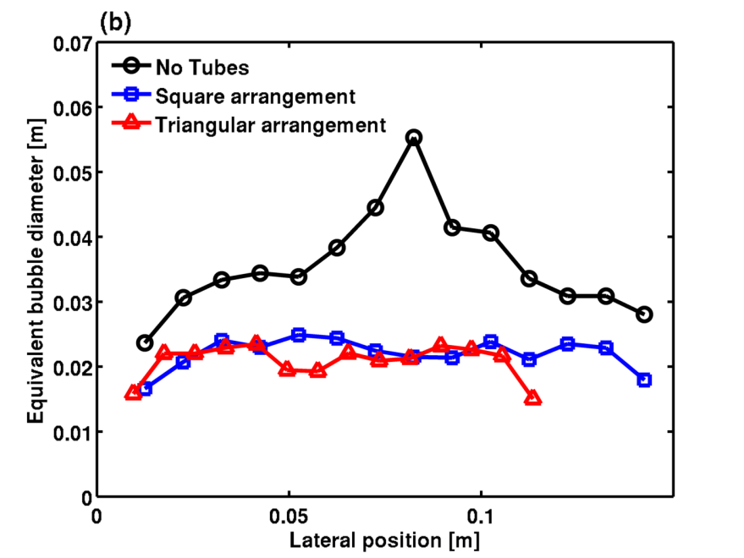
Equivalent bubble diameter
U/U_{mf} =2.3
U/U_{mf} =6.8
Bubble size is larger in the center for No tubes
Uniform bubble size predicted across the bed diameter when there are vertical tubes in the bed
Vertical tubes prevent coalescence and also promote larger bubbles to split
Slugging of bubbles can be prevented using vertical tubes, enhances quality fluidization
U/U_{mf} =4.5

Slide 14
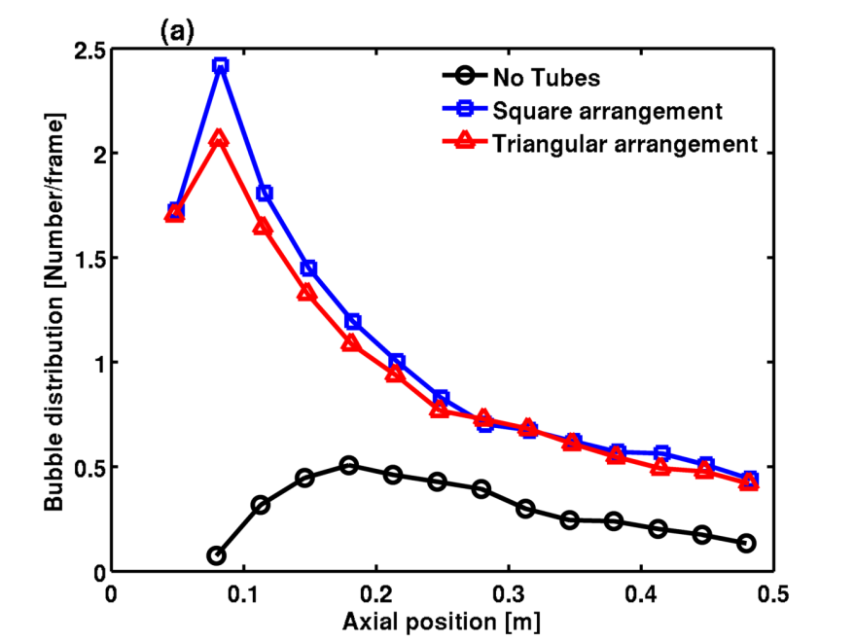
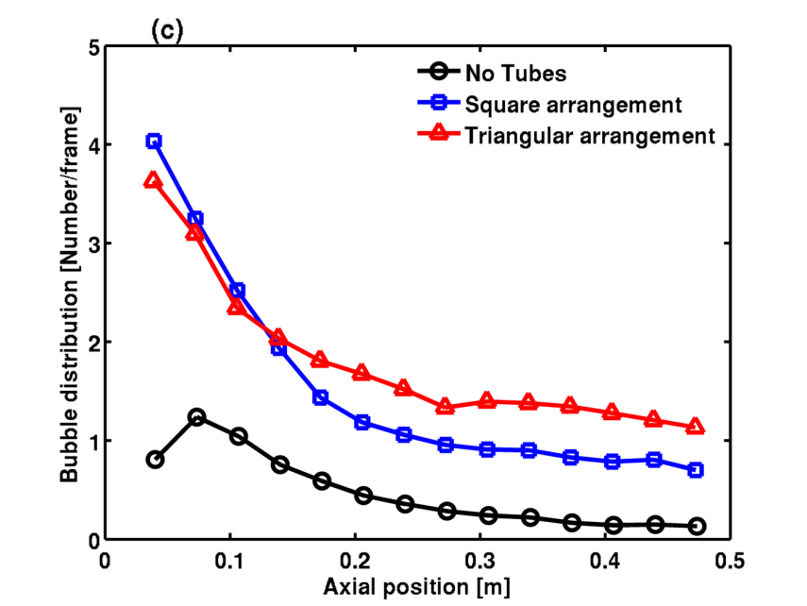
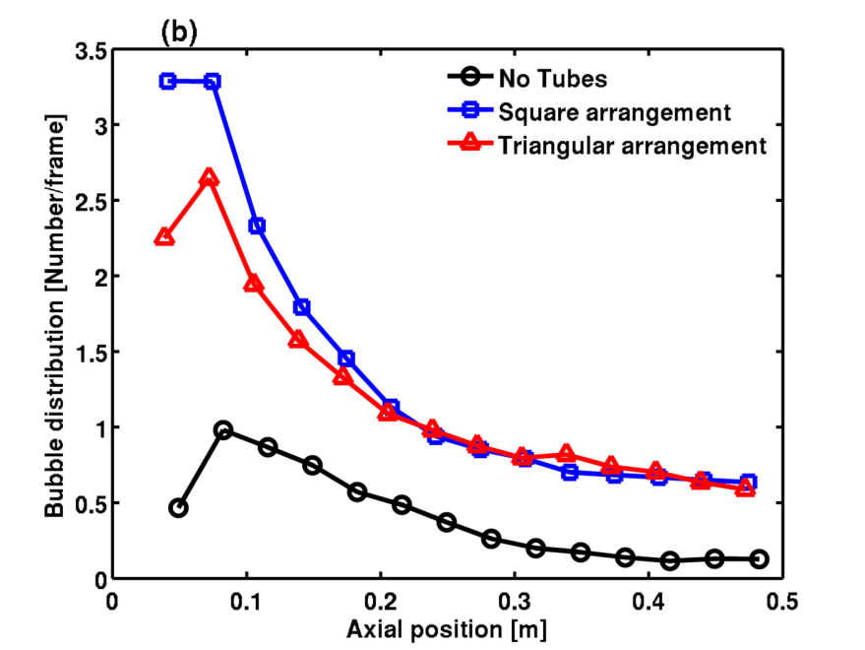
Bubble distribution
U/U_{mf} =2.3
U/U_{mf} =6.8
For vertical tubes inside, large number of bubbles are predicted throughout the height
Significantly more bubbles are predicted in the bottom section of the bed
U-shape bank prevents bubble coalescence at the initial stage as the bubble grows
Square tube arrangement create parallel chambers for the bubble to rise, hence efficient in preventing bubble coalescence
Triangular tube forms staggered alignment of the tubes, promote splitting of larger bubbles
U/U_{mf} =4.5

Slide 15
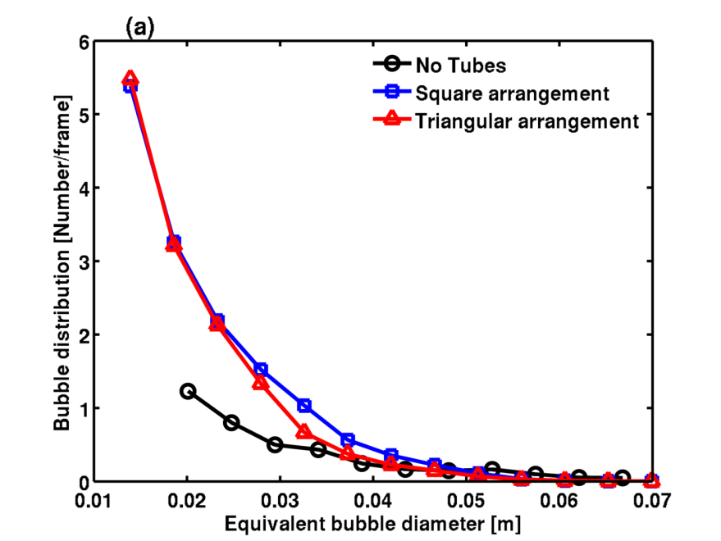
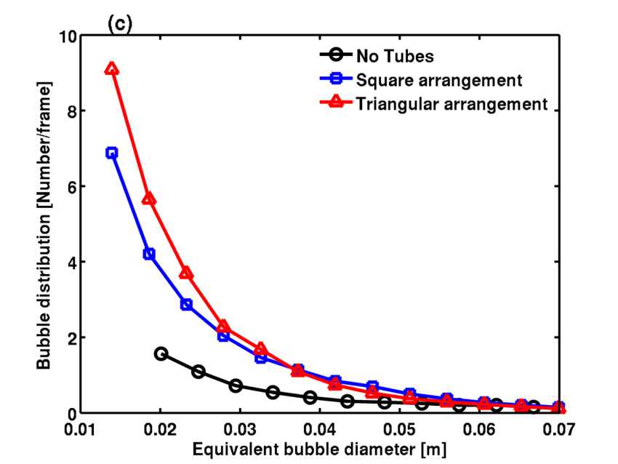
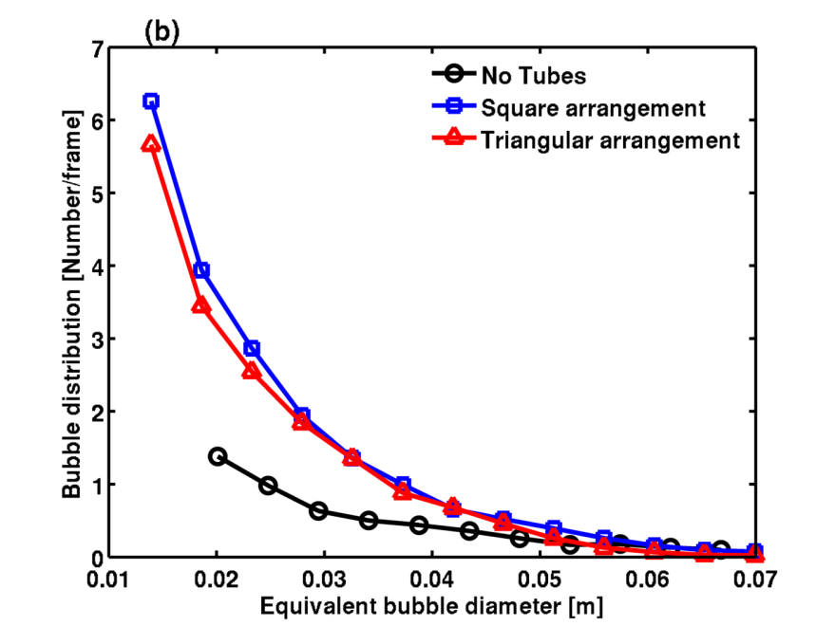
Bubble distribution
U/U_{mf} =2.3
U/U_{mf} =6.8
Number of small bubbles in the bed is significantly greater for the beds with vertical tubes when compared to the bed with no tubes
The number of larger bubbles is similar for both tube arrangements indicating that bubble size is unaffected if it is sufficiently large compared to the tube spacing
U/U_{mf} =4.5

Slide 16
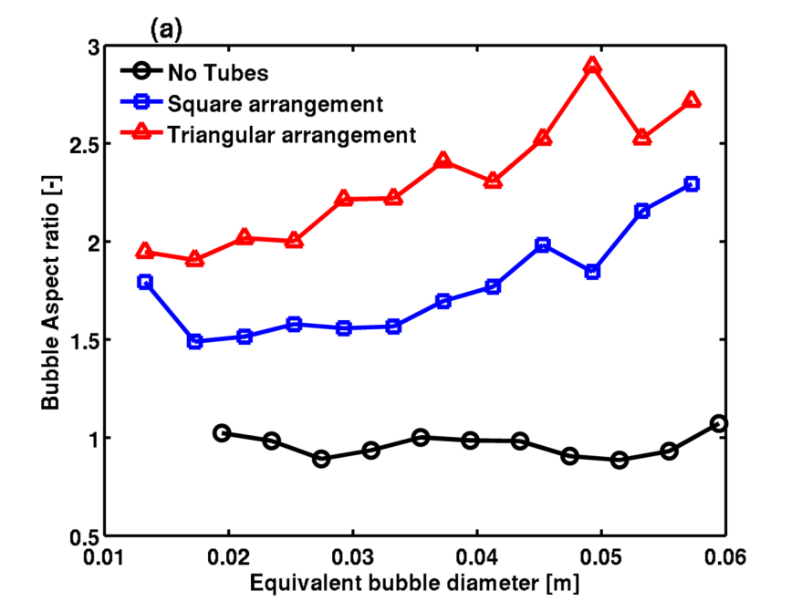
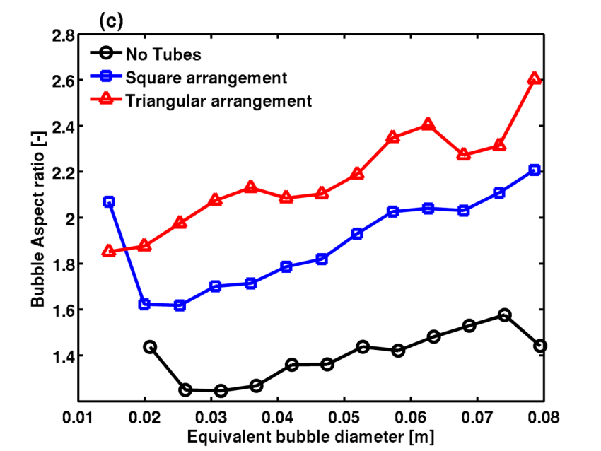
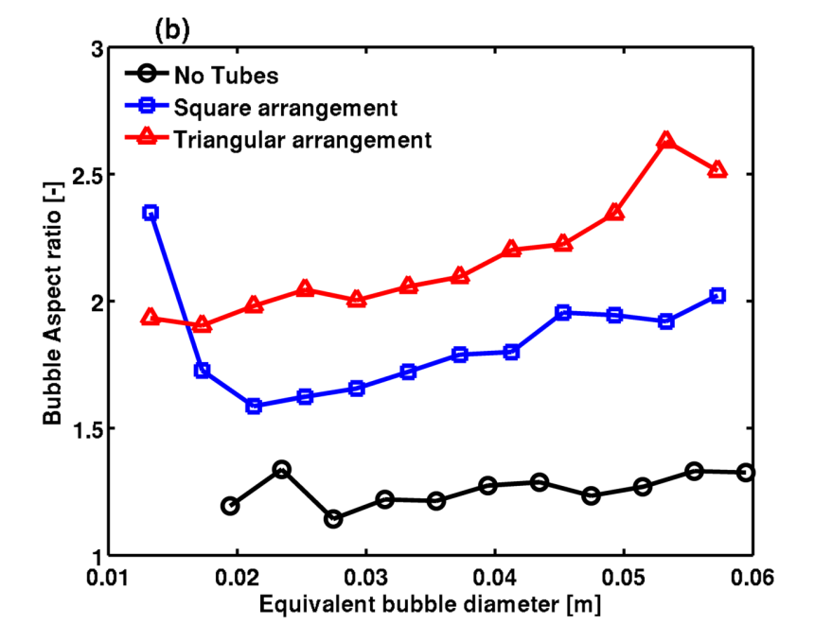
Bubble shape/Aspect ratio
U/U_{mf} =2.3
U/U_{mf} =6.8
The shape of the bubble is estimated from the bubble aspect ratio, i.e. ratio of vertical length to the horizontal length of the bubble
For no tubes, bubbles are nearly spherical in shape.
Bubbles elongate significantly under the influence of vertical tubes
The initial effect of vertical tubes is to squeeze and deform bubbles to fit the space between the tubes
Tri. tube arrangements shows considerable difference when compared with Sq. tube arrangement
U/U_{mf} =4.5

Slide 17
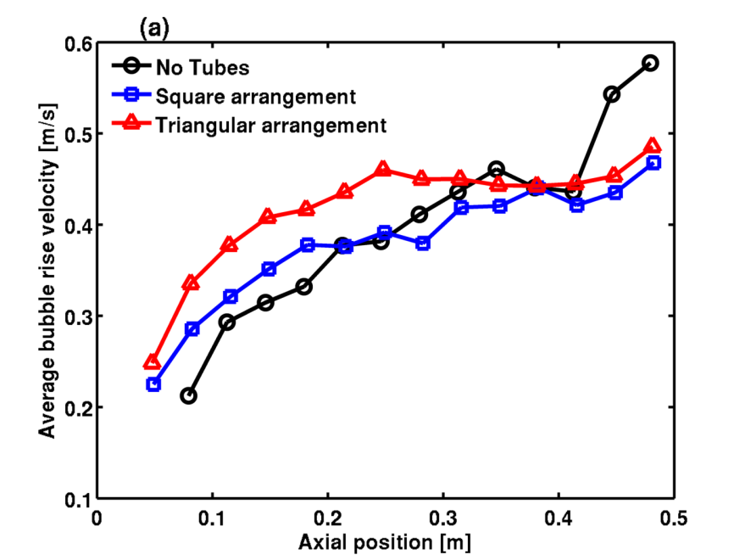
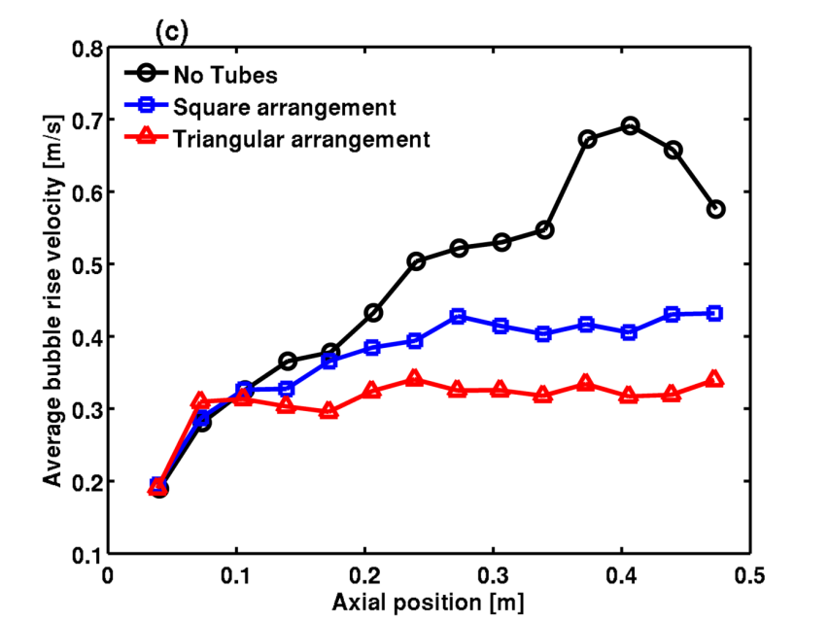
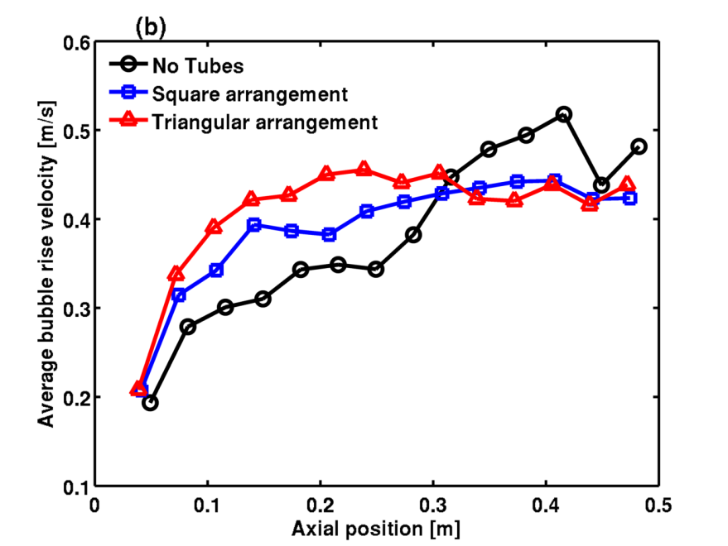
Average bubble rise velocity
U/U_{mf} =2.3
UU_{mf} =6.8
Bubble rise velocity shows an increasing trend in the presence of tubes for lower inlet gas velocity
At low inlet gas velocities bubble size is comparable to the tube spacing, therefore considerable squeeze occurs between the tubes and bubbles rise faster
Squeezing of bubble between the tubes, the centroid of bubble moves a longer distance than uniform size bubble
At higher gas velocities, bubble sizes are large enough that they enclose the tube and rise along the tube walls
U/U_{mf} =4.5

Slide 18
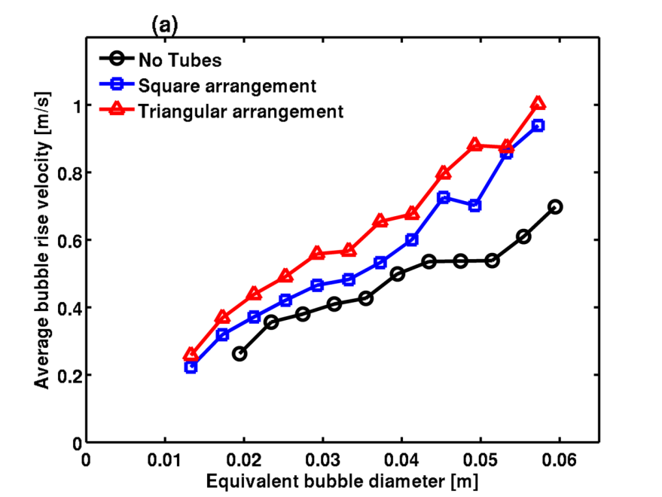
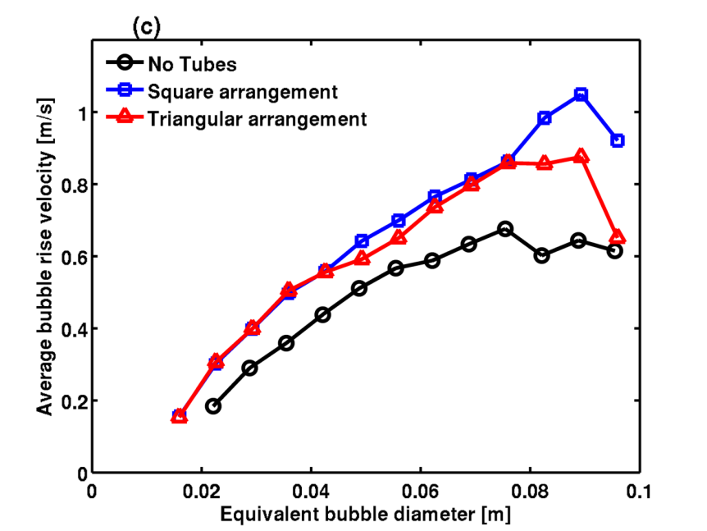
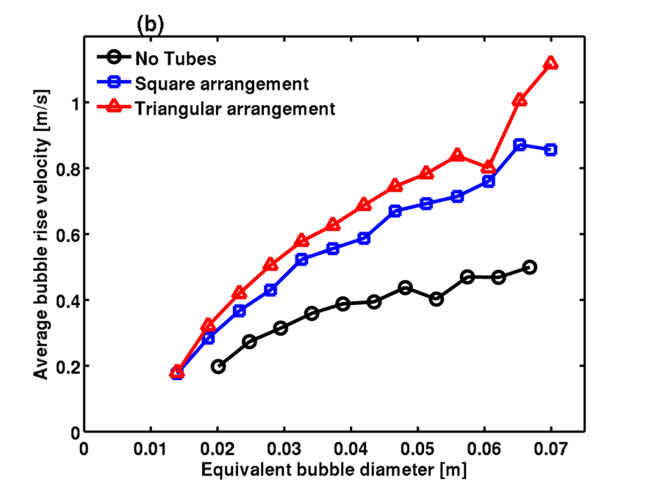
Average bubble rise velocity
U/U_{mf} =2.3
U/U_{mf} =6.8
Bubbles of the same size rise with different velocities, where bubbles travel faster in the bed with tubes
Because the bubble is elongated and follows preferential path along the vertical tubes
Bubble rise velocity in the bed with tubes depends upon fluidizing gas velocity and tube arrangements
U/U_{mf} =4.5

Slide 19
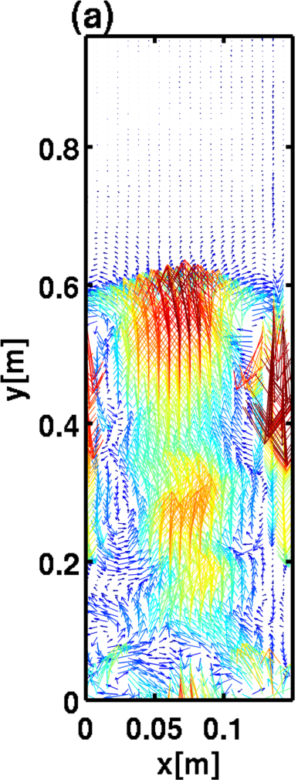


Solids circulations
m/s
NT
Sq. arrangement
Tri. arrangement

Slide 20



Solids velocity profile
NT
Upward motion of solids in the center and downward motion near to the walls for no tubes.
For tubes higher solids velocities lie in the region between the tubes.
The magnitude of solids velocities is nearly the same at these three heights for vertical tubes.
Sq. arrangement
Tri. arrangement

Slide 21
Conclusions
The influence of vertical tubes on bubble characteristics and solids motion in a fluidized bed has been investigated using the MFIX two-fluid model
A comparison of simulation results with experimental data shows good agreement
Square and triangular tube arrangements have been compared to the bed without tubes
A decrease in equivalent bubble diameter and a uniform distribution of bubble are seen for the bed with vertical tubes
Simulation results show that the square tube arrangement forms longitudinal, parallel chambers that prevent bubble coalescence
Triangular tubes are in a staggered arrangement, they promote bubble splitting
Splitting and squeezing of bubbles between the tubes their shapes change significantly, becoming more elongated and travel faster
Differences in solids circulation patterns are very distinct for the three bed configurations
Solids motion is rarely seen in the radial direction because the vertical tubes prevent lateral solids motion

Slide 22

Acknowledgements
This work is performed in support of the U.S. Department of Energy, Office of Fossil Energy's Carbon Capture Simulation Initiative (CCSI)

Slide 23
Thank you
Questions ?

Slide 24
Disclaimer
This presentation was prepared as an account of work sponsored by an agency of the United States Government. Neither the United States Government nor any agency thereof, nor any of their employees, makes any warranty, express or implied, or assumes any legal liability or responsibility for the accuracy, completeness, or usefulness of any information, apparatus, product, or process disclosed, or represents that its use would not infringe privately owned rights. Reference herein to any specific commercial product, process, or service by trade name, trademark, manufacturer, or otherwise does not necessarily constitute or imply its endorsement, recommendation, or favoring by the United States Government or any agency thereof. The views and opinions of authors expressed herein do not necessarily state or reflect those of the United States Government or any agency thereof.

