Slide 1
U.S. Department of Energy, National Energy Technology Laboratory’s (NETL) 2016 Workshop on Multiphase Flow Science Conversion of Petroleum Coke in a High-Pressure Entrained-Flow Gasifier: Comparison of CFD Model and Experiment
August 9, 2016
Allan Runstedtler, Robert Yandon, Marc Duchesne, Robin Hughes, Patrick Boisvert

Slide 2
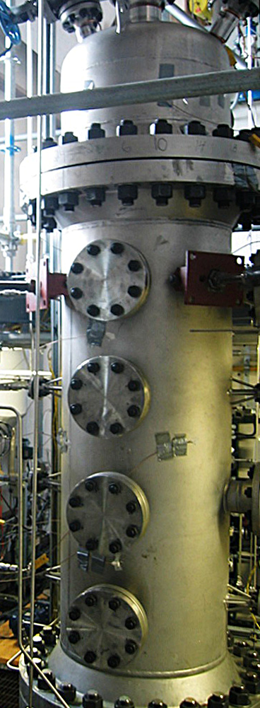
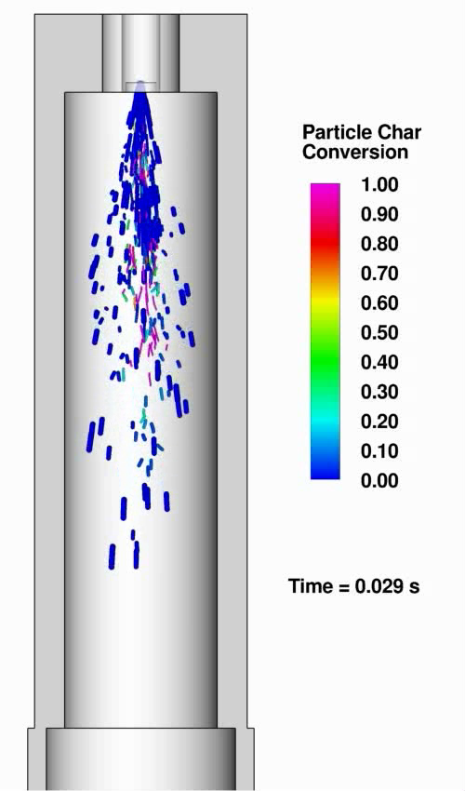
Entrained Flow Gasification

Slide 3
CFD Model Validation
Experimental measurements of high-pressure gasifiers usually consist only of wall temperatures and outlet gas temperature and composition.
How should a CFD model be validated with this data?
The approach taken here is to compare the model predictions with measurements over a range of operating conditions comprising both favorable and unfavorable performance.
The CFD model should able to track the performance of the gasifier over the range of operating conditions, i.e., to predict higher and lower solid fuel conversion levels.

Slide 4
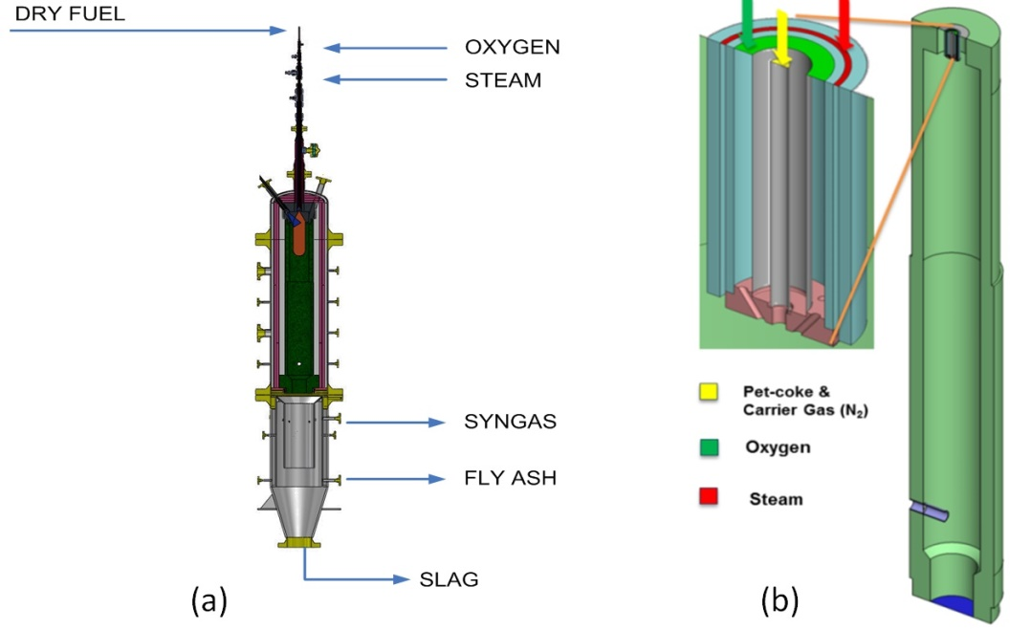
Geometry
ACTIVELY COOLED TOP HEAD
ACTIVELY COOLED TOP HEAD
WALL
THERMO-COUPLES
Petroleum Coke & Carrier Gas (N₂)
Probe
Probe
Modeled half-section with symmetry plane
Mesh consists of 1.5 million nodes, primarily hexahedral elements, refined near burner

Slide 5
Petroleum Coke Analysis
Proximate Analysis (mass percent)
Volatiles | 12.7
Fixed Carbon | 82.2
Ash | 4.6
Moisture | 0.5
Ultimate Analysis (mass percent)
Carbon | 86.4
Hydrogen | 4.2
Sulphur | 6.1
Nitrogen | 1.8
Oxygen | 1.5

Slide 6
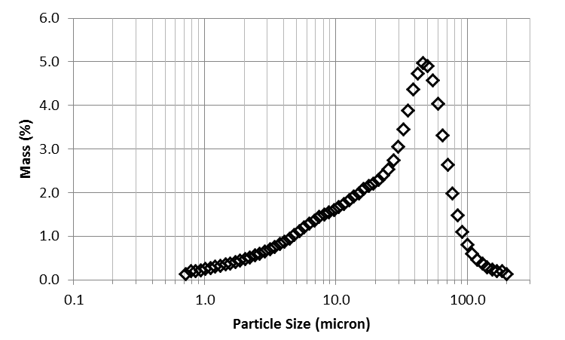
Particle Size Distribution
A total of 30,000 particles were injected in 66 particle groups

Slide 7
Model: Devolatilization
Devolatilization rate is modeled using a first-order Arrhenius rate equation, with the rate constants estimated from the PC Coal Lab® software
Volatile yield (weight loss on as-received basis) is 16.5%, implying a volatile yield factor of 1.3
Petroleum coke char composition after devolatilization (dry ash-free weight percent) predicted by PC Coal Lab® is C: 92.7%, H: 0.4%, O: 0.1%, N: 1.9%, S: 4.9%

Slide 8
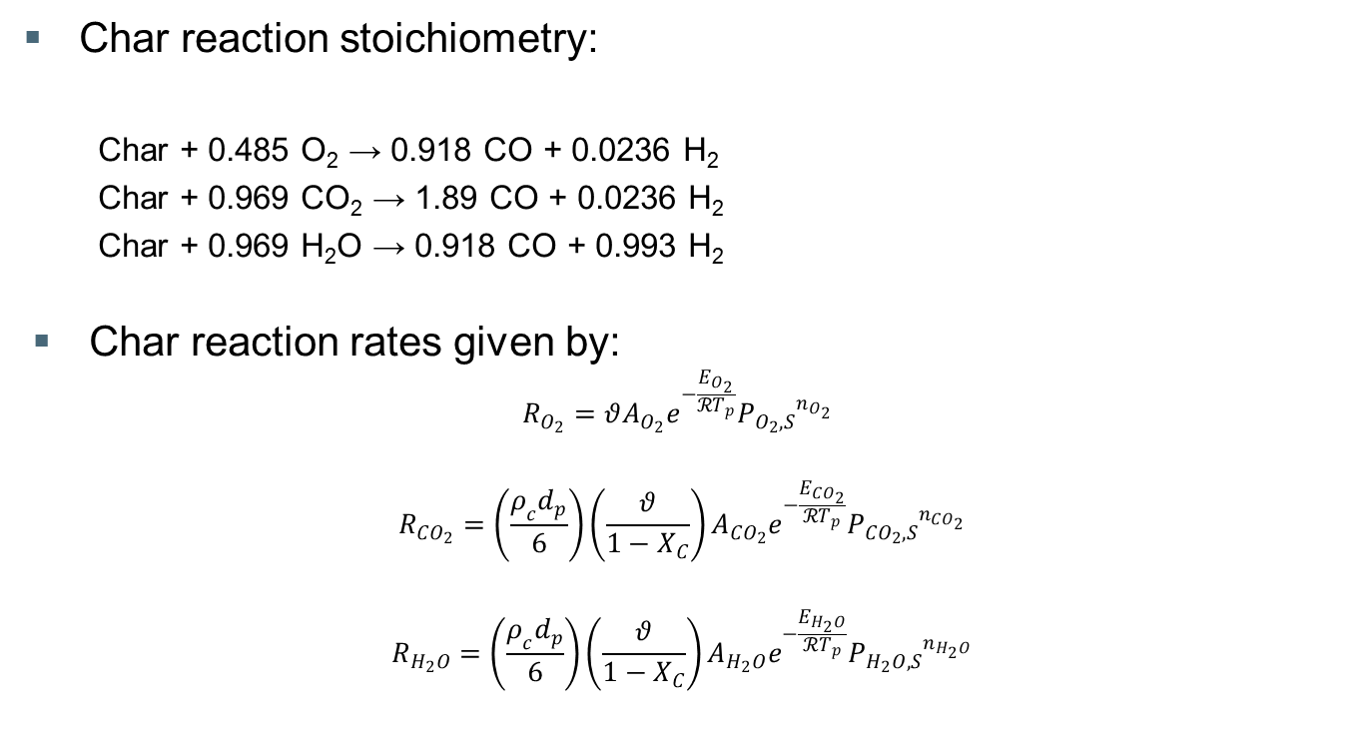
Model: Char Reactions
Char reaction stoichiometry:
Char + 0.485 O₂ → 0.918 CO + 0.0236 H₂
Char + 0.969 CO₂ → 1.89 CO + 0.0236 H₂
Char + 0.969 H₂O → 0.918 CO + 0.993 H₂
Char reaction rates given by:
$$R_{O_{2}}=θA_{O_{2}}e^{−\frac{E_{O_{2}}}{ℛT_{p}}}{P_{O_{2},S}}^{n_{O_{2}}}$$
$$R_{{CO}_{2}}=\left(\frac{ρ_{c}d_{p}}{6}\right)\left(\frac{θ}{1−X_{C}}\right)A_{{CO}_{2}}e^{−\frac{E_{CO_{2}}}{ℛT_{p}}}{P_{CO_{2},S}}^{n_{CO_{2}}}$$
$$R_{H_{2}O}=\left(\frac{ρ_{c}d_{p}}{6}\right)\left(\frac{θ}{1−X_{C}}\right)A_{H_{2}O}e^{−\frac{E_{H_{2}O}}{ℛT_{p}}}{P_{H_{2}O,S}}^{n_{H_{2}O}}$$

Slide 9
Model: Char Reactions (continued)
Char reactivity calibration points were obtained using thermogravimetric analysis performed at CanmetENERGY
Reaction rates were estimated from PC Coal Lab® simulations of a drop tube furnace with the gasifier environment

Slide 10
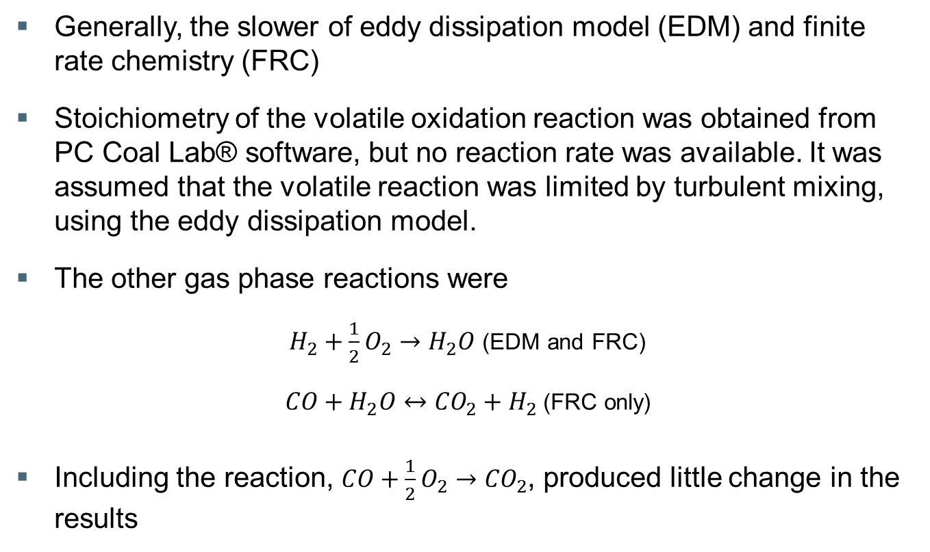
Model: Gaseous Reactions
Generally, the slower of eddy dissipation model (EDM) and finite rate chemistry (FRC)
Stoichiometry of the volatile oxidation reaction was obtained from PC Coal Lab® software, but no reaction rate was available. It was assumed that the volatile reaction was limited by turbulent mixing, using the eddy dissipation model.
The other gas phase reactions were
$H_{2}+\frac{1}{2}O_{2}→H_{2}O$ (EDM and FRC)
$CO+H_{2}O↔{CO}_{2}+H_{2}$ (FRC only)
Including the reaction, $CO+\frac{1}{2}O_{2}→{CO}_{2}$, produced little change in the results

Slide 11
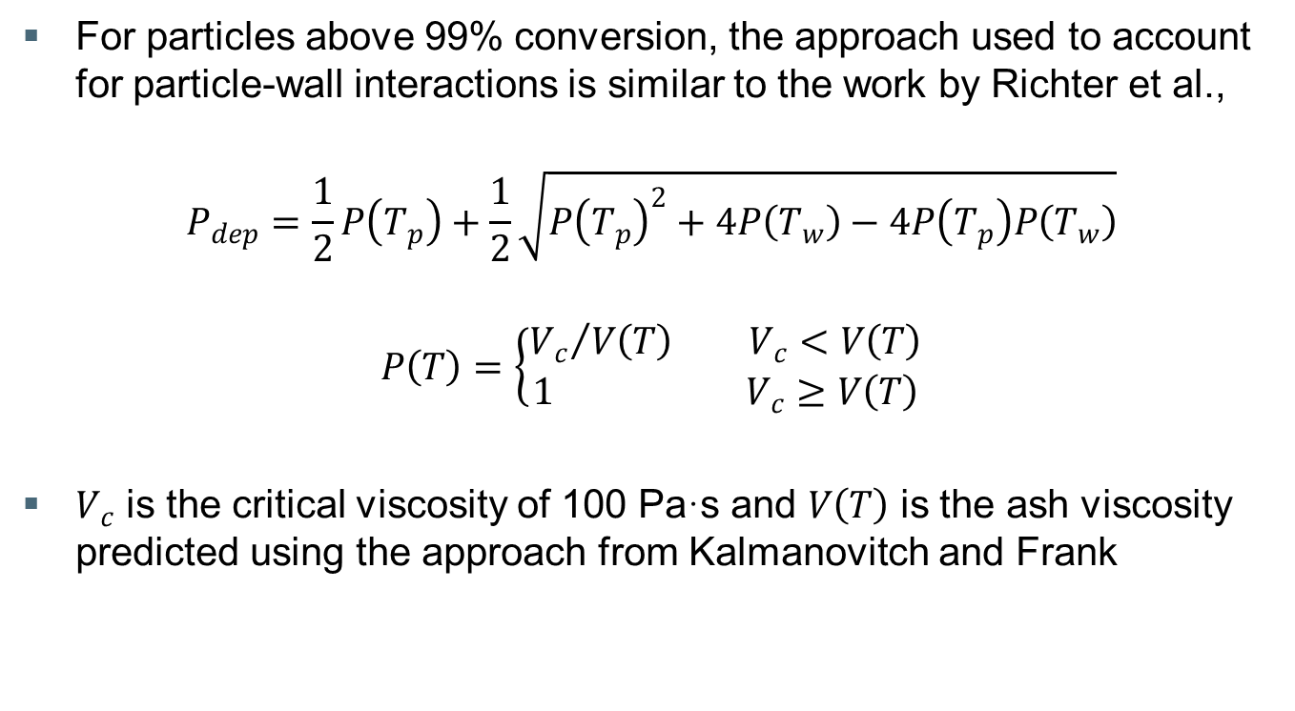
Model: Particle-Wall Interaction
For particles above 99% conversion, the approach used to account for particle-wall interactions is similar to the work by Richter et al.,
$$P_{dep}=\frac{1}{2}P\left(T_{p}\right)+\frac{1}{2}\sqrt{{P\left(T_{p}\right)}^{2}+4P\left(T_{w}\right)−4P\left(T_{p}\right)P\left(T_{w}\right)}$$
$$P\left(T\right)=\left\{\begin{aligned}{V_{c}}/{V\left(T\right)} V_{c}<V\left(T\right) \\ 1 V_{c}≥V\left(T\right)\end{aligned}\right.$$
$V_{c}$ is the critical viscosity of 100 Pa·s and $V\left(T\right)$ is the ash viscosity predicted using the approach from Kalmanovitch and Frank

Slide 12
Model: Heat Transfer
Discrete transfer radiation model with 8 rays and composition-dependent gas radiative properties
Blackbody temperature of 135°C was applied to the outlet to represent the effect of the water quench zone below

Slide 13

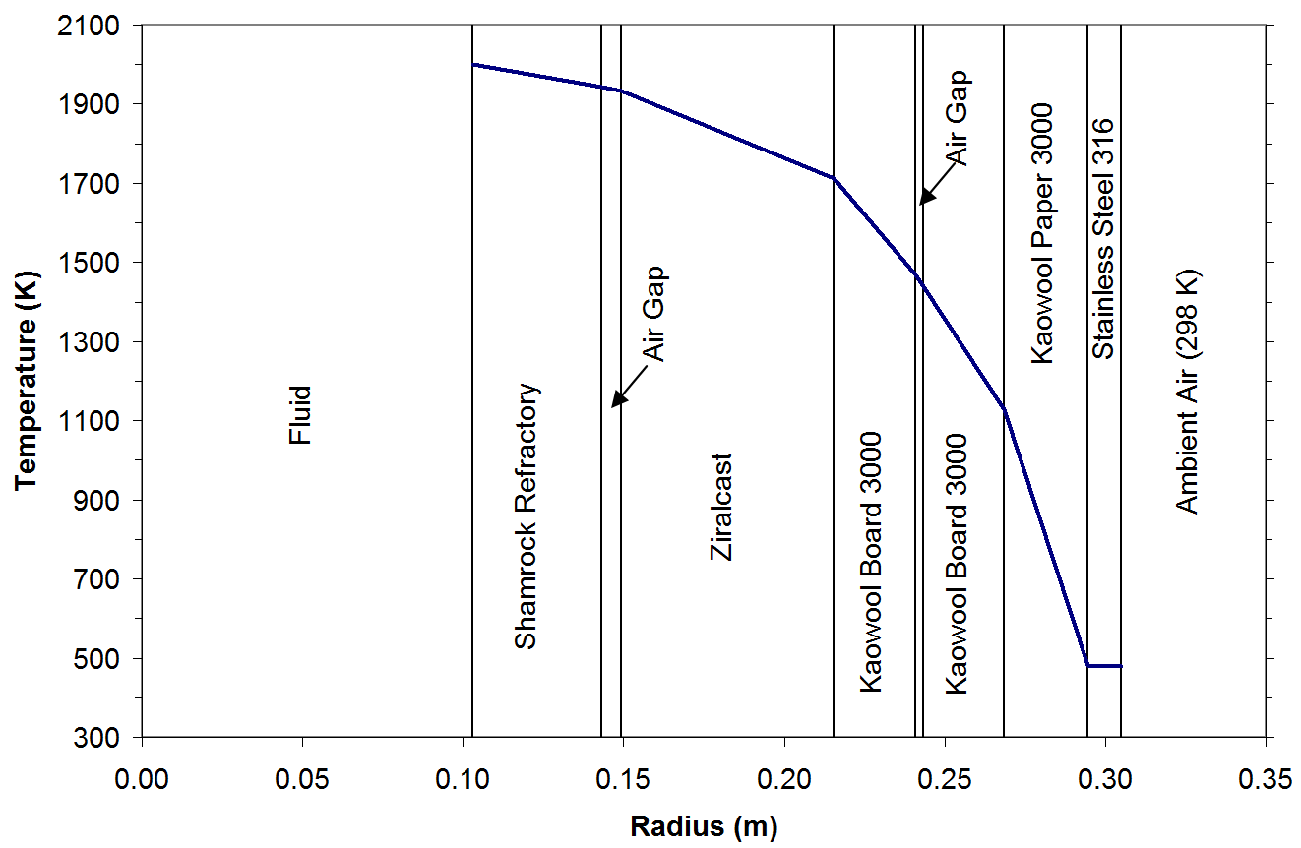
Model: Heat Transfer (continued)
Heat loss through wall
Part of CFD calculation
Coupled 1-D conduction heat transfer calculation

Slide 14
Operating Conditions
Case | 1 (base case) | 2 (higher fuel rate) | 3 (lower pressure)
Duration (minutes) | 300 | 25 | 25
Fuel flow rate (kg/h) Standard deviation (kg/h) | 41.2 7.7 | 59.7 5.5 | 43.1 3.4
Steam flow rate (kg/h) Standard deviation (kg/h) | 10.7 0.9 | 10.2 0.8 | 10.9 0.3
Oxygen flow rate (kg/h) Standard deviation (kg/h) | 37.2 2.1 | 43.6 0.3 | 36.8 0.7
Gasifier pressure (kPa gauge) | 1500 | 1500 | 700
Steam supply temperature (°C) | 226.6 | 230.6 | 206.3
N₂ flow (kg/h) for conveying fuel and for instrumentation ports | 12.1 | 11.1 | 7.2

Slide 15
Results: Solid Conversion
% Conversion of Solid to Gas
Case 1 (base case) |  | Case 2 (higher fuel rate) |  | Case 3 (lower pressure)
CFD | Experiment | CFD | Experiment | CFD | Experiment
92.3 | 89.7 | 74.1 | 77.2 | 82.0 | 77.3
Iteration-to-iteration variability of 3% in the conversion rate was observed during the numerical solution for Case 3, suggesting some flow instability for this case.

Slide 16
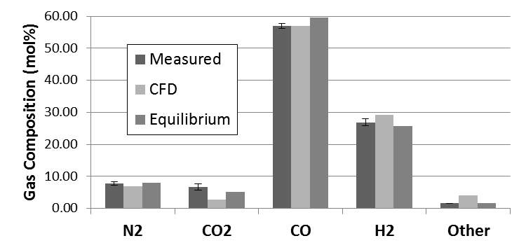
Results: Outlet Gas Composition
Case 1 (base case)
60
50
40
30
20
10
0

Slide 17
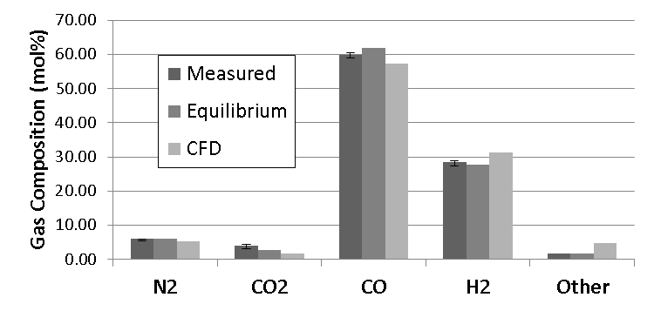
Results: Outlet Gas Composition
Case 2 (higher fuel rate)
70
60
50
40
30
20
10
0

Slide 18
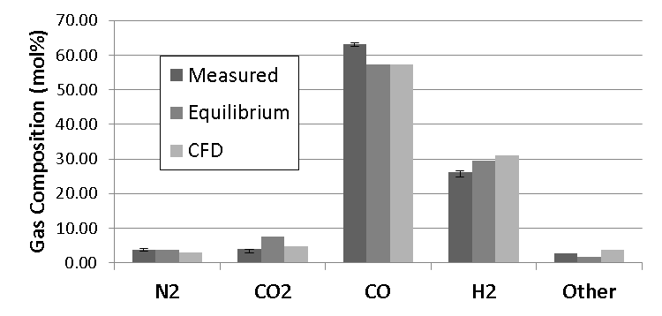
Results: Outlet Gas Composition
Case 3 (lower pressure)
70
60
50
40
30
20
10
0

Slide 19
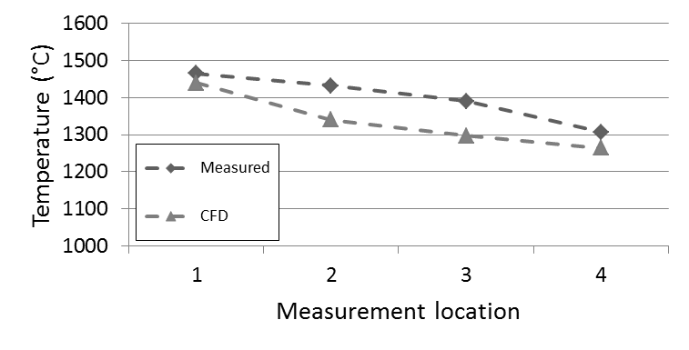
Results: Wall Temperature
Case 1

Slide 20
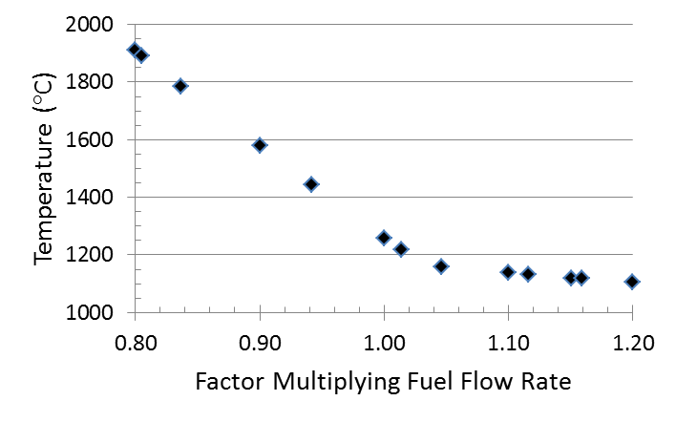
Note: Reactor Temperature Sensitivity
Adiabatic reactor temperature versus variation in fuel flow rate for Case 1

Slide 21
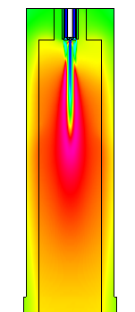
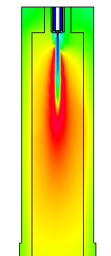
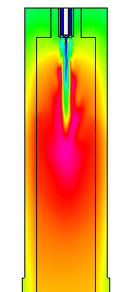

Results: Temperature
Case 1
(base case)
Case 2
(higher fuel rate)
Case 3
(lower pressure)
Solid
Temperature (°C)
2125
Gas
1705
1285
865
445
25

Slide 22
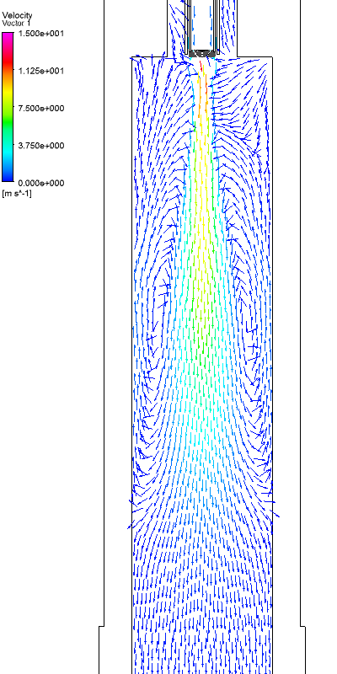
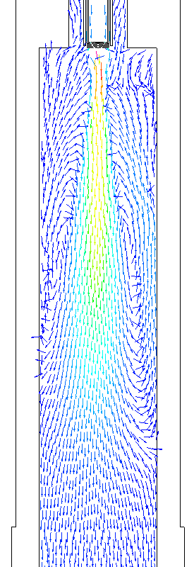
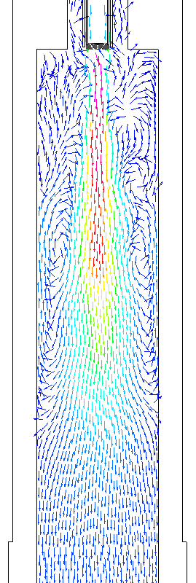
Results: Velocity
Case 1
(base case)
Case 2
(higher fuel rate)
Case 3
(lower pressure)
Velocity (m/s)
15.0
11.25
7.5
3.75
0.0

Slide 23
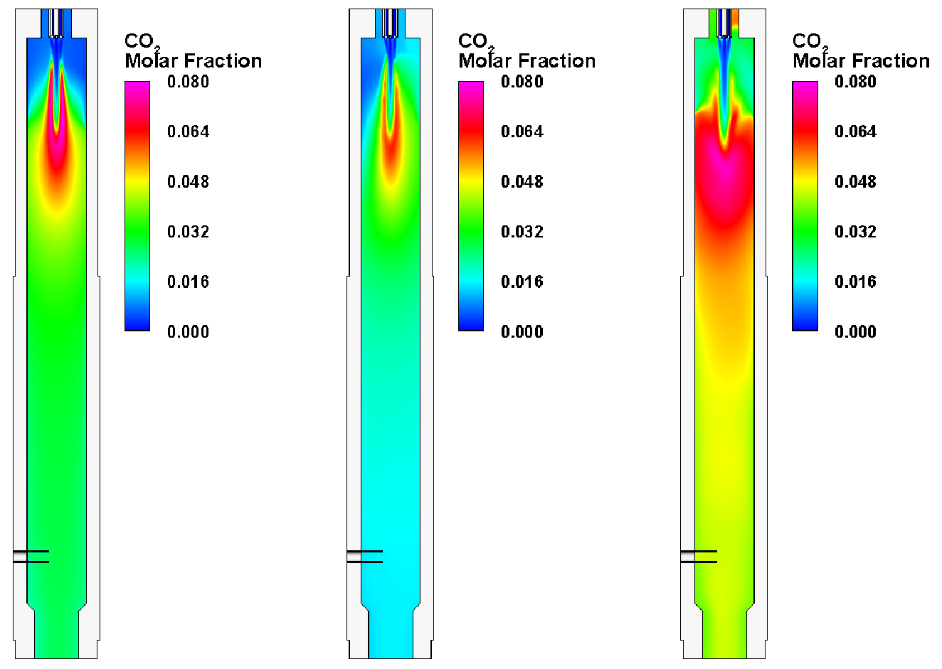
Results: CO₂ Molar Fraction
Case 1
(base case)
Case 2
(higher fuel rate)
Case 3
(lower pressure)
CO₂ Molar Fraction
0.080
0.064
0.048
0.032
0.016
0.0

Slide 24
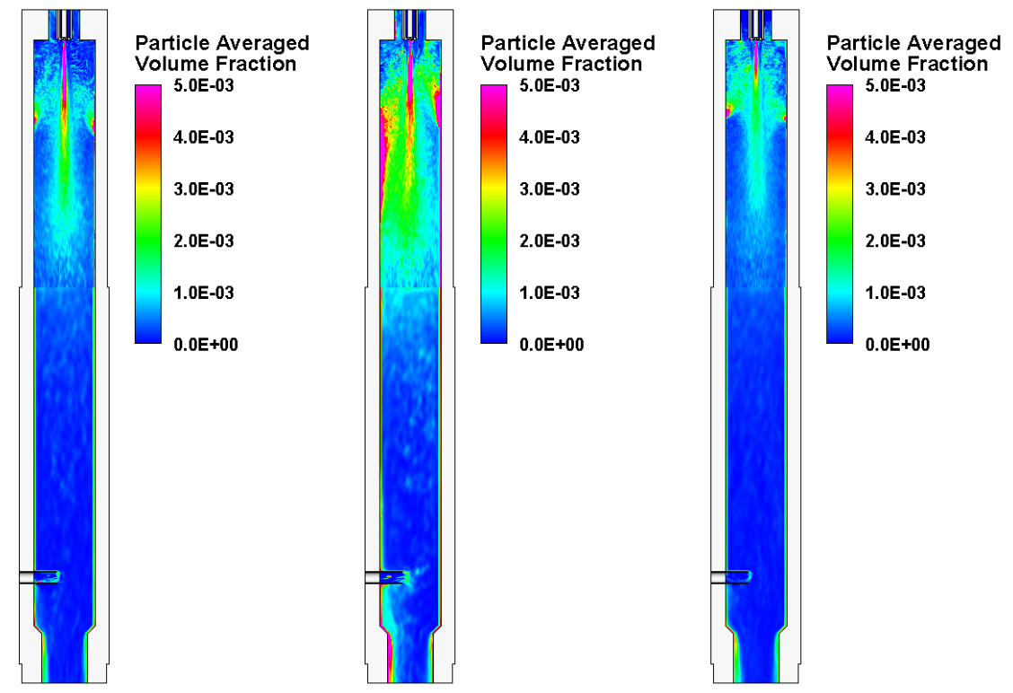
Results: Particle Concentration
Case 1
(base case)
Case 2
(higher fuel rate)
Case 3
(lower pressure)
Particle Average Volume Fraction
0.005
0.004
0.003
0.002
0.001
0.0

Slide 25
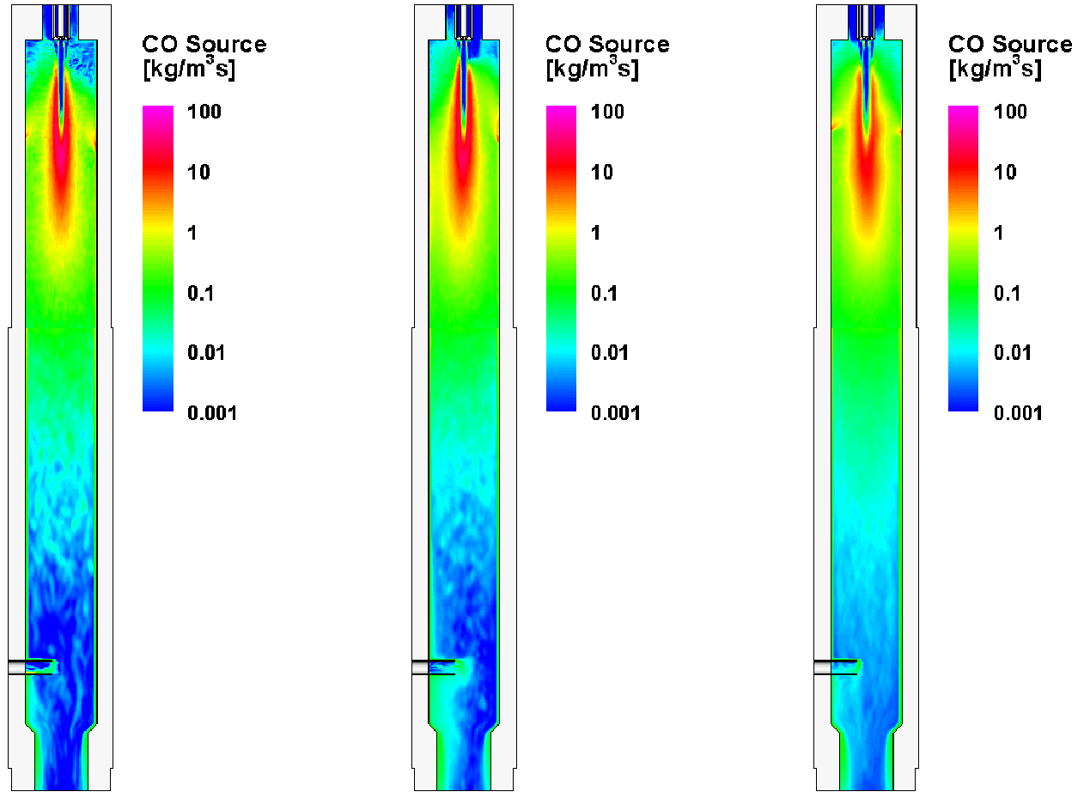
Results: CO Source
Case 1
(base case)
Case 2
(higher fuel rate)
Case 3
(lower pressure)
CO Source (kg/(m³·s))
100
10
1
0.1
0.01
0.001

Slide 26
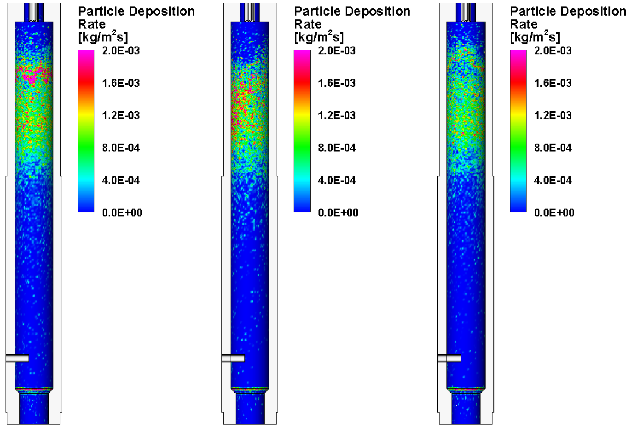
Results: Particle Deposition on Wall
Case 1
(base case)
Case 2
(higher fuel rate)
Case 3
(lower pressure)
Particle Deposition Rate (g/(m²·s))
2.0
1.6
1.2
0.8
0.4
0.0

Slide 27
Conclusions
The model predicted variation in solid fuel conversion over the range of conditions in agreement with the experimental findings, showing that it tracks a key gasifier performance indicator—conversion of solid fuel to gas and its dependence on burner and gasifier design and operating conditions.
The model provided further insight into the gasifier performance, showing that at the lower pressure operation, poor flow dynamics led to reduced solid fuel conversion.

