Slide 1


Emilio Ramirez Stuart Daw Charles Finney Sreekanth Pannala Jack Halow Qingang Xiong
Computational study of the
bubbling-to‐slugging transition
in a laboratory‐scale fluidized bed
NETL 2016
Workshop on Multiphase Flow Science
Day 1 - Tuesday, Aug. 9, 2016
Computational
Pyrolysis
Consortium
http://energy.ornl.gov/cpc

Slide 2
Why are we interested in slugging?
"The arrival time of a space probe traveling to Saturn can be predicted more accurately than the behavior of a fluidized bed reactor!”
Derek Geldart
“The art of engineering science is the art of seeing which steps should be taken to erase from real life (hopefully) irrelevant details which make it so complex, to look at the essential aspects of it, or, in other words, to decide what is the appropriate meta-problem to look at: to conceive the appropriate chain of idealization.”
Gianni Astarita and Julio Ottino

Slide 3
Are there challenges with slugging correlations?
Literature slugging correlations vary between studies
Possibly due to:
- qualitative methods used to identify slugging
Quantitative methods can provide a robust method to determine:
- onset of bubbling-to-slugging transition
- fully developed slugging
Bubbling-to-slugging transition (This study)
Stewart and Davidson, 1967
Fully
Developed Slugging
(This study)
Shaul et al., 2014
Broadhurst and Becker, 1975
Baeyens and Geldart, 1974
2.0
2.64
2.96
4.36
1.5
2.8
1
2
3
4
5
Inlet velocity (U_{mf})

Slide 4
Objectives
Develop clearer understanding of slugging physics and develop possible on-line diagnostic
What measurement can be used?
Can we be quantitative?
Can a numerical model be used as a tool to understand the physics involved in slugging beds?
How can an MFiX simulation be used to validate slugging studies?
What quantitative numerical tools can we use?
Scope of this study:
Bubbling/slugging beds
Bench scale reactor ~2 inch
Geldart type B particles
Hydrodynamics
Bubble analysis
Pressure analysis

Slide 5
Slugging is central feature of reactor flow regimes
Slugging is a complex process, even with regime maps it is difficult to design a reactor to always avoid slugging
Transition to slugging varies with:
- bed H/D ratio
- temperature
- pressure
- particle properties
- fluidizing gas properties
[1] S. Shaul, E. Rabinovich, H. Kalman, Generalized flow regime diagram of fluidized beds based on the height to bed diameter ratio, Powder Technol. 228 (2012) 264-271.http://dx.doi.org/10.1016/j.powtec.2012.05.029
Notes:
Background and motivation

Slide 6
Simulated experiment
P_{out} = 255 kPa
NREL bubbling bed reactor used to study biomass fast pyrolysis
Our goal is to help improve control and interpretation of the hydrodynamic aspects of this experiment
Freeboard
40 cm
H/H_{o}
Expanded Bed
1.0
0.8
Static Bed
H_{o}=20 cm
0.6
5 cm
diameter
Assumptions:
Minimum fluidization – Richardson correlation
N₂ density – ideal gas temperature and pressure corrected
N₂ viscosity – NASA 7-coefficient polynomial, temperature corrected
0.4
0.2
ṁ_{inlet}

Slide 7
Technical approach: computational
MFiX simulation parameters:
Eulerian-Eulerian (Two-Fluid Model)
Syamlal-O’Brien drag-model
Kinetic theory of granular flow
Schaeffer frictional stress tensor formulation
Sigmoidal blending stress function
Second order discretization
Modified SIMPLE with variable time stepping
Jackson and Johnson partial-slip wall boundary condition
Cylindrical Mesh

Slide 8
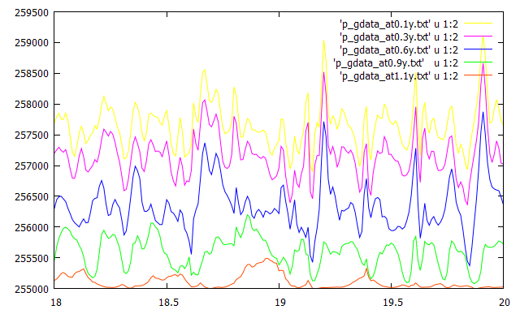
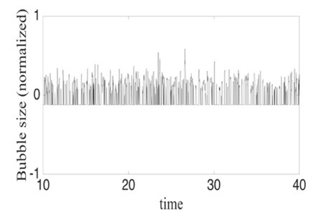
Technical approach:
dynamic spatio-temporal statistics
MFiX simulated pressure and bubble probes utilized data from locations relative to static bed height (H/H_{o})
Pressure Statistics
Bubble Statistics
Freeboard
postMFiX data output:
- absolute pressure time series
- void fraction time series
Post processed data:
- mean
- standard deviation
- skewness
- kurtosis
- probability distribution
MS3DATA- bubble statistics algorithm
- acquired data using postMFiX
Utilized MS3DATA bubble output:
- size time series (mean size)
- probability distribution
- bubbles per second
1.0
0.8
0.6
0.4
0.2
*MS3DATA details in
Bakshi et al. presentation

Slide 9
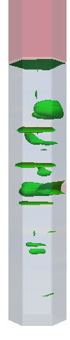
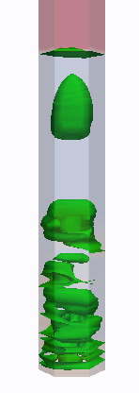
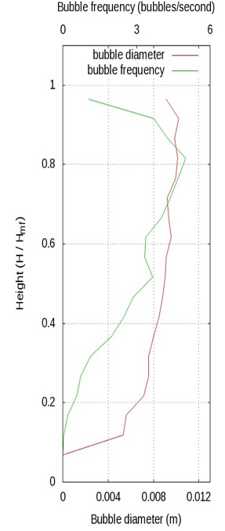

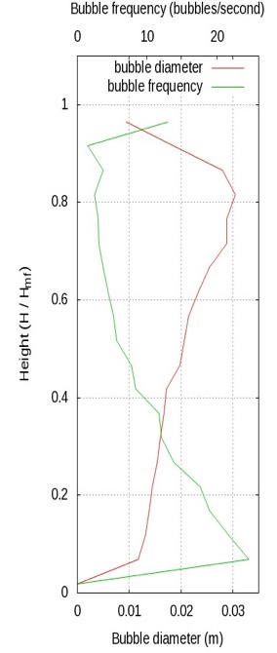
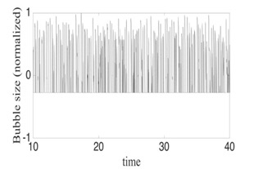
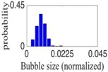
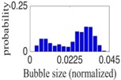
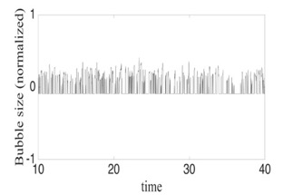
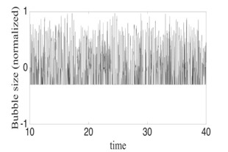
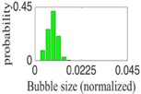
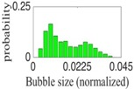
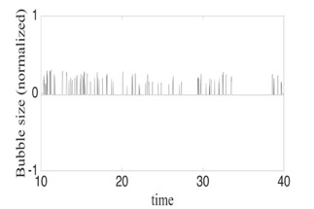
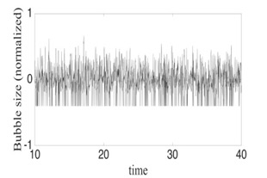
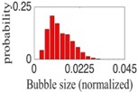
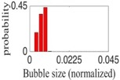
Bubbles at transition to slugging have a critical operating limit
1.25 U_{mf} – smooth bubbling
2.75 U_{mf} - slugging
*Bubbles smaller than reactor diameter
Bubble sizes grow smoothly with height
*Bubbles can span reactor diameter
Bubble sizes become bimodal
Good gas-solids mixing, low solids attrition and elutriation
Gas-solids mixing not as good, high solids attrition and elutriation
"Computational study of the bubbling-to-slugging transition in a laboratory-scale fluidized bed", E. Ramirez, C.E.A. Finney, S. Pannala, C. S. Daw, J. Halow, Q. Xiong, Chemical Engineering Journal, Submitted April 2016, revising manuscript
Notes:
Bubble spatiotemporal evolution

Slide 10
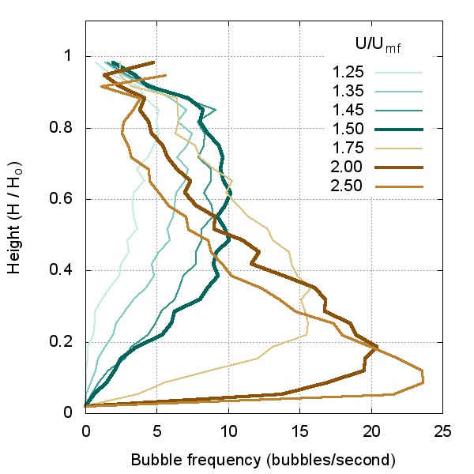
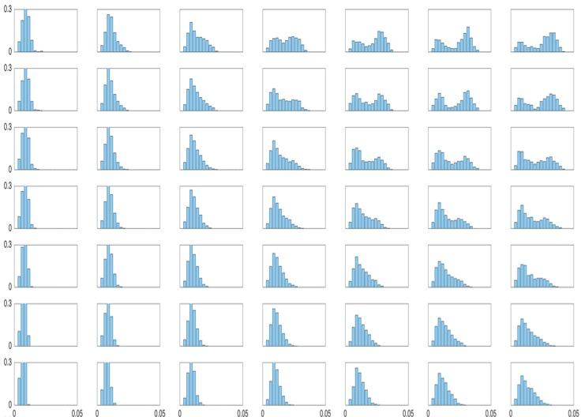
Bubble spatiotemporal relationship at slugging transition, also identified in bubble frequency
Max and min bubble frequency indicates beginning and end of bubbling to slugging transition in upper part of bed
Bimodal distribution appears at bubbling to slugging transition which varies with inlet velocity and height
min
U/U_{mf}
0.9
0.8
0.7
0.6
0.5
0.4
0.3
max
Height (H/H_{o})
1.25 1.50 1.75 2.00 2.25 2.50 2.75
Inlet velocity (U/U_{mf})
"Computational study of the bubbling-to-slugging transition in a laboratory-scale fluidized bed", E. Ramirez, C.E.A. Finney, S. Pannala, C. S. Daw, J. Halow, Q. Xiong, Chemical Engineering Journal, Submitted April 2016, revising manuscript

Slide 11
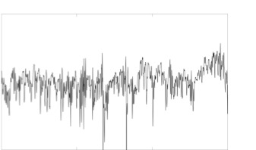
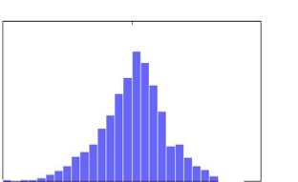
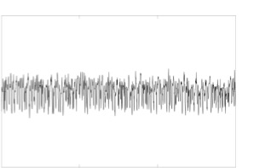
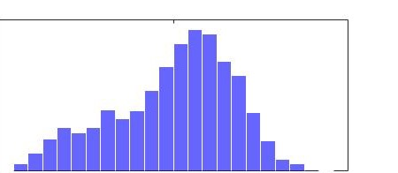
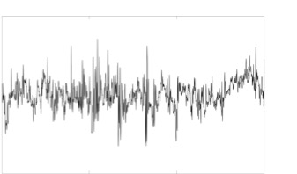
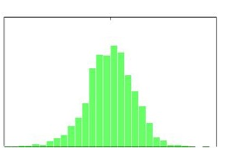
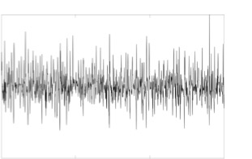
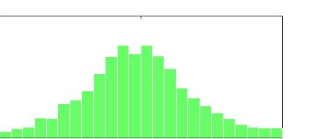
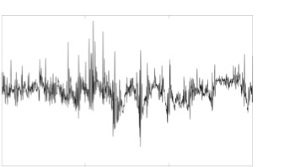
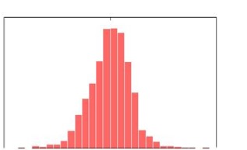
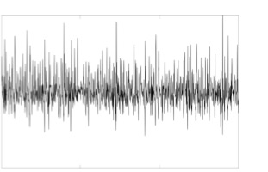
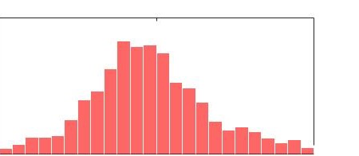
Pressure also has spatiotemporal relationship
Tail in distribution show differences in spikes down or up at different heights
1.25 U_{mf} – Free Bubbling
2.75 U_{mf} – Fully developed slugging
Pressure signals appear to be relate at different heights
Bimodal distribution appear to emerge where slugging bubbles reside
0.05
0
-0.05
(c)
0.16
0
0.75
0
-0.75
0.16
0
(f)
Top
(f)
(c)
0.05
0
-0.05
(b)
0.16
0
0.75
0
-0.75
0.16
0
(e)
(e)
(b)
Middle
0.05
0
-0.05
0.16
0
0.75
0
-0.75
0.12
0
(a)
(d)
(a)
(d)
Bottom
10 40
-1 0 1
10 40
-1 0 1
Time (s)
Bubble Size (m)
Time (s)
Bubble Size (m)

Slide 12
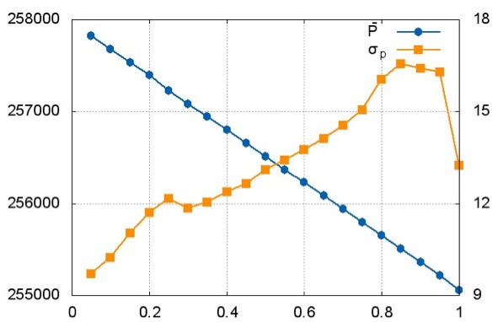
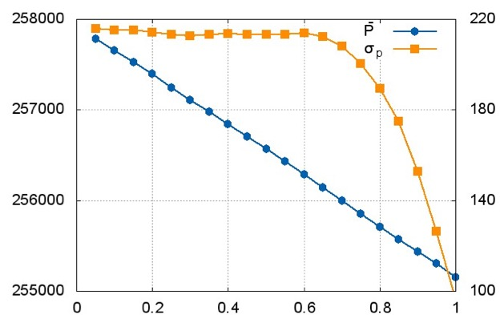
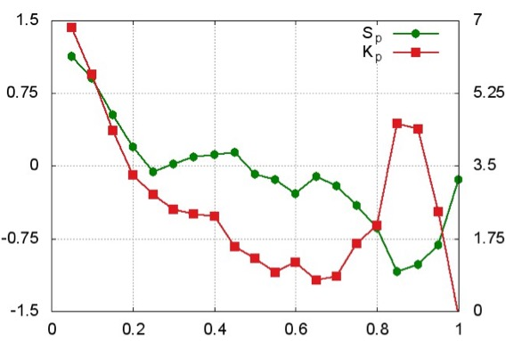
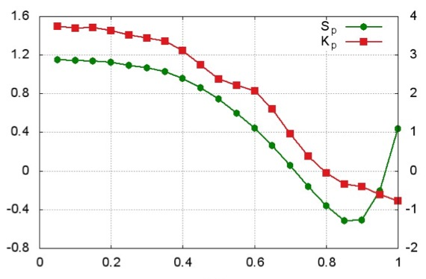


Pressure statistics indicate differences in dynamics along reactor height
1.25 U_{mf} – Free Bubbling
2.75 U_{mf} – Fully developed slugging
258
257
256
255
258
257
256
255
$\overline{P}$ (kPa)
σ_{P}
$\overline{P}$ (kPa)
(a)
σ_{P}
S_{P}
K_{P}
S_{P}
K_{P}
(b)
Height (H/H_{o})
Height (H/H_{o})

Slide 13
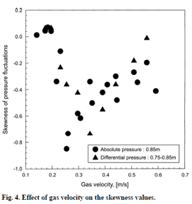
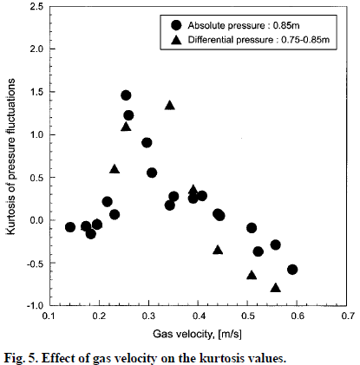
Can pressure statistics detect slugging transition?
MFIX study of pressure fluctuation diagnostics for mixing regimes
Looking for signals with simple, highly discriminating statistics
Simulated measurements (e.g., pressure signals) at different locations correlated with the bubbling dynamics (e.g., slugging transition)
Statistic trends at 0.7-0.9 H/H_{o} appear to agree with Lee et al. 2002 experimental results at 0.75 H/H_{o.}
Skewness at 0.75 H/H_{o} has a downward spike
Kurtosis at 0.75 H/H_{o} has a upward spike
Statistical and Deterministic Chaos Analysis of Pressure Fluctuations in a
Fluidized Bed of Polymer Powders, 2002
See Hoon Lee, Sang Done Kim† and Soung Hee Park

Slide 14
Temporal information is useful for relating bubbles and pressure in the slugging transition
Pressure and void fraction signal appear related
Cross correlation magnitude increases with inlet velocity
Upper bed section appears the most useful for slugging diagnostic
1.25 1.75 2.50
Inlet velocity (U_{mf})

Slide 15
Summary
Higher order statistics appear to capture the bubbling-to-slugging transition
Onset of the bubbling-to-slugging transition
Fully developed slugging
Time domain methods also capture slugging
The upper part of the bed may be the most significant for detecting slugging regime
The bubbling-to-slugging transition occurs over a range of flows
Bubble coalescence events begins near top of the bed and progresses downward as gas flow increases

Slide 16
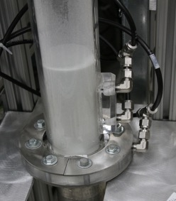
What’s next?
Identification of other practical methods to detect the bubbling-to-slugging transition
Experimental validation
NETL experimental expertise
Compare MFiX results
Experimental application
new instrumentation and diagnostics on the NREL reactor

Slide 17





Questions ?
Emilio Ramirez – eramire2@vols.utk.edu
Computational
Pyrolysis
Consortium
http://energy.ornl.gov/cpc

