Slide 1
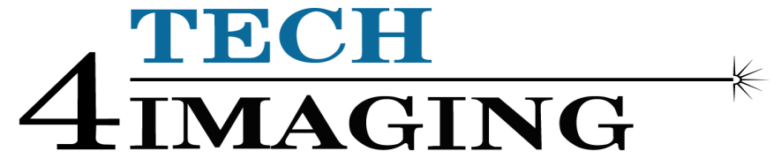
Development of Real-time Velocimetry Imaging Using Capacitive Sensors
Qussai Marashdeh, Fernando Teixeira, Shah Chowdhury

Slide 2
Outline
Gas-solid systems
Existing velocimetry methods
Velocimetry based on capacitive sensors
Electrical capacitance volume tomography (ECVT): basics
ECVT: comparison with other imaging techniques, e.g. X-ray CT, MRI.
Velocimetry based on cross-correlation (earlier approach)
Velocimetry based on sensitivity gradient (new approach)
Velocity reconstruction in real-time
Simulation and experimental results
References

Slide 3
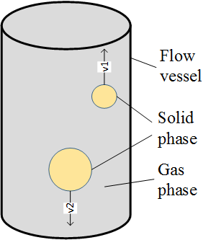
Gas-solid Systems
A flow of gas and solid phases of materials for the purpose of:
Accelerated chemical reaction, combustion, or heat transfer, e.g. fluidized bed.
Separation of gas from the solid particulates, e.g. cyclone separator.
A good knowledge of the flow dynamics is required to ensure
Proper operation,
Safe operation, and
Efficiency of the system.
Techniques used for flow measurements, i.e. velocimetry of gas-solid systems include:
Computational Fluid Dynamics (CFD)
Intrusive local measurements
Capacitive sensor based techniques
Fig 1: A two phase gas-solid flow

Slide 4
Velocimetry for Gas-solid Systems
Computational Fluid Dynamics (CFD)
A widely used simulation based technique
A limitation is that the actual physical scenario is sometimes difficult to model like on-site chemical reactions (e.g. agglomeration in cyclone separators [1])
Computationally intensive sometimes
Intrusive local measurements
Technique based on velocity measurements at certain locations of the system
Intrusive devices may change the actual flow pattern
Capacitive sensor measurement based techniques
Flow measurement based on Electrical Capacitance Tomography (ECT) [2]
Flow measurement based on Electrical Capacitance Volume Tomography (ECVT) [3]
Non intrusive
Suitable for fast moving flows

Slide 5
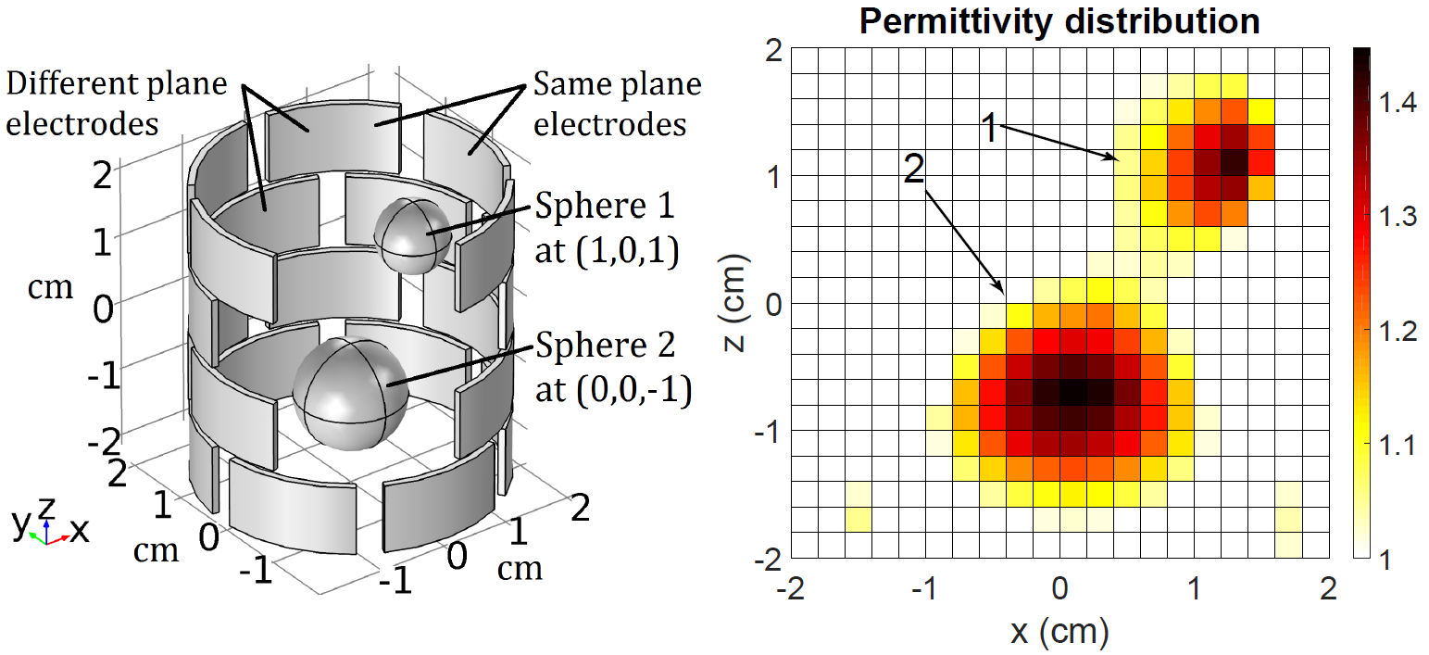
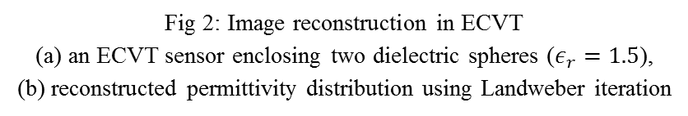
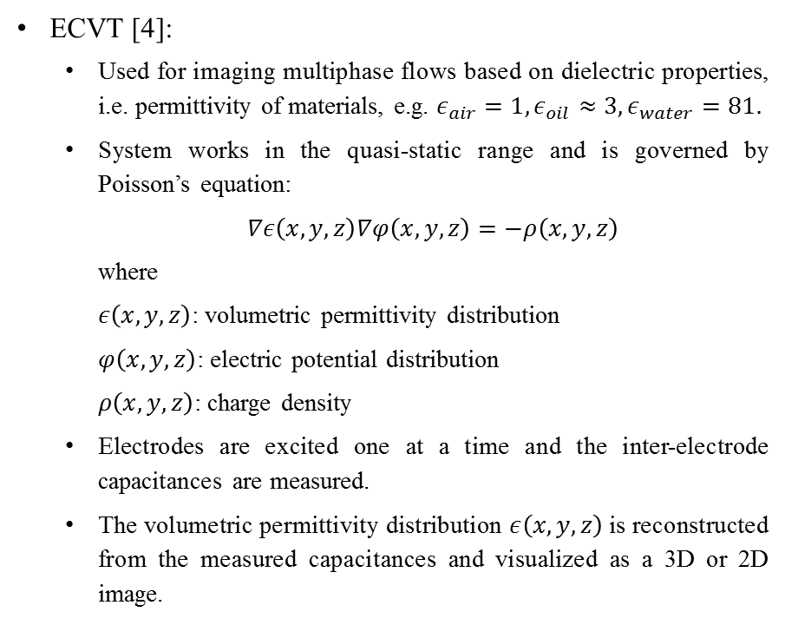
ECVT: Basics
ECVT [4]:
Used for imaging multiphase flows based on dielectric properties, i.e. permittivity of materials, e.g. $ε_{air}=1,ε_{oil}≈3,ε_{water}=81.$
System works in the quasi-static range and is governed by Poisson’s equation:
$∇ε\left(x,y,z\right)∇φ\left(x,y,z\right)=−ρ\left(x,y,z\right)$
where
$ε\left(x,y,z\right)$: volumetric permittivity distribution
$φ\left(x,y,z\right)$: electric potential distribution
$ρ\left(x,y,z\right)$: charge density
Electrodes are excited one at a time and the inter-electrode capacitances are measured.
The volumetric permittivity distribution $ε\left(x,y,z\right)$ is reconstructed from the measured capacitances and visualized as a 3D or 2D image.
(a)
(b)
Fig 2: Image reconstruction in ECVT
(a) an ECVT sensor enclosing two dielectric spheres ($ε_{r}=1.5$),
(b) reconstructed permittivity distribution using Landweber iteration

Slide 6
ECVT: Comparison with Other Imaging Techniques
Other imaging techniques for multiphase flow
X-ray CT, MRI, Ultrasound
Not cost effective for small installations
Not fast enough for high speed flows
Advantages of ECVT
Much cheaper
Fast acquisition rate: up to 1000 fps
Portable
Flexible sensor: fits arbitrary vessel shape
Disadvantages of ECVT
Image reconstruction problem is ill-posed
Highly nonlinear and sensitive to noise
Image resolution is lower than X-ray or MRI
Fig 3: Comparison of image resolution of voidage in a gas-fluidized bed
between ECVT and MRI [5]

Slide 7
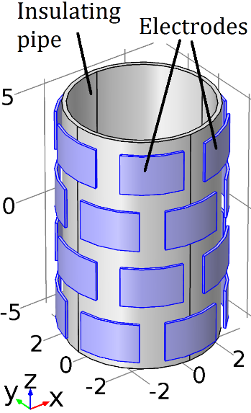
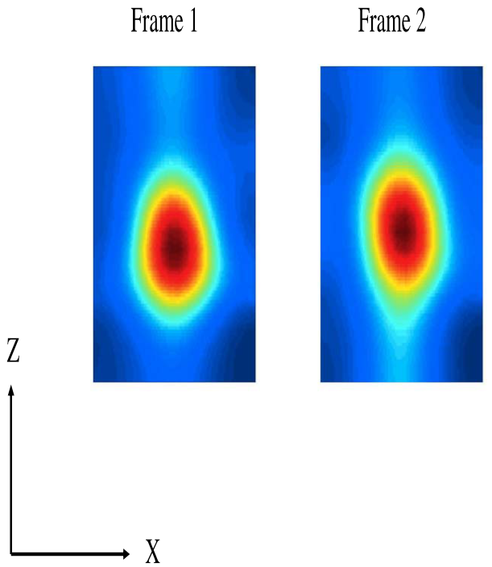
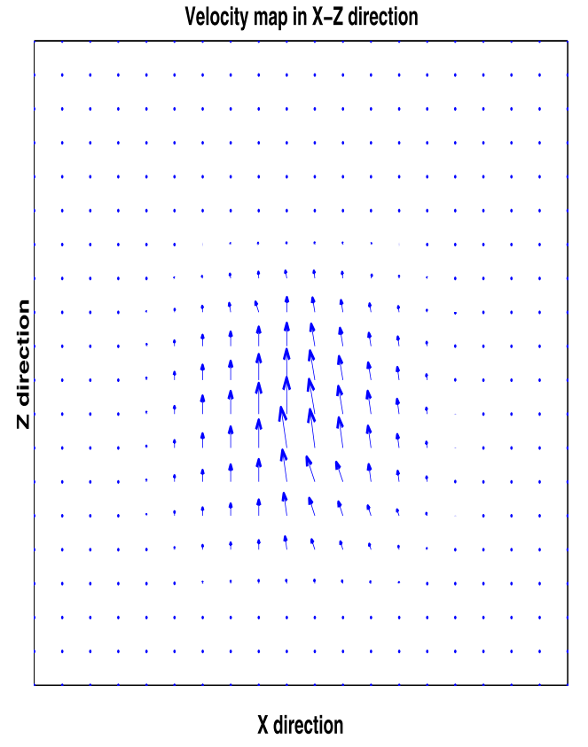
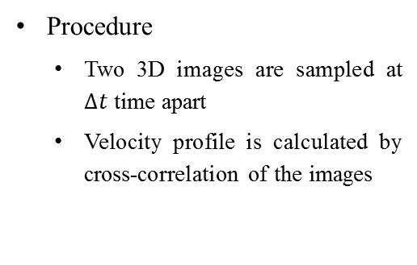

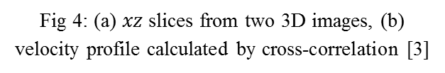
Velocimetry Based on Cross-correlation
Procedure
Two 3D images are sampled at $∆t$ time apart
Velocity profile is calculated by cross-correlation of the images
Data acquisition and image reconstruction
3D Image 1
Velocity profile
3D Image 2
Cross-correlation
$$∆t$$
Limitations
Cross correlation of 3D images is computationally intensive
Image reconstruction errors are compounded in velocity reconstruction
ECVT sensor
(a)
(b)
Fig 4: (a) $xz$slices from two 3D images, (b) velocity profile calculated by cross-correlation [3]

Slide 8
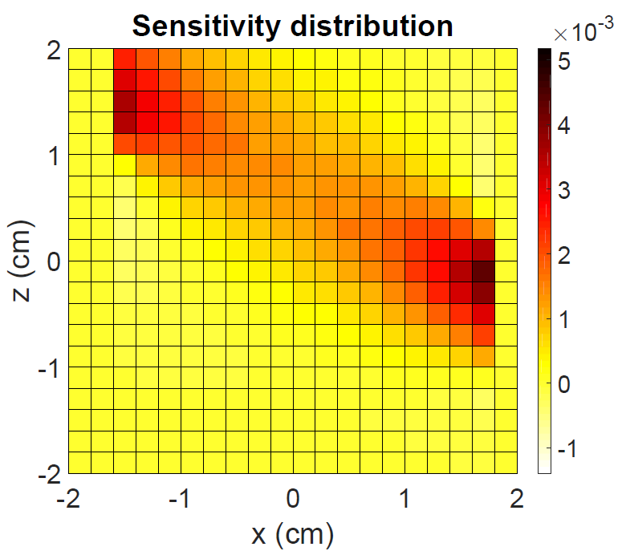
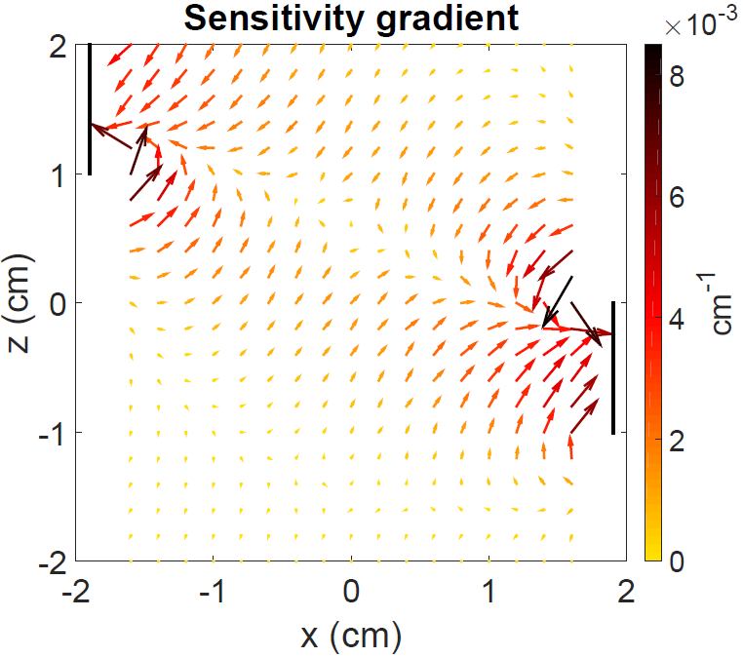
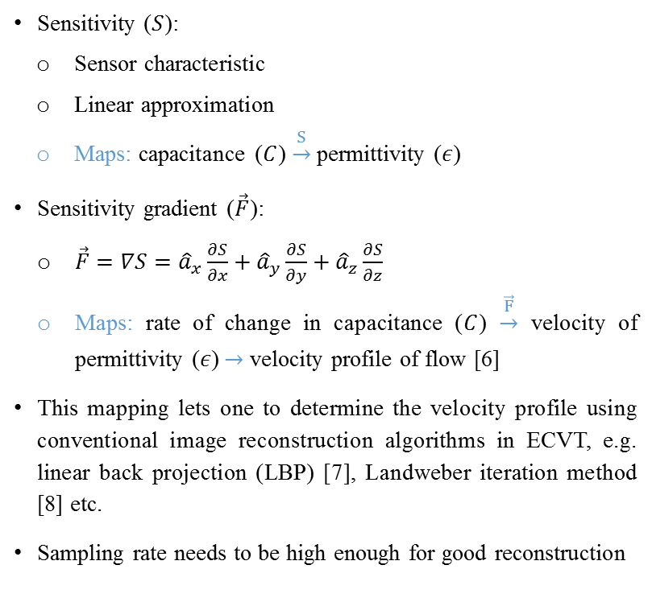
Velocimetry Based on Sensitivity Gradient
Sensitivity ($S$):
Sensor characteristic
Linear approximation
Maps: capacitance ($C$) $\underset{→}{S}$ permittivity ($ε$)
Sensitivity gradient ($\vec{F}$):
$\vec{F}=∇S={\hat{a}}_{x}\frac{∂S}{∂x}+{\hat{a}}_{y}\frac{∂S}{∂y}+{\hat{a}}_{z}\frac{∂S}{∂z}$
Maps: rate of change in capacitance ($C$) $\underset{→}{\vec{F}}$ velocity of permittivity ($ε$) $→$ velocity profile of flow [6]
This mapping lets one to determine the velocity profile using conventional image reconstruction algorithms in ECVT, e.g. linear back projection (LBP) [7], Landweber iteration method [8] etc.
Sampling rate needs to be high enough for good reconstruction
(a)
(b)
Fig 5: Normalized (a) sensitivity distribution and
(b) sensitivity gradient between a pair of electrodes

Slide 9
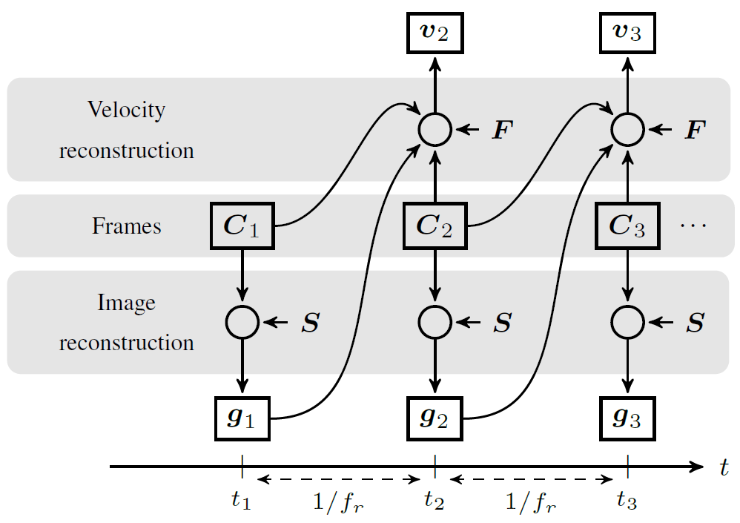
Velocity Reconstruction in Real-time
Factors contributing to real-time operation
Fast moving flows: high sampling rate, i.e. less computation time is available.
Slow moving flows: low sampling rate, i.e. more computation time is available.
Linear back projection (LBP): fastest but gives poor image resolution.
Landweber iteration or other iterative algorithms: slower but gives better image resolution.
Available computational resources.
Fig 6: Successive image and velocity reconstruction. $C$: capacitance frame, $g$: image vector, $v$: velocity profile, $S$: sensitivity, $F$: sensitivity gradient, $f_{r}$: frame rate, $t$: time

Slide 10
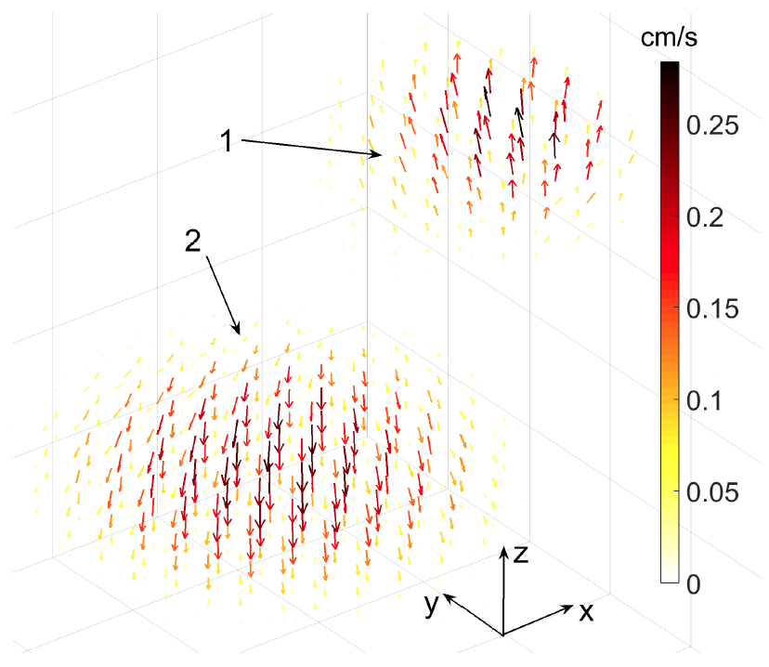
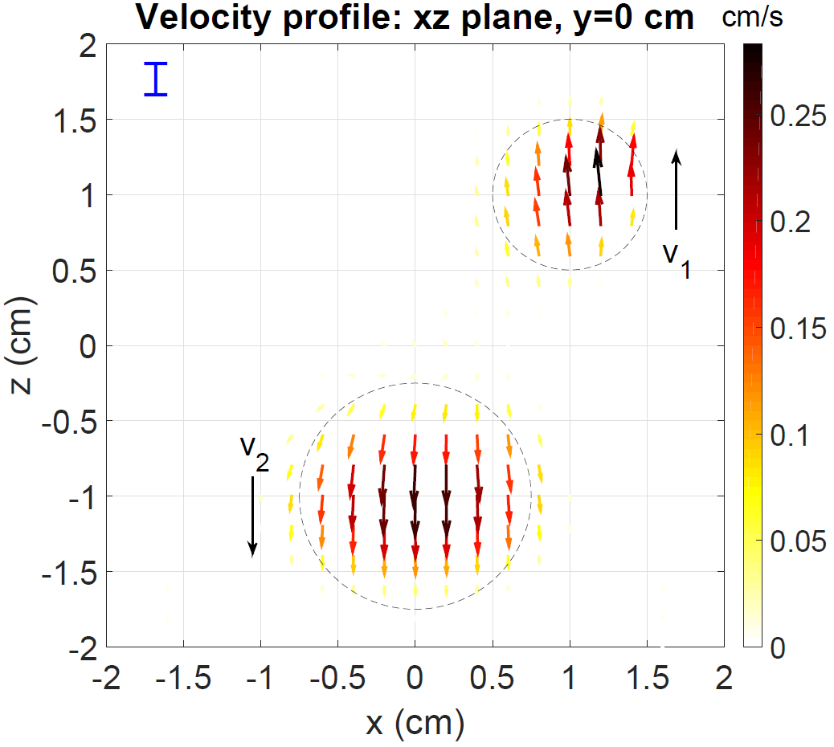
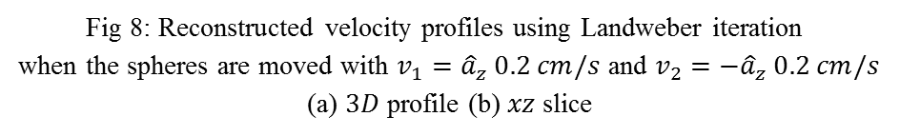
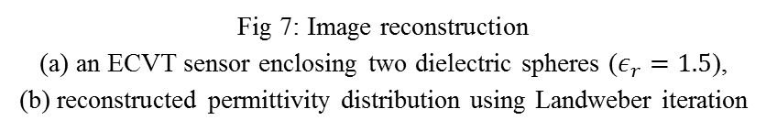
Simulation Results of a Two Phase Flow
(a)
(b)
Fig 7: Image reconstruction
(a) an ECVT sensor enclosing two dielectric spheres ($ε_{r}=1.5$),
(b) reconstructed permittivity distribution using Landweber iteration
(a)
(b)
Fig 8: Reconstructed velocity profiles using Landweber iteration
when the spheres are moved with $v_{1}={\hat{a}}_{z} 0.2 cm/s$ and $v_{2}=−{\hat{a}}_{z} 0.2 cm/s$
(a) $3D$ profile (b) $xz$ slice

Slide 11
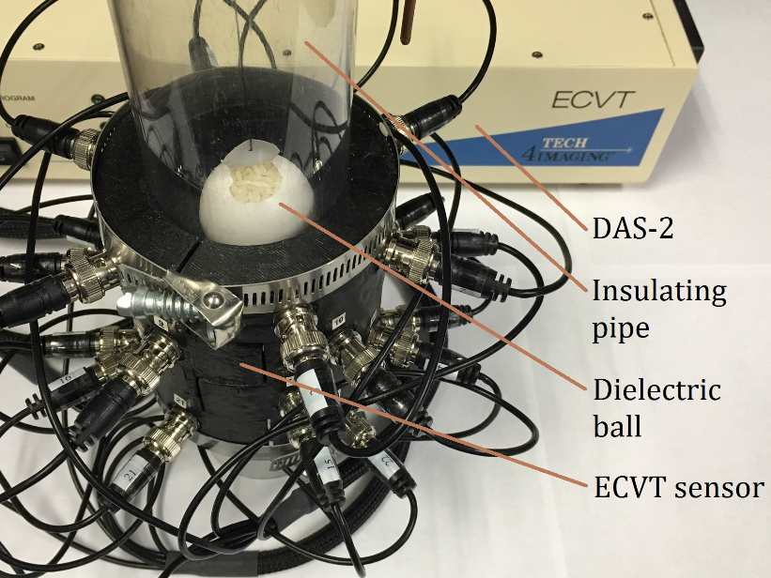
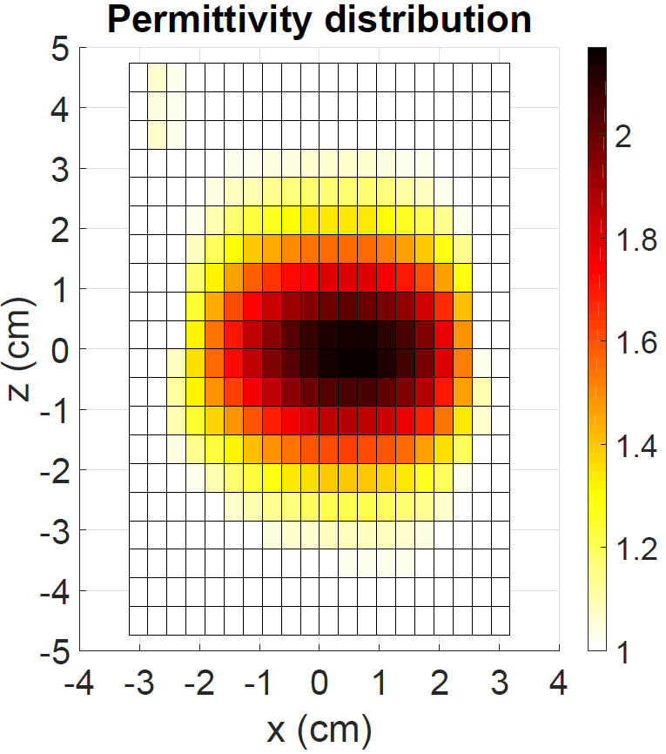
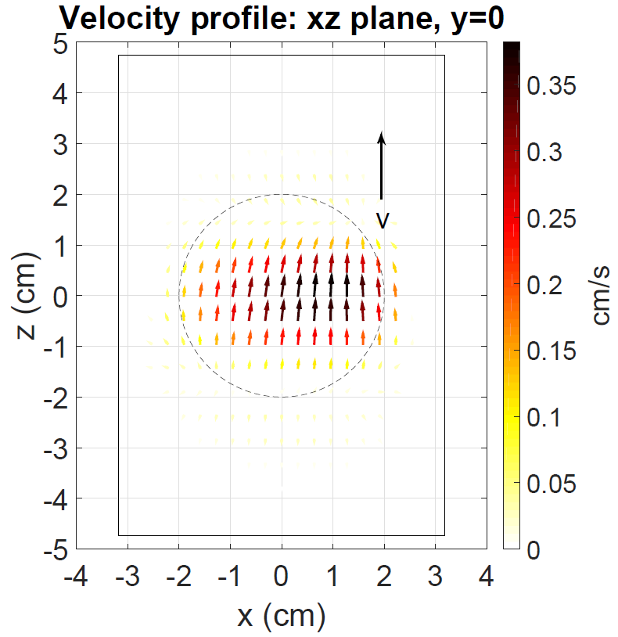
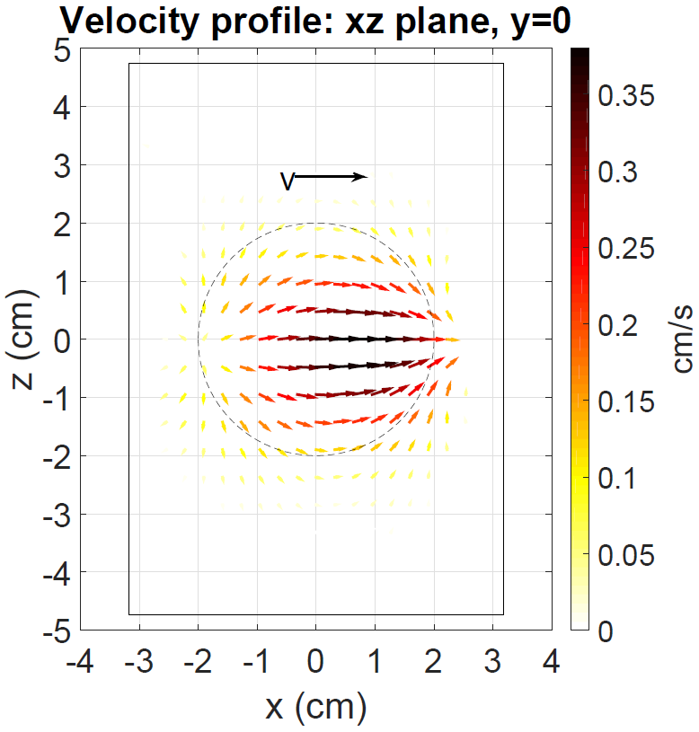
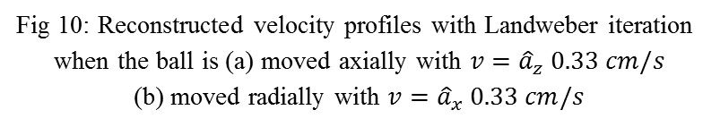
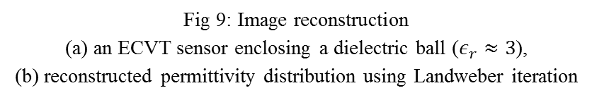
Experimental Results from a Two Phase Flow
(a)
(b)
(a)
(b)
Fig 9: Image reconstruction
(a) an ECVT sensor enclosing a dielectric ball ($ε_{r}≈3$),
(b) reconstructed permittivity distribution using Landweber iteration
Fig 10: Reconstructed velocity profiles with Landweber iteration
when the ball is (a) moved axially with $v={\hat{a}}_{z} 0.33 cm/s$
(b) moved radially with $v={\hat{a}}_{x} 0.33 cm/s$

Slide 12
References
Wikipedia (2016, March 13). Cyclonic seperation [Online]. Available: https://en.wikipedia.org/wiki/Cyclonic_separation.
W. Warsito and L.-S. Fan, “3D-ECT velocimetry for flow structure quantification of gas-liquid-solid fluidized beds,” The Canadian Journal of Chemical Engineering, vol. 81, no. 3–4, pp. 875–884, June 2003.
Q. Marashdeh, F. Wang, L.-S. Fan, and W. Warsito, “Velocity measurement of multi-phase flows based on electrical capacitance volume tomography,” in Sensors, 2007 IEEE, Atlanta, GA, USA, Oct. 2007, pp. 1017–1019.
W. Warsito, Q. M. Marashdeh, and L.-S. Fan, “Electrical capacitance volume tomography,” IEEE Sensors J., vol. 7, no. 4, pp. 525–535, Apr. 2007.
D. J. Holland, Q. M. Marashdeh, C. R. Muller, F. Wang, J. S. Dennis, L.-S. Fan et al., “Comparison of ECVT and MRI measurements of voidage in a gas-fluidized bed.” Ind. Eng. Chem. Res., vol. 48, no. 1, pp. 172–181, Aug. 2008.
Q. M. Marashdeh, F. L. Teixeira, and S. Chowdhury, “Velocity vector field mapping using electrical capacitance sensors,” U.S. non-provisional patent application no. 15 051 109, Feb. 23, 2016.
C. G. Xie, S. M. Huang, B. S. Hoyle, R. Thorn, C. Lean, D. Snowden, and M. S. Beck, “Electrical capacitance tomography for flow imaging system model for development of image reconstruction algorithms and design of primary sensor,” IEE Proc. G, vol. 139, no. 1, pp. 89-98, 1992.
W. Q. Yang, D. M. Spink, T. A. York, and H. McCann, “An image reconstruction algorithm based on Landweber iteration method for electrical-capacitance tomography,” Meas. Sci. Technol., vol. 10, no. 11, pp. 1065–1069, July. 1999.

Slide 13
Questions?

