Slide 1


Slide 2
Outline
Objectives
Background
  MFiX
  Trilinos
A framework to integrate MFiX with Trilinos
Results
Conclusions

Slide 3
Objectives
Create a framework to integrate the existing MFiX linear solvers with Trilinos linear solver packages
Evaluate the performance of the state-of-the-art preconditions and linear solver libraries in Trilinos with MFiX and
Test the performance on various computer architectures.

Slide 4
Background
MFIX is a widely used to model and understand the multiphase physics in a circulating fluidized bed.
MFiX has basic linear equations solvers and diagonal or line pre-conditioners to solve the system of equations.
poor convergence in the linear equation solver can increase the number of iterations and lead to non-convergence of the iterations.
An optimum degree of convergence has been determined from experience and is controlled by a specified number of iterations inside the linear solver.
The current capabilities in MFIX lack the advanced solvers(such as multi-level, segregated/block, algebraic preconditions, planned development time integration methods, modular and latest linear/non-linear solvers).
LEQ | Method
1 | SOR
2 | BICGSTAB
3 | GMRES
4 | BICGSTAB + GMRES
5 | CG

Slide 5
MFiX challenges
Although MFiX is widely being used to design fossil fuel reactors, overall utility of the multiphase models remains limited due to the computational expense of large scale simulations.
  Advanced solution algorithms increase the range of tractable problems and reduce the cost of solving existing problems.
  Well-designed solver libraries provide a mechanism for leveraging solver development across a broad set of applications and minimize the cost of solver integration.
  Sandia has developed a scalable solver algorithms as well libraries (Trilinos) to provide a good robust solvers and minimize the computational cost.
Notes:
5

Slide 6
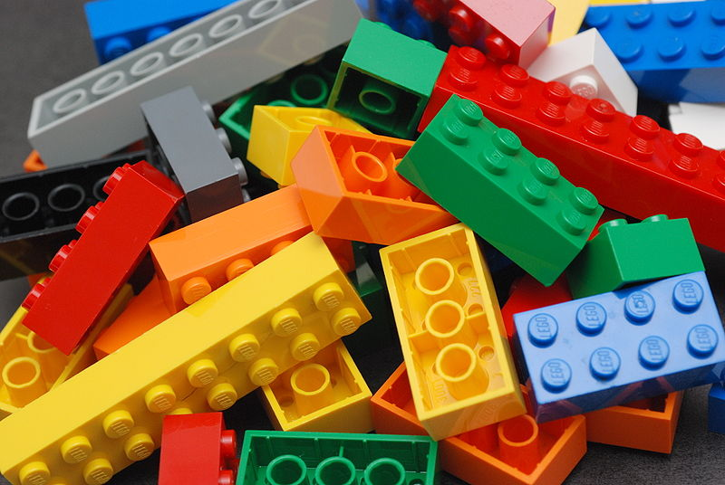
Trilinos ???
Trilinos Project is an effort to develop and implement robust algorithms and enabling technologies using modern object-oriented framework, while still leveraging the value of established libraries such as PETSc, Metis/ParMetis, SuperLU, Aztec, the BLAS and LAPACK. It emphasizes abstract interfaces for maximum flexibility of component interchanging, and provides a full-featured set of concrete classes that implement all abstract interfaces.
More like LEGO™ bricks than Matlab™
provides the state-of-the-art preconditions and linear solver libraries
demonstrates scalability on current HPC systems
plans for continued maintenance
include support for new hardware technologies
Notes:
Original of LEGO™ bricks picture:
https://secure.wikimedia.org/wikipedia/en/wiki/File:Lego_Color_Bricks.jpg
Accessed 12 Aug 2011. Author: Alan Chia. Licensed under a Creative Commons Attribution-Share Alike 2.0 Generic License.

Slide 7
Trilinos Packages
Trilinos is a collection of Packages.
Each package is:
  Focused on important, state-of-the-art algorithms in its problem regime.
  Developed by a small team of domain experts.
  Self-contained: No explicit dependencies on any other software packages (with some special exceptions).
  Configurable/buildable/documented on its own.
 | Objective | Package(s)
Discretizations | Meshing & Discretizations | Intrepid, Pamgen, Sundance, Mesquite, STKMesh
 | Time Integration | Rythmos
Methods | Automatic Differentiation | Sacado
 | Mortar Methods | Moertel

Slide 8
Trilinos package summary
 | Objective | Package(s)
Services | Linear algebra objects | Epetra, Tpetra
 | Interfaces | Xpetra, Thyra, Stratimikos, Piro
 | Load Balancing | Zoltan, Isorropia, Zoltan2
 | “Skins” | PyTrilinos, WebTrilinos
 | Utilities, I/O, thread API | Teuchos, EpetraExt, Kokkos, Phalanx, Trios
Solvers | Iterative linear solvers | AztecOO, Belos, Komplex
 | Direct sparse linear solvers | Amesos, Amesos2, ShyLU
 | Direct dense linear solvers | Epetra, Teuchos, Pliris
 | Iterative eigenvalue solvers | Anasazi
 | Incomplete factorizations | AztecOO, Ifpack, Ifpack2
 | Multilevel preconditioners | ML, CLAPS, MueLu
 | Block preconditioners | Meros, Teko
 | Nonlinear solvers | NOX, LOCA
 | Optimization | MOOCHO, Aristos, TriKota, GlobiPack, OptiPack

Slide 9
Flow chart of MFiX-Trilinos
Start
Initialization of computation
read inputs, initialize fluid variables
LEQ | Method
1 | SOR
2 | BICGSTAB
3 | GMRES
4 | BICGSTAB + GMRES
5 | CG
Decompose subdomains &
assign them to threads
Apply boundary conditions
Exchange information between processors
Solver in MFiX
No
Solve equations governing the fluid/solid
LEQ<6
6 | Iterative linear solvers
 | Direct sparse linear solvers
 | Direct dense linear solvers
 | Iterative eigenvalue solvers
 | Incomplete factorizations
 | Multilevel preconditioners
 | Block preconditioners
 | Nonlinear solvers
Interface
Yes
Output
Solver in Trilinos
No
Finished
time steps
Yes
Stop

Slide 10



A framework to integrate MFiX with Trilinos
LEQ = 6
Transfer A & b
Define solver
attributes
Transfer x
MFIX wrapper
Interpret
Structure of
Matrix & vector
Transfer x
Fortran wrapper
Semantic for memory
references
Transfer x
C wrapper
Communicator, Interpret Polymorphism representations
Transfer x
CPP wrapper
Create Epetra_MAP,
Fill A & b
Solution of Ax=b

Slide 11
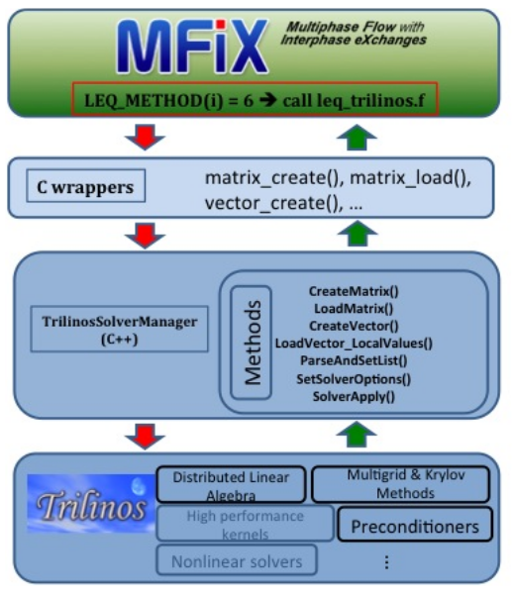
A framework to integrate MFiX with Trilinos
LEQ = 6
Transfer A & b
Define solver
attributes
Transfer x
MFIX wrapper
Interpret
Structure of
Matrix & vector
Transfer x
Fortran wrapper
Semantic for memory
references
Transfer x
C wrapper
Communicator, Interpret Polymorphism representations
Transfer x
Aytekin Gel and Jonathan Hu, Modernizing a legacy open source CFD code by leveraging scalable parallel pre-conditioners and linear equation solvers, Parallel CFD 2015.
CPP wrapper
Create Epetra_MAP,
Fill A & b
Solution of Ax=b

Slide 12
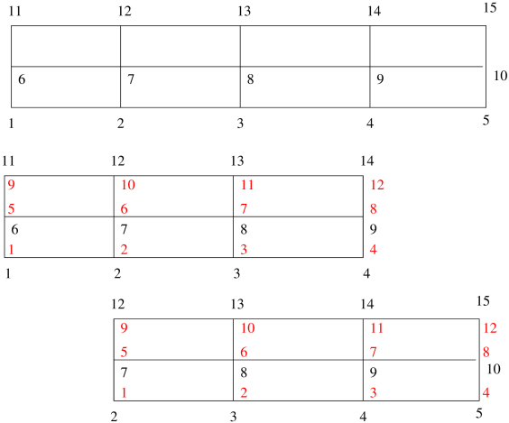
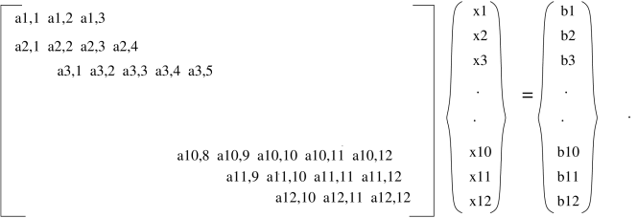
Domain-decomposition
Local nodes
Global nodes

Slide 13
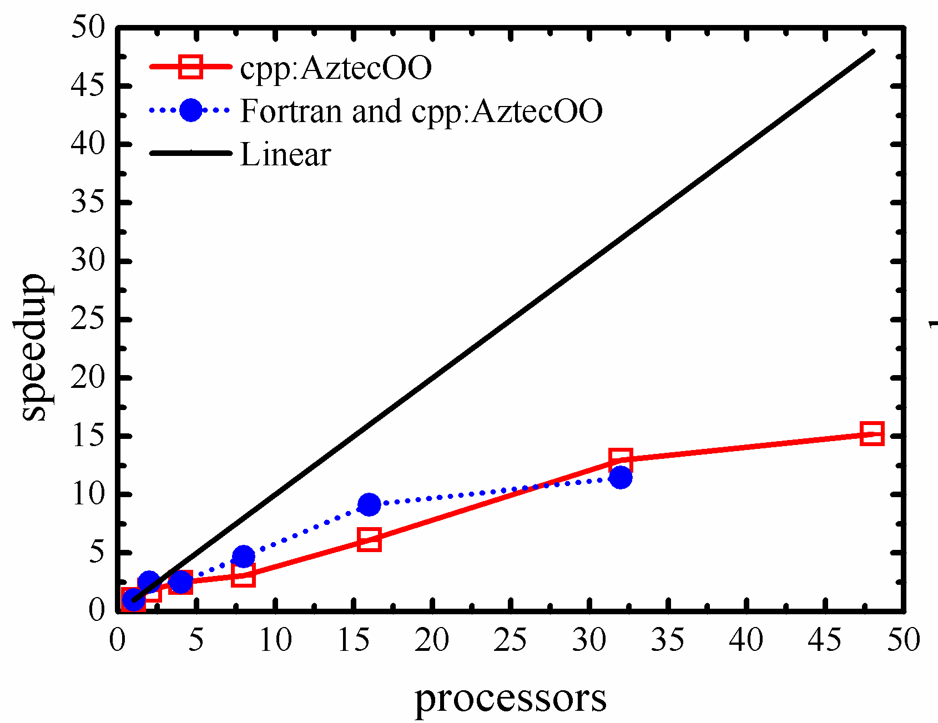
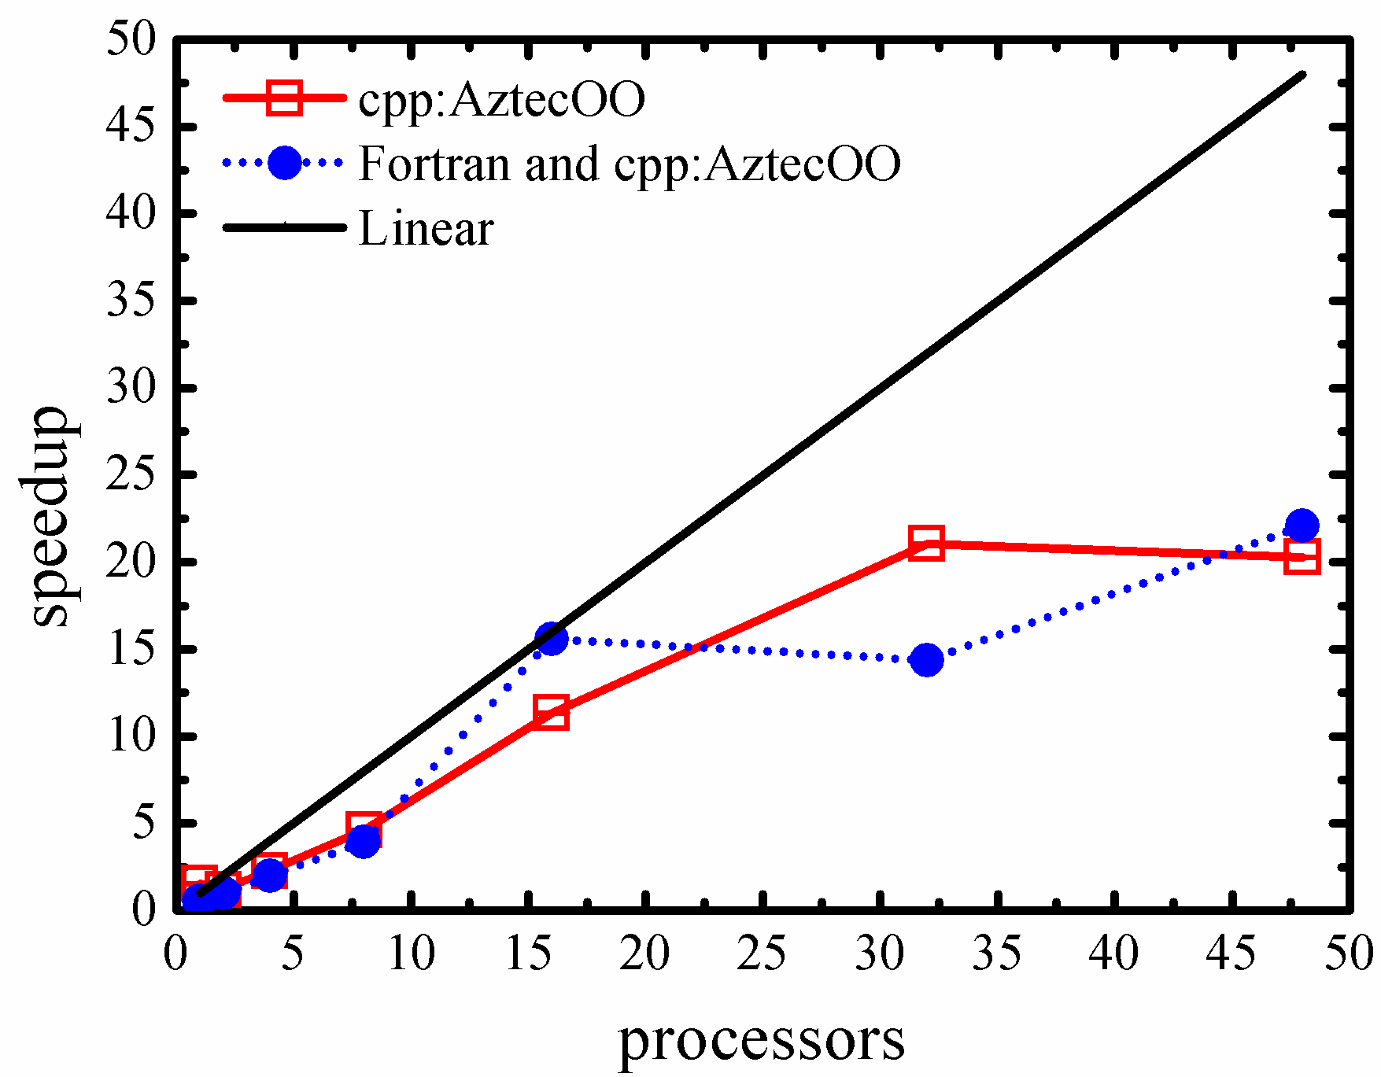
Validation
ndof = 10⁶
ndof = 5 x 10⁵
Fortran wrapper
CPP wrapper
CPP wrapper

Slide 14
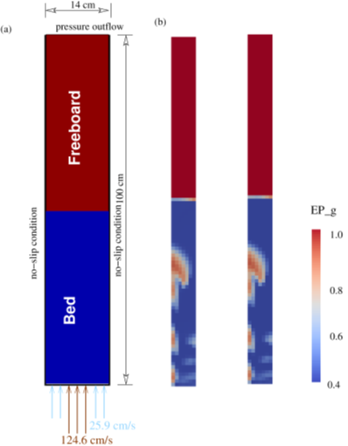
Results
Fluidized bed with central jet
Sand particle size = 400μm
density = 2g/cm³
EP_g at min fluidization = 0.42
Min fluidization velocity = 25.9cm/s
Density of air = 0.0012g/cm³
Viscosity of air = 0.00018 Poise
Structured mesh (14 X 100)
MFIX: BiCGSTAB solver
MFIX-Trilinos: BiCGSTAB
Tol = 1e-04
IT = 20
MFiX
MFiX-Trilinos

Slide 15
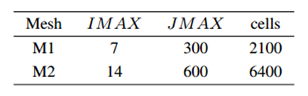
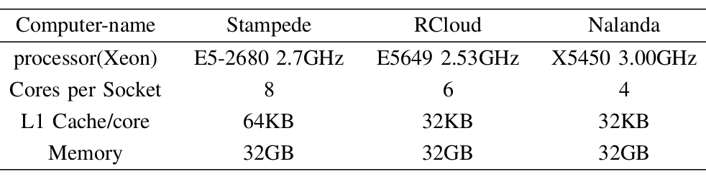
Results
Fluidized bed with central jet

Slide 16
Results
Fluidized bed with central jet
Stampede
BiCGSTAB
Rcloud
BiCGSTAB

Slide 17
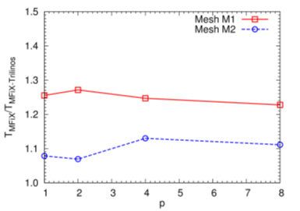
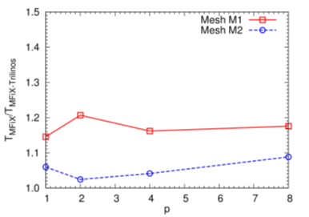
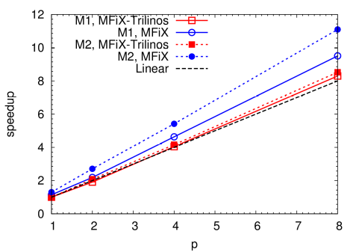
Results
Fluidized bed with central jet
Nalanda
BiCGSTAB
Stampede
GMRES

Slide 18
Conclusions
A framework is developed to integrate MFiX with linear solver packages in Trilinos via MFIX, Fortran, C and CPP wrappers.
Computations are carried out to simulate flow in a fluidized bed problem.
The performance of the integrated solver is tested on various computer architectures for variety of problem sizes.
The linear solvers in Trilinos are approximately 30% faster compared to the same solver in MFiX.

Slide 19
Scholarly contributions
A Chattopadhyay, V M K Kotteda and V Kumar, Next Generation Computing Framework for Exascale Simulations, Southwest Emerging Technology Symposium 2016, April 9, 2016, Wyndham Airport Hotel, El Paso, TX.
V M K. Kotteda, A Chattopadhyay, V Kumar and W Spotz, High Fidelity Computational Model for Simulating Large Scale Multiphase Flow Problems. 4th Annual IDR Symposium, April 25, 2016, The University of Texas at El Paso, El Paso.
V M K Kotteda, A Chattopadhyay, V Kumar and W Spotz, MFiX integrated with Trilinos for High Fidelity Multiphase Flow Simulations, National Energy Technology Laboratory’s (NETL) 2016 Workshop on Multiphase Flow Science, August 9 -10 , 2016, Morgantown, WV.
A Chattopadhyay, V M K Kotteda, V Kumar and W Spotz, Next generation exascale capable capable multiphase solver with Trilinos, Proceedings of the ASME international Mechanical Engineering Congress & Exposition, Nov 11-17, 2016, Pheonix, Arizona, USA (accepted).
V M K Kotteda, A Chattopadhyay, V Kumar and W Spotz, A framework to integrate MFiX with Trilinos for high fidelity fluidized bed computations, IEEE High Performance Extreme Computing Conference (HPEC), Sep 13-15, 2016, Waltham, MA USA (accepted).

Slide 20
Future work
Kokkos
Performance-portable abstraction over many different thread-parallel programming models: OpenMP, CUDA, Pthreads, …
  Avoid risk of committing code to hardware or programming model
  C++ library: Widely used, portable language with good compilers
Abstract away physical data layout & target it to the hardware
Memory hierarchies getting more complex; expose & exploit!
Data structures & idioms for thread-scalable parallel code
  Multi-dimensional arrays, hash table, sparse graph & matrix
  Automatic memory management, atomic updates, vectorization, ...
Stand-alone; does not require other Trilinos packages
  Used in LAMMPS molecular dynamics code; growing use in Trilinos
  Includes “pretty good [sparse matrix] kernels” for Tpetra

Slide 21
Future work
Test the performance of SMP MFiX-Trilinos with various pre-conditioners and smoothers.
Integrate DMP MFIX with subdomain solvers, pre-conditioners and smoothers.
Test the performance of DMP MFiX-Trilinos on various computer architectures for variety of problem sizes.
Thank you

