Slide 1
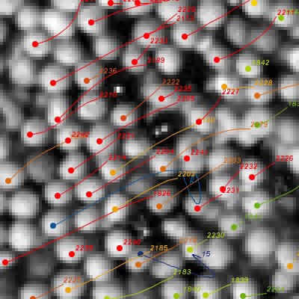
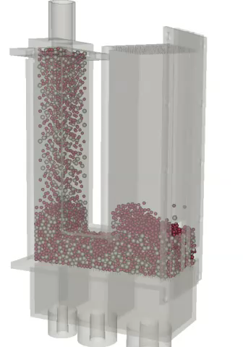
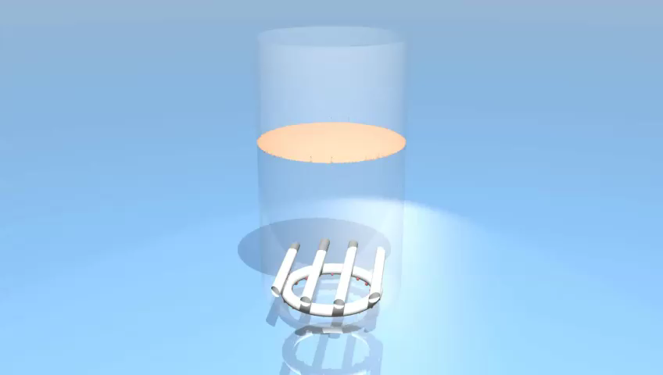
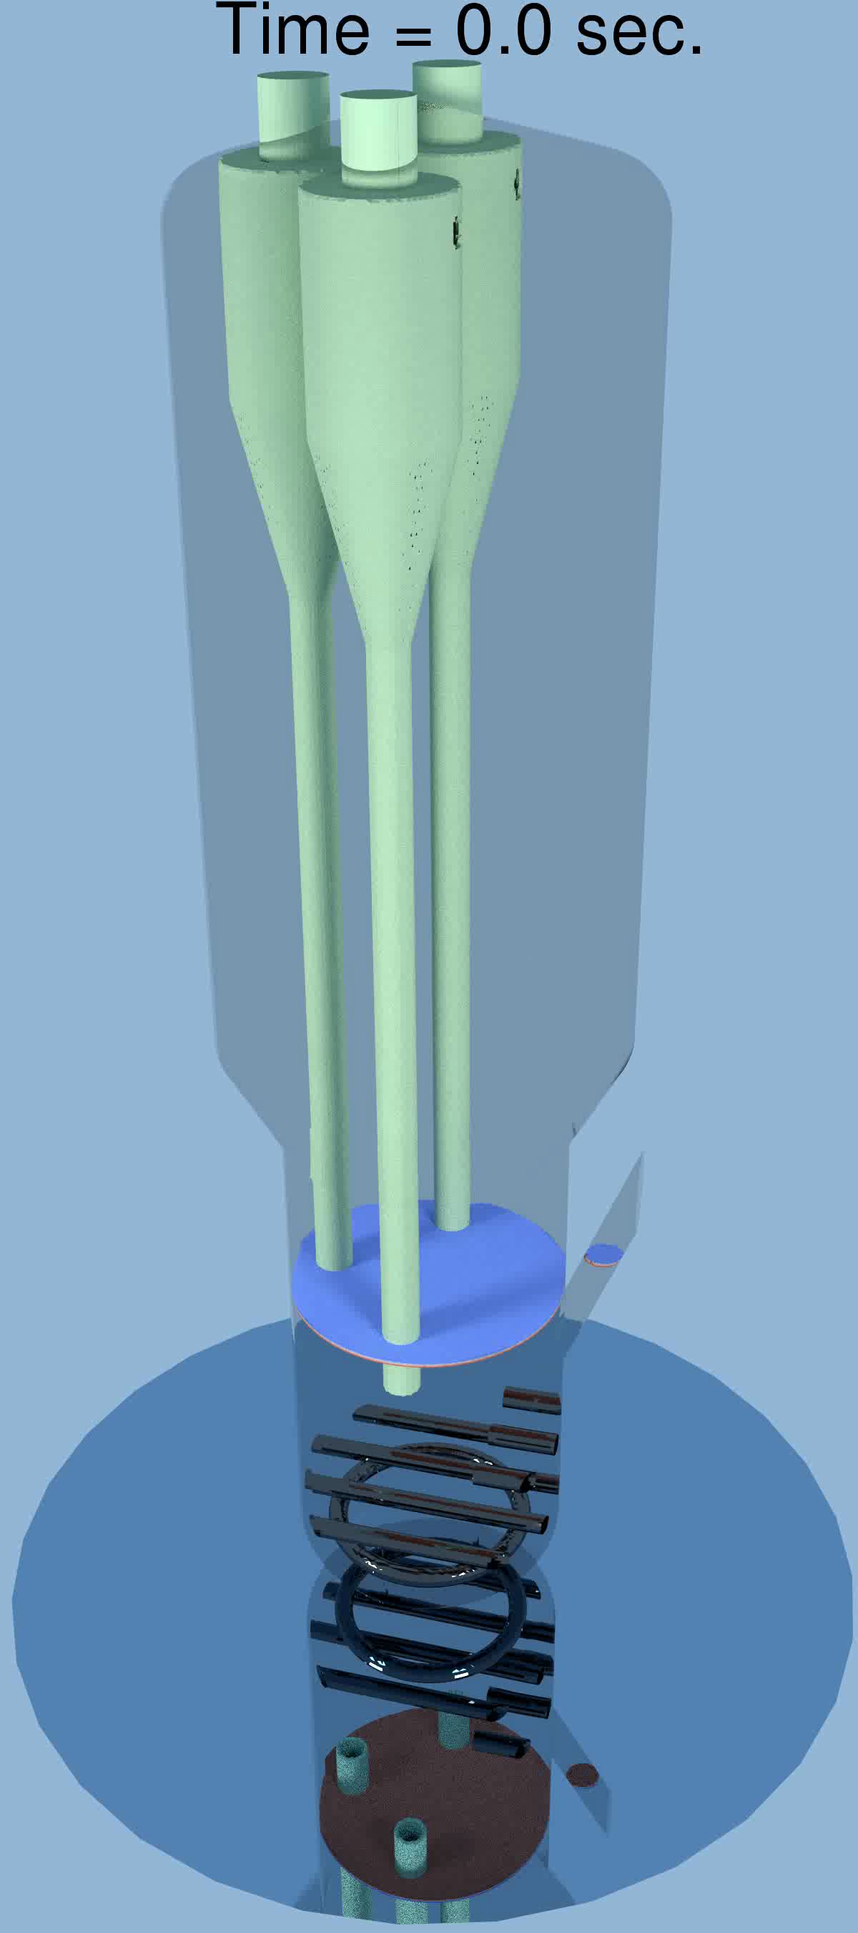
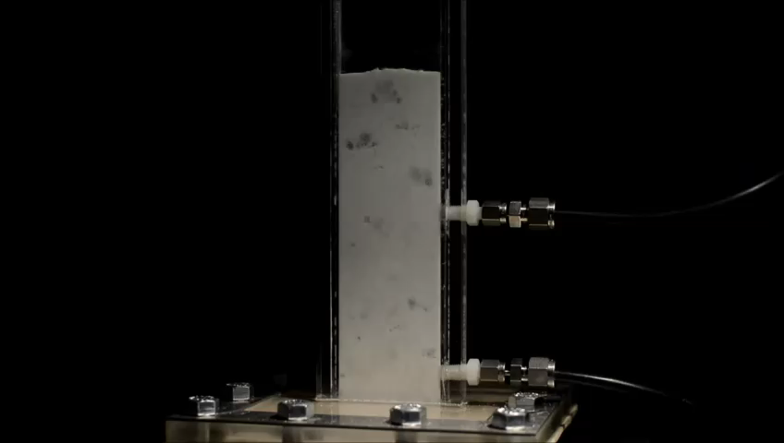
NETL Multiphase Flow Science Overview 2016
Bill Rogers
From Fundamentals to Cutting Edge
Multiphase Flow Science Team
August 09, 2016

Slide 2
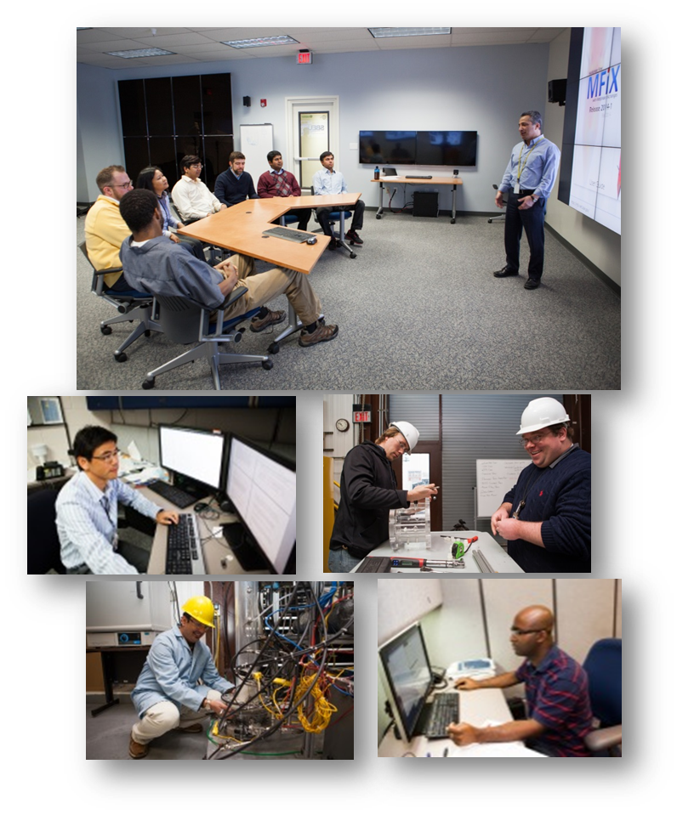
Team and Collaborators
MFS Team
S. Benyahia
G. Breault
K. Buchheit
J. Carney
J. Dietiker
J. Finn
R. Garg
A. Gel
B. Gopalan
C. Guenther
D. Huckaby
T. Jordan
H. Kim
A. Konan
Li
L. Lu
M. Meredith
Morris
J. Musser
P. Nicoletti
R. Panday
S. Rabha
W. Rogers
P. Saha
M. Shahnam
R. Singh
M. Syamlal
J. Tucker
D. Van Essendelft
A. Vaidheeswaran
V. Verma
J. Weber
Y. Xu
K. Yoo
Collaborators (PI)
G. Ahmadi (Clarkson)
I. Celik (WVU)
H. Emady (ASU)
C. Hrenya (UCB)
J. Hu (SNL)
V. Kumar (UTEP)
S. Mohaghegh (WVU)
J. De Wilde (UCL)
C. Roy (VT)
W. Spotz (SNL)
D. Tafti (VT)
C. Tong (LLNL)

Slide 3
From Fundamentals to Cutting Edge
Fundamentals
Grow the Multiphase Flow Science (MFS) program
Continued focus on MFiX Software Suite Development
Quality Assurance - VV&UQ efforts
Multiphase Flow Analysis Laboratory to support validation
Outreach to MFS stakeholders
Cutting Edge
Simulation-based optimization using multiphase software

Slide 4































Grow the MFS Program
MFS Funding has more than doubled in FY16 – now over $ 6 million!
Advanced Gasification
Coal and Coal-Biomass to Liquid
Advanced Combustion
Carbon Capture Simulation Initiative
Innovative Process Technology
Rare Earth Elements
MFS team members joining in FY16
Christos Altantzis – Mechanical Engineering
Subhodeep Banerjee – Mechanical Engineering
Kyle Buchheit – Chemical Engineering
Mary Ann Clarke –Mathematics
Eli Heady – Computer Science
Avinash Vaidheeswaran – Nuclear Engineering
George Waldman –Mathematics
Yupeng Xu – Chemical Engineering
Liqiang Lu – Chemical Engineering
Kisoo Yoo – Mechanical Engineering
Justin Finn – Mechanical Engineer

Slide 5

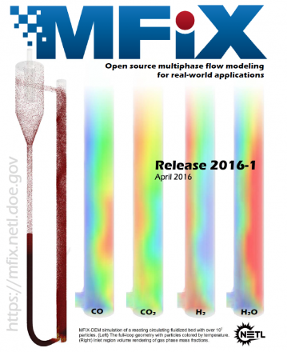
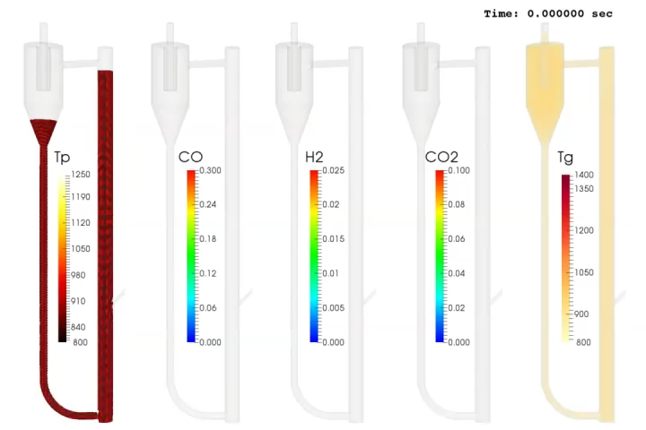
Two MFIX Releases
MFiX 2015-2 (Date: 10/27/2015)
Autotools Build System - MFIX now uses autotools to configure and compile the code. This increases code portability while reducing overall script maintenance
Semi-Explicit Coupling for DEM Simulation - A semi-explicit algorithm for coupled gas-solids flows was implemented in MFIX-DEM. This approach calculates gas-solids interaction forces during the gas phase time step resulting in decreased time to solution.
Two New Continuum Momentum Equation Formulations
MFiX 2016-1 (Date: 04/13/2016)
DMP support for DEM thermochemistry - MFIX-DEM simulations with heat transfer and/or chemical reactions now support parallel execution
This allows for larger particle counts in reacting flow simulations with reduced time-to-solution for greater modeling capability of MFIX-DEM.
DEM particle-wall heat transfer - MFIX-DEM particles may exchange heat with the domain boundaries via specified constant wall temperature boundary conditions
Greater UDF capabilities - Users may construct user-defined functions (UDFs) to specify source terms to the governing equations and many transport coefficients and field properties
Prototype Circulating Fluid Bed Gasifier – full loop

Slide 6
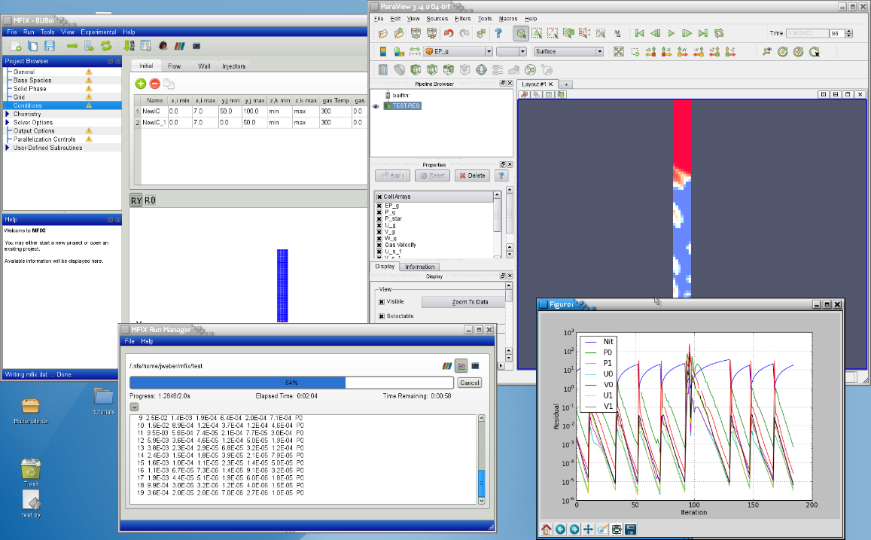
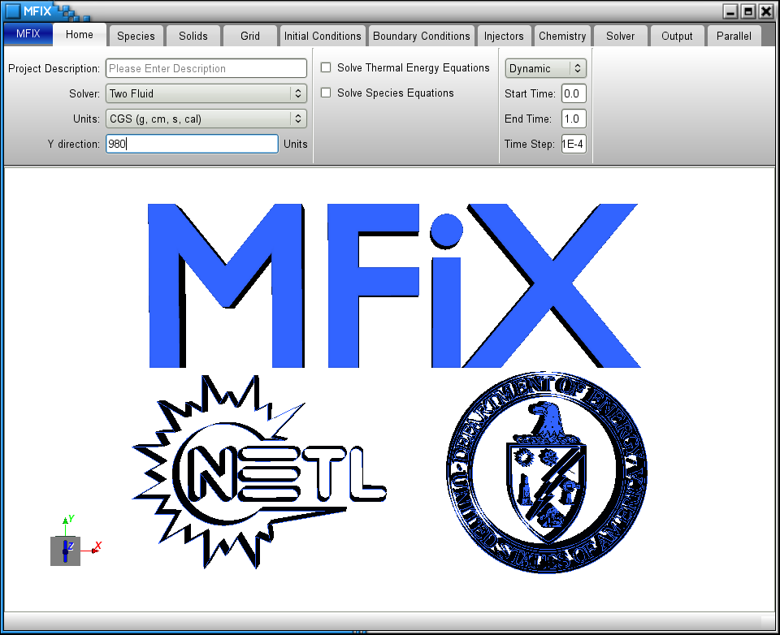
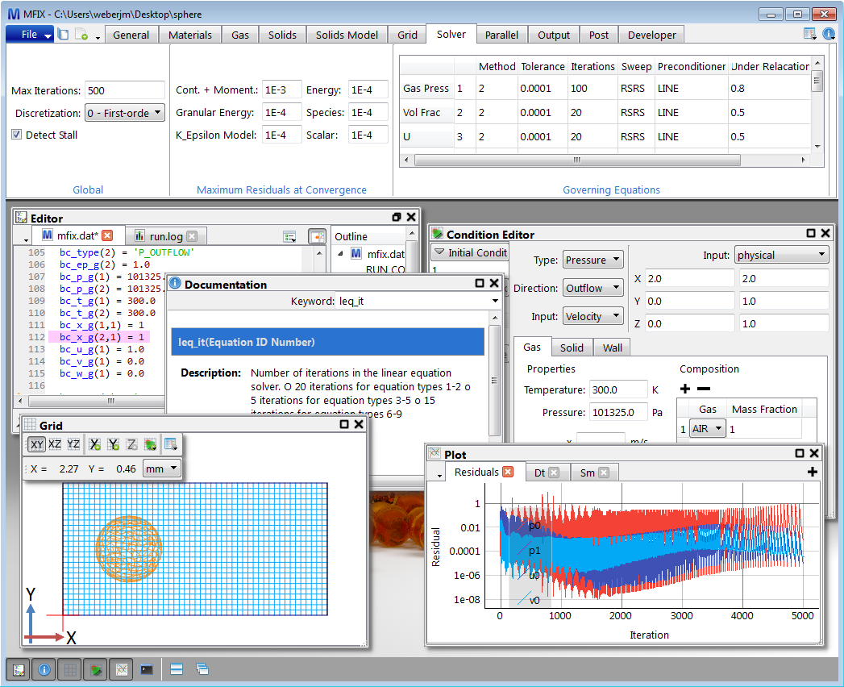
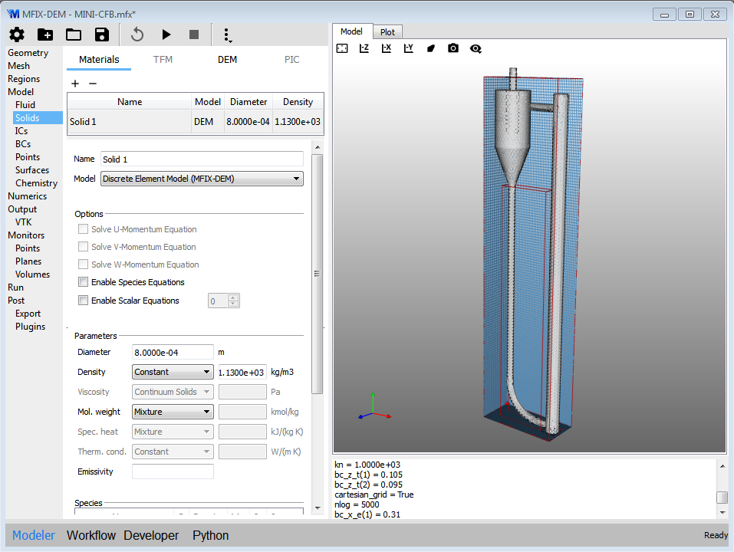
MFiX GUI
Demonstrated August 2013
Experimenting with 3D graphics (VTK), Sep 2013
Version 0.1 Released June 5, 2015
Today

Slide 7
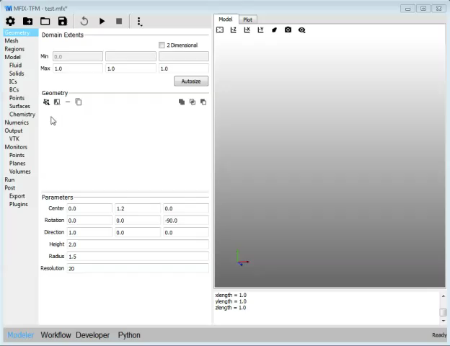
Geometry

Slide 8
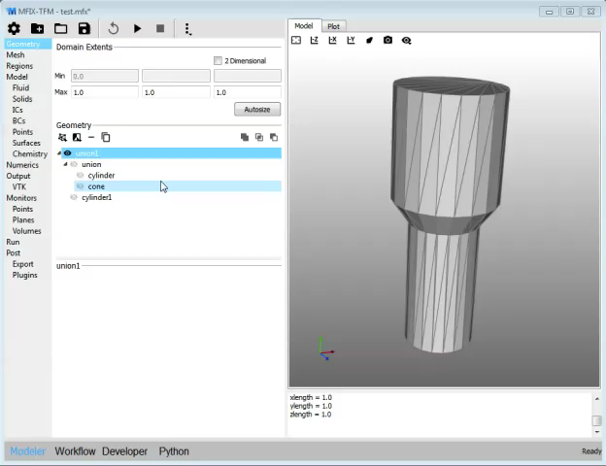
Background Mesh

Slide 9
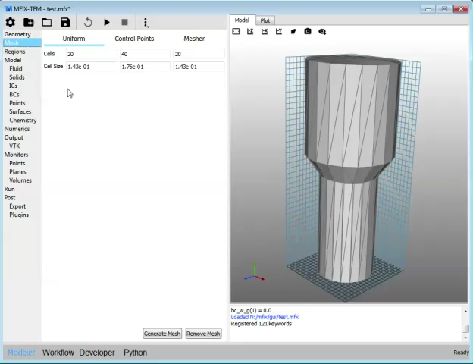
Regions

Slide 10
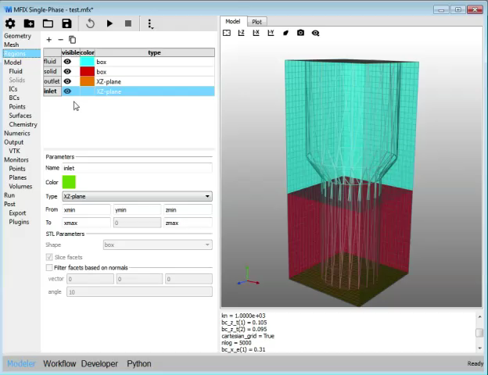
Model Parameters

Slide 11
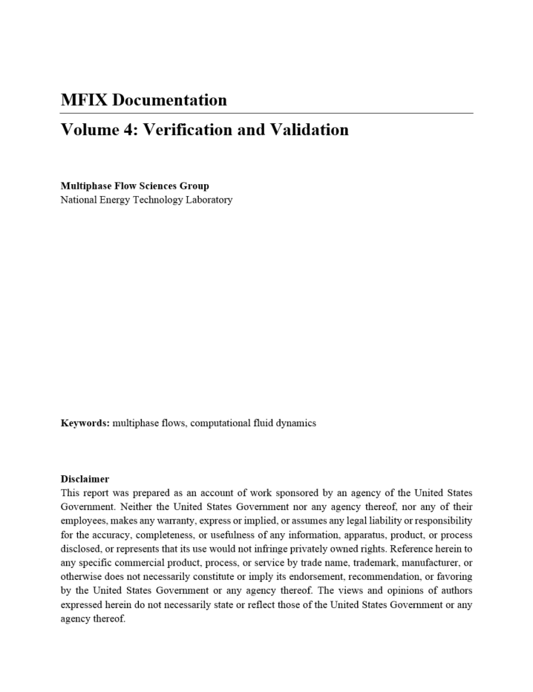
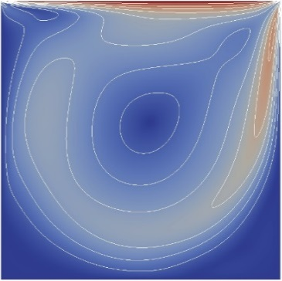
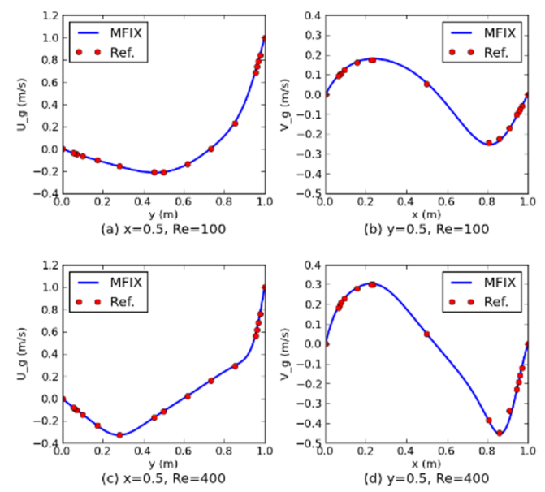
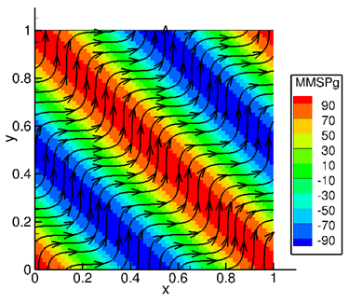
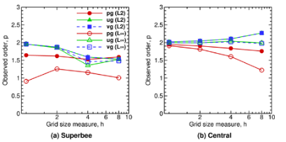
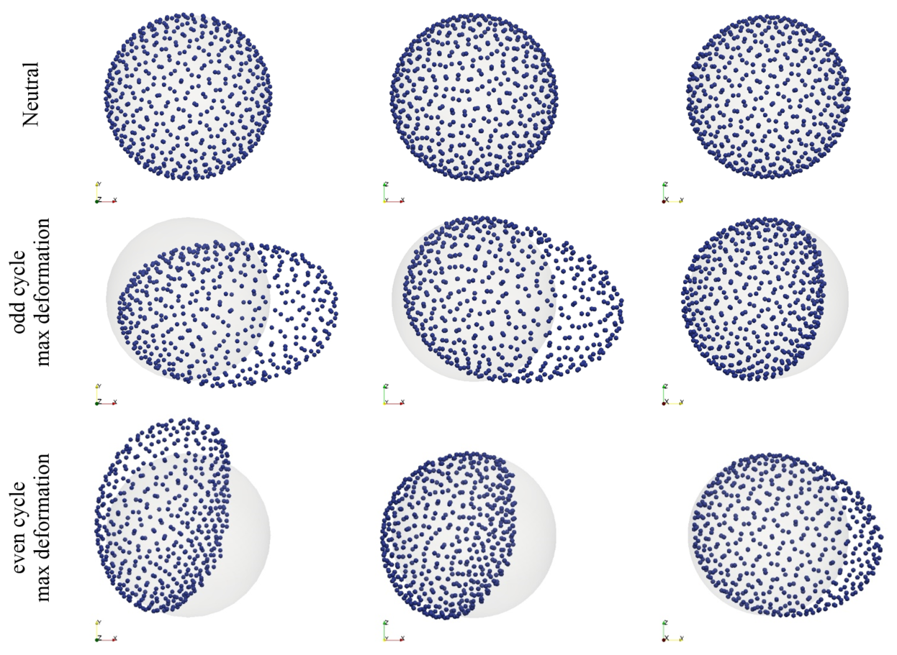
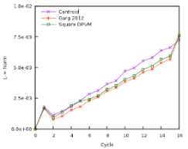
MFIX Software Quality Assurance (SQA)
MFIX SQA goal is to perform systematic verification of MFIX features for correctness and numerical accuracy.
Documented in MFIX Verification and Validation Manual (https://mfix.netl.doe.gov/download/mfix/mfix_current_documentation/MDV3-VVUQ-v0.5.pdf)
Test cases (1) exercise one or more sub-models, (2) are computationally inexpensive, and (3) strive for maximum code coverage with minimal test overlap.
Source code managed in NETL hosted GitLab repository.
GitLab repository is monitored by Jenkins, a continuous integration (CI) server:
Executes verification test suite after every commit
Reports results via email and archives daily ‘snapshots’ of test case performance
Uncertainty Quantification efforts
Fluid bed gasifier wraps up
UQ efforts will concentrate on hydrodynamics,

Slide 12


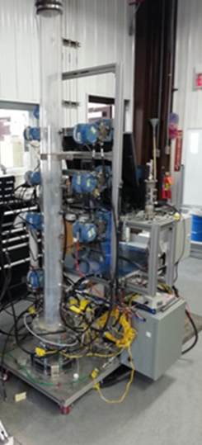
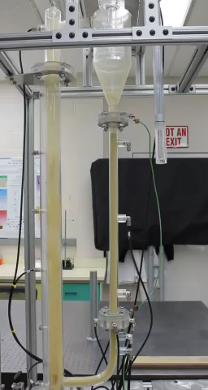
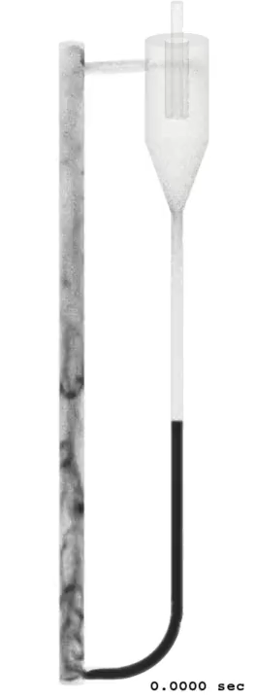
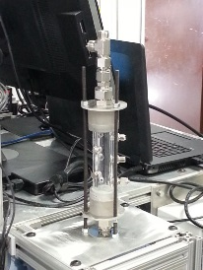
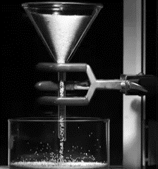
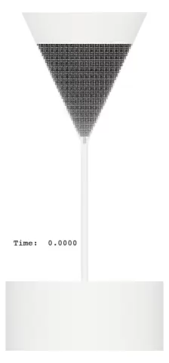
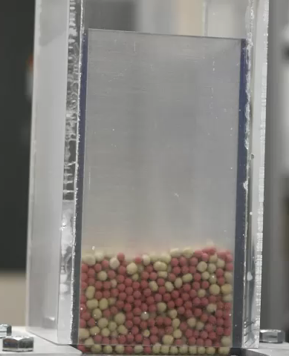
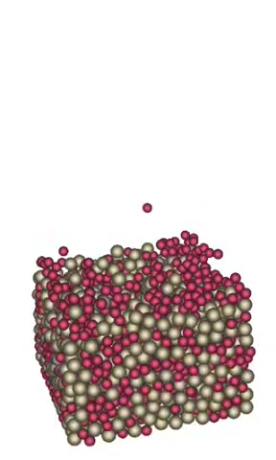
Multiphase Flow Analysis Laboratory
New Lab supporting model development and validation
Reacting beds:
fixed and bubbling
(CO₂ Sorbents)
Small bubbling beds with image analysis
Particle size distribution
Umf
Sphericity
Particle density, including skeletal and bulk
Porosity
Micrograph
Small-scale CFB
Particle separation and flow control
Particle characterization
Granular hopper flow

Slide 13
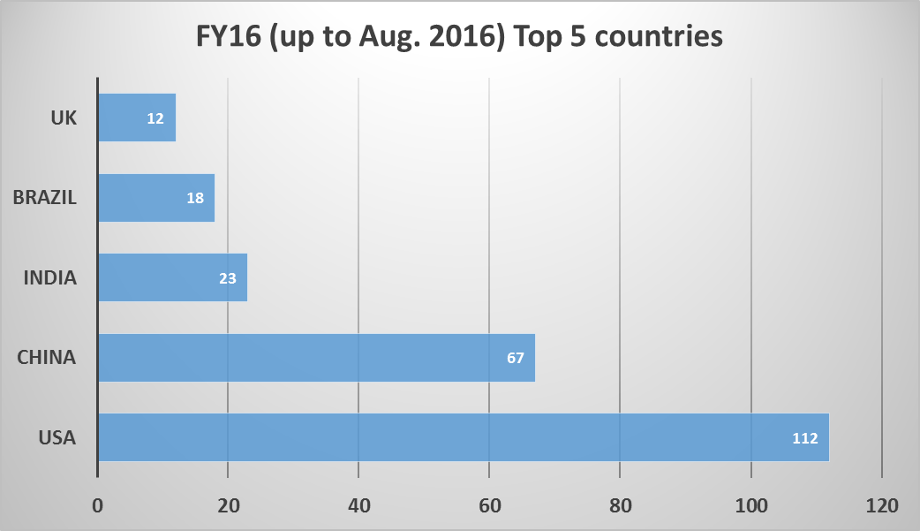
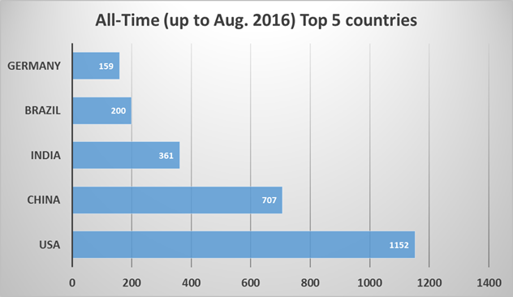
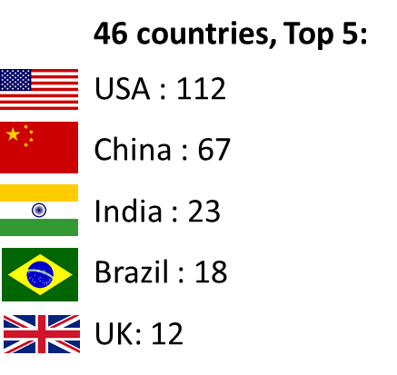
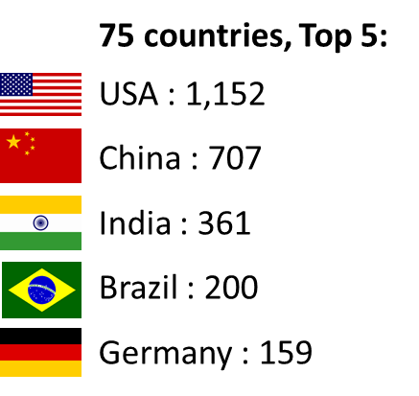
MFiX Stats FY16 (up to Aug. 2016)
FY16 MFIX registrations = 362
University = 257
Industry = 48
National Labs = 27
Other = 30
All-time MFIX registrations = 4,043
University = 2,884
Industry = 630
National Labs = 209
Other = 320
MFIX: 1,423 downloads
C3M: 126 downloads
MFIX GUI: 351 downloads

Slide 14
Cutting Edge - Simulation-based Reactor Design and Optimization
Dilute Flow
Novel reactor designs will require understanding and control of reacting multiphase flows
The ability to accurately simulate reacting multiphase flow is needed for optimal design and operation
We are developing an Optimization Toolset based on multiphase Computational Fluid Dynamics (CFD)
Uses the NETL MFiX Suite of multiphase CFD software for predicting reactor performance
Demonstrate and validate optimal designs
Dilute and Dense Flow
Regions
Solids Circulation
Dense Flow

Slide 15
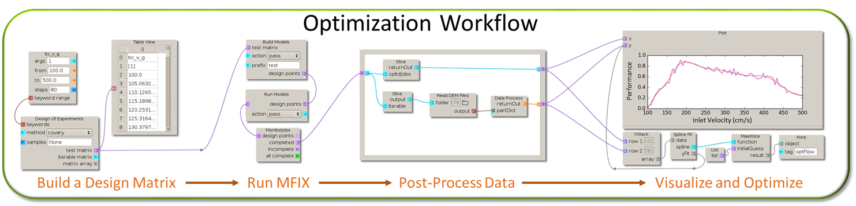
Optimization Toolset (OT)
A prototype of the Optimization Toolset has been developed in FY16
GUI-Based Software that manages the optimization process
Let’s look at a simple example application of OT for particle separation
Any candidate REMS design will depend on manipulation of reacting particles for optimal performance, e.g.
Coal “refining” – devolitilization requiring separation of coal/char/ash/volatiles;
Gasification – control of coal/biomass/char/ash;
Chemical looping combustion and gasification – control and separation of coal/biomass/char/ash/oxgen carrier
Solid sorbent-based carbon capture – sorbent regeneration and thermal management

Slide 16
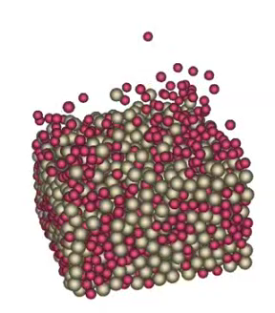
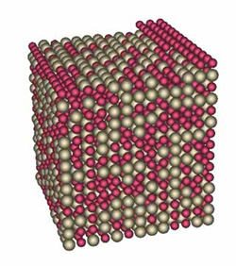
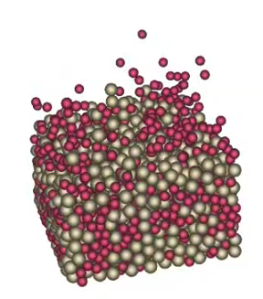

Optimization Toolset (OT)
Use the OT and MFiX to optimize a batch separation – What is the optimal gas velocity to separate the particle mixture?
Optimal Gas Velocity
Rectangular Bed
Gas Velocity Too High - Over Fluidized
2:1 Particle Density Ratio
4:3 Diameter Ratio
Gas Velocity Too Low - Under Fluidized
Particles Randomly placed in initial state
Uniform gas velocity

Slide 17
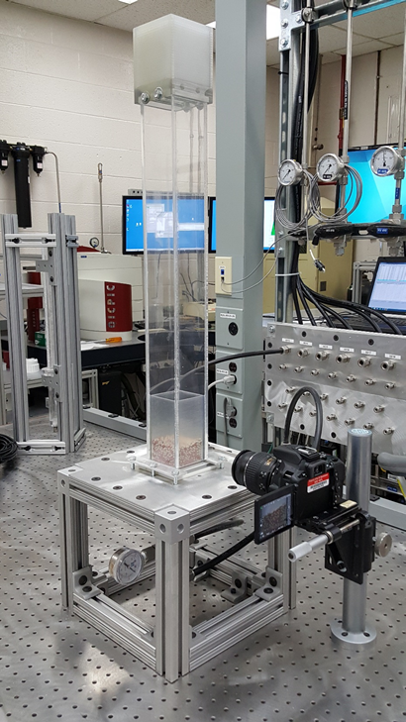
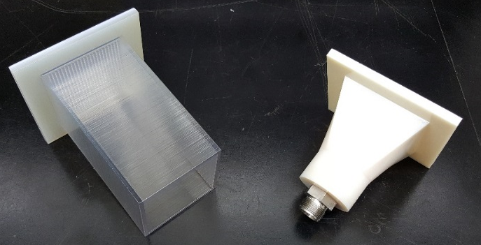
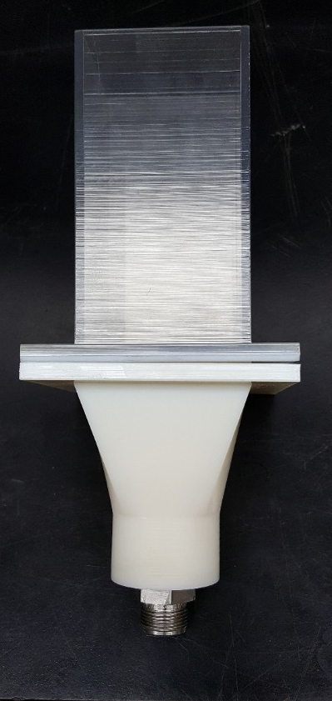
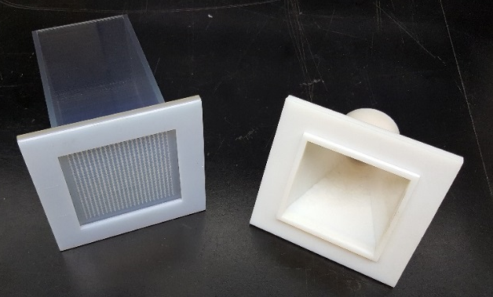
Application and Validation of the OT
Now - combine OT optimized design with additive manufacturing to 3D print the device and validate the results
Bed and Distributor Plate Assembly
Plenum
Bed and Distributor Plate Assembly
Plenum
3-D Printed Bed
Used to validate optimized batch separation example

Slide 18
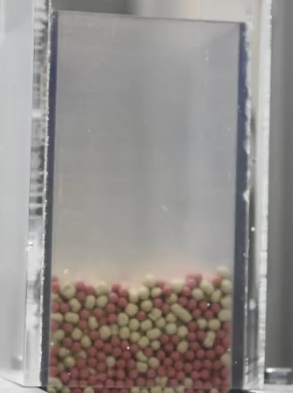
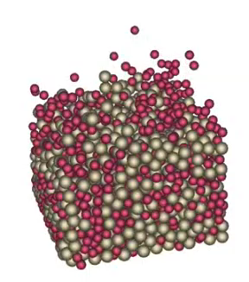
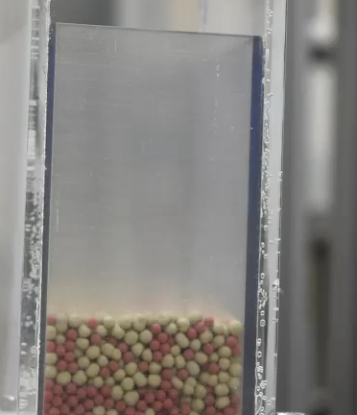
Application and Validation of the OT
Compare OT results to lab measurements – excellent qualitative agreement
An image analysis-based technique being developed for quantitative comparison
Optimal Gas Velocity
Gas Velocity Too High - Over Fluidized
Gas Velocity Too Low - Under Fluidized

Slide 19
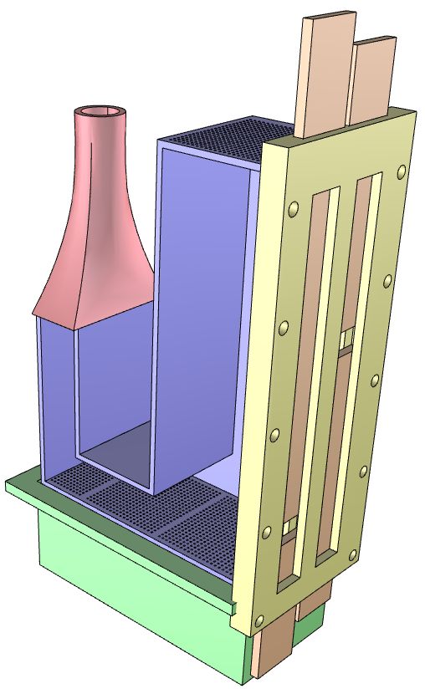
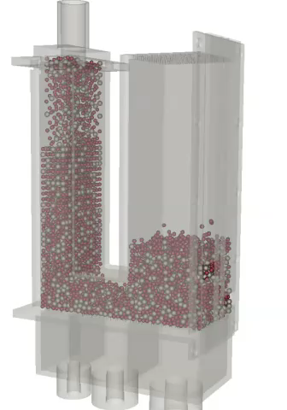
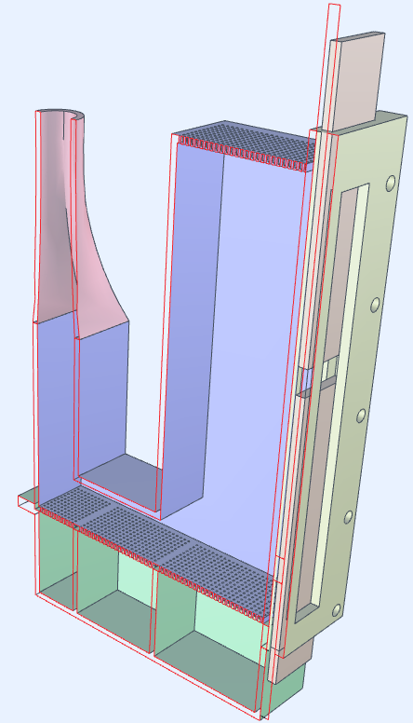

Application and Validation of the OT
Let’s kick it up a notch – Use the OT to optimize a continuous separation device

Slide 20
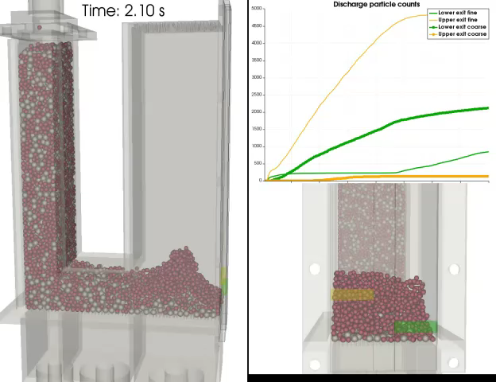





Application and Validation of the OT
e.g. Parametric Study of flow control

Slide 21



Application and Validation of the OT

Slide 22
Optimization Toolset – next steps
Application to reacting flows
Reactor network models to handle complex chemistry
Implementation with full MFiX Suite of Software
Incorporate into new MFiX GUI
Continued validation with cold and reacting flows
Open source, public release

Slide 23
MFS Team Presentations
Three Dimensional VOF Simulations for Wetting of Corrugated Sheet
Rajesh K. Singh and Janine E. Galvin
Particles Climbing Along a Vibrating Tube: Numerical Simulation using the Discrete Element Method (DEM)
Yupeng Xu, Jordan Musser, Tingwen Li, William A. Rogers
Coarse Grained Particle Method for Simulation of Liquid-Solids Reacting Flow
Liqiang Lu, Kisoo Yoo, Sofiane Benyahia

Slide 24





























Questions
Thanks for your time

Slide 25











It’s All About a Clean, Affordable Energy Future
For More Information, Contact NETL
the ENERGY lab
Delivering Yesterday and Preparing for Tomorrow
National Energy Technology Laboratory
25

