Slide 1
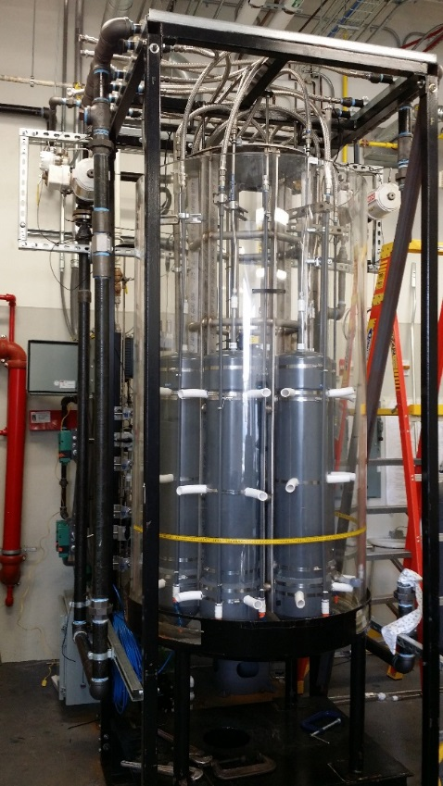
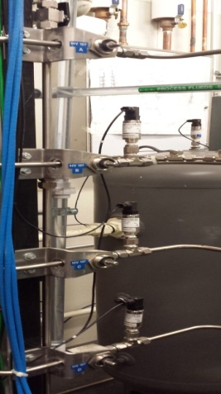
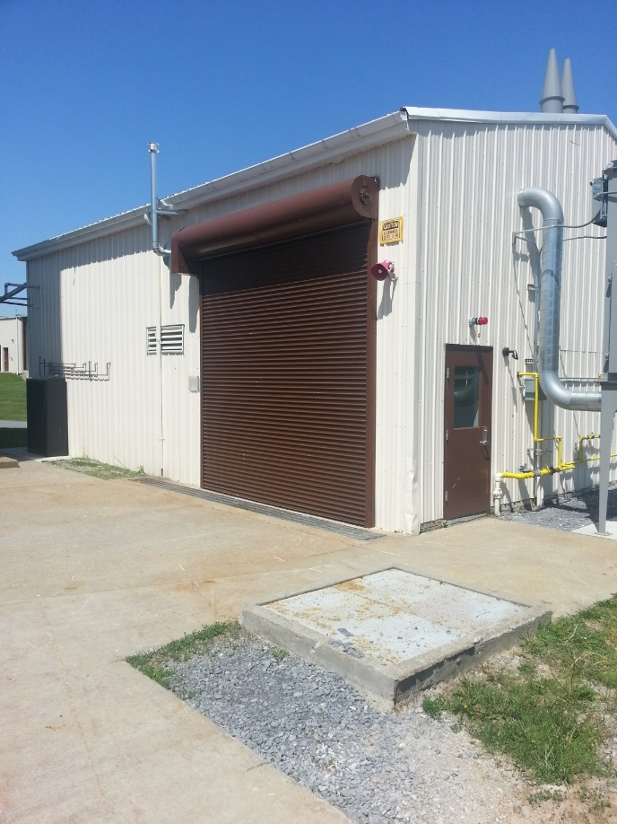
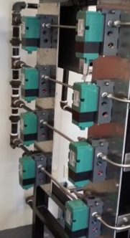
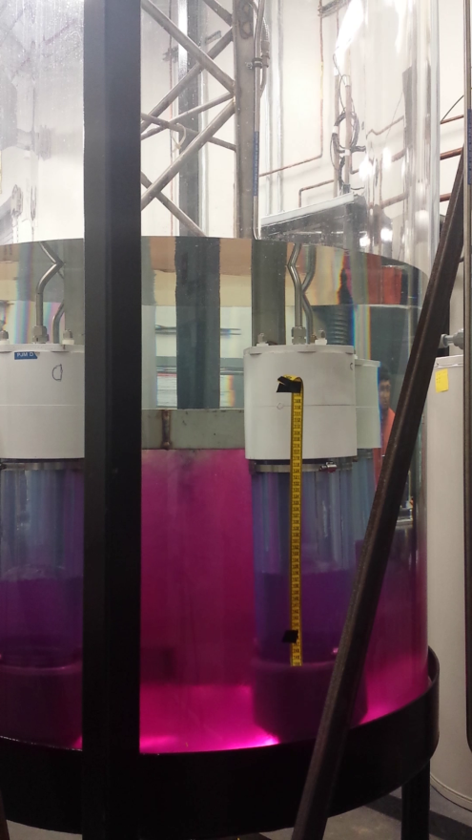
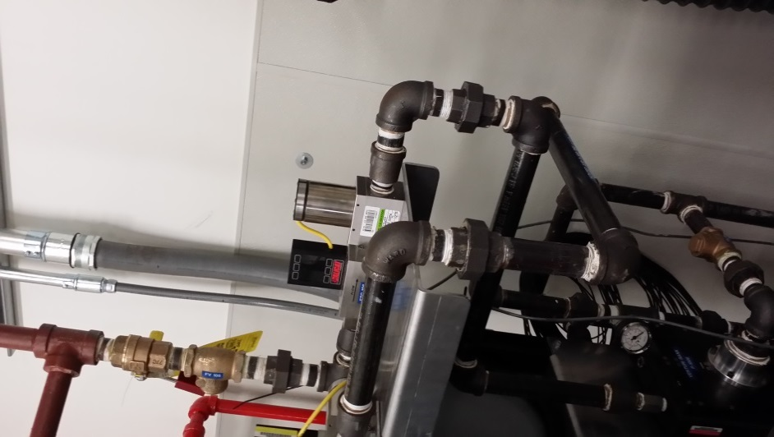
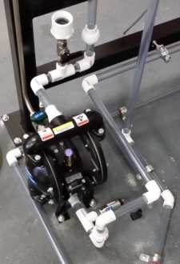
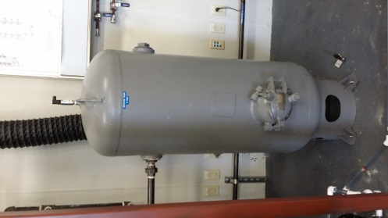
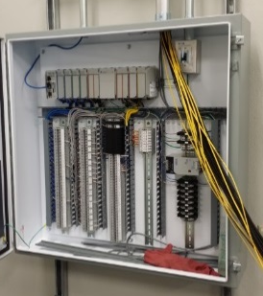
2016 Workshop on Multiphase Flow Science: Validation of the MFIX-DEM code
8-10-2016
Yupeng Xu, Ph.D.
Jordan, Musser, Ph.D.
William A. Rogers, Ph.D., P.E.

Slide 2
Outline
Background and Objective
Try to validate MFIX-DEM code
Model description
Simulation settings
Results
Conclusions

Slide 3
Background and Objective: Granular pump
An experiment work reported that vibrating a tube inside a granular silo can pump the granular particles. (Liu, C., Wu, P., & Wang, L. (2013). Soft Matter, 9(19), 4762-4766)
Use the experimental results as a validation case for MFIX-DEM code

Slide 4
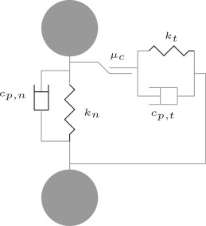




Model description
Experimental results showed that gas has minor effect.
Linear-spring/dashpot soft-sphere model

Slide 5
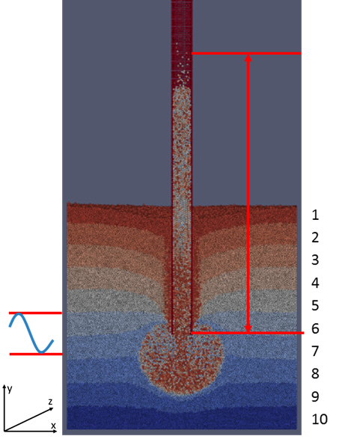
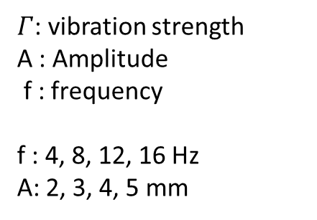
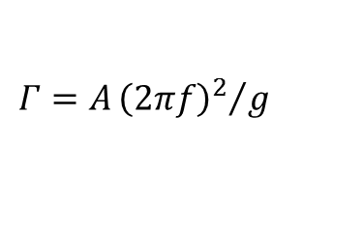
Simulation settings
Simulation settings
Gravity z-direction | m/s² | 9.81
Particle diameter | m | 0.00050
Particle density | Kg/m³ | 2556.00
Restitution coefficient (normal) | - | 0.90
Friction coefficient | - | 0.10
Normal spring stiffness | N/m | 1000.0
$Γ$: vibration strength
A : Amplitude
f : frequency
f : 4, 8, 12, 16 Hz
A: 2, 3, 4, 5 mm
$$Γ=A{{\left(2πf\right)}^{2}}/g$$
W×D×H(bed): 6×6×6 cm

Slide 6
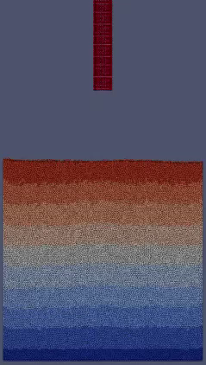
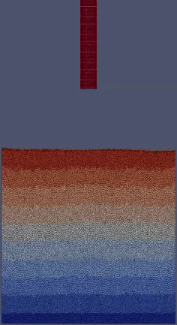
Particle inside the tube
f = 12 Hz, A = 5 mm
f = 12 Hz, A = 2 mm

Slide 7
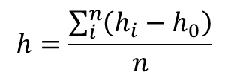
Climbing height
$$h=\frac{\sum_{i}^{n}{\left(h_{i}−h_{0}\right)}}{n}$$
Where i refers to the particles which are inside the tube and above of the lower end of the granular tube
h_{i} is the particle height
h₀ is the height of the lower end of the granular tube.

Slide 8
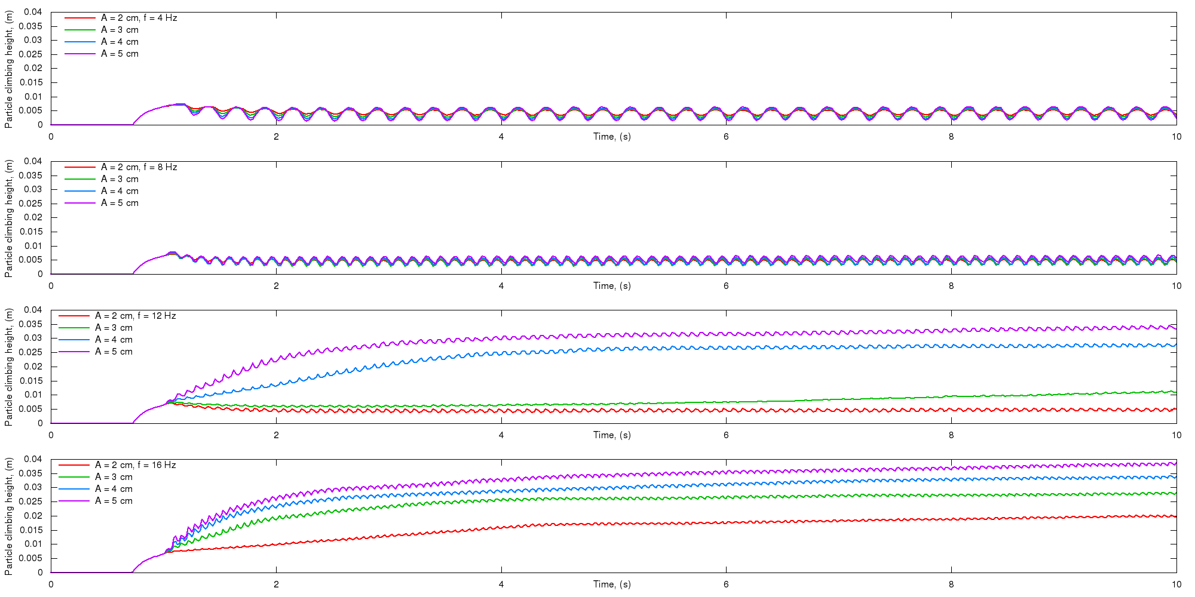
Climbing height

Slide 9
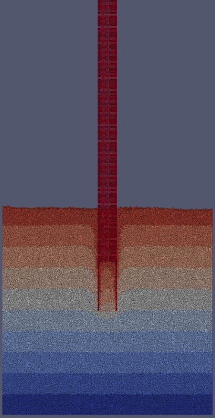
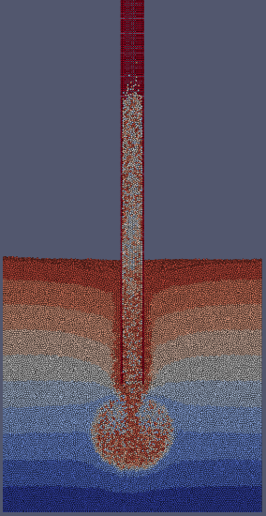
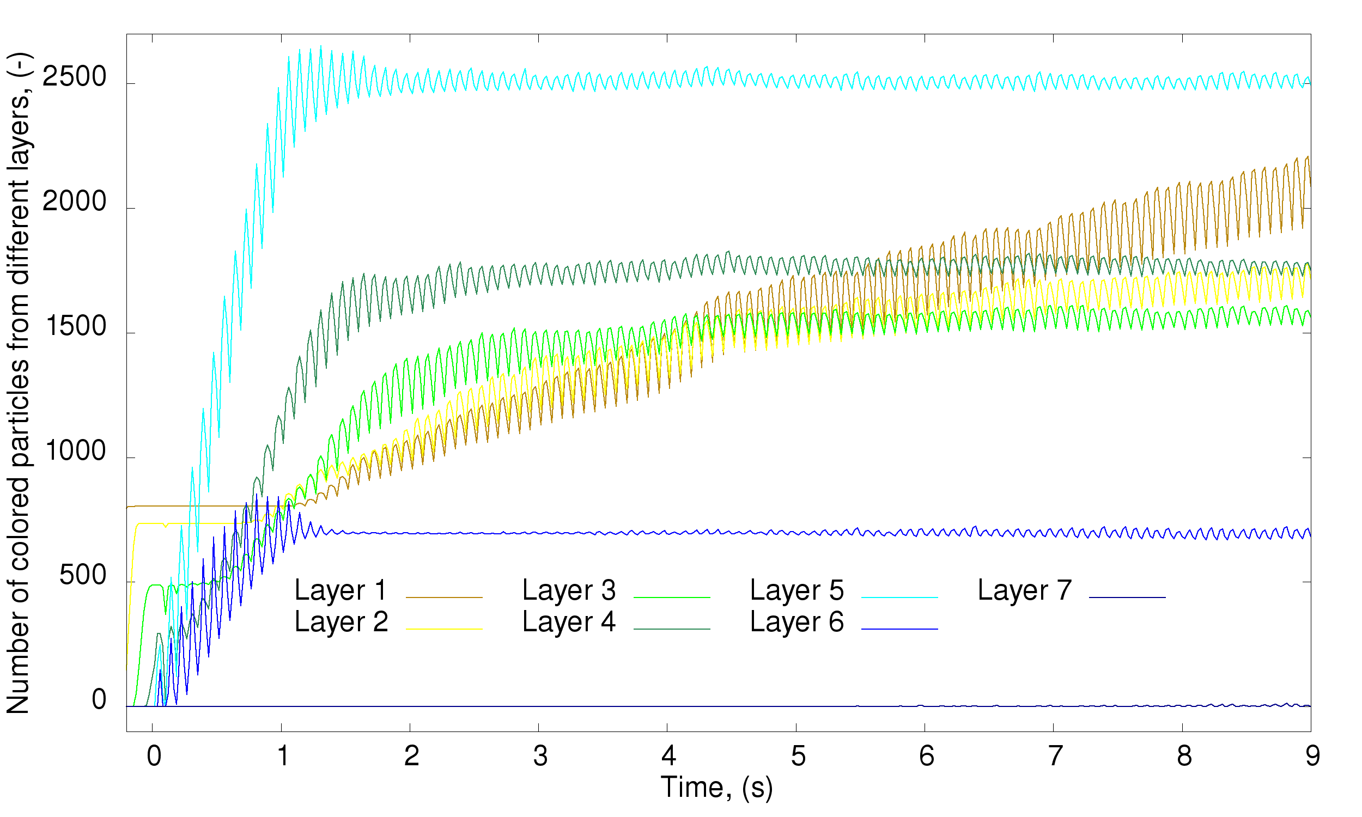
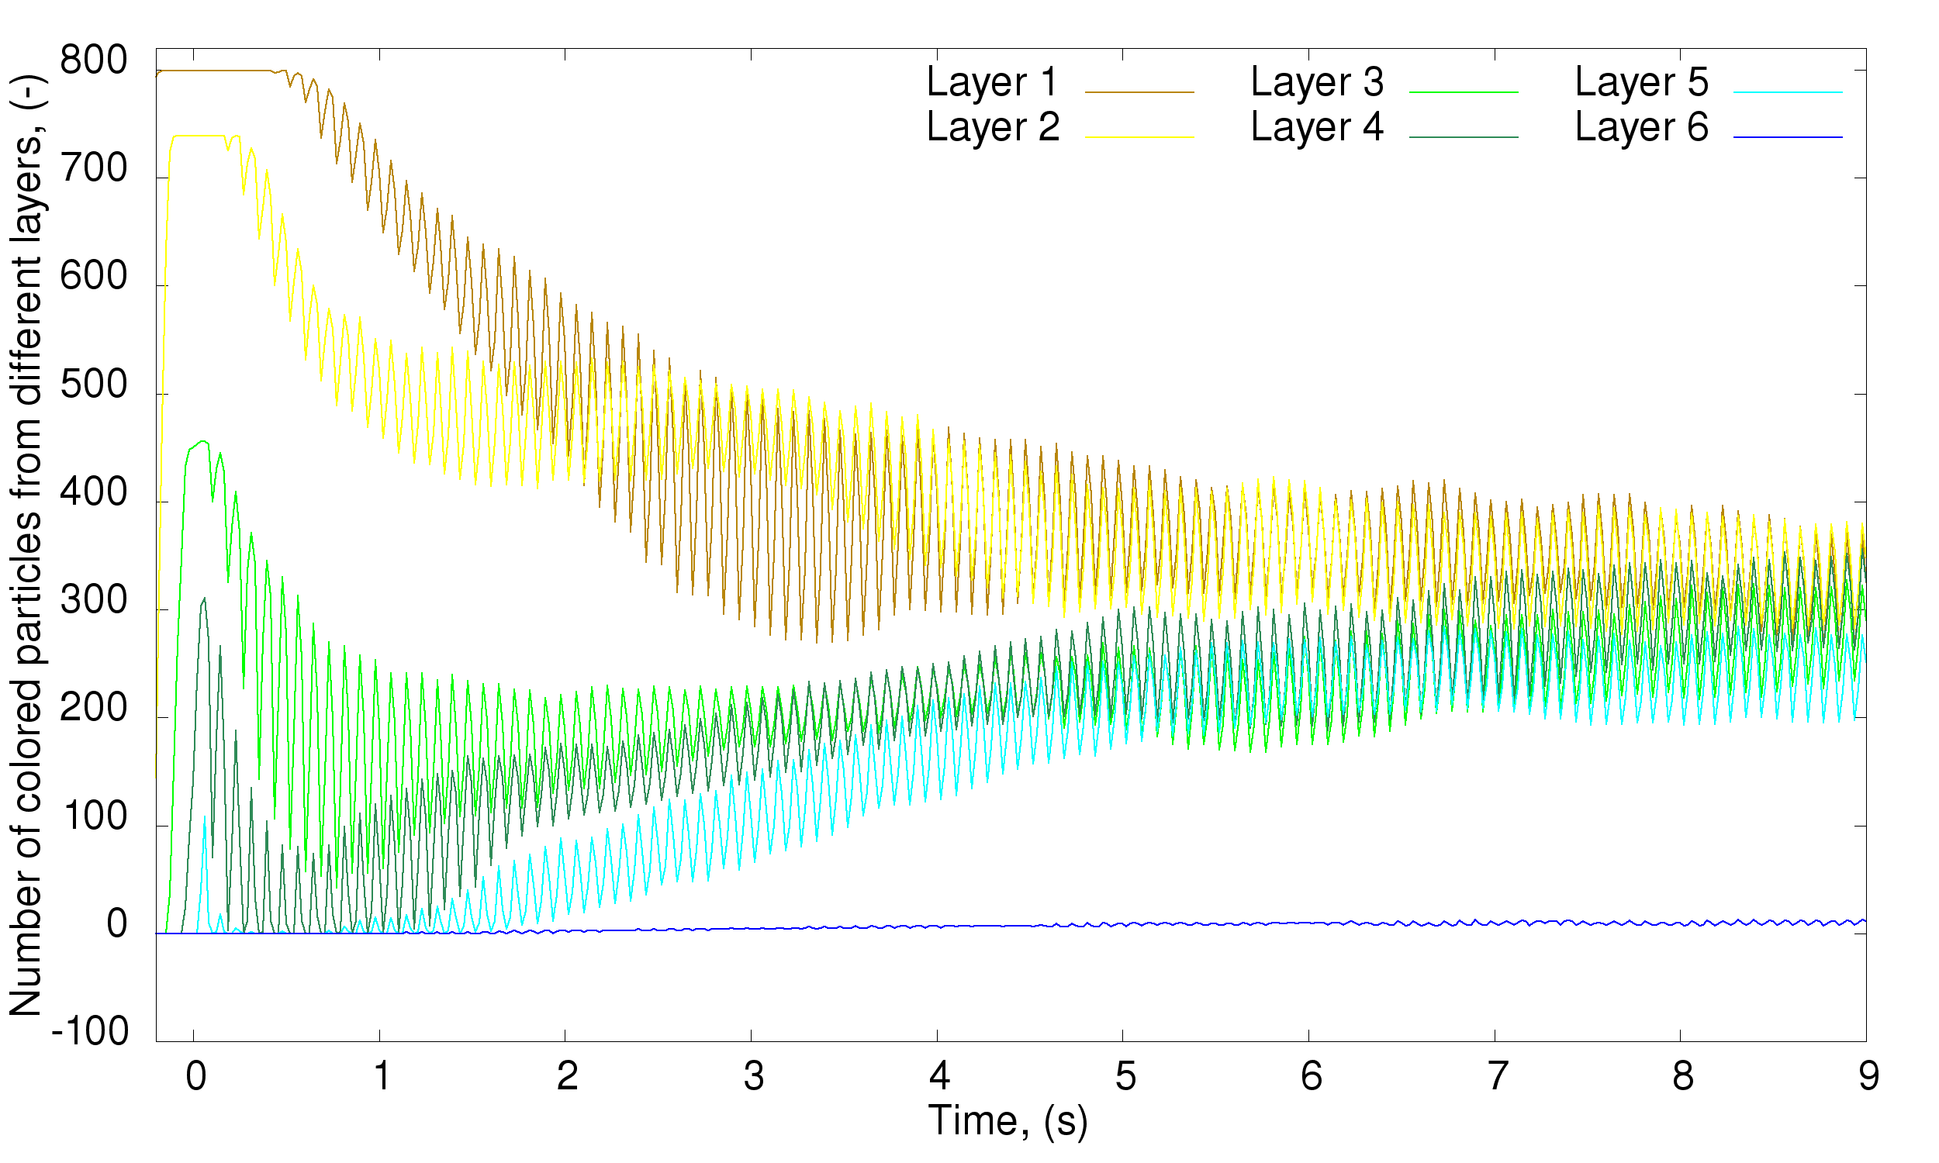
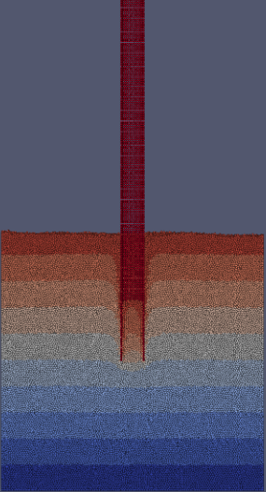

Evolution of the bed
High vibration strength
1
2
3
4
5
6
7
8
9
10
f = 12 Hz, A = 5 mm, t = 0, 8 s
Low vibration strength
1
2
3
4
5
6
7
8
9
10
f = 12 Hz, A = 2 mm, t = 0, 8 s

Slide 10
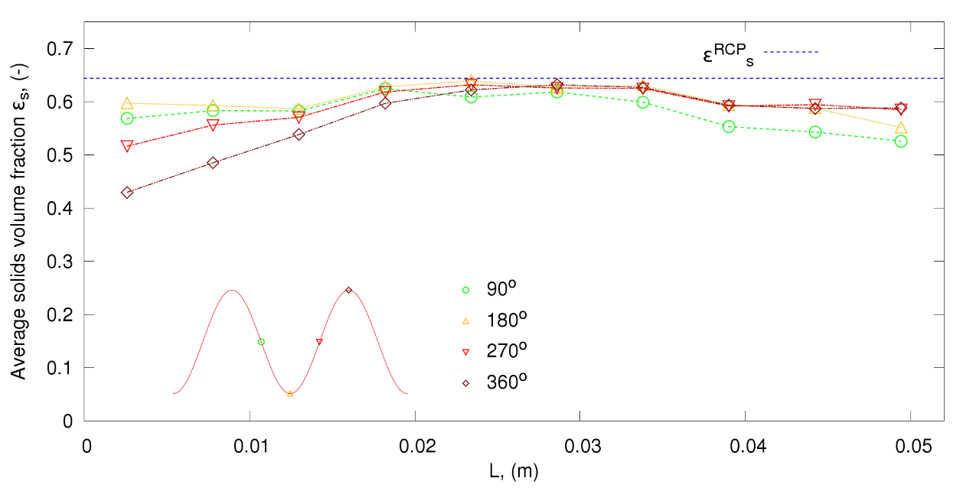
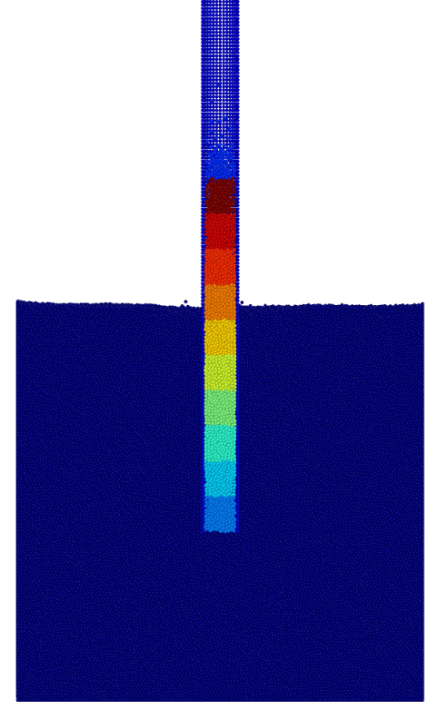
Solids volume fraction
10
5
1
The length of each section equals to the diameter of the tube.
The variation of the solid volume fraction of the lower sections create the chance of letting particles move inside.
The solids volume fraction of middle sections at four successive phases during one driving cycle doesn’t change much.
The jammed state of the middle section of the tube is the main cause of the particle climbing.

Slide 11
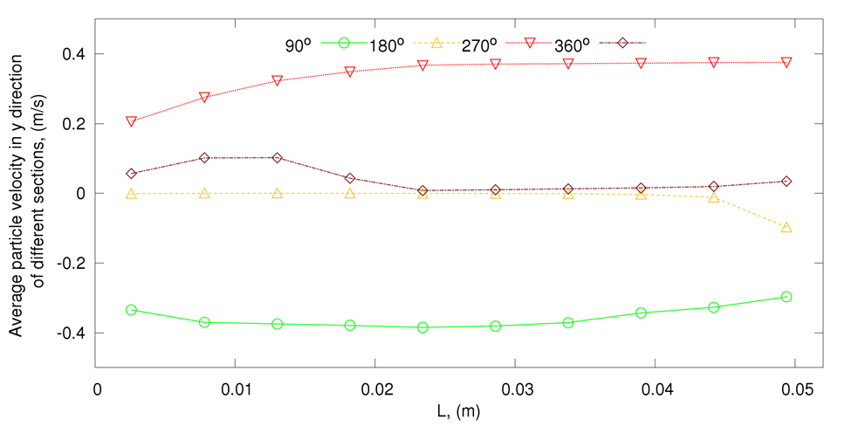
Average particle velocity
The average particle velocity of lower sections change a lot.
The average particle velocity of middle sections keep the same at certain phase.

Slide 12
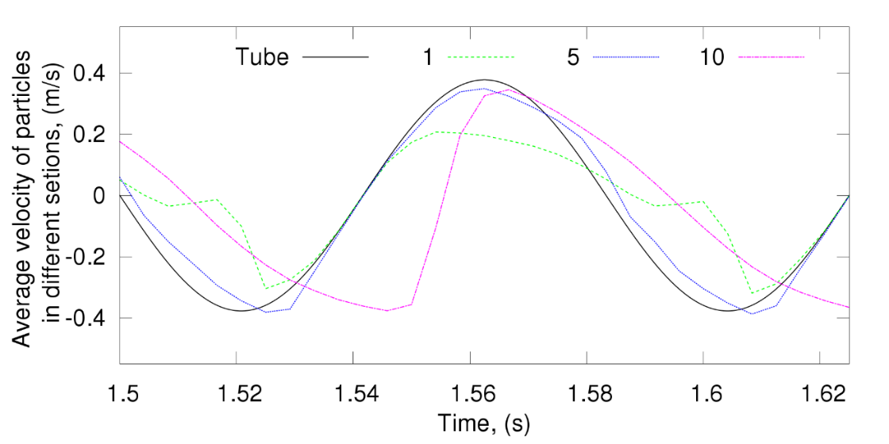
10
5
1
0º-90º, tube moves up, particles move up;
90º-180º, tube slows down (still up), due to inertia, particles slow down slowly.
While at the same time, particles fill the gap.
180º-360º, tube moves down, particles at the lower section become compacted and being pushed upward.

Slide 13
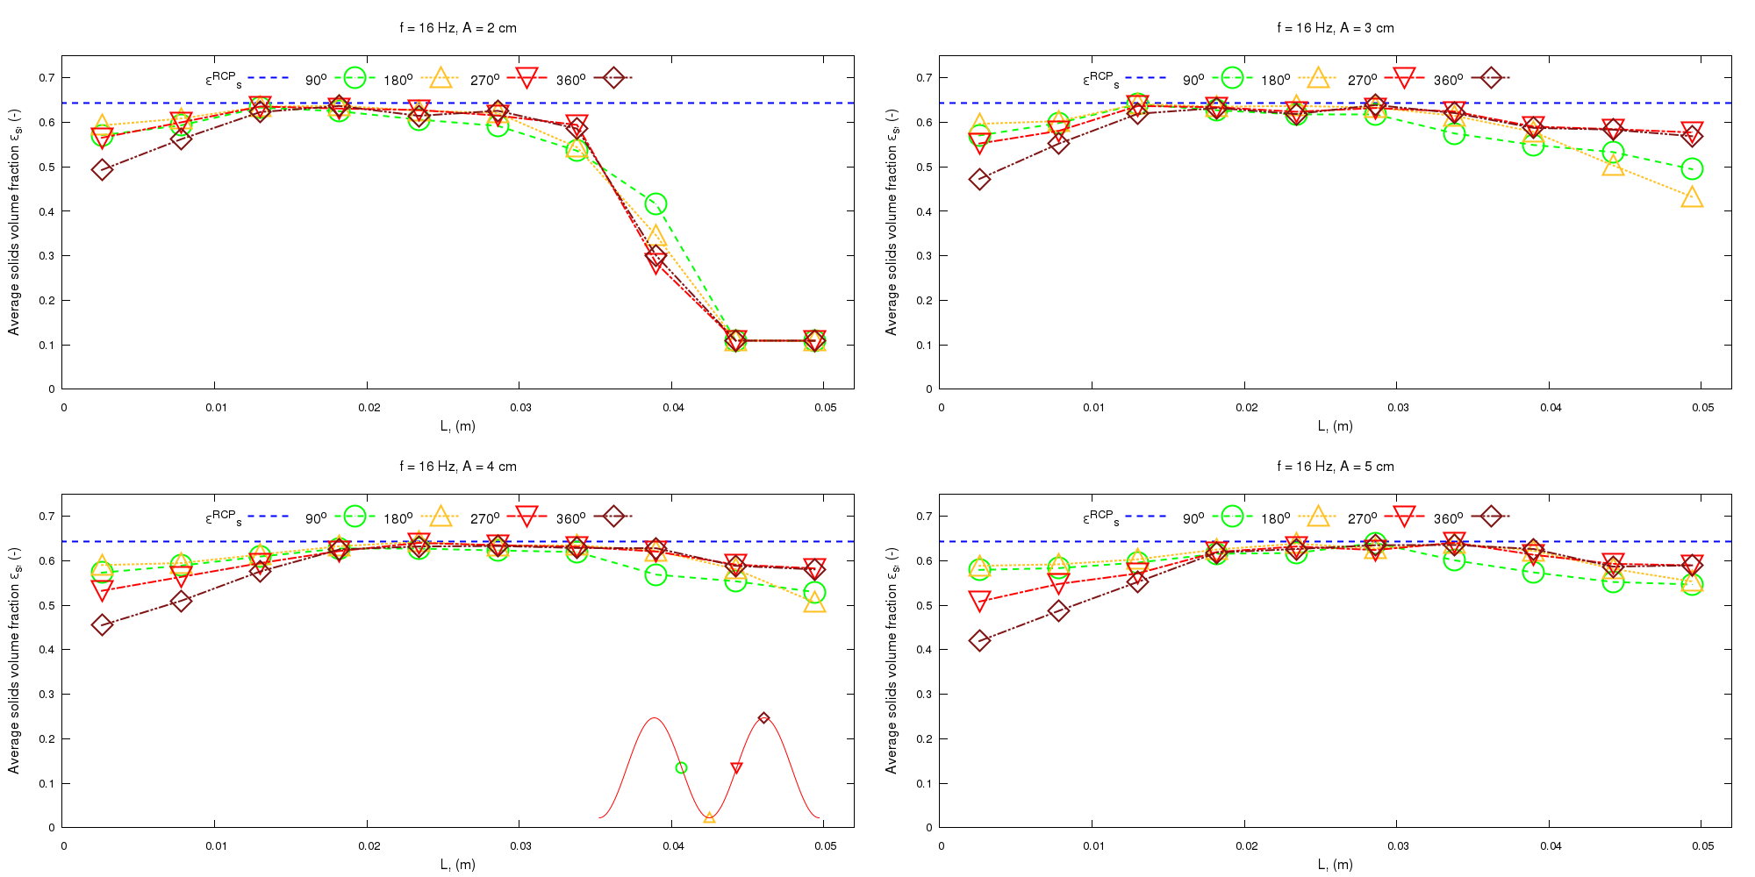
Influence of the amplitude A (f = 16 Hz)
Higher vibration amplitude create more void at the lower part of the tube, which can let the particles move inside the tube easily.
Higher vibration amplitude also create longer jammed region inside the tube.

Slide 14
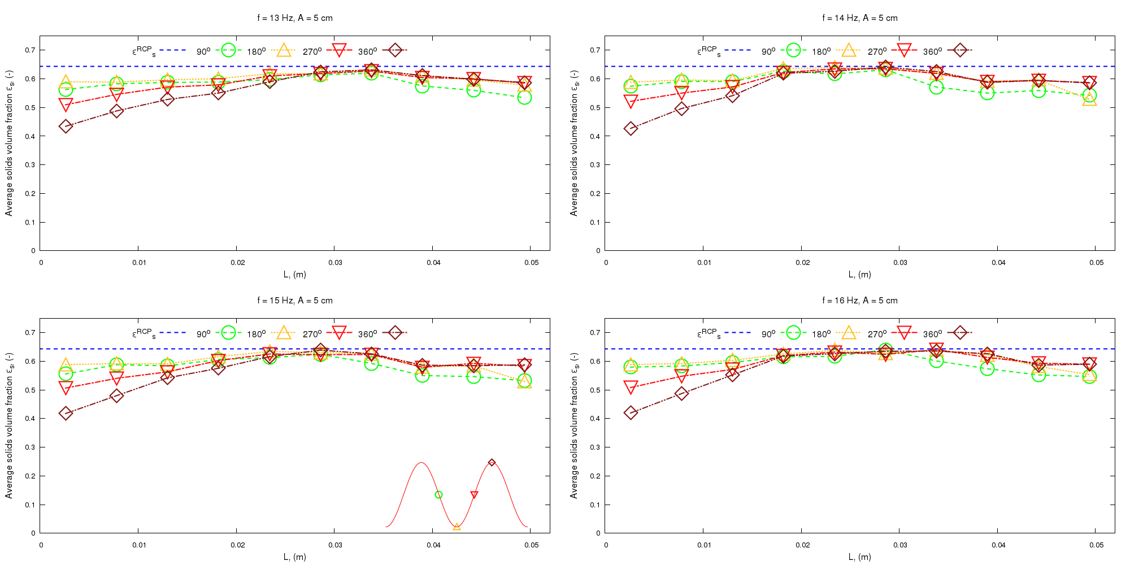
Influence of the frequency (A = 5 mm)
Higher vibration frequency also create longer jammed region inside the tube.

Slide 15
Conclusions
Kawamoto, H., Shigeta, A., &amp; Adachi, M. (2015). Utilizing electrostatic force and mechanical vibration to obtain regolith sample from the moon and mars. Journal of Aerospace Engineering, 29(1), 04015031.
Do it vigorously and quickly!

Slide 16
Thank you for your attention!

Slide 17











It’s All About a Clean, Affordable Energy Future
For More Information, Contact NETL
the ENERGY lab
Delivering Yesterday and Preparing for Tomorrow
National Energy Technology Laboratory
17

