Slide 1
Generic Framework for Modeling Radiative Heat Transfer in Gas-Solid Reacting Flows
Jian Cai
Assistant Professor
Department of Mechanical Engineering
University of Wyoming
jcai@uwyo.edu

Slide 2
Combustion Research at UW
New combustion group
3 junior faculty members
Expertise
Laser diagnostic and spectroscopy
Turbulent combustion (transported PDF)
Multiphase radiation
Heterogeneous reaction measurements

Slide 3
Radiative Transfer Equation
Emission
Absorption
Outbound Scattering
Inbound Scattering

Slide 4
Challenges
High dimensionality
3 spatial dimensions: CFD discretization
2 directional dimensions: RTE solvers
1 spectral dimension: spectral models
Regimes: dimensionless optical thickness
Extinction coefficient x length
Optically thin: emission dominates
Optically thick: mostly self absorbed
Unity optical thickness: strongest interactions

Slide 5
RTE solvers
Approximate directional variations
Spherical Harmonics (PN)
Discrete Ordinate Method (DOM)
Easy to extend to high orders
Expensive to model scattering
Photon Monte Carlo (PMC)
Random sampling
Expensive
Validation

Slide 6
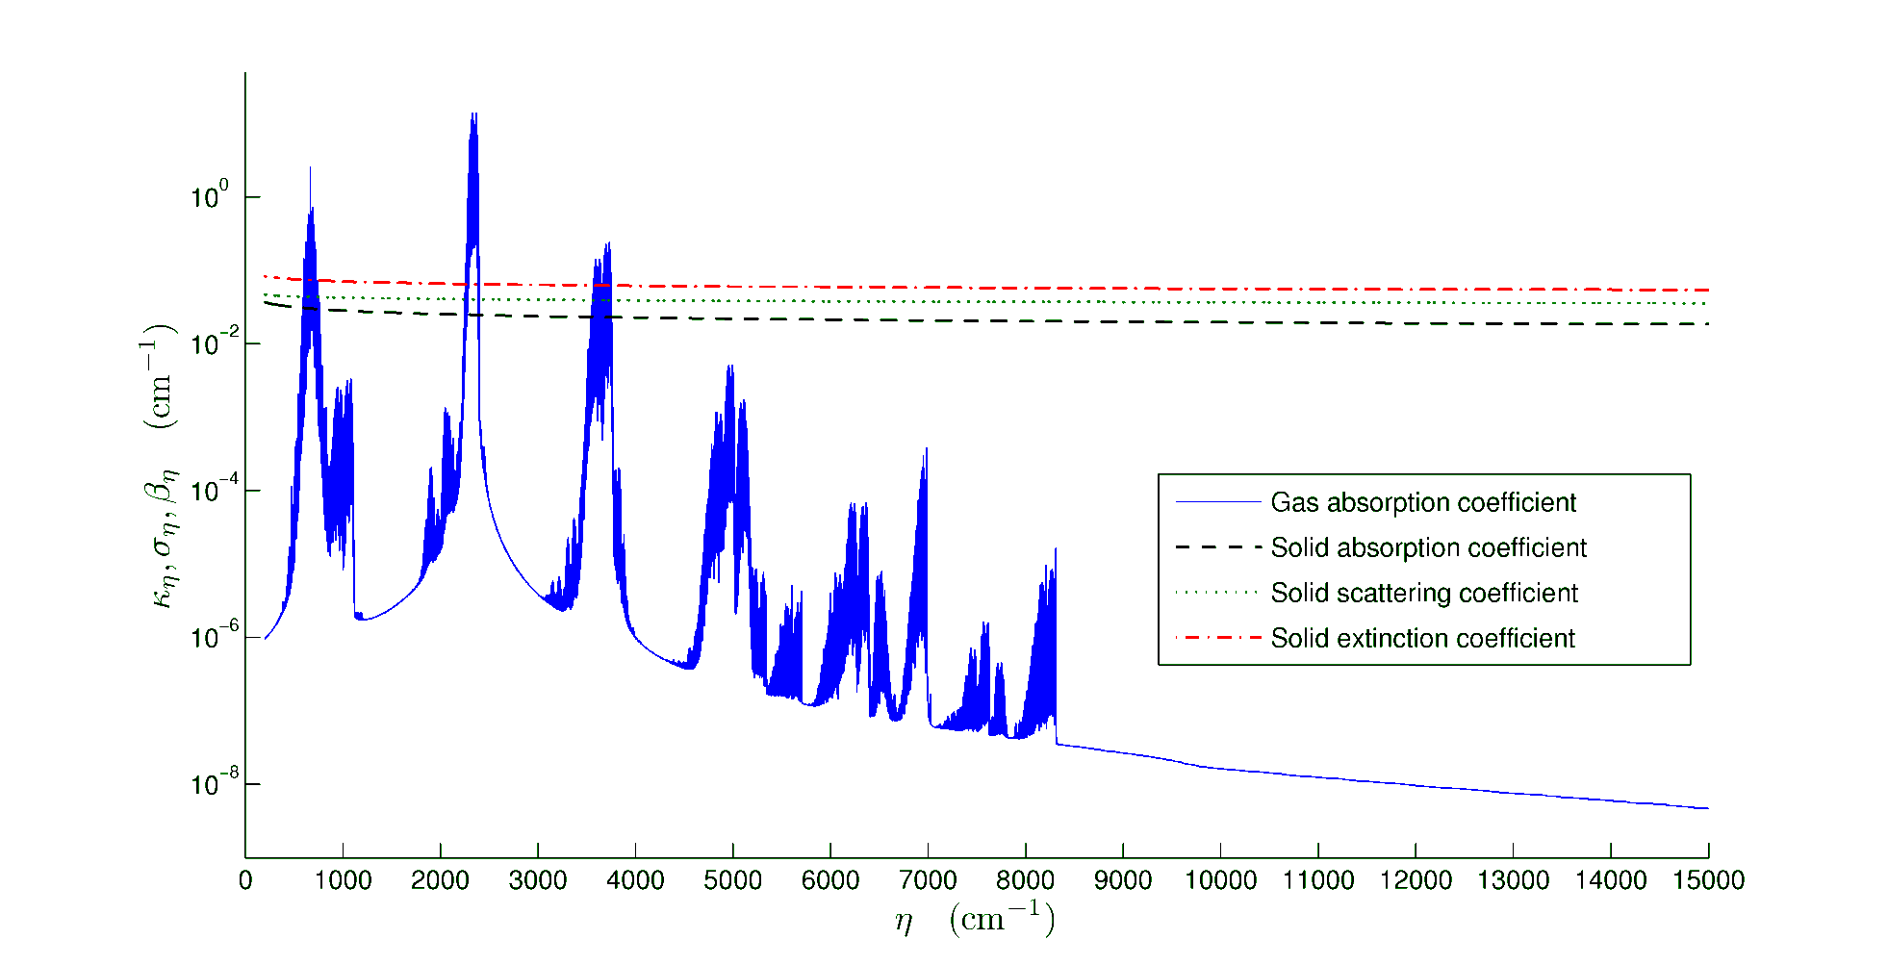
Spectral properties
Gas: abrupt variations, multi-scales
Particle: depends on refractive index, size
CO2 10% 600K, Particle m=2.2-1.12i, fv=0.001
Cai, Modest, Powder Tech. 265, 76-82, 2014

Slide 7
Spectral models
Gray
Neglect spectral variations
Line-by-line
Most accurate, accounts for all variations
Most expensive, ~10 million spectral evaluations
Non-gray reduced models
K-distribution methods
Absorption Line Blackbody Distribution Function (ALBDF)
Weighted Sum of Gray Gases (WSGG)

Slide 8
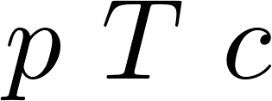
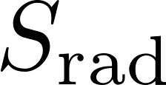
Generic Framework for Gas Radiation
Radiation-combustion interface
Gray
Flow fields previous step
K-Distribution
Spectral model
Line-by-line
Energy equation
RTE model
P1
Species equation
Pn
Momentum equation
DOM
Pressure equation
PMC

Slide 9
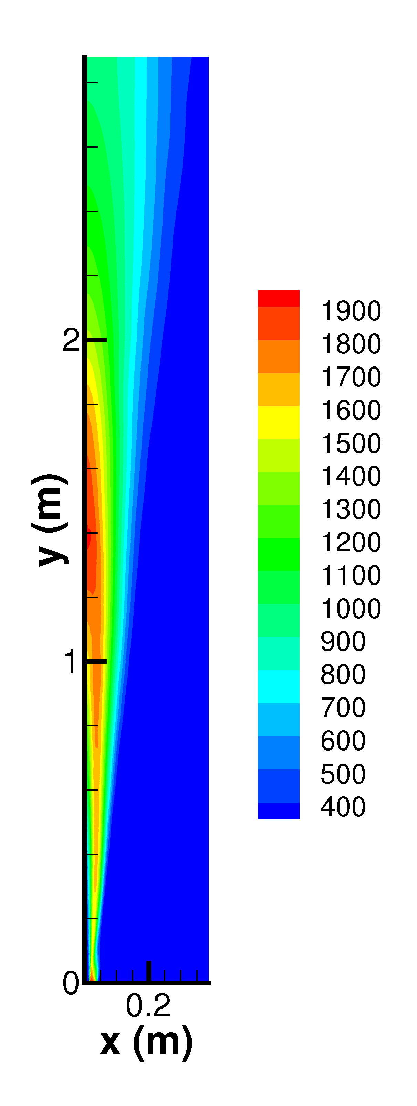
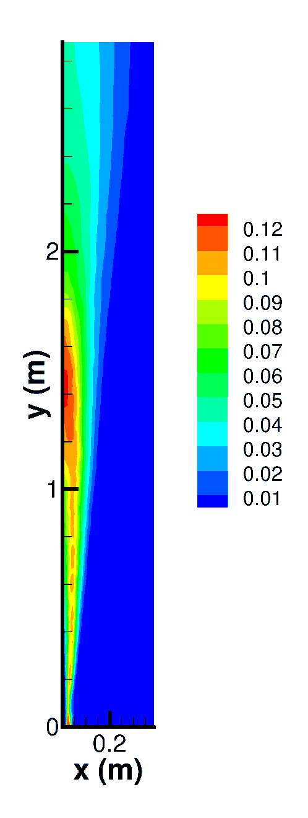
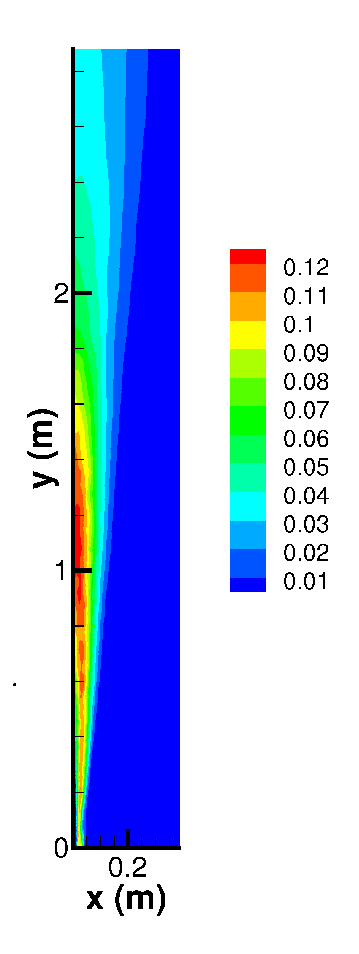
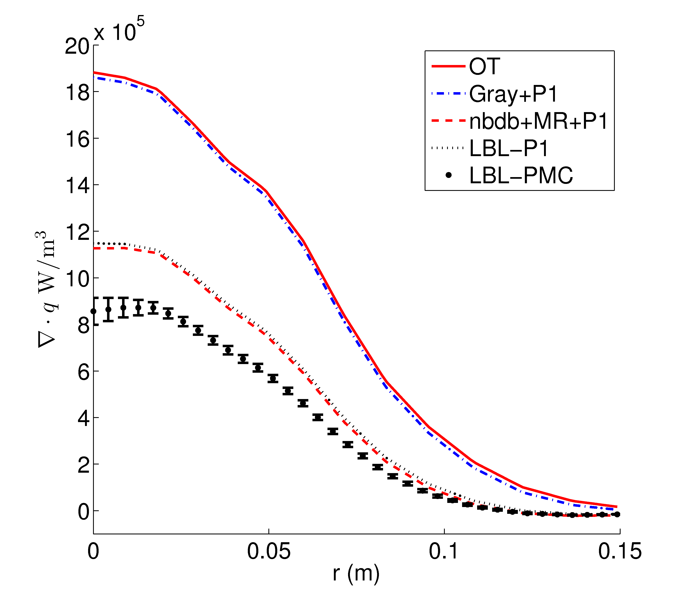
Comparing Models in Gas Flames
Investigate
Nongray self-absorption
Performance of k-distributions in inhomogeneous media
Performance of P1, SPn RTE solvers
Performance: accuracy, efficiency, robustness
T
CO2
H2O
Cai, Marquez, Modest, J. Heat Transfer. 136(11), 112702, 2014

Slide 10
Generic Framework for Gas-Solid Flows
RTE
Eulerian: Pn, DOM
Lagrangian: PMC
Code name | Carrier phase | Dispersed phase | Dispersed radiative properties | Additional averaging? | RTE
E-E-E-E | Eulerian | Eulerian | Eulerian | No | Eulerian
E-E-E-L | Eulerian | Eulerian | Eulerian | No | Lagrangian
E-L-E-E | Eulerian | Lagrangian | Eulerian | Yes | Eulerian
E-L-E-L | Eulerian | Lagrangian | Eulerian | Yes | Lagrangian
E-L-L-L | Eulerian | Lagrangian | Lagrangian | No | Lagrangian

Slide 11
Coal Flame Experiment
Pulverized coal
Lifted jet flame
Ignition by flue gas 1420 K
Re = 2500
Resembles major furnace flame features
E-L flame simulation with E-L-E-E radiation modeling
Coal
Air
Flue Gas

Slide 12
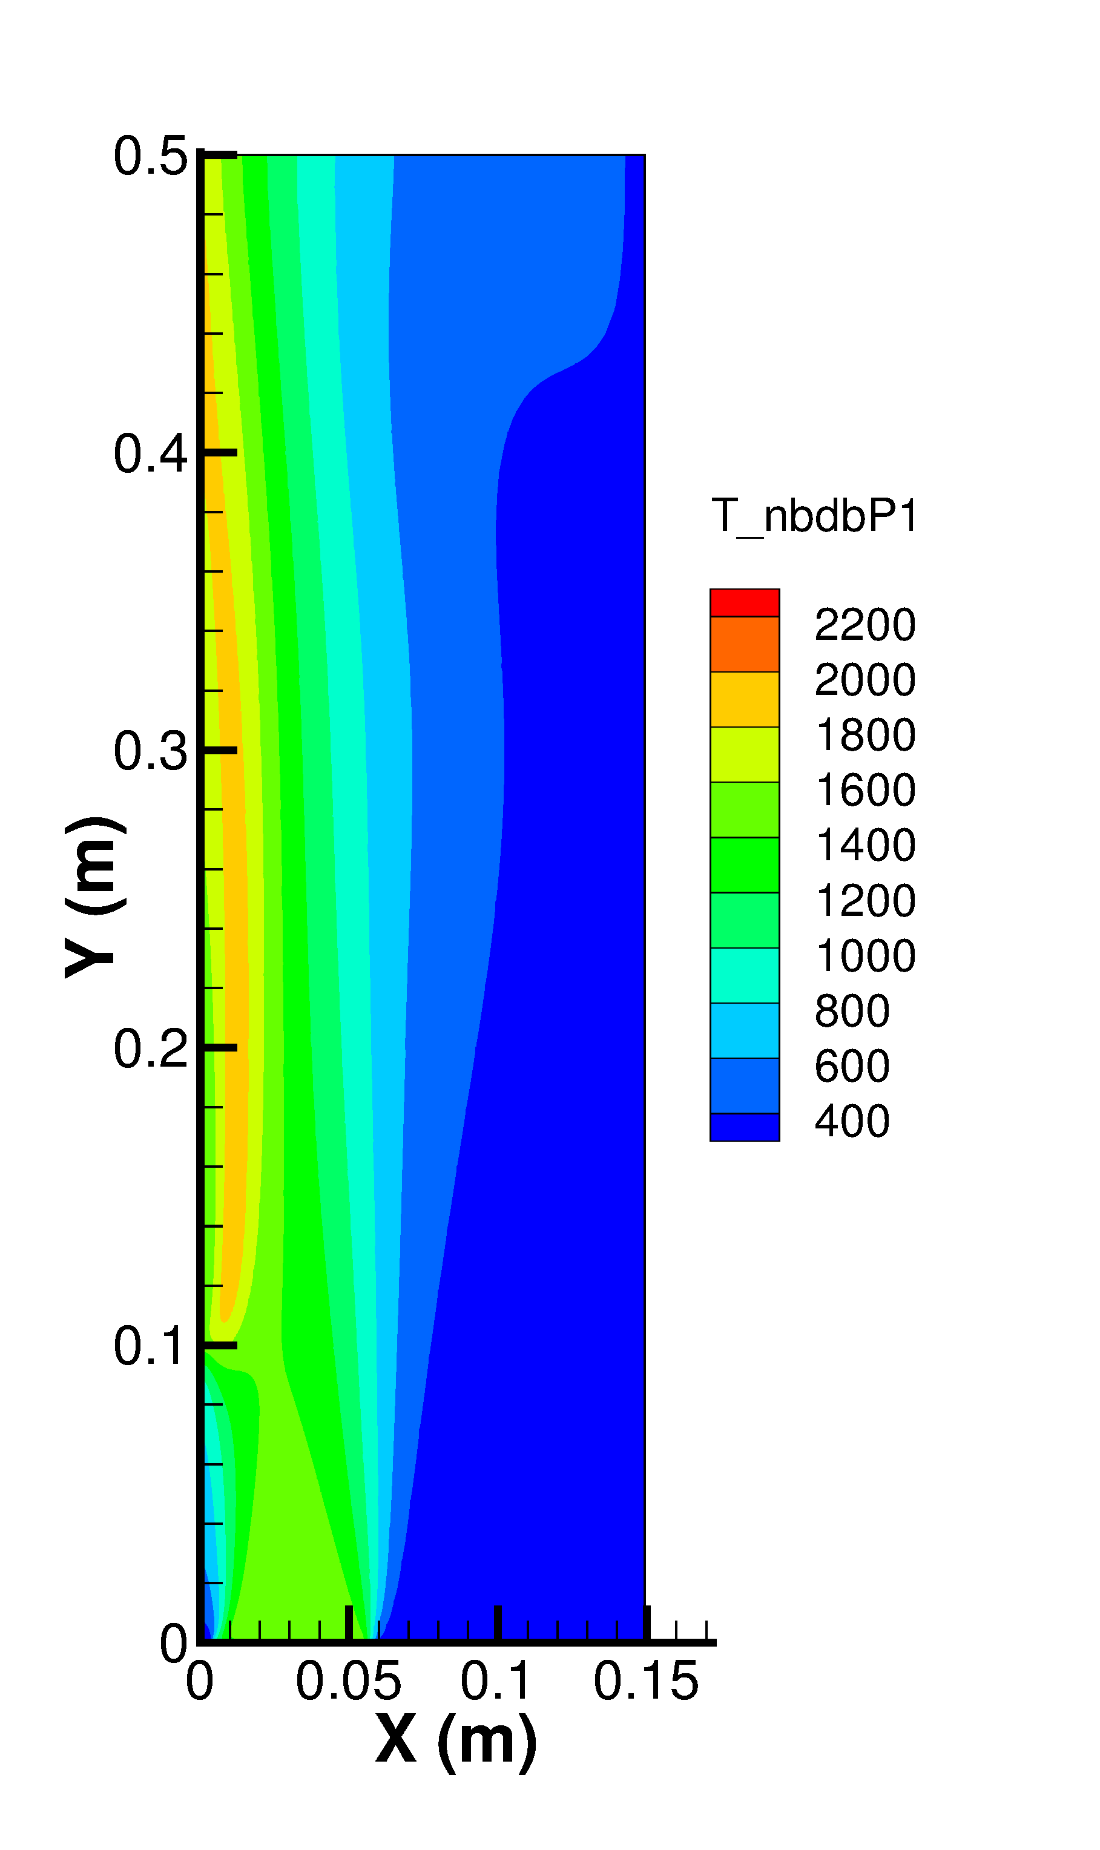
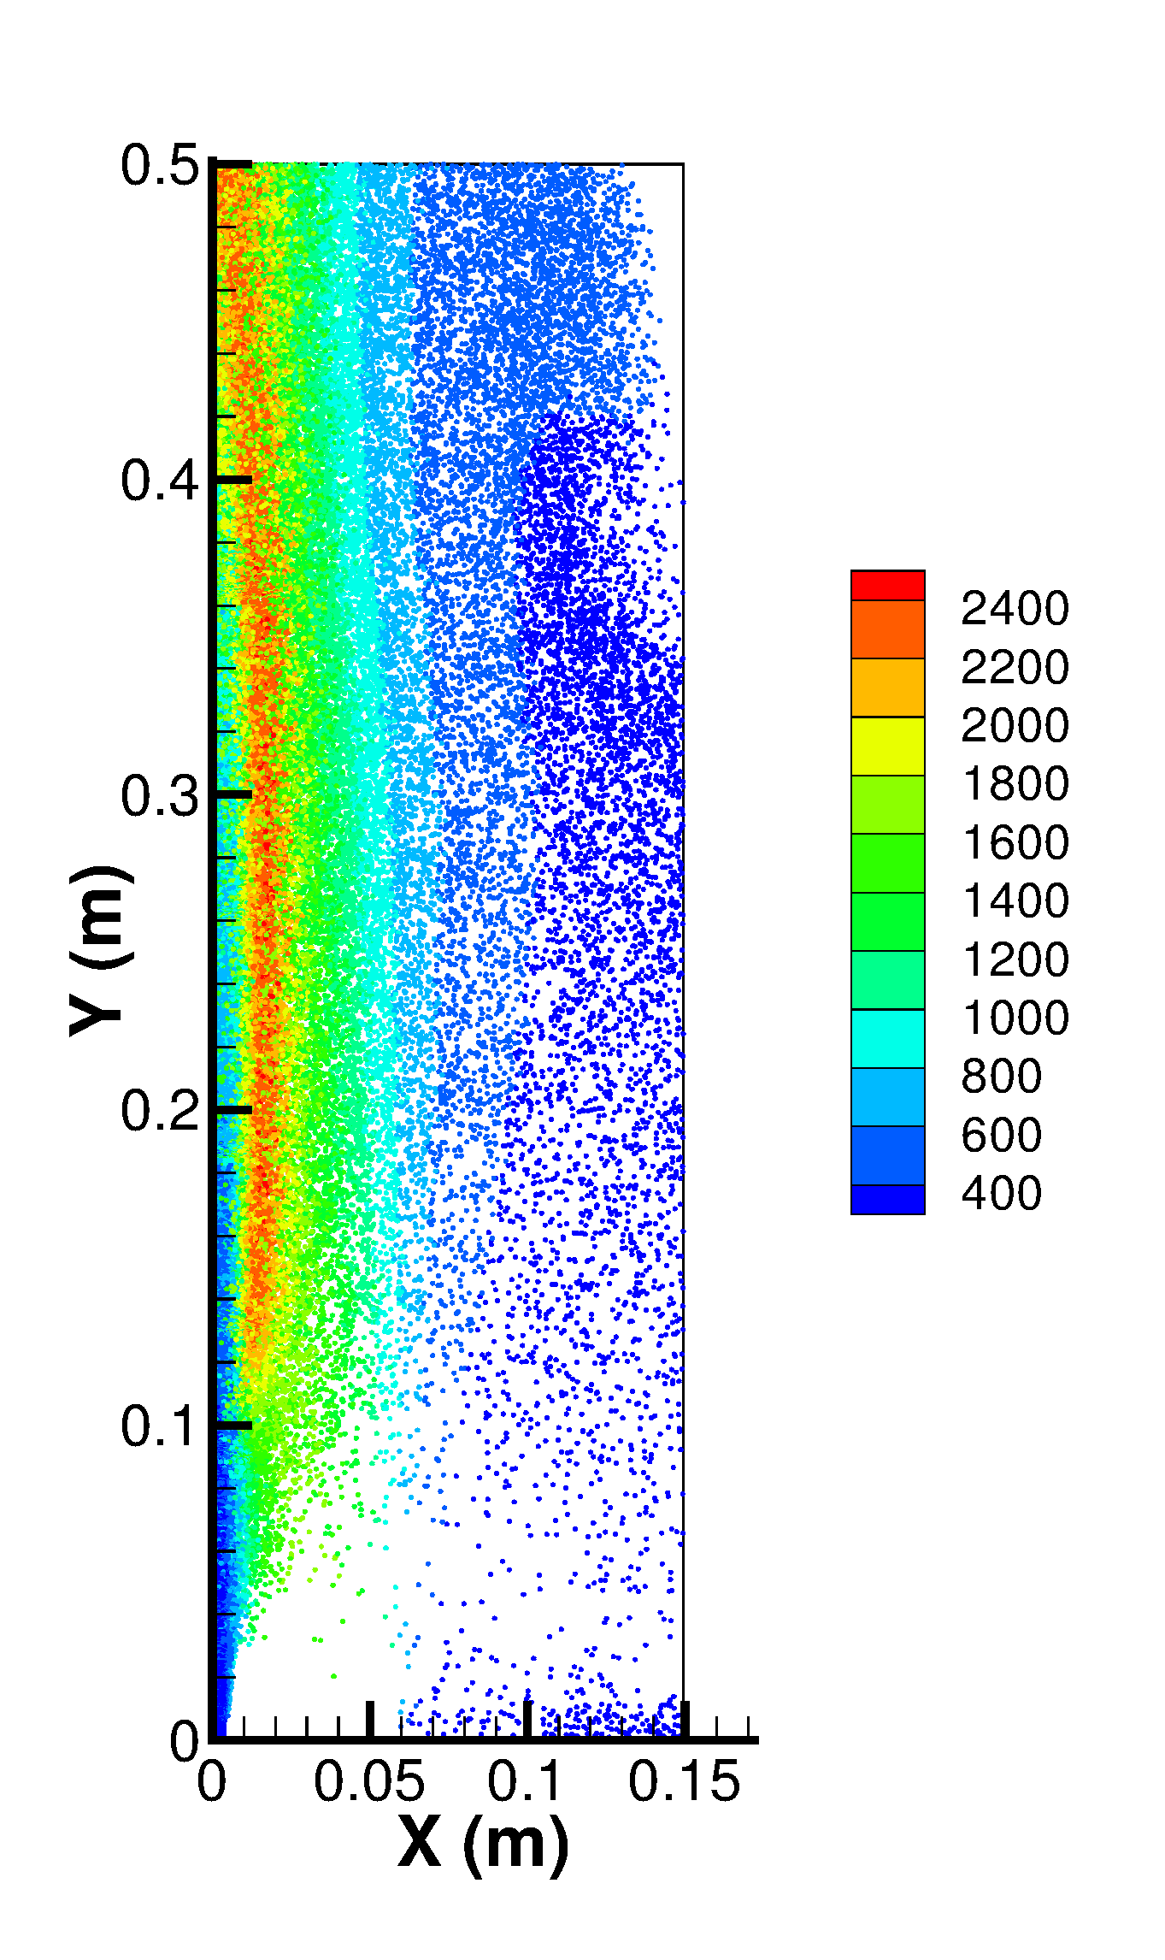
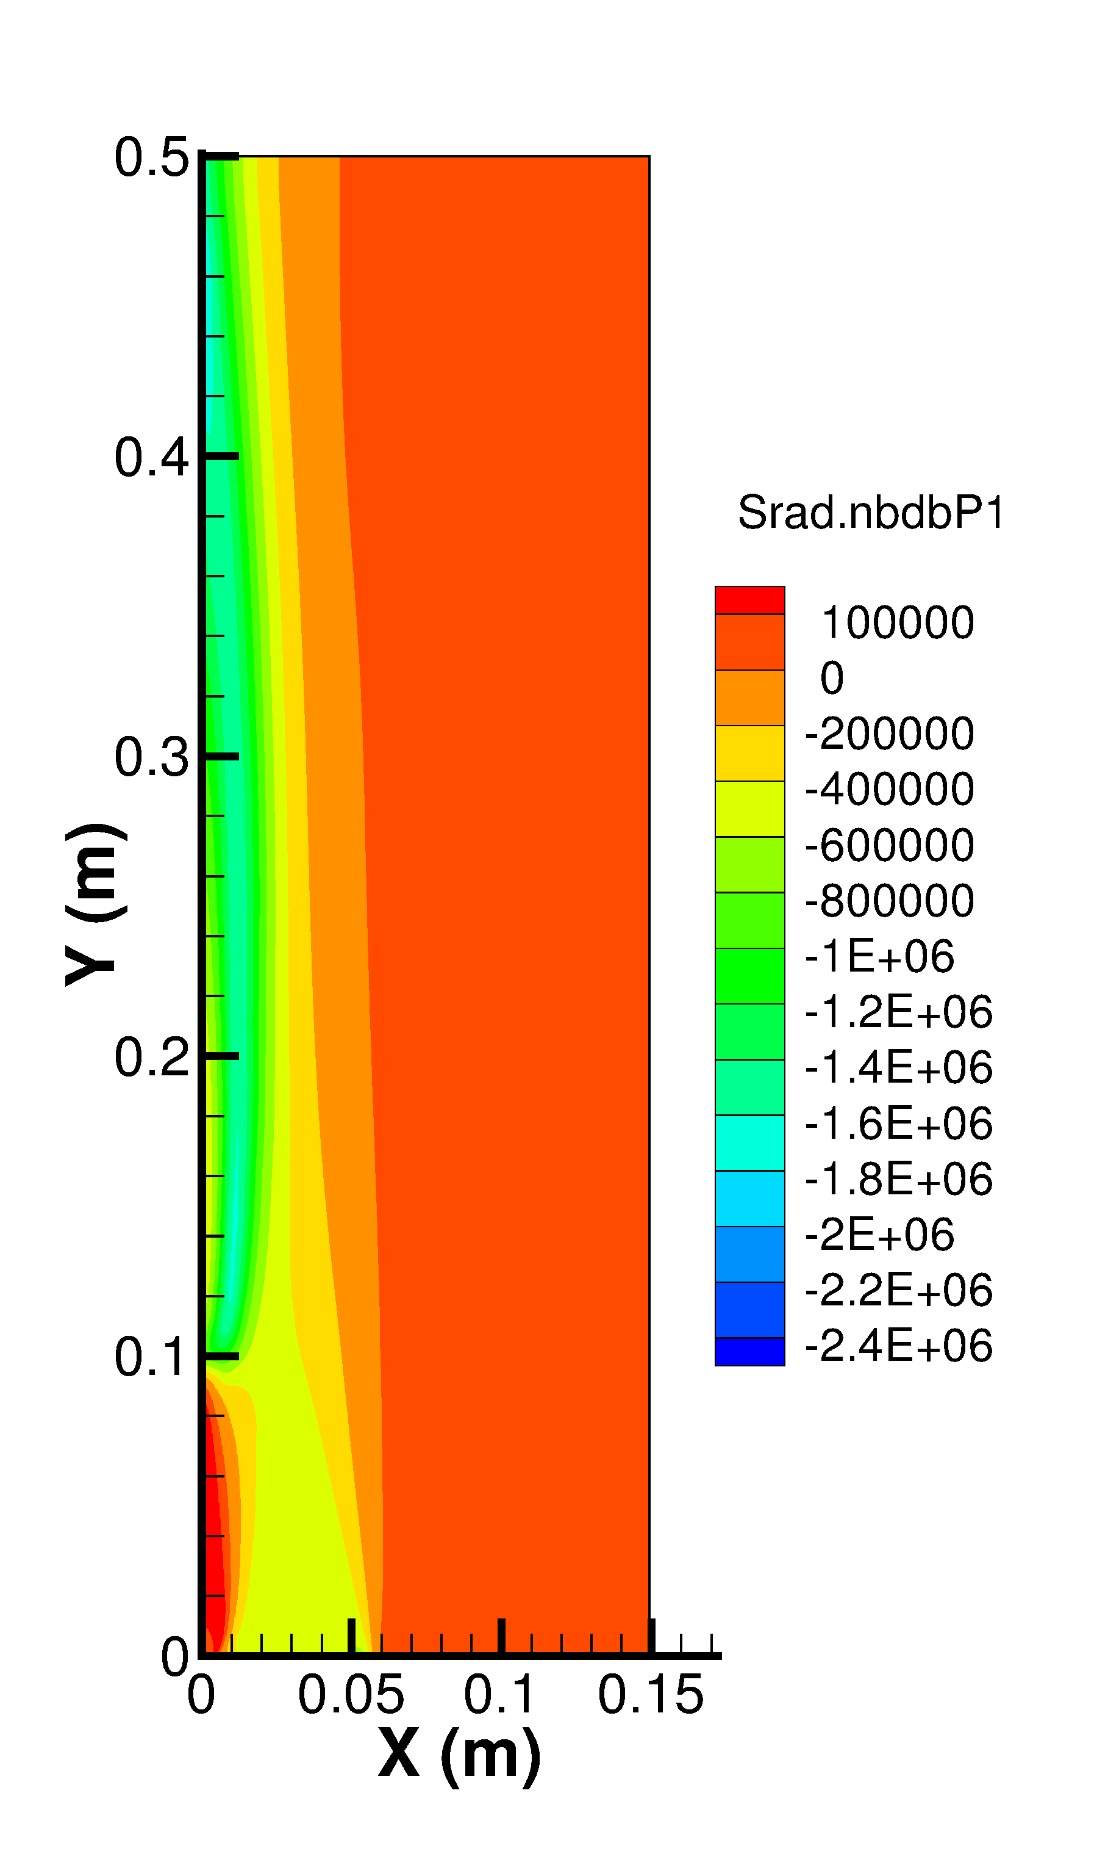
Temperature and radiative source
Cai, Zhao, Modest, Haworth, TFESC-12950, 2015

Slide 13
Pulverized coal flame
A similar coal ignition flame
Ignited by a methane flame
Close to optically thin
Significant radiative heat loss
E-E simulation
3 solid phases

Slide 14
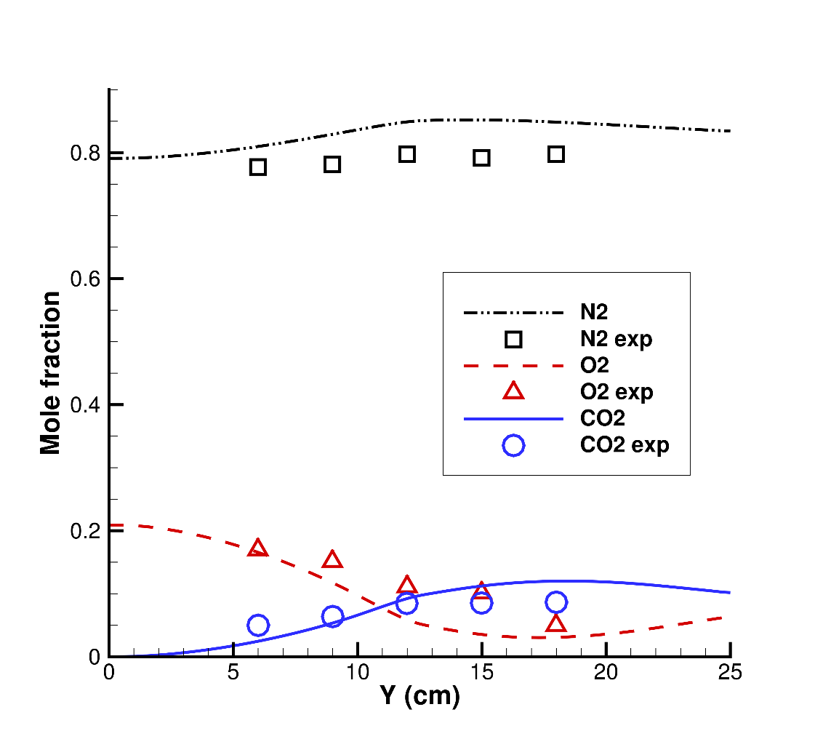
Good agreements with experiments
Cai, Handa, Modest, Combust. & Flame, 162(4), 1550-1565, 2015

Slide 15
Radiation impacts
Gas
Solid 16.6 um
24.8 um
35.9 um
Cai, Handa, Modest, Combust. & Flame, 162(4), 1550-1565, 2015

Slide 16
MFIX-RAD
Open source release
https://sourceforge.net/projects/mfix-rad/
MFIX-2016-1
Based on the generic framework
Capability
Gray spectral
P1 RTE

Slide 17
Conclusions
Radiation is important to flame simulations
Radiation model = Spectral + RTE models
Complicated model combinations for multiphase flows
Generic framework helps to organize models

