Slide 1
Endeavors to Improve Coarse Grained CFD-DEM Simulations Using Representative Particle Model
2016 NETL Workshop on Multiphase Flow Science
August 9-10, 2016, Morgantown, USA
Husam Elghannay¹, Kuahai Yu²
& Danesh Tafti¹
1. Mechanical Engineering Department
Virginia Polytechnic Institute and State University
2. Engineering Mechanics Department, Henan University of Science and Technology, Luoyang 471023, China

Slide 2
Outline
Numerical approach
Representative particle (RP) model
  validation case
Suggested methods to improve RP model predictions
  test on representative system
Improve trend prediction
  co-kriging surrogate model

Slide 3
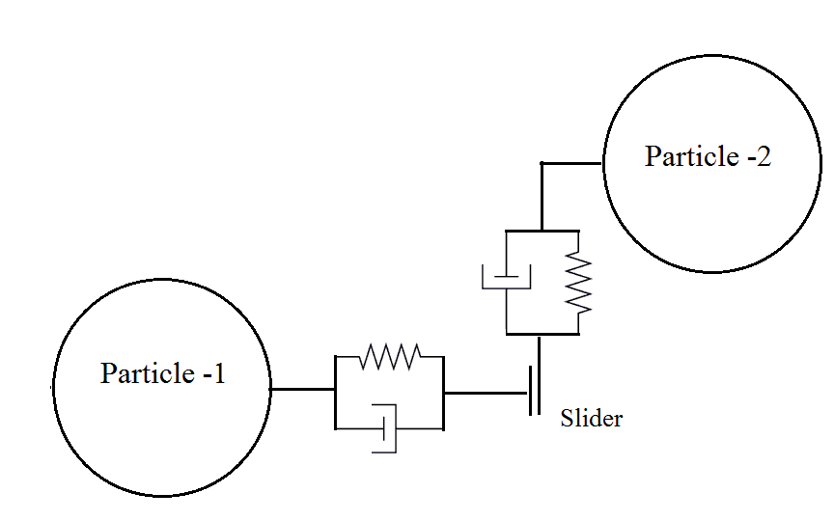
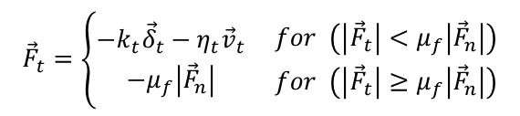


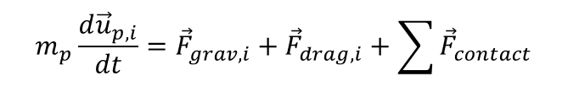
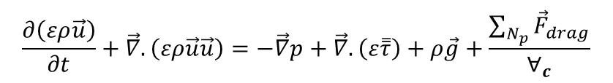
Numerical Approach (CFD-DEM)
$$\frac{∂\left(ερ\right)}{∂t}+\vec{∇}.\left(ερ\vec{u}\right)=0$$
GenIDLEST*
  in-house solver
DEM
  Drag: Ergun (ε<0.8) and Wen & Yu (ε>0.8)
  Collision: Soft sphere
CFD-DEM Simulations scale with N_{p}
$$\frac{∂\left(ερ\vec{u}\right)}{∂t}+\vec{∇}.\left(ερ\vec{u}\vec{u}\right)=−\vec{∇}p+\vec{∇}.\left(ε\overset{̿}{τ}\right)+ρ\vec{g}+\frac{\sum_{N_{p}}{{\vec{F}}_{drag}}}{∀_{c}}$$
$$m_{p}\frac{d{\vec{u}}_{p,i}}{dt}={\vec{F}}_{grav,i}+{\vec{F}}_{drag,i}+\sum{{\vec{F}}_{contact}}$$
$${\vec{F}}_{n}=−k_{n}{\vec{δ}}_{n}−η_{n}{\vec{v}}_{n}$$
$${\vec{F}}_{t}=\left\{\begin{aligned}−k_{t}{\vec{δ}}_{t}−η_{t}{\vec{v}}_{t} \\ −μ_{f}\left|{\vec{F}}_{n}\right|\end{aligned} \begin{matrix}for \left(\left|{\vec{F}}_{t}\right|<μ_{f}\left|{\vec{F}}_{n}\right|\right) \\ for \left(\left|{\vec{F}}_{t}\right|≥μ_{f}\left|{\vec{F}}_{n}\right|\right)\end{matrix}\right.$$
* Generalized Incompressible Direct and Large Eddy Simulation of Turbulence
Notes:
Incompressible flow solver

Slide 4
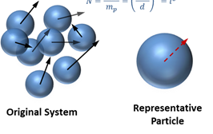

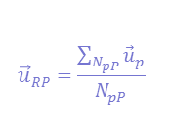
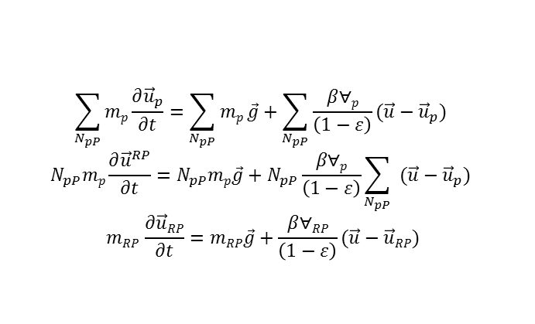
Representative Particle (RP) model
Particles are lumped together in representative entities
Currently used model
  particle and fluid properties are retained
  some point force models (e.g. drag) are adjusted
  when two RP collide, all internal particles make collisions
$$N_{pP}={\left(\frac{m_{RP}}{m_{p}}\right)}^{3}={\left(\frac{d^{RP}}{dp}\right)}^{3}$$
$$\vec{u}RP=\frac{\sum_{N_{pP}}{{\vec{u}}_{p}}}{N_{pP}}$$
$$\sum_{N_{pP}}{mp\frac{∂{\vec{u}}_{p}}{∂t}}=\sum_{N_{pP}}{mp}\vec{g}+\sum_{N_{pP}}{\frac{β∀p}{\left(1−ε\right)}(\vec{u}−{\vec{u}}_{p}) }$$
$$N_{pP}mp\frac{∂{\vec{u}}^{RP}}{∂t}=N_{pP}mp\vec{g}+N_{pP}\frac{β∀p}{\left(1−ε\right)}\sum_{N_{pP}}{ (\vec{u}−{\vec{u}}_{p}) }$$
$$mRP \frac{∂\vec{u}RP}{∂t}=mRP\vec{g}+\frac{β∀RP}{\left(1−ε\right)}(\vec{u}−\vec{u}RP)$$

Slide 5
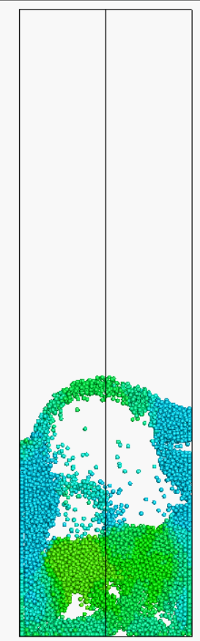
Validation case: Fluidized bed
Muller et al. (2009) Experiment
  44 mm × 160 mm × 10 mm
  U_{f}=0.9m/s (~3U_{mf})
Particles properties | l=1 | l=2 | l=3
Material | Poppy seeds
Diameter | 1.2 mm | 2.4 mm | 3.6 mm
# of particles | 9340 | 1168 | 346
Density | 1000 kg/m³
Friction coeff. | 0.1
Restitution coeff. | 0.9
Stiffness coeff. | 100 N/m | 800 N/m | 2700 N/m
Fluid properties (Air)
Density | 1.205 kg/m³
viscosity | 1.8 × 10⁻⁵ kg.m⁻¹s⁻¹
U_{f}
Notes:
Bubbling fluidized bed

Slide 6
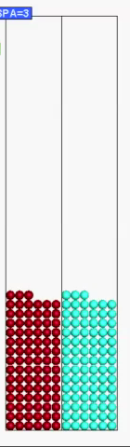
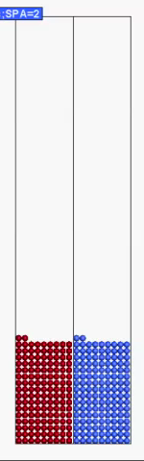
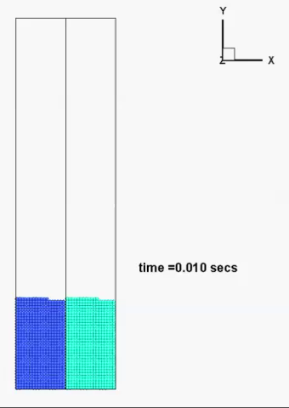
Comparison
l=3
l=2
l=1

Slide 7
Validation case
Average void fraction
Average solids velocity
ε
v_{p}/U_{f}
l=3
l=2
l=1
l=3
l=2
l=1

Slide 8
Reasons for deviation in results
Inherent reduction of mobility
  hard to recover
Collision frequency is not the same!
  internal particles collisions are not considered
  addressed by Benyahia & Galvin (2010)
Feedback/response to surrounding fluid
  e.g., flow events can dislodge one particles but not lumped particles

Slide 9

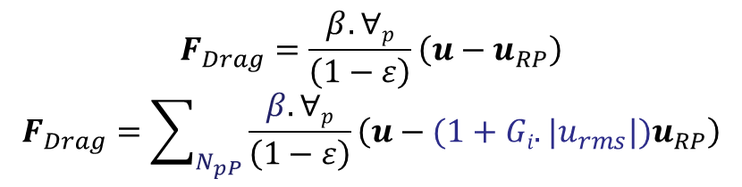
Attempts to improve RP predictions
Extrapolating parcel impact velocity at collision
Direct increase of energy dissipation through collisions
Random walks technique
  F_{RW}~ u_{p}-u_{p,av}
  F_{RW}~u_{p,rms}
Reassessment of drag force
F_{rand}=C_{RW}.G(u_{p}-u_{p,av})
u_{RP}’=u_{RP}+2a(r_{RP}-r_{p})
u_{RP}
$$F_{n}=−k_{n}δ_{n}−η_{n}u_{p,n}$$
$$F_{Drag}=\frac{β.∀p}{\left(1−ε\right)}\left(u−u_{RP}\right)$$
$$F_{Drag}=\sum_{N_{pP}}{\frac{β.∀p}{\left(1−ε\right)}\left(u−(1+Gi.|u_{rms}|)u_{RP}\right)}$$
Notes:
Goal is to increase mobility of the particles using field/particle properties. Conceptual, parameterized for coefficients

Slide 10
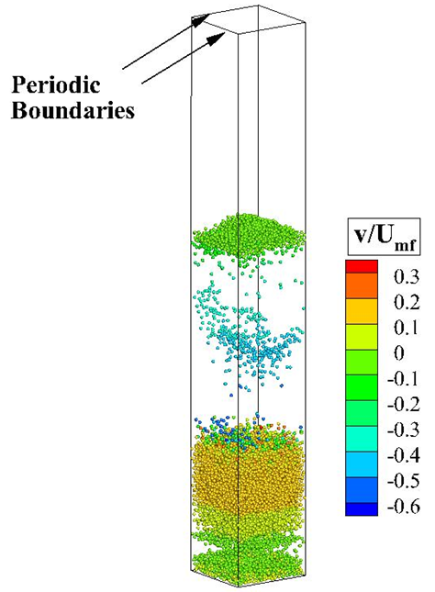
Test of suggested methods
Periodic fluidized-bed (no-side walls)
  18 mm × 150 mm × 18 mm
  particle properties as of Muller
  10164 particles
  U_{f}=1.5 m/s (~5U_{mf})
  l=1 vs. l=2
Fluid and particles are decoupled
Ideal (f=0.0, e=1) and dissipative (f=0.1,e=0.9) particles are tested

Slide 11
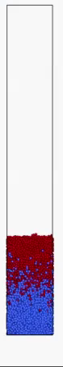
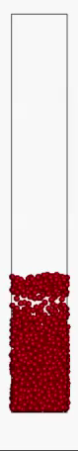
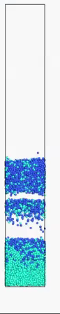
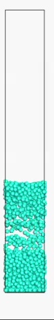
Animation of Results
f=0.0, e=1.0
f=0.1, e=0.9
l=1
l=2
l=1
l=2
Notes:
(e=1.0, f=0.0)

Slide 12
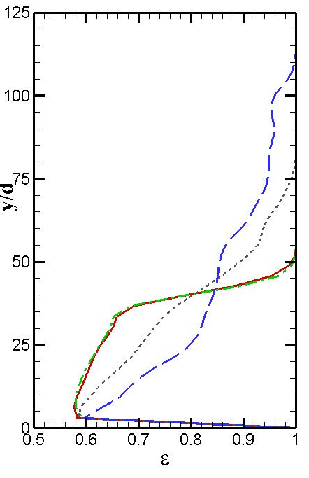
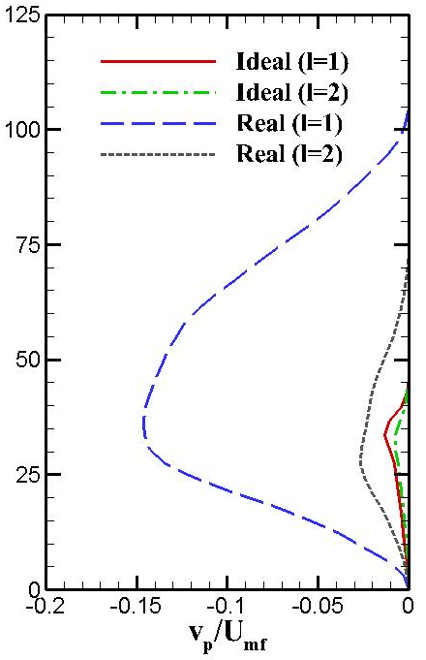
Averaged Base Results
Average void fraction
Average solids velocity
Notes:
For the selected case of fluidized bed, the deterioration of RP model prediction are mainly because of the unbalance in dissipation of energy rather than due to the inherent assumption of lumping particles

Slide 13
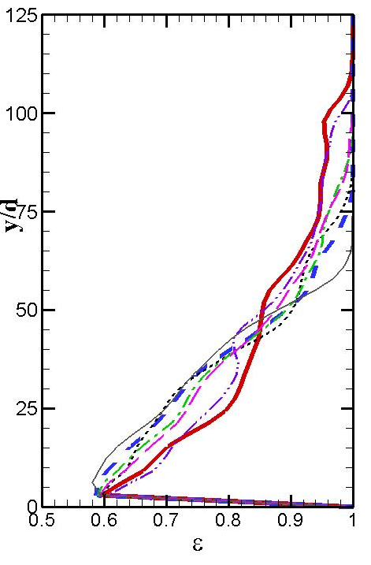
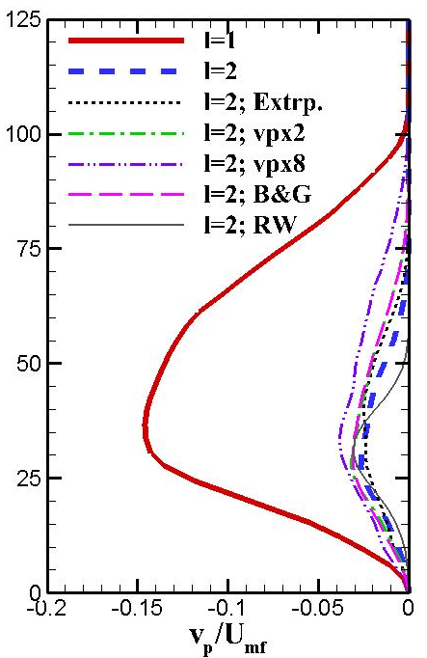
Test of suggested methods
(f=0.1, e=0.9)
Average solids velocity
Average void fraction

Slide 14
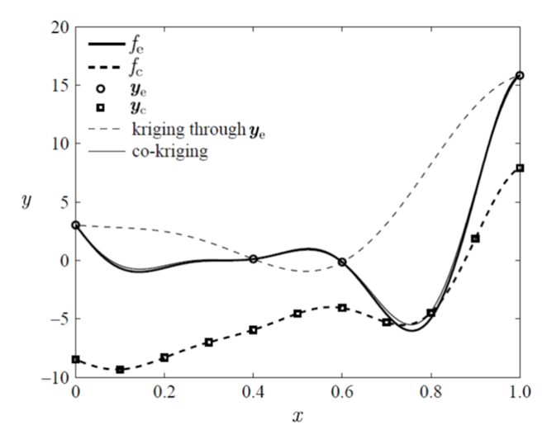

Improved trend
Co-kriging surrogate model is used (MATLAB ooDACE toolbox)
RP model predictions are treated as low fidelity points
Perform few unscaled (l=1) high fidelity simulations
Fig. Coukuyt, et al. 2013
MATLAB toolbox
Notes:
Kriging is a geostatistical interpolation method that is based on statistical models that include autocorrelations – that is, the statistical relationship among the measured points.

Slide 15
Test case: Sediment transport
Transport of sediment from essentially no motion to strong suspension
Parameter | value
Particle diameter | 0.5 mm
Coefficient of restitution | 0.01
Particle density | 2650 kg/m³
Friction Coefficient | 0.6
Stiffness coefficient | 100 (N/m)
Particle time step | 5.3x10⁻⁵ s

Slide 16
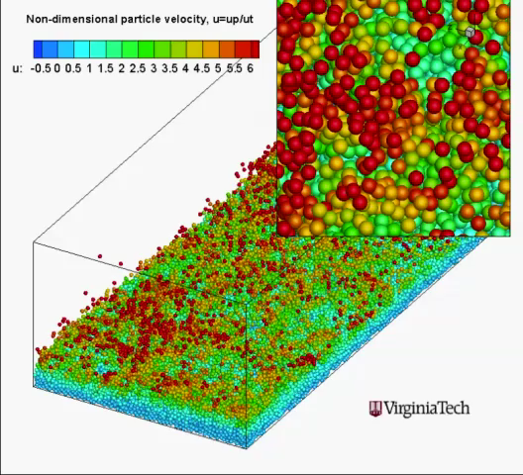
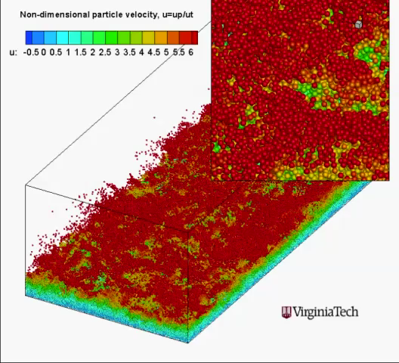
Results: Animation
Animation of Results
RP model (l=2)
Original size

Slide 17
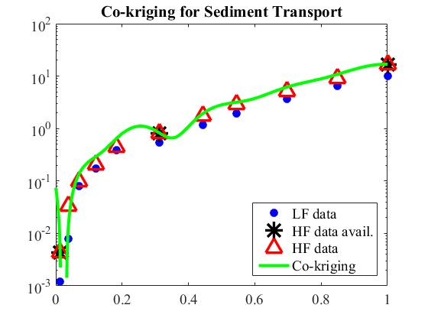
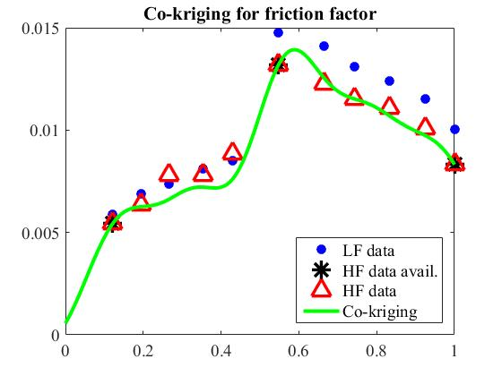
Fluidized bed case
Sediment transport
Friction factor

Slide 18
Summary
A number of (conceptual) methods are suggested (and parametrized) to recover part of the reduced RP model predictions.
Some of the suggested methods showed significant recovery of the reduction in bed height. The deviation in averaged solids velocity is not equally recovered.
A careful parametrization of a combination of these methods might be useful!
Large number of RP model simulation can be performed inexpensively and the overall trend of the system can be improved using Co-kriging surrogate model with few additional expensive (unscaled) calculations.

Slide 19
Acknowledgements
Libyan Ministry of Higher Education and Scientific Research
China Scholarship Council
Department of Mechanical Engineering at Virginia Tech

Slide 20
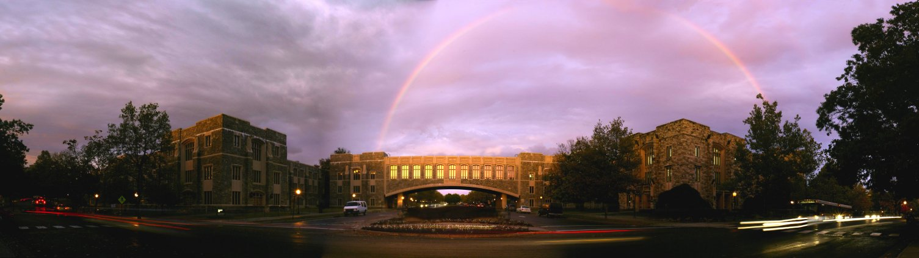



Thank You

Slide 21
References
Benyahia, S. and J.E. Galvin, Estimation of Numerical Errors Related to Some Basic Assumptions in Discrete Particle Methods. Industrial & Engineering Chemistry Research, 2010. 49(21): p. 10588-10605.
Coukuyt, I., T. Dhaene, and P. Demeester, ooDACE toolbox, a matlab kriging toolbox: getting started. J Mach Learn Res, 2013. 15: p. 3183-3186.
Sakai, M., et al., Large‐scale discrete element modeling in a fluidized bed. International Journal for Numerical Methods in Fluids, 2010. 64(10‐12): p. 1319-1335.
Müller, Christoph R., et al. "Validation of a discrete element model using magnetic resonance measurements." Particuology 7.4 (2009): 297-306.

Slide 22
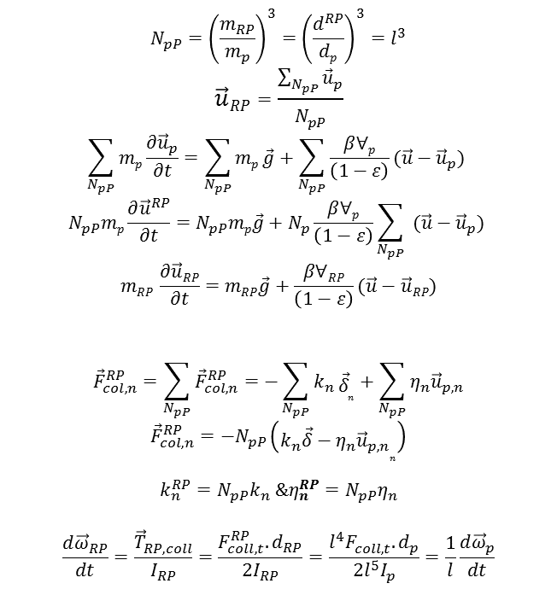
Model Assumptions and Formulation
Particle EOM assuming drag and gravity forces
  momentum exchange coefficient based on original particle diameter
Contact mechanics
  consider normal collision
  maintain the same overlap
Rotational motion
  indicated relation is obtained
$$N_{pP}={\left(\frac{m_{RP}}{m_{p}}\right)}^{3}={\left(\frac{d^{RP}}{dp}\right)}^{3}=l^{3}$$
$$\vec{u}RP=\frac{\sum_{N_{pP}}{{\vec{u}}_{p}}}{N_{pP}}$$
$$\sum_{N_{pP}}{mp\frac{∂{\vec{u}}_{p}}{∂t}}=\sum_{N_{pP}}{mp}\vec{g}+\sum_{N_{pP}}{\frac{β∀p}{\left(1−ε\right)}(\vec{u}−{\vec{u}}_{p}) }$$
$$N_{pP}mp\frac{∂{\vec{u}}^{RP}}{∂t}=N_{pP}mp\vec{g}+N_{p}\frac{β∀p}{\left(1−ε\right)}\sum_{N_{pP}}{ (\vec{u}−{\vec{u}}_{p}) }$$
$$mRP \frac{∂\vec{u}RP}{∂t}=mRP\vec{g}+\frac{β∀RP}{\left(1−ε\right)}(\vec{u}−\vec{u}RP)$$
$${\vec{F}}_{col,n}^{RP}=\sum_{N_{pP}}{{\vec{F}}_{col,n}^{RP}}=−\sum_{N_{pP}}{k_{n}}{\vec{δ}}_{n}+\sum_{N_{pP}}{η_{n}{\vec{u}}_{p,n}}$$
$${\vec{F}}_{col,n}^{RP}=−N_{pP}\left({k_{n}\vec{δ}−η_{n}{\vec{u}}_{p,n}}_{n}\right)$$
$${k_{n}^{RP}=N_{pP}k}_{n} \&η_{n}^{RP}=N_{pP}η_{n}$$
$$\frac{d{\vec{ω}}_{RP}}{dt}=\frac{{\vec{T}}_{RP,coll}^{}}{I_{RP}}=\frac{F_{coll,t}^{RP}.d_{RP}}{2I_{RP}}=\frac{l^{4}F_{coll,t}^{}.d_{p}}{2l^{5}I_{p}}=\frac{1}{l}\frac{d{\vec{ω}}_{p}}{dt}$$

Slide 23
Review on Coarse Graining Technique
Source Sakano 2000
1995 Kazari et al. used similarity model
2000 Sakano et al. Imaginary particle
2004 Kuwagi et al. SPA
2009 Sakai et al Coarse Grain Model
Source Mokhtar et al, 2012
Source Sakai et al, 2012 (for CG)
Notes:
1#Coarse Graining of particles was first Proposed by Kazari et al. on 1995. A larger particle replaces a group of particles but the density of the representative particle was decreased such that the mass of the large particle is equivalent to the small particle (rho_{RP}=rho_{p}/l³,l=d_{RP}/d_{p}). Similarity laws applied to the fluid to maintain Reynolds number (vd/nu) and Archimedes number (gL³rhp((rho/rho)-1)) to be the same between both systems. With the assumption that the solids density to fluid ratio (scaled/unscaled) is much larger one, we get RHO_f=l*rho_f (i.e., higher fluid density for coarse grained simulation, also MU_f=mu_f*l². The model was validated in a 2-D fluidized bed; however, good agreement has not obtained for the pressure drop or bubble behavior. Some investigators (Kawaguchi et. al 2002) attributes the reason to the unsuitability of the grid used. The same model was recently validated by different group (Kamaranian et al. 2014) on an experimental spouted fluidized bed (with central jet) were they reported agreement in the bubble size, the rising velocity was, however, smaller (l ranged from 10-16).
Liu et al (2013) also employed the use of similarity to coarse-grain CFD-DEM simulations. In their approach they retained the particle density but changed the fluid properties according to similarity laws (they also assumed the density of the solids to be much higher than the fluid density and end-up with the same relations above). More complicated use of similarity conditions was adapted by Wahsino et al (2007-paper in japanese) were the fluidization velocity (along with particle and fluid densities and fluid viscosity) is also changed for fluidized bed applications.
2# Sakano (2000 paper in Japanese) employed an imaginary particle with larger diameter and lower density. The particles were structures in Fcc arrangement (he did not show change in fluid properties!). Agreement on bubble size distribution above the distributed was reported in 2D fluidixed bed. Some investigators (Mokhtar et al. 2012) argue that the meaning of the assumed structure is not clearly described. This model was not used elsewhere.
3# This model was first presented in 2004 (Kuwagi et al.) and a description of the model can be found in (Mokhtar et al. 2012). In this model a representative system that occupy an equal space of the original system but uses lower number of particles and behaves the same. Accordingly d_{RP}=l*d_{p} (hence, l=n^{1/3}). In their formulation they compared the equation of motion for an original particle with that of l-times larger system (Equations 12 and 3 in Mokhtar et. al. 2012). They applied scaling laws directly to the particle-particle and particle-fluid interaction forces and concluded that the original particle diameter should be used in order to satisfy scaling laws (I should mention that at this point they did not show any explicit point mass forces expressions except the weight of the particles in their Equations of motions – their statement may not be so obvious from what they present and they did not actually show any treatment of collisions and rotational motion). The model showed good comparison for group-D and A particles (with adhesion force) when validated with fluidized bed (they recommended the use of scaling factor of 3 to maintain proper comparison –they got poor prediction for bubble size distribution with scaling factor of 6).
4# In this model a coarse grained particle represents a group of the original particles. Unlike other systems which focused on particle-fluid interaction (drag), this formulation provided scaling of the collision mechanics as well (the formulation that we use). A scaling relation of the rotational motion is also provided. The model was validated for pneumatic conveying system on 2009 and later in a psudo 3D fluidized bed system (2012). The model was also used/validated by Hilton &Cleary 2012 (we use this).

Slide 24
Kriging Surrogate Model
Kriging; Is an optimal prediction model to approximate noise-free data
  First fits data on a regression function f(x)
  Construct a stochastic -Gaussian- process Z(x) through the residuals
  Y(x)=f(x)+Z(x)
Cokriging; Exploit the correlation between fine and coarse model data to enhance the prediction accuracy
MATLAB toolbox
Notes:
https://www.youtube.com/watch?v=ewJ3AxKclOg
https://www.youtube.com/watch?v=0F0QoMCSKJ4

Slide 25
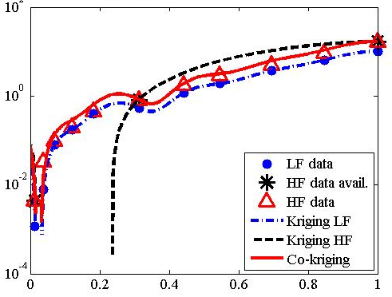
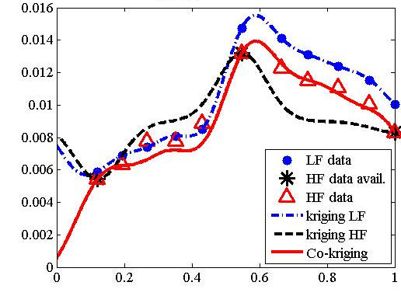
Fluidized bed case
Sediment transport
Friction factor

