Slide 1
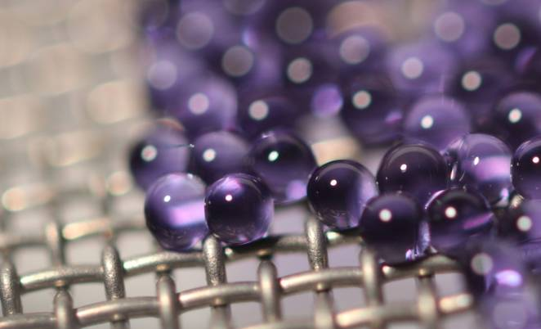

Simulating carbon capture with encapsulated carbonate solutions
A discrete particle model
Justin Finn^{1,2} & Janine Galvin¹
¹National Energy Technology Laboratory
²ORISE
NETL Workshop on Multiphase Flow Science
Marriott, Waterfront Place
Morgantown, WV
Tuesday August 8th, 2017
Image credit: John Vericella, LLNL
Notes:
This work is part of CCSI2: Carbon capture simulation for industry impact.
Image here is closeup of micro-encapsulated sodium carbonate solution (a common solvent for carbon capture):
This talk is going to cover a discrete particle CFD model we are developing to simulate their dynamics in various carbon-capture scenarios.

Slide 2
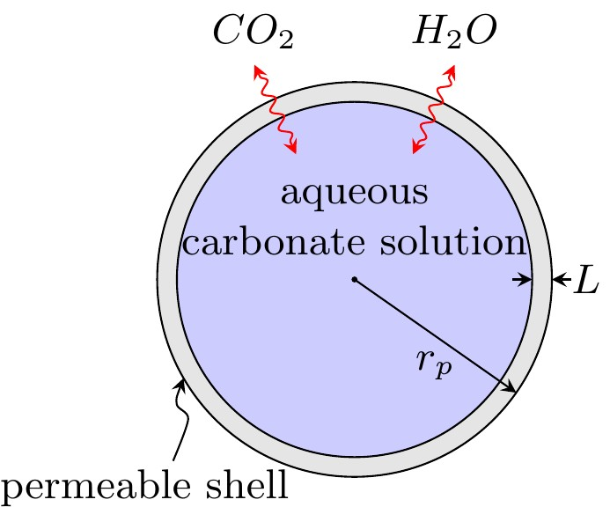
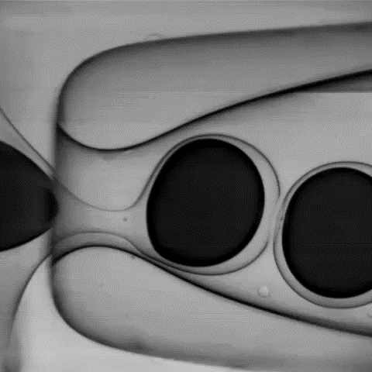
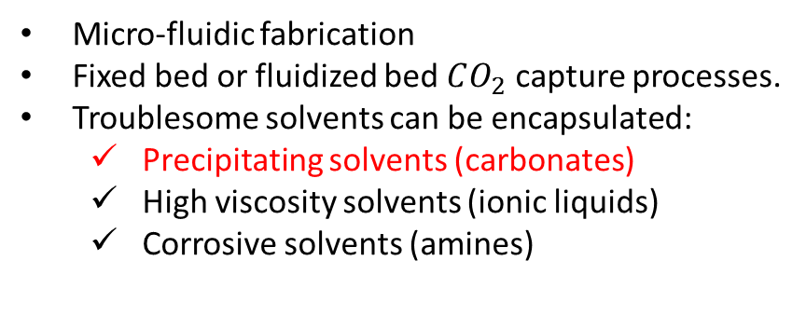
Micro-encapsulation for carbon capture
MECS: Micro-Encapsulated Carbon Sorbent¹
Combines benefits of solvents & sorbents
Solvents
  High Capacity
  High Selectivity
Sorbents
  High surface area
  Low volatility
Micro-fluidic fabrication
Fixed bed or fluidized bed $CO_{2}$ capture processes.
Troublesome solvents can be encapsulated:
  Precipitating solvents (carbonates)
  High viscosity solvents (ionic liquids)
  Corrosive solvents (amines)
FIG: Microfluidic MECS fabrication¹
FIG: MECS schematic
Process Design
CCSI² Goal: Enable device-scale predictive capability for CO2 capture using MECS technology to accelerate development and deployment.
Capsule size?
Fixed bed?
Solvent type?
Gas flow rate?
Fluidized bed?
Cooling tubes?
Circulating solids?
Reactor Dimensions?
Shell Thickness?
¹Vericella et al., Nature Comms, v. 6, 2015;
Notes:
Encapsulation of CO2 solvents is a very new technology, developed at LLNL (nature comms paper in 2015). Still at the very early stages of development
Fabrication on microfluidic chips
MECS potentially combine benefits of BOTH solvents and sorbents
Within CCSI2, our goal is to develop device scale CFD simulations that will aid in process development and eventual deployment of MECS technology in industry

Slide 3
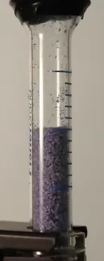







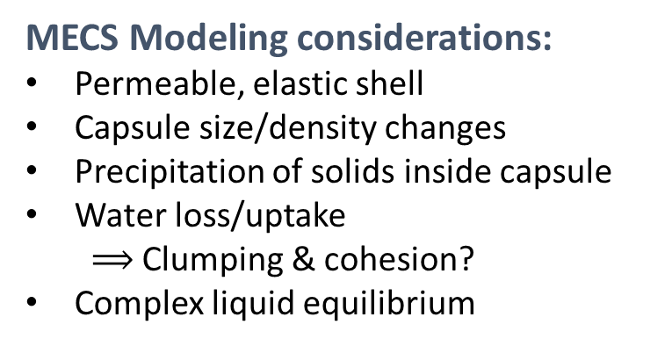





Modeling Challenges
MECS Modeling considerations:
Permeable, elastic shell
Capsule size/density changes
Precipitation of solids inside capsule
Water loss/uptake
  $⟹$ Clumping & cohesion?
Complex liquid equilibrium
4x Swelling in $H_{2}O$
FIG: Swelling of MECS capsules in water (Images from ¹)
$$CO_{2}$$
Absorption
$OH^{−}$(aq)
$$Na_{2}CO_{3}(s)$$
$$CO_{3}^{−−}(aq)$$
$$H_{2}O(l)$$
$$H_{3}O^{+}(aq)$$
$$CO_{2}(aq)$$
$$CO_{2}$$
Desorption
$$HCO_{3}^{−}(aq)$$
$Na^{+}$(aq)
$$NaHCO_{3}(s)$$
FIG: Cycling of sodium carbonate filled capsules between crystalized and aqueous states¹
FIG: Species in chemical equilibrium in sodium carbonate solutions
¹Vericella et al., Nature Comms, v. 6, 2015;
FIG: MECS fluidization¹
Notes:
To date, LLNL has really only pursued MECS filled with carbonate solutions, which have several unique features:
Water loss/uptake
Precipitation
Temperature & loading dependent chemical equilibrium
The observed behavior of these capsules poses several potential modelling challenges.
We really don’t know how MECS will behave hydrodynamically, especially when fluidized. Some clues are available from basic test from LLNL (video)

Slide 4
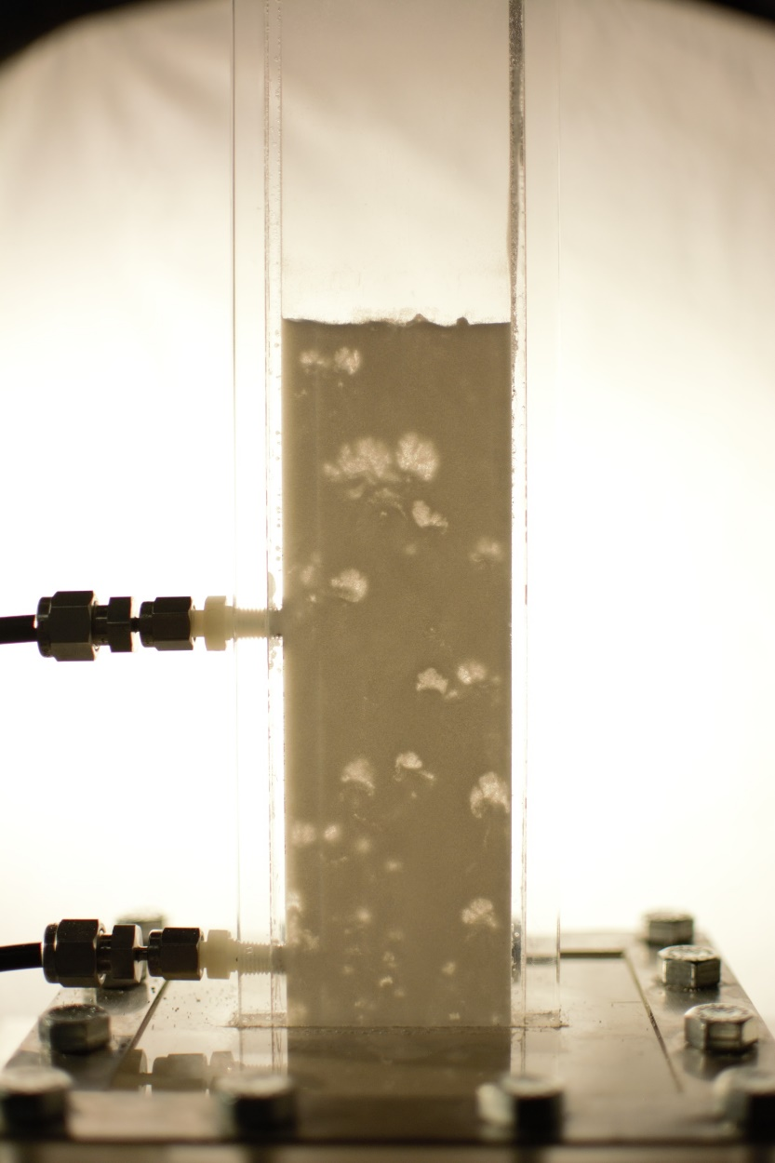
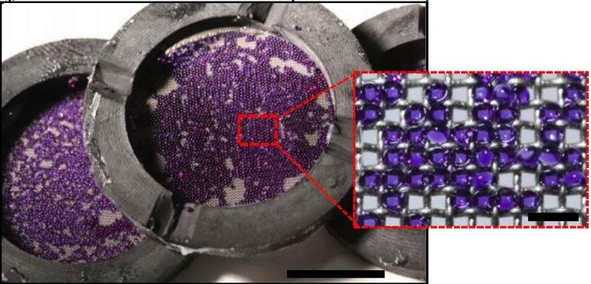
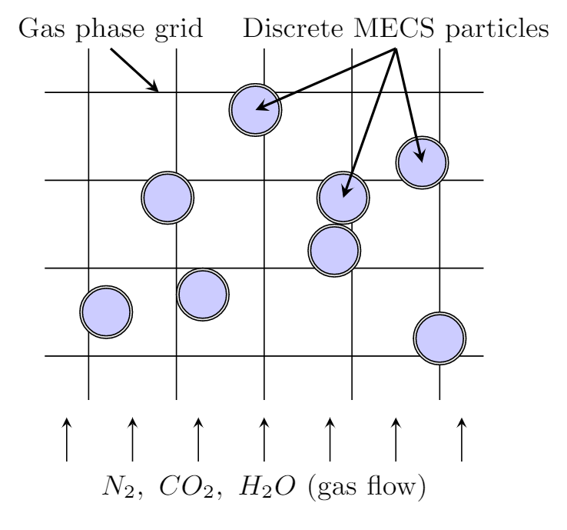
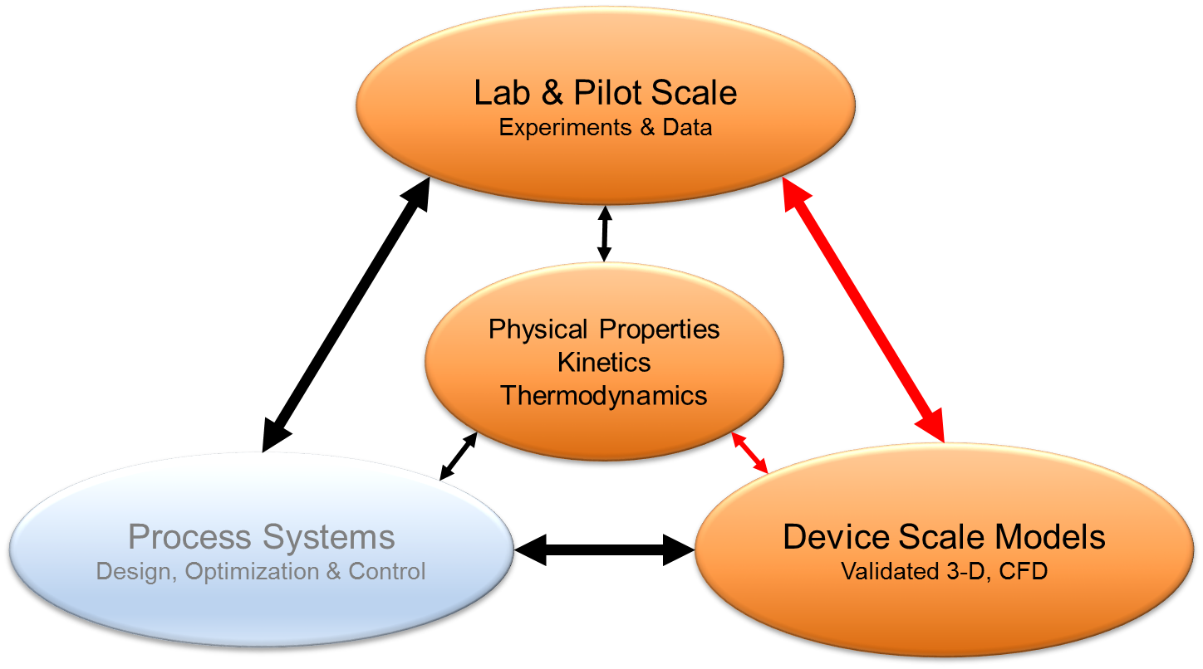
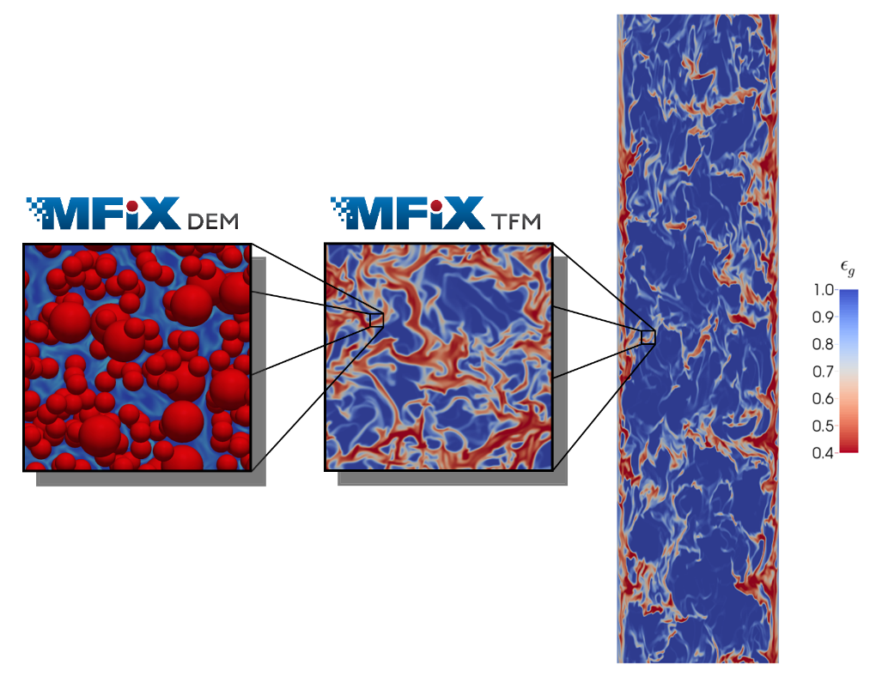

Approach
FIG: Discrete particle MECS model in MIFX-DEM
FIG: MECS in LLNL absorption chamber used to acquire basic data
FIG: NETL’s $μ$Fluidized Bed
FIG: Multi-scale simulation strategies in MFIX
Notes:
CCSI wants to enable MECS technology through different “tiers” of modeling
Many inputs required for CFD: Basic data, process constraints, etc
Idea is to start with MIFX-DEM at small lab scale, and eventually scale models up to device scale using MFIX-TFM
Considering MECS modeling challenges (size/density/composition changes), DEM is a more natural in DEM starting point: Lots of unknown behavior that we can examine more closely in dem
Eventual scale up of models to MFIX-TFM for device scale simulation
This is the CCSI2 big picture: Emphasize that a lot of moving parts are required to get a successful process design.

Slide 5
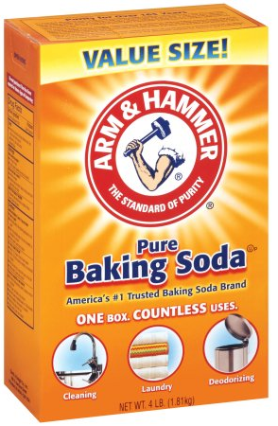
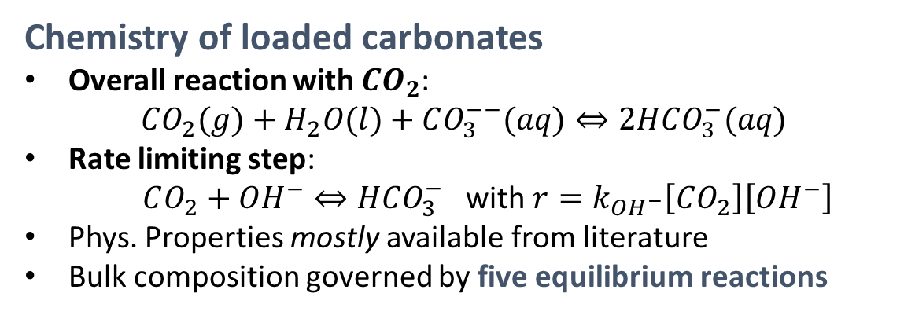
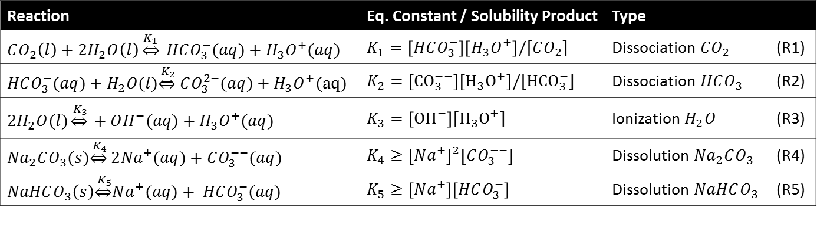
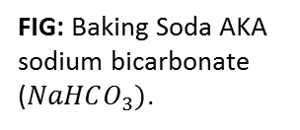
Carbonate solutions for carbon capture
Benefits of carbonates
Benign, abundant, and cheap!
Low regeneration (desorption) energy
Slow kinetics can be catalytically enhanced
Chemistry of loaded carbonates
Overall reaction with $CO_{2}$:
$$CO_{2}(g)+H_{2}O(l)+CO_{3}^{−−}(aq)⇔2HCO_{3}^{−}(aq)$$
Rate limiting step:
$CO_{2}+OH^{−}⇔HCO_{3}^{−}$ with $r=k_{OH^{−}}\left[CO_{2}\right]\left[OH^{−}\right]$
Phys. Properties mostly available from literature
Bulk composition governed by five equilibrium reactions
FIG: Baking Soda AKA sodium bicarbonate ($NaHCO_{3})$.
Tab: Liquid equilibrium reactions governing bulk composition of sodium carbonate solutions loaded with $CO_{2}$.
Reaction | Eq. Constant / Solubility Product | Type
$$CO_{2}\left(l\right)+2H_{2}O\left(l\right)\underset{⇔}{K_{1}} HCO_{3}^{−}(aq)+H_{3}O^{+}(aq)$$ | $$K_{1}=\left[HCO_{3}^{−}\right]\left[H_{3}O^{+}\right]/[CO_{2}]$$ | Dissociation $CO_{2}$ | (R1)
$$HCO_{3}^{−}(aq)+H_{2}O(l)\underset{⇔}{ K_{2}} CO_{3}^{2−}(aq)+H_{3}O^{+}(aq)$$ | $$K_{2}=\left[{CO}_{3}^{−−}\right]\left[H_{3}O^{+}\right]/[{HCO}_{3}^{−}]$$ | Dissociation $HCO_{3}$ | (R2)
$${2H}_{2}O(l)\underset{⇔}{ K_{3}} +OH^{−}(aq)+H_{3}O^{+}(aq)$$ | $$K_{3}=\left[{OH}^{−}\right][H_{3}O^{+}]$$ | Ionization $H_{2}O$ | (R3)
$${Na}_{2}CO_{3}(s)\underset{⇔}{ K_{4}} 2{Na}^{+}(aq)+CO_{3}^{−−}(aq)$$ | $$K_{4}≥{\left[Na^{+}\right]}^{2}\left[CO_{3}^{−−}\right]$$ | Dissolution ${Na}_{2}CO_{3}$ | (R4)
$$NaHCO_{3}\left(s\right)\underset{⇔}{ K_{5}}Na^{+}(aq)+ HCO_{3}^{−}(aq)$$ | $$K_{5}≥\left[Na^{+}\right]\left[HCO_{3}^{−}\right]$$ | Dissolution $NaHCO_{3}$ | (R5)
Notes:
LLNL chose carbonates, as there are some good reasons to look at this as a solvent. Precipitation is why carbonates are typically a problem, encapsulation allows a way around this problem.
Overall reaction of CO2 with carbonate to form Bicarbonate
Rate limiting step is reaction reaction with OH ion, with second order kinetics.
So… We need to know the concentration of [OH], which is governed by several equilibrium reactions.
It was not possible to obtain stable solution for instantaneous, liquid phase equilibrium reactions in traditional MFIX chem framework, so we implemented our own Equilibrium chemistry solver

Slide 6
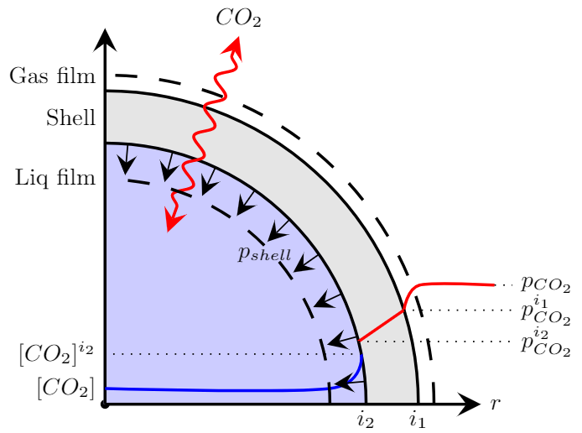
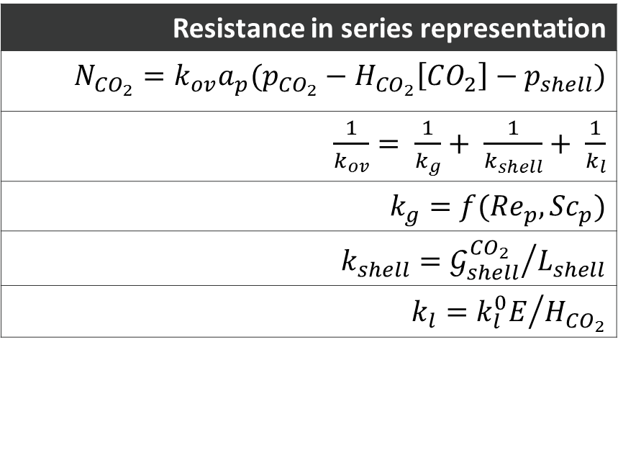
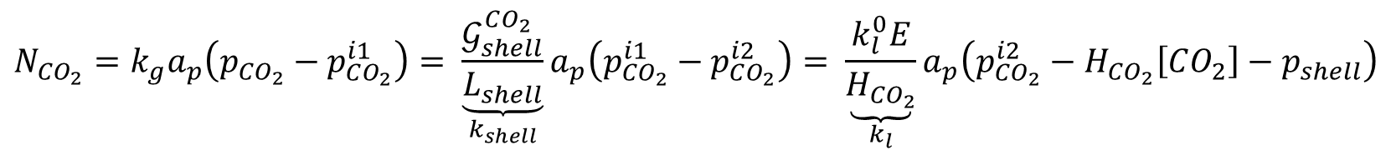

Mass Transfer: $CO_{2}\left(g\right)⇔CO_{2}(aq)$
Gas Film + Shell Resistance + Liquid Film:
$$N_{CO_{2}}=k_{g}a_{p}\left(p_{CO_{2}}−p_{CO_{2}}^{i1}\right)= {\underset{k_{shell}}{\underbrace{\frac{𝒢_{shell}^{CO_{2}}}{L_{shell}}}}a}_{p}\left(p_{CO_{2}}^{i1}−p_{CO_{2}}^{i2}\right)= \underset{k_{l}}{\underbrace{\frac{k_{l}^{0}E}{H_{CO_{2}}}}}a_{p}\left(p_{CO_{2}}^{i2}−H_{CO_{2}}\left[CO_{2}\right]−p_{shell}\right)$$
Resistance in series representation
$$N_{CO_{2}}=k_{ov}a_{p}(p_{CO_{2}}−H_{CO_{2}}\left[CO_{2}\right]−p_{shell})$$
$\frac{1}{k_{ov}}= \frac{1}{k_{g}}+ \frac{1}{k_{shell}}+ \frac{1}{k_{l}}$
$$k_{g}=f({Re}_{p},{Sc}_{p})$$
$$k_{shell}={𝒢_{shell}^{CO_{2}}}/{L_{shell}}$$
$$k_{l}={k_{l}^{0}E}/{H_{CO_{2}}}$$
FIG: $MECS CO_{2}$mass transfer (1/4 capsule shown)
Notes:
Physical mass transfer reactions ARE handled within MFIX’s traditional des_reaction hooks.
Overall rate is determined by modeling each particle with modified two film theory:
Chemically enhanced mass transfer is modeled using an enhancement factor, E.
Our model has additional considerations for the permeable, elastic shell
Use an enhancement factor to represent the contribution of chemical reaction in the carbonate solution

Slide 7
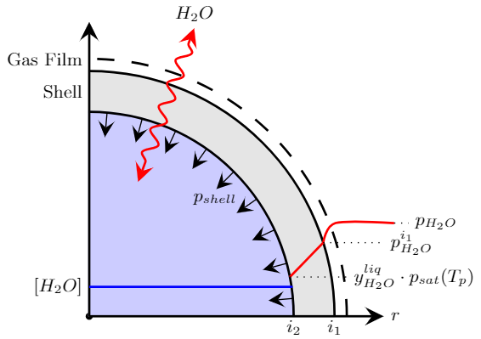


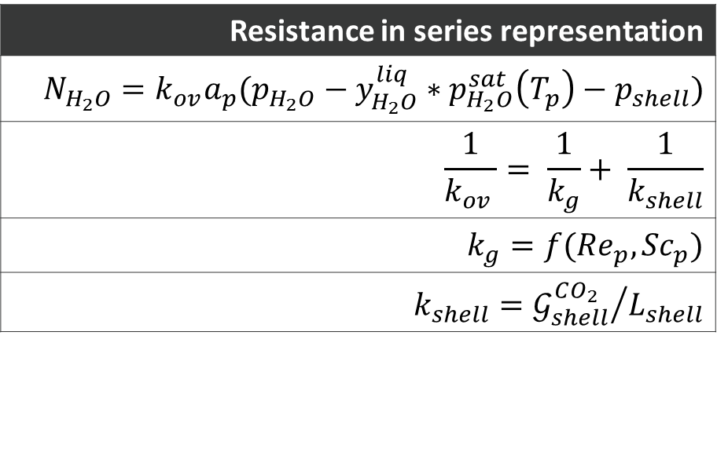
Mass Transfer: $H_{2}O\left(g\right)⇔H_{2}O (l)$
Gas Film + Shell Resistance:
$$N_{H_{2}O}=k_{g}a_{p}\left(p_{H_{2}O}−p_{H_{2}O}^{i1}\right)= {\underset{k_{shell}}{\underbrace{\frac{𝒢_{shell}^{H_{2}O}}{L_{shell}}}}a}_{p}\left(p_{H_{2}O}^{i1}−y_{H_{2}O}^{liq}∗p_{H_{2}O}^{sat}\left(T_{p}\right)−p_{shell}\right)$$
Resistance in series representation
$$N_{H_{2}O}=k_{ov}a_{p}(p_{H_{2}O}−y_{H_{2}O}^{liq}∗p_{H_{2}O}^{sat}\left(T_{p}\right)−p_{shell})$$
$$\frac{1}{k_{ov }}= \frac{1}{k_{g}}+ \frac{1}{k_{shell}}$$
$$k_{g}=f({Re}_{p},{Sc}_{p})$$
$$k_{shell}={𝒢_{shell}^{CO_{2}}}/{L_{shell}}$$
FIG: MECS $H_{2}O$mass transfer (1/4 capsule shown)
Notes:
Similarly, for H2O…
PHYSICAL mass transfer only here. We still have gas side resistance and shell resistance.

Slide 8
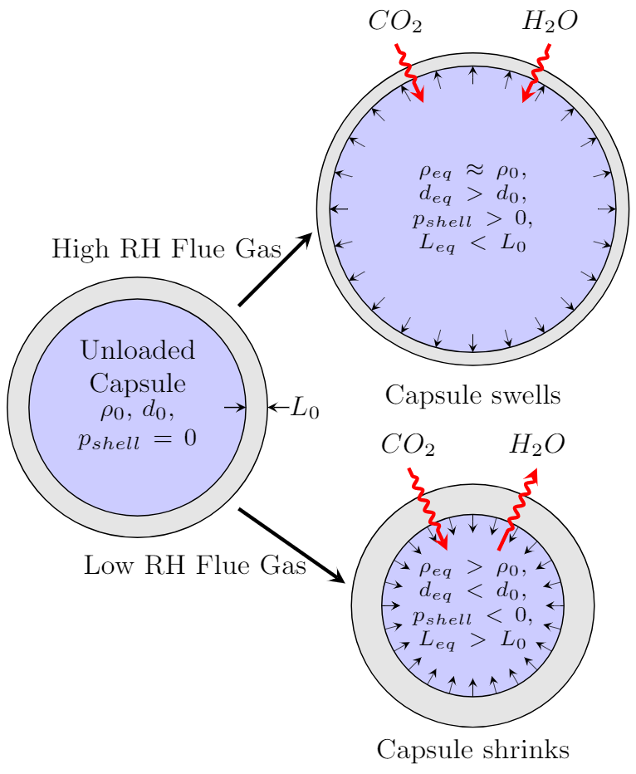
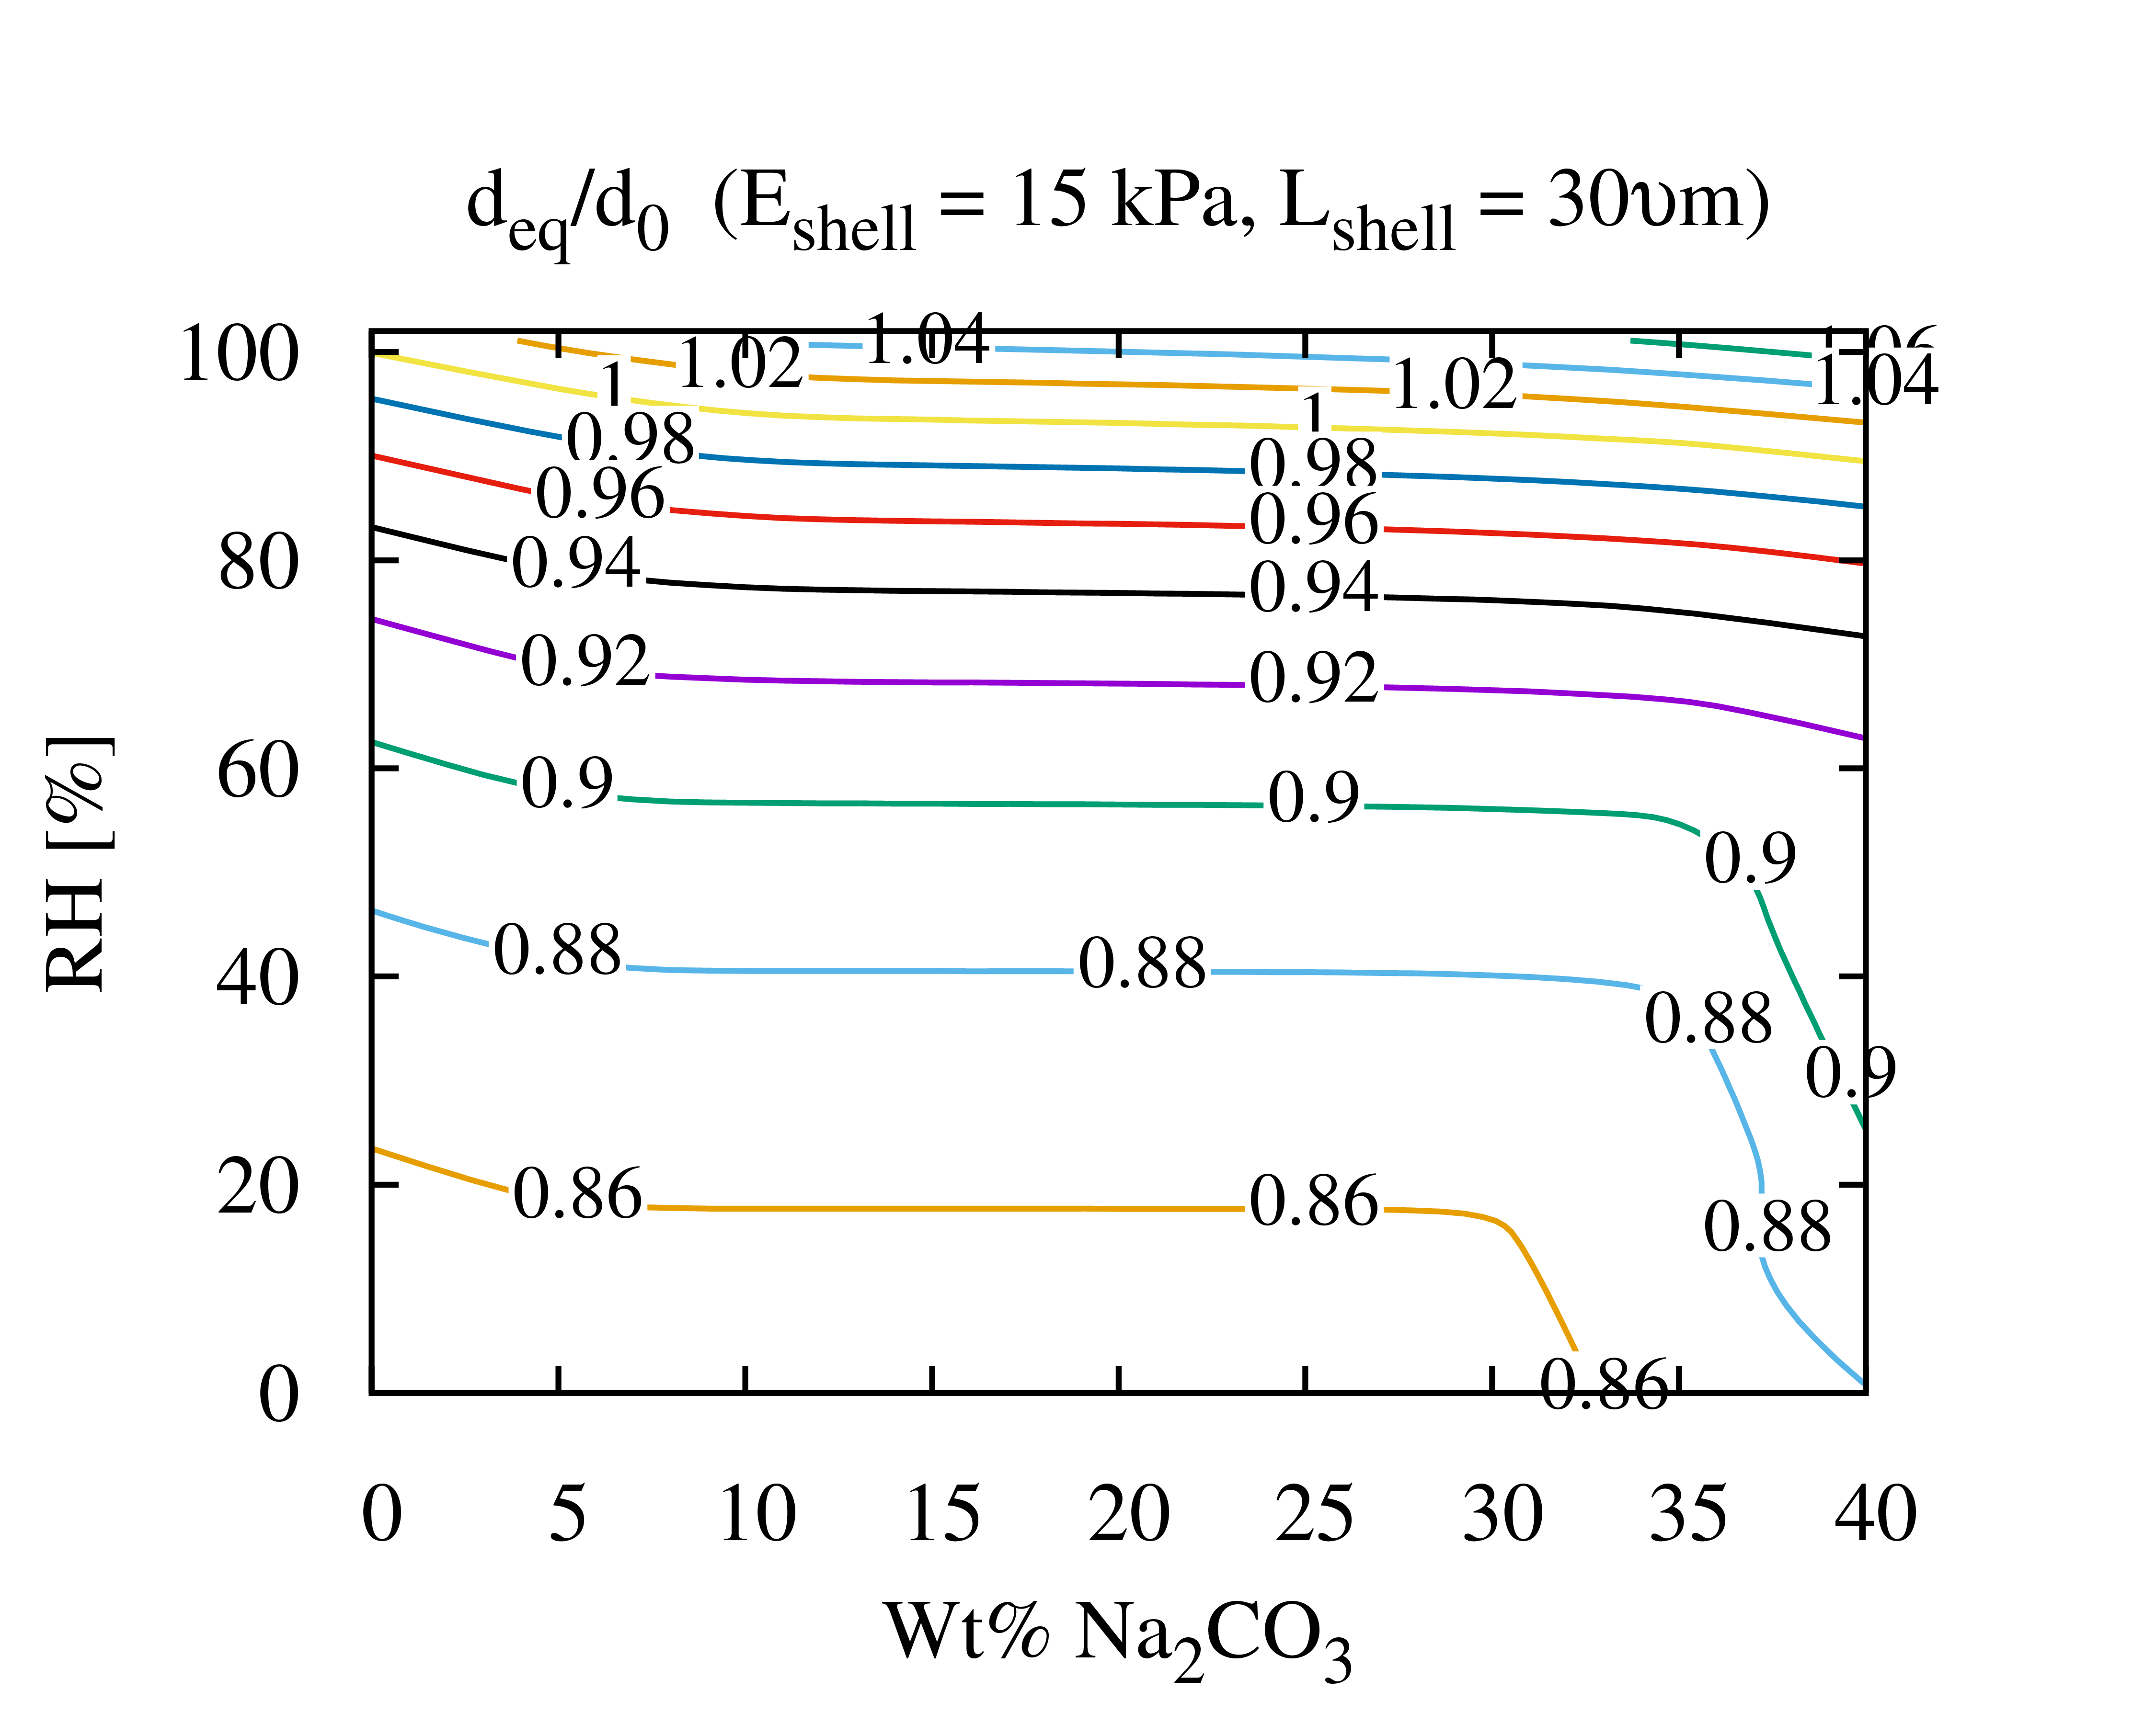
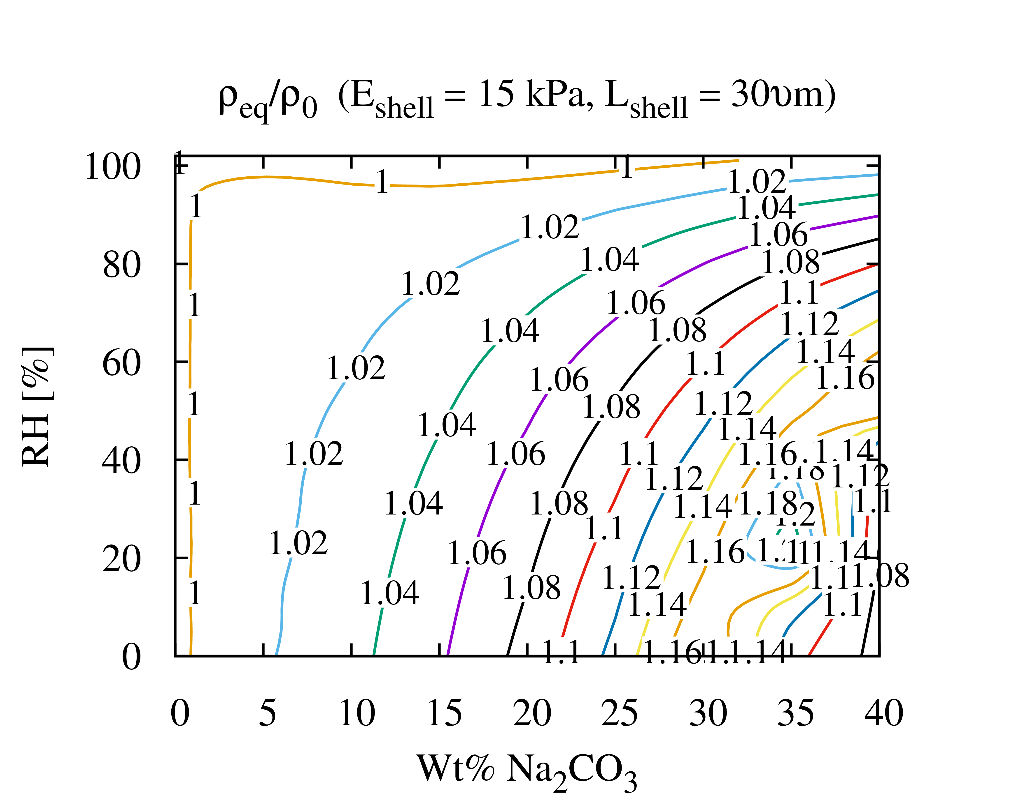
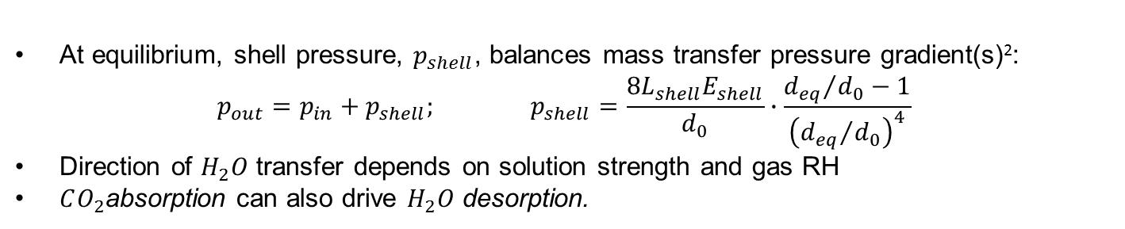
Modeling size and density changes
At equilibrium, shell pressure, $p_{shell}$, balances mass transfer pressure gradient(s)²:
$$p_{out}=p_{in}+p_{shell}; p_{shell}=\frac{8L_{shell}E_{shell}}{d_{0}}∙\frac{{d_{eq}}/{d_{0}}−1}{{\left({d_{eq}}/{d_{0}}\right)}^{4}}$$
Direction of $H_{2}O$ transfer depends on solution strength and gas RH
$CO_{2}$absorption can also drive $H_{2}O$ desorption.
FIG: Predicted Eq. capsule size (left) and density (right) after exposure to flue gas at 1atm pressure and T=40C.
FIG: MECS size change mechanisms.
²Nabavi et al., Langmuir, v. 32, 2016;
Notes:
Particles change size density as they absorb/desorb CO2 and H2O.
To model the size change, we adopted a model for pressure induced by the shell developed by another group that has been studying this problem
Shell pressure provides a limit on size/density changes: If you don’t have it, your particle may grow/shrink an unlimited amount
Shell thickness ($L_{shell})$ and elastic modulus ($E_{shell})$ set rigidity of capsule: magnitude of size/density changes influenced strongly by E_shell and L_shell: Softer, thinner capsules will have potentially more size/density change.
Ultimately, for these conditions… these particles do not change size/density much. There is potential to design a capture process around this effect( size/density changes), but for THIS solvent the overall changes do not seem to be significant, so we probably cannot leverage.

Slide 9
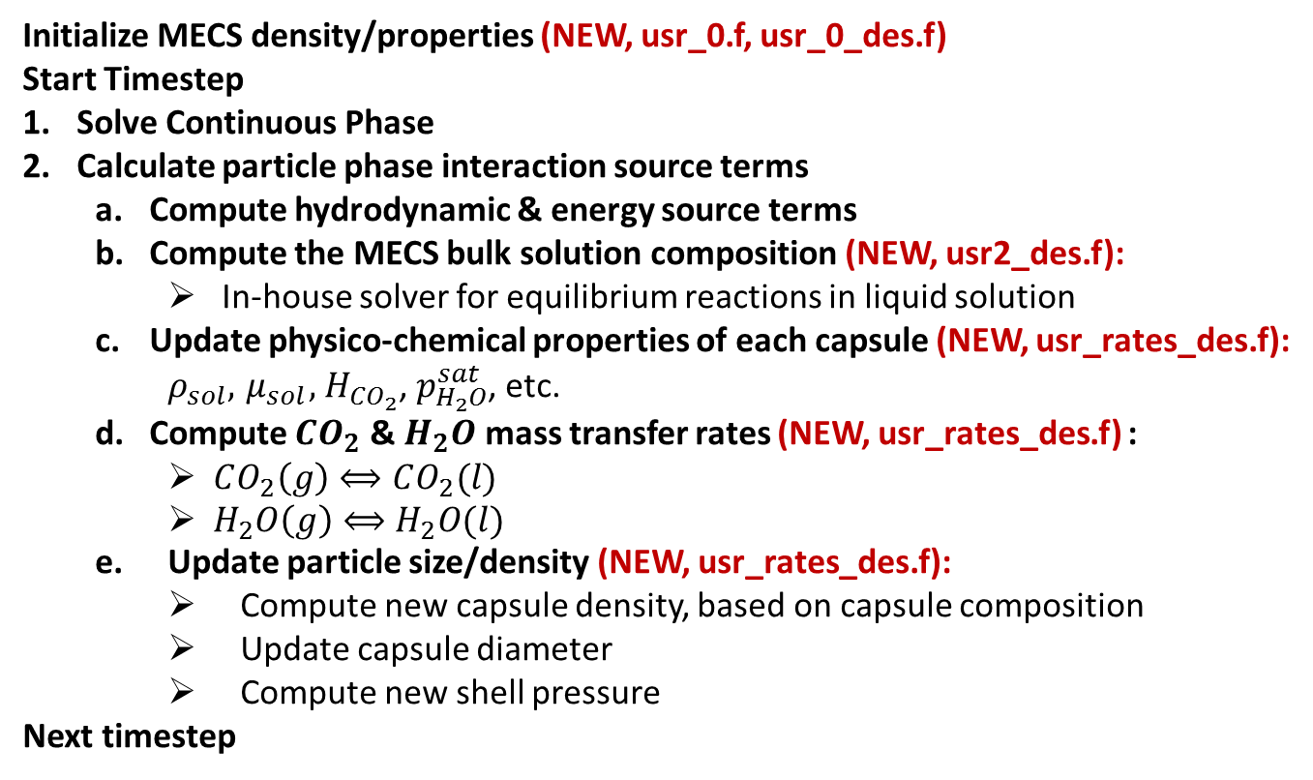
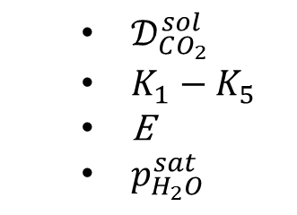
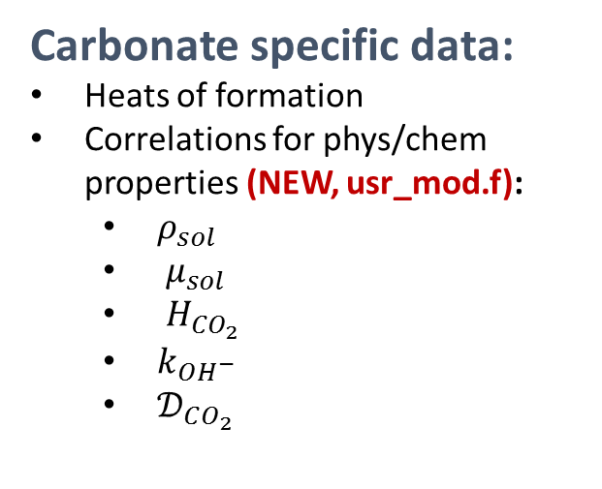
MFIX-DEM Integration
Major Steps:
Initialize MECS density/properties (NEW, usr_0.f, usr_0_des.f)
Start Timestep
Solve Continuous Phase
Calculate particle phase interaction source terms
  Compute hydrodynamic & energy source terms
  Compute the MECS bulk solution composition (NEW, usr2_des.f):
    In-house solver for equilibrium reactions in liquid solution
  Update physico-chemical properties of each capsule (NEW, usr_rates_des.f):
    $ρ_{sol}, { μ}_{sol},{ H}_{CO_{2}}$, $p_{H_{2}O}^{sat}$, etc.
  Compute $CO_{2}$ & $H_{2}O$ mass transfer rates (NEW, usr_rates_des.f) :
    $CO_{2}\left(g\right)⟺CO_{2}(l)$
    $H_{2}O\left(g\right)⟺H_{2}O(l)$
  Update particle size/density (NEW, usr_rates_des.f):
    Compute new capsule density, based on capsule composition
    Update capsule diameter
    Compute new shell pressure
Next timestep
New mfix.dat keywords:
SHELL_THICKNESS
SHELL_DENSITY
SHELL_PERMEABILITY_CO2
SHELL_PERMEABILITY_H2O
Carbonate specific data:
Heats of formation
Correlations for phys/chem properties (NEW, usr_mod.f):
  $ρ_{sol}$
  ${ μ}_{sol}$
  ${ H}_{CO_{2}}$
  $k_{OH^{−}}$
  $𝒟_{CO_{2}}$
  $𝒟_{CO_{2}}^{sol}$
  $K_{1}−K_{5}$
  E
  $p_{H_{2}O}^{sat}$
Notes:
All new development done within standard MFIX user constructs
Here are the major points of new code, which were implemented in certain stages of MFIX to make sure the timing was correct.
A few new MECS specific keywords, and LOTS of new physical properties.
The one thing to maybe emphasize here is the new equilibrium solver.

Slide 10
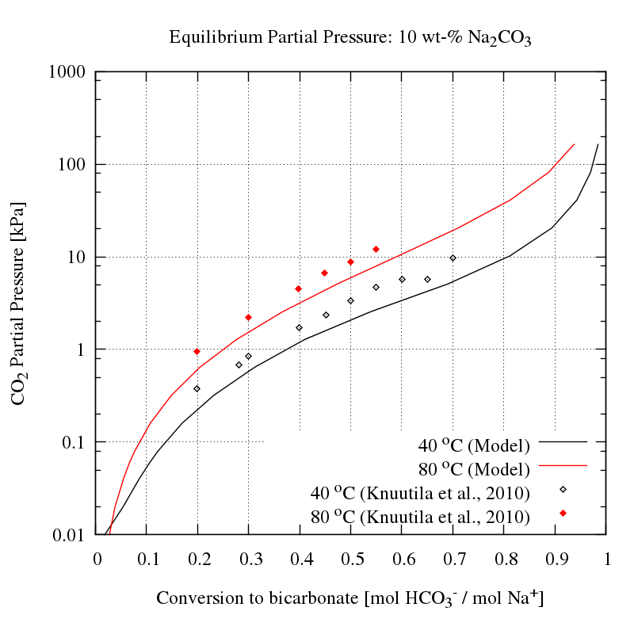
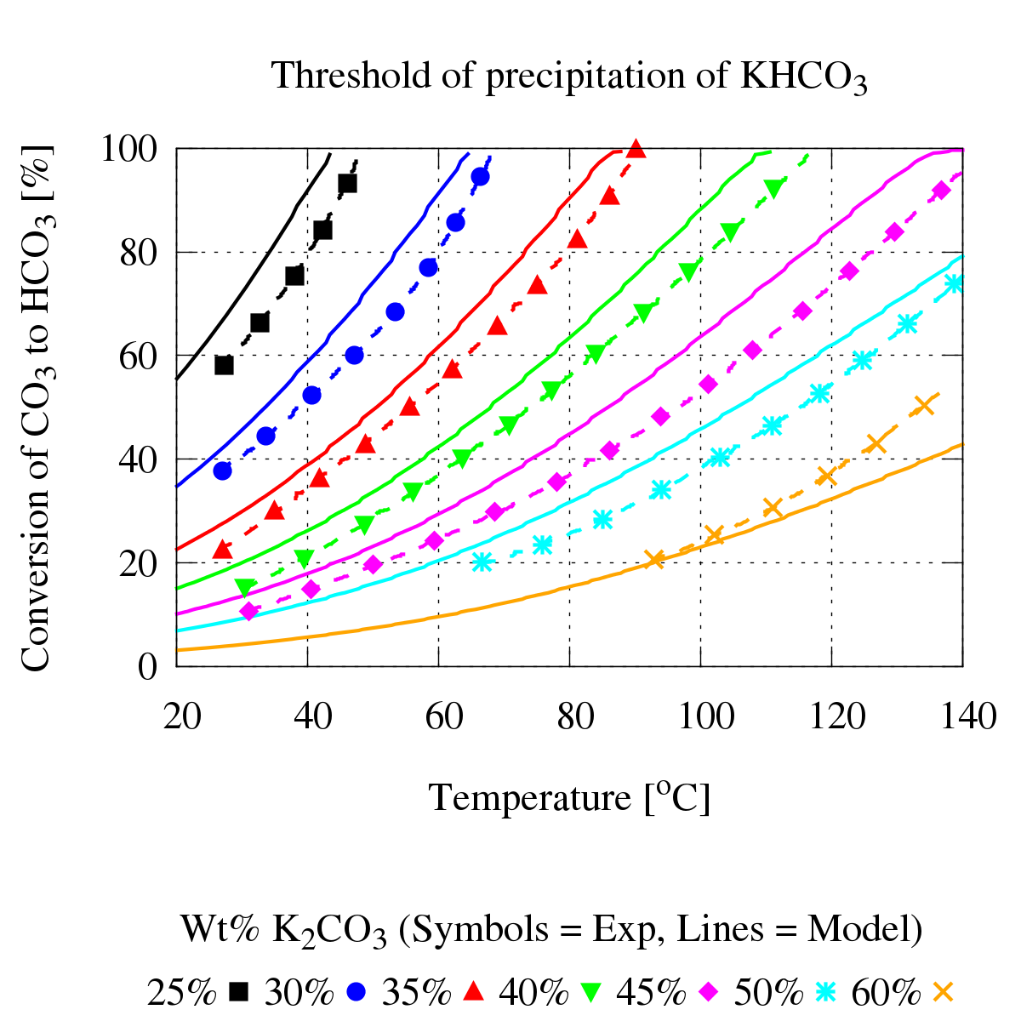
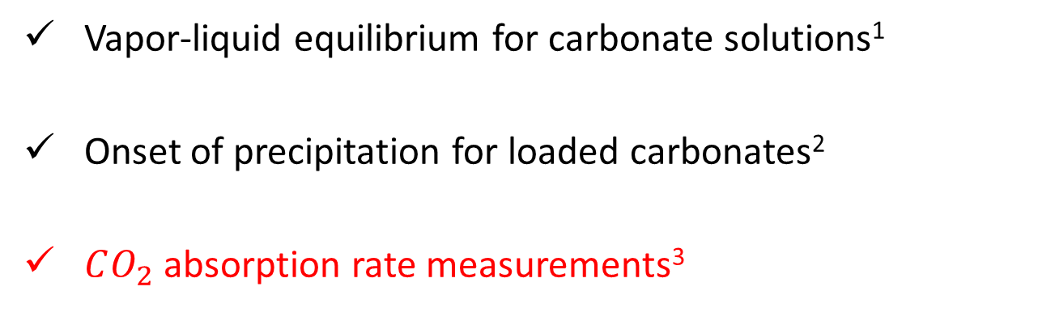
Model Validation: Overview
Vapor-liquid equilibrium for carbonate solutions¹
Onset of precipitation for loaded carbonates²
$CO_{2}$ absorption rate measurements³
FIG: VLE comparison with Knuutila et al¹
FIG: MECS in LLNL absorption chamber
FIG: Threshold of precipitation for potassium bicarbonate, comparison with Kohl & Nielsen²
¹Knuutila et al., CES, v. 65, 2010(a,b,c);
²Kohl and Nielsen, Gas Purification, 1997;
³LLNL Data, Private Communication, July 2017;
Notes:
We have done a variety of validation test for the heat and mass transfer
Will go into more detail on the LLNL Absorption data…
NO data available YET for hydrodynamics.

Slide 11
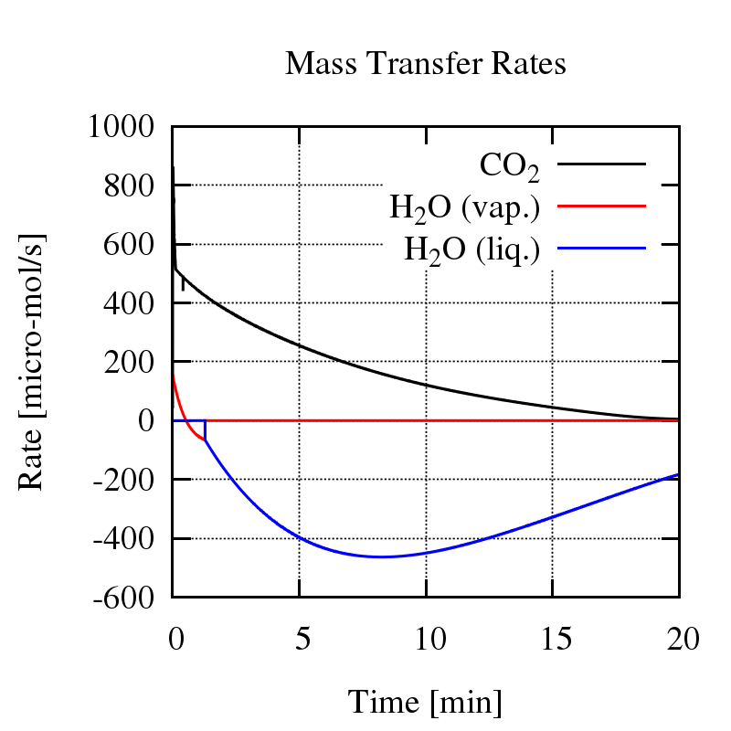
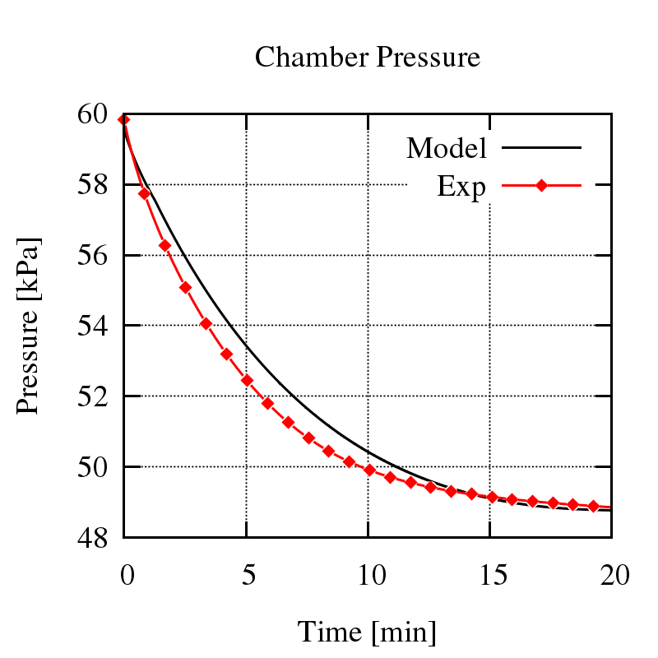
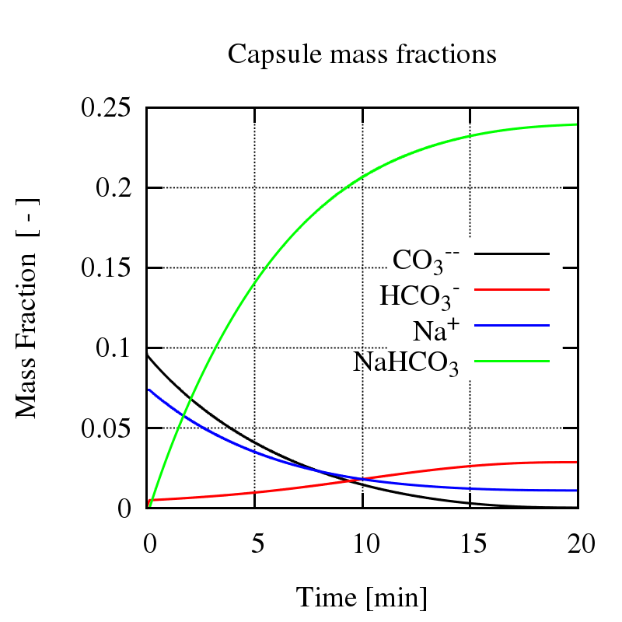
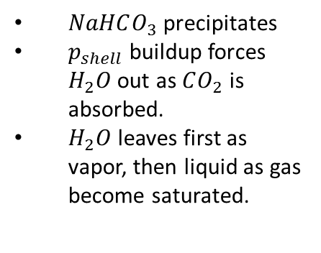

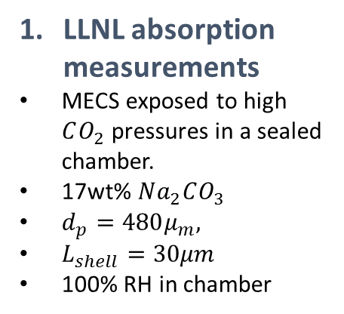
LLNL Absorption measurements
Use calibrated model to infer MECS behavior.
$NaHCO_{3}$precipitates
$p_{shell}$ buildup forces $H_{2}O$out as $CO_{2}$ is absorbed.
$H_{2}O$ leaves first as vapor, then liquid as gas become saturated.
Photo: Vericella/LLNL¹
2. Tune Enhancement Factor¹
1. LLNL absorption measurements
MECS exposed to high $CO_{2}$ pressures in a sealed chamber.
17wt% $Na_{2}CO_{3}$
$d_{p}=480μ_{m},$
$L_{shell}=30μm$
100% RH in chamber
¹ E is tuned by adjusting $k_{OH^{−}}$ and $𝒟_{CO_{2}}$
Notes:
Chamber pressure measurements for CO2 absorption.
First, we validate the model vs LLNL
Then we can look into the direction/magnitude/timing of CO2 and H2O transfer
What goes on with the capsule speciation inside? Precipitation, etc…
We are modeling the H2O transfer, and it seems to be consistent with what is observed by LLNL. If the chamber starts at 100% RH, the model was predicts over-saturated gas. We have also seen some evidence of liquid water exiting the capsules in videos from LLNL . Unclear what the source is. This model could offer one explanation.
We don’t quite know what to do with the liquid water yet… Our choice is to represent this liquid H2O as another gas phase species (for now).

Slide 12
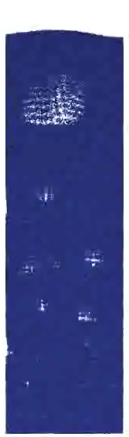
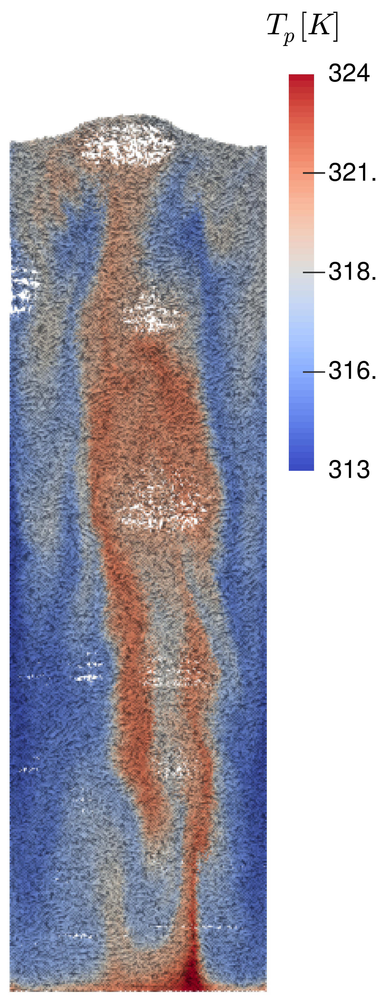

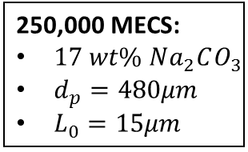

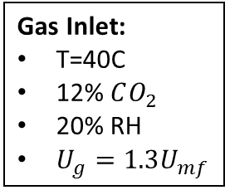
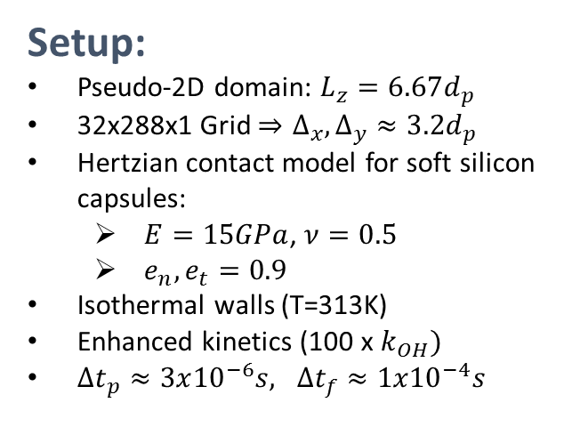
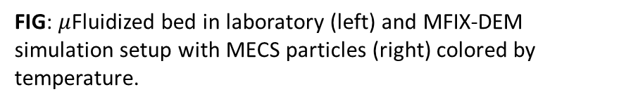
Bench Scale Simulation of MECS Carbon Capture
Bubbling fluidization in NETL’s $μ$Fluidized Bed:
Setup:
Pseudo-2D domain: $L_{z}=6.67d_{p}$
32x288x1 Grid $⇒Δ_{x},Δ_{y}≈3.2d_{p}$
Hertzian contact model for soft silicon capsules:
  $E=15GPa$, $ν=0.5$
  $e_{n}, e_{t}=0.9$
Isothermal walls (T=313K)
Enhanced kinetics (100 x $k_{OH})$
$Δt_{p}≈3x{10}^{−6}s, Δt_{f}≈{1x10}^{−4}s$
NETL’s $μ$Fluidized Bed:
5cm x 45cm x 0.32cm
Detailed exp. possible
To Outlet:
$$P=P_{atm}$$
250,000 MECS:
$17 wt\% Na_{2}CO_{3}$
$d_{p}=480μm$
$L_{0}=15μm$
Gas Inlet:
T=40C
12% $CO_{2}$
20% RH
$U_{g}=1.3U_{mf}$
FIG: $μ$Fluidized bed in laboratory (left) and MFIX-DEM simulation setup with MECS particles (right) colored by temperature.
FIG: Simulated bubbling behavior
Notes:
We don’t have hydrodynamic data for MECS yet, but we hope to be able to use a similar setup for validation purposes.
We don’t know the fluidization behavior yet, we hope to be able to learn how to model this in the future.
SETUP:
Mention contact model: We know these are soft
Isothermal assumption on reactor walls
Kinetics of carbonate reaction with CO2 are enhanced in order to demonstrate absorption dynamics in this column within a reasonable timeframe: Otherwise, overall absorption would be small for U~U_mf

Slide 13
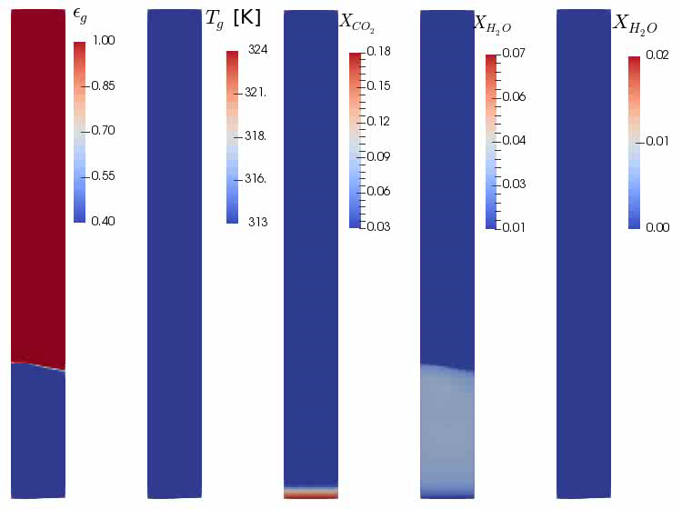
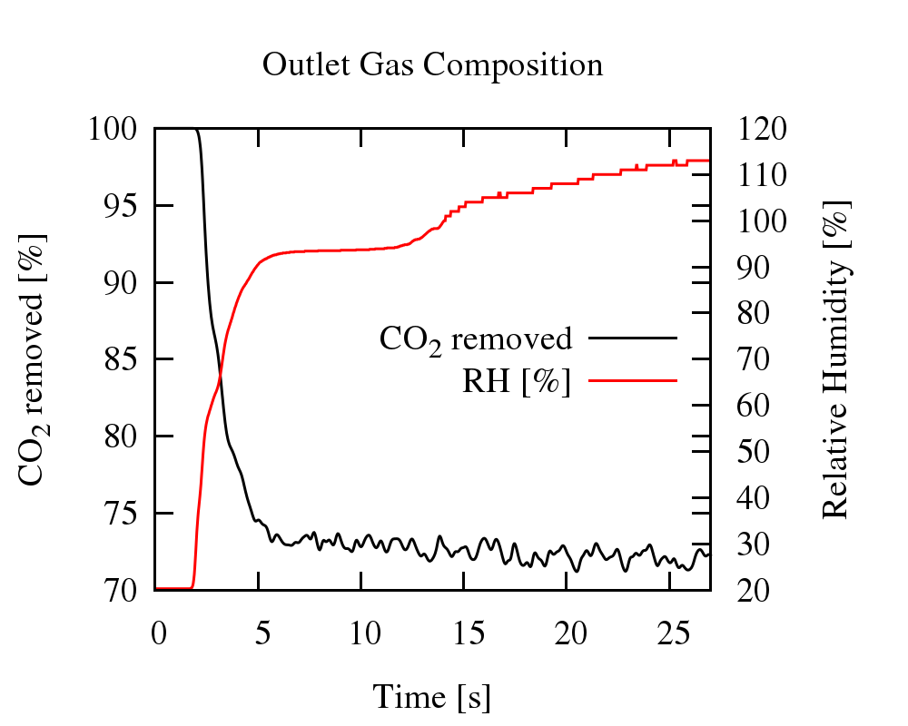

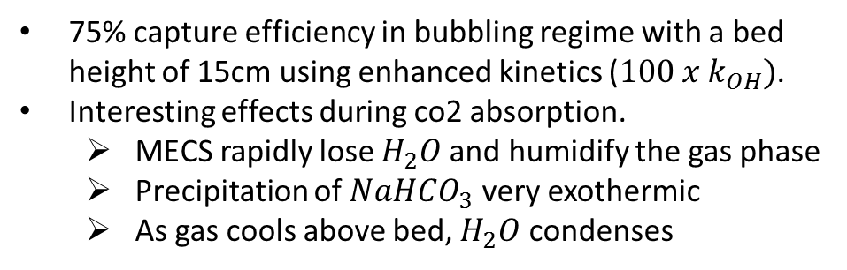


Bench Scale Simulation
75% capture efficiency in bubbling regime with a bed height of 15cm using enhanced kinetics (${100 x k}_{OH})$.
Interesting effects during co2 absorption.
  MECS rapidly lose $H_{2}O$and humidify the gas phase
  Precipitation of $NaHCO_{3}$ very exothermic
  As gas cools above bed, $H_{2}O$ condenses
Vapor $H_{2}O$
Condensed$H_{2}O$
FIG: Time evolution of outlet gas composition.
FIG: From left to right: Gas fraction, gas temp, $CO_{2}$ mass fraction, $H_{2}O$ vapor mass fraction, condensed $H_{2}O$ mass fraction.
Notes:
Discuss how MECS are behaving here, and what this means for carbon capture processes:
Roughly 75% capture efficiency of CO2
CO2 absorption at the same time as significant H2O desorption
Onset of Nahcolite formation, results in temperature rise, further water loss
As gas cools (toward top of reactor, it H2O condenses (hence the higher than 100% humidity at the outlet). We don’t know if / how we want to model this.
Capture efficiency DECREASES as loading of capsules INCREASES. Not a huge change, kinetics are still slow.
Animation is slowed down by half compared to real time (30s) of simulation)
Overall reaction when nahcolite is formed: 500 kJ/mol

Slide 14
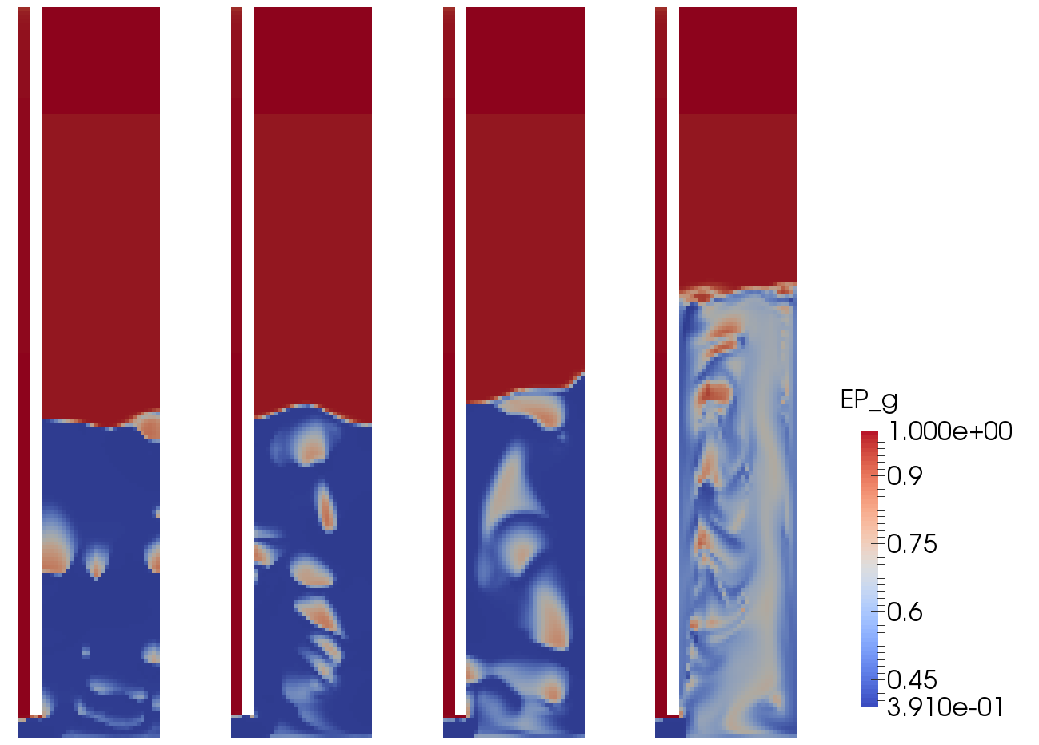
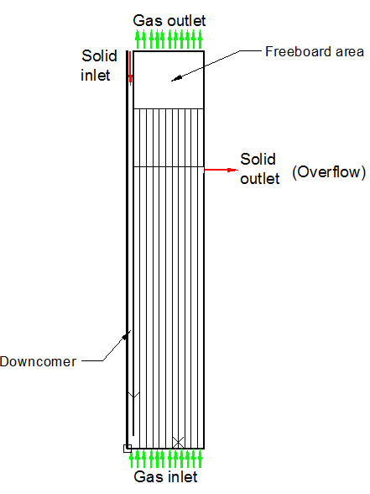
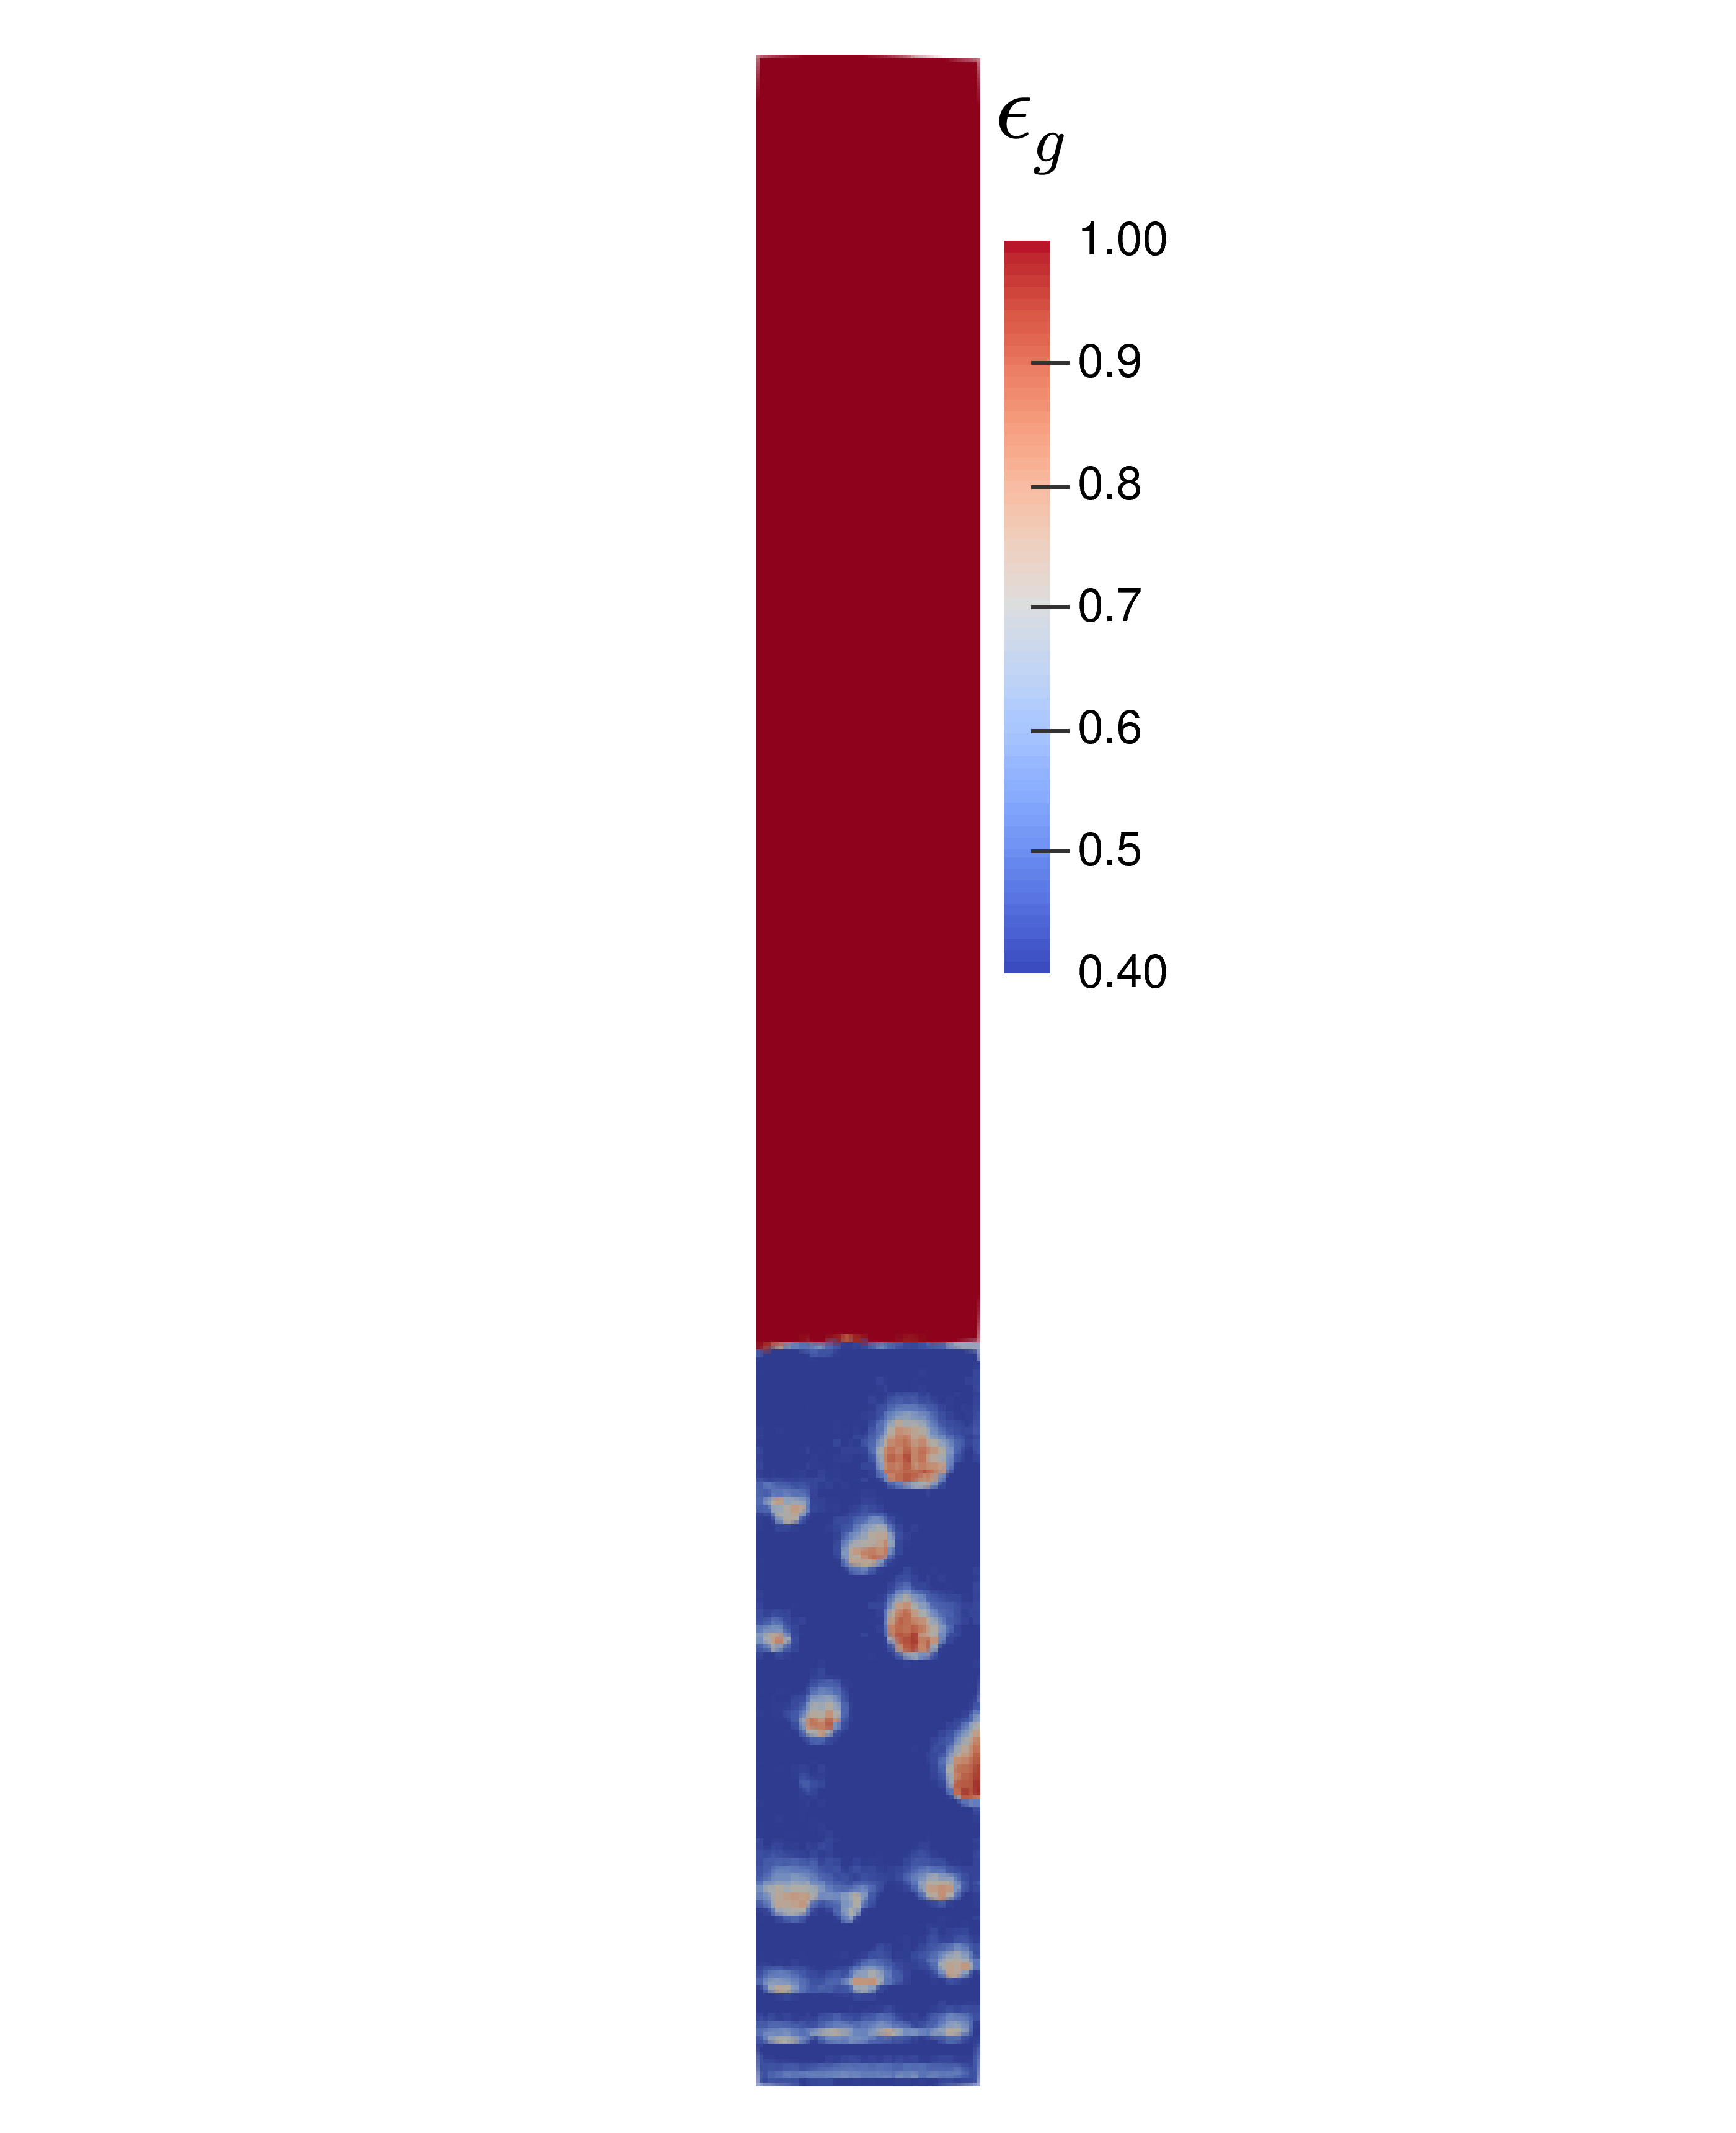
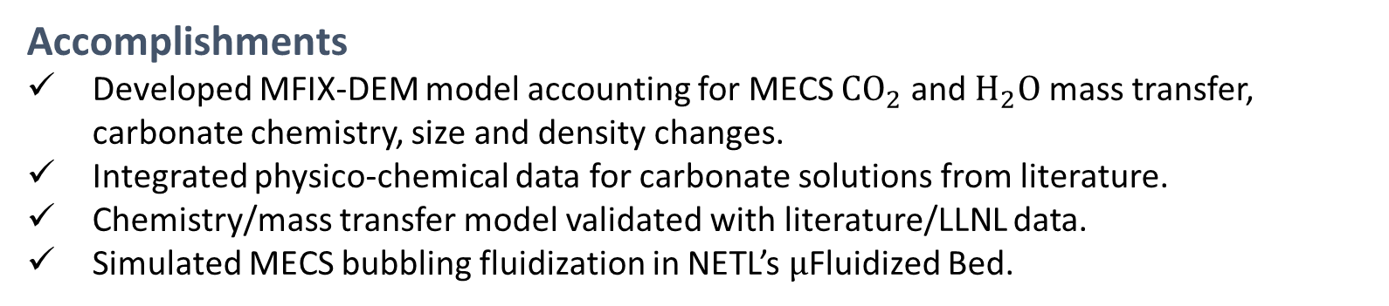
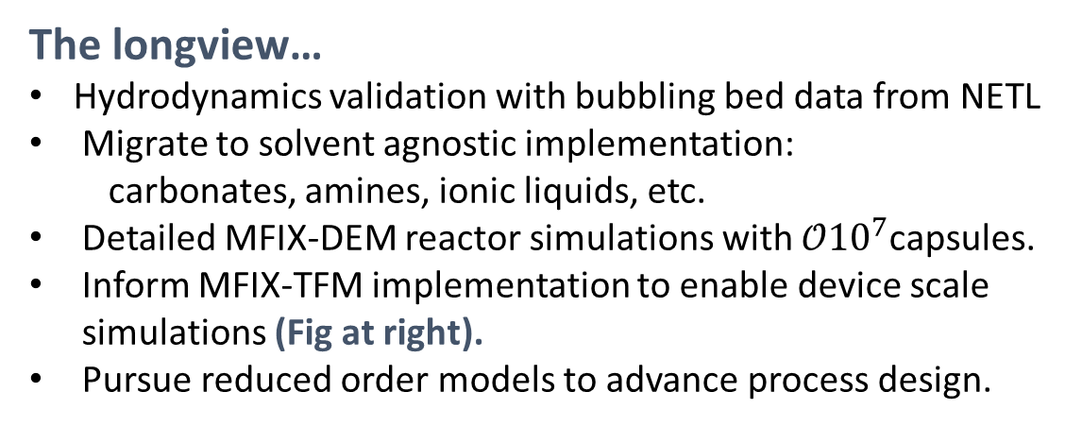
Conclusions
Accomplishments
Developed MFIX-DEM model accounting for MECS $CO_{2}$ and $H_{2}O$ mass transfer, carbonate chemistry, size and density changes.
Integrated physico-chemical data for carbonate solutions from literature.
Chemistry/mass transfer model validated with literature/LLNL data.
Simulated MECS bubbling fluidization in NETL’s $μ$Fluidized Bed.
FIG: Study of MECS hydrodynamics in 1 MW pilot-scale carbon capture system. Left: flow configuration, Right: gas fraction under fluidized condition (Collaboration with PNNL)
The longview…
Hydrodynamics validation with bubbling bed data from NETL
Migrate to solvent agnostic implementation:
  carbonates, amines, ionic liquids, etc.
Detailed MFIX-DEM reactor simulations with $𝒪10^{7}$capsules.
Inform MFIX-TFM implementation to enable device scale simulations (Fig at right).
Pursue reduced order models to advance process design.

Slide 15


Thank you!
Contact
Justin Finn
ORISE Postdoctoral Fellow
Multiphase Flow Science Team
National Energy Technology Lab
e: Justin.Finn@netl.doe.gov
p: 541-918-4423
Janine Galvin
Research Scientist
Multiphase Flow Science Team
National Energy Technology Lab
e: Janine.Carney@netl.doe.gov
p: 541-918-5841
Acknowledgments
CCSI² leadership: Mike Matuszewski, David Miller, Lynn Brickett
LLNL MECS Team: Joshua Stolaroff, Katherine Ong, Bill Bourcier, Jennifer Knipe, Kathya Chavez
PNNL: Zhijie Xu, Wang Chao
More Information
www.acceleratecarboncapture.org

Slide 16
Extra slides…

Slide 17


Reacting gas-solid flow simulation: MFIX-DEM
Gas Phase: $$\frac{∂}{∂t}\left(ε_{g}ρ_{g}\right)+∇∙\left(ε_{g}ρ_{g}u_{g}\right)=\sum_{n=1}^{N_{g}}{R_{i}}$$ | (1)
$$\frac{∂ }{∂t}{{(ε}_{g}ρ_{g}u}_{g})+∇∙\left(ε_{g}ρ_{g}u_{g}u_{g}\right)={−ε}_{g}∇P_{g}+∇∙\left(ε_{g}τ_{g}\right)+ε_{g}ρ_{g}g+F_{p→g}$$ |  | (2)
$$\frac{∂}{∂t}\left(ε_{g}ρ_{g}X_{i,g}\right)+∇∙\left(ε_{g}ρ_{g}u_{g}X_{i,g}\right)=∇∙\left(𝒟_{i,g}∇X_{i,g}\right)+R_{i,g}$$ | (3)
$$ε_{g}ρ_{g}C_{p,g}\left[\frac{∂T_{g}}{∂t}+u_{g}∙∇T_{g}\right]=−∇∙\left(−λ_{g}∇T_{g}\right)−\sum_{n=1}^{N_{g}}{h_{i,g}}R_{i,g}+S_{i}$$ |  | (4)
Solid (MECS) Phase:
PUT PARTICLE EQNS HERE…
FIG: Multiscale simulation strategies in MFIX (top). MECS represented as discrete particles in reactive gas flow (left)
Focus of this talk: MECS mass transfer, $R_{i}$

Slide 18

Model Closures
Symbol | Property |  | Dependencies | Reference
Shell Properties (assumed constant)
$$𝒫_{shell}^{CO_{2}}$$ | $CO_{2}$ Permeability Coefficient | - |  |  | Vericella, Baker et al. (2015)
$$𝒫_{shell}^{H_{2}O }$$ | $H_{2}O$ Permeability Coefficient | - |  |  | TBD
Liquid Solution Properties
$$ρ_{sol}$$ | Carbonate solution density | $T_{p}$, wt% $Na_{2}CO_{3}$ |  |  | Knuutila, Juliussen et al. (2010)
$$μ_{sol}$$ | Carbonate solution viscosity | $T_{p}$, wt% $Na_{2}CO_{3}$ |  |  | Fit data from Roberts and Mangold Jr (1939)
$$𝒟_{CO_{2}}^{sol}$$ | Diffusivity of $CO_{2}$ in solution | $T_{p}$, $μ_{sol}$, $μ_{H_{2}O}$ |  |  | $N_{2}O$ Analogy (Versteeg and Van Swaalj, 1988), Stokes-Einstein (Kucka et al., 2002), (Vogel???)
$$𝒟_{OH^{−}}^{sol}$$ | Diffusivity of $OH^{−}$ in solution | $$𝒟_{CO_{2}}^{sol}$$ |  |  | Const diffusivity ratio (Hikita et al., 1976)
$$𝒟_{HCO_{3}^{−}}^{sol}$$ | Diffusivity of $HCO_{3}^{−}$ in solution | $$𝒟_{CO_{2}}^{sol}$$ |  |  | Const. diffusivity ratio (Hikita et al., 1976)
Liquid Solution Chemistry
$$k_{OH^{−}}$$ | 2nd order kinetic constant | $$T_{p}\text{,} \left[Na^{+}\right], [CO_{3}^{−−}]$$ |  |  | Pohorecki and Moniuk (1988)
$$K_{1}, K_{2}, K_{3}$$ | Equilibrium constants (R1, R2, R3) | $$T_{p}$$ |  |  | Edwards, Maurer et al. (1978)
$$K_{4}, K_{5}$$ | Solubility products (R4, R5) | $$T_{p}$$ |  |  | Fit data from Haynes (2014)
Mass Transfer
$$H_{CO_{2}}$$ | Solubility of $CO_{2}$in carbonate solution | $T_{p}$, $H_{CO_{2 }−N_{2}O}$ |  |  | Knuutila, Juliussen et al. (2010), Versteeg and Van Swaalj (1988)
$$E$$ | Mass transfer enhancement factor ($CO_{2}$) | $𝒟_{CO_{2}}^{sol}$, $𝒟_{OH^{−}}^{sol}$, $𝒟_{HCO_{3}^{−}}^{sol}$, $k_{OH^{−}}$ |  |  | Reversible 2nd order: Gaspar and Fosbøl (2015)
$$k_{l}^{0}$$ | Physical liq. mass transfer coeff ($CO_{2}$) | $$d_{p}, 𝒟_{CO_{2}}^{sol}$$ |  |  | Kumar and Hartland (1999); Stagnant drop model
$$p_{H_{2}O}^{sat}$$ | $H_{2}O$ vapor pressure | $$T_{p}$$ |  |  | Reynolds (1979)
Basic data availability can be a challenge!
Notes:
Need to update this slightly.

Slide 19


Capsule size change
Model development
GOAL: Determine the MECS particle density, $ρ_{p}$, that will allow MFIX to update the MECS volume/diameter in des_reaction_model.f according to:
$𝒱_{p}\left(t\right)=\frac{m_{p}\left(t\right)}{ρ_{p}\left(t\right)}, d_{p}\left(t\right)={\left(\frac{6}{π}\frac{m_{p}\left(t\right)}{ρ_{p}\left(t\right)} \right)}^{1/3}$
MODEL INPUT: $T_{0}, X_{0}, d_{p,0}, L_{shell,0},ρ_{shell}$
TIME DEPENDENT VARS:$ρ_{p}, ρ_{sol}\left(T_{sol},X_{sol}\right), 𝒱_{sol}, m_{sol},L_{shell}, d_{p}, d_{sol}$
ASSUMPTIONS: Shell material is incompressible
IMPLEMENTATION STEPS:
Initialize $m_{p},{ 𝒱}_{p}$, $ρ_{p}$ (usr0.f, or when particles are added):
$m_{p}=m_{sol,0}+m_{shell}; { 𝒱}_{p}=\frac{π}{6}d_{p,0 }^{3}; ρ_{p}=\frac{m_{p}}{𝒱_{p}}$
Compute $𝒱_{shell}, m_{shell}$ according to Equation 3,7 (usr0.f).
MFIX evaluates changes in $m_{p}(t)$ in des_reaction_model.f (Eq. 4-5).
Compute $ρ_{p}\left(t\right)$ (usr_rates_des.f)
  Evaluate $ρ_{sol}\left(T,X_{sol}\right)$
  Compute $m_{sol}$ (Eq. 4)
  Compute $𝒱_{sol}, {𝒱_{p}, d}_{p}$ (Eq. 2, 1)
  Compute $L_{shell}$ (Eq. 10)
  Set $ρ_{p}=m_{p}/𝒱_{p}$
ADDITIONAL CONSIDERATIONS:
Does size change feed into particle collision model?
$ρ_{shell}$ will require new keyword in mfix.dat
$ρ_{sol}$ could have contributions from aqueous solution AND solid precipitates.
It seems best to compute $ρ_{p}$ in usr_rates.f, where we already need to evaluate $ρ_{sol}$ and $L_{shell}$ for the mass transfer model.
Need to ensure that SOLVE_ROs is set to FALSE at runtime. What is the correct way to do this?
Particle volume, $𝓥_{p}$
$$𝒱_{p}=𝒱_{sol}+\underset{constant}{\underbrace{𝒱_{shell}}}=\frac{π}{6}d_{p}^{3}$$ | (1)
$$𝒱_{sol}=m_{sol}/ρ_{sol}$$ | (2)
$$𝒱_{shell}=\frac{π}{6}\left[d_{p,0}^{3}−{\left(d_{p,0}−2L_{shell,0}\right)}^{3}\right]$$ | (3)
Particle mass, $m_{p}$
$$m_{p}=m_{sol}+\underset{constant}{\underbrace{m_{shell}}}$$ | (4)
$$m_{sol}=\underset{Initial solution mass}{\underbrace{m_{sol}^{0}}}+\underset{Changes due to absorption/desorption}{\underbrace{\int_{0}^{t}{N_{CO_{2}}M_{CO_{2}}}+N_{H_{2}O}M_{H_{2}O} dτ}}$$ | (5)
$$m_{sol}^{0}={ρ_{sol}\left(T_{0},X_{0}\right)∙𝒱}_{sol,0}=ρ_{sol}\left(T_{0},X_{0}\right)∙\frac{π}{6}{\left(d_{p,0}−2L_{shell,0}\right)}^{3}$$ | (6)
$$m_{shell}=ρ_{shell}∙𝒱_{shell}$$ | (7)
Particle size, $d_{p}$
$$d_{p}=d_{sol}+2L_{shell}$$ | (8)
$d_{sol}={\left(\frac{6}{π}𝒱_{sol}\right)}^{1/3}$ | (9)
$$L_{shell}= \frac{d_{p}}{2}\left(1+\sqrt[3]{\frac{𝒱_{shell}}{𝒱_{p}}−1}\right)$$ | (10)

Slide 20

Model Validation: VLE
$Na_{2}CO_{3}$ VLE data (Knuutila, Hessen, Kim, Haug-Warberg, & Svendsen, 2010)
Equilibrium composition of loaded carbonate solutions:
Initially lean capsules exposed to known partial pressure of $CO_{2}$
Equilibrium composition compared to VLE data Knuutila et al. (2010)
Reasonable agreement considering simple speciation model.
Notes:
This test validates the implementation of the liquid equilibrium calculation, as well as the Solubility of CO2 in solution

Slide 21


Model Validation: Solids Precipitation
$KHCO_{3}$ precipitation data (Kohl & Nielsen, 1997)
Precipitation test:
Add $CO_{2}$ to $K_{2}CO_{3}$ solution at fixed $T$ until precipitation of $KHCO_{3}(s)$ is predicted.
Record % conversion $CO_{3}⇒HCO_{3}$
Compare to data of Kohl and Nielsen (1997) for $K_{2}CO_{3}$ solutions.
Notes:
As far as I know, there is no similar open data for Na2CO3 solutions.
Figure on Left shows the speciation of K2CO3 solution as more co2 is added. At the point where solids begin to precipitate, we compute the % conversion of CO3 to HCO3 (ie, ratio of mol fractions). This is how we obtain the curves on the right figure.
This test demonstrates that the liquid/solid equilibrium can be predicted when solids precipitation occurs (so long as good solubility data is available).

Slide 22




Model Validation: Absorption Rate (1)
Low wt % encapsulated $Na_{2}CO_{3}$ (LLNL data: Jan, 2017)
Test | Wt % $Na_{2}CO_{3}$ | $$T [^{o}C]$$ | $$N_{cap}$$ | $$d_{p} [μm]$$ | $$L_{shell} [μm]$$ | $$𝓟_{CO_{2}} \left[\frac{mol}{m−s−Pa}\right]$$
A | 1.3 | 27 | 1597 | 540 | 30 | 1.054E-12
B | 2.4 | 40 | 1550 | 540 | 30 | 1.054E-12
C | 1.8 | 60 | 3058 | 540 | 30 | 1.054E-12
Model tuning
$k_{l}^{0}=C_{1}\frac{2π^{2}}{3}\frac{𝒟_{CO_{2}}}{d_{p}}$ (stagnant drop)
$$C_{1}=0.1$$ (fit to data)

