Slide 1
2019 NETL Multiphase Flow Science Workshop
Microwave Doppler Sensing of
Particulate Flow in a Chemical Looping Reactor
August 6-8, 2019
M. Spencer^{1,2}, J. Charley^{1,2}, J. Stoffa^{1,2}, S. Bayham¹, D. Straub¹ , B. Chorpening¹
August 6-8, 2019, Morgantown
¹National Energy Technology Laboratory, 3610 Collins Ferry Road, Morgantown, WV 26507, USA
²Leidos Research Support Team, 3610 Collins Ferry Road, Morgantown, WV 26507, USA

Slide 2
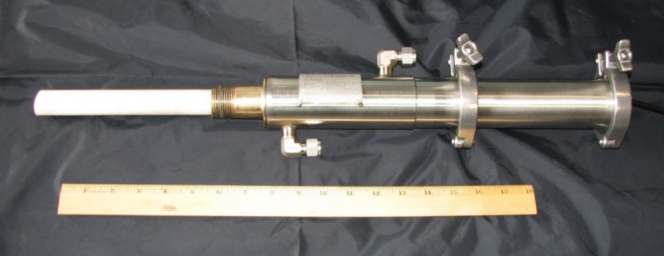
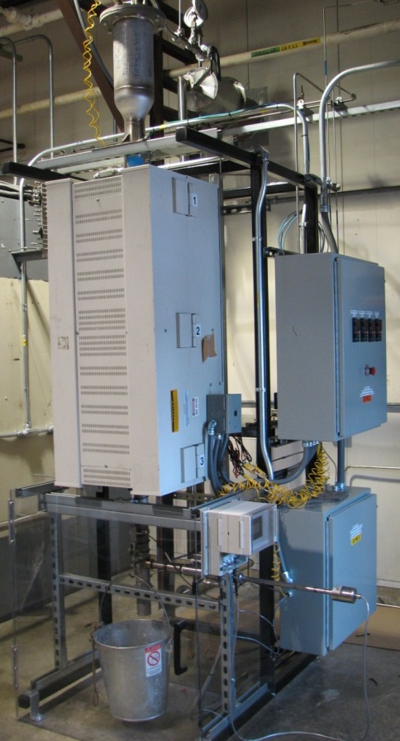
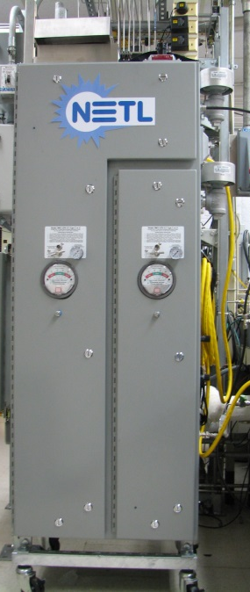
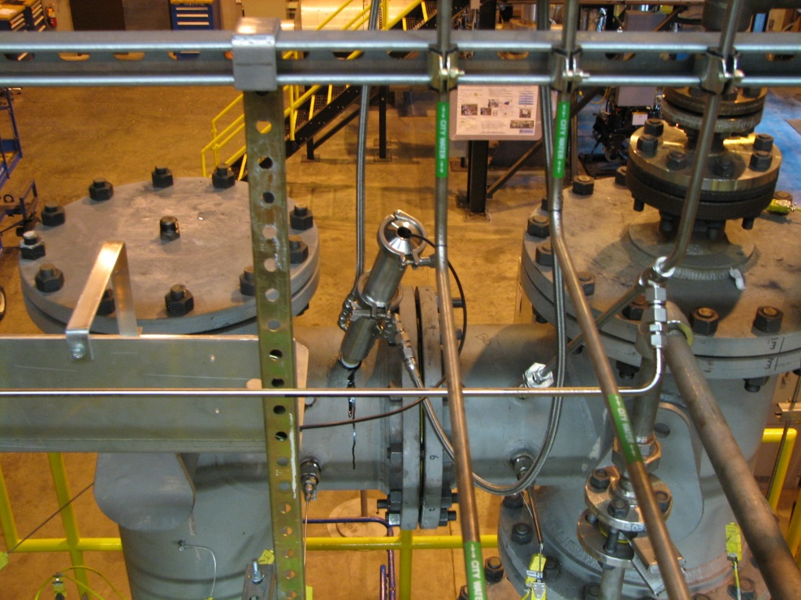
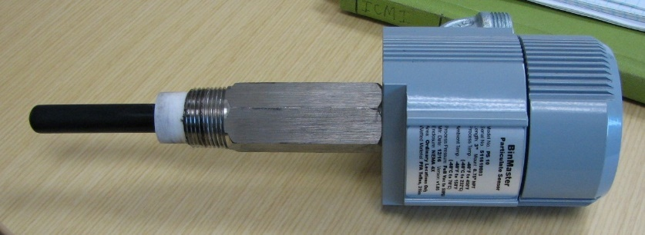
Transformational Technologies for New and Existing Plants Task 14. Sensors and Controls
Objectives
  Develop innovative sensors to improve CLC system operations and reliability
  Support CLC experimental research with advanced diagnostics

Slide 3
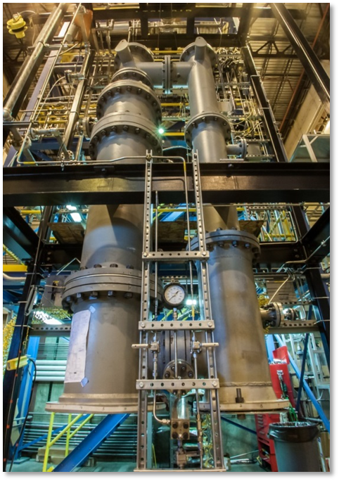
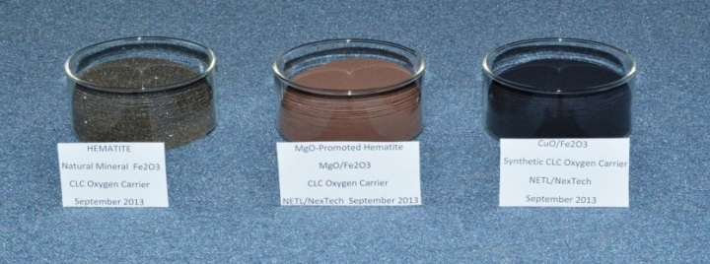
Application: NETL Chemical Looping Reactor
Sensor challenge: 1000°C, 12.5 atm (175 psig)
Hematite
Promoted
Hematite
Synthetic
Carrier
Sensor
location

Slide 4
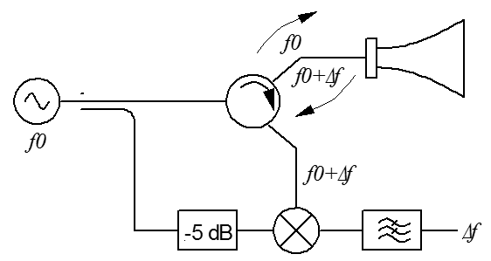
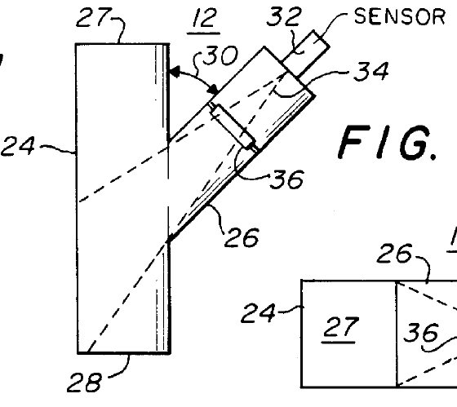
Microwave Doppler
Flow velocity determined from Doppler effect (frequency shift)
Reflection magnitude related to density
particle velocity
θ
36.2 Hz per m/s
at 77° and 24.125 GHz
scattering cross-section
number density

Slide 5
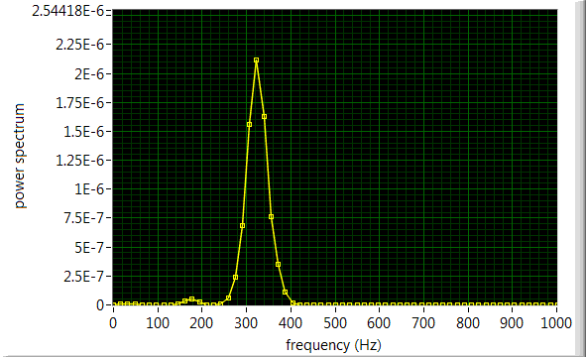
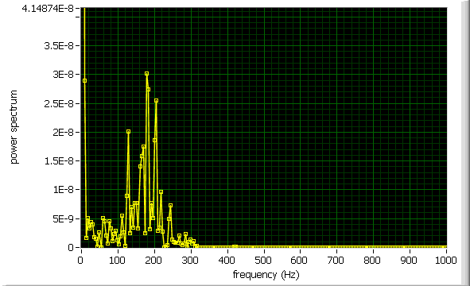
Single particle vs. flow of many particles
Compute Fourier power spectrum of demodulated signal
Get frequency shift of reflected signal
Single Particle
Many Particles
steel ball 0.157" diameter falling 1.8 m, horn angle 42 degrees; 10 GHz
ilmenite falling 2.1 m, horn angle 52 degrees; 10 GHz
Many particles produce a frequency shift distribution

Slide 6
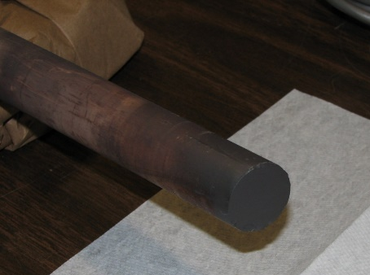
2nd Generation Design
2nd generation design moves pressure boundary away from flow passage, uses hollow stainless steel waveguide
1st Generation design suffered from multiple internal reflections and plating under CLR operating conditions

Slide 7
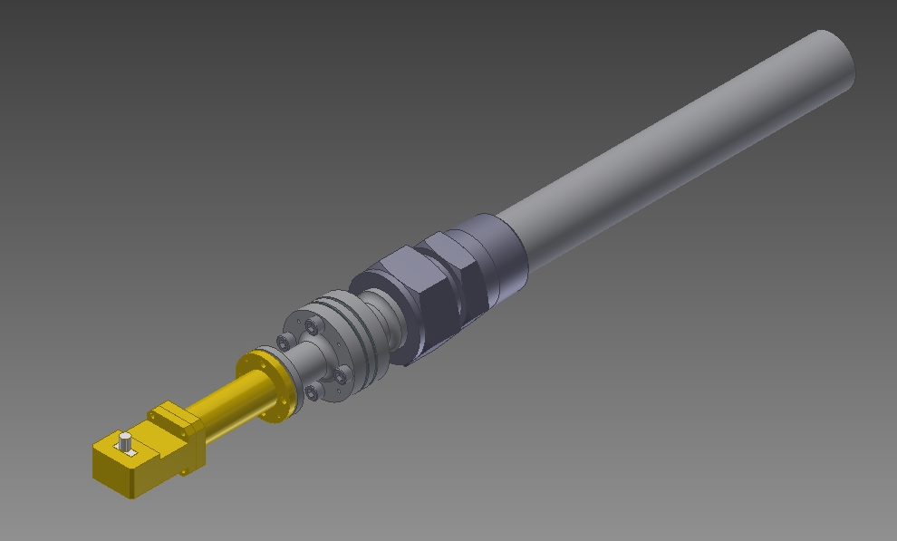
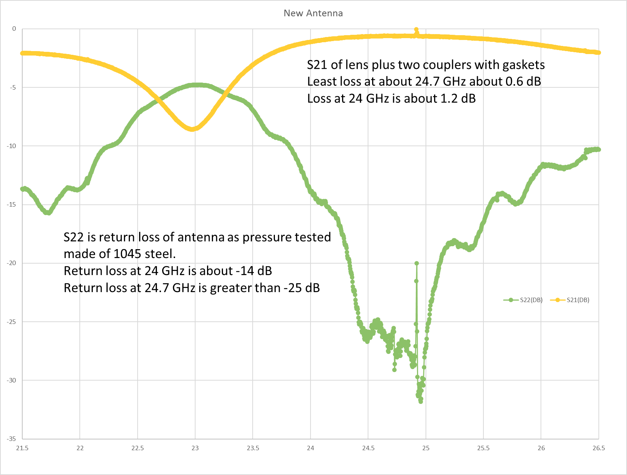
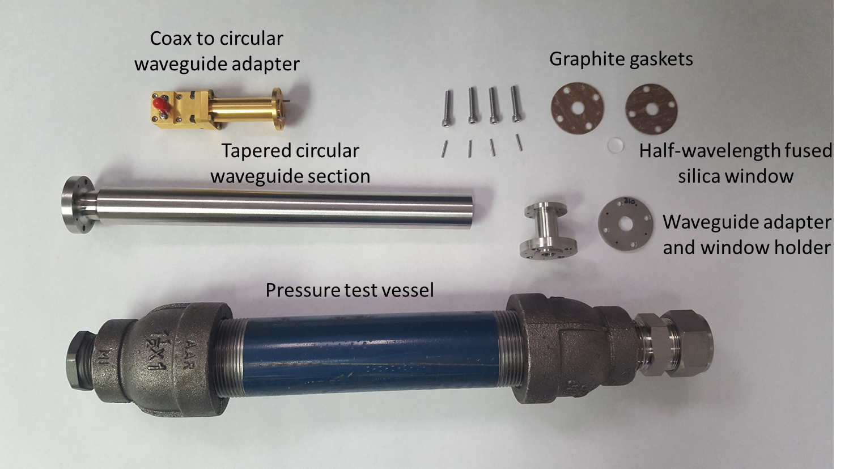
Redesigned High Temperature Antenna
Custom redesigned high temperature antenna
Pressure tested
Bench test of electromagnetic performance with VNA.
Bench testing with CL carrier materials

Slide 8
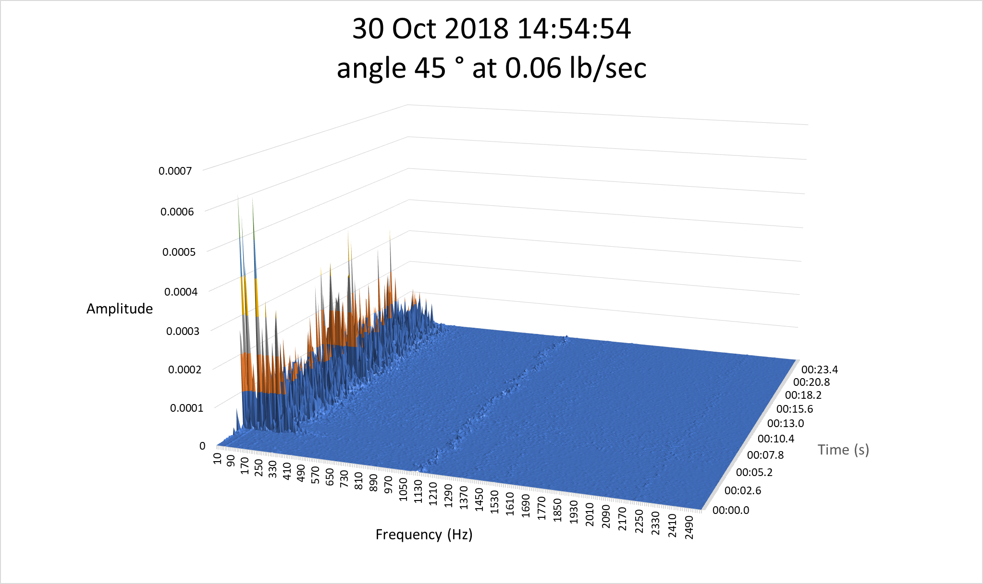
Table feeder results
Drop tube distance to antenna, d = 0.406m
Velocity at antenna from acceleration due to gravity, V = (2*g*d)^{1/2} = 2.822 m/s
Doppler frequency shift,
df = 2*f*V/c*cos (theta)
= 2*24.125E09*2.822/2.998E08*cos(45)
= 321.1Hz
1 m/s = 113.8 Hz

Slide 9
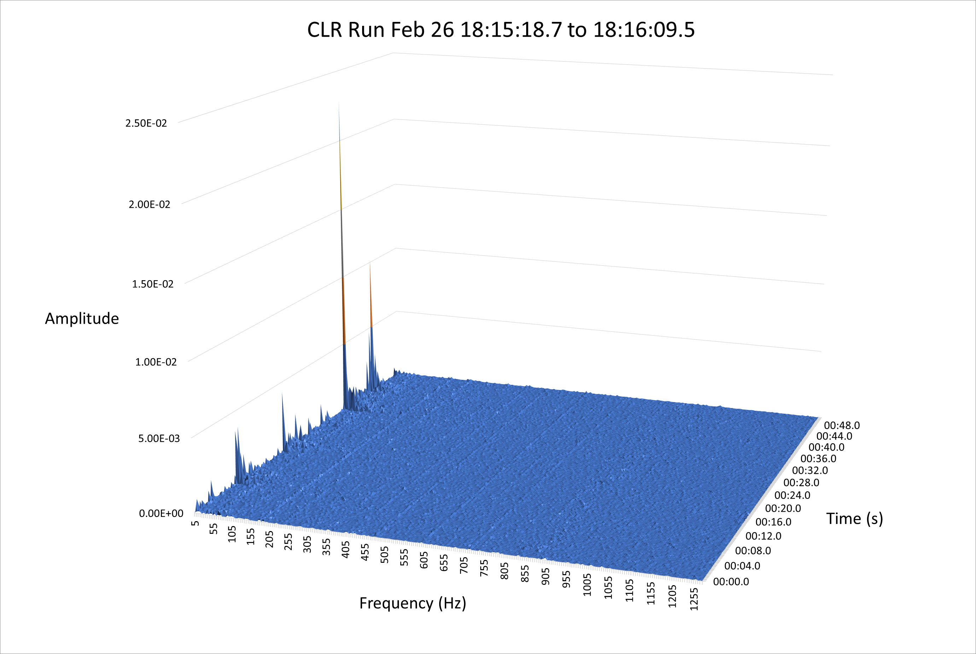
CLR testing results
50 Sec. Microwave data sample during a period of oxygen carrier, CuFe_{1.5}Al_{0.5}O₄ 180-600 micron, circulation.
Temperature in the riser at the time was 816 °C and the gas velocity was around 12.2 m/s.

Slide 10
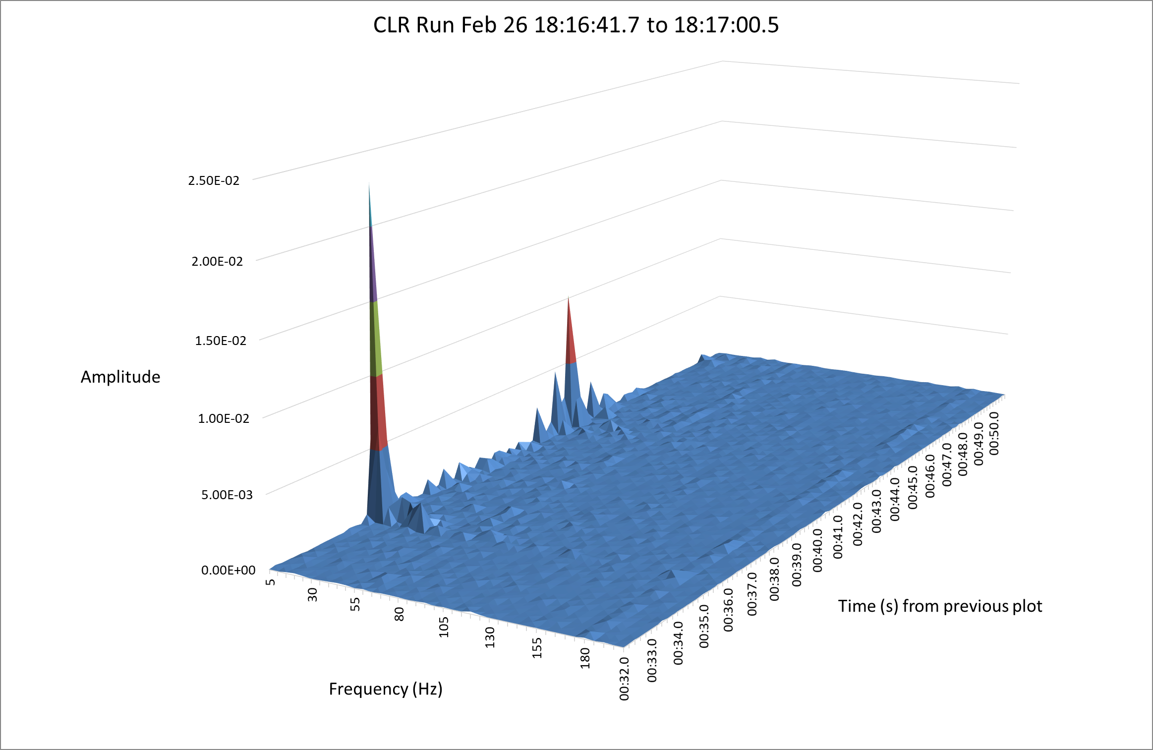
CLR testing results
Zoomed in 18 seconds of previous plot.
At an angle of 77°, 36.2 Hz = 1 m/s
60 Hz = 1.65 m/s

Slide 11
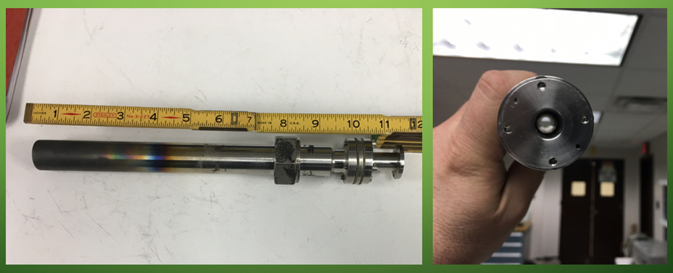
CLR testing results
New antenna after the CLR run

Slide 12
Conclusions and Future Work
New antenna design survived the run and performed well.
Mixer failed part way through run without having been able to calibrate but we did get some qualitative data.
Future work includes exploring more complicated receiver architectures and mass flow extraction algorithms.

Slide 13
Acknowledgment
This work was performed in support of the US Department of Energy’s Fossil Energy Transformative Power Generation Research Program and Advanced Combustion Systems Research Program. The Research was executed through the NETL Research and Innovation Center’s Transformational Technologies for New and Existing Plants FWP. Research performed by Leidos Research Support Team staff was conducted under the RSS contract 89243318CFE000003.
Disclaimer
This work was funded by the Department of Energy, National Energy Technology Laboratory, an agency of the United States Government, through a support contract with Leidos Research Support Team (LRST). Neither the United States Government nor any agency thereof, nor any of their employees, nor LRST, nor any of their employees, makes any warranty, expressed or implied, or assumes any legal liability or responsibility for the accuracy, completeness, or usefulness of any information, apparatus, product, or process disclosed, or represents that its use would not infringe privately owned rights. Reference herein to any specific commercial product, process, or service by trade name, trademark, manufacturer, or otherwise, does not necessarily constitute or imply its endorsement, recommendation, or favoring by the United States Government or any agency thereof. The views and opinions of authors expressed herein do not necessarily state or reflect those of the United States Government or any agency thereof.

