Slide 1

Computational study on biomass fast pyrolysis:
Hydrodynamic effects on the performance of a laboratory-scale fluidized bed reactor
Emilio Ramirez^{1,2}, Charles E.A. Finney¹,
Tingwen Li ³, Mehrdad Shahnam⁴, C. Stuart Daw¹
¹ Oak Ridge National Laboratory, Oak Ridge TN 37831 USA
² University of Tennessee, Knoxville TN 37996 USA
³ SABIC Americas, Sugar Land TX 77478 USA
⁴ National Energy Technology Laboratory, Morgantown WV 26507 USA
Presented at the 2019 U.S. Department of Energy,
National Energy Technology Laboratory’s (NETL)
Workshop on Multiphase Flow Science
Morgantown, West Virginia, August 7, 2019
This research used resources of the Compute and Data Environment for Science (CADES) at the Oak Ridge National Laboratory, which is supported by the Office of Science of the U.S. Department of Energy under Contract No. DE-AC05-00OR22725
Notes:
notes:

Slide 2
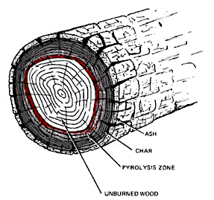
Background and Motivation (1)
Thermochemical conversion of biomass via fast pyrolysis
High yield and composition of raw oil are key, so commercial risk and economics depend on accurate performance predictions.
Most available basic lab data are from bubbling fluidized bed reactors (FBRs).
Good physics-based models are necessary for interpreting and scaling up lab experiments.
Source: Heat-Its Role in Wildland Fire by Clive M. Countryman
Ash
Char
Pyrolysis Zone
Unburned wood
Vapor Phase Upgrading (VPU)
Pyrolysis
Raw Biomass
Non-condensable
Gas
Hydrocarbon
Fuel Feedstock
Raw Bio-
Oil Vapor
(Tar)
Stable
Bio-Oil
Vapor
Biomass Feed Preprocessing
Fast Pyrolysis
Vapor Phase Catalytic Upgrading
Condensation
Liquid Phase Catalytic Upgrading
Char & Recycle
Bed Solids
Aqueous
Phase
Hydrogen
Notes:
What is fast pyrolysis?

Slide 3
How do bubbling-bed hydrodynamics affect raw oil yield & composition?
Background and Motivation (2)
Hydrodynamics directly impact:
Particle residence time
Gas residence time
Particle heating rate
Particle attrition/fragmentation
Particle and ash elutriation
Particle segregation
All the above significantly impact raw oil yield and composition.
Figure: S.-H. Lee, M.-S. Eom, K.-S. Yoo, N.-C. Kim, J.-K. Jeon, Y.-K. Park, B.-H. Song, S.-H. Lee, The yields and composition of bio-oil produced from quercus acutissima in a bubbling fluidized bed pyrolyzer, J. Anal. Appl. Pyrolysis 83 (2008) 110-114. http://dx.doi.org/10.1016/j.jaap.2008.06.006
We need to have one or more slides that summarize graphically the major factors that affect raw oil yield in bubbling beds: particle residence time, gas residence time, particle heating rate, particle attrition/fragmentation, particle and ash elutriation, particle segregation. We want it to be obvious to folks why these factors matter.
Notes:
Are there specific conditions that are critical to yield?

Slide 4
Approach (1)
MFiX simulations of FBR pyrolysis
Two-Fluid Model
Pyrolysis reactor physics
Char Particle elutriation
  Version and assumptions:
    Eulerian-Eulerian (Two-Fluid Model)
    Syamlal-O’Brien drag model
    Kinetic theory of granular flow
        Schaeffer frictional stress tensor formulation
        Sigmoidal stress blending function
    Modified SIMPLE integration with variable time stepping
    Jackson and Johnson partial-slip wall boundary condition
    3D cylindrical
    Constant biomass density (char)
    Liden reduced kinetics for biomass
    DLSODA ODEPACK chemistry solver
      First-order irreversible Arrhenius rates
      Liden 1988 biomass pyrolysis kinetics
Tar (oils)
Gas
Particle
k1
tar
k3
gas
Particle Segregation
wood
gas + char
k2
Bed of sand particles
gas
Ramirez, E., Finney, C. E. A., Pannala, S., Daw, C. S., Halow, J., & Xiong, Q. (2017). Computational study of the bubbling-to-slugging transition in a laboratory-scale fluidized bed. Chemical Engineering Journal, 308, 544-556. doi:https://doi.org/10.1016/j.cej.2016.08.113
Notes:
Is there a less complex approach to model this reactor?

Slide 5
Approach (2)
Interpret MFIX Results with Low-Order Models
Use simplified reactor models to ‘compress’ essential hydrodynamic information from MFIX and combine it with pyrolysis chemistry
Tar (oils)
Gas
  Quantify impact of bubbles and bed solids circulation on biomass solids and pyrolysis vapor residence time distributions (RTDs)
  Identify major reaction/mixing zones needed to understand/approximate performance trends
  Relate solids and gas RTDs to predict trends for how biomass particle properties and reaction chemistry impact overall yields
  Utilize low-order models for rapid studies of operating/design parameter sweeps
Mixing and residence time
Bed of sand particles
gas

Slide 6
Fast pyrolysis model using low-order chemistry + MFiX-based hydrodynamics (‘Hybrid’ modeling approach)
Approach (3)
Step 1. Use MFiX gas and biomass RTDs to create zone reactor model approximation
Step 2. Use zone model + Liden kinetics to predict yields
E. Ramirez, Tingwen Li, Mehrdad Shahnam, C. Stuart Daw, Computational study on biomass fast pyrolysis: Hydrodynamic effects on the performance of a laboratory-scale fluidized bed reactor, Manuscript in preparation.
Notes:
What type of physics are we trying to capture with the model?

Slide 7
Approach (4)
Compare MFiX predictions with target reactor data
P_{out} = 101 kPa
P_{out} = 101 kPa
Key steps:
  Simulate expected particle and gas RTDs with MFiX including segregation and elutriation
  Questions:
  Are MFiX mixing patterns consistent with the literature?
  Can existing FB correlations capture MFiX predicted RTD trends?
  When chemistry is added, do predicted bio-oil yields agree with experiments?
  Are MFiX improvements needed?
P_{out} = 101 kPa
Freeboard
Freeboard
Freeboard
50 cm
40.1 cm
43 cm
Expanded Bed
Expanded Bed
Expanded Bed
11.5 cm
diameter
Static Bed
H_{o}=15.92 cm
10 cm
diameter
Static Bed
H_{o}=16.3 cm
5 cm
Static Bed
H_{o}=10 cm
H.C. Park, H.S. Choi, The segregation characteristics of char in a fluidized bed with varying column shapes, Powder Technology 246 (2013) 561-571.
F. Berruti, A.G. Liden, D.S. Scott, Measuring and modelling residence time distribution of low density solids in a fluidized bed reactor of sand particles, Chemical Engineering Science 43 (1988) 739-748.
ṁ_{inlet}
ṁ_{inlet}
ṁ_{inlet}
Mixing biomass char
Park and Choi 2013
RTD study
Berruti 1988
NREL Pyrolysis Experiment
Notes:
Simulation must capture at least 3 product yields to compare with experiments
Tar (or oil) treated as a heavy molecular gas
Gas considered light, non-condensable gases
Char particle phase properties must be defined such that particle can elutriate
scale up and temperature
lab to industrial

Slide 8
Approach (5)
NREL pyrolyzer conditions

Slide 9
Results (1)
Comparison of the three models with experimental yields

Slide 10
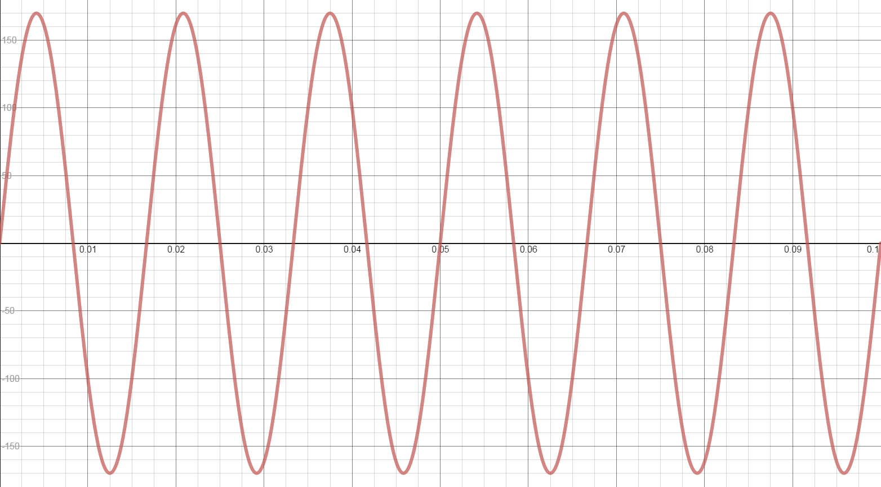
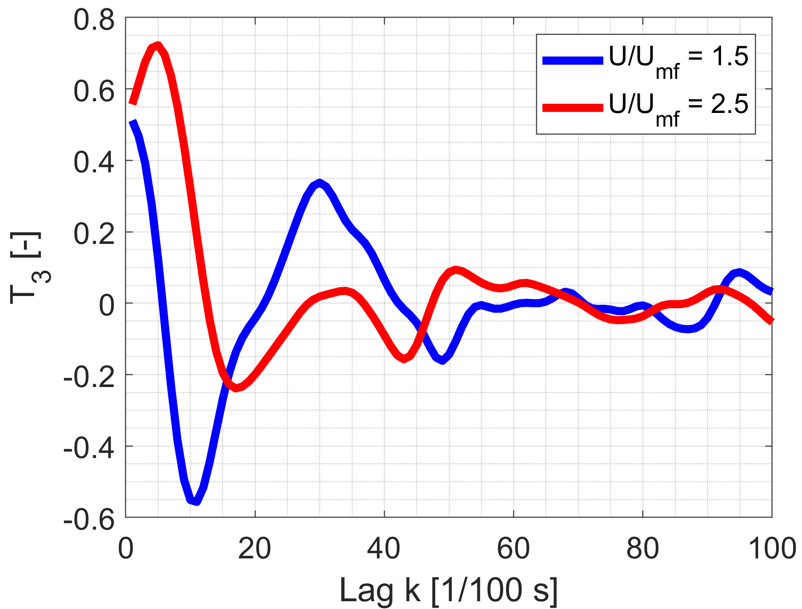
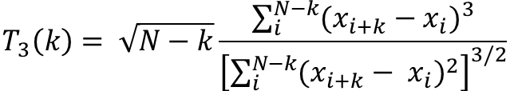
Approach (5)
Time-irreversibility functions show change in bubble passage profiles
Sine wave (reversible)
Sawtooth wave (irreversible)
Forward time
Reverse time
$$T_{3}\left(k\right)= \sqrt{N−k}\frac{\sum_{i}^{N−k}{{(x_{i+k}−x_{i})}^{3}}}{{\left[\sum_{i}^{N−k}{{(x_{i+k}− x_{i})}^{2}}\right]}^{3/2}}$$
Summary metrics: magnitude and location (lag) of maximum T₃
Observable: time series of a variable at a chosen location
Notes:
What other metrics can we quantify?

Slide 11
Results (2)
Time-irreversibility metric captures bubbling-to-slugging transition
Maximum time irreversibility
Location of maximum time irreversibility
Bubbling-to-slugging transition
Max (T3) [-]
Bubbling-to-slugging transition
Fully developed slugging
Max (T3) [s]
Bubbling
Bubbling
Fully developed slugging
2
3
4
2
3
4
U/U_{mf}
U/U_{mf}
Observable: time series of bed pressure averaged over slice of 0.9–1.0 ∙ H₀
“Jitter” due to finite-sample effects (limited observation time of ~30–40 s)
Notes:
What other metrics can we quantify?

Slide 12
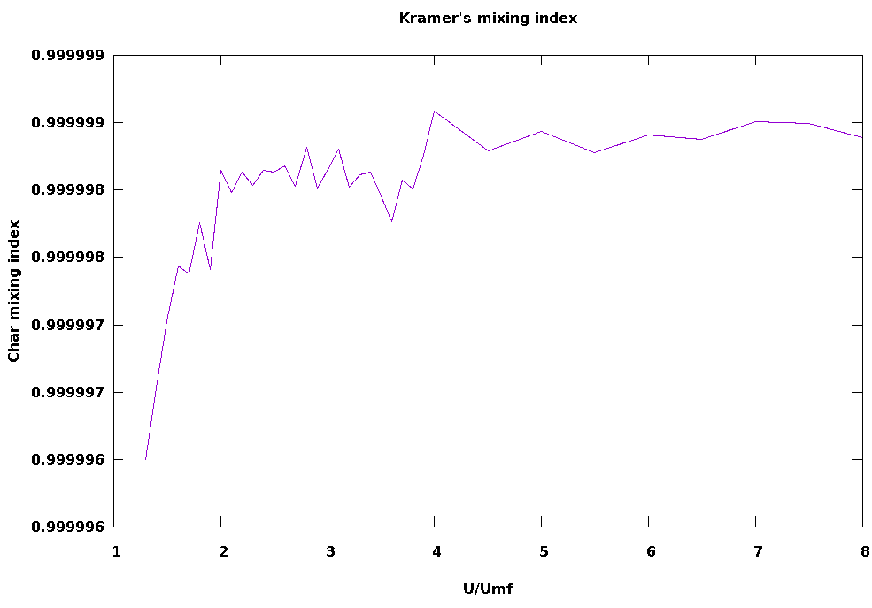
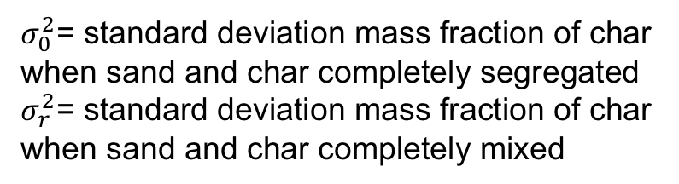
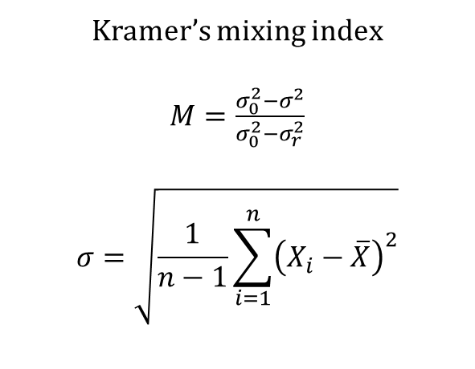
Results (3)
Char mixing changes with fluidization regime
Fluidization regime affects char particle mixing intensity
Hydrodynamics must be considered
0.999999
Kramer’s mixing index
$M=\frac{σ_{0}^{2}−σ^{2}}{σ_{0}^{2}−σ_{r}^{2}}$
$$σ=\sqrt{\frac{1}{n−1}\sum_{i=1}^{n}{{\left(X_{i}−\overline{X}\right)}^{2}}}$$
0.999998
Char mixing index
Bubbling-to-slugging transition
Fully developed slugging
0.999997
Bubbling
Turbulent
0.999996
$σ_{0}^{2}$= standard deviation mass fraction of char when sand and char completely segregated
$σ_{r}^{2}$= standard deviation mass fraction of char when sand and char completely mixed
2
4
6
8
U/U_{mf}
Gyenis, J. (1999). Assessment of mixing mechanism on the basis of concentration pattern. Chemical Engineering and Processing: Process Intensification, 38(4), 665-674. doi:10.1016/S0255-2701(99)00066-5
Notes:
Anything else unique at these fluidization regimes?

Slide 13
Results (4)
Char spatial distribution changes with fluidization regime
At bubbling-to-slugging transition char concentration at bottom decreases, but increase in top
At slugging more char in top region
At turbulent least char in the bed
Note: this considers up to H₀ and does not include freeboard.
Notes:
Does fluidization regime affect biomass fast pyrolysis chemistry?

Slide 14
Results (5)
Bubbles/mixing/elutriation affect pyrolysis yield
Bubbling-to-slugging transition
Fully developed slugging
Turbulent
Slugging beds reach a maximum in tar (oil) yield in the bubbling-to-slugging transition
Maximum tar (oil) yield occur at turbulent fluidization where slip velocity between gas and particles is high with a very short residence time
Bubbling
U/U_{mf}
“Jitter” due to finite-sample effects (limited bubble events seen during tracing)
Notes:
What other operating parameters affect pyrolysis yield?

Slide 15
Results (6)
Particle size and density affect residence time distribution
Biomass particle size
Biomass particle density
Particle size and density must be selected carefully such that elutriation will occur
Pecha, M. B., Ramirez, E., Wiggins, G. M., Carpenter, D., Kappes, B., Daw, S., & Ciesielski, P. N. (2018). “Integrated Particle- and Reactor-Scale Simulation of Pine Pyrolysis in a Fluidized Bed.” Energy & Fuels, 32(10), 10683-10694.

Slide 16
Results (7)
Char concentration varies with particle size and feed rate
100 μm char
278 μm char
Larger particles create char layer at top of sand bed and freeboard region
Tar vapors may be reduced through the char layer
Char particle concentration changes bed particle size distribution and possibly fluidization
0.1181 g/s particle feed rate
Monodisperse cases from among 100–500 μm PSD
Notes:
Why is char concentration important?
In summary

Slide 17
Concluding remarks
Quantifying the combined effects of hydrodynamics and chemistry is essential in utilizing lab-scale biomass pyrolysis reactor data for scale up
Biomass particle properties and fluidization intensity have major impacts on product yields
Two-fluid codes like MFiX can yield useful details about pyrolyzer hydrodynamics and gas and solid RTDs but improvements to the physics are still needed
Combining MFiX hydrodynamics with low-order chemistry models appears to offer potential benefits
Biomass pyrolysis reactor geometry and operating conditions must be designed in conjunction with a model that can capture the physics of interest
Biomass particle properties and feed rate have the potential to negatively affect pyrolysis yield and composition
Char mixing and concentration in the bed and freeboard should be considered at the reactor design stage

Slide 18

Acknowledgements
This research was supported by the U.S. Department of Energy Bioenergy Technologies Office (BETO) as part of ChemCatBio, an Energy Material Network, and the Consortium for Computational Physics and Chemistry. The authors would like to thank BETO sponsors Jeremy Leong, Cynthia Tyler, and Kevin Craig for their guidance and support.
NREL – Brennan Pecha, Kristiina Iisa, Kristin Smith, Katherine
Gaston, Jessica Olstadt, Thomas Foust, Rick French,
Danny Carpenter, Peter Ciesielski
NETL – William Rogers, Justin Weber, Dirk VanEssendelft
ORNL – Gavin Wiggins, James Parks, John Turner,
Maggie Connatser, Charles Finney
SABIC – Sreekanth Pannala
University of Tennessee – Nourredine Abdoulmoumine and
Biomass convErsion And Modeling (BEAM) team,
Bredesen Center for Interdisciplinary Research and Graduate Education
www.chemcatbio.org
cpcbiomass.org

Slide 19





Questions?
Emilio Ramirez – eramire2@vols.utk.edu
Consortium for
Computational
Physics and
Chemistry
http://cpcbiomass.org

Slide 20
Extra slides if there are questions

Slide 21
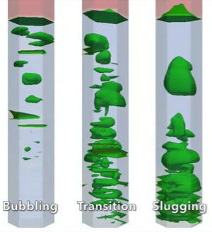
Background and Motivation (3)
How should lab FBR data be interpreted/analyzed?
FB Hydrodynamics directly impact:
Particle residence time
Gas residence time
Particle heating rate
Particle attrition/fragmentation
Particle and ash elutriation
Particle segregation
All the above significantly impact raw oil yield and composition.
Bubble dynamics
Bubbling regime
  gas/solid particle mixing intensity increases with fluidizing gas mass flow
Slugging regime
  Gas and solid particles not mixed well
  Gas bypassing through bubbles
Bubbling to Slugging Transition
  Mixture of bubbling and slugging
Note: Bubble boundary depicted where void fraction > 0.65
E. Ramirez, C.E.A. Finney, S. Pannala, C.S. Daw, J. Halow, Q. Xiong, Computational study of the bubbling-to-slugging transition in a laboratory-scale fluidized bed, Chemical Engineering Journal 308 (2017) 544-556. http://dx.doi.org/10.1016/j.cej.2016.08.113

Slide 22
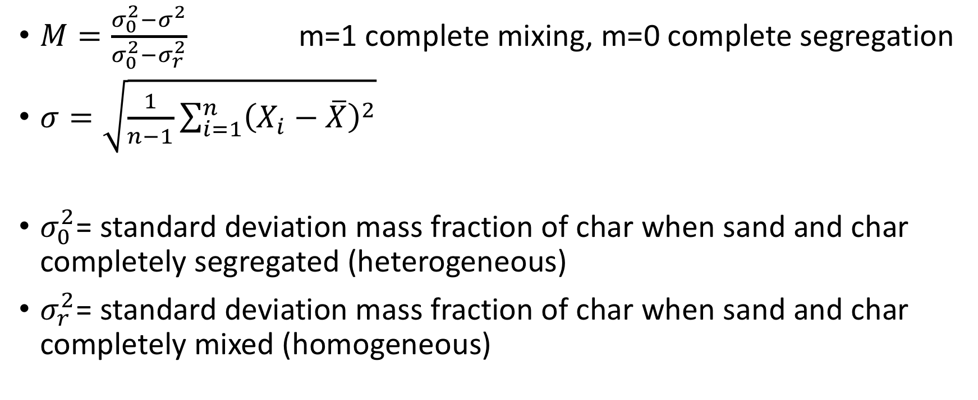
Kramer’s mixing index for char mixing
$M=\frac{σ_{0}^{2}−σ^{2}}{σ_{0}^{2}−σ_{r}^{2}}$ m=1 complete mixing, m=0 complete segregation
$σ=\sqrt{\frac{1}{n−1}\sum_{i=1}^{n}{{\left(X_{i}−\overline{X}\right)}^{2}}}$
$σ_{0}^{2}$= standard deviation mass fraction of char when sand and char completely segregated (heterogeneous)
$σ_{r}^{2}$= standard deviation mass fraction of char when sand and char completely mixed (homogeneous)
Created segregated and complete mixed case for analysis
Gyenis, J. (1999). Assessment of mixing mechanism on the basis of concentration pattern. Chemical Engineering and Processing: Process Intensification, 38(4), 665-674. doi:10.1016/S0255-2701(99)00066-5
Pu, W., Zhao, C., Xiong, Y., Liang, C., Chen, X., Lu, P., & Fan, C. (2010). Numerical simulation on dense phase pneumatic conveying of pulverized coal in horizontal pipe at high pressure. Chemical Engineering Science, 65(8), 2500-2512. doi:10.1016/j.ces.2009.12.025

Slide 23


Complete mixing case (Homogeneous)
Static bed height
MFiX has multiple cells 10620 cells in static bed height
Each cell char and sand mass measured (time averaged time 15-19 s)
Char fraction in each cell used for stats (standard deviation)
20 cm
118 cells
$σ_{r}^{2}$=0 (standard deviation)
Assumption for fully mixed:
Bed region emulsion and bubbles have the same char fraction throughout
6 cells
azimuthal
2.54 cm
15 cells radial

Slide 24


Complete segregated case (Heterogenous)
MFiX has multiple cells 10620 cells in static bed height
Each cell char and sand mass measured (time averaged time 15-19 s)
Char fraction in each cell used for stats (standard deviation)
Char layer volume based on 0.51 void fraction (expanded bed-fluidized).
$σ_{0}^{2}$=0.312996541687 (standard deviation)
Static bed height
Char layer 0.2 cm
Assumption for fully segregated:
Char layer above bed of sand is just char. Bubbles and emulsion in char layer have the same char fraction =1.
20 cm
118 cells
6 cells
azimuthal
2.54 cm
15 cells radial

Slide 25

Mixing cases (1.3 – 8.0 U_{mf})
MFiX has multiple cells 10620 cells in static bed height
Each cell char and sand mass measured (time averaged time 15-19 s)
Char fraction in each cell used for stats (standard deviation)
$σ_{r}^{2}$ (standard deviation)
Static bed height
Assumption for mixing cases:
Char mass fraction=
char mass/(char mass + sand mass)
Averaged of 15.0 – 19.0 seconds
Bubbling bed at stationary state
20 cm
118 cells
6 cells
azimuthal
2.54 cm
15 cells radial

Slide 26
Phase 3: Preliminary Work
What is unique about bubbles that affects RTD and yields?
Total Gas Flow =
dense flow
+ visible bubble flow
+ through-flow
Bubble swarms offer low-resistance pathway for shortcut of gas => minimal contact with dense phase
A. Bakshi, C. Altantzis, R.B. Bates, A.F. Ghoniem, Multiphase-flow statistics using 3d detection and tracking algorithm (ms3data): Methodology and application to large-scale fluidized beds, Chemical Engineering Journal 293 (2016) 355-364. http://dx.doi.org/10.1016/j.cej.2016.02.058

Slide 27
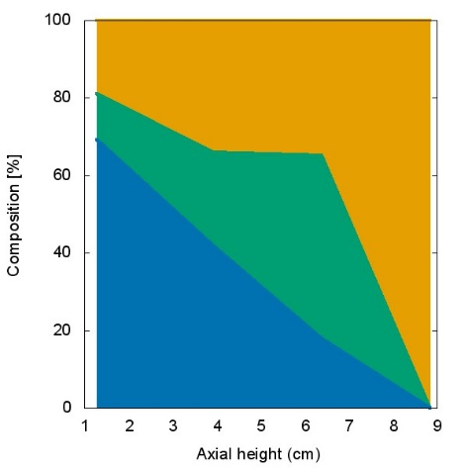
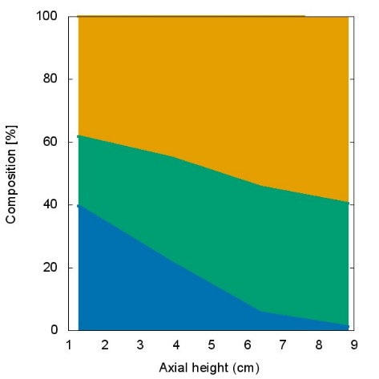
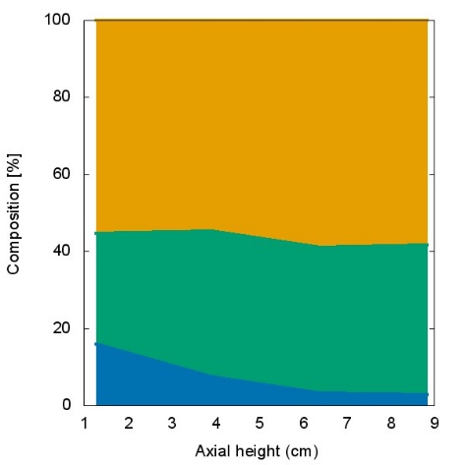
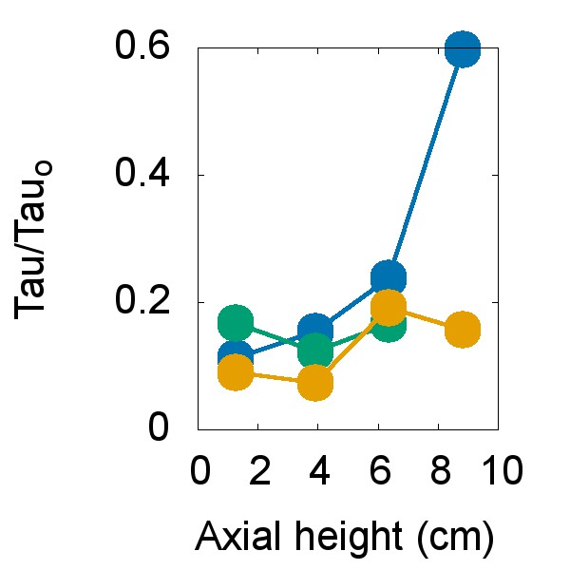
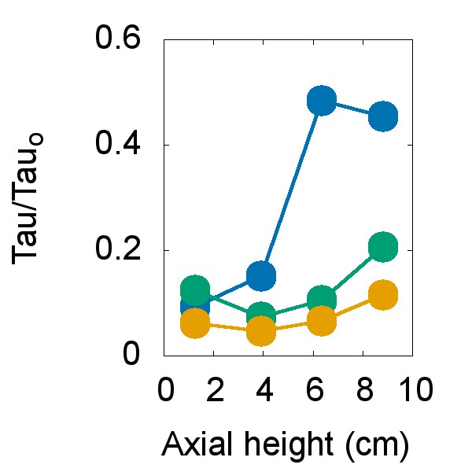
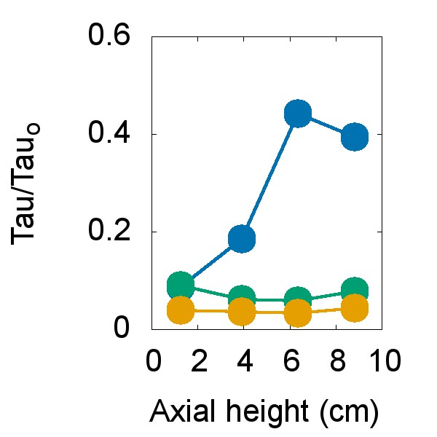
Phase 3: Preliminary: Pyrolysis chemistry + CFD
Low Flow 2.4 U_{mf}
Medium Flow 4.4 U_{mf}
High Flow 8.4 U_{mf}
Bubbles affect residence time along reactor height
Through flow
Through flow
Through flow
Bubble
Bubble
Bubble
Dense
Dense
Dense
Time (s)

Slide 28
Peer reviewed publications
Ramirez, E., Li, T., Shahnam, M., & Daw, C. S. (In Preparation). “Computational study on biomass fast pyrolysis: Hydrodynamic effects on the performance of a laboratory-scale fluidized bed reactor.” Chemical Engineering Journal.
Ramirez, E., Finney, C.E.A., Daw, C. S. (In Preparation). “Computational study on biomass fast pyrolysis: Design considerations for a laboratory-scale fluidized bed.” Chemical Engineering Journal.
Pecha, M. B., Ramirez, E., Wiggins, G. M., Carpenter, D., Kappes, B., Daw, S., & Ciesielski, P. N. (2018). “Integrated Particle- and Reactor-Scale Simulation of Pine Pyrolysis in a Fluidized Bed.” Energy & Fuels, 32(10), 10683-10694.
Ramirez, E., Finney, C.E.A., Pannala, S., Daw, C.S., Halow, J., Xiong, Q. (2017). "Computational study of the bubbling-to-slugging transition in a laboratory-scale fluidized bed." Chemical Engineering Journal, 308: 544-556.
Xiong, Q., et al. (2016). "Modeling the impact of bubbling bed hydrodynamics on tar yield and its fluctuations during biomass fast pyrolysis." Fuel 164: 11-17.
Daw, C.S., Wiggins, G., Xiong, Q., Ramirez, E. (2016) “Development of a Low-Order Computational Model for Biomass Fast Pyrolysis: Accounting for Particle Residence Time.” ORNL/TM-2016/69.
Clark, E., Griffard, C., Ramirez, E., & Ruggles, A. (2015). Experiment attributes to establish tube with twisted tape insert performance cooling plasma facing components. Fusion Engineering and Design, 100, 541-549.

