Slide 1
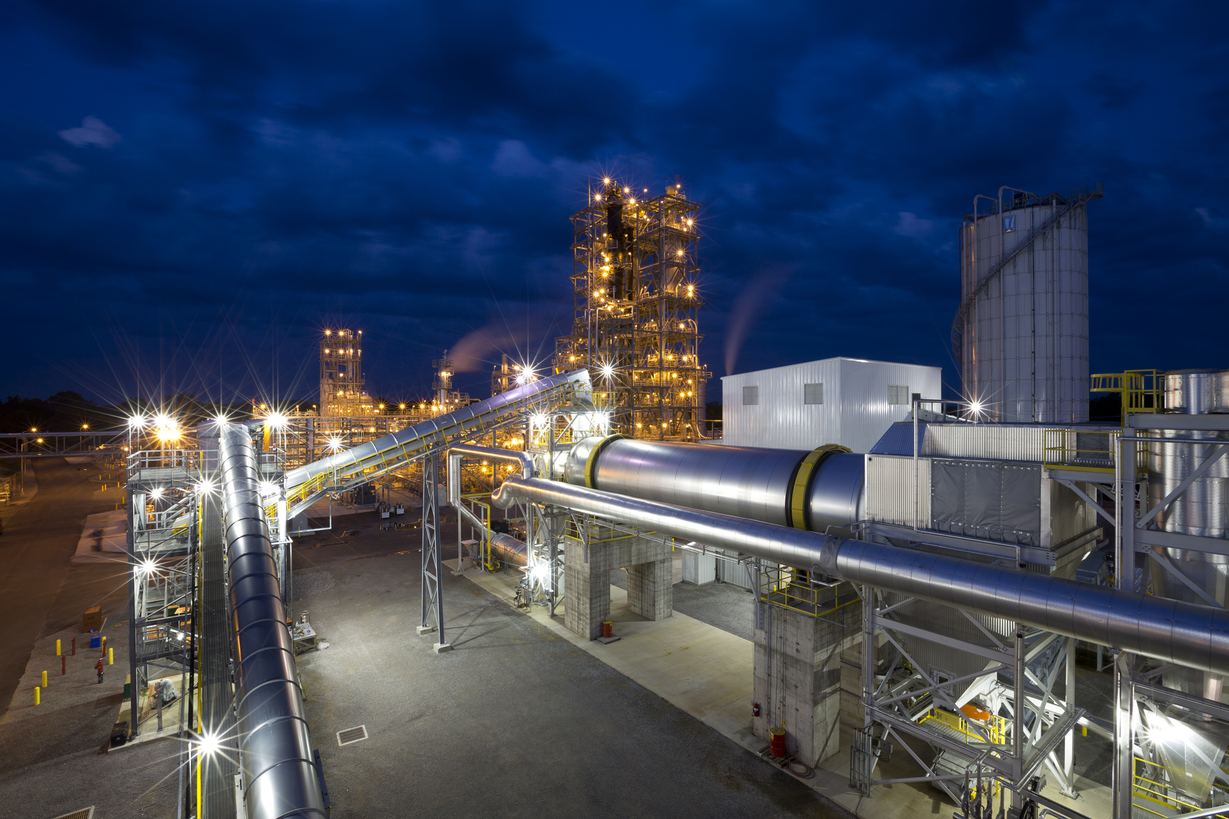


CFD Modeling of KiOR’s Proprietary CFP Reactors Using Barracuda™
NETL Multiphase Workshop 2019
Bruce Adkins*
* Formerly KiOR/Inaeris, Currently at ORNL

Slide 2
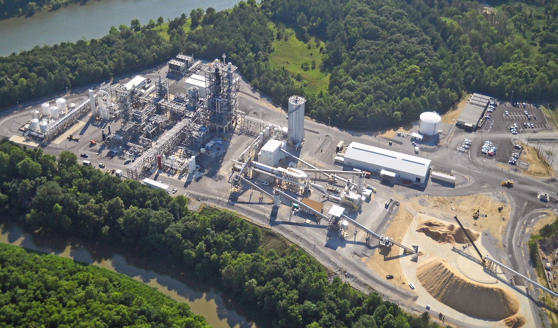
Columbus Plant: 500 T/day Biomass
Flipping & Decanting
N2 Plant
Distillation
Converter
VRU
Product
Tanks
Feed Silo
Milling & Sizing
SMR
Hydrotreaters
Existing
Chip Mill
Dryer
5 Quarters, ~1,000,000 Gallons

Slide 3
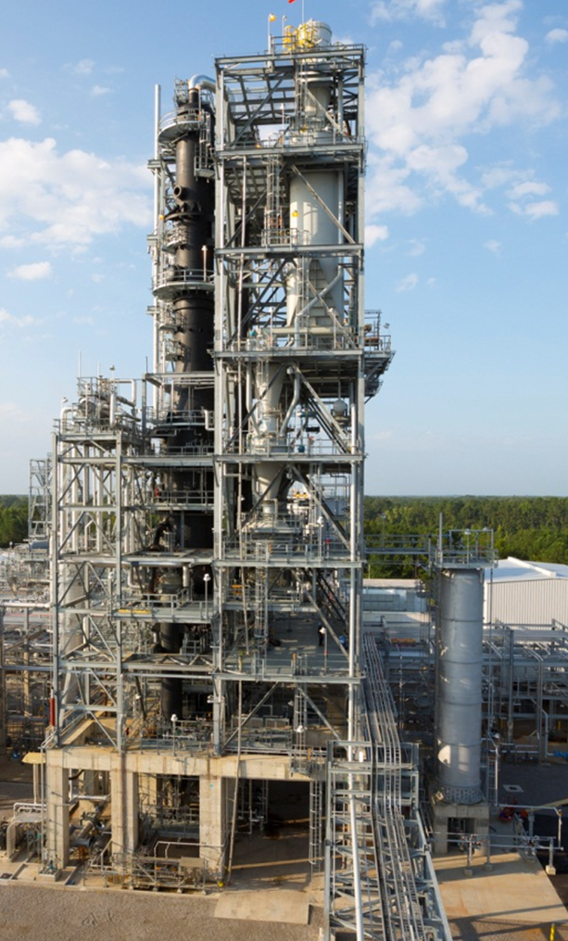
KiOR’s in-Situ CFP Process is Based on FCC
Product Vapors
Flue
Gas
Stripper
Spent (Coked)
Catalyst
Riser Reactor
Regenerator
Steam
Biomass
100-1000 μm
D50 ~ 400 μm
Regenerated
Catalyst (e-cat)
D50 65-95 μm
Lift Gas
Air

Slide 4
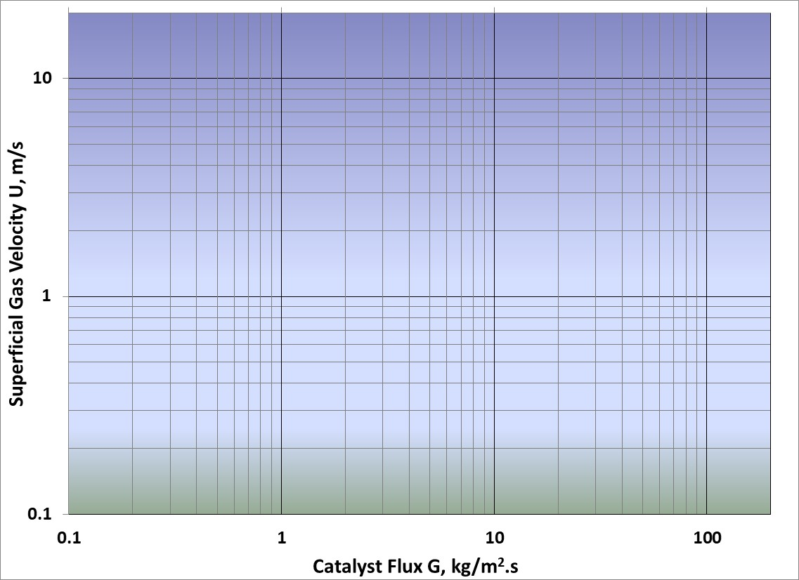
Hydrodynamic Regime Map
Fast Fluidization
(Riser)
FCC
BFCC
Transport Rxr
Turbulent Moving Bed
Bubbling Moving Bed

Slide 5
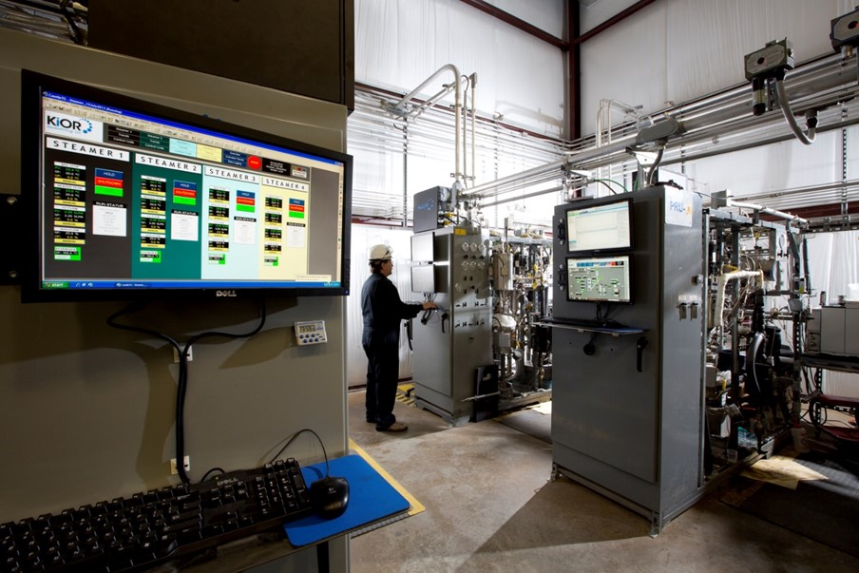
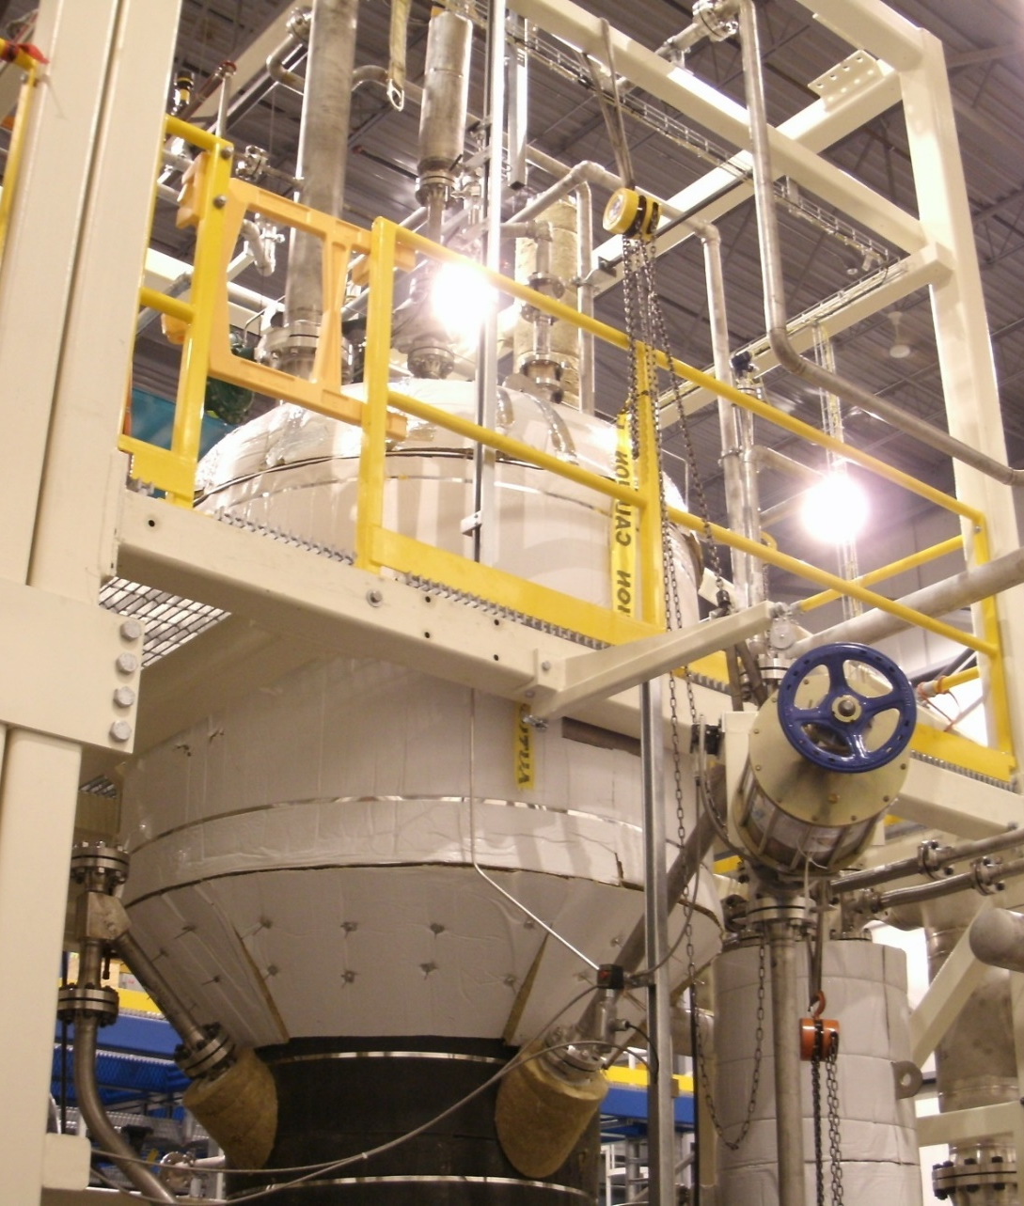
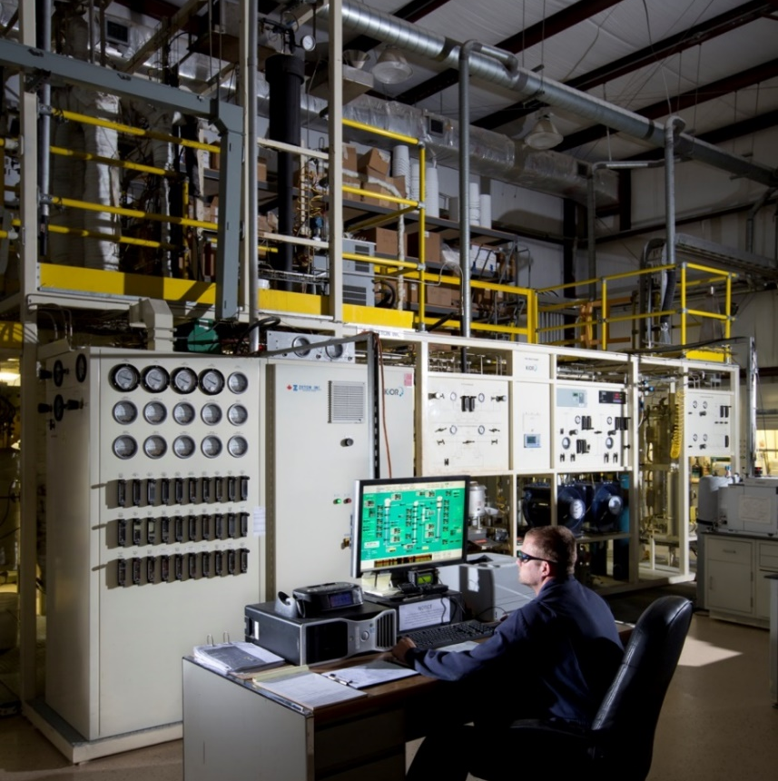
KiOR’s Test Units
10 TPD Demo
> 18,000 Hrs
PRUs x 3
> 9,000 Tests
KCRs x 2
> 50,000 Hrs

Slide 6
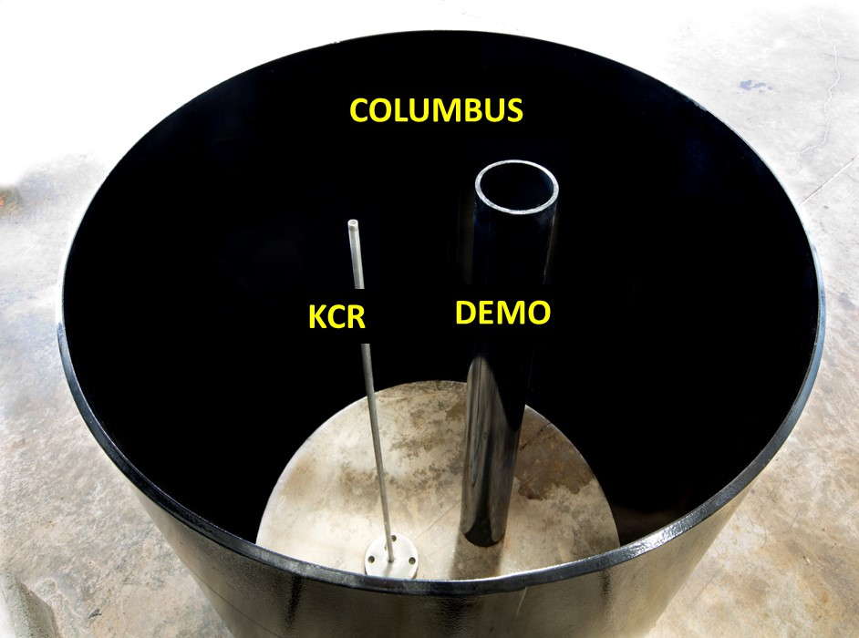
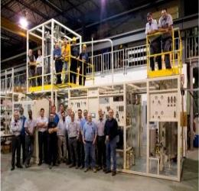
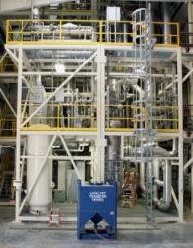
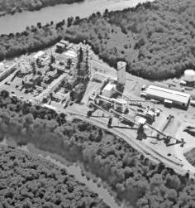
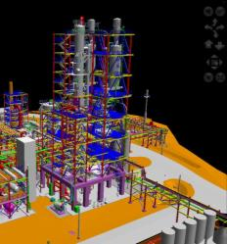
Scaleup Path
CFD .
2,200
(BDT/Day)
500
(BDT/Day)
10
(BDT/Day)
0.025
(BDT/Day)
400X
Scale Up
220X
Scale Up
Pilot Plant
Demo Unit
Columbus Plant
nth Plant

Slide 7
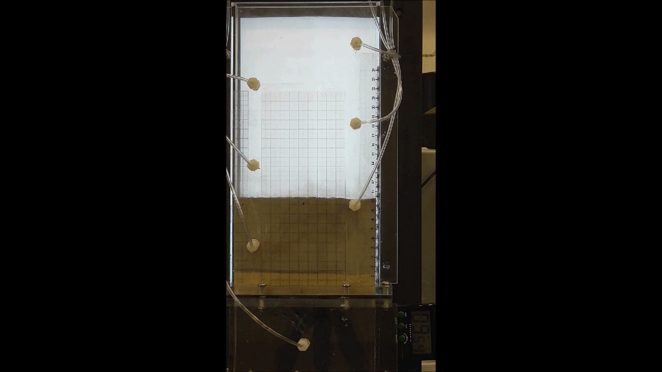
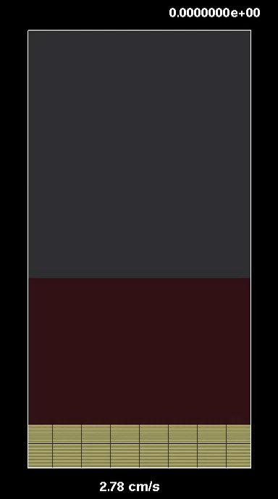
Mix Chamber Part 1
U = 2.8 cm/s

Slide 8
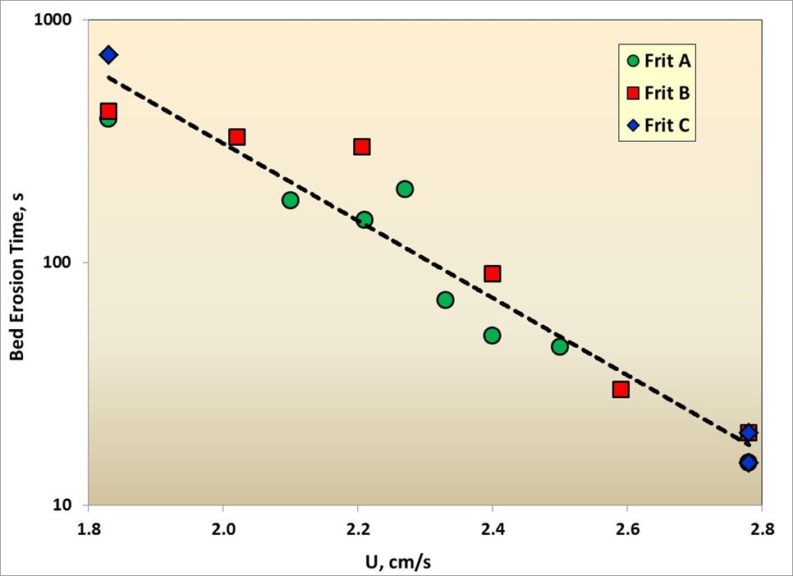
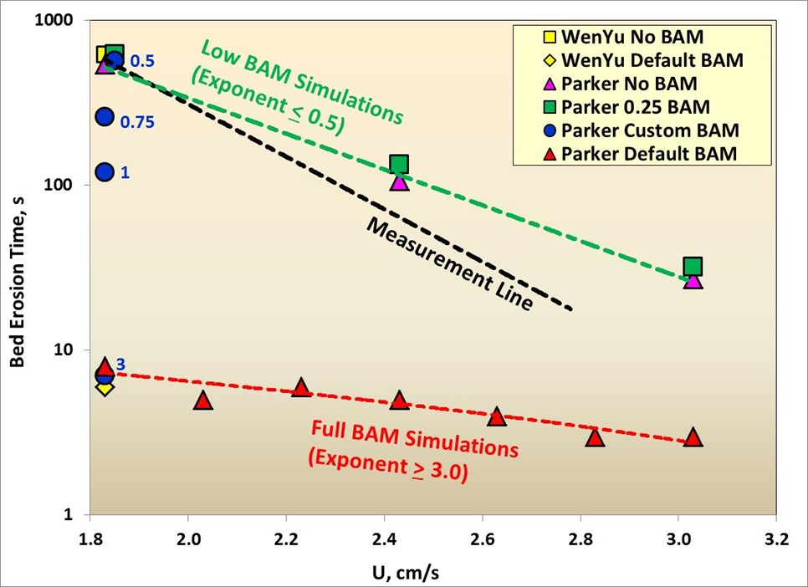
Mix Chamber Part 1
Experiments vs CFD
Experiments
Two orders of magnitude reduction in erosion time, with less than doubling of velocity!
Set the baseline drag model (Parker-2) and Blended Acceleration Model (BAM) exponent
B. Adkins, N. Kapur, J. Parker, P. Blaser, J. Prendergrass, “KiOR Update: Incorporating Barracuda® in Our Development Process”
  Barracuda Users Conference, Oct 2015
  AIChE Annual Meeting, Nov 2015
  tcBiomass, Nov 2015

Slide 9
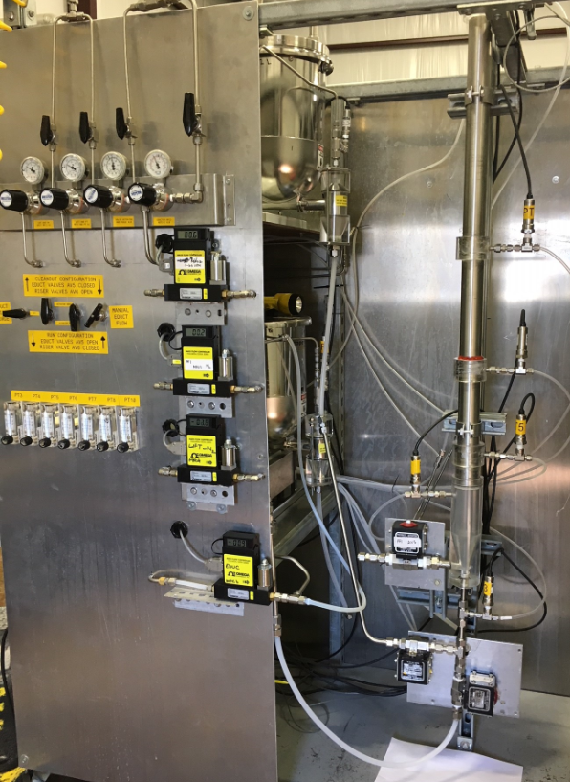
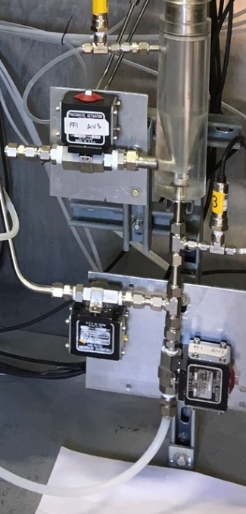
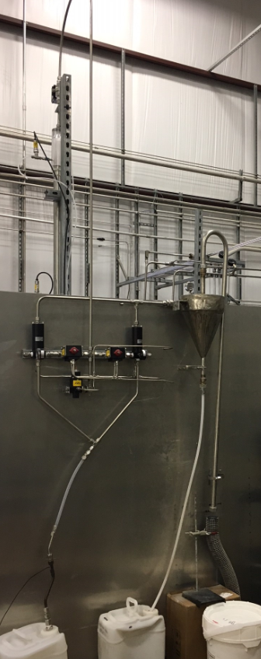
Cold Flow Unit for Producing KCR-Scale CFD Validation Data
Catalyst Feeder
Isolation
Valves
PTs
Cyclone
Biomass Feeder
MFCs
Venturi
Eductors

Slide 10
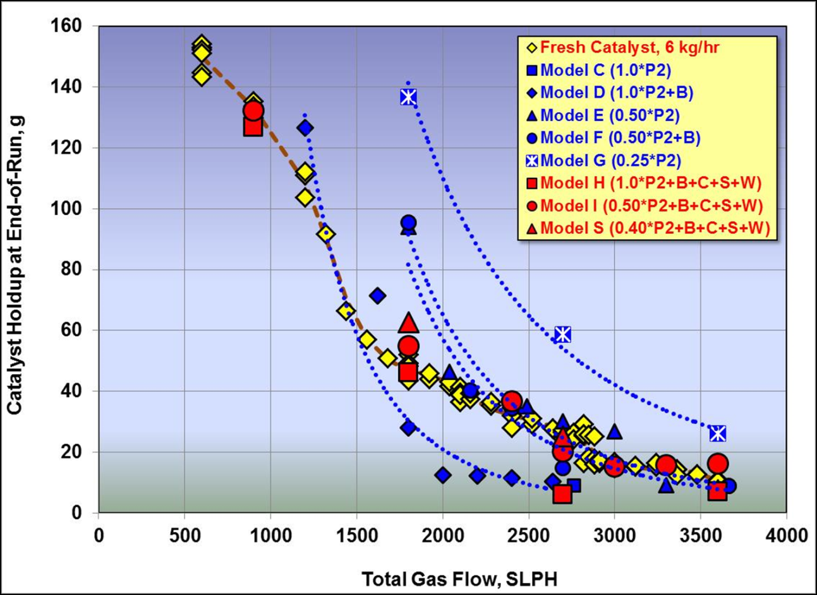
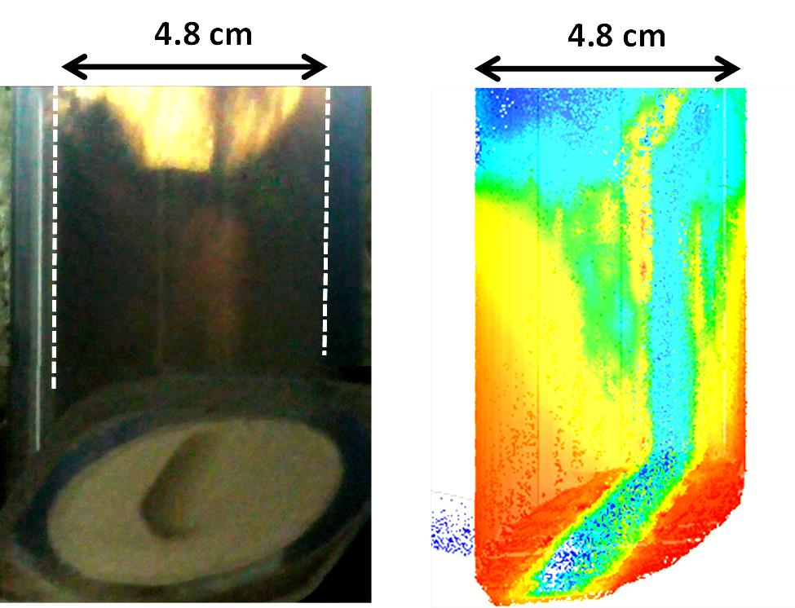
Mix Chamber Part 2: Side Jetted CFB
Jetted-BED CFB Experiments vs CFD
Also validated:
ΔP across CFB
Fines classification
E-cat
Other circ rates
B. Adkins, N. Kapur, T. Dudley, S. Webb, P. Blaser, “Experimental Validation of CFD Hydrodynamic Models for Catalytic Fast Pyrolysis”
Fluidization XV, May 2016
Powder Technology v.316 (2017) 725-739

Slide 11
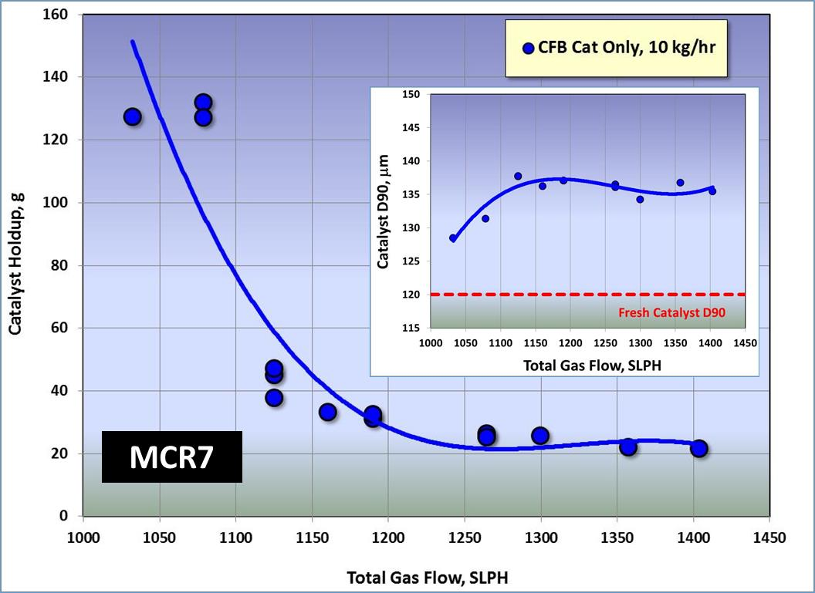
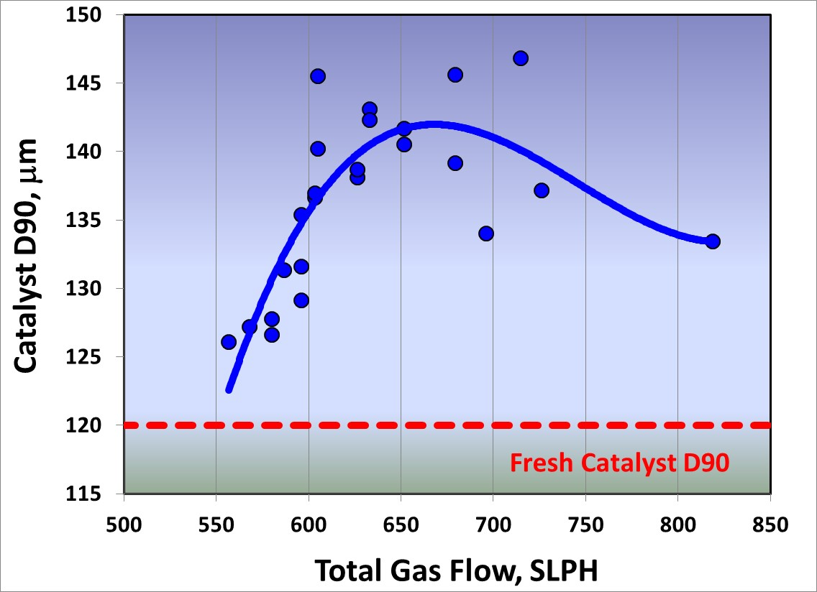
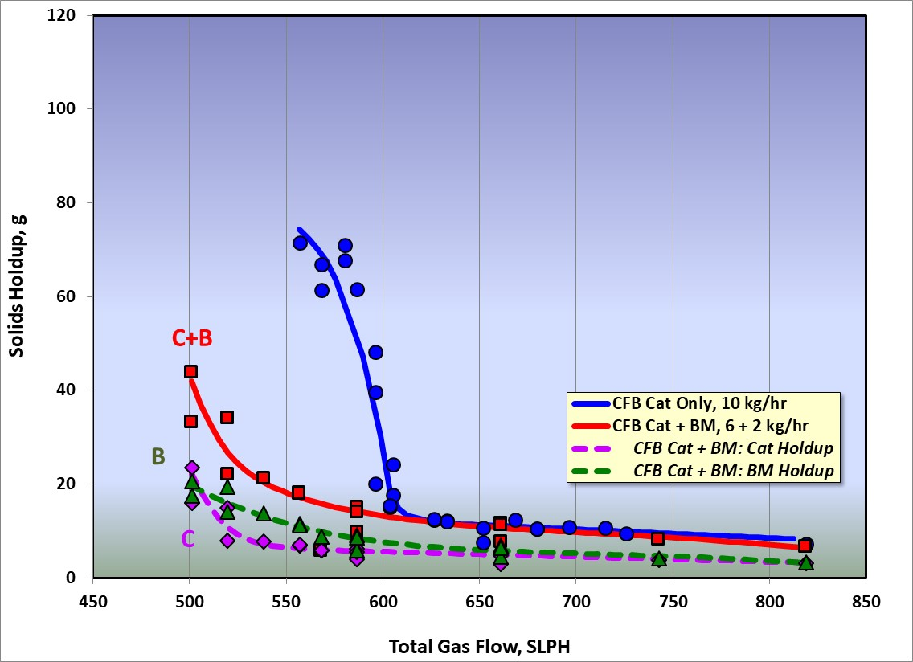
Mix Chamber – Riser (MCR) Experimental Data
MCR8

Slide 12
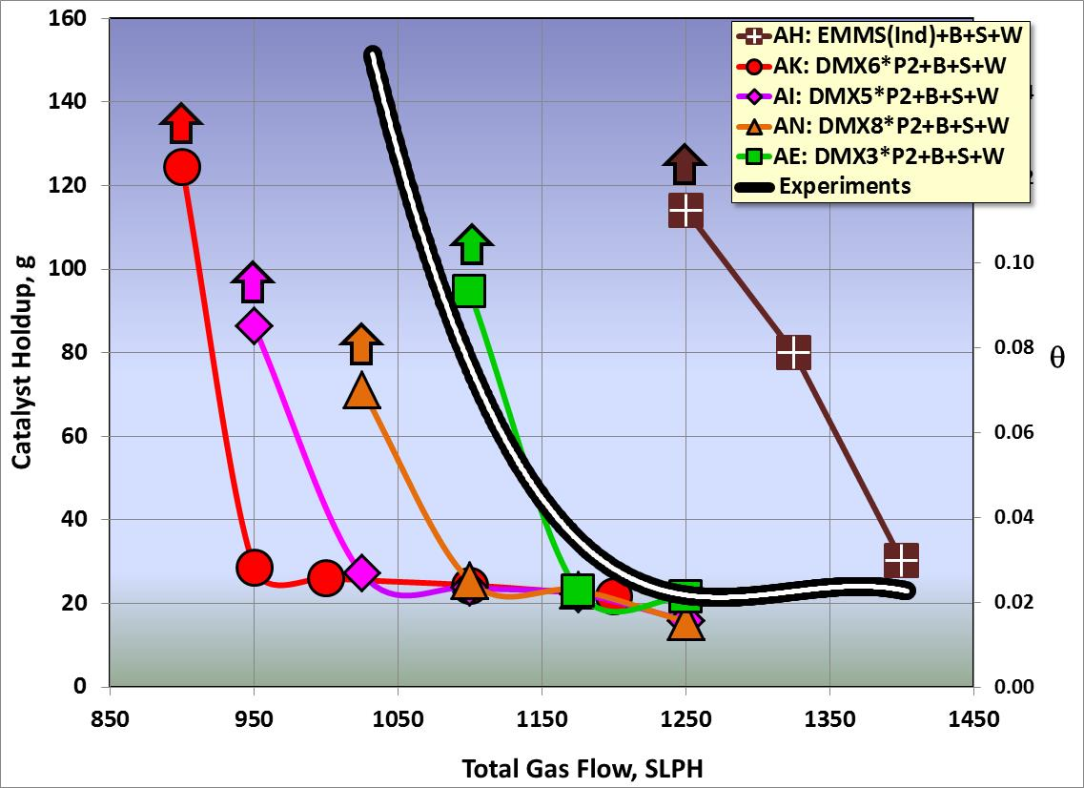
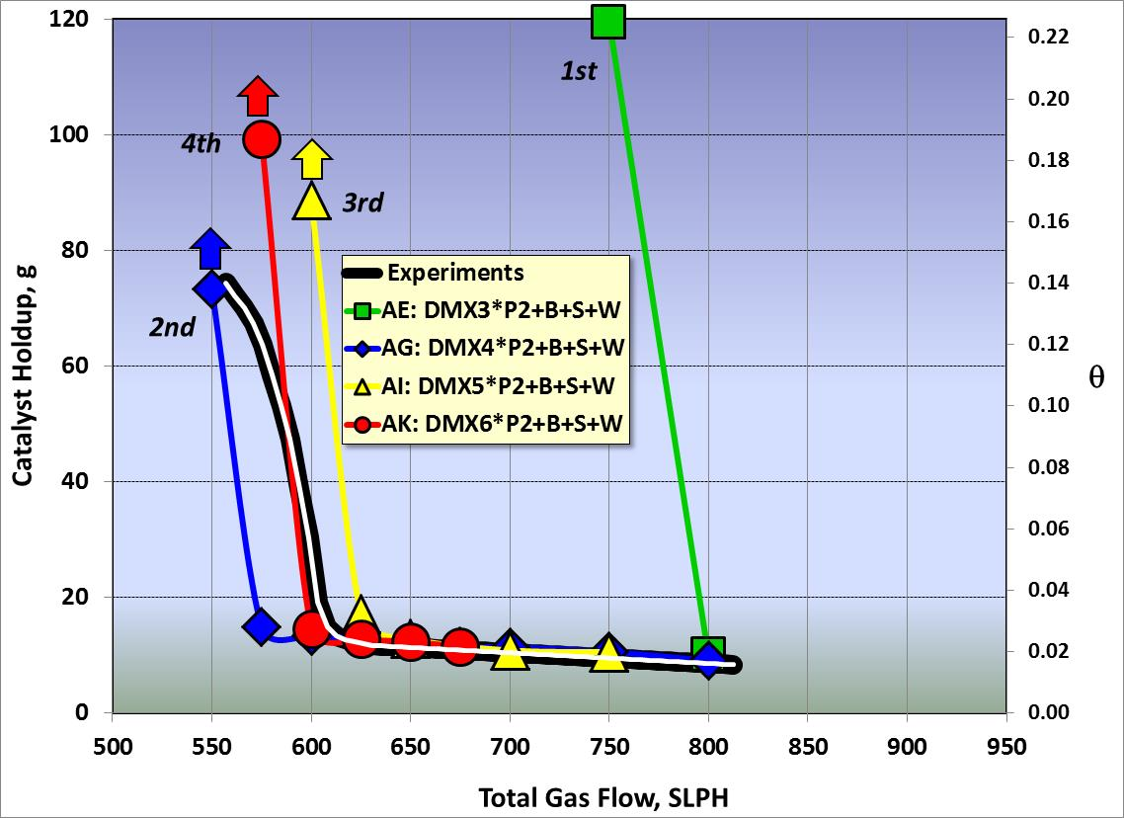
Custom Drag Multiplier (DMX) vs EMMS
Experiments vs CFD
Catalyst Only
Full PSD (35 Size Bins)
1st
MCR7
2nd
4th
3rd
Best-Fit DM Curve is a Function of Reactor Size (Just Like EMMS)
MCR8

Slide 13
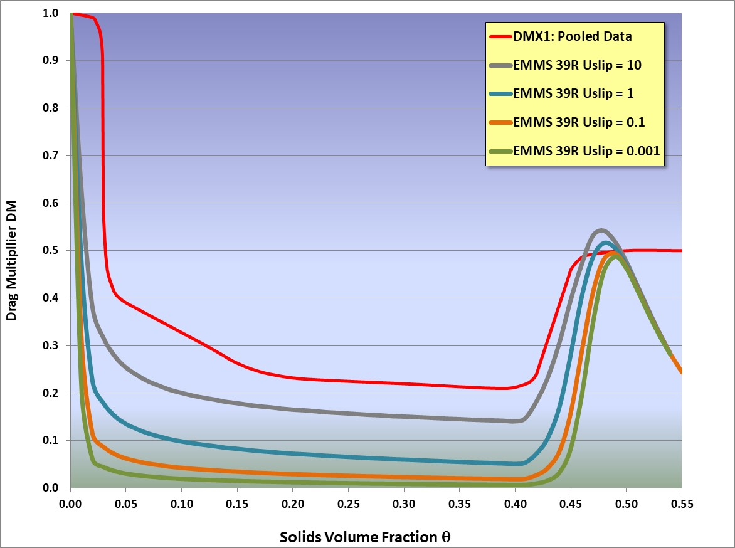
Custom DMX Function vs EMMS
Dilute Regime
EMMS uses Wen-Yu
DMX uses Parker-2
Clustering Transition
Dense-Bed
FFB Studies
Cluster Regime
“ala EMMS”

Slide 14
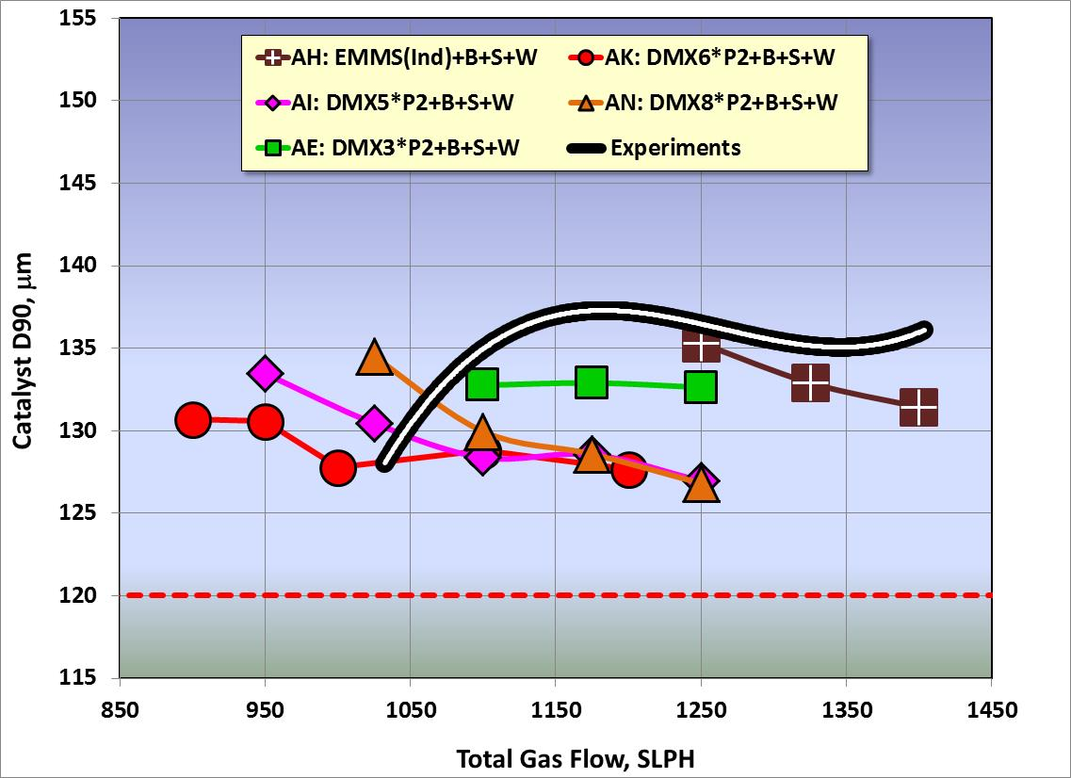
Particle Size Classification Predicted Reasonably Well
Experiments vs CFD
MCR7 Catalyst Only
Fresh Catalyst D90

Slide 15
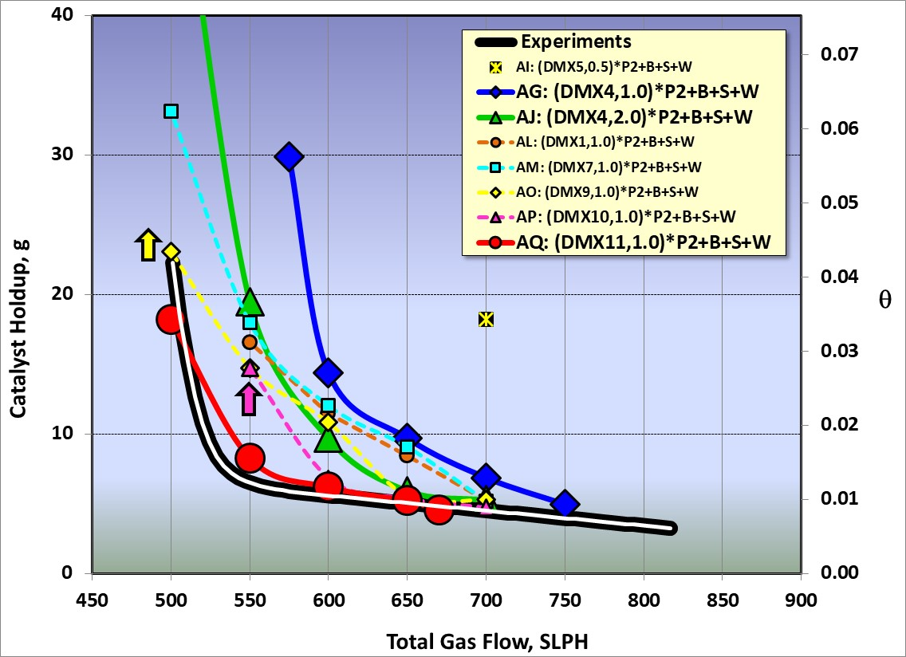
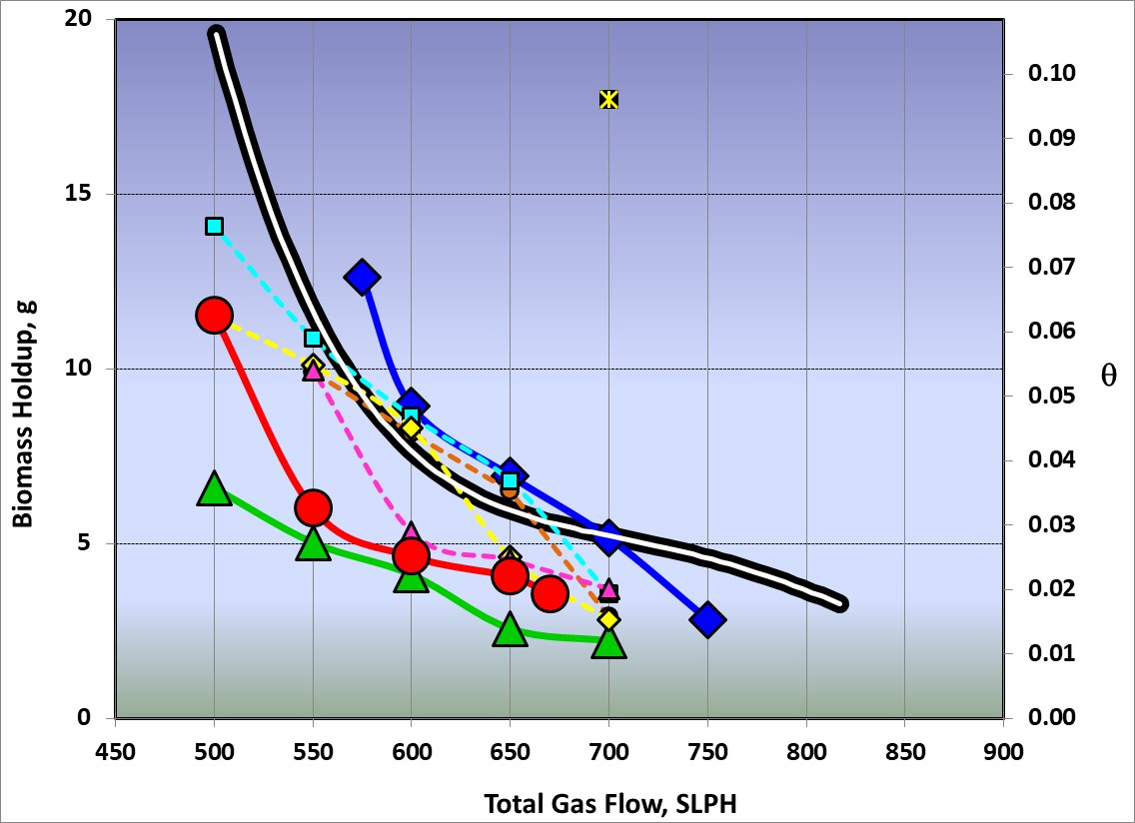
Catalyst-Biomass Mixing: Getting Close…
Experiments vs CFD MCR8
Catalyst + Biomass Full PSDs
Biomass Drag Model Affects Catalyst Holdup
And Vice-Versa

Slide 16
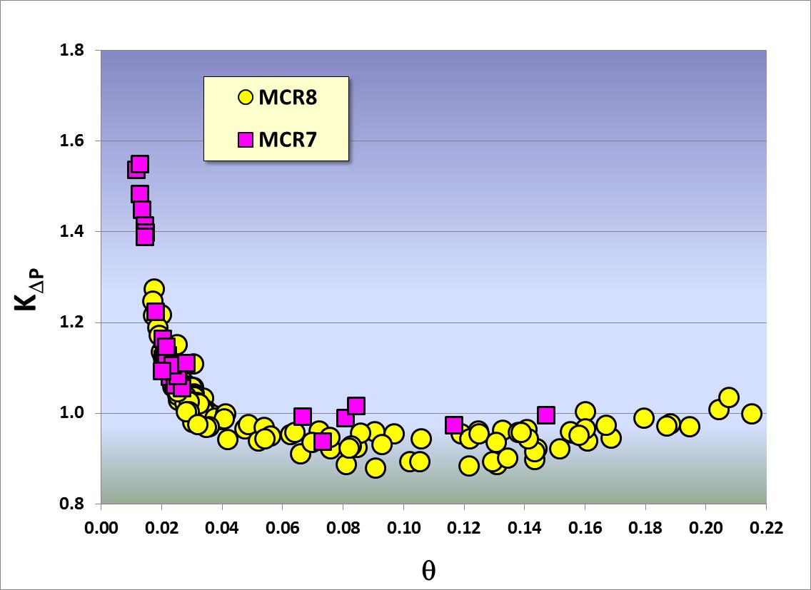
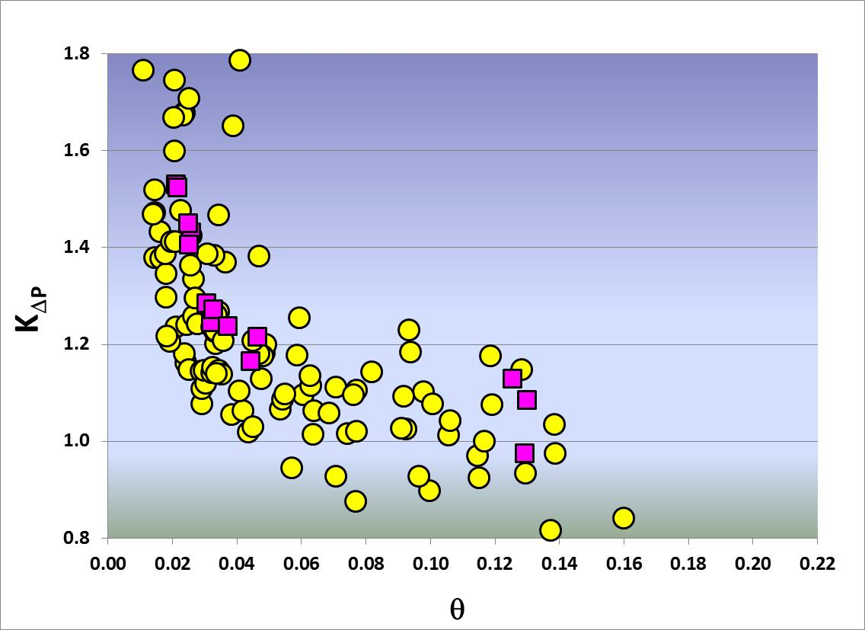
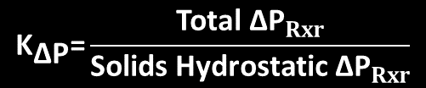
ΔP_{Rxr} Predictions Agree Reasonably With Experiments …
$${\text{K}}_{\text{∆}\text{P}}\text{=}\frac{\text{Total} {\text{∆}\text{P}}_{Rxr}}{\text{Solids} \text{Hydrostatic}{\text{ ∆}\text{P}}_{Rxr}}$$
CFD
Experiments

Slide 17
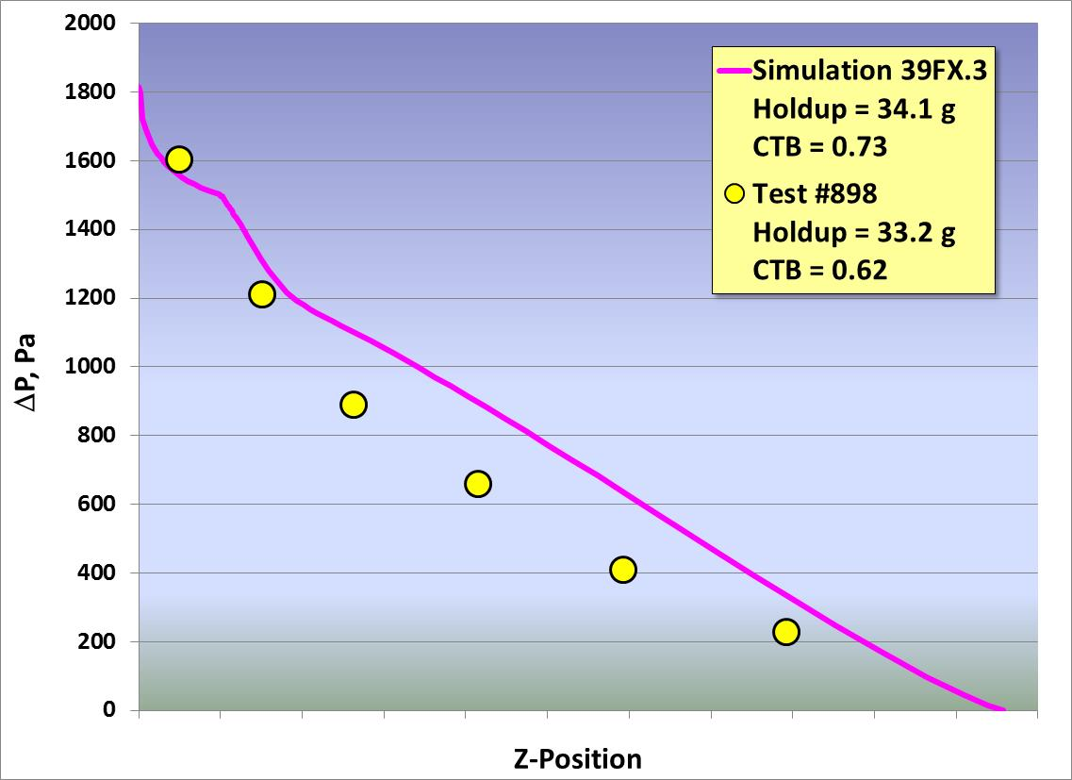
… as do Pressure Profiles, When Holdup is Predicted Correctly
Time-Averaged
Steady-State
Experiments vs CFD
Catalyst + Biomass Cofeed

Slide 18
Conclusions
Inaeris Technologies has developed quantitative hydrodynamic models for in-situ CFP reactors using Barracuda Virtual Reactor®. The models:
  Are sufficiently accurate to assist scale-up
  Apply equally well to bubbling-bed and MCR fluidization regimes
  Use full particle size distributions for catalyst and biomass
For this system:
  EMMS drag models do not fit the Inaeris data
  Custom drag multiplier (DM) tables were developed to fit the data. Like EMMS, these are conceptually based on clustering, and are functions of reactor diameter
  Catalyst-biomass mixing can be modeled using the DM tables
  Blended acceleration model (BAM) has value for dense-phase mixing behavior, but only for low value for BAM exponent (0.5-1 iso 6)
  Other CPFD recommended parameters proved to be sufficient
  CPFD’s BGK “collision” model over-homogenizes velocities of catalyst and biomass particles and was not used

Slide 19
Thank You!
Questions?

Slide 20
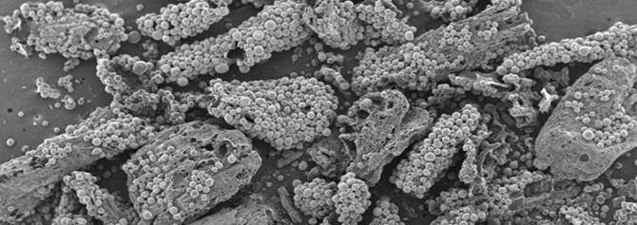
BFCC is Not FCC
BFCC feed is solid, not liquid
  Pyrolysis is slower and more complex than vaporization
  Pyrolysis leaves behind the char “skeleton” particle
  Physical interactions of catalyst and biomass/char particles are important
Deoxygenation reactions are slower than C-C cracking reactions
  Need much longer residence times than FCC – especially since modern FCC is short contact time!
  Need larger catalyst inventories in the reactor

