Slide 1

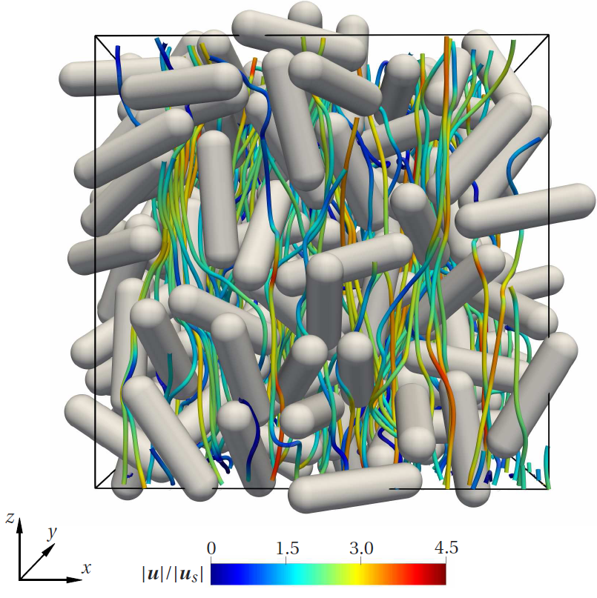
DNS of flow around assemblies of non-spherical particles
Sathish K. P. Sanjeevi
National Energy Technology Laboratory, Morgantown

Slide 2
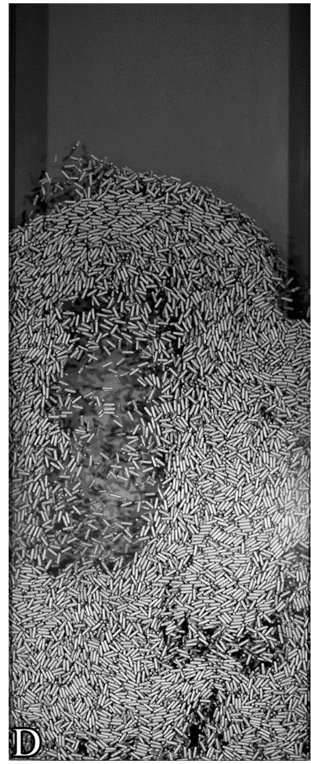
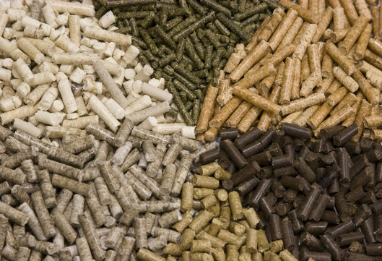
Motivation
Renewable energy is the need of the future - Biomass.
Particles simplified as spheres traditionally.
Orientation effects, lift, torque?
Large parameter space - simplified models required for Euler-Lagrangian simulations of non-spherical particles.
High Stokes number flow.
Milled biomass particles
Fluidization of biomass particles
Notes:
Wood and tree wastes are milled into pellets which are called Biomass pellets
Renewable energy is the need of the future - Biomass.
Particles simplified as spheres traditionally.
Orientation effects, lift, torque ?
Large parameter space - simplified models required for Euler-Lagrangian simulations of non-spherical particles.

Slide 3
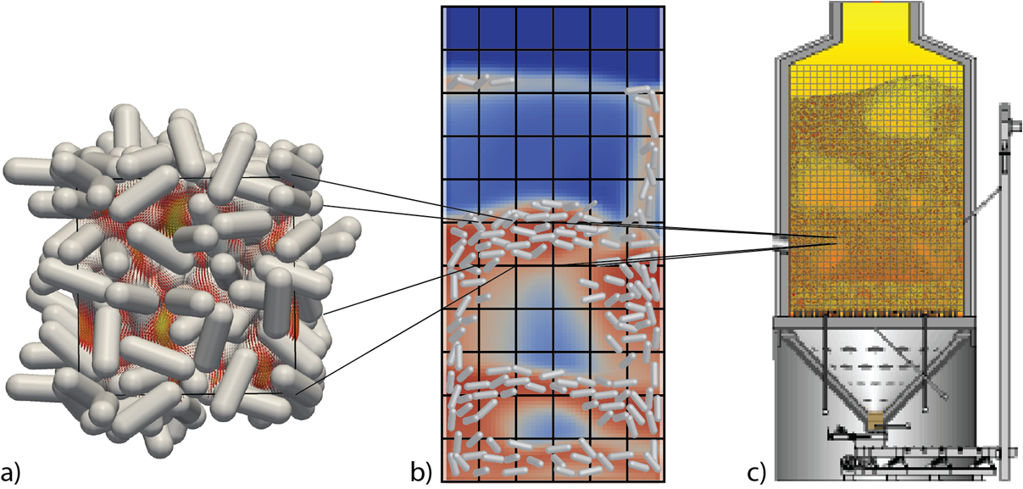
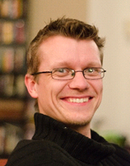




Multi-scale modeling of non-spherical particles
Johan Padding
Direct numerical simulations
(DNS)
Euler-Lagrangian:
CFD-DEM
Multi-particle collision (MPC)
Sathish Sanjeevi
Vinay Mahajan
Ivan Mema
Vikrant Verma

Slide 4
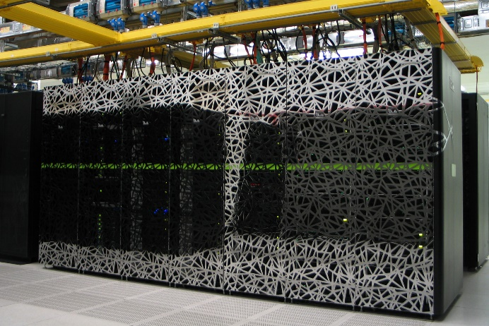
Numerical method
Lattice Boltzmann method (LBM) with multi-relaxation time.
MPI parallelized. Linear scaling up to 300,000 cores.
Interpolated bounce back scheme applied for particle surface.
Mass leakage issue with interpolated bounce back schemes addressed^{[1]}.
Cartesius supercomputer in Amsterdam
[1] Sanjeevi S. K. P., Zarghami A. & Padding J. T. (2018). Phys. Rev. E 97, 043305.

Slide 5
Flow around isolated non-spherical particles

Slide 6
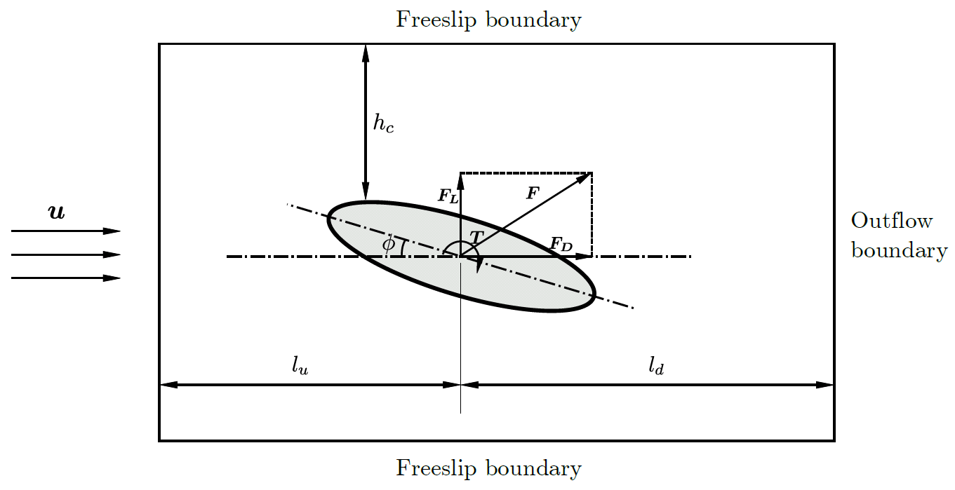
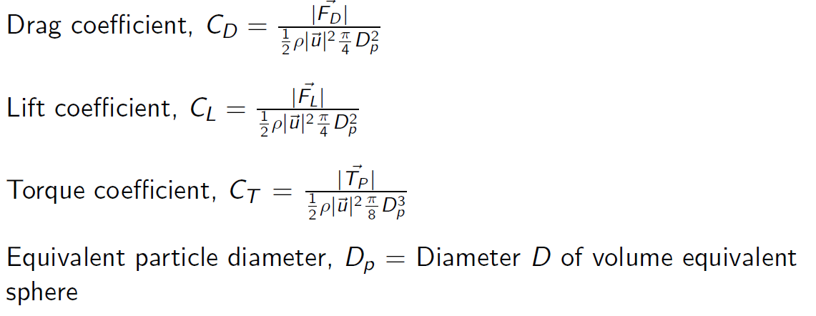


Flow around isolated particle
^{Parameter of interest}
^{Range}
Notes:
around “a” or “an”?

Slide 7
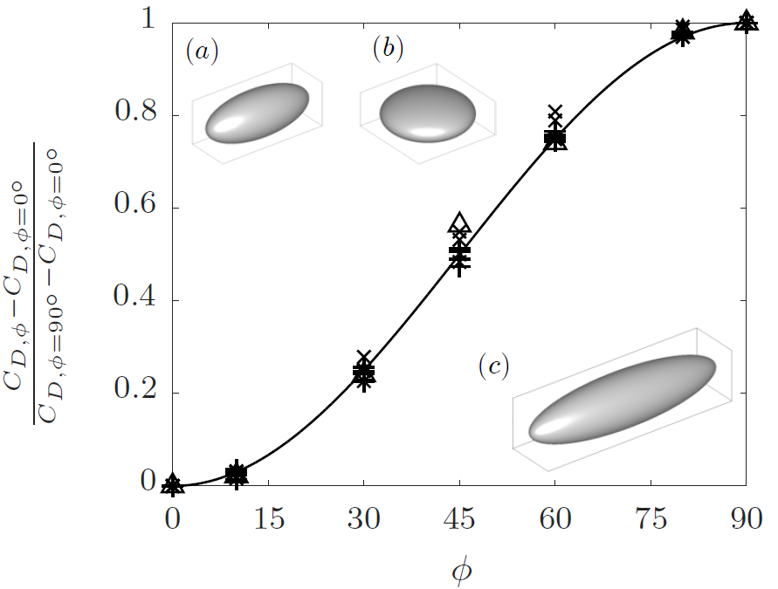
An interesting phenomenon …
(+)
(x)
(△)
Different particles tested. Data from Re=0.1 up to 2000.
Observed even at complex, unsteady flows of Re=2000.
Take home message: two simulations are sufficient:
Sanjeevi, S. K. P., & Padding, J. T. (2017). J. Fluid Mech., 820, R1.

Slide 8
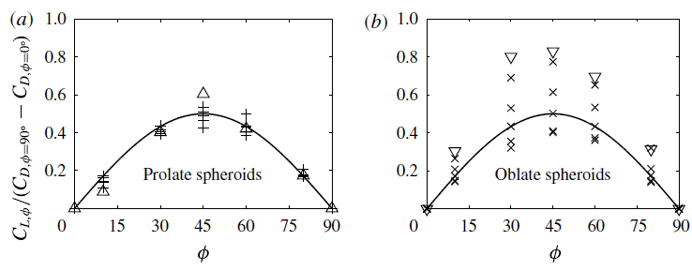
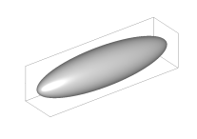
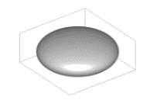
Lift coefficients
Lift coefficient scales as
Prolate spheroids of aspect ratio 2.5 (+) up to Re=2000 and aspect ratio 4 (△) at Re=2000.
Oblate spheroids of aspect ratio 2.5 (+) up to Re=2000 and aspect ratio 4 (▽) at Re=100.
Sanjeevi, S. K. P., & Padding, J. T. (2017). J. Fluid Mech., 820, R1.

Slide 9
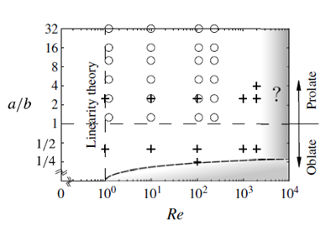

Limitations and regime map
Possible valid regime (unshaded)
Sine-squared drag law not applicable for flatter discs.
Re=2000 limitation is from flow solver.
Unknown for Re>2000.

Slide 10
Flow around assemblies of particles

Slide 11
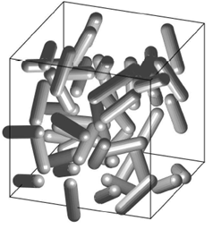
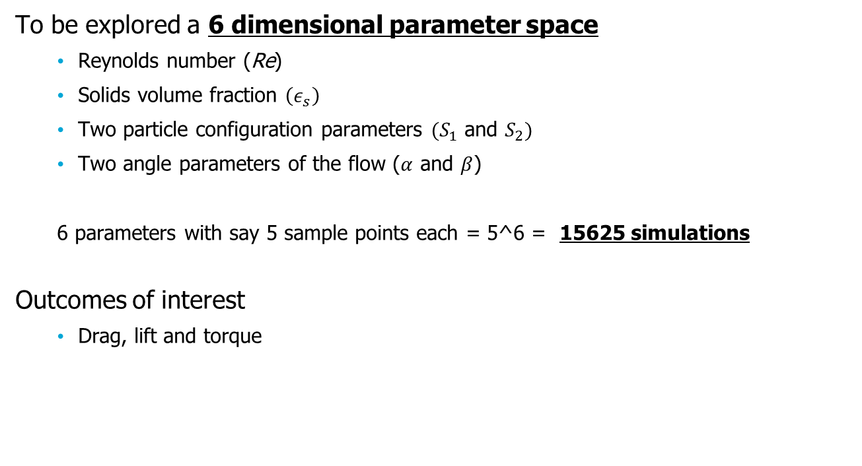
Nonspherical multiparticle systems
Flow around elongated non-spherical particle assemblies
To be explored a 6 dimensional parameter space
  Reynolds number (Re)
  Solids volume fraction $\left(ε_{s}\right)$
  Two particle configuration parameters ${(S}_{1}$ and $S_{2})$
  Two angle parameters of the flow ($α$ and $β$)
  6 parameters with say 5 sample points each = 5^6 = 15625 simulations
Outcomes of interest
  Drag, lift and torque
Flow direction

Slide 12
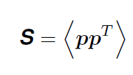
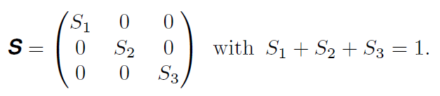
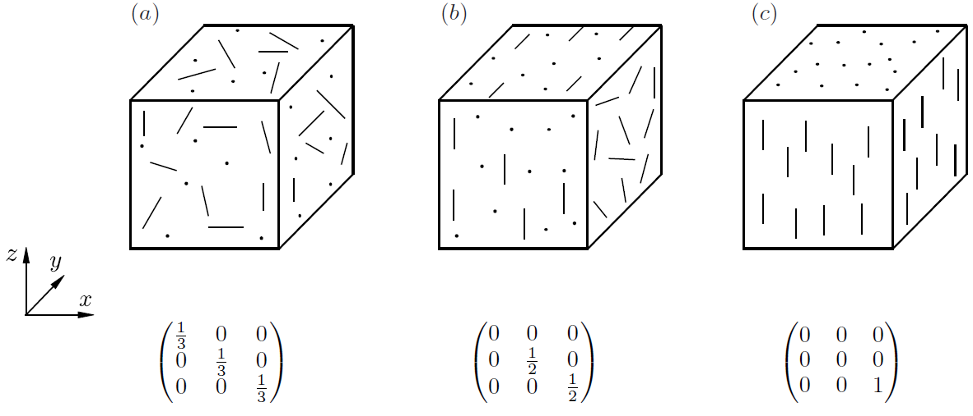
Configuration tensor
Random
Planar random
Unidirectional

Slide 13
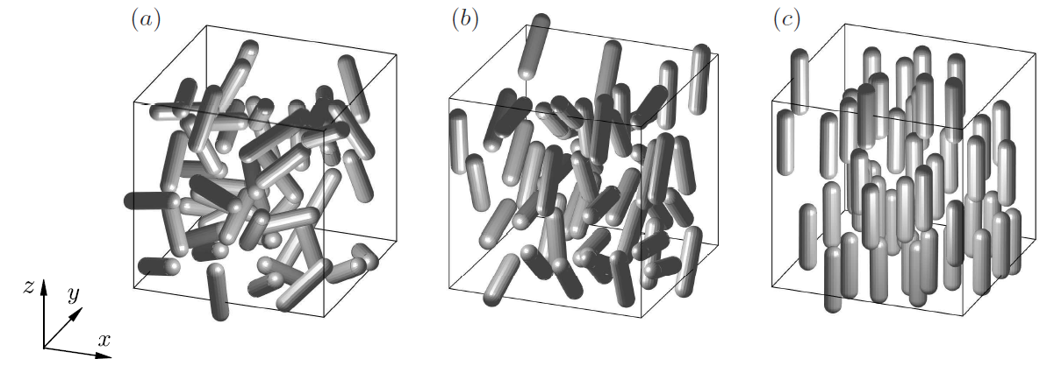
Generating a configuration
Different configurations developed using Maier-Saupe potential: (a) Random (without M-S), (b) planar random (with M-S) and (c) unidirectional (with M-S).

Slide 14
Flow around assemblies of particles
  Re=100 and solids volume fraction $ε_{s}$= 0.3; 200 particles.

Slide 15
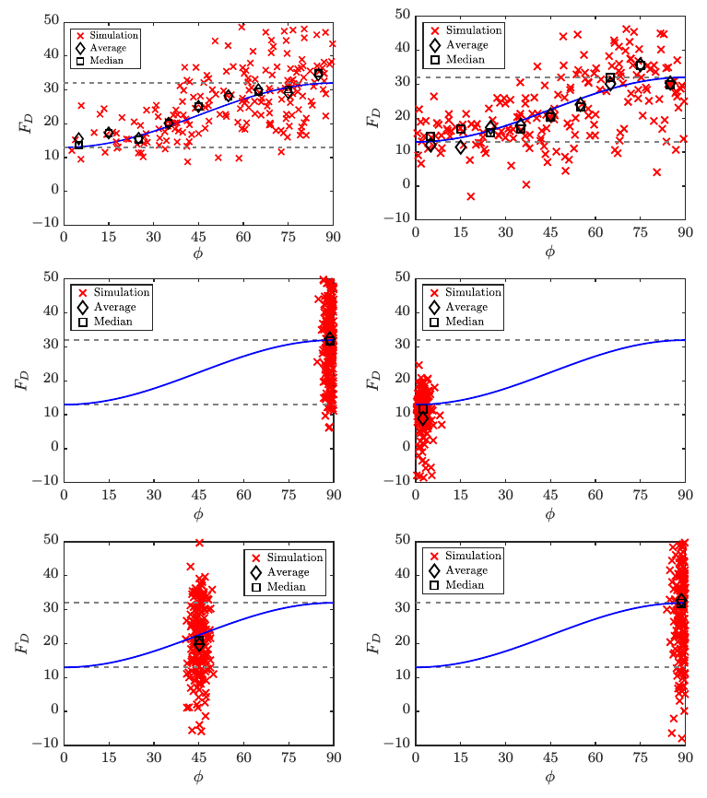
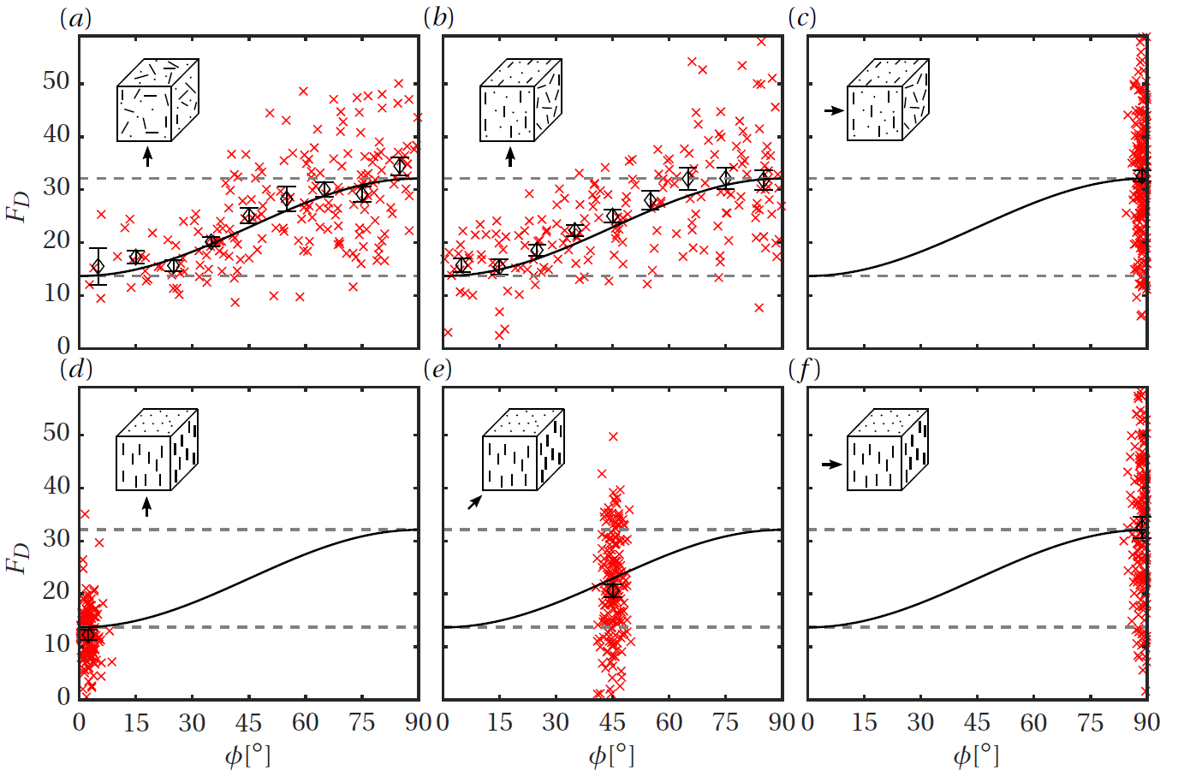
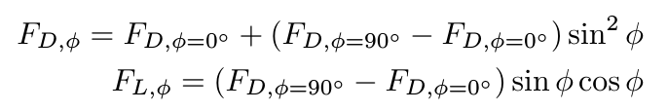
Configuration independence test
  Re=100 and solids volume fraction $ε_{s}$= 0.3; 200 particles.
(solid blue line)

Slide 16


Nonspherical multiparticle systems
Similarly, configuration independence is verified for all Re and $ε_{s}$
To be explored: only a 3 dimensional parameter space
  Reynolds number (Re): $0.1≤Re≤1000$
  Solids volume fraction $\left(ε_{s}\right)$: $0≤ε_{s}≤0.5$
  Two particle configuration parameters ${(S}_{1}$ and $S_{2})$
  Two angle parameters of the flow ($α$ and $β$)
  Incident angle of individual particles ($φ$): $0°≤φ≤90°$
A random configuration is sufficient for a particular Re and $ε_{s}$ !

Slide 17
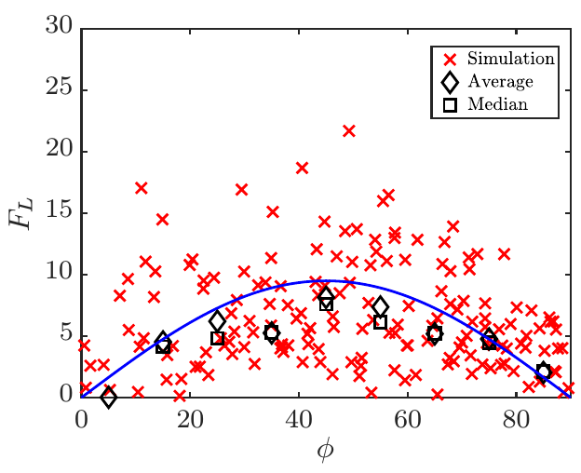
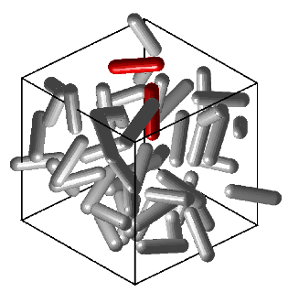
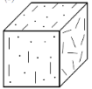
Lift correlation
Another important finding.
Lift can be predicted with just the knowledge of drag alone.

Slide 18

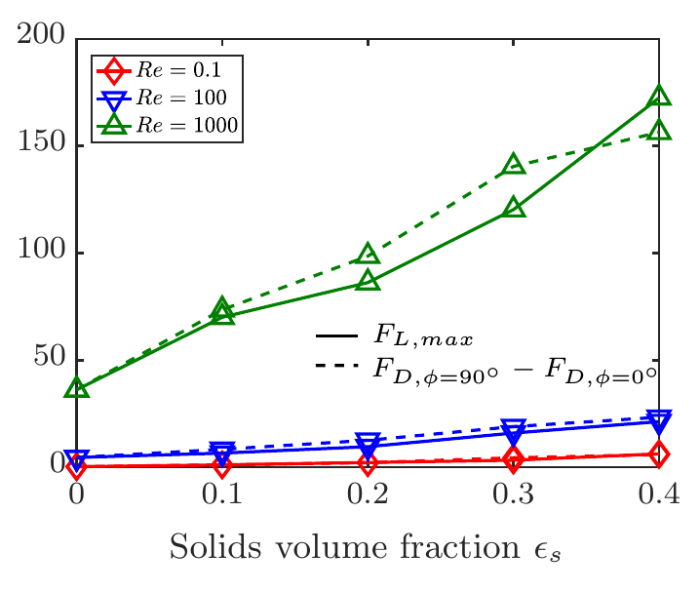
Lift correlation
  Hypothesis:
  From simulations:

Slide 19
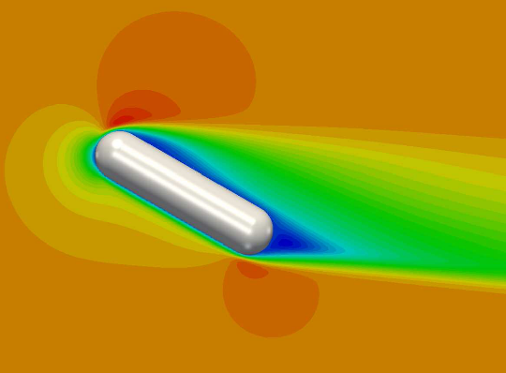
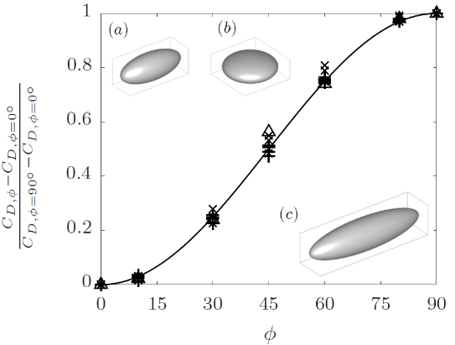
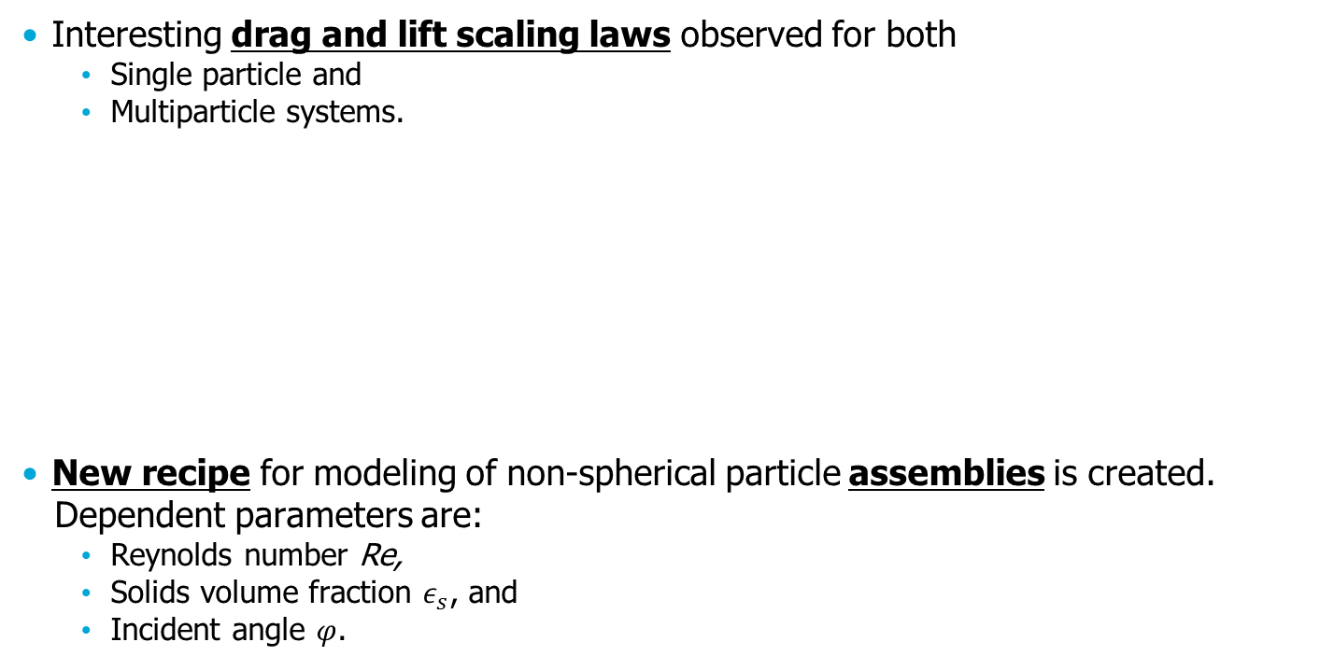
Conclusion
Interesting drag and lift scaling laws observed for both
  Single particle and
  Multiparticle systems.
New recipe for modeling of non-spherical particle assemblies is created.
Dependent parameters are:
  Reynolds number Re,
  Solids volume fraction $ε_{s}$, and
  Incident angle $φ$.
(+)
(x)
(△)

Slide 20
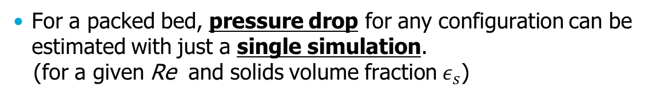
Conclusion (contd…)
For a packed bed, pressure drop for any configuration can be estimated with just a single simulation.
(for a given Re and solids volume fraction $ε_{s}$)

Slide 21



Acknowledgements
Financial support
Computational support
Dutch HPC agency
(Grant number: 615096)

Slide 22
Thank you!

Slide 23
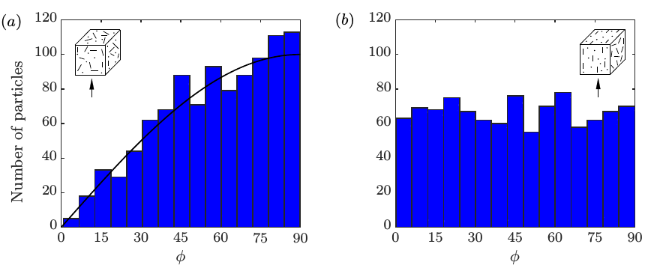
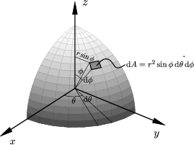
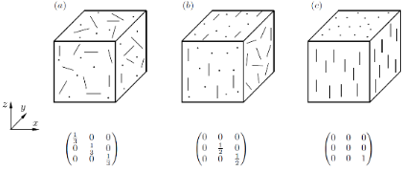
Histogram of particle orientations
  Therefore, atleast two simulation sets are performed for better statistics.

Slide 24
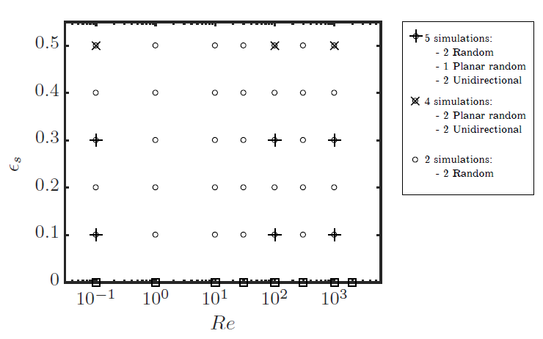
Number of simulations

Slide 25
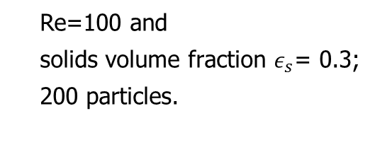
Configuration independence test
x Simulation
 Mean
  Re=100 and
  solids volume fraction $ε_{s}$= 0.3;
  200 particles.
(solid black line)

Slide 26
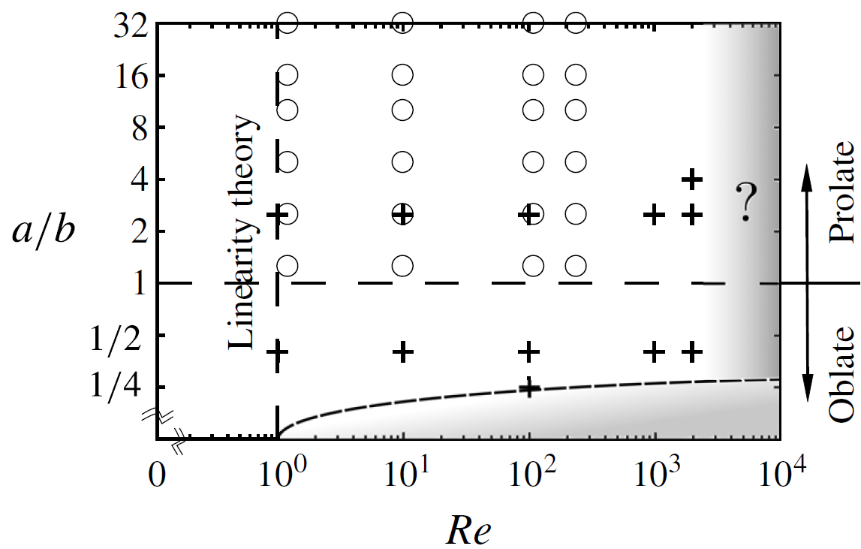
Regime map
Valid regime (unshaded)
Sine-squared drag law not applicable for flatter discs.
Re=2000 limitation is from flow solver.

Slide 27
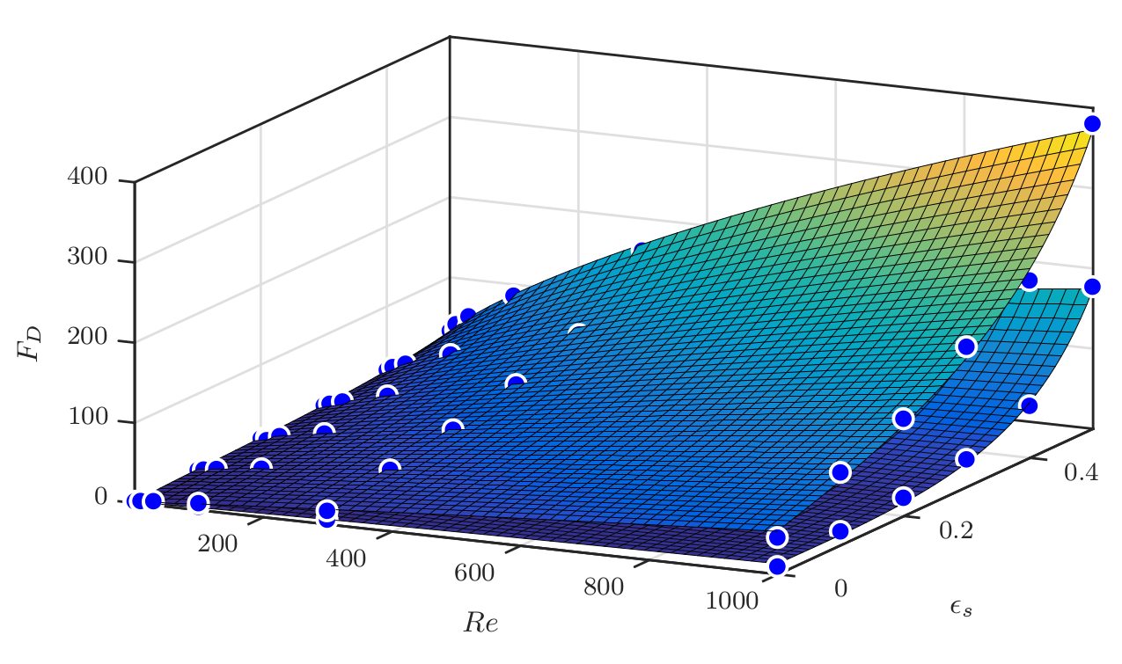
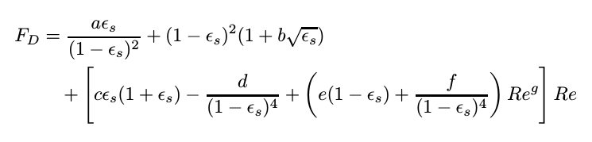
Drag correlation
ϕ =90°
ϕ =0°
with different constants a,b,c,…,g

Slide 28
Lift correlation
  Hypothesis:
  From simulations:

