Slide 1

Hinze scale bubble deformation and breakup in strong turbulence
Ashik Ullah Mohammad Masuk
Ashwanth Salibindla
Rui Ni
Department of Mechanical Engineering
Johns Hopkins University

Slide 2
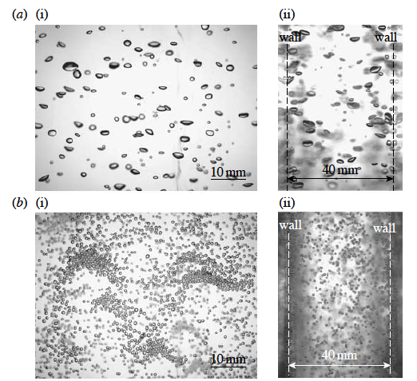
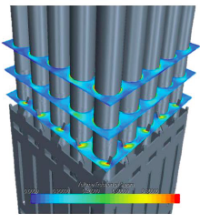
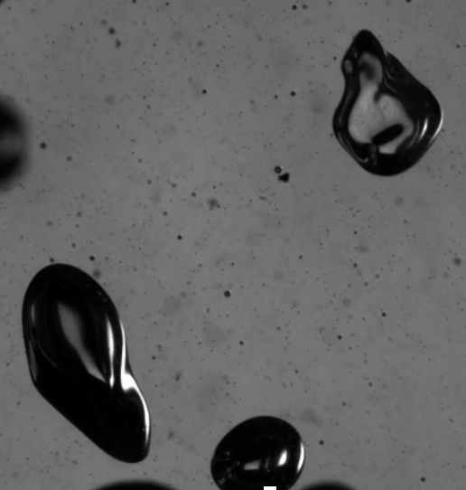
Motivation
Addressing the complex shapes in multiphase flows is challenging in both simulations and experiments
Experimental challenges:
Measurement e.g. imaging
Reconstruction
Nuclear thermo-hydraulics
Gas bubbles
Gas flow
Fluidized bed reactor

Slide 3
Motivation
Fitting ellipsoid to the 2D images of
Bubbles.
Spherical assumption
Rigid assumption
Ellipsoid fitting
Ravelet et. al.
(2011)
shape
forces
Dynamics
Numerical simulations considering complex rigid shape [(Paschkewitz et. al. (2004), He et. al. (2017)] or deformable shapes [Lu and Tryggvasson (2008), Spandan et. al. (2017)] are very rare

Slide 4
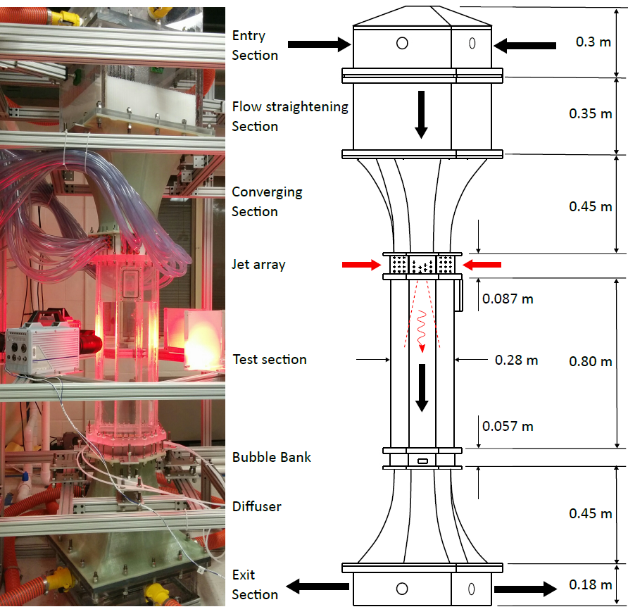
V-ONSET(Vertical Octagonal Non-corrosive Stirred Energetic Turbulence)
Opposing mean flow
High energy dissipation rate
Masuk et. el. (RSI, 2019)

Slide 5
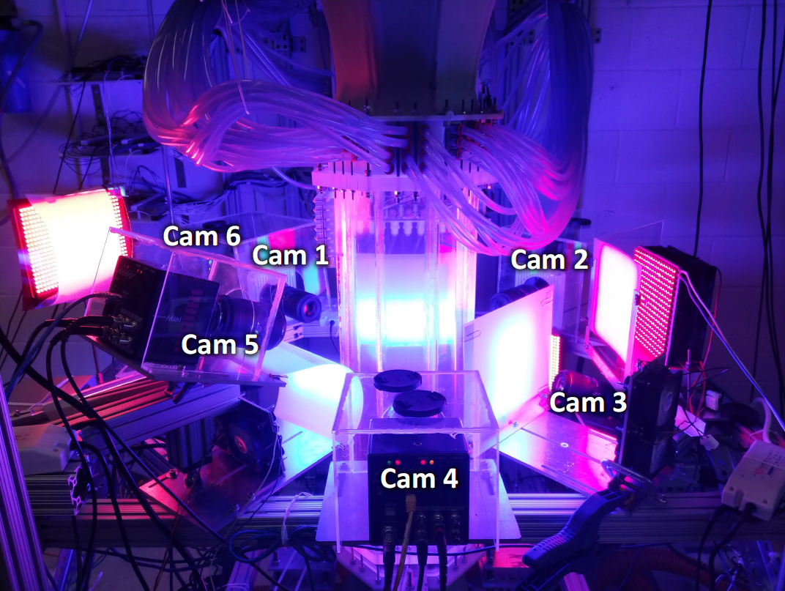
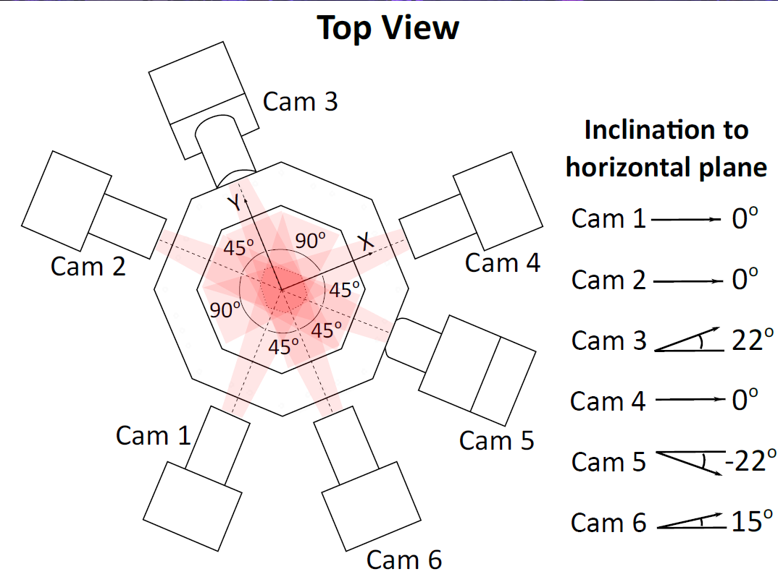
Imaging of the test section with 6 high speed cameras
4 Photron AX200
2 Photron SA Series
Upto 6400 fps

Slide 6
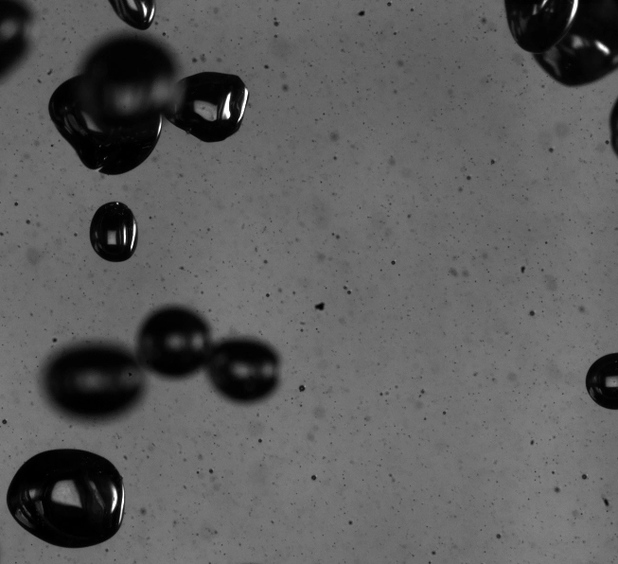
2.5 mm
Raw images of air bubbles in turbulent water imaged at 4000 fps

Slide 7
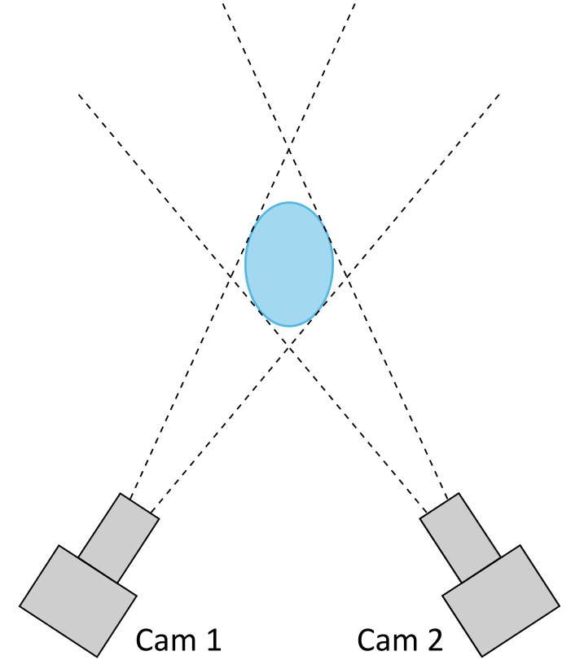
Visual hull reconstruction
Image plane (Black)
Image (White)

Slide 8
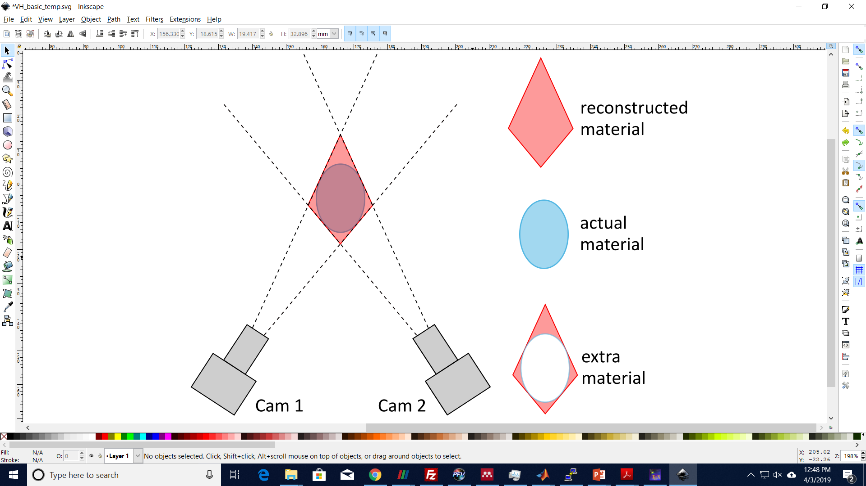
Visual hull reconstruction

Slide 9
Visual hull reconstruction

Slide 10
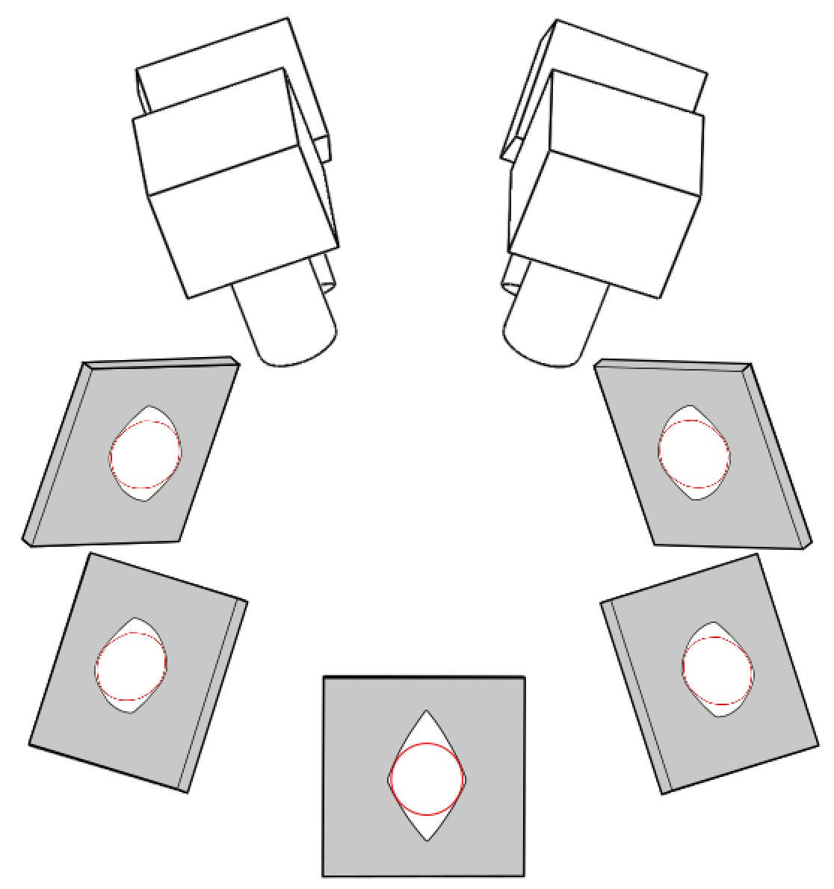
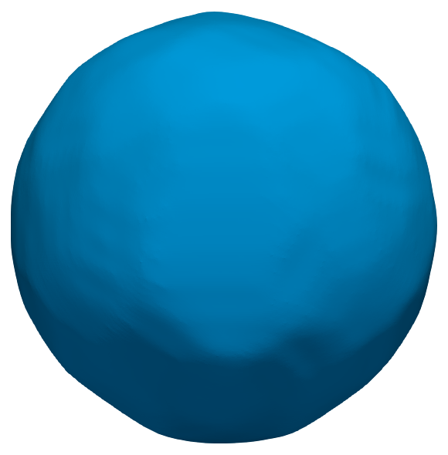
Virtual Camera
Method
Real cameras
4 real cameras viewing an spherical object from one side

Slide 11
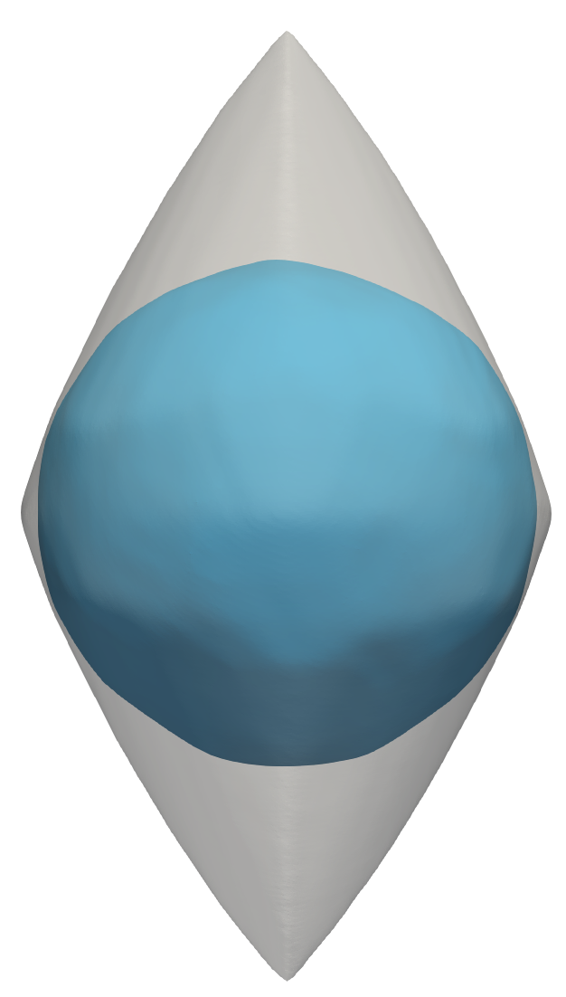
Virtual Camera
Method
Visual hull shown as gray envelope

Slide 12
Virtual Camera
Method
Image plane of the
first virtual camera
Optimize the angle between a virtual camera and other existing cameras

Slide 13
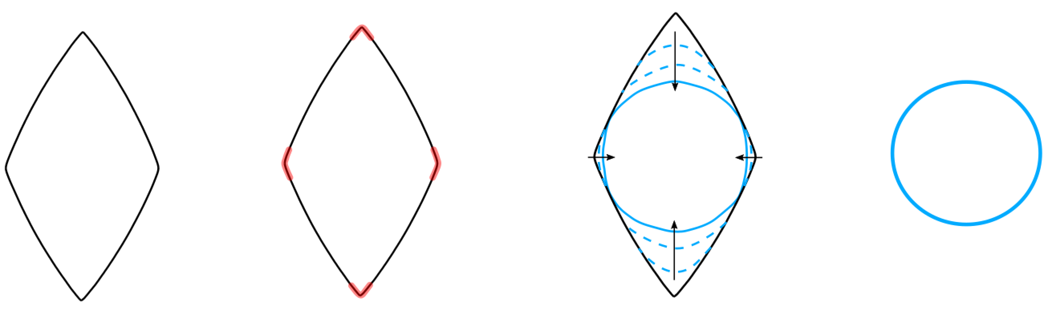
Virtual Camera
Method
Image plane of the
first virtual camera
outline

Slide 14
Virtual Camera
Method
Image plane of the
first virtual camera
outline
High
curvature

Slide 15
Virtual Camera
Method
Image plane of the
first virtual camera
Real
Camera
Check
outline
High
curvature
smoothing

Slide 16
Virtual Camera
Method
Image plane of the
first virtual camera
Real
Camera
Check
outline
High
curvature
smoothing

Slide 17
Virtual Camera
Method
Image plane of the
first virtual camera
Real
Camera
Check
final
outline
outline
high
curvature
smoothing

Slide 18
Virtual Camera
Method
Real
Camera
Check
final
outline
outline
high
curvature
smoothing

Slide 19
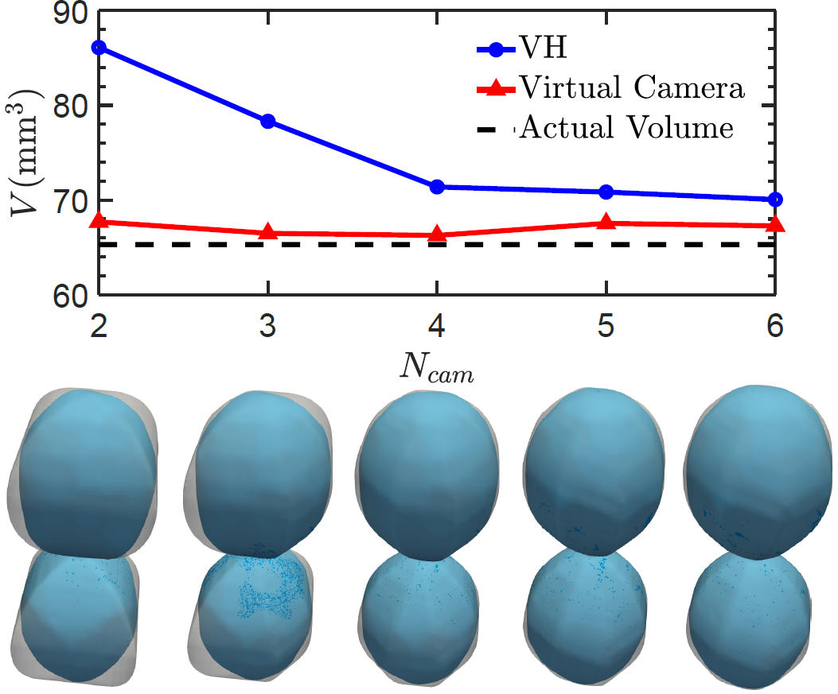
Synthetic Dumbbell Reconstruction
breakup scenario

Slide 20
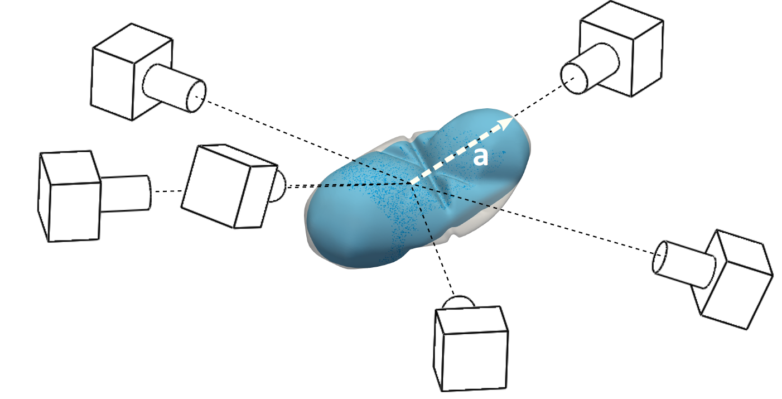
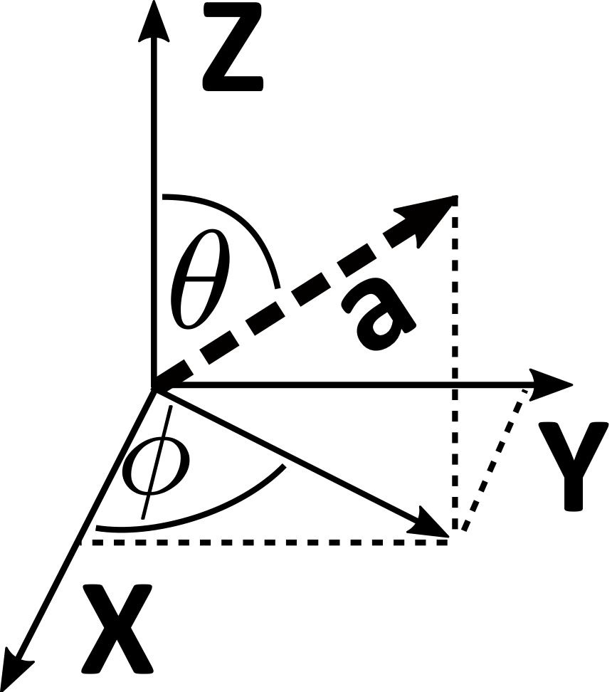

Slide 21
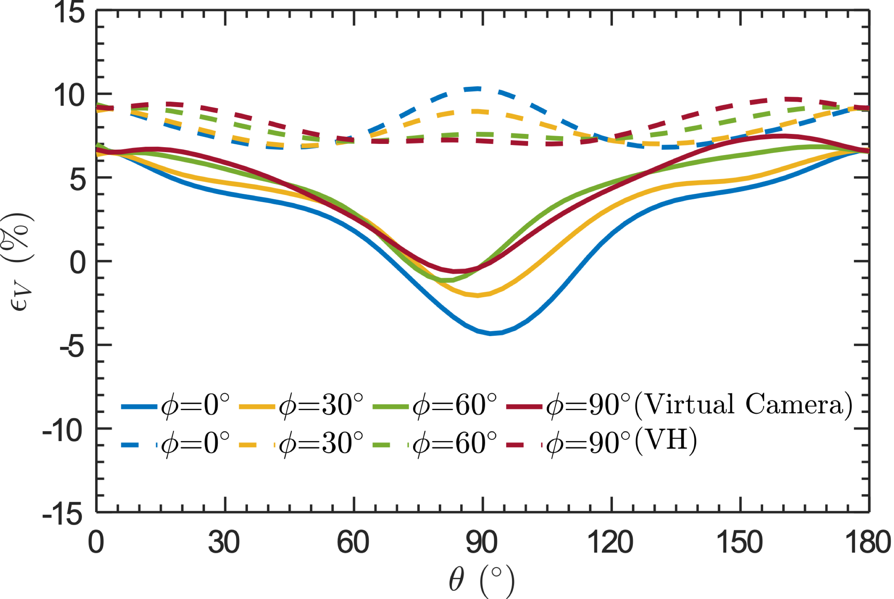
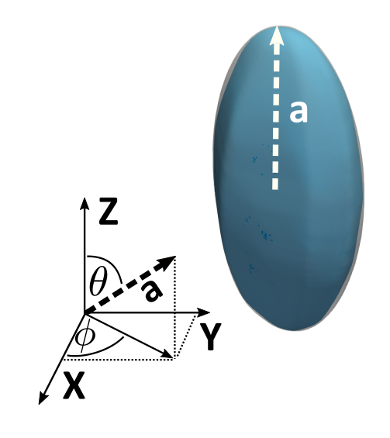

$$α=3$$

Slide 22
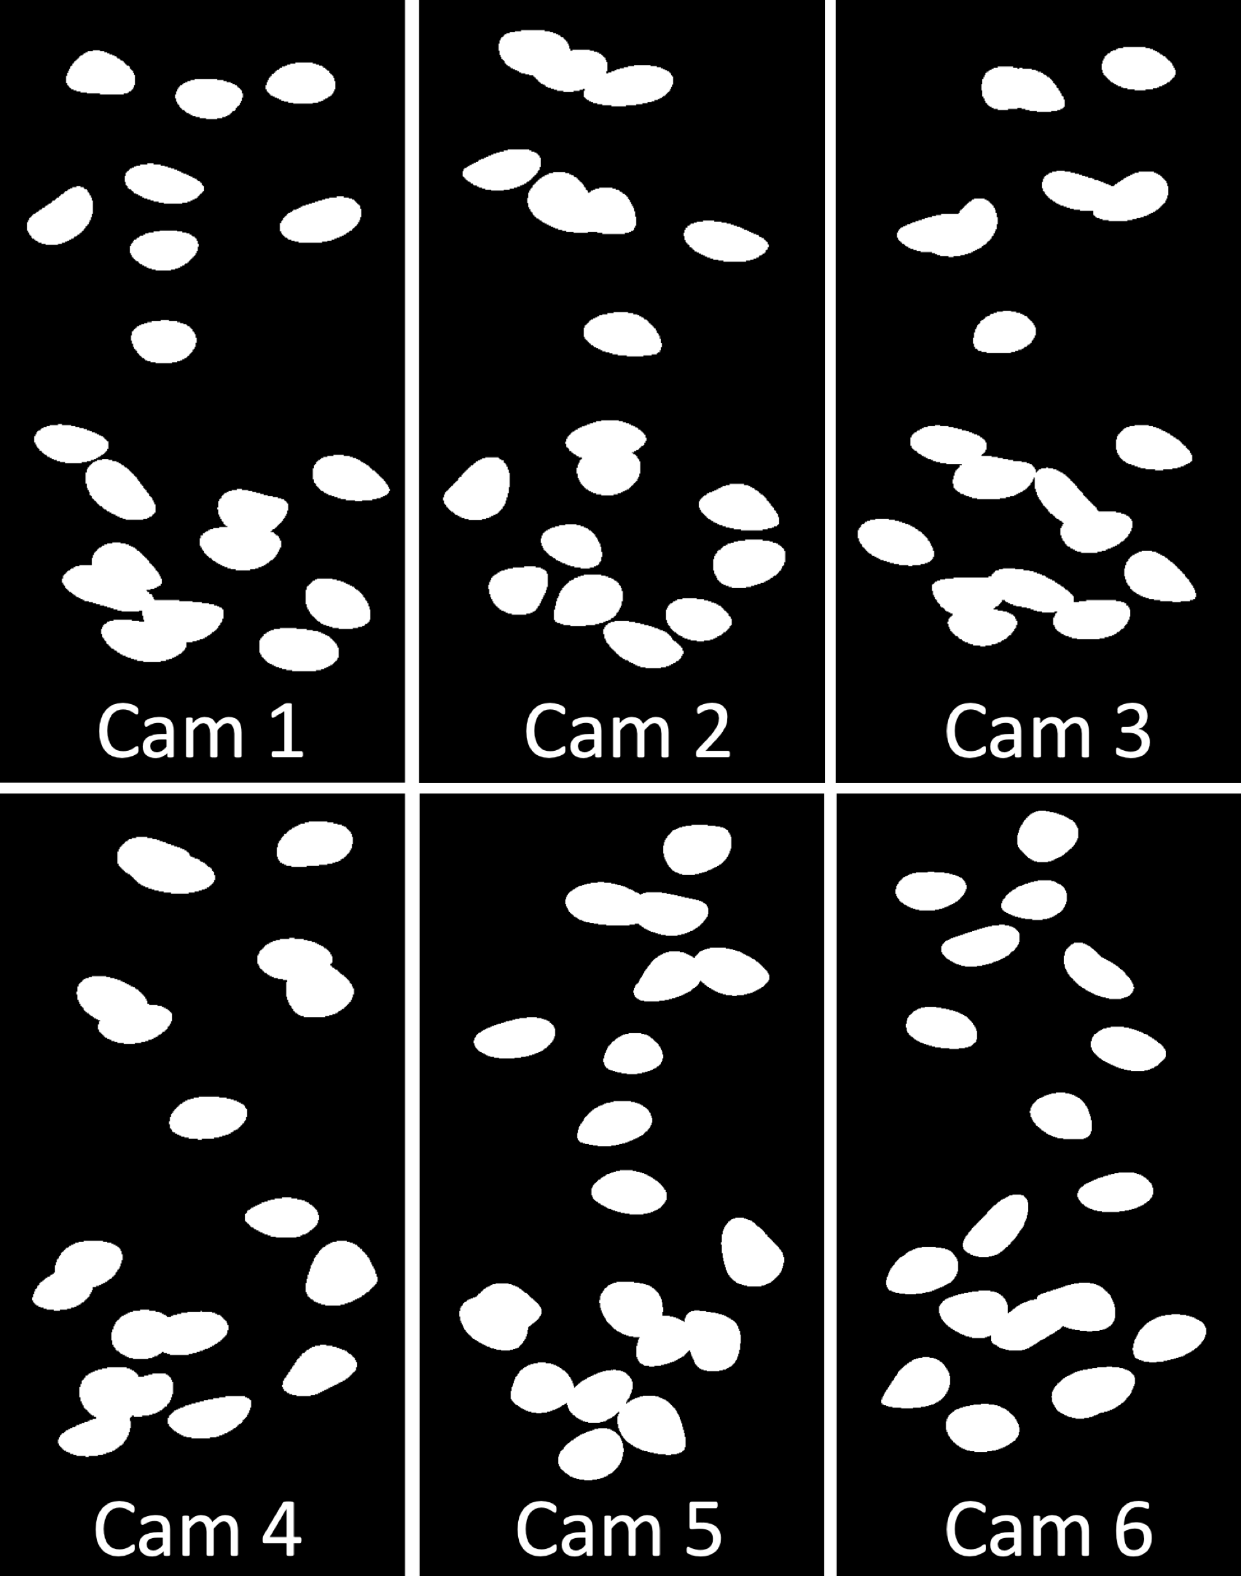
DNS data reconstruction
Synthetic images from DNS dataset
No need for 2D
Segmentation!
Lu and Tryggvasson (2008)

Slide 23
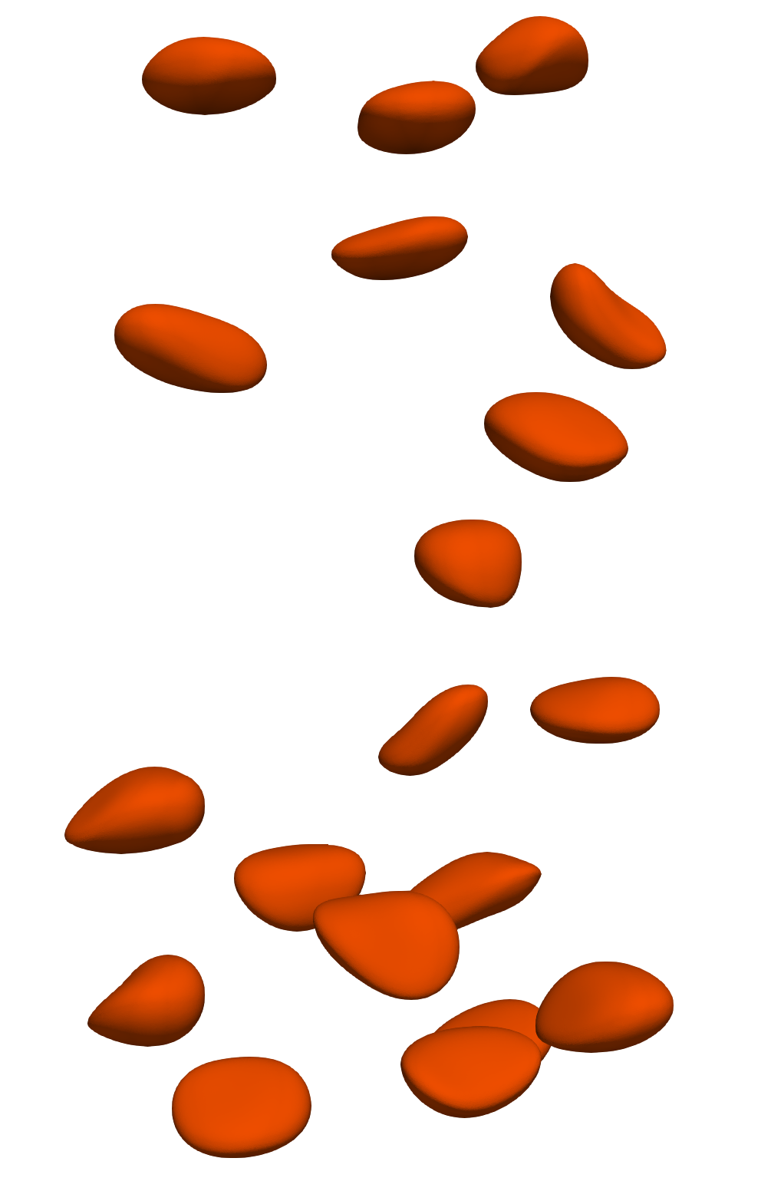
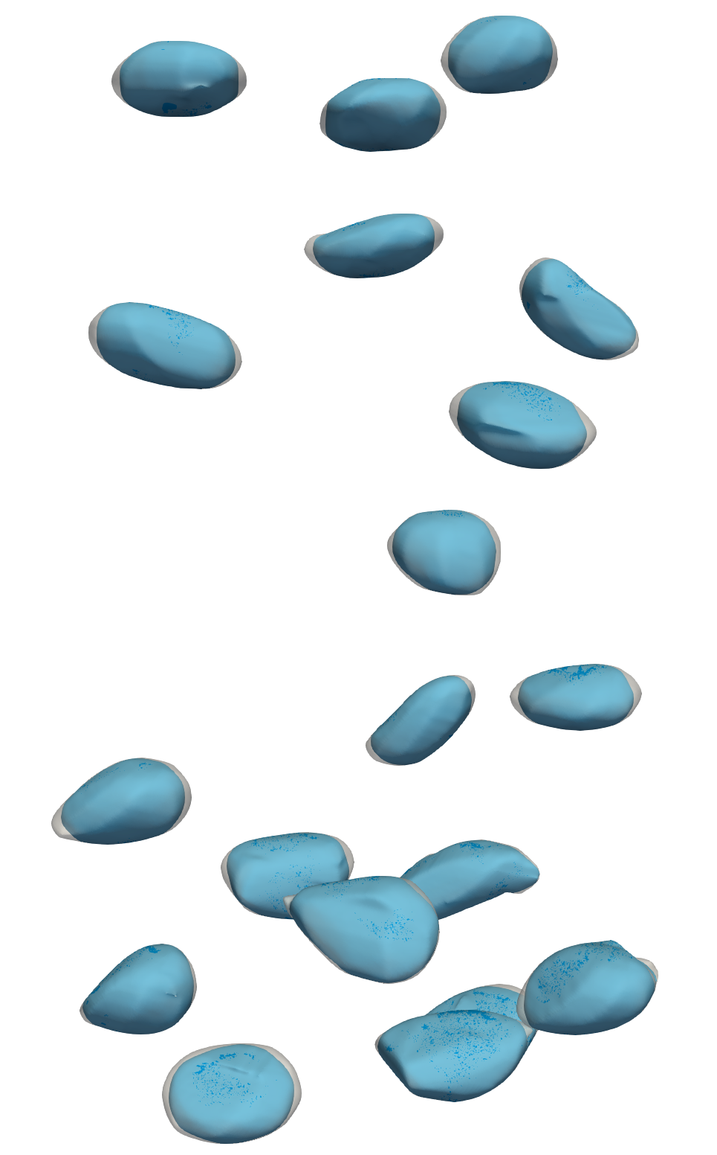
DNS data reconstruction
DNS
Virtual Camera

Slide 24
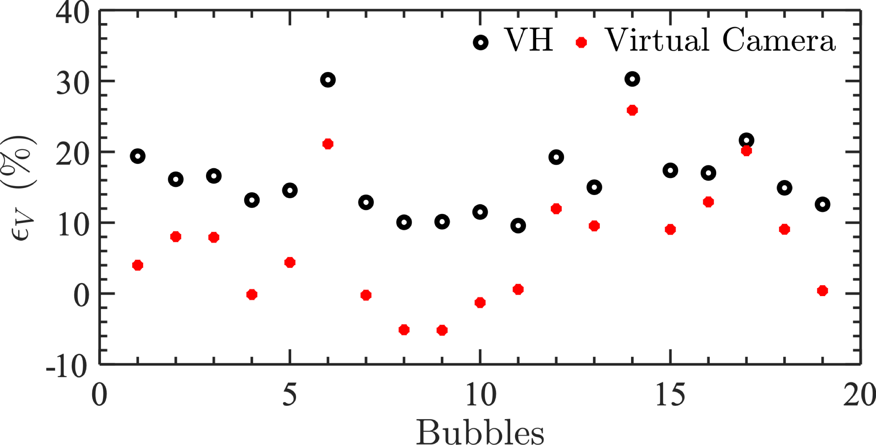
DNS data reconstruction
10%

Slide 25
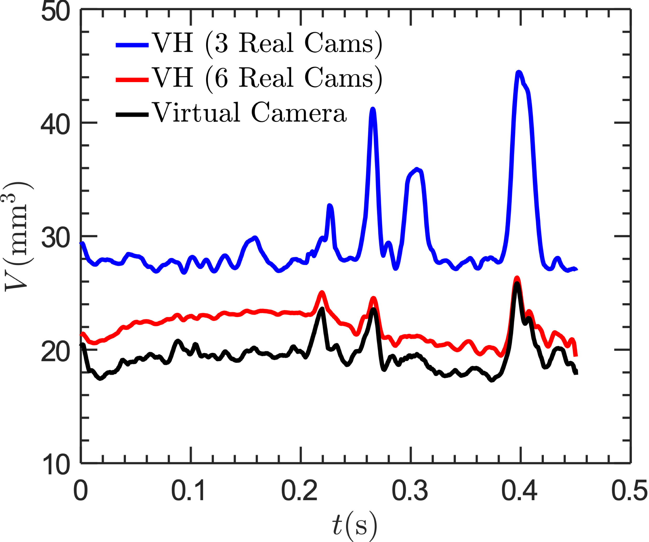
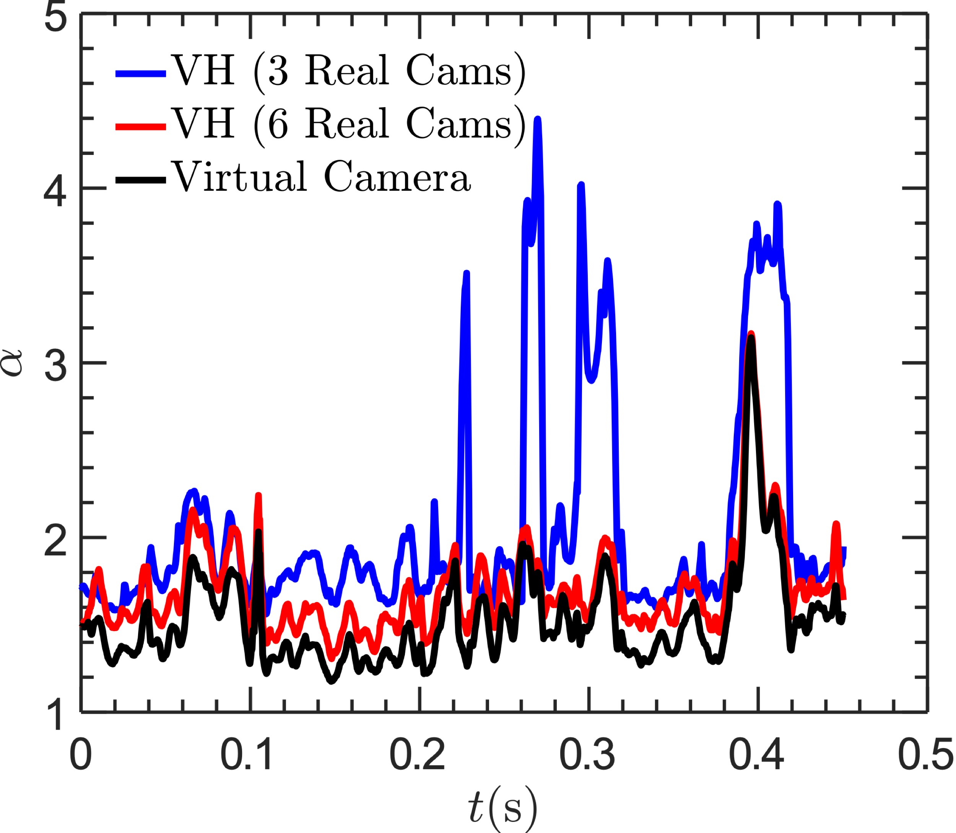
Experimental Results
A robust virtual-camera 3D shape reconstruction of deforming bubbles/droplets with additional physical constraints (IJMF, under review)

Slide 26
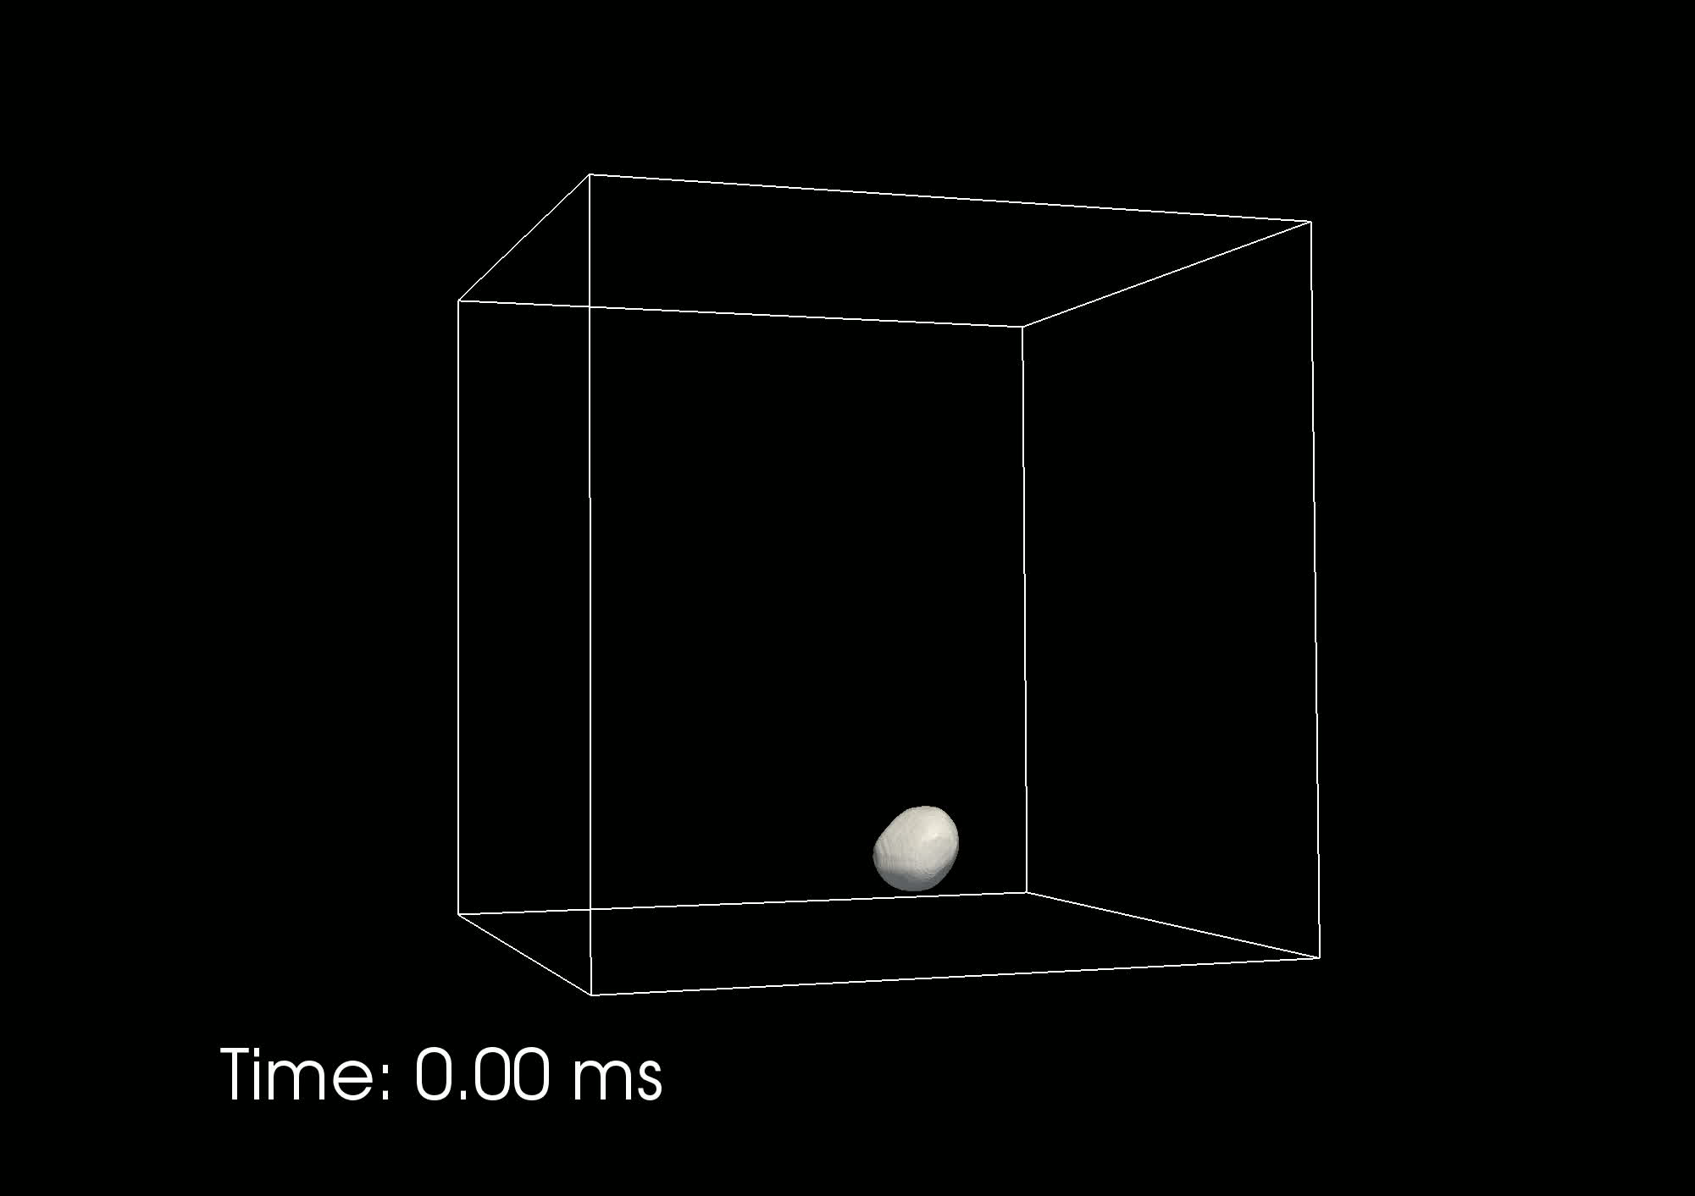

Slide 27
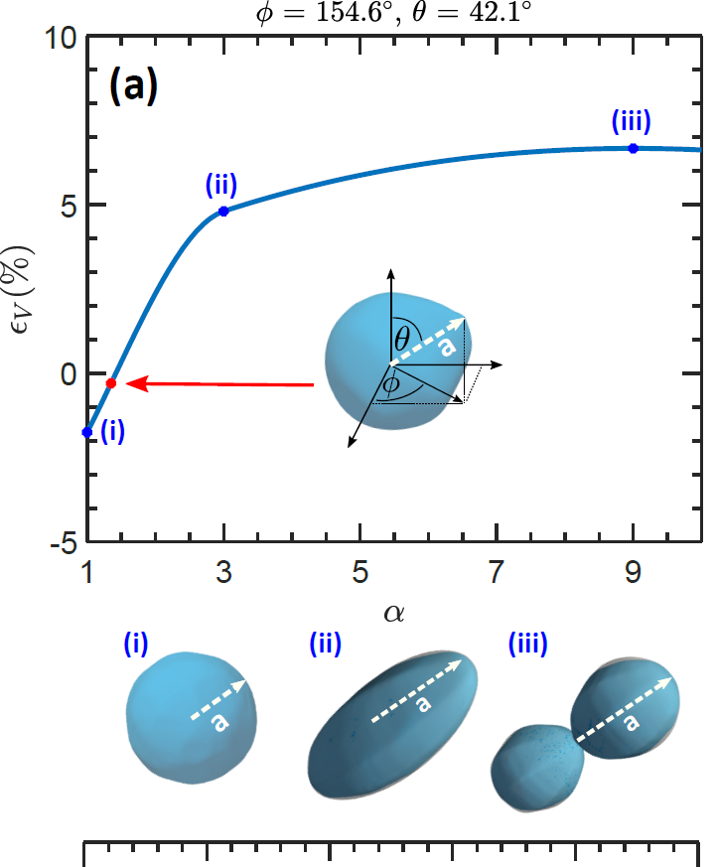
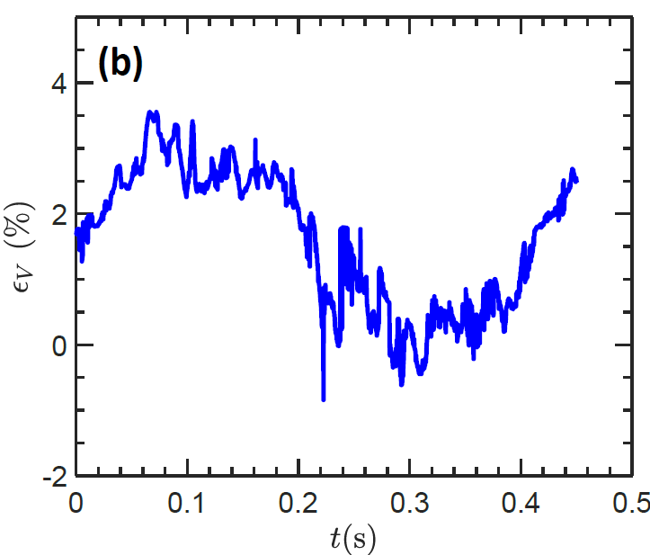
Uncertainty Quantification

Slide 28
Bubble size distribution
2 – 3 mm

Slide 29

Aspect ratio PDF
$$α=r_{max}/r_{min}$$

Slide 30

Surface area increases due to non-affine deformation
$$α_{s}=A/A_{Sphere}$$

Slide 31
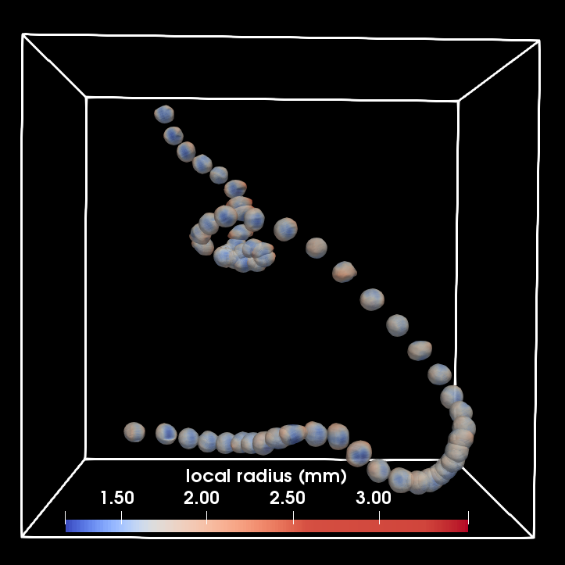
Conclusion
A new Virtual Camera method was developed for 3D shape reconstruction of bubbles/droplets in turbulence.
No need for 2D segmentation
The methods helps to reconstruct non-affine deformation in turbulence.
In strong turbulence bubbles deform significantly more than that represented by an ellipsoid
Award Nos. 1705246
CAREER-1653389

Slide 32
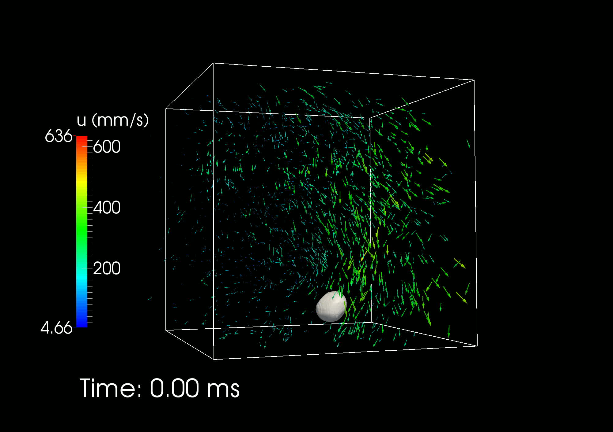
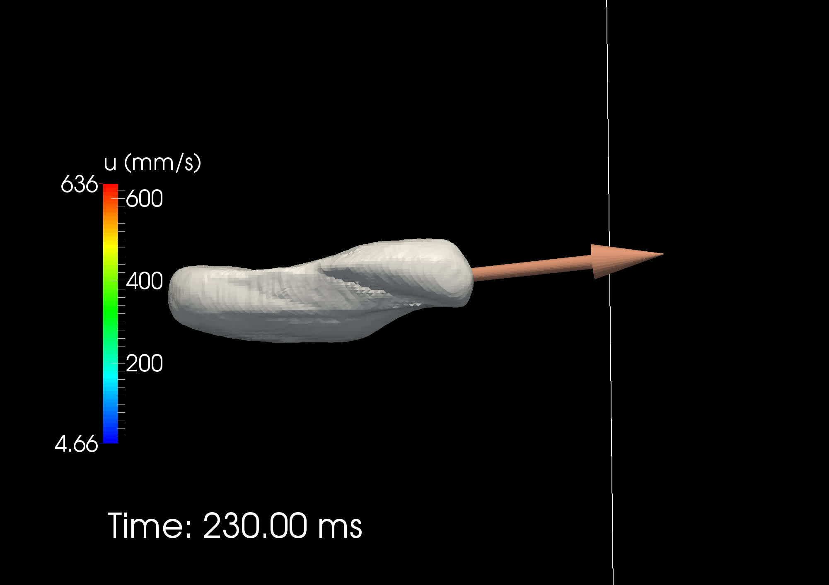
Vorticity magnitude: 1900 1/s (six times mean)

Slide 33
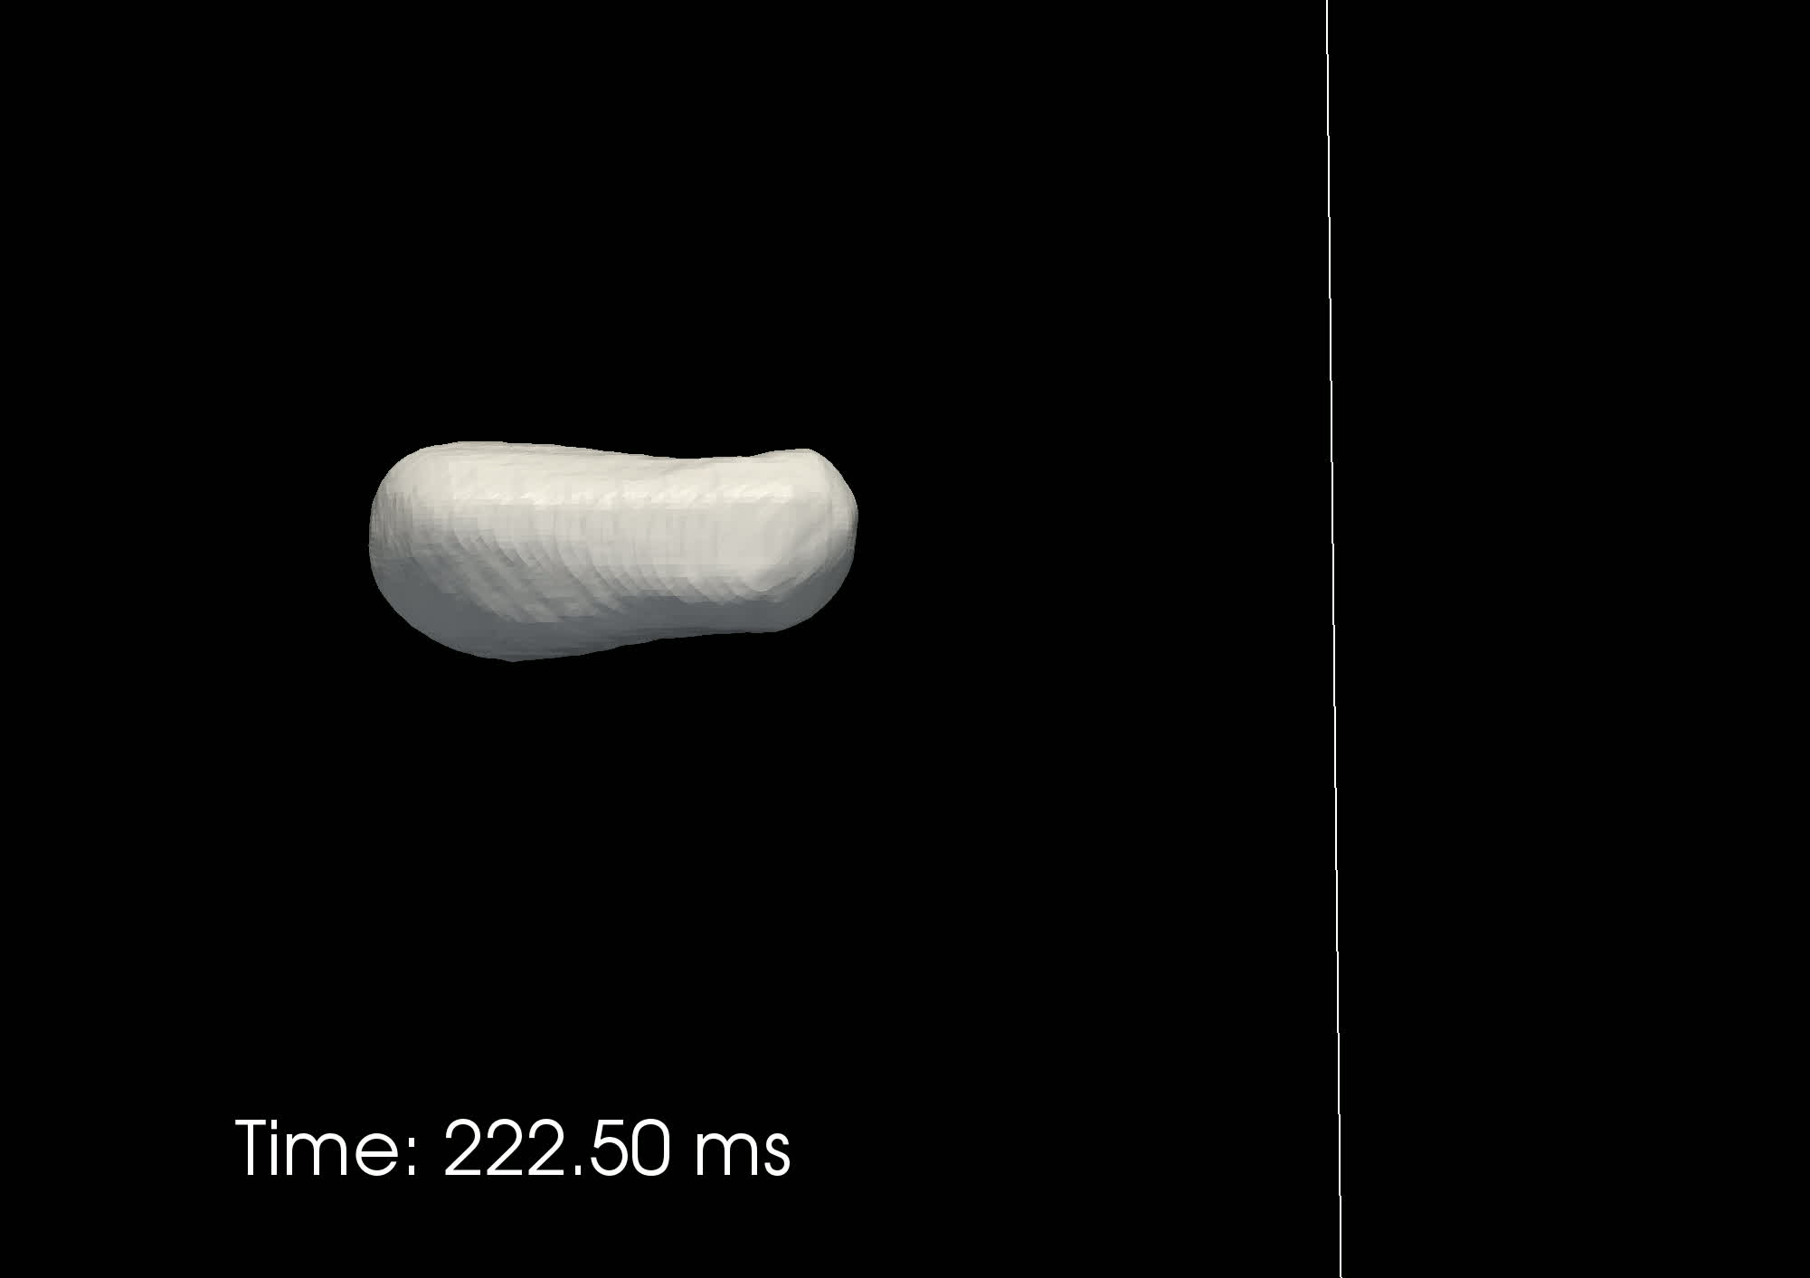
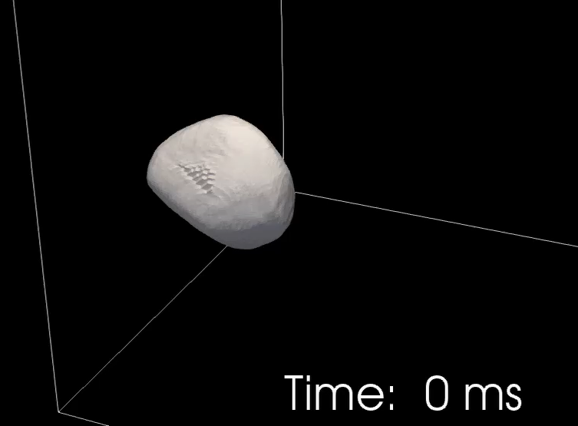
Thank you!
Built a water tunnel to create turbulence with high energy dissipation rate.
Simultaneously measured both phases.
Reconstructed bubble geometry in 3D.
Breakup in turbulence is complicated!

