Slide 1
Advanced measurement techniques for the validation of a single-pseudophase CFD model to predict the thermal behaviour of nanofluids
Sebastián Uribe^{1*}, Muthanna Al-Dahhan¹
¹ Chemical and Biochemical Engineering Department, Missouri University of Science and Technology, Rolla, MO 65409 USA
* uribelopezj@umsystem.edu

Slide 2
Content
Introduction
Experimental setup
CFD modelling
  Geometry
  Governing equations
Results and discussion
Remarks

Slide 3
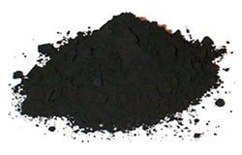
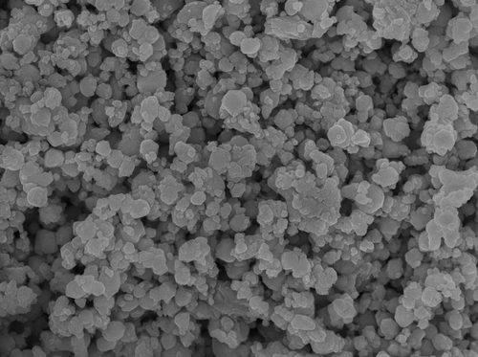
Introduction
Nanofluids are stable suspensions of solid nanoparticles in a base fluid in order to improve their thermal properties for diverse industrial applications.
It has been observed that the size of the nanoparticle, volume concentration (φ), material of the nanoparticles and base fluid have important effects over the performance and stability of the nanofluids
Many experimental studies of nanofluids have focused on the development of correlations to predict the thermophysical properties of nanofluids and their thermal behaviour
(Cupper oxide nanoparticles)

Slide 4
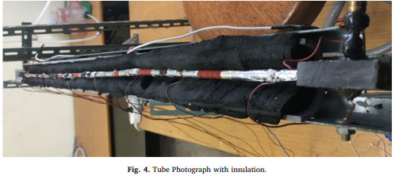
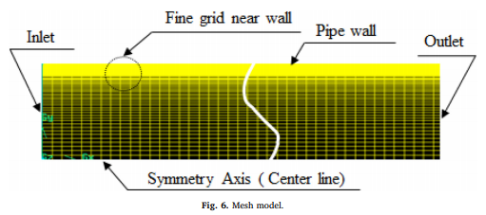
Introduction
CFD techniques have seem to be a promising tool to study and predict the thermal behavior of nanofluids
Single-pseudo-phase vs two-phase flow
For both approaches, deviations of up to 35% in the prediction of heat transfer coefficients can be found in literature
In most of the works found in literature, important simplifications are made on either the geometry of the system (2D systems) or on the coupling of the multiscale phenomena
(Experimental and CFD modeling study – Kim et al, 2018)

Slide 5
Experimental setup

Slide 6
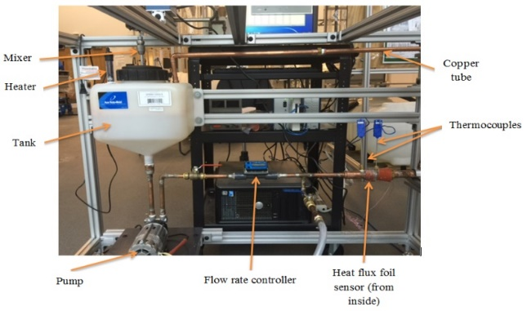
Experimental setup
Closed loop of copper tube
  ID = 2.54 cm; L = 40 cm
Nanoparticles
  Material: CuO, Fe₂O₃, Al₂O₃
  D_{np} = 30 nm
  ρ_{np} = 6350, 5240, 3600 kg/m³
  k_{np} = 69, 20, 40 W/m K
  C_{p,np} = 550, 650, 765 J/gr K
Operartion conditions
  T = 25 – 55 °C
  Q = 1 – 6 l/min
  φ = 0.01 – 0.05%

Slide 7
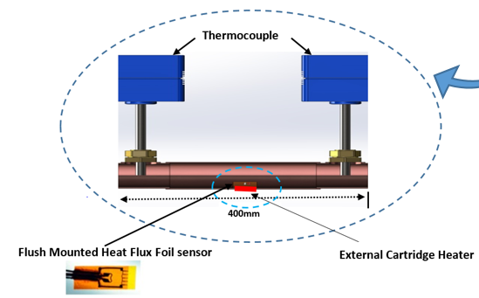
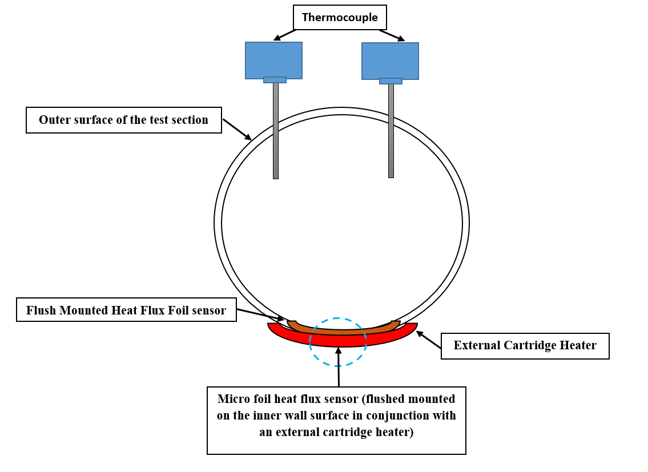

Experimental setup
Non-invasive heat transfer coefficient probe
Fast response measurements of heat flux and temperature

Slide 8
CFD modelling

Slide 9
Geometry
Geometrical characteristics were set according to the experimental setup
Only the test section, was considered in the geometry of the CFD model

Slide 10
Governing Equations
A single-pseudo-phase model was implemented. Effect of nanoparticles over the base fluid was accounted through effective thermophysical properties
  Momentum balance
  Continuity
  Heat transfer balance
Thermophysical properties of the nanofluids are simultaneously estimated by the model

Slide 11
Closures/sub-models
Sub-models/correlations are required to estimate the nanofluid thermophysical properties
  Density
  Viscosity
  Thermal conductivity
  Heat capacity
Water properties are also simultaneously estimated by the model based on polynomial correlations

Slide 12
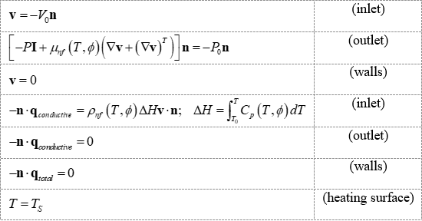
Boundary conditions
The following boundary conditions were set to the implemented model

Slide 13
Results and discussion

Slide 14
Results: Heat transfer coefficient
48 cases were reproduced on the CFD simulations.
a)
b)
c)
Heat transfer coefficient at a) T = 25°C Q = 3 l/min; b) T = 55°C Q = 3 l/min; c) T = 55°C Q = 6 l/min

Slide 15
Results: Thermal boundary layer
Enhancement of the heat transfer coefficient and thermal boundary layer thickness can be predicted by the implemented CFD model
a)
b)
c)
Thermal boundary layer at a) T = 25°C Q = 3 l/min; b) T = 55°C Q = 3 l/min; c) T = 55°C Q = 6 l/min

Slide 16
Results: Average deviations
a)
b)
Average deviations in the prediction of at a) heat transfer coefficients; b) thermal boundary layer

Slide 17
Results: Heat transfer coefficient
a)
b)
c)
Heat transfer coefficient and thermal boundary layer thickness at T = 25°C φ = 0.01% for a) CuO/water; b) Fe₂O₃/water; c) Al₂O₃/water

Slide 18
Results: Heat transfer coefficient
a)
b)
c)
Heat transfer coefficient and thermal boundary layer thickness at T = 55°C φ = 0.01% for a) CuO/water; b) Fe₂O₃/water; c) Al₂O₃/water

Slide 19
Remarks

Slide 20
Remarks
A 3D CFD single-pseudo-phase simulation of an experimental horizontal pipe system to determine the heat transfer coefficient and thermal boundary layer of a nanofluid was implemented
An advanced non-invasive heat transfer coefficient probe developed at the mFReal was used on the experimental study
The CFD model incorporated the dependence of the physical and thermal properties of the nanofluids on the temperature and volume concentration of the nanoparticles through the inclusion of correlations reported in literature
Local heat transfer coefficients and thermal boundary layer thickness are predicted by the implemented CFD model with average deviations down to 2.93% and 2.55%, respectively

Slide 21
Remarks
The model predicted the trends in the enhancement of the local heat transfer coefficient and reduction of thermal boundary layer when increasing the volume concentration of the nanoparticles
The model exhibits an enhancement in the agreement between the experimental measurements and the predicted heat transfer coefficients when compared with other models found in literature
The results from the model suggest that there is no need to include a two-phase model to predict the behaviour of the nanofluid

Slide 22
References
Naik, B.A.K., Vinod, A.V., Heat transfer enhancement using non-Newtonian nanofluids in a shell and helical coil heat exchanger. Experimental Thermal and Fluid Science, 2018. 90: p. 132-142.
Behroyan, I., Ganesan, P., Sivasankaran, S., Turbulent forced convection of Cu-water nanofluid: CFD model comparison. International Communications in Heat and Mass Transfer, 2015. 67: p. 163-172
Kakac, S., Pramuanjaroenkij A., Review of convective heat transfer enhancement with nanofluids. International Journal of Heat and Mass Transfer, 2009. 52: p. 3187-3196
Sun, B., W. Lei, Yang, D., Flow and convective heat transfer characteristics of Fe2O3–water nanofluids inside copper tubes. International Communications in Heat and Mass Transfer, 2015. 64: p. 21-28
Said, I.A., Taha, M.M., Usma, S., Woods, B.G., Al-Dahhan, M.H., Investigation of natural convection heat transfer in a unique scaled-down dual-channel facility. AIChE Journal, 2017. 63: p. 387-396
Said, I.A., Taha, M.M., Usma, S., Al-Dahhan, M.H., Experimental investigation of the helium natural circulation heat transfer in two channels facility using varying riser channel heat fluxes. Experimental Thermal and Fluid Science, 2018. 93: p. 195-209
Kim, S., Song, H., Yu, K., Tserengombo, B., Choi, S., Chung H., Kim, J., Jeong, H., Comparison of CFD simulations to experiment for heat transfer characteristics with aqueous Al2O3 nanofluid in heat exchanger tube. International Communications in Heat and Mass Transfer, 2018. 95: p. 123-131
Maxwell, J. C., A treatise on electricity and magnetism. Vol. 1. Clarendon press, 1881
Einstein, A., Eine neue bestimmung der molekuldimensionen. Annalen der Physik, 1906. p. 289–306
Xuan, Y, Roetzel, W. Conceptions for heat transfer correlation of nanofluids. International Journal of Heat and Mass Transfer, 2000. 43: p. 3701-3707
Pendyala, R., Ilyas, S.U., Lim, L.R., Marneni, N., CFD Analysis of Heat Transfer Performance of Nanofluids in Distributor Transformer. Procedia Engineering, 2016. 148: p. 1162-1169

Slide 23
Gracias

