Slide 1

CFD DEM Analysis of a Dry Powder Inhaler with containerization MFiX on Cloud
Vinod Kumar, V M Krushnarao Kotteda, Antara Badhan
University of Texas at El Paso
2019 NETL Workshop on Multiphase Flow Science, August 6-8, 2019

Slide 2
Outline
Introduction
    DPI
    MFiX
    Dakota
  Framework to implement MFiX in Dakota
  Verification and Validation
  Results

Slide 3
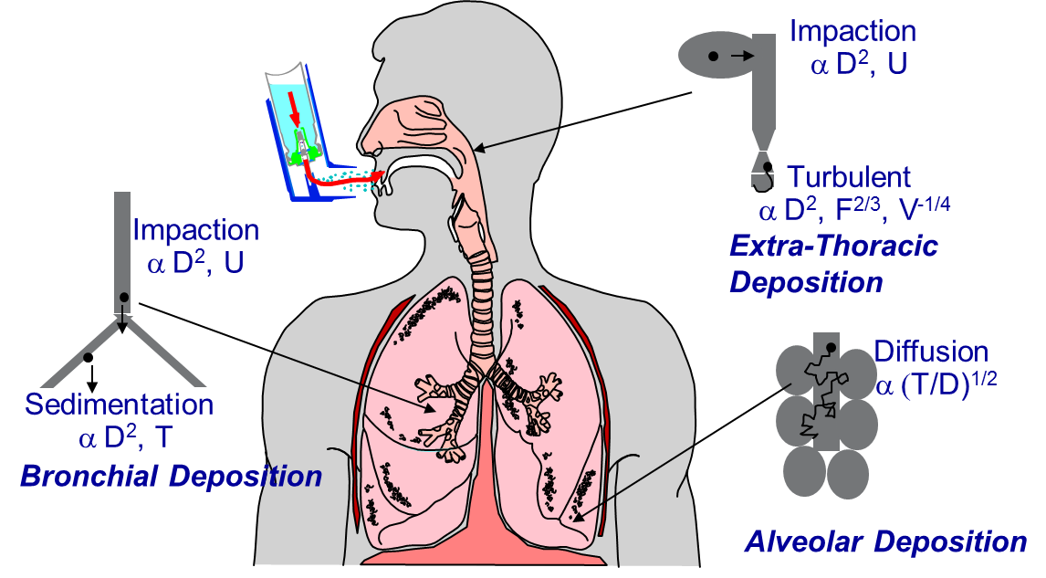
Introduction
Inhalation Therapy refers to direct delivery of the medications to/via the lungs by inhalation
    Regional Therapeutic Effect
      Respiratory Disease
        Asthma and Chronic obstructive pulmonary disease (COPD)
      Pulmonary Hypertension
Advantages of Inhalation Therapy
    Delivery of the Medications Directly to the Action Site
    Rapid Onset
    Enhanced Bioavailability by Avoiding First Pass Effect
https://www.catalent.com/index.php/thinking/science/formulation-of-inhaled-products

Slide 4
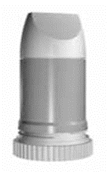
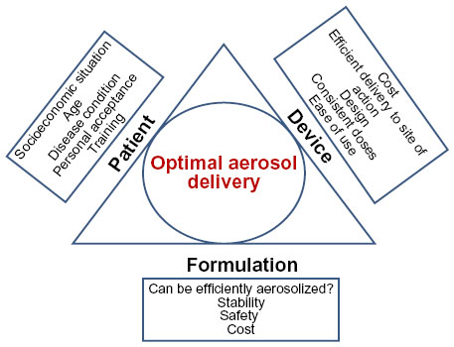
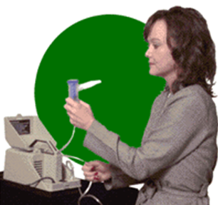
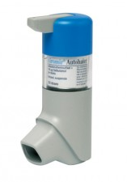
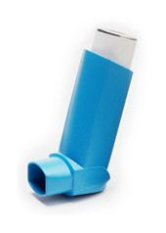
Introduction
Inhaler Considerations
Types of Inhaler
Inhaler
Dry Powder Inhaler (DPI)
Nebulizer
Breath Activated Inhaler
Pressurized Metered Dose Inhaler (pMDI)
Image sourcess: http://www.whitehousepharmacy.co.za/medicine-usage-guides/breath-actuated-inhalers/
Google images
4

Slide 5
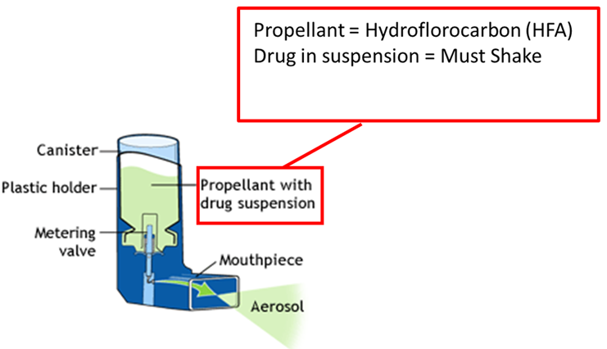
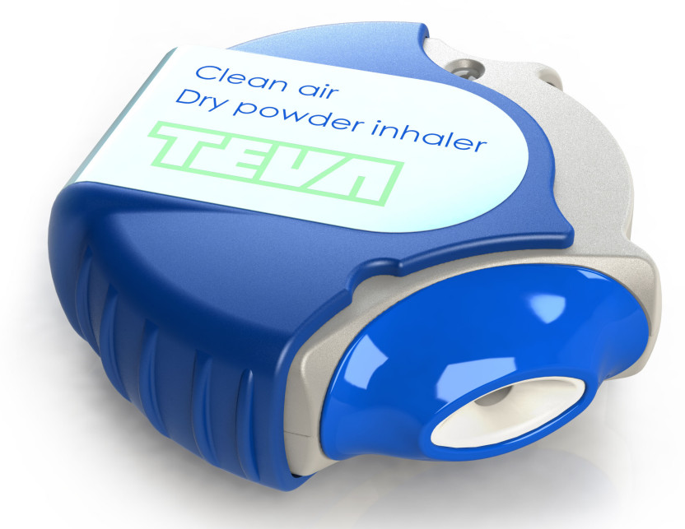
Pressurized Metered Dose Inhaler (pMDI)
Introduction
Most common form of inhalers.
Medication stored in solution in a pressurized canister.
Propellants should be nontoxic, nonflammable, and compatible with drugs
Breath-activated inhaler
Works immediately
DPI does not contain a propellant
Strong inhalation is required
Drug in loose powder form
  Micronized drug particles(1-5µm)
Image: http://www.asthma.ca/adults/treatment/meteredDoseInhaler.php

Slide 6
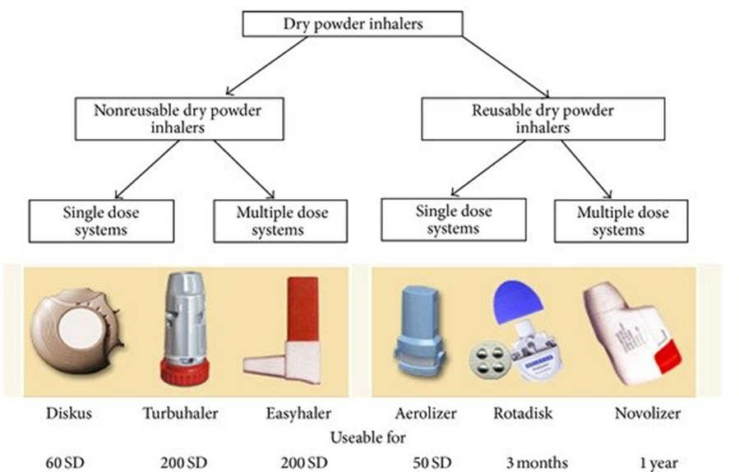
Types of DPI
Introduction
SD : single dose

Slide 7
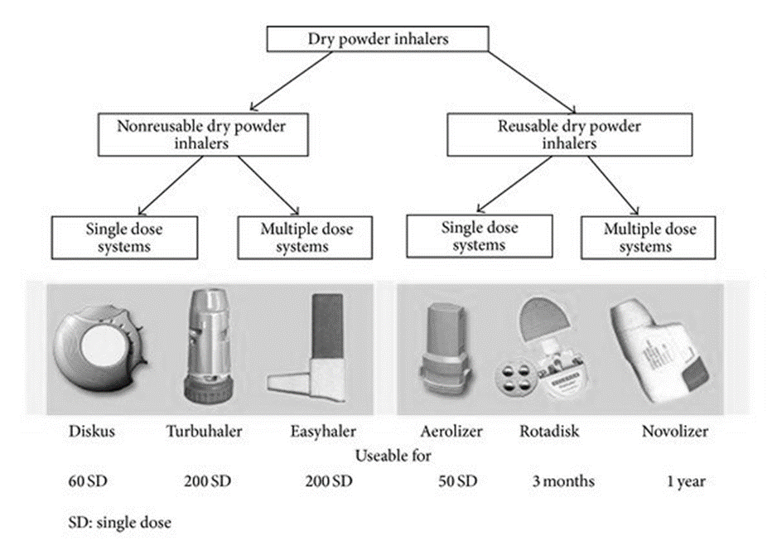
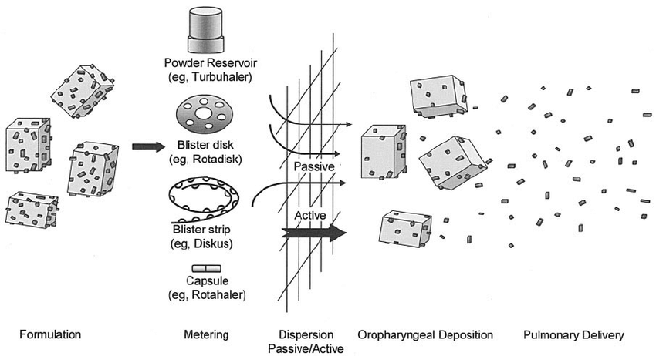
Working principle of a DPI
Introduction

Slide 8
Future Challenges of DPI
Challenge/objective | Solution
Reducing patient errors | Simple self-intuitive DPI design Minimal number of handling steps The same inhaler for all inhaled medication
Improving patient compliance with the inhalation instruction | Simple, self-intuitive DPI design Feedback on inhalation performance
Improving patient adherence to the therapy | Minimizing the number of inhalations per dose Simple, compact DPI design Minimal number of handling steps
Improving safety | No unnecessary excipients Disposal inhalers for special applications e.g. hygroscopic drugs, vaccines, antibiotics (when the risk of bacterial resistance development in the DPI)
Improving efficacy | More powerful inhaler design (balancing between inter particulate, dispersion, and disposition forces)
Specialized inhalation | Patient (group) tailored DPI design
Reducing the costs of inhaled therapy | Simple and cheap (but effective) DPI design Simple drug formulation technologies

Slide 9
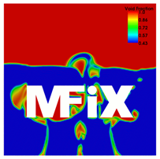
MFiX
Solution time
MFiX is
a multiphase CFD software
developed by NETL (Opensource)
a legacy code written in Fortran
Model uncertainty
Provides a suite of models that treat the carrier phase (gas phase) and disperse phase (solids phase) differently.
MFIX-TFM (Two-Fluid Model)
MFIX-DEM (Discrete Element Model)
MFIX-PIC (Multiphase Particle in Cell)

Slide 10

Dakota has grown significantly beyond an optimization toolkit.
  state-of-the-art optimization methods,
  methods for sensitivity analysis, parameter estimation, uncertainty quantification, and verification
The toolkit provides a flexible and extensible interface between simulation codes and iterative analysis methods.
Uncertainty in input variables u
Uncertainty in output f(u)
variability,
probabilities,
intervals (ranges)
UQ method
Probability densities
Intervals

Slide 11
UQ methods
Sampling (Monte Carlo, LHS)
Robust, understandable, and applicable to any model
Slow to converge
Moments, PDF/CDF, correlations, min/max
Reliability
Goal-oriented; target particular response or probability levels
Efficient local (require derivatives) / global variants
Moments, PDF/CDF, importance factors
Stochastic Expansions
Surrogate models tailored to UQ for continuous variables
Highly efficient for smooth model responses
Moments, PDF/CDF, Sobol indices
Epistemic
Non-probabilistic methods
Generally applicable, can be costly when no surrogate
Belief/plausibility, intervals, probability of frequency
Consider variable characterizations, model properties, ultimate UQ goal to choose a method
Notes:
Dakota can calculate the derivatives for you to use the reliability methods.

Slide 12


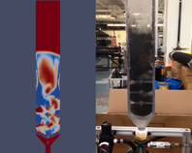
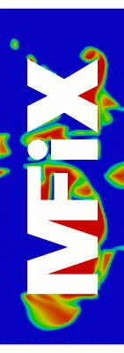
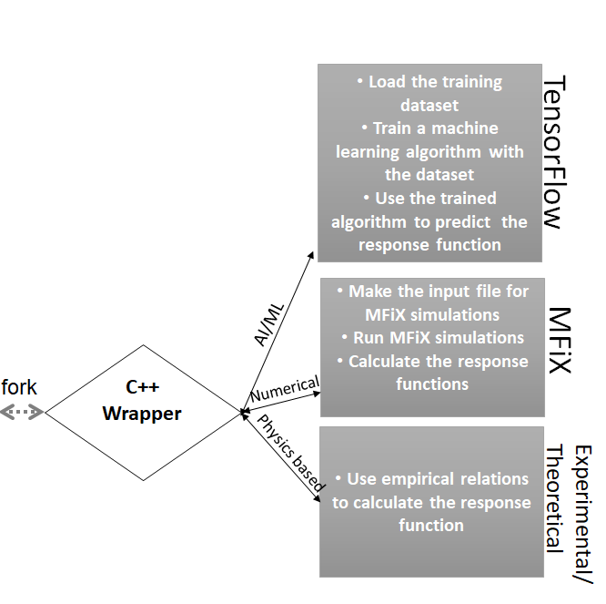
A Practical Process for UQ
environment
method
sampling
sample_type lhs
samples = 1000
seed = 98765 rng rnum2
variables
normal_uncertain = 2
means = 0.80 0.80
std_deviaions = 0.10 0.10
descriptors 'x1' 'x2’
interface
fork
analysis_driver = 'mfix'
responses
response_functions = 1
no_gradients
no_hessians
Identify uncertain input parameters
Characterize input uncertainties and map them into Dakota variable specifications
UQ Analysis
Simulations
Experiments
SciML or Hybrid
Training & Trained model
Select a method appropriate to variables, goal, and problem
Set up Dakota input file and interface to simulation
Run study
Interpret the results

Slide 13
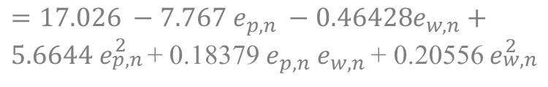
MCS with 100,000 samples
UQ results with Dakota
Case # | Input1 e _{p,n} | Input 2 e _{w,n} | Bed height Sample mean | Bed height Sample Std deviation
1 | N(0.8,0.1) | N(0.8,0.1) | 14.374 | 1.7e-01
2 | N(0.8,0.1) | N(0.8,0.05) | 14.372 | 1.6e-1
Flow in the fluidized bed
e _{p,n} = particle-particle restitution co-efficient
e _{w,n} = Particle-wall restitution co-efficient
UQ results with PSUADE
Response function (Bed height) =
MCS with 100,000 samples
$$=17.026 −7.767 e_{p,n} −0.46428e_{w,n}+$$
$5.6644 e_{\begin{aligned}p,n \\ \end{aligned}}^{2}$+ 0.18379 $e_{p,n}$ $e_{w,n}$ + 0.20556 $e_{\begin{aligned}w,n \\ \end{aligned}}^{2}$
Case # | Input1 e _{p,n} | Input 2 e _{w,n} | Bed height Sample mean | Bed height Sample Std deviation
1 | N(0.8,0.1) | N(0.8,0.1) | 14.371 | 1.7e-1
2 | N(0.8,0.1) | N(0.8,0.05) | 14.367 | 1.5e-1
Gel, A., Garg, R., Tong, C., Shahnam, M. and Guenther, C., 2013. Applying uncertainty quantification to multiphase flow computational fluid dynamics. Powder technology, 242, pp.27-39.
Notes:
We validated the results with Dakota.
The mismatch in case #2, could be due to rounding off the numbers in the formula.

Slide 14
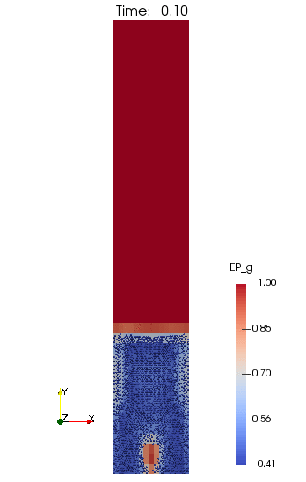
Flow in a fluidized bed
Central jet fluidized bed
The air is injected at a speed of 4200 cm/s through a narrow inlet having width of 1 cm and located exactly at the geometric center of the bottom wall.
cells size: 1 cm x 2 cm
Number of cells: 675 (=15x45) computational cells.
The bed is initialized with 217.15 g of particles with a diameter of 0.4 cm and density of 2.7 g/cm3, resulting in total of 2400 spherical particles.
DEM
Non reacting flow
VMK Kotteda, A Stephens, W Spotz, and V Kumar, and A Kommu, ‘Uncertainty quantification of fluidized beds using a data-driven framework’, Powder Technology 354, 709-718 (2019)
Notes:
Show the instantaneous value.

Slide 15

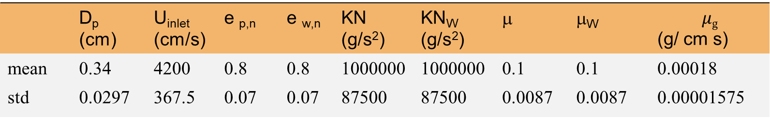
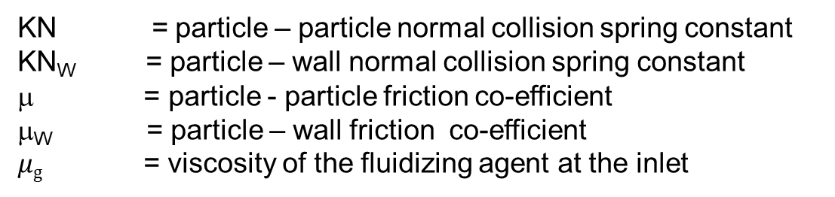
Flow in a fluidized bed: parameters for UQ analysis
 | D_{p} (cm) | U_{inlet} (cm/s) | e _{p,n} | e _{w,n} | KN (g/s²) | KN_{W} (g/s²) | μ | μ_{W} | $$μg$$ (g/ cm s)
mean | 0.34 | 4200 | 0.8 | 0.8 | 1000000 | 1000000 | 0.1 | 0.1 | 0.00018
std | 0.0297 | 367.5 | 0.07 | 0.07 | 87500 | 87500 | 0.0087 | 0.0087 | 0.00001575
D_{p} = Particle diameter
U_{inlet} = Velocity of the fluidizing agent at the inlet
e _{p,n} = particle-particle restitution co-efficient
Response function
Average bed height
$$H_{p}(t)=\sum_{n=1}^{N_{p}}{Y^{n} /N_{p}}$$
e _{w,n} = particle-wall restitution co-efficient
KN = particle – particle normal collision spring constant
KN_{W} = particle – wall normal collision spring constant
μ = particle - particle friction co-efficient
μ_{W} = particle – wall friction co-efficient
$μg$ = viscosity of the fluidizing agent at the inlet

Slide 16
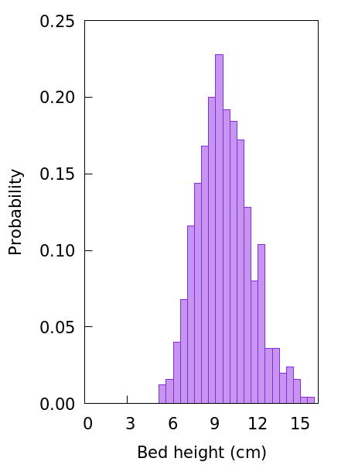

UQ results: Flow in a fluidized bed
 | D_{p} (cm) | U_{inlet} (cm/s) | e _{p,n} | e _{w,n} | KN (g/s²) | KN_{W} (g/s²) | μ | μ_{W} | $$μg$$ (g/ cm s)
mean | 0.34 | 4200 | 0.8 | 0.8 | 1000000 | 1000000 | 0.1 | 0.1 | 0.00018
std | 0.0297 | 367.5 | 0.07 | 0.07 | 87500 | 87500 | 0.0087 | 0.0087 | 0.00001575
Response function
Average bed height
Bed height
9.87853e-01
7.65915e-01
1.26841e-03
-2.19558e-02
-5.44667e-02
-4.08984e-02
-1.03671e-02
6.74702e-02
-1.76986e-02
D_{p}
U_{inlet}
e _{p,n}
e _{w,n}
KN
KN_{W}
μ
μ_{W}
$$μg$$
Bed height at t=40 is 9.86838 cm
Number of samples = 500
Mean:
Std:
Partial Correlation Matrix between
inputs and output
9.6826836828
1.9528769373

Slide 17
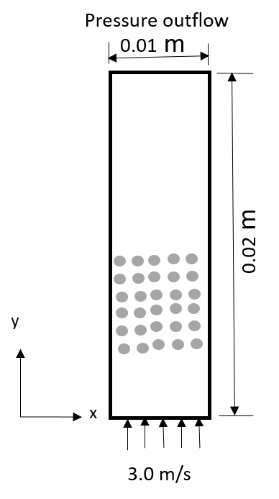
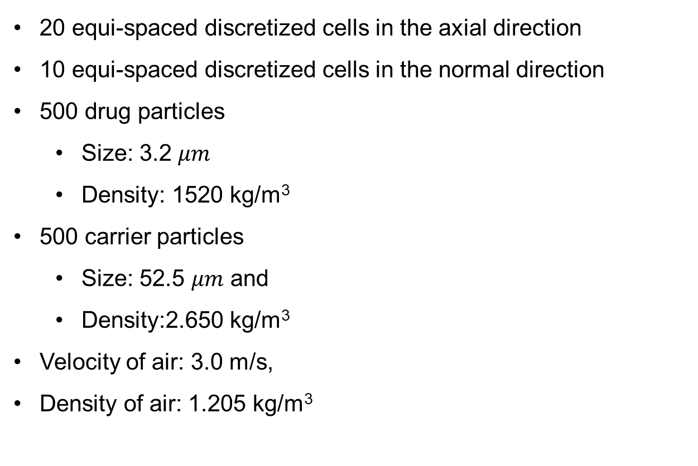
DPI: Problem definition
20 equi-spaced discretized cells in the axial direction
10 equi-spaced discretized cells in the normal direction
500 drug particles
  Size: 3.2 $μm$
  Density: 1520 kg/m³
500 carrier particles
  Size: 52.5 $μm$ and
  Density:2.650 kg/m³
  Velocity of air: 3.0 m/s,
  Density of air: 1.205 kg/m³

Slide 18
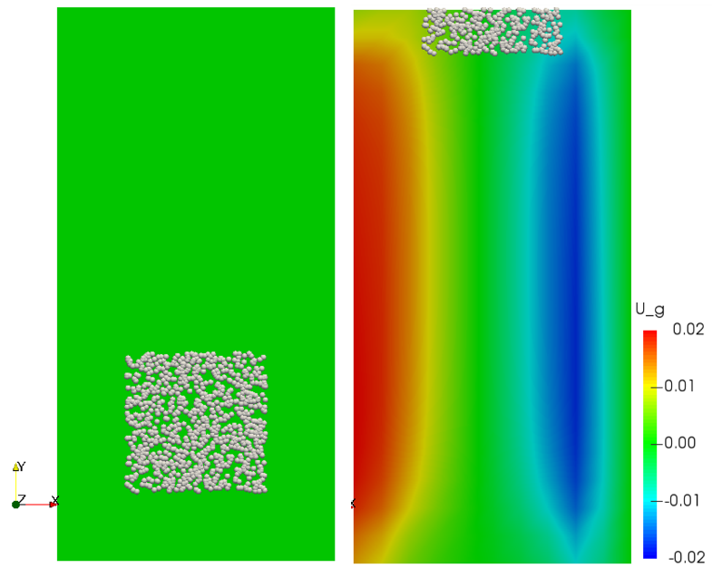
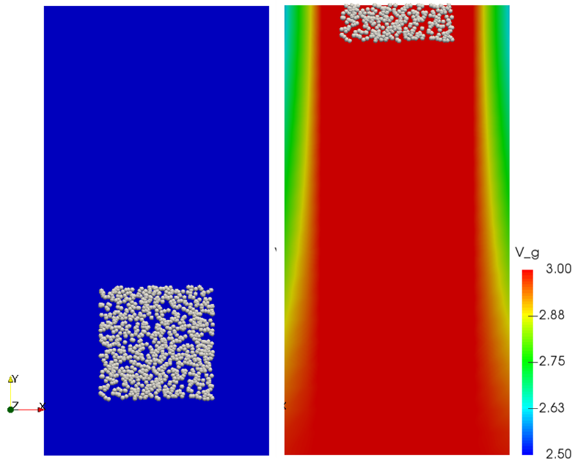
Results
t=0.0 s
t=1.0 s
t=0.0 s
t=1.0 s
Velocity fields along the x-direction
Velocity (y-direction) fields along the y-direction

Slide 19
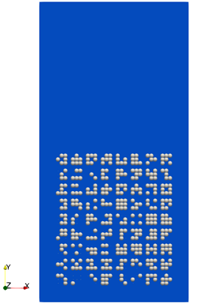
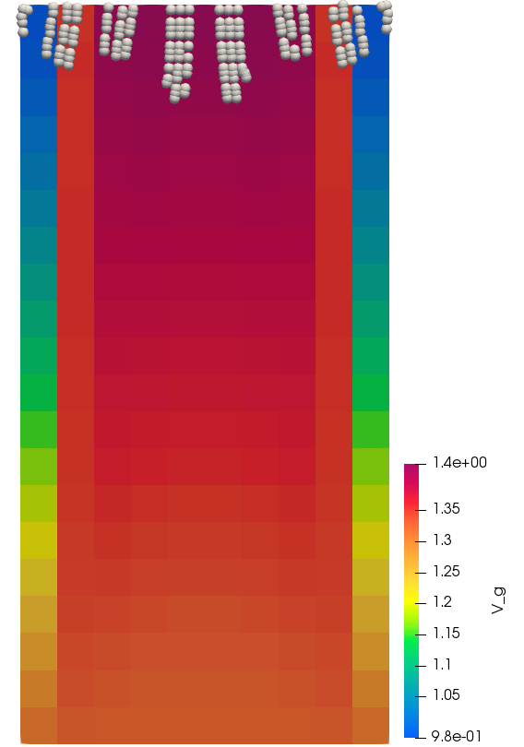
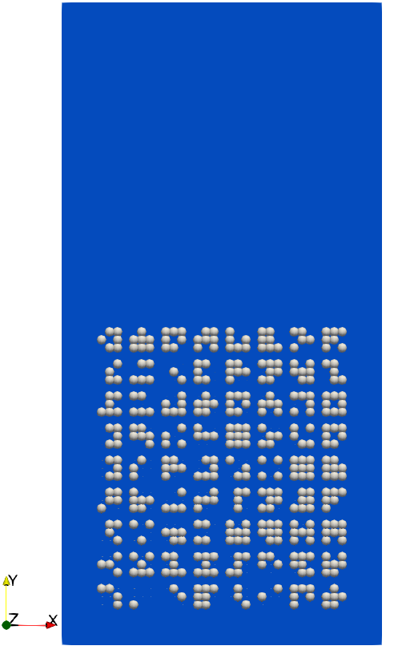
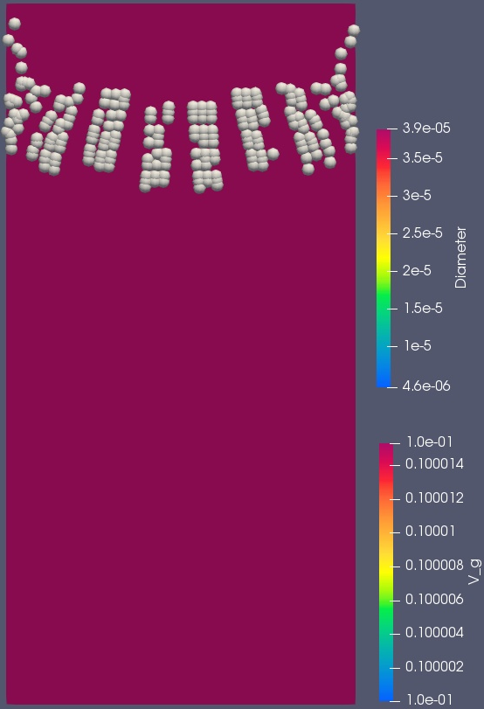
Results: Effect of particles diameter
t=0.0 s
t=2.0 s
t=0.0 s
t=3.0 s
V_{inlet} =1.32 m/s
D_{P1}=3.17e-⁰⁵ m
ρ_{p1} =2344.94 kg/m³
D_{P2}=3.41e-⁰⁶ m
ρ_{p1} =1562.45 kg/m³
V_{inlet} =1.35 m/s
D_{P1}=3.89e-⁰⁵ m
ρ_{p1} =2867.71 kg/m³
D_{P2}=4.63e-⁰⁶ m
ρ_{p1} =1489.88 kg/m³
axial velocity (y-direction) fields
axial velocity (y-direction)

Slide 20
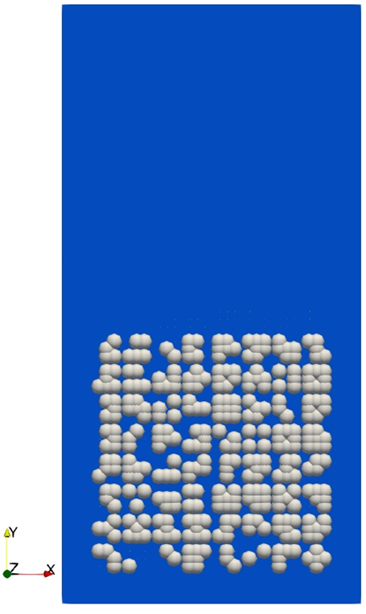
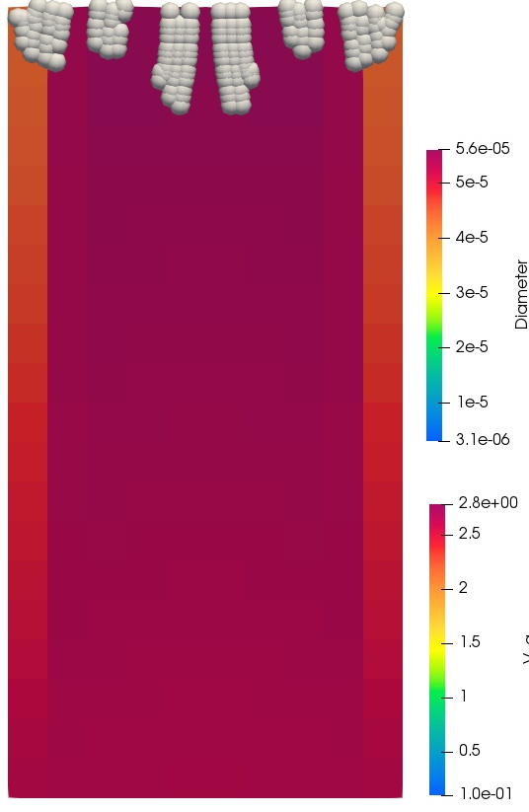
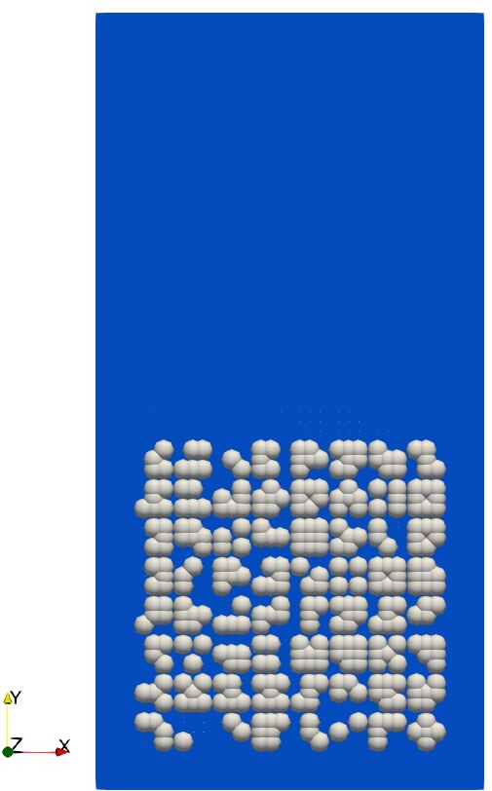
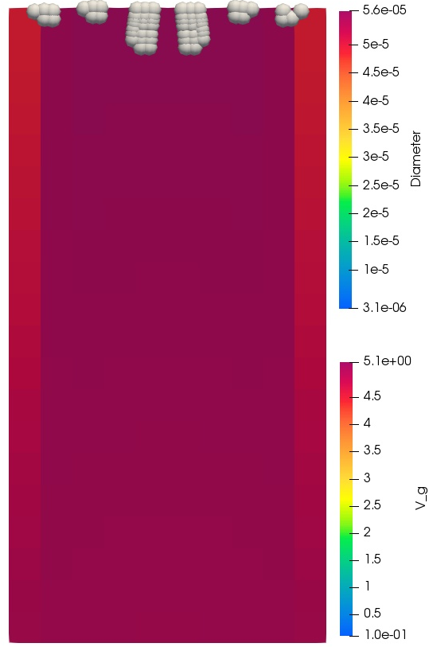
Results: Effect of velocity at the inlet
t=0.0 s
t=3.0 s
t=0.0 s
t=2.0 s
V_{inlet} =2.64 m/s
D_{P1}=5.6e-⁰⁵ m
ρ_{p1} =2694.64 kg/m³
D_{P2}=3.11e-⁰⁶ m
ρ_{p1} =1731.72 kg/m³
V_{inlet} =5 m/s
D_{P1}=5.6e-⁰⁵ m
ρ_{p1} =2694.64 kg/m³
D_{P2}=3.11e-⁰⁶ m
ρ_{p1} =1731.72 kg/m³
axial velocity (y-direction) fields
axial velocity (y-direction)

Slide 21
Summary
A framework is used to implement MFiX in Dakota-UQ toolkit
The framework has been validated on various test cases.
2D simulations are carried out with MFiX to simulate flow in an inhaler.
Particles residence time increases with the particle diameter
Particle residence time decreases with an increase in the inflow velocity.

Slide 22


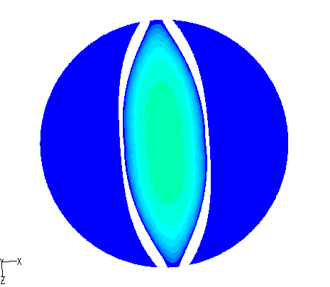
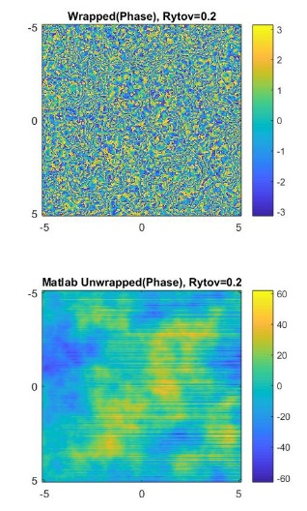
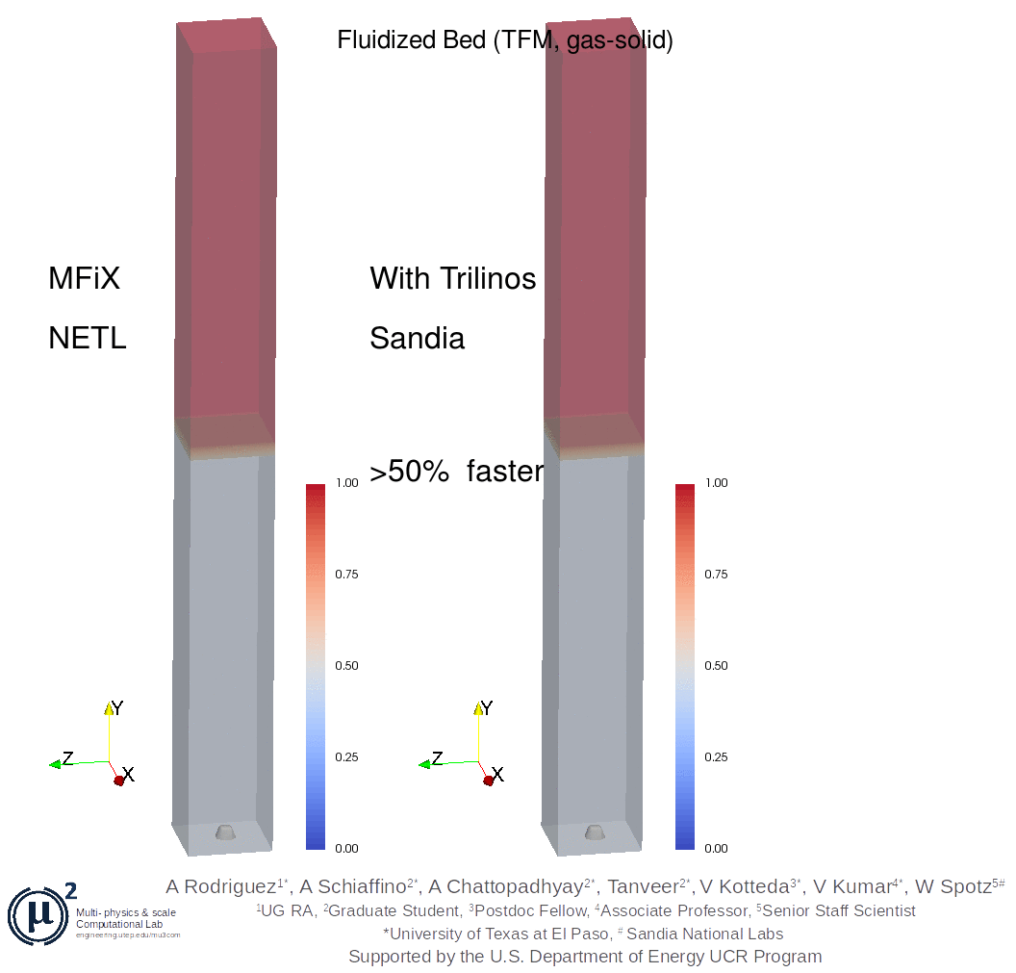
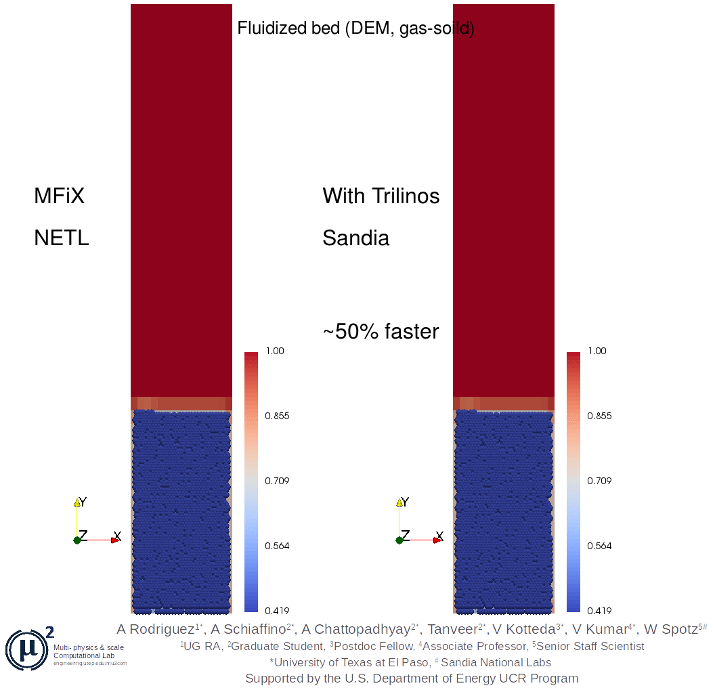
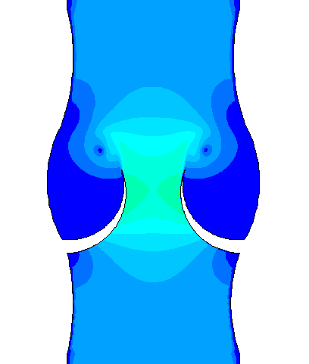
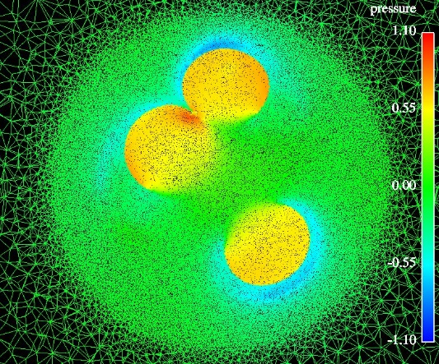
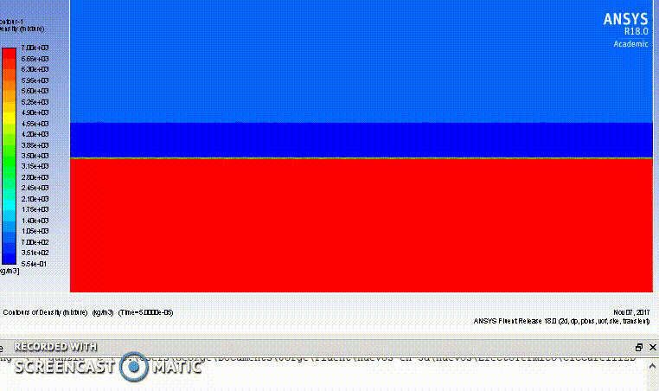
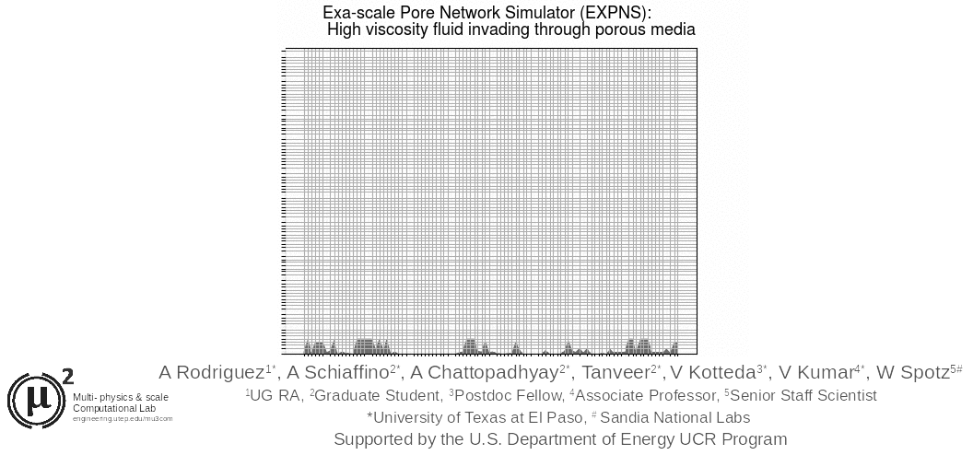
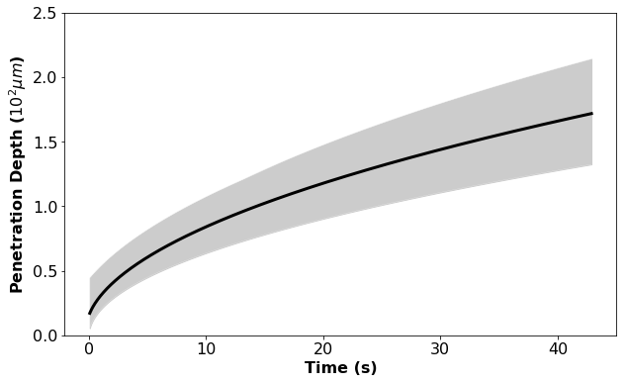
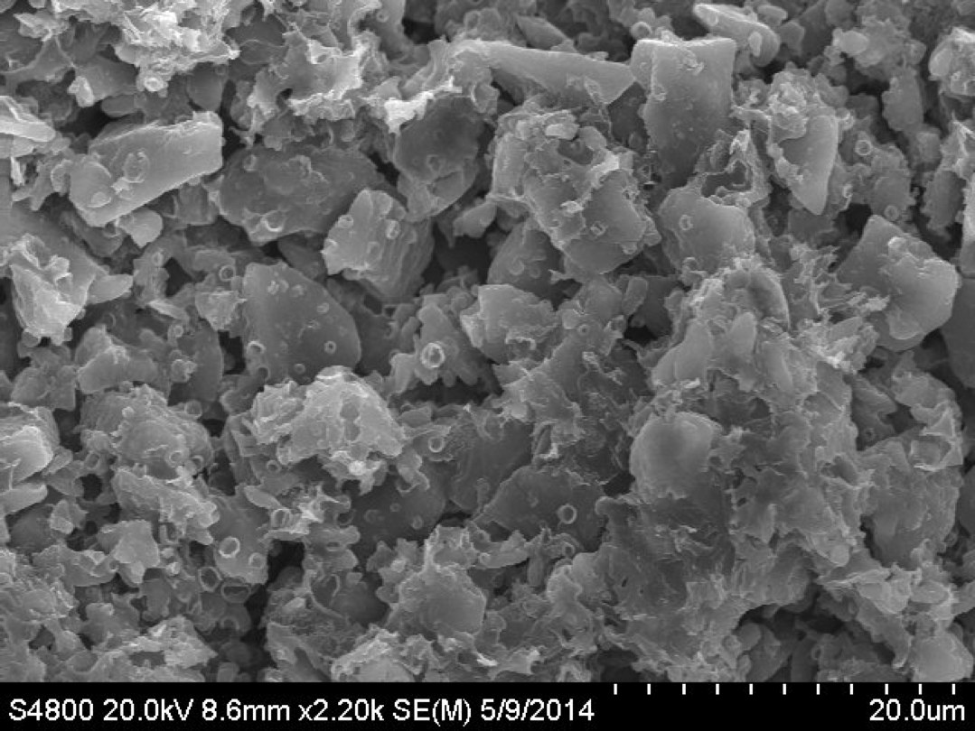
Multi- physics & scale
Computational Lab
engineering.utep.edu/mu3com
Uncertainty quantification

Slide 23


Acknowledgement
THANK YOU …………………
QUESTIONS ?

