Slide 1
MFIX-Exa Development Update
August 9, 2018
Jordan Musser

Slide 2


Exascale Computing Project (ECP)
Exascale supercomputers will be capable of a quintillion (10¹⁸) calculations each second
ECP is a joint effort of two DOE organizations
Office of Science
National Nuclear Security Administration (NNSA)
ECP has three key focus areas
Application Development
Software Technology
Hardware and Integration
exascaleproject.org
“The ECP is focused on accelerating the delivery of a capable exascale computing ecosystem to provide breakthrough solutions that can address our most critical challenges in scientific discovery, energy assurance, economic competitiveness, and national security.”

Slide 3
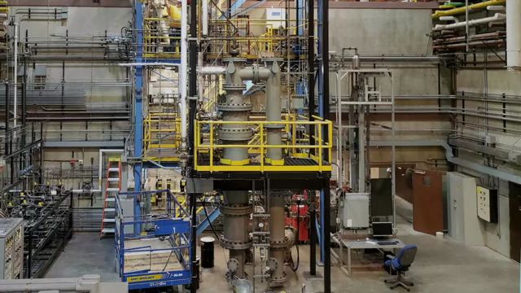
Our Challenge problem
FY19 Target application:
Simulate cold flow in the chemical looping reactor with 10⁷ particles
Exascale challenge problem:
Simulate the NETL’s 50kW hot flow chemical loop reactor (CLR)
Reduction / Oxidation reactions
5B particles for carrier
Natural gas as the fuel
M.A. Clarke, and J.Musser, Simulation of NETL’s 50kW CLR using MFIX-PIC; NETL Technical Report Series; U.S. Department of Energy, National Energy Technology Laboratory: Morgantown, WV (manuscript in preparation)

Slide 4
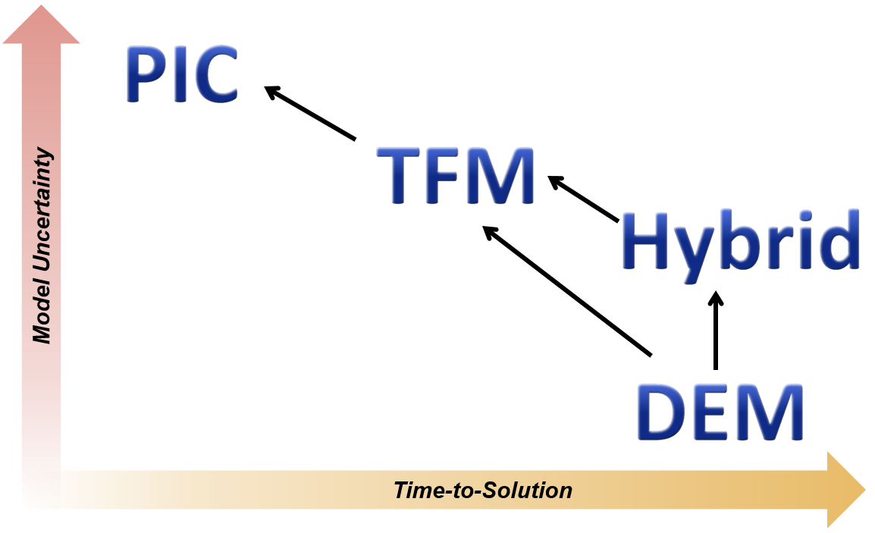



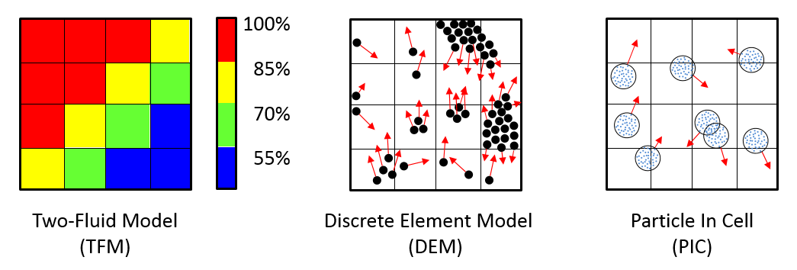
MFIX: The Starting Point
SIMPLE Fluid solver coupled to three different solids models
Energy and species equation support
Distributed memory parallelism (MPI)
Cartesian grid cut-cell for realistic geometries
Two-Fluid Model (TFM)
Discrete Element Model (DEM)
Particles In Cell (PIC)
PDEs describe fluid and solids as interpenetrating continua.
PDEs describe fluid. Newton’s Laws of motion to track particles and resolve collisions.
PDEs describe fluid. Contrived laws approximate inter-parcel forces.

Slide 5
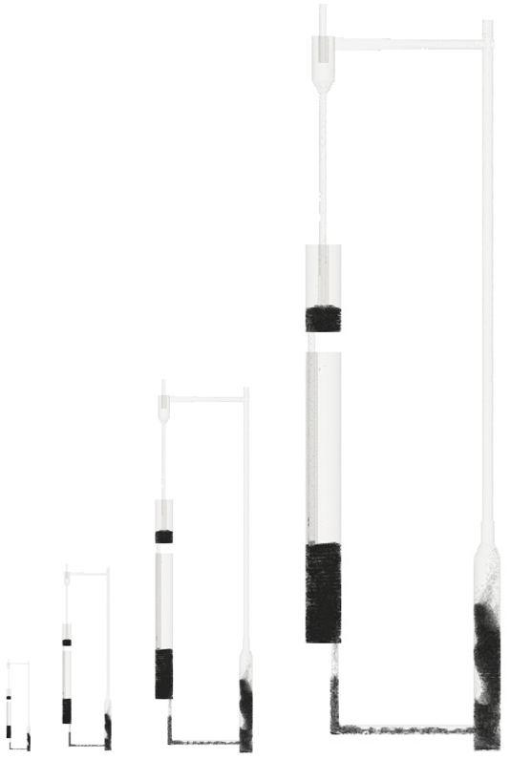
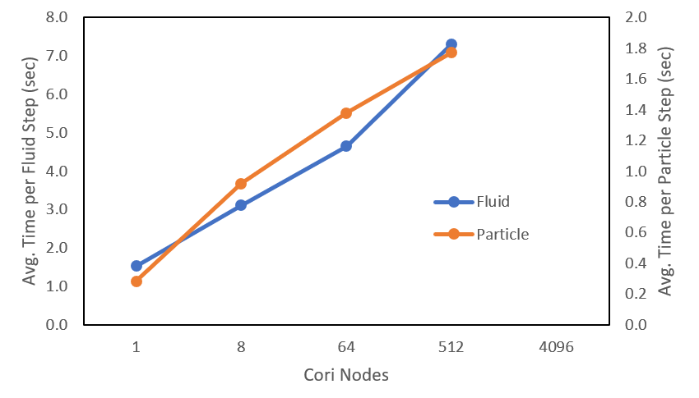
MFIX: The Starting Point
8m
Ideal Scaling
__________________________
MFIX version R2016-1
No “tuning” performance
Naïve MPI decomposition
871 um HDPE particles
Nodes | Cores | Cells | Particles
1 | 64 | 660,000 | 1,115,999
8 | 512 | 5,280,000 | 9,445,748
64 | 4,096 | 42,240,000 | 76,771,071
512 | 32,768 | 337,920,000 | 619,427,261
1m

Slide 6


MFIX-Exa = MFiX-DEM + AMReX
+
AMReX
AMReX is a software framework for massively parallel block-structured AMR calculations – supported by the ECP AMReX Co-Design Center

Slide 7
Fluid Algorithm: MFIX-Classic
Fluid solver (SIMPLE)
Two iterations per time step (minimum)
Four linear solves per iteration
Iterative linear solver (BiCGstab)
A lot of work per time step
A lot of global communication per internal iteration

Slide 8
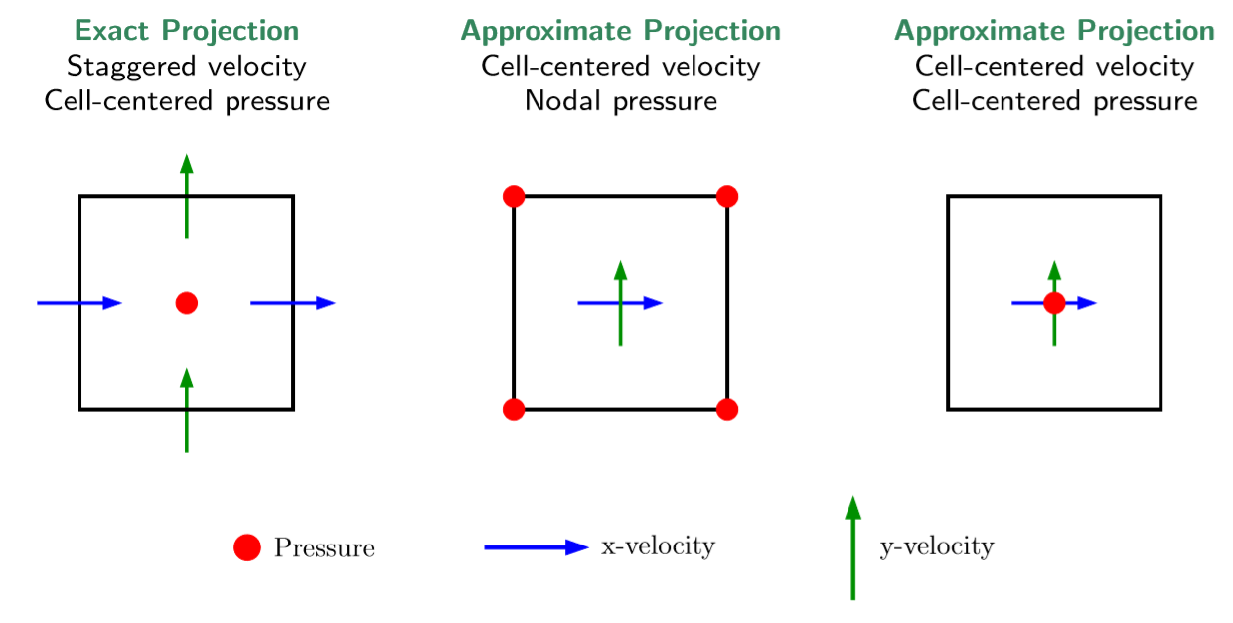
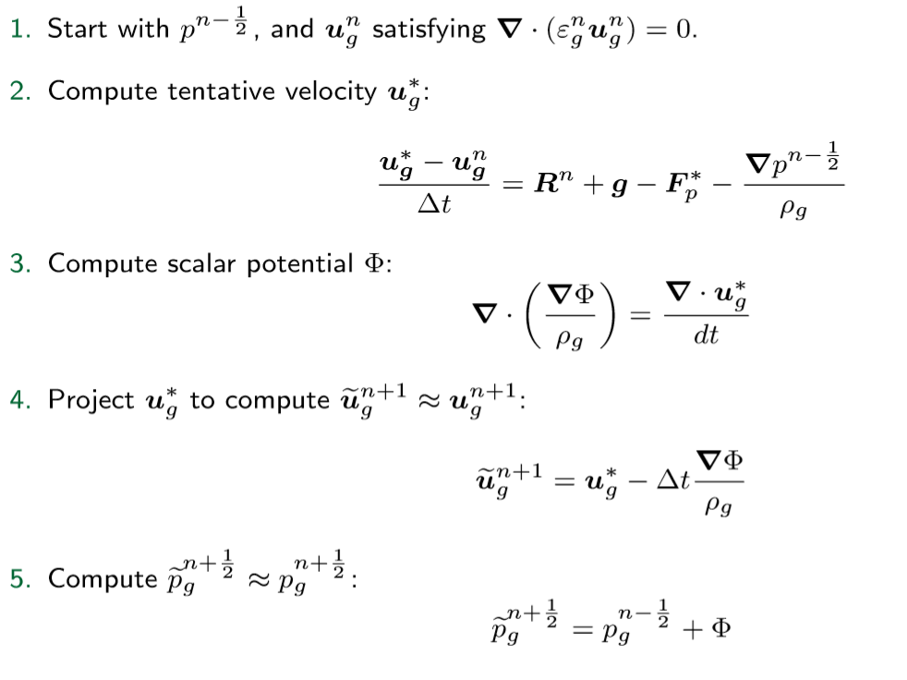
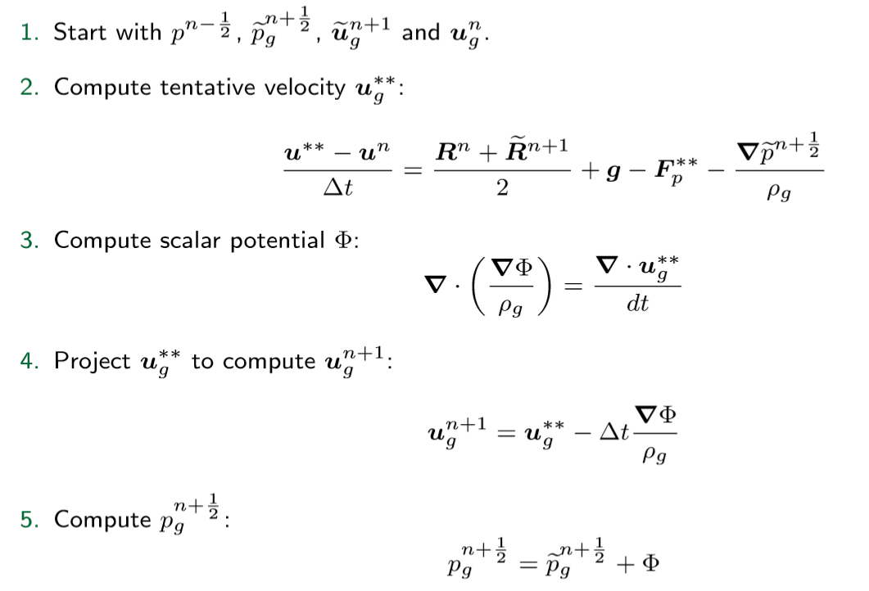
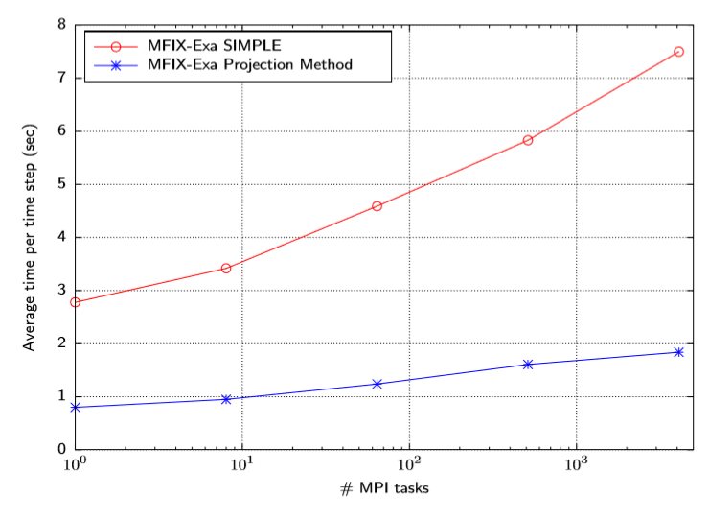
Fluid Algorithm: MFIX-Exa
Low Mach number projection method
Predictor Step
Corrector Step
Initial scaling study

Slide 9
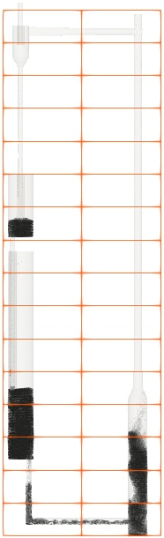
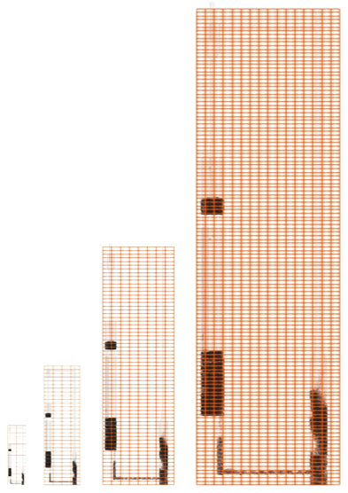
Grid Management: MFIX-Classic
Naïve domain decomposition assigns cores to “dead space” where there is no fluid or particle work.
Largest scaled size
512 KNL nodes (32,768 cores)
16x128x16 domain decomposition
8m
1m
Initial problem size
1 KNL node (64 cores)
2x16x2 domain decomposition

Slide 10
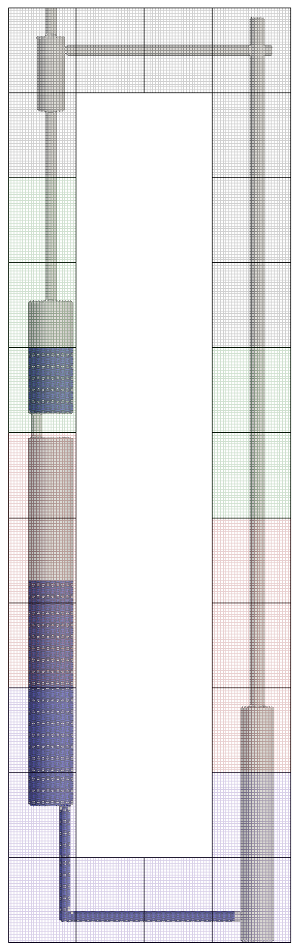
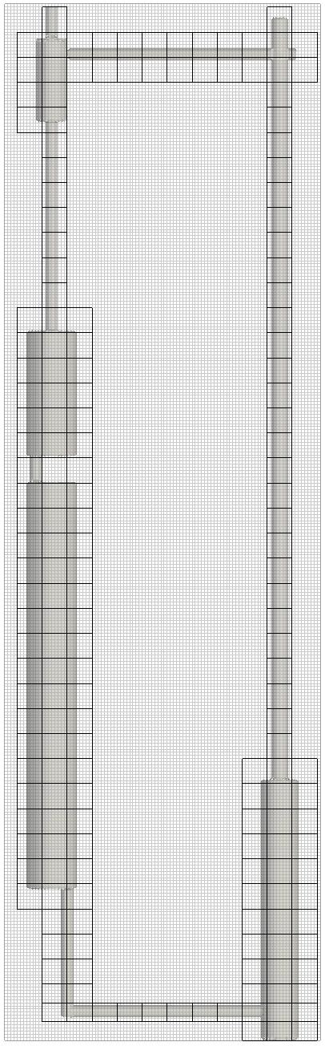
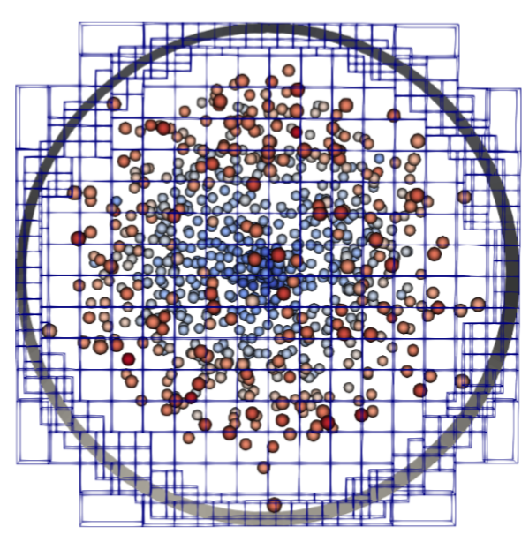
Grid Management: MFIX-Exa
By contrast – MFIX-Exa can construct grids covering only the CLR – no resources assigned to “empty” space
In addition, we can refine the grid near the boundary to better refine geometric features
WBS 2.2.2.04, Milestone Report ECP-ADSE21-15

Slide 11
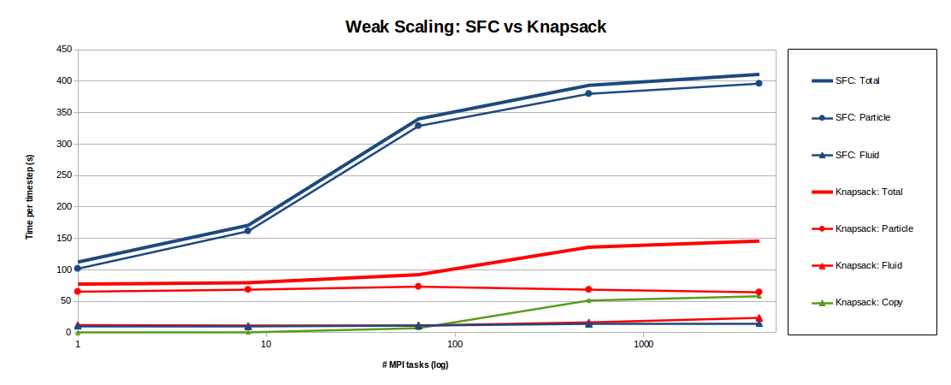
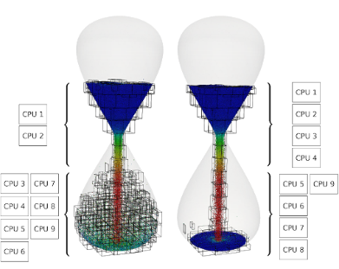
Grid Management: MFIX-Exa
Managing fluid and particle work dynamically gives us the ability to make better use of computing resources.
Change the size of grids and distribution of grids to processes
Logical tiling with OpenMP on CPUs
Larger blocks of work for GPUs
Use separate (dual) grids for the fluid and particles
Choose appropriate weighting function for dynamic load balancing
WBS 2.2.2.04, Milestone Report ECP-ADSE21-15

Slide 12
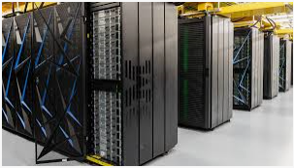
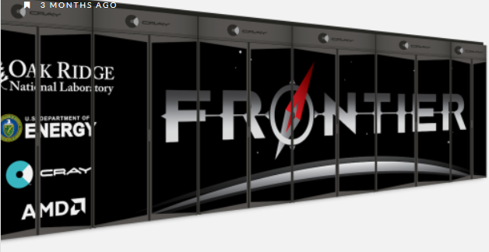
Enabling GPUs: MFIX-Exa
Converting compute kernels from Fortran to CPP.
Following AMReX’s approach:
Easier to maintain. We don’t need separate host and device versions of every function.
Ensures portability. Observed trend is that industry is giving CPP priority over Fortran.
Remove dependency on CUDA Fortran. Who doesn’t having likes less dependencies?
Summit 2018
Dual socket nodes with 2 IBM Power9 CPUs
6 NVIDIA Volta GPUs
Frontier 2021
Kevin Gott “AMReX: Enabling Applications on GPUs,” NERSC
Single socket nodes with 1 AMD Epyc CPU
4 Radeon Instinct GPUs

Slide 13
Enabling GPUs: MFIX-Exa
Ported key particle kernels to GPUs
Launched new kernels from CPU to GPU
Demonstrated 4.7x speedup of key particle kernels for single GPU (Summit) relative to single KNL node (Cori)
Ported key particle-fluid kernels to GPUs
Launched MPI tasks sharing a single GPU
Demonstrated 8x speedup in the particle time step for 8 MPI tasks sharing one GPU (Summit) relative to single KNL node (Cori)
WBS 2.2.2.04, Milestone Report ECP-ADSE21-87
WBS 2.2.2.04, Milestone Report ECP-ADSE21-17

Slide 14
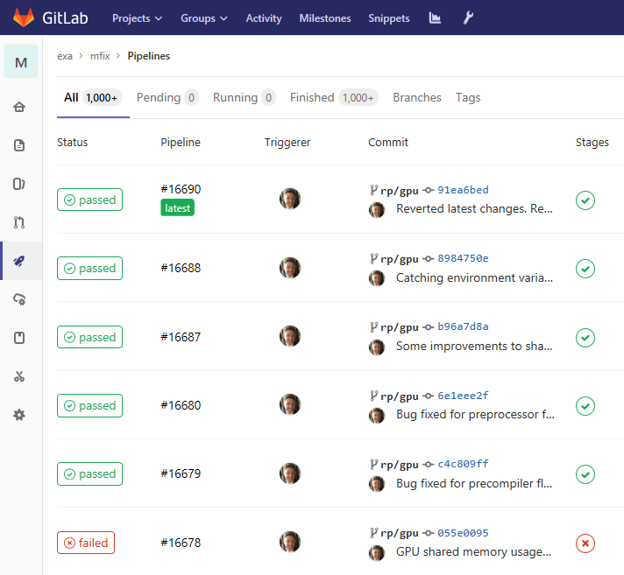
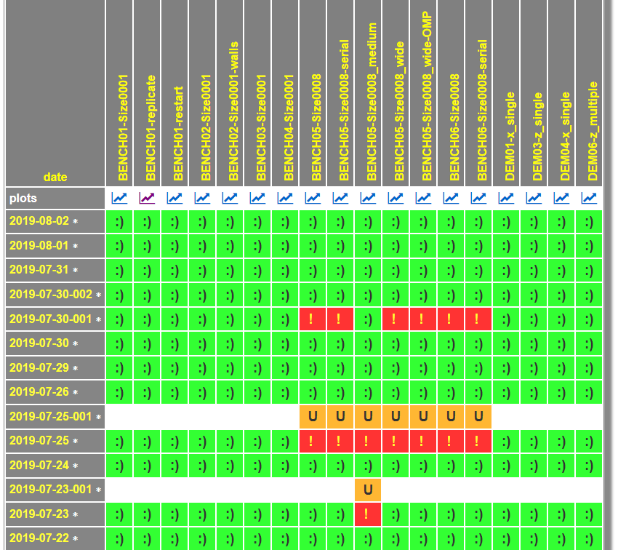
Quality Assurance: MFIX-Exa
GitLab CI Pipelines run a set of ‘smoke tests’ on each commit
LBL-CCSE Nightly Regression tests point comparison of variables

Slide 15
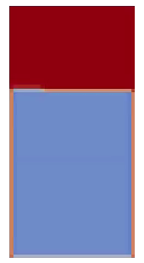
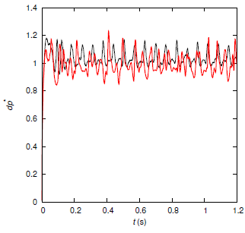
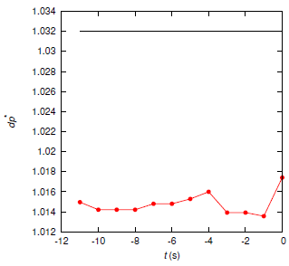
Quality Assurance: MFIX-Exa
“Level 2 Regression Tests ” look at physical quantities like normalized pressure drop.
Transient data from MFIX-Exa is compared to archived “benchmark data” from MFIX-Classic
Results from past tests are compared to assess trends.
Slice of single bubble injection with MFIX-Exa. Courtesy of William Fullmer

Slide 16
Looking Forward: MFIX-Exa
Science Capability:
Add energy and chemistry transport for fluid and particles
Implement MFIX-PIC for potential boot-strapping of initial conditions
Algorithms:
Explore new time discretization of fluid/particle system to improve coupling
Explore alternative models in dense granular region (PIC)
Software:
Migrate more kernels from Fortran to C++
Harden the linear solvers for complex geometries

Slide 17


Thank you

Slide 18
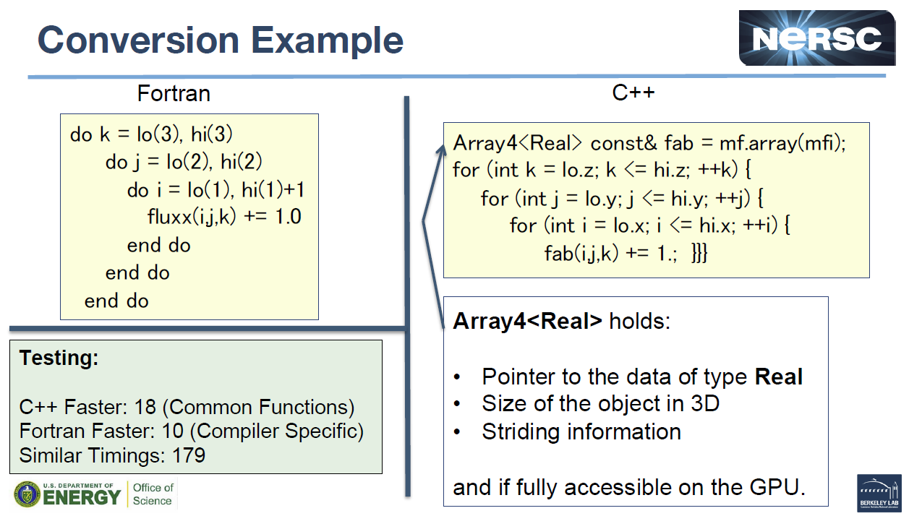
MFIX-Exa Porting to GPUs
Kevin Gott “AMReX: Enabling Applications on GPUs,” NERSC

Slide 19
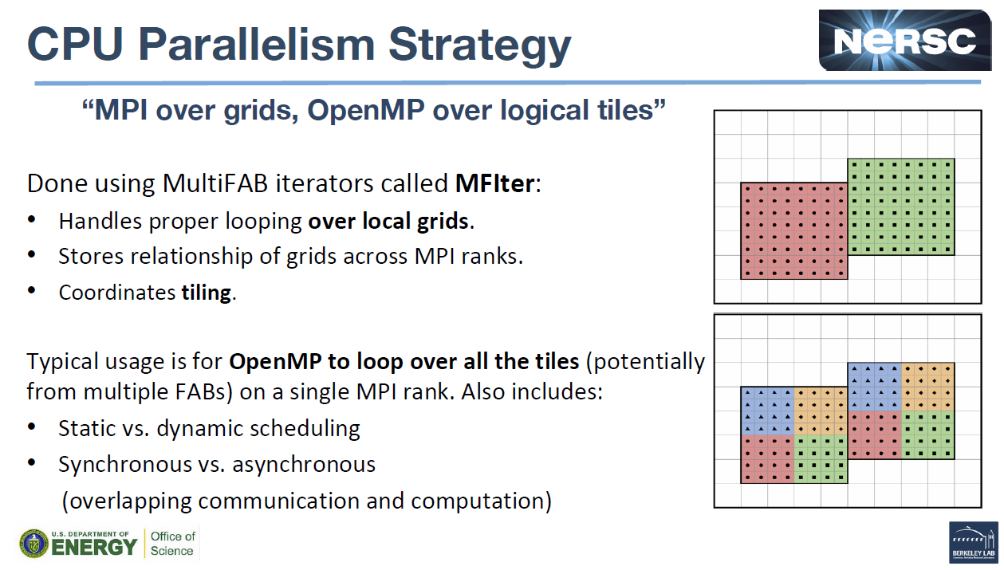
MFIX-Exa Porting to GPUs
Kevin Gott “AMReX: Enabling Applications on GPUs,” NERSC

Slide 20
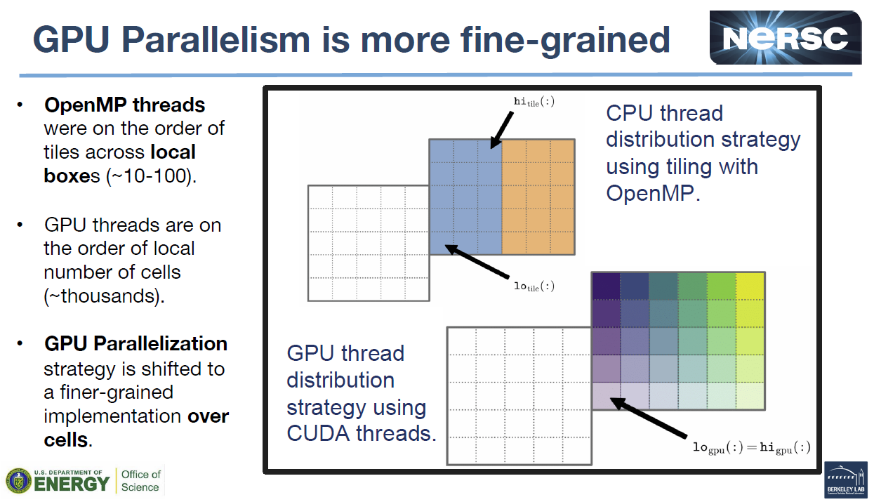
MFIX-Exa Porting to GPUs
Kevin Gott “AMReX: Enabling Applications on GPUs,” NERSC

