Slide 1

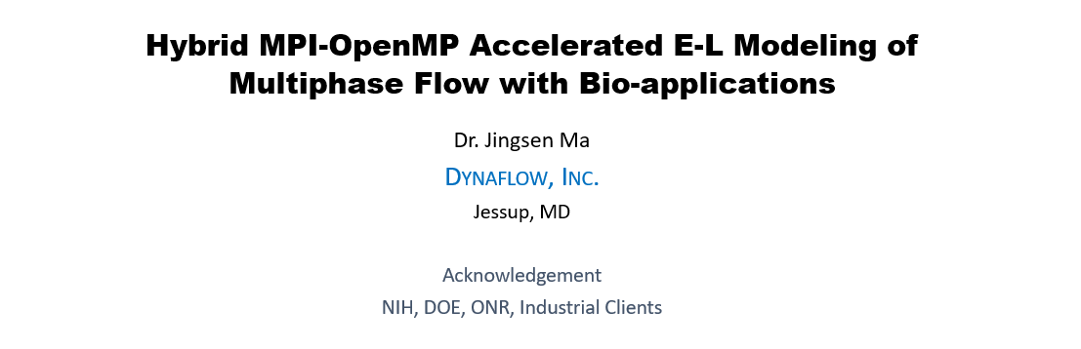


Slide 2
Outline
High Intensity Focused Ultrasound (HIFU)
Numerical Model: Euler-Lagrange Method
Hybrid MPI-OpenMP Parallelization
Simulations & Validations
Parallelization Efficiency
Summary
www.dynaflow-inc.com NETL MFS 1 of 20

Slide 3
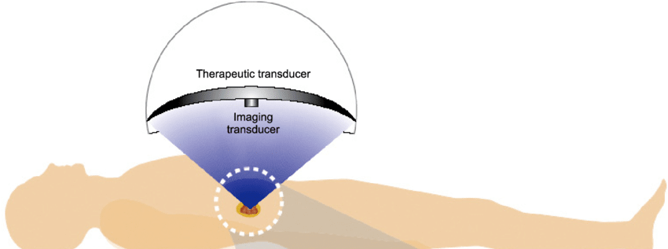
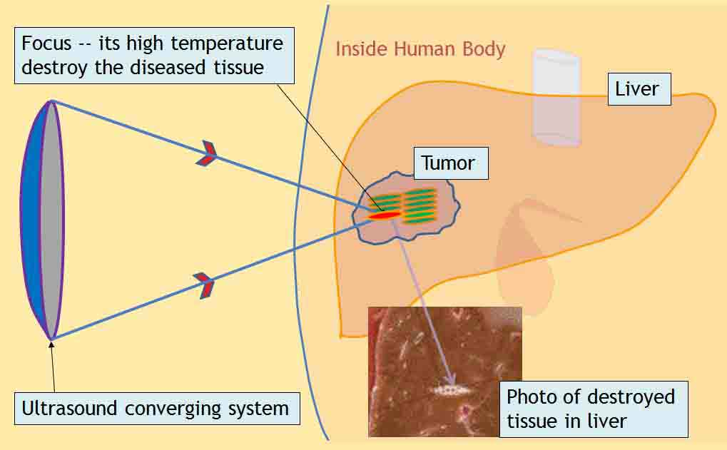
HIFU - Medical Applications
High Intensity Focused Ultrasound (HIFU)
  Thermally ablate solid tumors such as in liver, brain, breast, and other parts of body
Advantages:
  Targeted: treatment with ultrasound that deposits energy only into a small volume to heat and destroy the tissue near focus
  Noninvasive: surgery and cancer therapy
  Enhanced: by injection of microbubbles
Multiphase Numerical Modelling Desirable:
  Analytical: further understanding
  Practical: procedure planning & optimization
Image source : www.agadamedical.it/en-hifu-high-intensity-focused-ultrasound.html/
www.dynaflow-inc.com NETL MFS 2 of 20

Slide 4
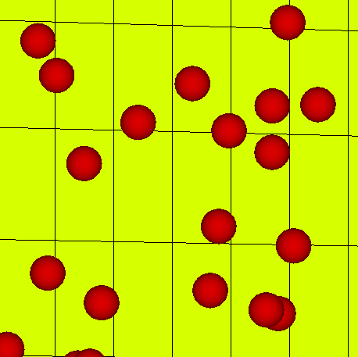
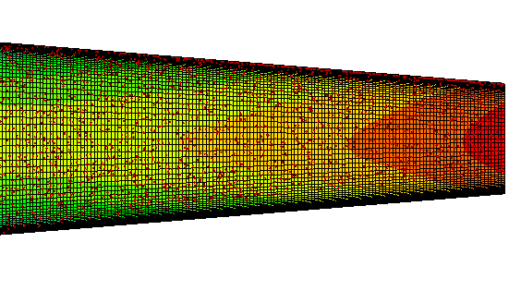
Eulerian-Lagrangian Two-Phase Flow Model
Bubble dynamics & motion Equations (Lagrangian approach)
P & V
α
Navier-Stokes Equations (Eulerian approach)

Slide 5
MPI: Domain Decomposition

Slide 6
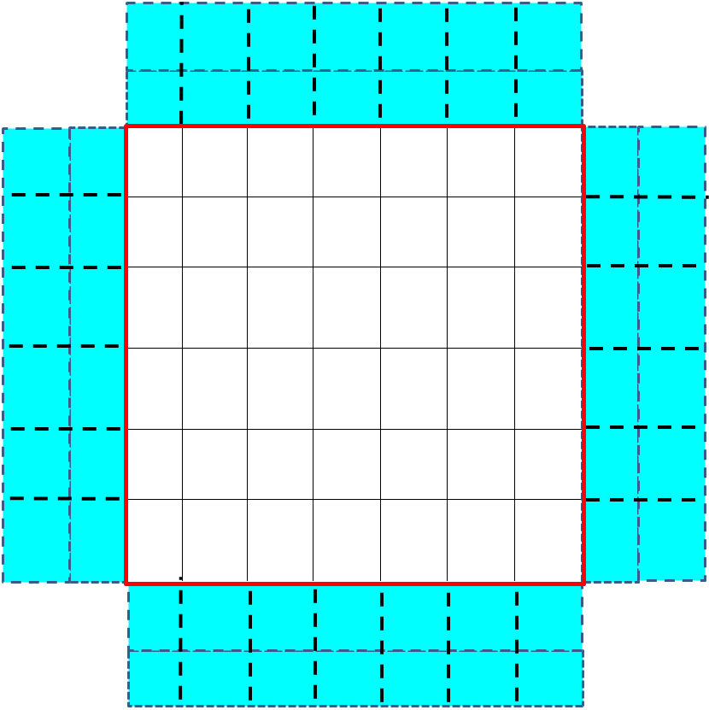
Subdomain & Ghost Cells
Ghost Cells of A
Subdomain A
Ghost Cells of A
Real Cells
Ghost Cells of A
Ghost Cells of A

Slide 7
Flow Data Transfer:
Real→Ghost Cells
A
B

Slide 8
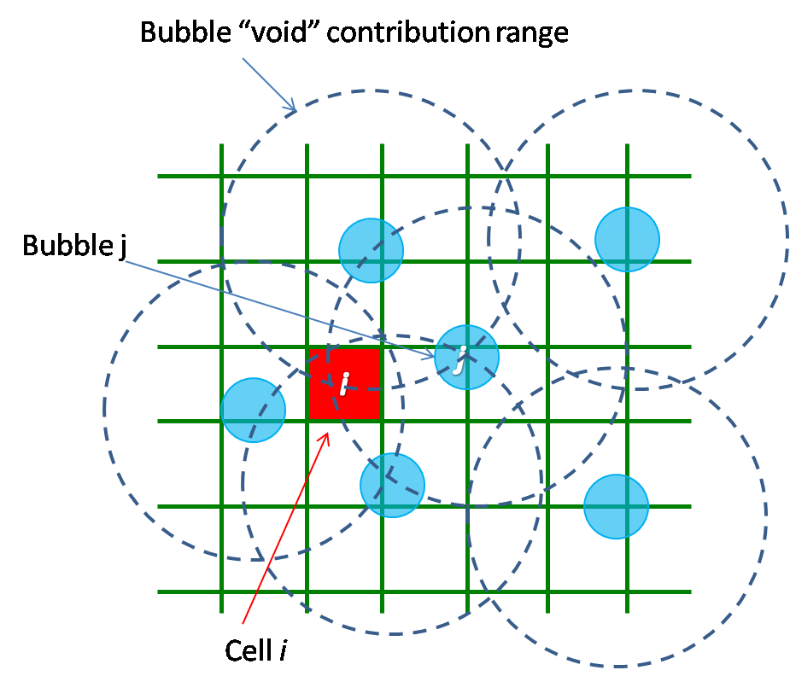
Eulerian-Lagrangian Mapping: Void Fraction (α ) Computation
R
j
1, Bubble(e.g., j) needs cell info. from Neighbor Procs.
2, Cell(e.g., i) needs bub. info. from Neighbor Procs.

Slide 9
α Data Transfer: Ghost → Real Cells
A
B

Slide 10
α Data Transfer: Double Ghost

Slide 11
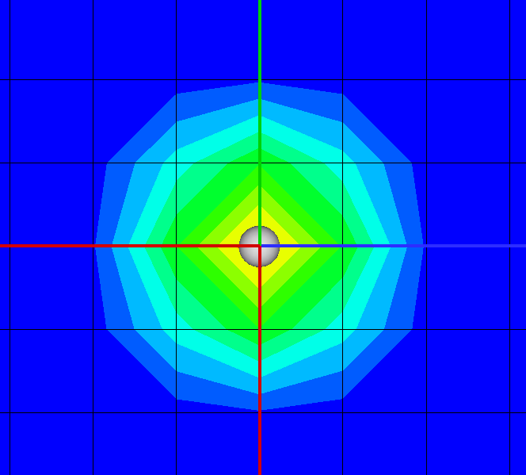
Exercise: a Bub. @ A’ Double Corner
D
C
A
B

Slide 12
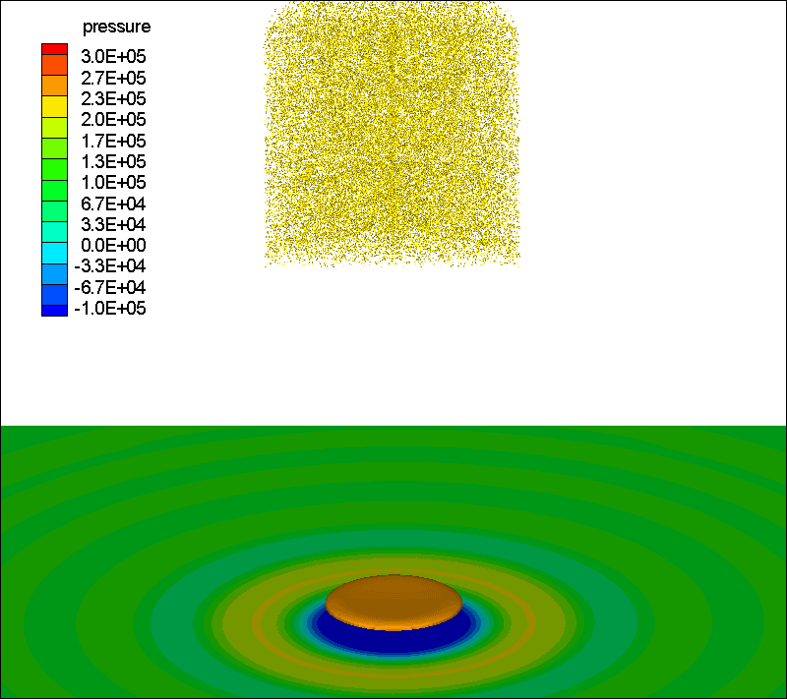
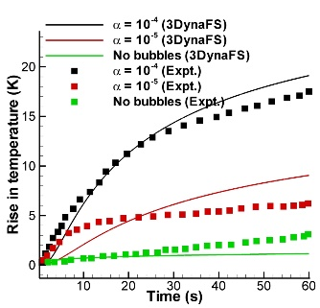
HIFU Simulation with Microbubbles
Scattering & Acoustic emission
Temperature rise near the focal region
A Gnanaskandan, CT Hsiao, G Chahine, Modeling of Microbubble-Enhanced High-Intensity Focused Ultrasound, Ultrasound in medicine & biology, 2019

Slide 13
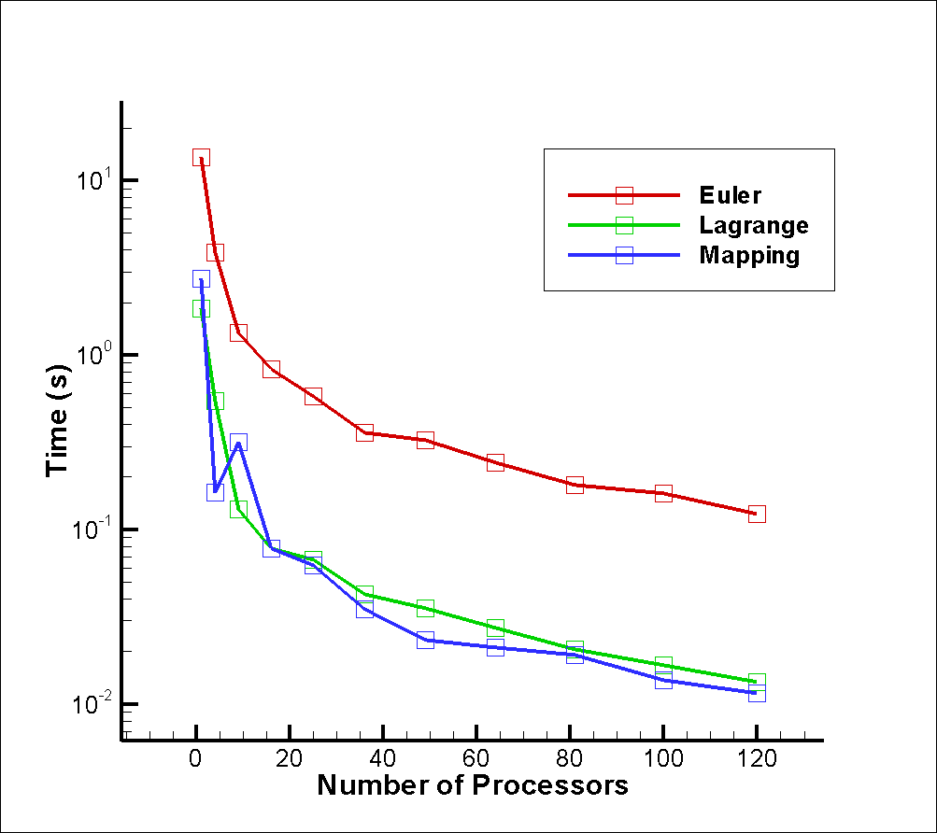
Test of Parallelization Efficiency
Cluster: DynaHive
( Ten 12-Xeon-CPUs Nodes )
  Total: 120 Procs.
  Speed: 3.00 GHz
  Memory: 272 GB

Slide 14
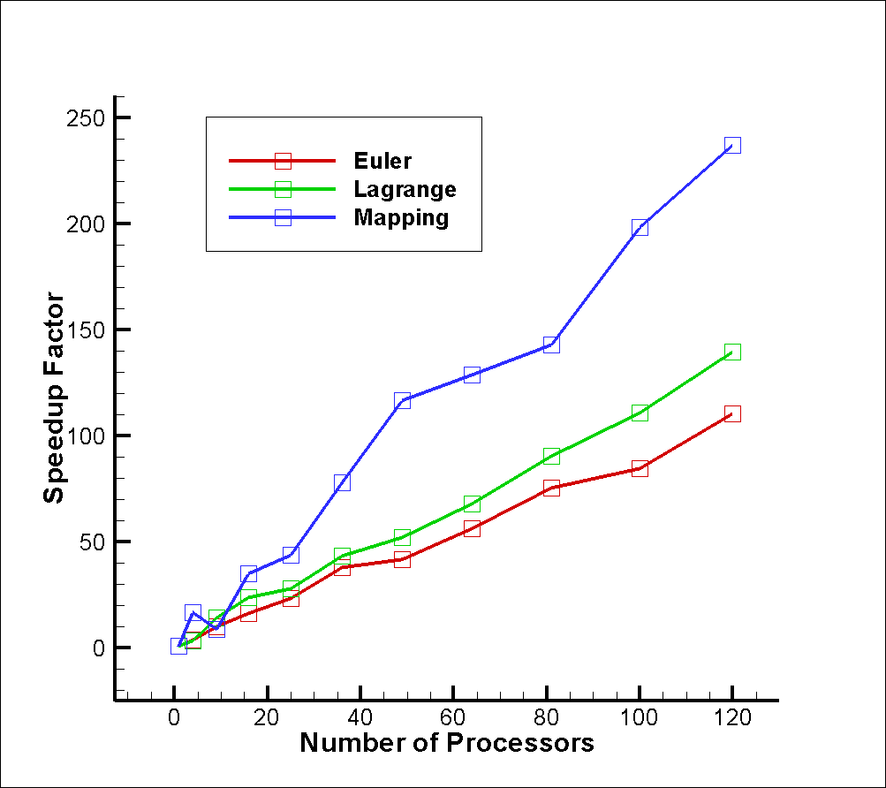
Speedup of Each Module
Linear Speedup

Slide 15
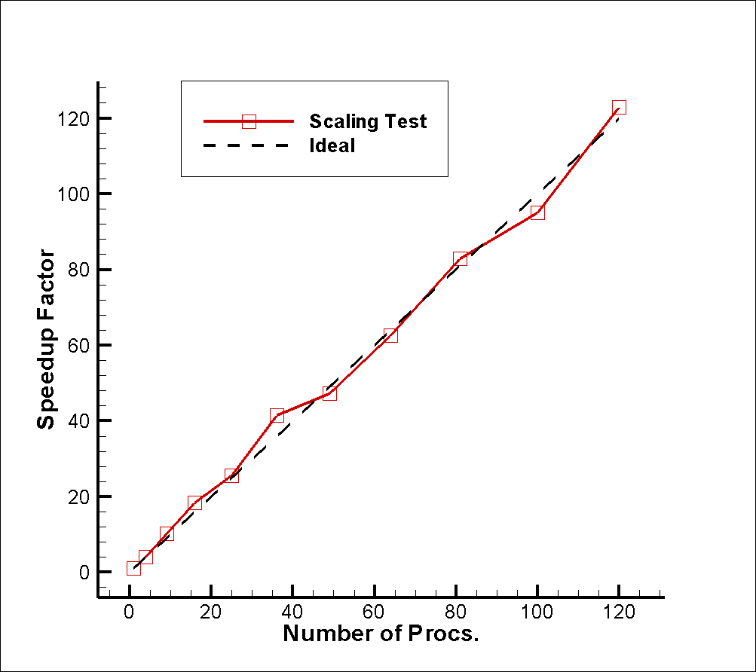

Overall Scalability

Slide 16
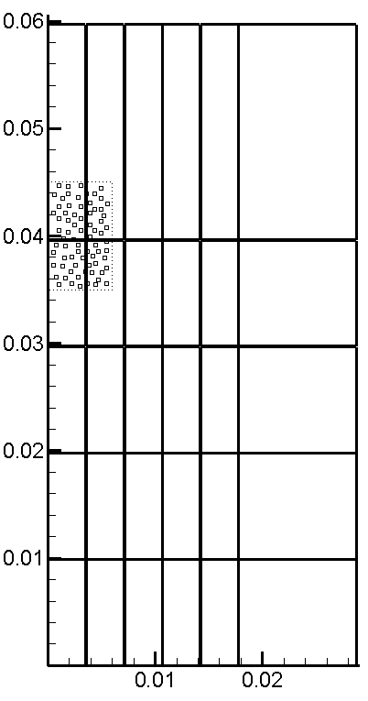
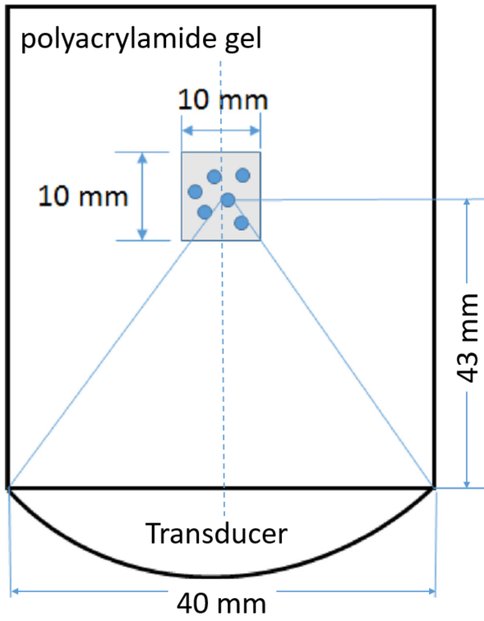
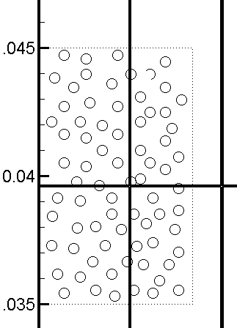
OpenMP for Bubs. inside Subdomain
nTh = 6
nTh = 3
nTh = 6
nTh = 3

Slide 17
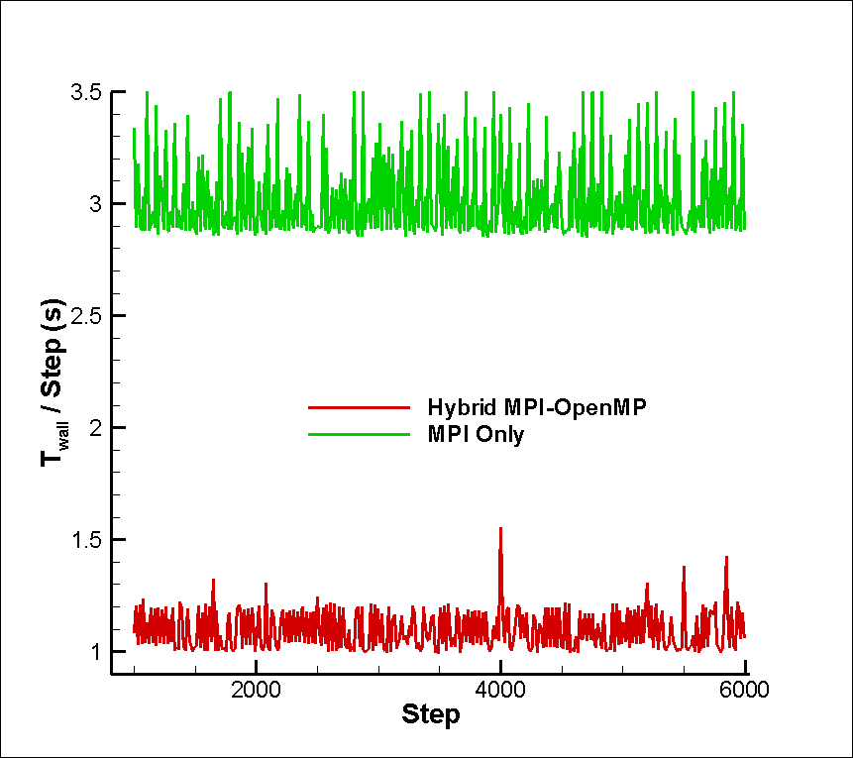
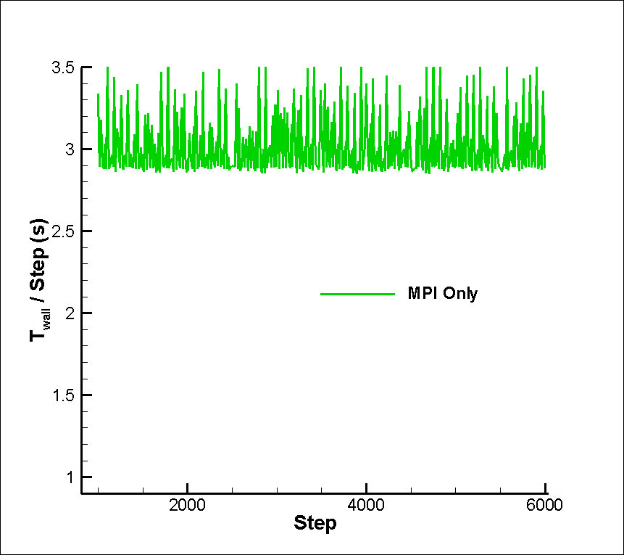
Gain of Hybrid Parallelization
MPI Procs: 48
In-House Cluster:
(Four 12-Cores CPU Nodes )
  Total: 48 Cores
  Speed: 3.00 GHz
  Memory: 272 GB
MPI Procs: 30
OpenMP Threads: 18

Slide 18
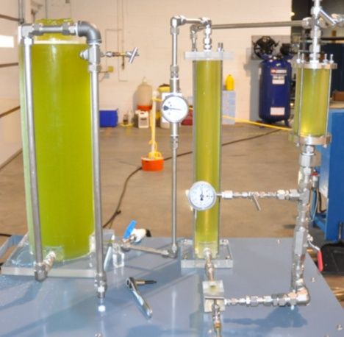
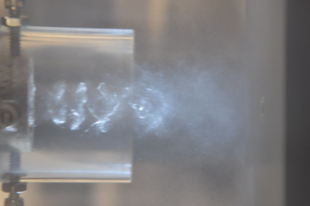
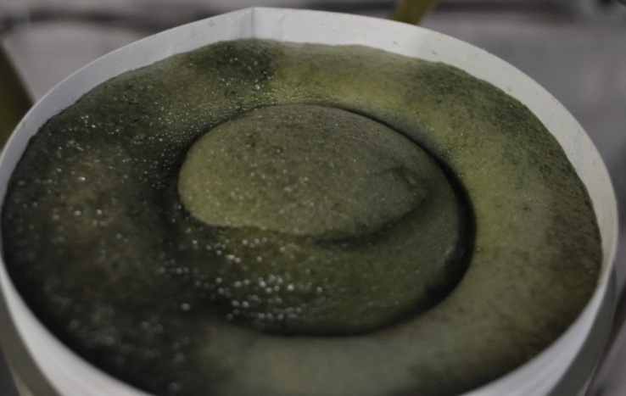
Bio-energy: Bio-extraction of Algae

Slide 19
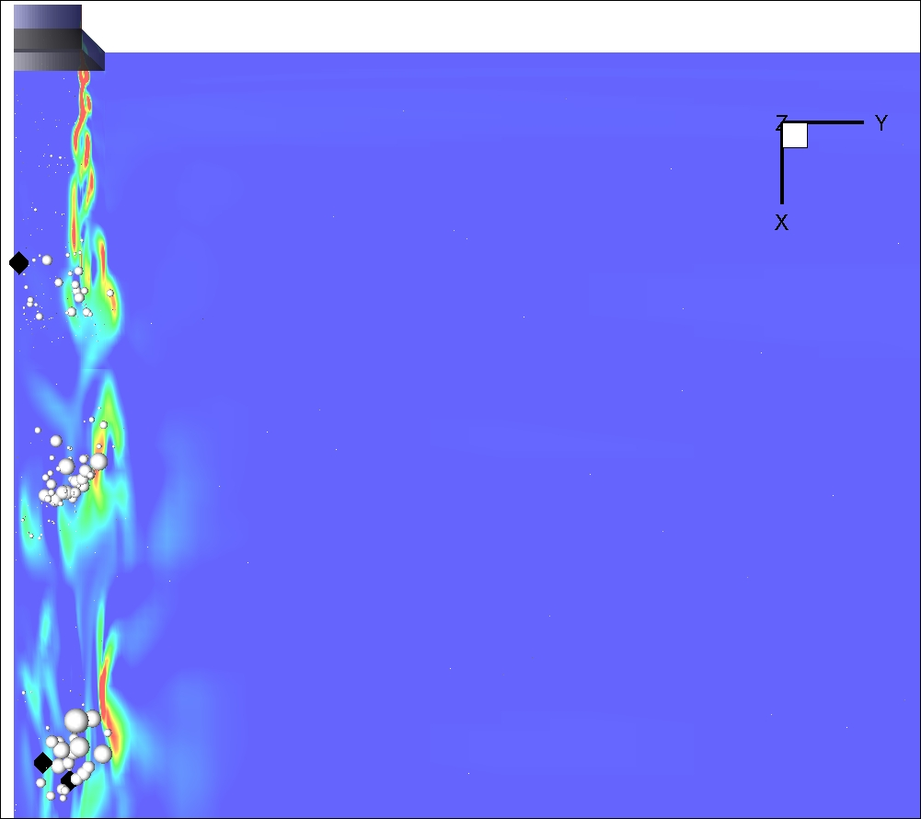
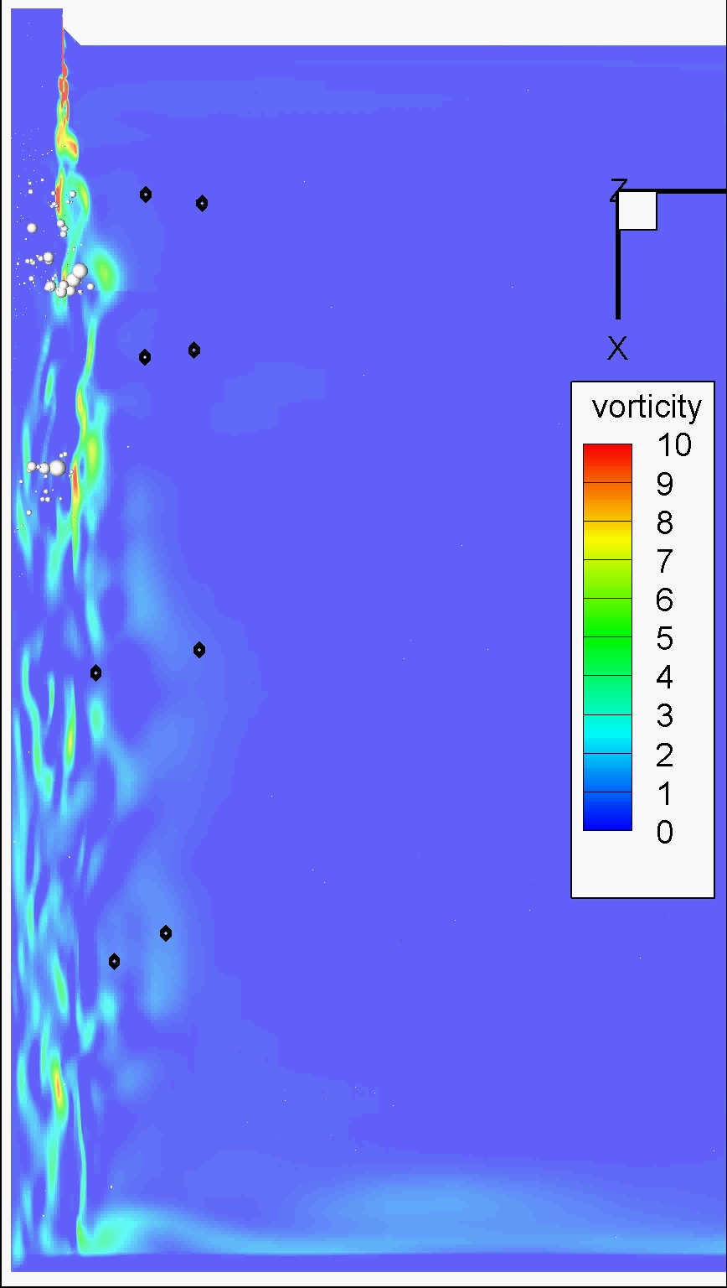
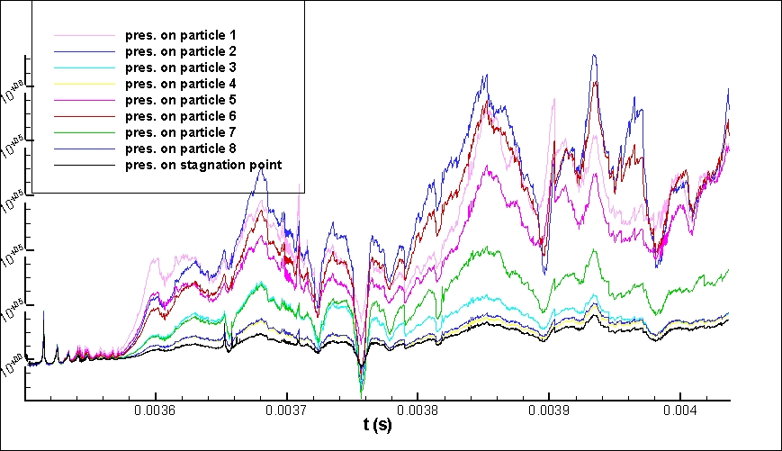
Three Phase Simulations
www.dynaflow-inc.com NETL MFS 13 of 20

Slide 20
Summary
A MPI-OpenMP parallelized Eulerian-Lagrangian model was developed for microbubble enhanced HIFU problems
Domain decomposition was adopted for both the continuum Eulerian domain and the Lagrangian discrete bubbles
An innovative utilization of ghost cells surrounding each subdomain is designed to avoid the need of sending bubble information across all processors while enabling the bubbles to smoothly spread their effects into all neighboring subdomains
Addition of OpenMP mitigates load imbalance
Platform is generalized to be applicable to 2&3-phase systems in biomedical, energy and other industries

Slide 21
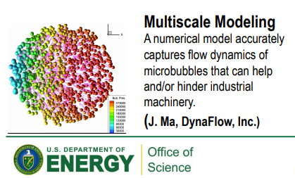
Speedup for Real-world Applications
OpenMP Parallelization
Ma, J., Hsiao, C-T., & Chahine, G.L. "Shared-Memory Parallelization for Two-Way Coupled Euler–Lagrange Modeling of Cavitating Bubbly Flows". ASME J. of Fluids Eng., 2015. ( HPC Tutorial )
MPI Parallelization
Ma, J., Gnanaskandan, A., Hsiao, C., & Chahine, G. L. "Message Passing Interface Parallelization for Two-Way Coupled Euler–Lagrange Simulation of Microbubble Enhanced HIFU." ASME. J. Fluids Eng., 2021 (ASME CFDTC Best Paper of 2020)
Hybrid MPI-OpenMP Parallelization
Ma, J., Deng, X., Hsiao, C., & Chahine, G. L. “Hybrid MPI-OpenMP Accelerated Euler–Lagrange Simulation of Microbubble Enhanced HIFU." FEDSM, 2021 (ASME MFTC Best Paper of 2021)
OpenMP+OpenACC(GPU) Parallelization
Hsiao, C-T., Ma, J., Kapahi, A., & Chahine, G.L. Multiscale Modeling of Two-Phase Bubbly Flows, DoE SBIR Report, 2015 (NERSC User Science Highlights)
www.dynaflow-inc.com NETL MFS 20 of 20

Slide 22

Questions ?
jingsen@dynaflow-inc.com
www.dynaflow-inc.com

