Slide 1
MFIX-Exa: CFD-DEM Simulations of Thermodynamics and Chemical Reactions in Multiphase Flows
Roberto Porcu
Data Scientist at Battelle, NETL Support Contractor
2023 NETL Multiphase Flow Science Workshop
Aug. 2, 2023

Slide 2
Disclaimer
This project was funded by the United States Department of Energy, National Energy Technology Laboratory, in part, through a site support contract. Neither the United States Government nor any agency thereof, nor any of their employees, nor the support contractor, nor any of their employees, makes any warranty, express or implied, or assumes any legal liability or responsibility for the accuracy, completeness, or usefulness of any information, apparatus, product, or process disclosed, or represents that its use would not infringe privately owned rights. Reference herein to any specific commercial product, process, or service by trade name, trademark, manufacturer, or otherwise does not necessarily constitute or imply its endorsement, recommendation, or favoring by the United States Government or any agency thereof. The views and opinions of authors expressed herein do not necessarily state or reflect those of the United States Government or any agency thereof.

Slide 3
Authors and Contact Information
Roberto Porcu^{1,2}, Jordan Musser¹, Ann S. Almgren³, John B.Bell³, William Fullmer^{1,2}, Aaron Lattanzi³, Andrew Myers³, Andy Nonaka³, Deepak Rangarajan^{1,2}, Weiqun Zhang³
¹National Energy Technology Laboratory, 3610 Collins Ferry Road, Morgantown, WV 26507, USA
²NETL Support Contractor, 3610 Collins Ferry Road, Morgantown, WV 26507, USA
³Lawrence Berkeley National Laboratory, 1 Cyclotron Road, Berkeley, CA 94720, USA

Slide 4
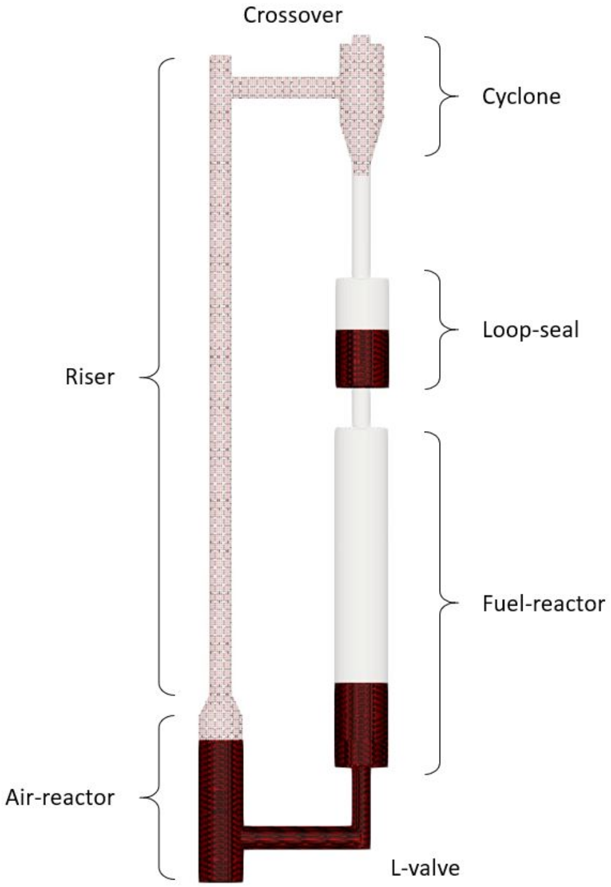
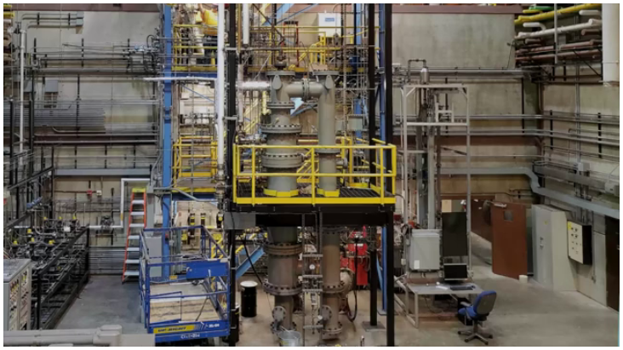
Problem: Industrial-Scale CLR Design
NETL’s 50 kW Hot Flow Chemical Looping Reactor (CLR)
Unlike in standard power plants, the CO₂ is mixed only with water vapor, making it easier to capture or sequestrate it before it is emitted into the atmosphere.

Slide 5
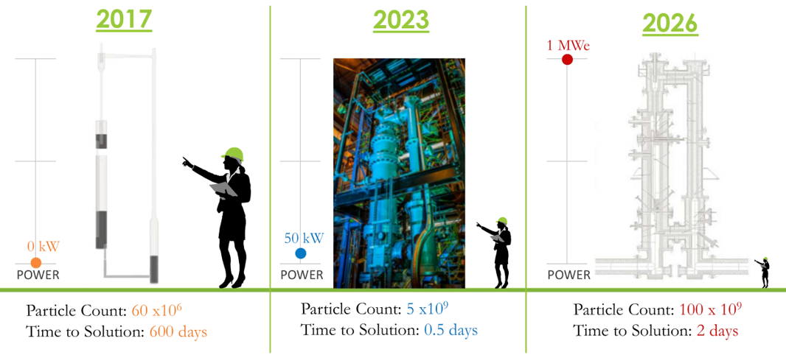
ECP : Exascale Computing Project
MFIX-Exa ECP Challenge Problem

Slide 6
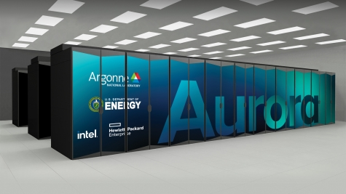
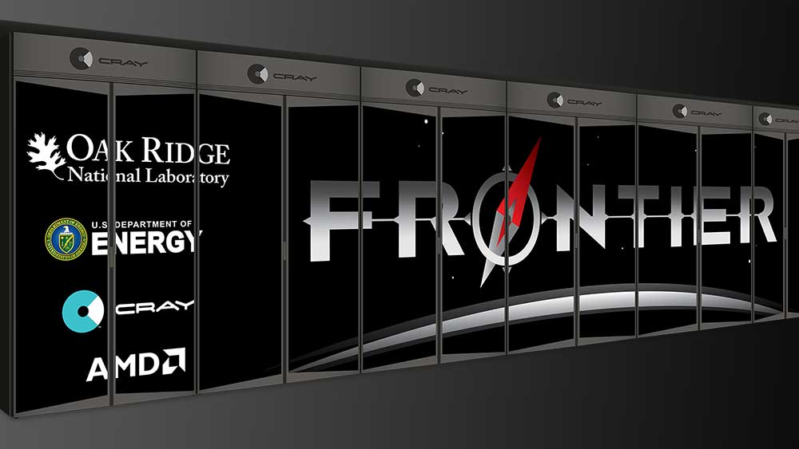
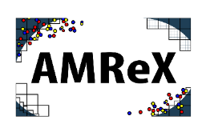
MFIX-Exa to Run on Next-Gen HPC Facilities
Pre-Exascale supercomputers
Summit (OLCF), Perlmutter (NERSC), Polaris (ALCF), etc.
Exascale supercomputers
Sunspot → Aurora (ALCF) peak performance > 2 ExaFLOPs Crusher → Frontier (OLCF) peak performance 1.6 ExaFLOPs
HPC Multi-phase flow solver Written in C++ Implements hybrid parallelism Empowered by
Multi-task (MPI) + Multi-thread (either NVIDIA, AMD or Intel GPUs)

Slide 7
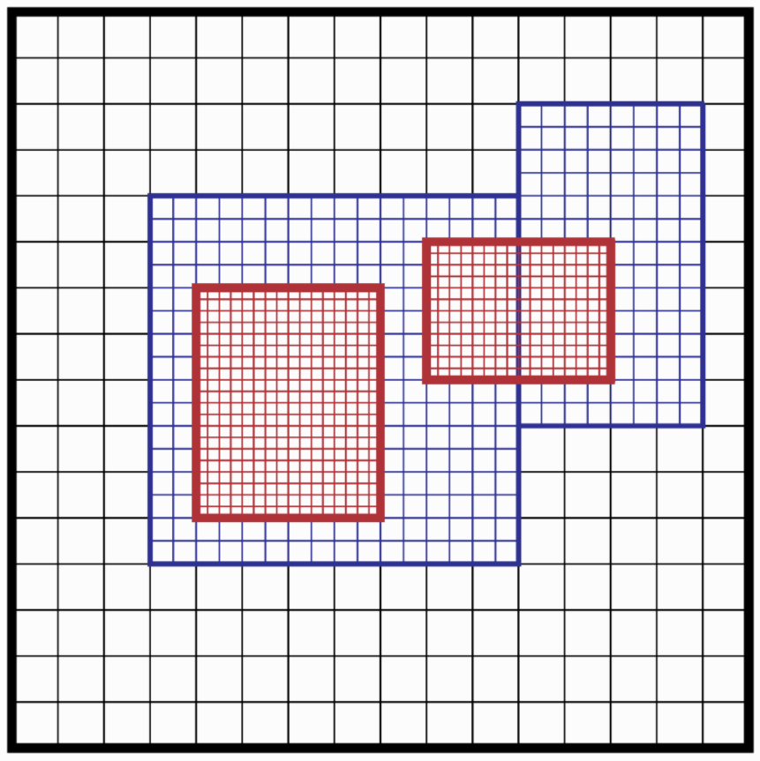
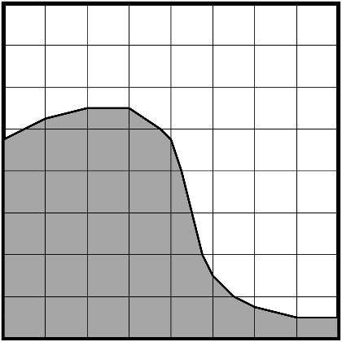
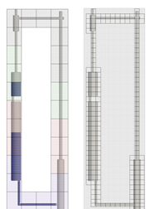
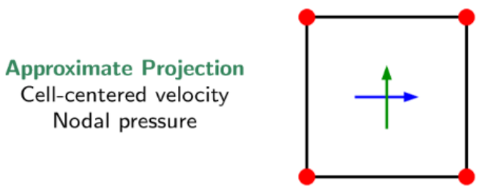
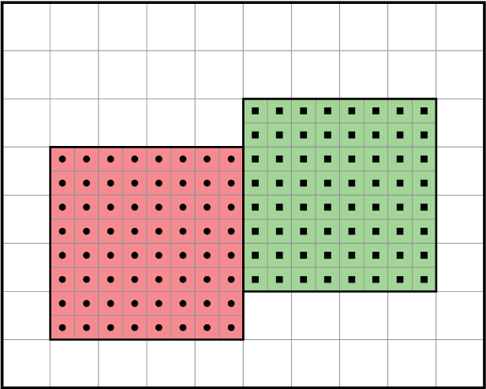
MFIX-Exa: Fluid Phase Solver
Multi-Level-Multi-Grid
Embedded Boundaries
Solver characteristics
Particles-unresolved approach: first advance fluid keeping particles unchanged, then solve particles
Modern implementation of a low-Mach number approximate projection method with a Godunov time advancement scheme
Solving enthalpy, species equations and heterogeneous chemical reactions can be switched on/off
Incompressible fluid & Ideal-Gas continuity constraints
Either AMReX internal linear solvers or solvers can be used
Levels
Level 0
Level 1
Level 2
Grids
Level 0
Level 1 = {Grid 0, Grid 1}
Complex geometries are generated from a user provided constructive solids geometry (CSG) file
Images source: AMReX online documentation

Slide 8
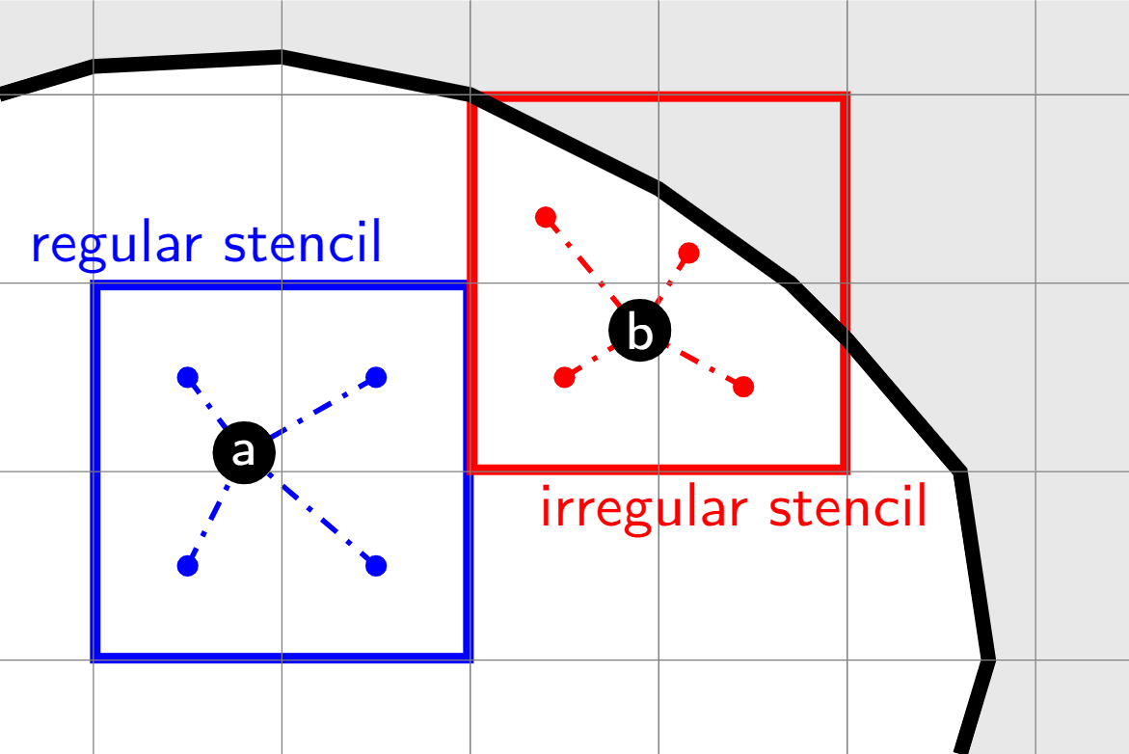
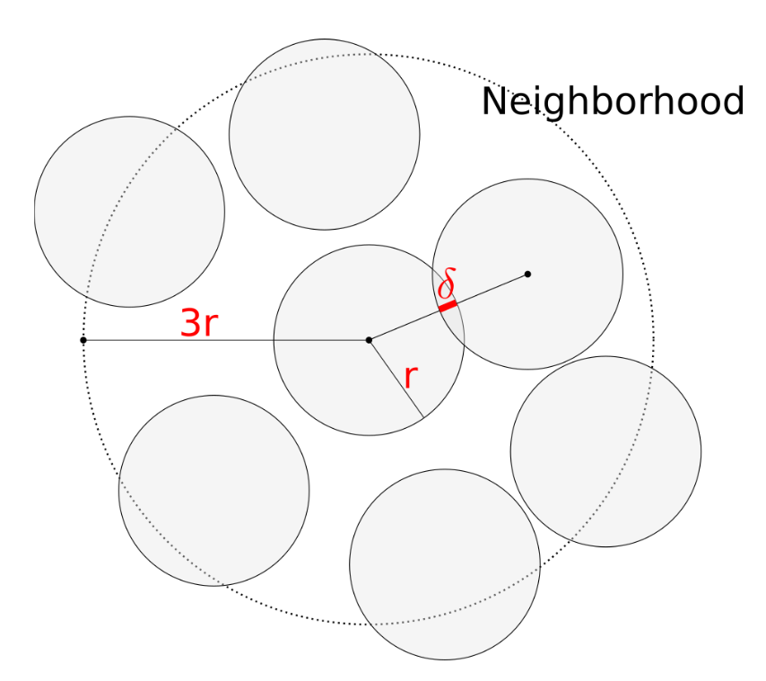
MFIX-Exa: Solid Phase Solver
Data Layout
Fluid-Particle Coupling
Short-Range Forces
nb of particles
Particle-Walls collisions computed by representing the boundaries through a level-set function
The DEM model uses a soft-sphere spring-dashpot model for particle-particle collisions
The PIC model uses an iterative solids stress model to minimize over-packing
radius
r₁
r₂
r₃
r₄
r₅
…
mass
m₁
m₂
m₃
m₄
m₅
…
etc.
…
…
…
AMReX “Struct-of-Arrays”
improves coalescence when
accessing the GPU global memory
Deposition and interpolation kernels:
linear kernel for regular stencils
nonlinear kernel for irregular stencils
Musser, J., Almgren, A.S., Fullmer, W.D., et al. (2021). Mfix-exa: A path toward exascale cfd-dem simulations. The International Journal of High Performance Computing Applications

Slide 9
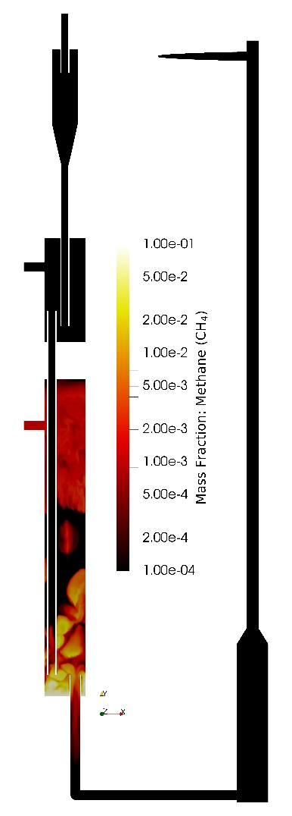
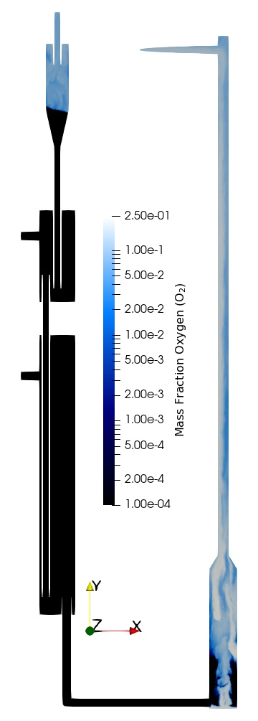
Bootstrapping Initial Conditions
PIC to DEM conversion
1) MFIX-Exa PIC run
Run PIC until transient regime is over, then save the current status in a checkpoint file and stop the simulation.
2) PIC → DEM conversion
Use the PIC checkpoint file to create a restart file for the full CFD-DEM simulation containing over 800M active control volumes for the fluid and more than 5.3B DEM particles!
3) MFIX-Exa DEM restart
Restart the CFD-DEM run from the converted checkpoint file.
4) Visualization of the results
MFIX-Exa provides data reduction methods in the form of “user monitors” and supports in-situ visualization with Ascent.
Musser, J., Porcu, R., Fullmer, W.D., (submitted). A demonstration of CFD-DEM at the exascale. Journal of Fluids Engineering

Slide 10
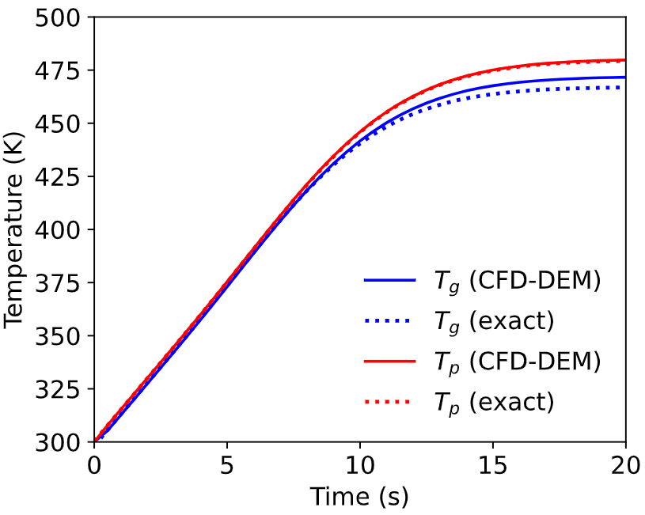
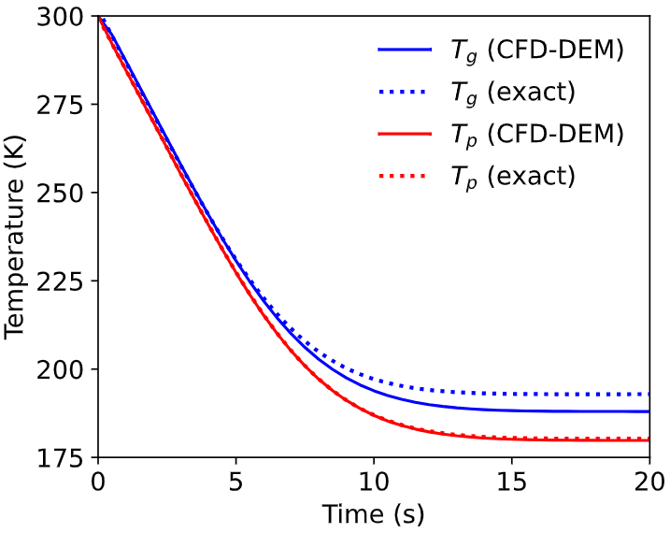
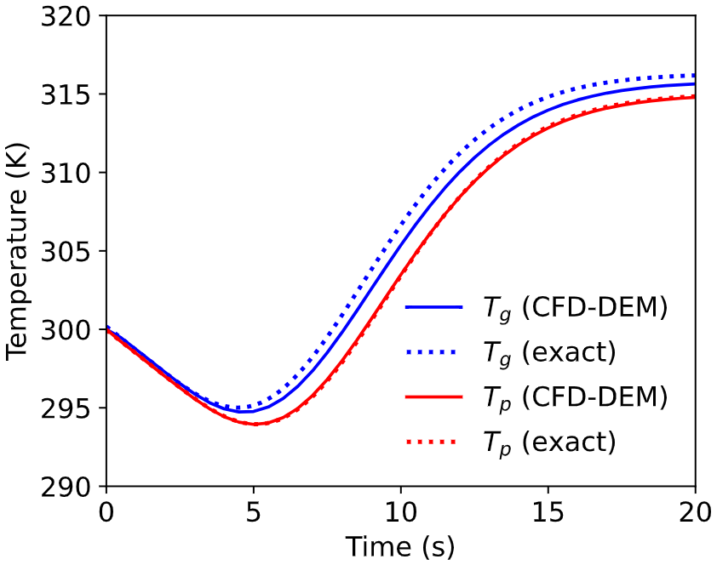
Numerical Results
Transient Heat Conduction in Packed Beds
strong source 𝑞 = +0.5 J∕(kgK)
strong sink 𝑞 = −0.5 J∕(kgK)
weak sink 𝑞 = −0.05 J∕(kgK)
Schumann, T.E.W. (1929). Heat transfer: a liquid flowing through a porous prism. Journal of the Franklin Institute
Salehi, M.S., Askarishahi, M., Radl, S. (2017). Analytical solution for thermal transport in packed beds with volumetric heat source. Chemical Engineering Journal

Slide 11
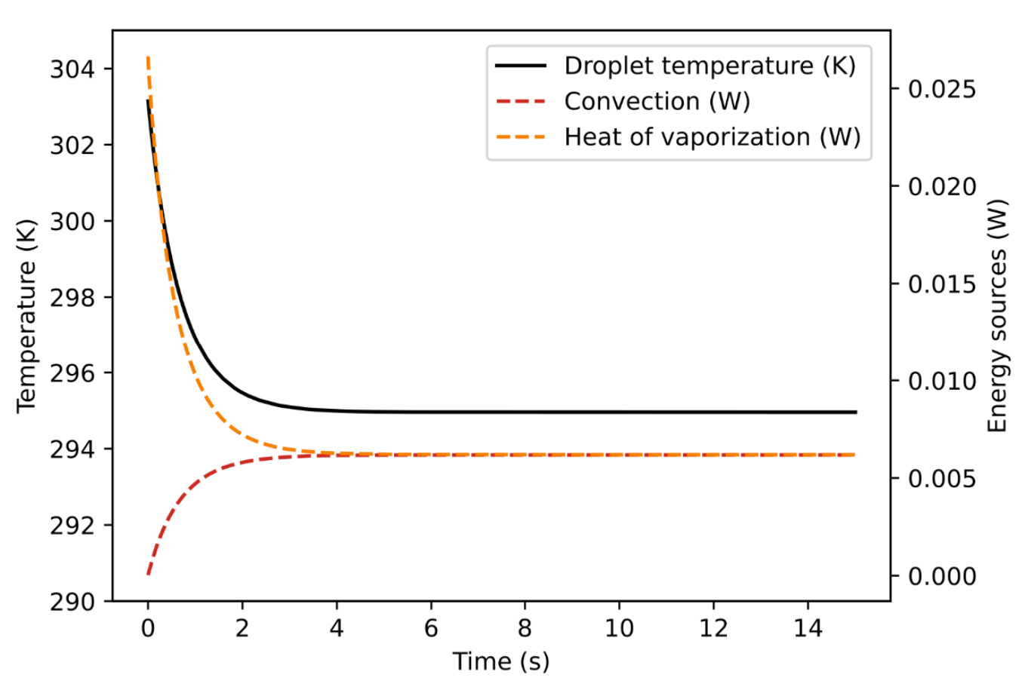
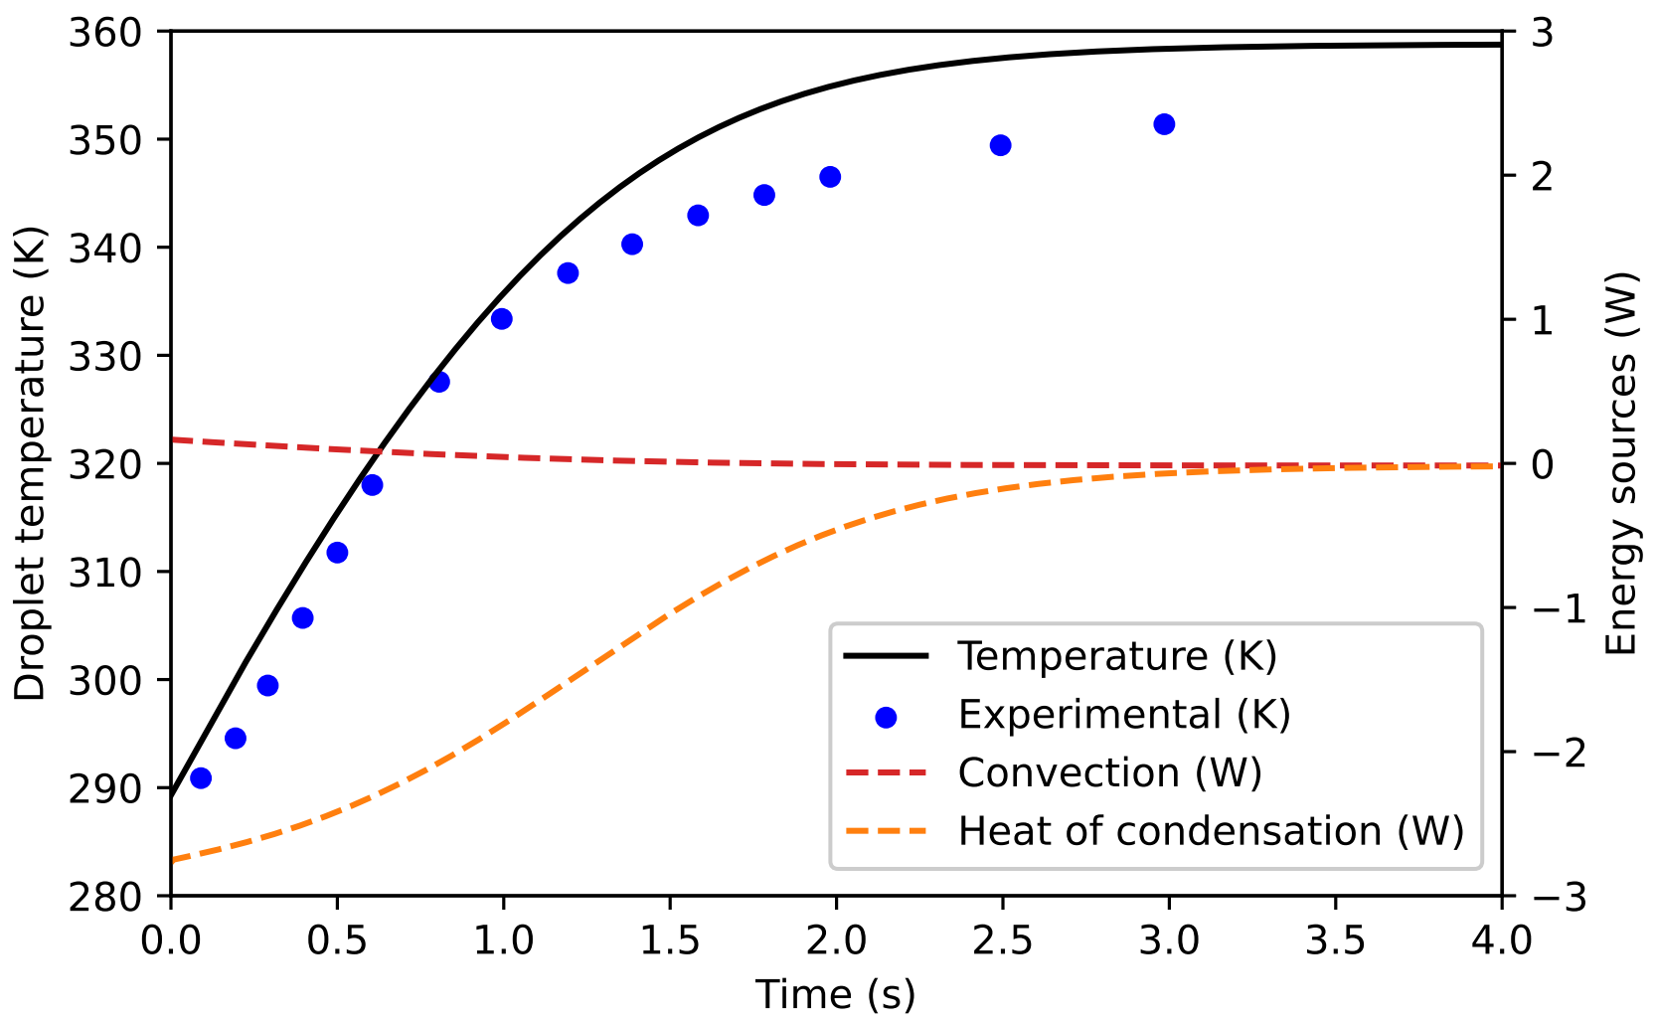
Numerical Results
Wet-Bulb: Water Droplet in a Humidified Air Stream
Droplet evaporation
Water vapor condensation
Musser, J., Syamlal, M., Shahnam, M., Huckaby, D., (2015). Constitutive equation for heat transfer caused by mass transfer. Chemical Engineering Science
Kulic, E., (1976). An experimental and theoretical study of simultaneous heat and mass transfer applied to steam dousing. Ph.D. thesis. University of Waterloo. Waterloo, Ontario, Canada

Slide 12
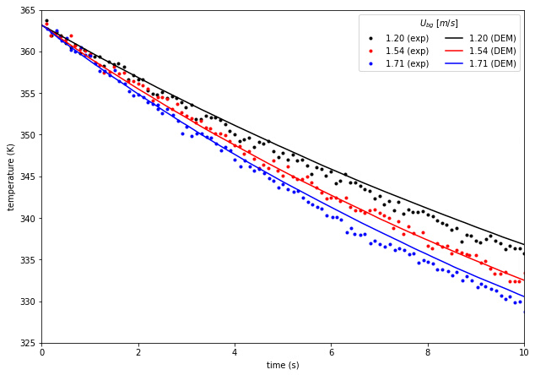
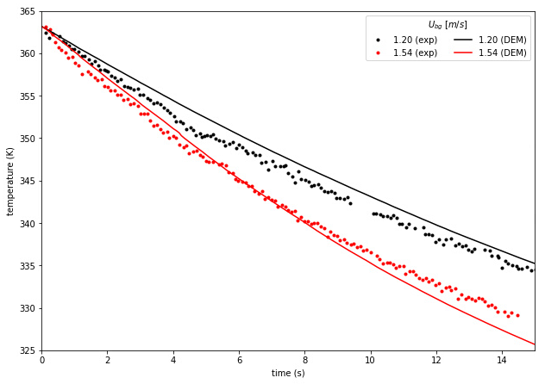
Numerical Results
Bench-Scale Fluidized Bed
75g Bed Mass
125g Bed Mass
Patil, A.V., Peters, E.A.J.F., Sutkar, V.S., Deen, N.G., Kuipers, J.A.M. (2015). A study of heat transfer in fluidized beds using an integrated dia/piv/ir technique. Chemical Engineering Journal

Slide 13
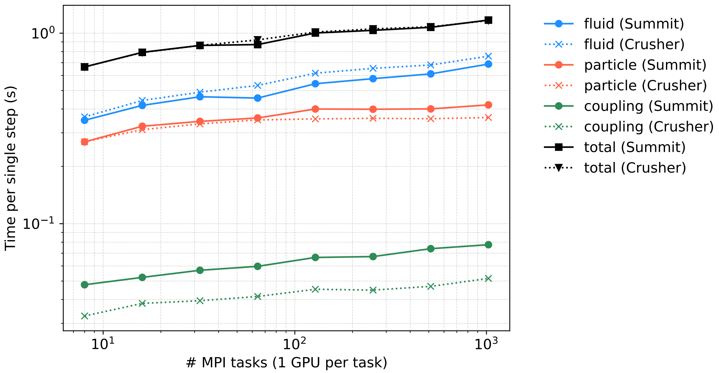
Performance Analysis
Weak Scaling Results
On Summit, each rank is a CPU-GPU pair running on an Intel Power9 and NVIDIA P100 GPU architecture.
On Crusher, each rank is mapped to a CPU-GCD pair using AMD EPYC 7A53 CPUs and AMD MI250X, where each MI250x contains two Graphics Compute Dies (GCDs).
The results show that MFIX-Exa maintains good performance and scalability on current and emerging leadership-class facilities
Porcu, R., Musser, J., Almgren, A., Bell, J., Fullmer, W., Rangarajan D. (2023). MFIX-Exa: CFD-DEM simulations of thermodynamics and chemical reactions in multiphase flows. Chemical Engineering Science

Slide 14
THANKS!!

Slide 15
NETL
Resources
VISIT US AT: www.NETL.DOE.gov
@NETL_DOE
@NETL_DOE
@NationalEnergyTechnologyLaboratory
CONTACT:
Roberto Porcu
roberto.porcu@netl.doe.gov

